Slide 1
DIURETICS
BY
ERICK KEMBOI

Slide 2
INTRODUCTION
All diuretics drugs produce their effects by decreasing the reabsorption of water and electrolytes by renal tubules and allowing more water and electrolytes to be excreted.
Uses to manage:
Edema and ascites
Heart failure
Hypertension

Slide 3
Cont.
The diuretic drugs fall into various classes, depending on their site and mechanism of action.
Loop diuretics
Osmotic diuretics
Thiazide diuretic
Potassium-Sparing diuretics
Carbonic anhydrase inhibitors

Slide 4
Loop diuretics
This group of diuretics is the most powerful of the diuretics but less effective as anti-hypertensive.
Mechanism of action
Loop diuretics inhibit sodium and chloride reabsorption in the ascending limb of the Loop of Henle .Thus much sodium is presented to the colleting ducts.
Examples: Furosemide,bemetanide ,torasemide
Side effects; hypokalemia, dehydration

Slide 5
  Uses /indication of loop diuretics
  -Edema – Irrespective of the cause eg in Congestive heart failure cases to promote renal excretion of excessive water /fluid and sodium
  -HTN
  -Along with blood transfusion in severe anemia to prevent fluid overload.
  -hypercalcemia related to kidney stone formation.

Slide 6
Adverse effects
  GiT disturbance,
  headache , Fatigue
  Orthostatic hypotension
  hypokalemia,
  hyponaetremia,
  hypomagresemia,
  allergic reaction

Slide 7
Thiazides diuretics
Chemically related to sulfonamides so caution with sulfa allergies, used in long term management of heart failure and hypertension
Mode of action
They interfere with the reabsorption of salt and water by the early distal tubules by binding to and inhibiting a sodium chloride pump: Thus less sodium chloride is reabsorbed and salt together accompanying water passes out of the tubules and cause diuresis.

Slide 8
Cont.
Examples: Hydrochlorothiazide (HCTZ), Bendroflumethiazide, Chlorothiazide, indapamide,Metolazone,Chlortalidone
Adverse Effects:
  Hypokalaemia – muscle pain and fatigue
  Hyperglycemia: Inhibition of insulin release due to K+ depletion ( precipitation of diabetes)
  Hyperlipidemia: rise in total LDL level – risk of stroke

Slide 9
Cont.
  Hyperurecaemia: inhibition of urate excretion
  Allergic manifestations rashes, photosensitivity
  Magnesium depletion
  GIT / CNS disturbances – nausea, vomiting diarrhea
  NB - Average fall in BP with thiazides is 10 mm of Hg

Slide 10
Osmotic diuretics
The osmotic diuretics are filtered by the glomerulus and increase the osmotic pressure in the tubules. This inhibits the passive reabsorption of water from the tubules hence promoting water loss in urine. Osmotic diuretics have their major effect in the proximal convulated tubule and the descending limb and collecting ducts (these sites are freely permeable to water)

Slide 11
CONT
Osmotic diuretics also act by reducing intracranial pressure and intraocular pressure by raising serum osmolality and drawing fluid back into the vascular and extravascular space.
Example: Mannitol

Slide 12
Uses of Mannitol
To reduce increased Intra-cranial pressure caused by cerebral edema
reduction of intraocular pressure before certain ophthalmic surgery
for urinary excretion of toxic substances.
Osmotic diuretics prevent renal failure in specific situations, such as hypovolemic shock and severe hypotension

Slide 13
C0nt
In patient with fluid volume

Slide 14
Potassium sparing diuretics
Act at distal tubule to decrease reabsorption of sodium by blocking the action of aldosterone on the renal tubule. It also inhibits potassium excretion.
Examples: sprinolactone,amiloride,triamterene

Slide 15
Potassium sparing diuretics
Act at distal tubule to decrease reabsorption of sodium by blocking the action of aldosterone on the renal tubule. It also inhibits potassium excretion
.Examples:sprinolactone, amiloride,triamterene

Slide 16
Adverse Effects;
Hyperkalemia (K+ greater than 5.0 mEq/L)
Endocrine effects (impotence in male clients; irregularities of menstrual cycle in female clients)

Slide 17
Contraindications/Precaution
Do not administer to clients who have hyperkalemia.
Potassium-sparing diuretics are contraindicated in clients who have severe renal failure and anuria.

Slide 18
Carbonic anhydrase inhibitors diuretics
Examples: Acetazolamide, Methazolamide ,Dorzolamide, Diclofenamide
Mode of action
Inhibit activity of carbonic anhydrase in the proximal convoluted tubules thus prevent reabsorption bicarbonate, resulting in decreased of the apical sodium –hydrogen exchanger causing diuresis due to retention of sodium in the renal tubules

Slide 19
Cont.
Uses /indications
Rx of chronic open angle glaucoma(Acetazolamide)
Adjuvant in Rx of edema due to CCF
Rx of elevated intraocular pressure

Slide 20
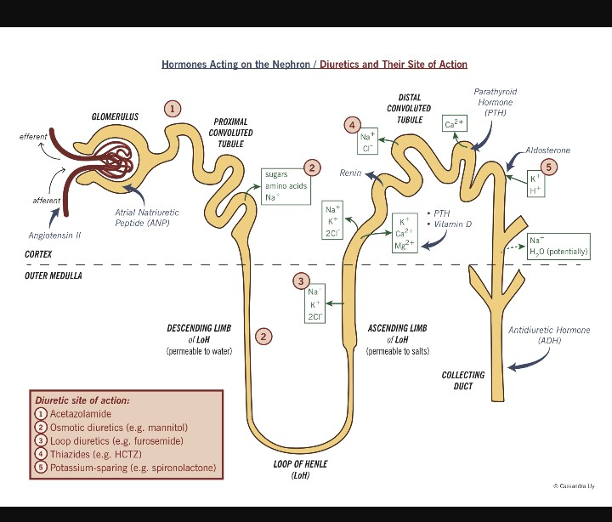

Slide 21
Assignment
Draw a well labeled diagram to show four sites of actions of Diuretics
Outline 6 Nursing responsibilities in the pts. receiving furosemide /diuretics

Slide 22
cont.
Discuss furosemide under the following headings :
Mode of action
Five indications
3 contraindications
5 side effects
5 Nursing responsibilities

