Slide 1
NEONATAL TETANUS
Outcome:
Manage a baby with Neonatal Tetanus

Slide 2
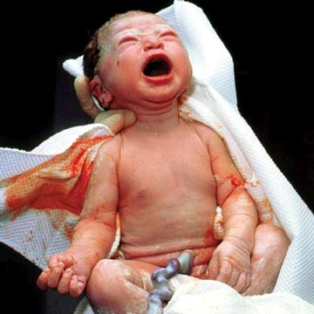
NEONATAL TETANUS

Slide 3
Objectives
Define neonatal tetanus (case definition)
Describe the features
Outline the risk factors
State the investigations
Explain the treatment

Slide 4

Neonatal tetanus

Slide 5
N T
His body is rigid.
Infection can occur when the newly cut umbilical cord is exposed to dirt.
Most newborns who get tetanus die

Slide 6
N. T
Begins in neonatal period – 3—10/7
Is generalized type
Follows contamination of umbilical stamp during delivery, associated with high mortality

Slide 7
HISTORY
H/O a newborn who was able to breast feed suddenly develops inability to breast feed, lock jaw, spasms, seizures & death
h/o un sterile cutting of the cord or
Rx of stamp with cow dung

Slide 8
PREVENTION
Tetanus toxoid to all pregnant women
Education on hygiene
Appropriate cord care

Slide 9
Mnx
Sedate baby by
Phenobarbitone 15mg/ kg start
Diazepam 0.2mg/kg over 3 minutes. Repeat every 30 min x 3 doses
Do not exceed 2mg/kg/24hrs
Clean cord thoroughly
Pass a NGT for feeding

Slide 10
Subsequent care
Nurse the baby in a quiet dark room
Avoid too much handling
Keep umbilical cord clean & dry
Paint cord with povidine iodine or spirit
Feed EBM through NGT
Phenobarbitone 5mg/ kg/ day in 2 doses
Chlorpromazine 2mg / kg /day

Slide 11
NT
Antibiotics iv crystalline penicillin 100 000u/kg/day in 2 doses
Monitor v/s – watch resp.
Counsel the mother.
Refer to ICU
Immunize baby after recovery.

