Slide 1
DISORDERS OF THE ESOPHAGUS
MEDICAL OVERVIEW

Slide 2
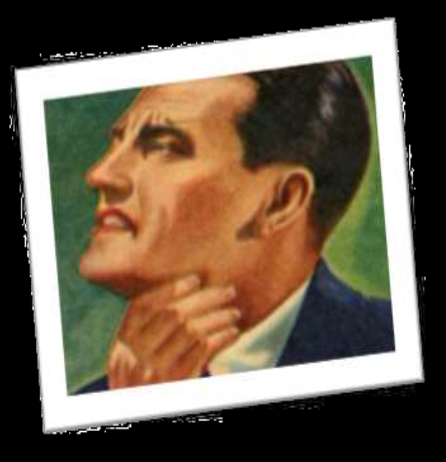
DYSPHAGIA
Overview

Slide 3
DYSPHAGIA
The word dysphagia is derived from the Greek phagia (to eat) and dys (with difficulty).
Eating becomes unenjoyful.
It refers to the sensation of food being obstructed in the food passage anywhere from the mouth to the stomach.
The basic impairment behind dysphagia are
  neurological
  mechanical / obstructive

Slide 4
DYSPHAGIA
Dysphagia can be a serious health threat because of the risk of aspiration pneumonia, malnutrition, dehydration, weight loss, and airway obstruction, and it exerts a large influence on the outcome of rehabilitation (eg, length of hospital stay, mortality/morbidity).

Slide 5
EPIDEMIOLOGY
The incidence of post-stroke dysphagia is higher in Asians.
Stroke is the leading cause of neurologic dysphagia, with the condition occurring in approximately 51-73% of patients with stroke.
Delay functional recovery in patients with stroke and is also the most significant risk factor for the development of pneumonia.

Slide 6
SWALLOW MECHANISM
The act of swallowing requires the passage for food and drink from the mouth into the stomach.
From mouth to hypopharynx covers 1/3rd of passage (distance) while 2/3rd is covered by the esophagus .
The swallowing center in brain stem is located in the floor of fourth ventricle and adjacent regions of medulla. From here it is connected to cerebral cortex, vomiting and respiratory centre.

Slide 7
SWALLOW MECHANISM
All these areas works in coordinated manner to provides voluntary as well the involuantary control of swallowing.
An adult swallow approximately 580 times daily and the act goes on unconsciously .
Swallowing phase
  Oro-Pharyngeal phase( voluntary phase)
  Esophageal phase( involuntary phase)

Slide 8
ESOPHAGEAL PHASE
Food bolus is propelled through the esophagus by an involuntary wave of contraction mediated by the enteric nervous system.
Pressure gradient speeds the movement of food from the hypopharynx into the esophagus when the cricopharyngeus muscle relaxes.
The primary peristaltic contraction which is initiated by a swallowing , moves down the esophagus at the rate of 2 to 4 cm/s and reaches the distal esophagus about 9 seconds .
This duration varies from 8 to 20 seconds

Slide 9
CLINICAL PRESENTATION
Pain and difficulty in swallowing.
Sensation of food being stuck into throat or chest.
Coughing or gagging while swallowing.
Nasal regurgitation
Dysarthria
Nasal speech because of associated muscle weaknesses
Frequent burning sensation in chest.
Having food or stomach acid back up into the throat.
Unexpectedly losing weight.

Slide 10
FUNCTIONAL GRADES OF DYSPHAGIA
There are 6 grades of dysphagia
GRADE 1 : Complains of dysphagia but still eating normally
GRADE 2 : Requires liquid with Meals
GRADE 3 : able to take semisolid ,but unable to take any solids
GRADE 4 : able to swallow liquids only
GRADE 5 : unable to swallow liquid, but able to swallow saliva
GRADE 6 : unable to swallow saliva also

Slide 11
ABNORMALITIES CAUSING OROPHARYNGEAL DYSPHAGIA
Inability to initiate the act of swallowing.
Etiology
1. Neuromuscular Diseases
Central nervous system (CNS)
• Cerebral vascular accident involving the brain stem.
Parkinson disease
Wilson disease
Multiple sclerosis
Brain stem tumor
Peripheral nervous system
poliomyelitis
Peripheral neuropathies (e.g. diphtheria, tetanus rabies, diabetes mellitus)
Motor end plate
Myasthenia gravis
Muscle
Oculopharyngeal muscular dystrophy
Primary myositis
Metabolic myopathy (e.g., glycogen storage disease, lipid storage disease)

Slide 12
ABNORMALITIES CAUSING OROPHARYNGEAL DYSPHAGIA
2. mechanical or obstructive Lesions
Inflammatory
Pharyngitis
Abscess ( peri-tonsillar , paraphryngeal/retrophryngeal )
Tuberculosis
Syphilis
Neoplastic
Plummer-Vinson syndrome (dysphagia, iron-deficiency anemia and esophageal webs)
Extrinsic compression
Thyromegaly (hashimoto’s thyroiditis)
cervical osteophytes
Lymphadenopathy

Slide 13
ABNORMALITIES CAUSING OROPHARYNGEAL DYSPHAGIA
Disorders of the Upper Esophageal Sphincter (UES)
It is related to the abnormal UES relaxation or opening
Incomplete relaxation
  cricopharyngeal achalasia
  oculopharyngeal muscular dystrophy
Inadequate opening
  cricopharyngeal bar
  Zenker diverticulum
Delayed relaxation
  familial dysautonomia

Slide 14
ESOPHAGEAL DYSPHAGIA
Patients usually complains of feeling of food getting stuck several seconds after swallowing and will point towards the suprasternal notch or behind the sternum.
ETIOLOGY
1. Neuromuscular (Motility) Disorders
• Most common
Achalasia
Diffuse esophageal spasm

Slide 15
ESOPHAGEAL DYSPHAGIA
Other motility abnormalities
Nutcracker esophagus
Hypertensive lower esophageal sphincter
motility disorders secondary to
  Scleroderma
  collagen disorders
  Chagas disease

Slide 16
ESOPHAGEAL DYSPHAGIA
2. Mechanical or obstructive
Esophagitis: dysphagia is due to mucuosal edema or benign stricture
Gastroesophageal reflux disease (GERD)
Infectious esophagitis HIV , H. pylori, Herpes, Candidiasis
Radiation treatment
Medication-induced esophagitis NSAIDs , K+, vitB. complex), Iron sulphate
Disorders of wall
Esophageal stricture
Zenker diverticulum
Epiphrenic diverticula

Slide 17
ESOPHAGEAL DYSPHAGIA
Disease causing external compression
Hiatus hernia ( mainly paraesophageal hernia )
Cervical osteophytes
Mediastinal growth
Vascular ring (dysphagis lusoria)
Luminal obstruction:
Foreign bodies
Esophageal webs
Schatzki rings
Carcinoma esophagus

Slide 18
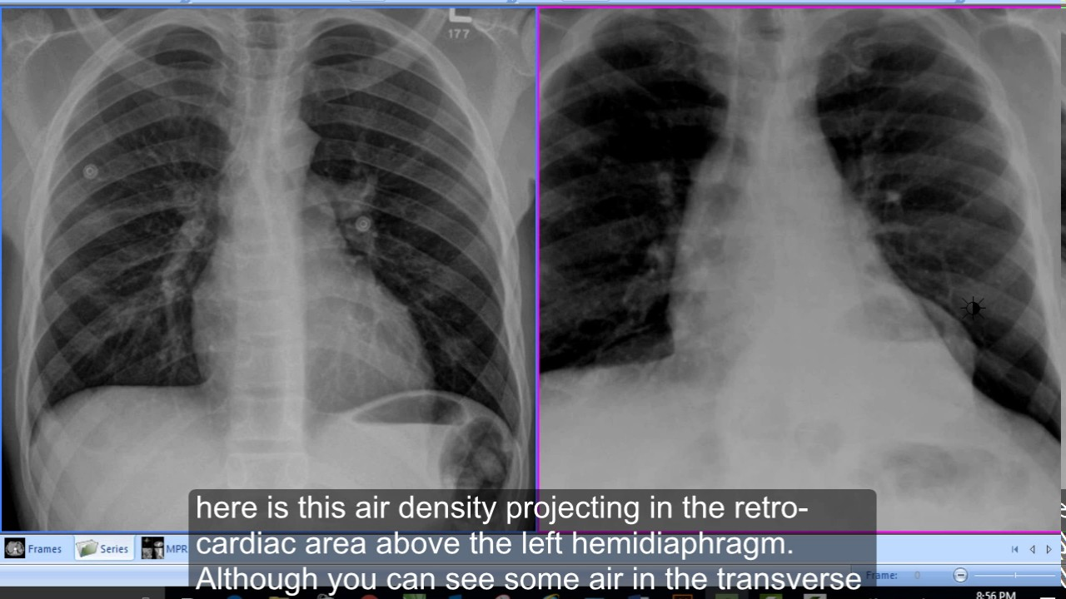

Slide 19
Condition | Diagnosis to consider
Difficulty in initiating swallow | Oropharyngeal dysphagia
Food sticks after swallow in chest | Esophageal dysphagia
Progressive dysphagia | Neuro muscular dysphagia, carcinoma
Sudden dysphagia | Foreign body, esophagitis
Intermittent dysphagia | Rings and webs, Diffuse esophageal spasm, Nutcracker esophagus
Cough: Early in swallow Late in swallow | Neuromuscular dysphagia Obstructive dysphagia
Weight loss: In elder patient With regurgitation | Carcinoma Achalasia
Pain after swallowing | Esophagitis
Dysphagia related to: solid foods only Solid and liquid both | Obstructive dysphagia Neuromuscular dysphagia
Regurgitation of old food and halitosis | Zenkers diverticulum

Slide 20
EVALUATION OF DYSPHAGIA
History
Clinical examination
Blood investigations
Radiology – plain x-ray , barium meal
Upper GI endoscopy
laryngoscopy
Endoscopic ultrasound
Histopathology

Slide 21
HISTORY
Onset.
Duration
Progression
Severity of symptoms
Types of food intake that causes problems
Alleviating factors

Slide 22
ASSOCIATED SYMPTOMS
Regurgitation
Pain on swallowing
Hoarseness of voice
Otalgia
Coughing after eating
Frequent chest infections

Slide 23
EXACERBATING AND RELIEVING FACTORS
Greater difficulty swallowing liquids than solids (OPD)
Precipitation or worsening of dysphagia with consumption of very cold liquids or ice cream (ED)
Dysphagia that progresses from solid to semisolid food or liquid in a brief period of time suggests esophageal stricture related to tumor.

Slide 24
CLINICAL EXAMINATION
Complete Head and neck examination
  Inspection of oral cavity
  Dentition
  Oropharynx
Cranial nerve examination ( tongue, gag and cough reflex, hoarseness, vocal cord mobility)
Neck for lymph nodes, neck masses, thyroid enlargement, loss of laryngeal crepitus and integrity of laryngeal cartilages.

Slide 25
INVESTIGATIONS
Blood tests to exclude anaemia (? Cause or effect)
ESR or C-Reactive Protein raised in malignancy or chronic inflammatory process
LFT, RFT along with S. Calcium when nutrition is impaired or metastasis is suspected
Thyroid function tests if dysphagia is caused by goiter or malignancy of thyroid

Slide 26
Radiology
Plain x-ray neck & chest – for foreign bodies

Slide 27
Barium swallow
Dysphagia due to motility disorder like achalasia cardia, diffuse esophageal spasm
Dysphagia due to mechanical causes like carcinoma, benign strictures and neoplasms, external compression
Pharyngeal pouch and other diverticula.
Gastro esophageal reflux disease

Slide 28
Barium swallow

Slide 29
Barium Swallow
Bird beak sign –Achalasia
Sigmoid esophagus
Achalasis

Slide 30
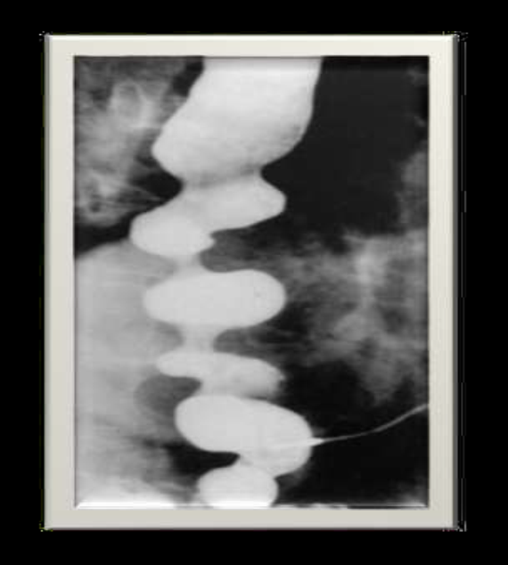
Barium Swallow

Slide 31
Barium Swallow

Slide 32
Endoscopy
Rigid
Flexible
Diagnostic
visual
biopsy
Therapeutic
foreign bodies
removal
Stentings
Dilations

Slide 33
Endoscopy

Slide 34
Endoscopy

Slide 35
TREATMENT
Life style modification
Drug therapy
Therapeutic endoscopy
Dilation
Stentings
Chemo-radiation
Surgery

Slide 36
LIFE STYLE MODIFICATION

Slide 37
ESOPHAGITIS
OVERVIEW

Slide 38
ESOPHAGITIS
Esophagitis is a general term for any inflammation, irritation, or swelling of the esophagus, the tube that leads from the back of the mouth to the stomach

Slide 39
COMMON TYPES OF ESOPHAGITIS
Reflux Esophagitis/GERD
Infectious esophagitis
  Candidiasis
  HSV
  CMV
Eosinophilic esophagitis
Pill Induced esophagitis
Radiation esophagitis
Caustic esophagitis
Esophageal cancer

Slide 40
GASTROESOPHAGEAL REFLUX DISEASE
GERD

Slide 41
DEFINITIONS OF REFLUX
Gastroesophageal reflux disease (GERD) is a condition in which the stomach contents (food or liquid) leak backwards from the stomach into the esophagus (the tube from the mouth to the stomach).
This action can irritate the esophagus, causing heartburn and other symptoms.
GERD is preferable to "reflux esophagitis“
In its milder forms, is common.
Its most severe forms is uncommon but life-threatening.

Slide 42
DEFINITIONS OF REFLUX
Clinical manifestations occurs as a result of reflux of stomach & duodenal contents into the esophagus.
Characterized by any combination of symptoms, radiologic, endoscopic, or pathologic changes.
GERD may be associated with a sliding HH, but "symptomatic HH" is an anatomic entity & not the underlying pathophysiology in GERD.

Slide 43
PATHOGENESIS.
The most common event :
Transient relaxation of the LES unassociated with swallowing or the distention of the esophagus.
2 abnormalities:
A LES with very low tone & pressure.
Inappropriate relaxation of a normally competent sphincter.
Acid within the esophagus is cleared less well by pts with GERD than by normal subjects.

Slide 44
PATHOGENESIS.
Gastric acid
Bile salts & pancreatic enzymes, may be responsible if acid is absent.
The combination of bile salts plus acid is more injurious to the esophagus than either agent alone.
Altered or abnormal esophageal mucus
Abnormal saliva content.
Diminished resistance of the esophageal mucosa to digestion.

Slide 45
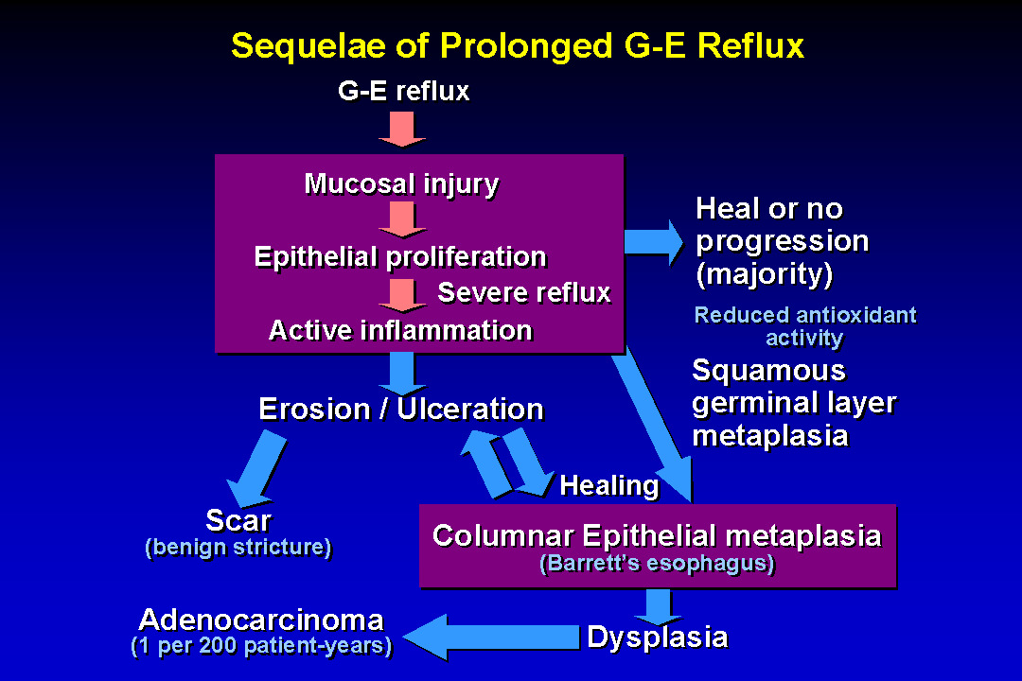
Notes:
13. Sequelae Of Prolonged G-E Reflux.
Gastroesophageal reflux damages the surface epithelium leading to increased turnover of epithelial cells (reflux change - see slides 5, 9 and 10). If reflux is of limited duration, increased epithelial cell production leads to healing. However, reflux commonly persists at a low level producing continuing low grade damage to the epithelium that is manifested by continuing reflux change on biopsy.
If reflux induced cell loss exceeds epithelial replacement rate, esophageal erosions and/or ulcers develop. Granulation tissue will develop at the base of unhealed ulcers and can then mature as scarring, and may ultimately lead to a benign esophageal stricture. Healing of the ulcer may occur by re-epithelialization with squamous cells, especially if the frequency and severity of G-E reflux decreases. Alternatively, the mucosal defect may be repaired by ingrowth of a more acid resistant columnar epithelium from contiguous cardia (1). This gastric-type surface epithelium usually shows evidence of metaplasia as demonstrated by presence of goblet cells. This metaplastic columnar epithelium is called Barrett’s epithelium of “distinctive” or “specialized” type. Another possible explanation for appearance of the columnar Barrett’s epithelium in the distal esophagus is that multipotential undifferentiated stem-type cells showing both squamous and columnar cell markers are stimulated by the reflux injury to proliferate in order to repair the damaged epithelium (2,3). This could occur by direct conversion of squamous epithelium to the Barrett’s type columnar epithelium either with or without initial presence of ulceration.
1) Hamilton SR. Pathogenesis of columnar cell-lined (Barrett’s) esophagus. In: Spechler SJ, Goyal RK (Eds.) Barrett’s Esophagus, New York, Elsevier, 1985, pgs. 29-37.
2) Boch JA, Shields HM, Antonioli DA, Zwas F, Sawhney RA, Trier JS. Distribution of cytokeratin markers in Barrett’s specialized columnar epithelium. Gastroenterology. 1997;112:760-5.
3) Glickman JN, Chen Y-Y, Wang HH, Antonioli DA, Odze RD. Phenotypic characteristics of a distinctive multilayered epithelium suggests that it is a precursor in the development of Barrett’s esophagus. Am J Surg Pathol 2001;25:569-578.

Slide 46
GERD RISK FACTORS
The risk factors for reflux include
hiatal hernia
Pregnancy
Scleroderma
Obesity
Cigarettes
Alcohol
Certain meds:
  Anticholinergics
  Beta blockers, CCB
  Bronchodilators
  Dopamine
  Sedatives/anxiety meds, tricyclic antidepressants

Slide 47
GERD RISK FACTORS
Pregnancy:
From increased abdominal pressure by the fetus.
Diminished LES strength caused by increased estrogen & progesterone.
Weight gain also aggravate reflux through an unknown mechanism.
Resection of the lower esophageal area for cancer or myotomy for achalasia.
Hiatus hernia is not significantly ass

Slide 48
SYMPTOMS.
Heartburn-the most common- can be severe markedly limiting a pt's lifestyle.
Regurgitation of gastric contents- into the mouth or into the respiratory tree:
Respiratory tree-nocturnal wheezing, coughing, hoarseness, a need to clear the throat repeatedly, or a sensation of deep pressure at the base of the neck.

Slide 49
SYMPTOMS.
Dysphagia- often present may progress to stricture
Blood loss - may result from esophageal erosions & shallow ulcers.
Rarely life-threatening hemorrhage & much likely chronic low grade, producing IDA.
Some have very few other clinical manifestations & discovered by endoscopy during evaluation of occult GIB.
Alcohol abuse produce severe erosive esophagitis with bleeding.
In these abstinence from alcohol is important.

Slide 50
DIAGNOSIS.
History &clinical manifestations are the most important .
Objective testing quantify the extent & severity.
diagnosed by typical symptoms & the response to Rx.
Diagnostic evaluation becomes important when symptoms are atypical &/or do not respond to therapy.

Slide 51
DIAGNOSIS
Diagnosis include:
  Documenting reflux.
  Linking reflux to symptoms.
  Assessing the effect of reflux on eso mucos.

Slide 52
DOCUMENTING REFLUX
Barium studies
Reflux during a barium swallow in adults is uncommon.
The absence of reflux radiographically does not exclude GERD.
The 24-hour monitoring of esophageal pH.
Relationship between symptoms (heartburn, chest pain, wheezing) & episodes of acid reflux confirmed.
Repeated - prolonged bursts of acid exposure suggest that abnormal GERD.

Slide 53
ASSESSING THE EFFECT OF REFLUX ON THE ESOPHAGEAL MUCOSA.
A barium swallow detects gross changes, as stricture or ulcer
Misses shallow ulcerations - erosions, detected by OGD.
On OGD only lesions such as erosions & ulcerations should be taken as proof of esophageal damage.
In 50% with moderate - severe symptoms, the mucosa appears absolutely normal, but a biopsy may demonstrate histologic changes(NERD).

Slide 54
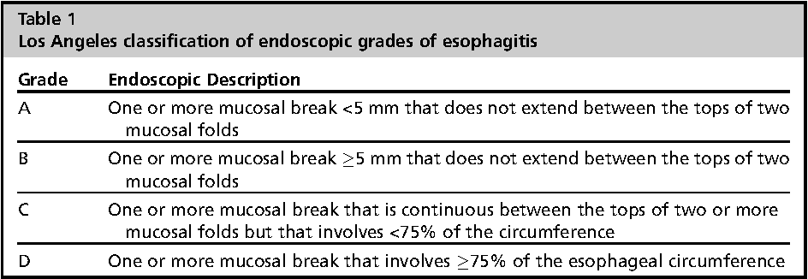
CLASSIFICATION SYSTEM

Slide 55
APPROACH TO THE PATIENT
Endoscopy indicated if:
  Hematemesis is present.
  Prolonged symptoms
  No response to empiric treatment.
  Systemic manifestations-weight loss, anemia.
  Occult blood–positive stool are present.
If the appearance of the esophageal mucosa is normal during endoscopy take biopsies to search for objective evidence of microscopic esophagitis (NERD).

Slide 56
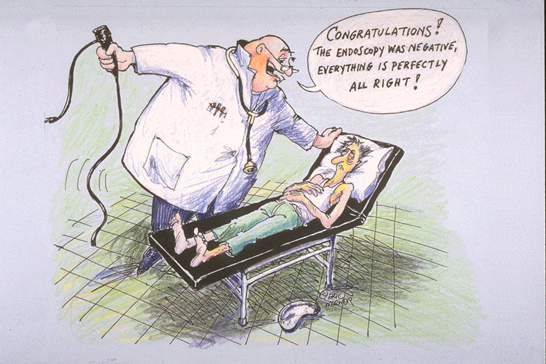
GI symptoms
bother me!
I’m worried
and concerned
Heartburn
disturbs my sleep
I cannot bend
over or exercise
I cannot eat and drink whatever
I like
My whole life is
affected

Slide 57
APPROACH TO THE PATIENT
After first evaluation, it may be appropriate to begin empiric Rx.
If the response to Rx is poor, esophageal pH monitoring can confirm the diagnosis.
At the same time, esophageal manometry may be performed to estimate LES pressure
If dysphagia is present, a barium swallow is appropriate,
This may reveal reflux, stricture or a deep ulcer seen, which leads to immediate endoscopy for more complete evaluation.

Slide 58
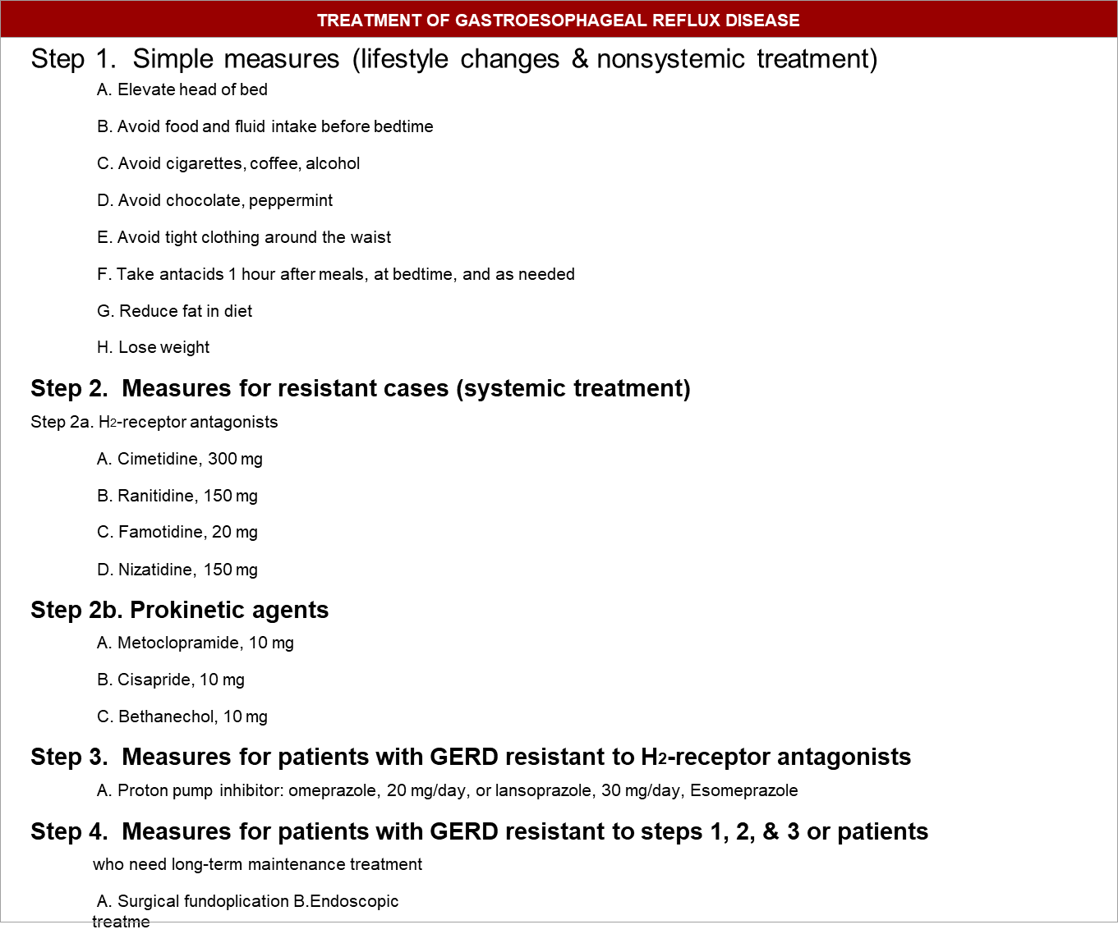

Slide 59
TREATMENT
PPIs more effective compared to H2 receptor antagonists
  Omeprazole 20-40 mg/day
  Esomeprazole 20-40 mg/day
  Lansoprazole 30-60mg/ day
4 weeks- non- erosive GERD
8 weeks –erosive GERD

Slide 60
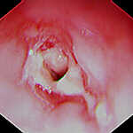
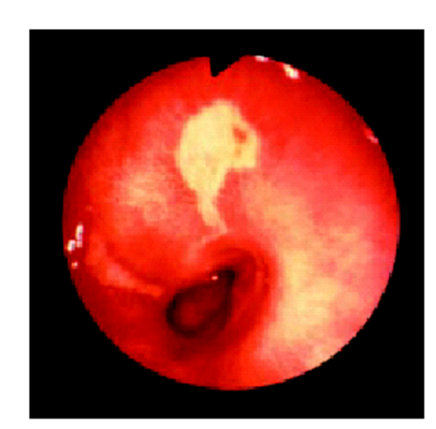
COMPLICATIONS.
1.ESOPHAGEAL STRICTURE
Only a few develop strictures.
2. ESOPHAGEAL ULCER
Characteristically produce severe & unrelenting pain, often with radiation of the pain to the back
Can brisk hemorrhage.
The ulcer usually is in columnar (Barrett's) epithelium.

Slide 61
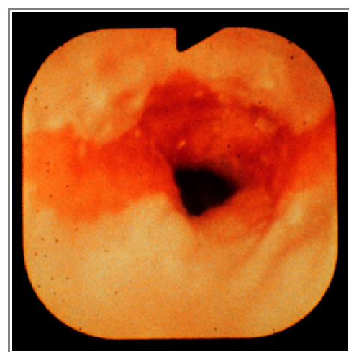
3.BARRETT'S ESOPHAGUS (COLUMNAR EPITHELIUM).
The presence on biopsy of specialized columnar epithelium with goblet cells in the esophagus.
In some patients with chronic reflux esophagitis, the healing epithelium replaced with a specialized columnar epithelium with intestinal metaplasia.
The junctional zone between squamous & columnar (Barrett's) epithelium can progress upwards over years.

Slide 62
4.PULMONARY ASPIRATION.
Into the larynx & tracheobronchial tree.
Produces mild laryngeal or respiratory symptoms or hoarseness or intense respiratory stridor.
The gastric contents do not have to reach the larynx,
acid in the esophagus can cause closure of small bronchi by a vagal reflex Or volatile HCL can reach upper airways.
Wheezing, hoarseness, or coughing occur.
Treatment of reflux followed by disappearance of pulmonary symptoms may confirm the relationship.

Slide 63
Possible extraesophageal manifestations of GERD
Asthma
Sinusitis
Dental erosions
Reflux laryngitis
Vocal cord ulcers
Subglottal/tracheal stenosis
Laryngospasm

Slide 64
INFECTIVE ESOPHAGITIS
OVERVIEW

Slide 65
CAUSES OF INFECTIOUS ESOPHAGITIS
The primary infectious causes of esophagitis are fungal and viral.
There are also case reports of bacterial esophagitis and esophagitis caused by parasites, but these are quite rare.
The most common fungal infection causing esophagitis, and the most common form of infectious esophagitis overall, is Candida esophagitis.
Viral esophagitis is generally caused by one of two viruses: herpes simplex virus or cytomegalovirus.

Slide 66
RISK FACTORS
The patient populations affected by esophageal infections are those that are immunocompromised.
  These include transplant patients, patients receiving radiation therapy, and HIV-infected patients.
Patients with an esophageal stricture from achalasia→ In these patients, the esophagus does not empty normally, thus compromising the esophageal defense mechanisms. These patients can occasionally develop Candida esophagitis.

Slide 67
RISK FACTORS
Patients taking antibiotics can also develop Candida esophagitis
A diabetic patient with poorly controlled hyperglycemia can develop Candida esophagitis
It is very rare that viral esophagitis from acute herpes simplex or cytomegalovirus will occur in a healthy individual. These etiologies, particularly cytomegalovirus, are almost exclusively associated with severe immunocompromise.

Slide 68
How is infectious esophagitis differentiated from reflux esophagitis?
There is little symptomatic overlap between infectious esophagitis and reflux esophagitis.
Reflux manifests in the chest as heartburn or in the throat as regurgitation.
Infectious esophagitis presents symptomatically as a difficulty with swallowing saliva.
Patients with severe esophagitis with deep ulceration will develop painful swallowing or odynophagia regardless of the cause
Candida esophagitis generally causes dysphagia, or slow movement of food bolus through the esophagus.
From a diagnostic standpoint, if a patient has classic reflux symptoms and very painful swallowing, it may be severe erosive esophagitis.
However, if the same patient is at risk for infection (eg, AIDS), one should suspect an infection instead of reflux.

Slide 69
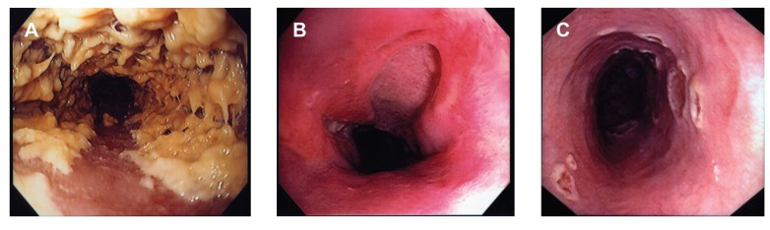
A- candida; B- CMV; C- Herpes simplex

Slide 70
MANAGEMENT
Depends on causative microorganism
YEAST INFECTION
(1st line)
Fluconazole 200mg po daily 14-21 days
Itraconazole 200mg po daily 14-21 days
(2nd line)
Amphotericin B 0.3-0.7mg/kg IV daily

Slide 71
MANAGEMENT
HERPES SIMPLEX
Acyclovir 200mg po 5 times daily 7-10 days
Acyclovir 400mg po tid 7-10 days
Famciclovir 250mg tid po 7-10 days
Valacyclovir 1g bd po 7-10 days
For resistant cases, intravenous foscarnet, 60 mg/kg every 8 hours for 2 to 4 weeks, is effective

Slide 72
MANAGEMENT
CMV
Intravenous ganciclovir, 5 mg/kg every 12 hours for 2 to 4 weeks
For resistant cases, foscarnet is administered intravenously at 60 mg/kg every 8 hours for 2 to 4 weeks

Slide 73
PILL-INDUCED ESOPHAGITIS
commonly develops in patients, particularly the elderly, who are taking medication improperly (i.e., while supine or with too little liquid).
It also occurs in patients with a preexisting abnormality, such as a stricture, diverticulum, or motor disorder.
Pills adhere to the esophageal mucosa and cause necrosis and ulceration by the topical release of caustic medication

Slide 74
MANAGEMENT
Discontinuation of the offending medication
Treatment with sucralfate suspension (1 g orally four times a day for 1 to 2 weeks) or a cocktail (equal parts viscous lidocaine, antacid, and diphenhydramine [Benadryl]) may control the symptoms.
Once-a-day PPI therapy is useful to prevent aggravation by reflux.
Education about the proper method of taking medication may prevent recurrence

Slide 75
RADIATION ESOPHAGITIS
Occurs after chest radiation therapy
Severe esophagitis and ulceration can develop and lead to hemorrhage, perforation, or fistula.
Substernal pain, odynophagia, and dysphagia are typical.
Barium swallow and endoscopy can demonstrate the extent and severity of mucosal inflammation, ulceration, and luminal narrowing
Endoscopy has the added benefit of biopsy for exclusion of infectious esophagitis

Slide 76
MANAGEMENT
A liquid diet or intravenous fluids plus the treatments described for pill-induced esophagitis are helpful.
Strictures may require dilation or even esophagectomy with colonic or jejunal interposition.

Slide 77
EOSINOPHILIC ESOPHAGITIS
uncommon, immunologically mediated entity
a chronic, immune/antigen-mediated, esophageal disease characterized clinically by symptoms related to esophageal dysfunction and histologically by eosinophil-predominant inflammation
The disease is due to food allergy and can be manifested as chest pain or heartburn, but solid food dysphagia and food impaction are characteristic.
Skin testing and a radio allergosorbent assay (RAST) for allergy should be performed to identify and remove the offending agent or agents—the most common being seafood, nuts, milk, eggs, and soy. Dietary changes

Slide 79
CAUSTIC ESOPHAGITIS
occurs from accidental ingestion in children and from suicidal attempts in adults.
Among the more common materials ingested are drain cleaners (sodium hydroxide), bleach (sodium hypochlorite), detergents (sodium tripolyphosphates), and disc batteries (sodium hydroxide).
has the potential to cause acute ulceration, perforation, and later stricture formation

Slide 80
CAUSTIC ESOPHAGITIS
When perforation is excluded by contrast swallows, endoscopy may be of value to assess the esophageal injury, but passage of the scope beyond an area of severe injury is not recommended to avoid perforation.
Emergency esophagogastrectomy is indicated for free perforation and mediastinitis
In the absence of these complications, esophagitis is treated supportively with intravenous fluids and prophylactic antibiotics.
Steroids in tapering dosage are often given but are without proven efficacy

Slide 81
BARRETT’S ESOPHAGUS
Barrett's esophagus is replacement of reflux-damaged squamous epithelium in the distal part of the esophagus by metaplastic, specialized columnar epithelium.
It is found in 10 to 15% of patients with GERD, principally in white individuals.
The lesion is suspected on endoscopy by the presence of reddish epithelium extending from the stomach into the tubular lumen of the esophagus

Slide 83
BARRETT’S ESOPHAGUS
Confirmation is by biopsy.
Barrett's metaplasia is a premalignant lesion that increases the risk for esophageal adenocarcinoma 30- to 125- fold over that of the general population.
Factors that increase the risk for malignancy in Barrett's esophagus include:
  white race
  male sex
  alcohol and tobacco use
  obesity
  and its length.

Slide 84
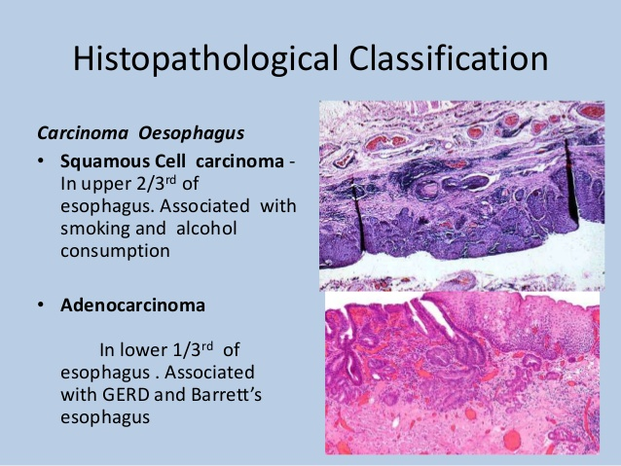

Slide 85
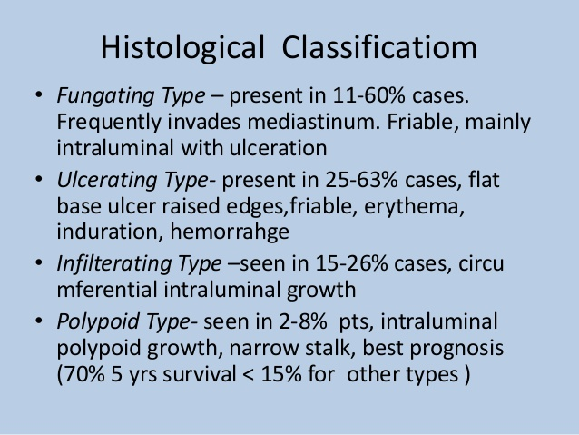

Slide 86
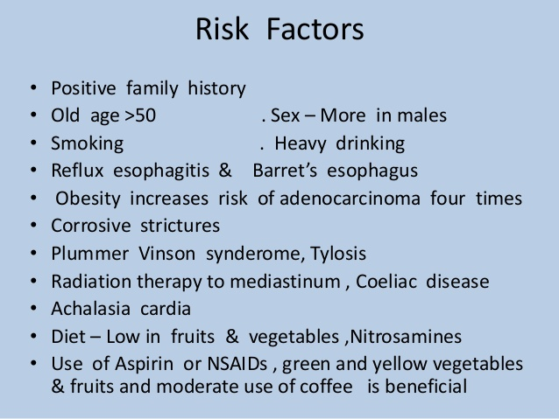

Slide 89
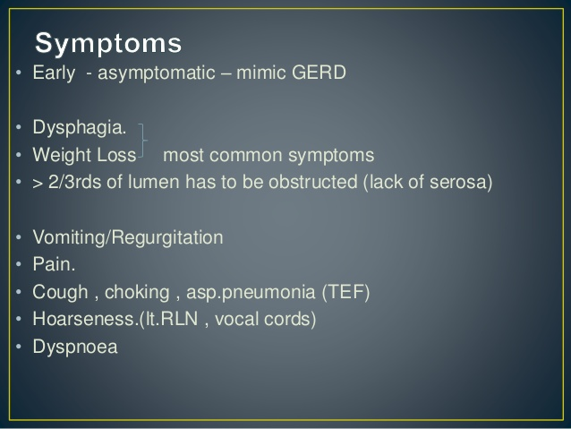

Slide 90
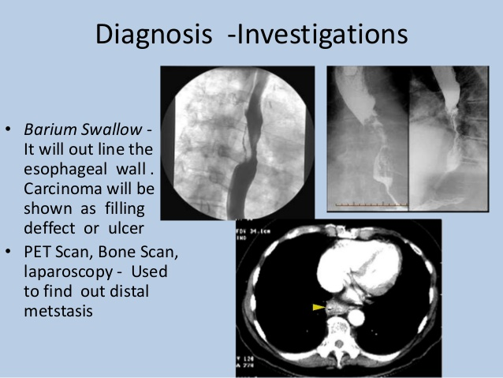

Slide 91
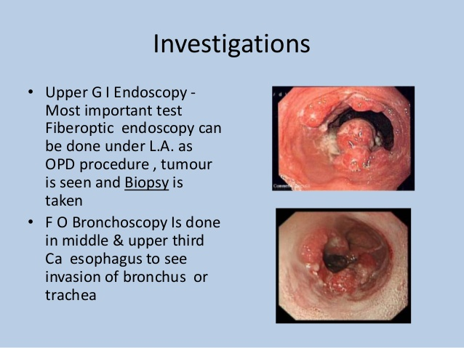

Slide 92
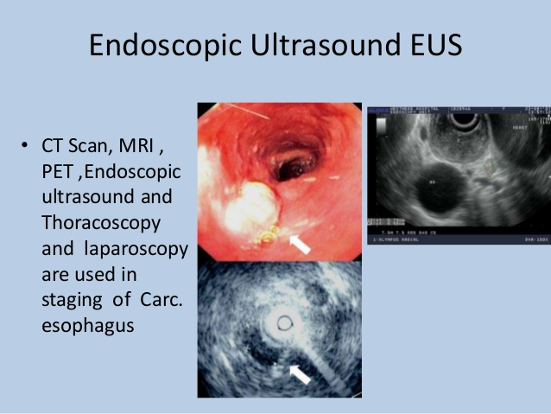

Slide 93
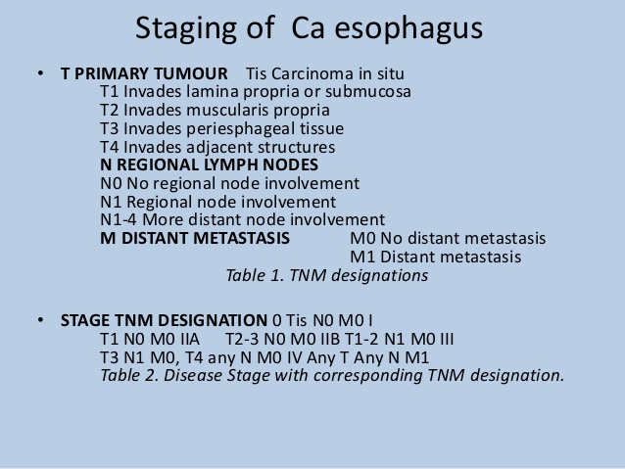

Slide 94
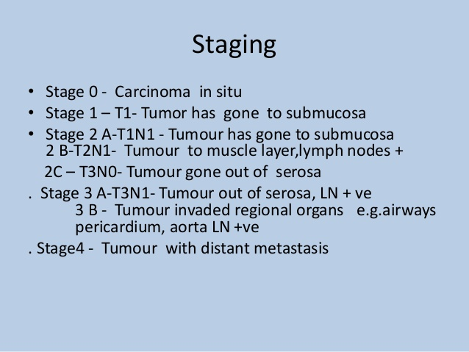

Slide 95
ESOPHAGEAL CANCER
Diagnostic evaluation starts with
Endoscopy (EGD)
Endoscopic ultrasound (EUS)
The two major treatment options for early esophageal cancer are surgical esophagectomy and endoscopic therapy.
The depth of tumor invasion into the wall of the esophagus is an important factor in selecting treatment.

Slide 96


