Slide 1
Chronic complications of DM(Microvascular)
Mamaru S.(R2)
Moderator: Dr. Tewodros, Endocrinology Fellow
Feb,2020

Slide 2
Outlines
Introduction
Classification
Mechanisms of complications
Microvascular complications
Pathogenesis
Clinical features and dx
Management
References

Slide 3
Introduction
The chronic complications of DM affect many organ systems and are responsible for the majority of morbidity and mortality associated with the disease
The importance of tight glycemic control for protection against microvascular and cardiovascular disease in diabetes has been studied in multiple trials.

Slide 4
Classification of CXNS
Hyperglycemia related
Result of chronic hyperglycemia
Takes decades(2)
Insulin resistance related
May occure before diagnosis of DM(type 2)

Slide 5
Classification
CHRONIC COMPLICATIONS
VASCULAR
NON -VASCULAR
Microvascular
Macrovascular
Gastroparesis
Infections
Sexual dysfunction
Dermatologic Neurocognitive abn.
Glaucoma, cataract
Hearing loss
Retinopathy
Nephropathy
Neuropathy
PAD
CAD
CVD

Slide 6
Mechanism of CXNs
The mechanism(s) by which hyperglycemia leads to such diverse cellular and organ dysfunction is unknown
Four prominent theories
Formation of AGEs
Sorbitol pathway
Formation of diacylglycerol
Hexosamine pathway

Slide 7
Microvascular complications
Shared pathophysiologic features
Intracellular hyperglycemia- endothelial cells are most affected cells
Abnormal cell function
Increase in vessel wall protein accumulation
Microvascular cell loss
Post hyperglycemic memory
Genetic susceptibility
Micro-RNAs
Progenitor cells

Slide 8
Hyperglycemia VS complications:DCCT/EDIC

Slide 9
1.Ocular complications
Diabetics are 25x more likely to become legally blind than individuals without DM
Type 1 DM pts have higher risk of ocular complications
25% of diabetic patients will have retinopathy after 5 years
60% of them at 10 years and
80% of them at 15 years
67% of type 1 DM patients for >35 years will have PDR
Severe vision loss is primarily the result of
Progressive diabetic retinopathy
Clinically significant macular edema

Slide 10
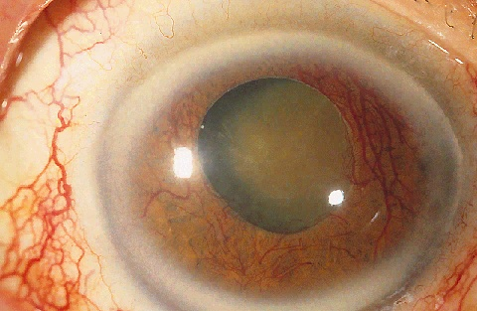
Ocular complications -manifestations
Retinopathy
Maculopathy
Cataract
Glaucoma-neovascular
Iris neovascularization
Corneal changes
CN neuropathy

Slide 11
Diabetic Retinopathy—Pathogenesis(1)
Primarily affects microvascular circulation
Precise pathological sequence unknown
Several theories of pathogenesis
Notes:
4
4
4
4

Slide 12
Diabetic Retinopathy-Pathogenesis(2)
NPDR- Pathogenesis
The pathophysiologic mechanisms invoked in NPDR include
Loss of retinal pericytes
Increased retinal vascular permeability
Alterations in retinal blood flow, and
Abnormal retinal microvasculature>>>all of which lead to RETINAL ISCHEMIA
Notes:
Pericytes are contractile cells that wrap around the endothelial cells of capillaries and venules through out the body
Also known as Rouget cells or mural cells
These are embedded in the basement membrane where they communicate with endothelial cells of the body’s smallest blood vessels by means of both direct physical contact and paracrine signaling

Slide 13
Diabetic Retinopathy-Pathogenesis(3)
PDR- Pathogenesis
This ischemic injury is followed by subsequent release of vasoproliferative factors [such as vascular endothelial growth factor (VEGF), erythropoietin, and many others in the ischemic retinal area
These diffusible factors incite the development of new vessels (neovascularization) from the adjacent retinal vessels, in an abortive attempt to revascularize the diseased tissue

Slide 14
Diabetic retinopathy -classification
Notes:
This international classification describes five clinical levels of diabetic
retinopathy: no apparent retinopathy (no abnormalities),
mild NPDR (microaneurysms only), moderate NPDR (more
than microaneurysms only but less than severe NPDR),
severe NPDR (any of the following: more than 20 intraretinal hemorrhages in each of four retinal quadrants, definite
venous beading in two or more retinal quadrants, prominent intraretinal microvascular abnormalities in one or
more retinal quadrants, and no PDR), and PDR (one or
more of retinal neovascularization, vitreous hemorrhage,
or preretinal hemorrhage). Table 33-2 compares levels of
retinopathy in the international classification to those
defined by the landmark ETDRS

Slide 15
Diabetic Macular edema

Slide 16
Classification…..

Slide 17
Risk factors
Duration of DM
Poor glycemic control
Renal disease
HTN-PDR
Dyslipidemia

Slide 18
Screening

Slide 19
Management of DR and DME
Optimize glycemic control, BP and lipid control
Retinal leather photocoagulation
Anti-angiogenic factors-intravitrous injection
Medical Vitrectomy
Hyaluronidase
Chondroitinase
Plasmin
Vitrectomy

Slide 20
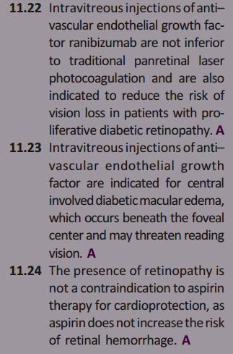
Treatment recommendations-ADA 2020

Slide 21
Management algorithm

Slide 22
Follow up

Slide 24
2. Diabetic Kidney disease
Complicates 20-40 % of diabetic patients
Typically after 10 years of type 1 DM
May occure at Dx of type 2 Dm
Leading cause of ESRD in US
Presence of CKD markedly increases CVD risk
DM pts are at high risk of developing AKI
Medications for glycemia and other comorbidities

Slide 25
pathogenesis
Several pathogenetic mechanisms are thought to be involved:-
Hyperglycemia: necessary to the development of diabetic nephropathy and sustainment of the lesions
Hyperglycemia may directly induce mesangial expansion and injury, perhaps in part via increased matrix production or glycation of matrix proteins.
Hyperglycemia induces production of AGEs
Hemodynamic mechanisms
Glomerular hyperfilteration and hypertension
Increased IGF, Intracellular accumulation of Sorbitol, Formation of AGEs and Increased Na reabsorption

Slide 26
pathogenesis
Cytokines
Activation of cytokines, profibrotic elements, inflammation, and vascular growth factors (vascular endothelial growth factor, VEGF) may be involved in the matrix accumulation in diabetic nephropathy
Other mechanisms
Glomerular mononuclear cell infiltration may also be associated with diabetic nephropathy.
The various hypothesis overlap and intersect

Slide 27
Diabetic nephropathy- pathology

Slide 28
Risk factors
Genetic susceptibility
Risk increased if diabetic sibling or parent who has diabetic nephropathy
Age
Association with DN is uncertain
Race
Blacks are more likely to develop diabetic nephropathy compared to Caucasians.
High Blood pressure
↑ GFR
In type 1 DM, ↑ GFR early in the disease is associated with ↑ propensity to develop microalbuminuria.
Poor Glycemic control (higher HgA1c levels)
Obesity
Smoking

Slide 29
Diabetic nephropathy- natural history
Less well understood in type 2 Dm than Type 1 Dm
May be due to long undiagnosed hyperglycemia
Other comorbidities in type 2 dm
Possible similar natural history

Slide 30
Manifestations
DX=clinical-typical
Persistent protienuria without hematuria
Long duration of DM
Retinopathy –most type 1
Progressive decrement of eGFR+HTN
Some exceptions
CKD may be present at diagnosis and without retinopathy
Low GFR without albuminuria –in type 1 DM

Slide 31
Management-ADA 2020
Glycemic control
Target – near normoglycemia
Outcomes lag 2-10 years
Selection of medications
Metformin- CI if eGFR<30
Shouldn’t be started if eGFR<45
D/C metformin for a while for eGFR 30-60 having iondine containing contrast imaging

Slide 32
Management- glycemic control/ADA-2020
SGLT2 inhibitors
have direct renal effects
Decrease renal oxidative stress by >50%
GLP-1 RA also have improves renal outcomes
Both groups have
Less risk of hypoglycemia
Less risk of CVD events
Less risk of CKD progression
Evidences –EMPA-REG,CANVAS,LEADER,SUSTAIN-6- secondary endpoints
CREDENCE-primary endpoint

Slide 33
Management – Nutrition-ADA-2020
Non-dialysis dependent CKD-
Protien-0.8gm/kg/d
Dialysis dependent patients- higher dietary protein
Dietary sodium and potassium restriction for pts with advanced CKD

Slide 34
Management – BP management- ADA 2020
Target BP-<140/9
reduced risk of CKD progression and risk of CVD events
UACR>=300 mg/gm
ACEI/ARBs- proven benefits of CKD progression,CVD events
UACR 30-299 mg/gm- both have benefits on progression of albuminuria and CVD events but no effect on ESRD
Both groups have similar benefits and risks

Slide 35
3. Diabetic neuropathy
Diabetic neuropathy occurs in 50% of individuals with long-standing type 1 and type 2 DM
It may manifest as polyneuropathy, mononeuropathy, and/or autonomic neuropathy
Associated with the duration of diabetes and glycemic control.
Other risk factors: Smoking, Increased BMI
Diagnosis of exclusion

Slide 36
Classification
Classified depending on the component of the peripheral nervous system that is affected
Distal Symmetric polyneuropathy- most common
Mononeuropathy
Mononeuritis multiplexa
Polyradiculopathy
Autonomic Neuropathy

Slide 37
Distal Symmetric Polyneuropathy:DSP
The most common type of diabetic neuropathy
It is often considered synonymous with the term diabetic neuropathy
It is characterized by a progressive loss of distal sensation correlating with loss of sensory axons, followed, in severe cases, by motor weakness and motor axonal loss.
Classic "stocking-glove" sensory loss is typical in this disorder.

Slide 38
DSP: Risk Factors
Duration of hyperglycemia
Severity of hyperglycemia
Dyslipidemia
Higher BMI
Hypertension, and
Smoking

Slide 39
DSP: Pathogenesis
In diabetes, a complex array factors of shift the balance between nerve fiber damage and nerve fiber repair in favor of the former
Metabolic Factors
Vascular Factors
Nerve ischemia
Hormonal Factors

Slide 40
DSP: Clinical Features
It most frequently presents with distal sensory loss
But up to 50% of patients do not have symptoms of neuropathy.
10-18% of patients have evidence of nerve damage at the time their diabetes is diagnosed, suggesting that even early impairment of glucose handling, classified as prediabetes, is associated with neuropathy.

Slide 41
DSP: Clinical Features
It could be silent
Detected during neurologic exam or revealed by painless trauma or burns or trophic changes that include plantar ulcer’s or neuropathic osteoarthropathy (Charcot’s joints)-’painless foot deformity’
Minor motor involvement causing weakness and atrophy.

Slide 42
DSP: Clinical Features
Symptoms range from numbness (“deadness”) to severe pain.
Burning feet, pins-and-needles, alteration of temperature sensation, parasthesias, shooting, stabbing or lightning pains are common.
Burning pains can be exacerbated by contact.
Worsen at night

Slide 43
DSP: Clinical Features
With disease progression, sensory loss ascends and, when reaching approximately mid-calf, appears in the hands.
This gradual evolution causes the typical "stocking-glove" sensory loss.
This pattern reflects preferential damage according to axon length; the longest axons are affected first.
Motor involvement with frank weakness occurs in the same pattern, but only later and in more severe cases

Slide 44
DSP: Clinical Features
Loss of vibratory sensation (128Hz tuning fork) and altered proprioception reflect large-fiber loss
Impairment of pain, light touch and temperature is secondary to loss of small fibers
Decreased or absent ankle reflexes occur early in the disease, while more widespread loss of reflexes and motor weakness are late findings

Slide 45
DSP: Clinical Features
Hyperesthesia, paresthesia, and dysesthesia also may occur.
Symptoms may include a sensation of numbness, tingling, sharpness, or burning that begins in the feet and spreads proximally
Signs and symptoms progress from distal to proximal over time

Slide 46
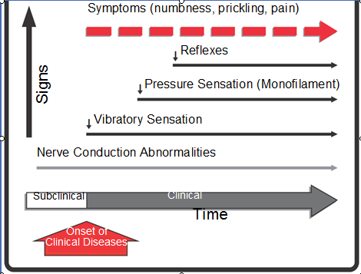
DSP: Clinical Features

Slide 47
DSP: Complications
Foot ulcer
Muscle and Joint diseases
Claw-toe deformity
Distal motor axonal loss results in atrophy of intrinsic foot muscles and an imbalance between strength in toe extensors and flexors shifts weight to the metatarsal heads

Slide 48
DSP: Diagnosis
Proposed criteria for the diagnosis of DSPN are two or more of the following:
Symptoms or signs of neuropathy
Abnormal EDx studies,
Quantitative sensory test abnormalities,
Quantitative autonomic test abnormalitities
Although DSPN is a diagnosis of exclusion, complex investigations to exclude other conditions are rarely needed

Slide 49
DSP: DDx
Up to 10-20% have other etiologies:
Metabolic etiologies: B12/ folate deficiency, Hypothyroidism, Uremia
Toxic etiologies: ETOH, Heavy metals, Medications
Inflammatory etiologies: Vasculitis, Sarcoid, SLE, Syphilis, Leprosy
Other: Paraneoplastic, Leukemia, Amyloid

Slide 50
Mononeuropathy
Mononeuropathy (dysfunction of isolated cranial or peripheral nerves) presents with pain and motor weakness in the distribution of a single nerve
Two types
Cranial Mononeuropathy
Peripheral Mononeuropathy

Slide 51
Mononeuritis Multiplex
Multiple mononeuropathies in the same patient
Also called asymmetric polyneuropathy
The other major disorder that can produce this syndrome is vasculitis, which should also be considered in affected patients

Slide 52
Polyradiculopathy
Diabetes frequently injures the nerve roots at one or more thoracic or high lumbar levels with subsequent axonal degeneration and frequent contralateral, cephalad, or caudal extension.
Affected patients are typically older, have coexisting peripheral polyneuropathy, and have weakness and atrophy in the distribution of one or more contiguous nerve roots with frequent territorial expansion

Slide 53
Polyradiculopathy
Diabetic polyradiculopathy can be classified as
Diabetic amyotrophy (lumbar polyradiculopathy)
Thoracic polyradiculopathy
Others
Fortunately, diabetic polyradiculopathies are usually self-limited and resolve over 6–12 months.

Slide 54
Prevention
Glycemic Control
Treating dyslipidemia
Treating hypertension and other cardiovascular risk factors

Slide 55
Screening (ADA 2020)

Slide 56
DSP: Screening test
Vibration sensation (128Hz tuning fork)- large fiber
Protective sensation (10gm monofilament)
Superficial pain (pinprick) or temperature sensation- small fiber

Slide 58
Treatment
Improved glycemic control
Treatment of hypertension and hyperlipidemia
Avoidance of neurotoxins (alcohol) and smoking
Supplementation with vitamins for possible deficiencies (B12, folate)
Symptomatic therapy

Slide 59
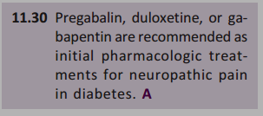
Treatment

Slide 60
Autonomic Neuropathy
Diabetic autonomic neuropathy (DAN) is classified as subclinical or clinical depending upon the presence or absence of symptoms.
Multiple organs can be involved and DAN can be classified in to four:-
Peripheral DAN
Cardiovascular DAN
Gastrointestinal DAN
Genitourinary DAN

Slide 61
Tests of autonomic neuropathy

Slide 62
Treatment of DAN
CAN
Fluid, mineralocorticoid, desmopressin, BB
GAN
Small frequent meals, plasil, erythromycin
Loperamide, octreotide
Abx for BO
GUAN
Vaginal lubricants, oestrogen, self catheterization
Sildenafil
PDAN
Stop precipitants, foot elevation, supportive stocking, diuretics, sympathomimetics

Slide 63
References
Williams textbook of endocrinology 13th ed
Uptodate 2018
ADA 2020 guideline

Slide 64
Thank You

