Slide 1
Diagnostic and Therapeutic Procedures
Samuel Ngigi K.
KMTC

Slide 2
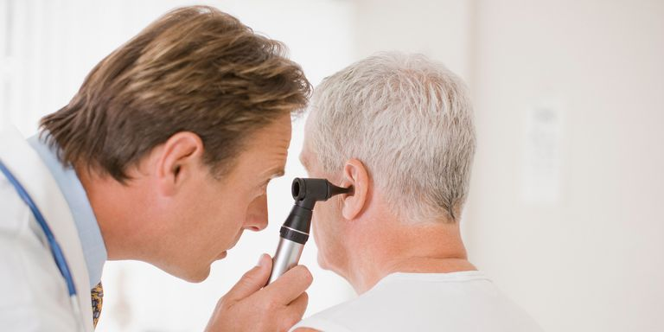
Otoscopy
Otoscopy is an examination that involves looking into the ear with an instrument called an otoscope (or auriscope).
This is performed in order to examine the 'external auditory canal' – the tunnel that leads from the outer ear (pinna) to the eardrum.
Inspection of the eardrum can also provide a lot of information about what's happening within the middle ear – the space within the skull where the hearing and balance mechanisms are situated.

Slide 3
Otoscopy cnt’d…
An otoscope consists of three parts:
the handle, which contains the power for the light source
the head, which contains the light bulb and magnifying lens
the cone, which is inserted into the ear canal.
Inspection of the outer ear
Before inserting the otoscope cone into the ear canal, the outer ear is inspected for any signs of disease that may relate to the patient's symptoms. For example, if the complaint is of ear pain, there may be evidence of an infection of the outer ear in the form of redness or slight swelling.

Slide 4
Otoscopy cnt’d…
Examination of the external auditory canal
The examination is performed by gently pulling the outer part of the ear upwards and backwards. This action straightens the external auditory canal, which has a natural curve, and makes it easier to see the eardrum.
The normal external auditory canal has some hair, often lined with yellow to brown wax. The total length of the ear canal in adults is approximately 2cm, which gives it a resonance frequency of approximately 3400 Hz, which is an important frequency region for understanding speech.
Abnormal findings may include:
a dry, flaky lining suggestive of eczema. The usual symptom is of itch.
an inflamed and swollen, narrowed canal, possibly with a discharge indicating infection (otitis externa). The usual symptoms include itch, local discomfort, a discharge and often an unpleasant smell from the ear.
wax obscuring the eardrum.
a foreign body in the ear, such as the rubber from the end of a pencil.

Slide 5
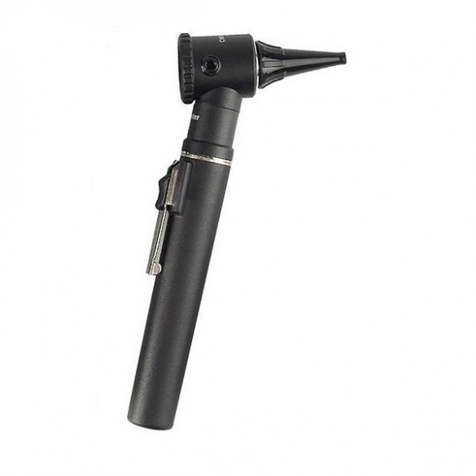
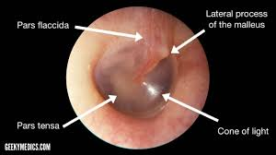
Otoscopy cnt’d…

Slide 6
Laryngoscopy
Laryngoscopy is an examination that lets your doctor look at the back of your throat, your voice box (larynx), and vocal cords with a scope (laryngoscope). There are two types of laryngoscopy, and each uses different equipment.
They may do this to figure out why you have a cough or sore throat, to find and remove something that’s stuck in there, or to take samples of your tissue to look at later.

Slide 7
Laryngoscopy Cnt’d…
Indirect laryngoscopy
For the indirect method, you’ll sit up straight in a high back chair. Numbing medicine or a local anesthetic will usually be sprayed on your throat. Your doctor will cover your tongue with gauze and hold it to keep it from blocking their view.
Next, your doctor will insert a mirror into your throat and explore the area. You might be asked to make a certain sound. This is designed to make your larynx move. If you have a foreign object in your throat, your doctor will remove it.

Slide 8
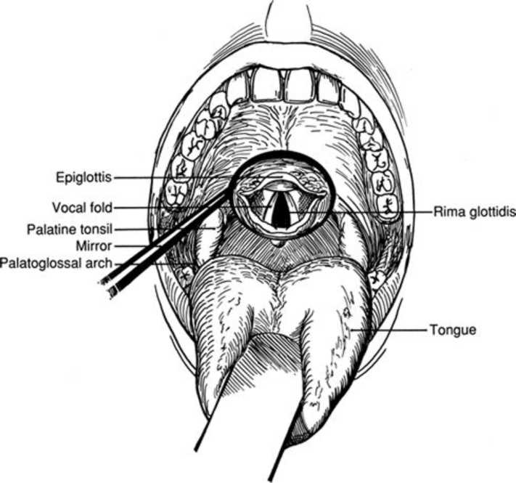
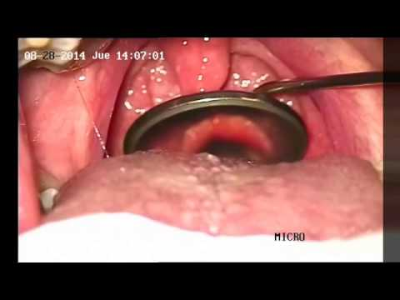
Laryngoscopy Cnt’d…

Slide 9
Laryngoscopy Cnt’d…
Direct laryngoscopy
The direct laryngoscopy can happen in the hospital or your doctor’s office, and usually you’re completely sedated under expert supervision. You won’t be able to feel the test if you’re under general anesthesia.
A special small flexible telescope goes into your nose or mouth and then down your throat. Your doctor will be able to look through the telescope to get a close view of the larynx. Your doctor can collect samples and remove growths or objects.

Slide 10
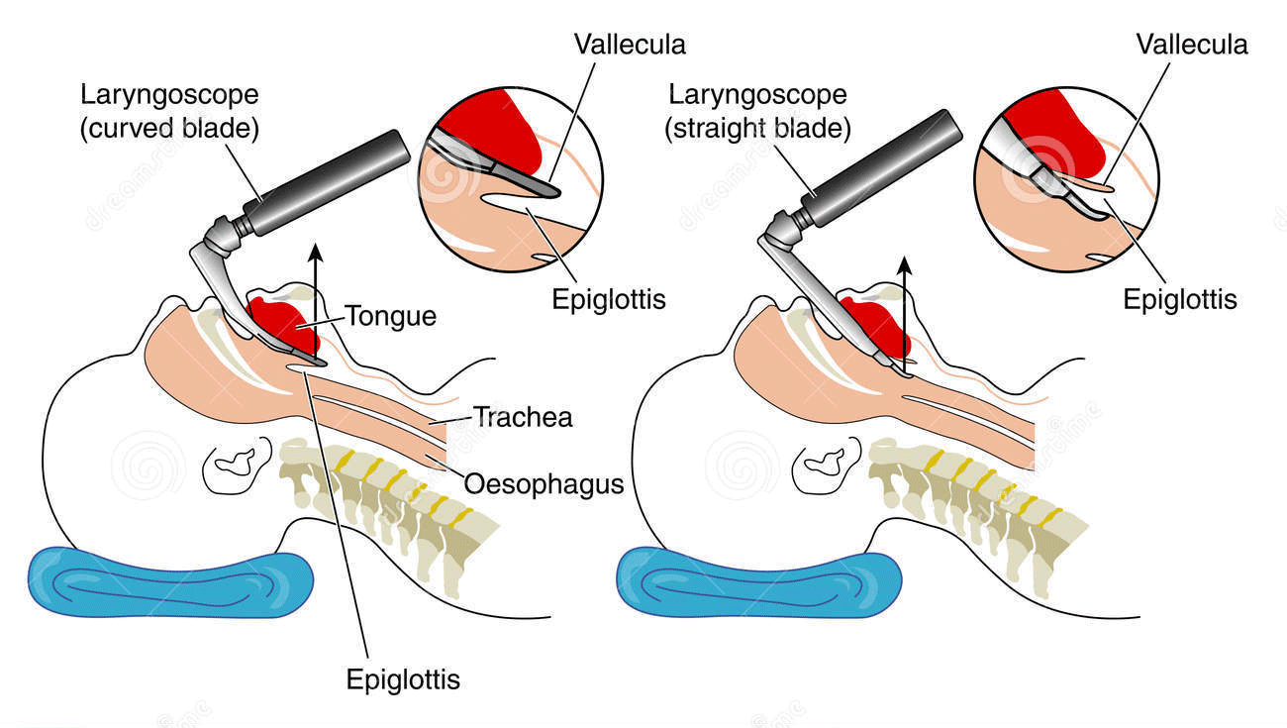
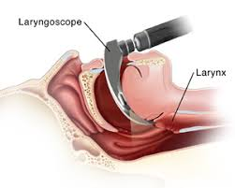
Laryngoscopy Cnt’d…

Slide 11
Laryngoscopy Cnt’d…
Possible Complications
It’s rare to have problems after a laryngoscopy, but it can still happen. Some of these complications include:
Pain or swelling in the mouth, tongue, or throat
Bleeding
Hoarseness
Gagging or vomiting
Infection
If you were given anesthesia, you might feel nauseous or sleepy afterward. You might have a dry mouth or a sore throat. These are common reactions to the anesthesia.

Slide 12
Ophthalmoscopy
Ophthalmoscopy (also called fundoscopy) is a test that lets a doctor see inside the back of the eye, which is called the fundus. The doctor can also see other structures in the eye. He or she uses a magnifying tool called an ophthalmoscope and a light source to see inside the eye. The test is done as part of an eye exam. It may also be done as part of a routine physical exam.
The fundus has a lining of nerve cells called the retina. The retina detects images seen by the clear, outer covering of the eye, called the cornea. The fundus also contains blood vessels and the optic nerve.

Slide 13
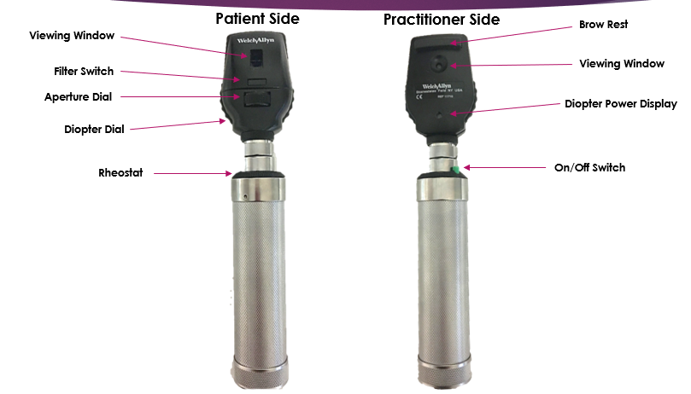
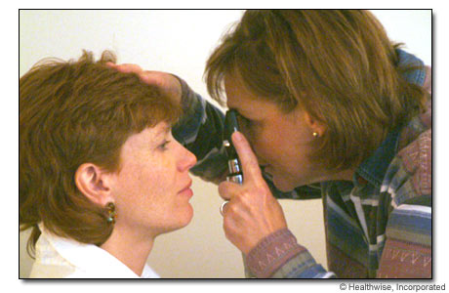
Ophthalmoscopy Cnt’d…

Slide 14
Ophthalmoscopy Cnt’d…
How Is an Ophthalmoscopy Done?
There are three main types:
Direct ophthalmoscopy: Your exam takes place in a darkened room. If you wear glasses, you’ll have to take them off. Your doctor will ask you to stare directly ahead and keep your head still. Then he'll use the ophthalmoscope to shine a light straight into your eyes. It has two or three tiny lenses that allow him to see inside.

Slide 15
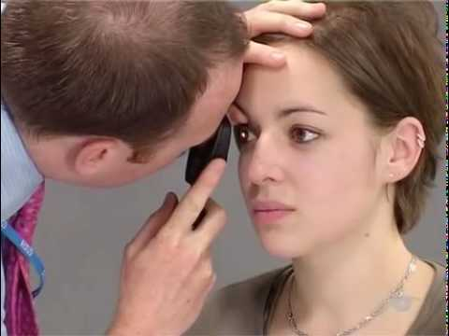
Ophthalmoscopy Cnt’d…
Direct ophthalmoscopy

Slide 16
Ophthalmoscopy Cnt’d…
Indirect ophthalmoscopy: This exam uses an indirect ophthalmoscope. It’s worn on the doctor's head and looks a lot like a miner's light.
Your doctor will have you lie down or sit in a reclined position. He’ll hold your eye open while shining the light into your eyes.
This method lets your doctor to get a much better look at the entire retina, including the front portions which are hard to see with the other methods.

Slide 17
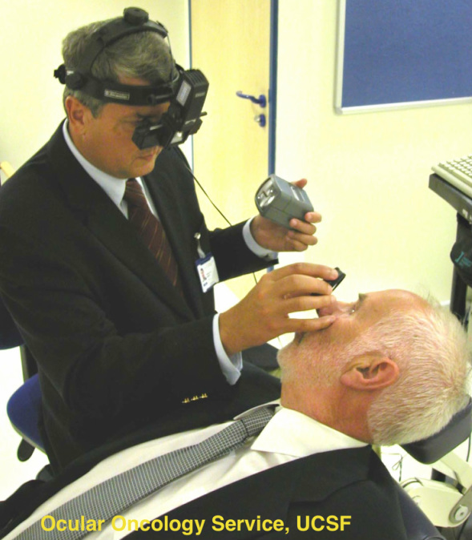
Ophthalmoscopy Cnt’d…
Indirect ophthalmoscopy

Slide 18
Ophthalmoscopy Cnt’d…
Slit-lamp ophthalmoscopy: In this exam, you'll sit in a chair in front of an instrument called a slit-lamp microscope. A slit lamp is a high-intensity light.
Your doctor will have you rest your chin and forehead on something to keep your head steady. Then he'll use the microscope and a tiny lens to look into your eye.
What the doctor sees is similar to indirect ophthalmoscopy, but the images are much bigger.

Slide 19
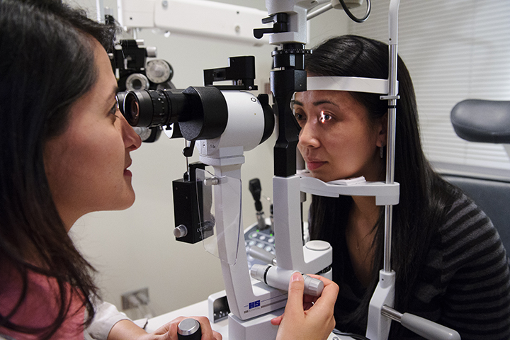
Ophthalmoscopy Cnt’d…
Slit-lamp ophthalmoscopy

Slide 20
Venepuncture
This skill involves taking blood from a patient's vein. This is then sent to the laboratory and tested for various conditions, depending upon which tests you request.
The following slides will be demonstrating the use of the Vacutainer system.
Remember that different hospitals may use different coloured blood tubes, so if you are asked to take a specific blood sample be sure to check which colour of tube you will require.
This is a core clinical skill that you should be proficient in, and as such is frequently examined on.

Slide 21
Venepuncture Cnt’d…
Procedure Steps
Step 01
Introduce yourself to the patient and confirm their identity. Explain what you are going to do and obtain consent. As this is a potentially painful procedure so explain that they may feel some discomfort and answer any questions they may have.

Slide 22
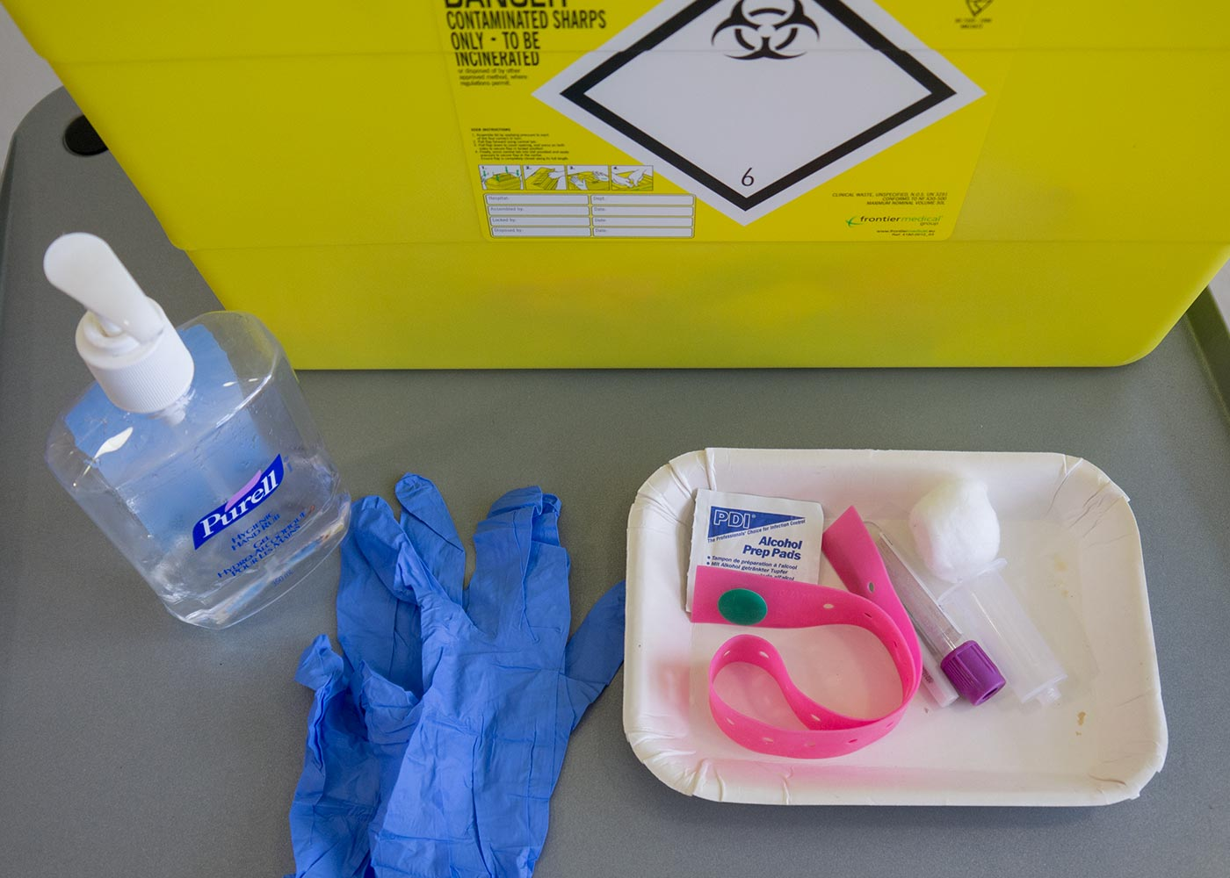
Venepuncture Cnt’d…
Step 02
Ensure that you have all of your equipment ready as follows:
Alcohol cleanser.
Gloves.
An alcohol wipe.
A disposable tourniquet.
Needle.
Needle holder.
Appropriate sample tubes.
Gauze.
A plaster.
A clinical waste bin.

Slide 23
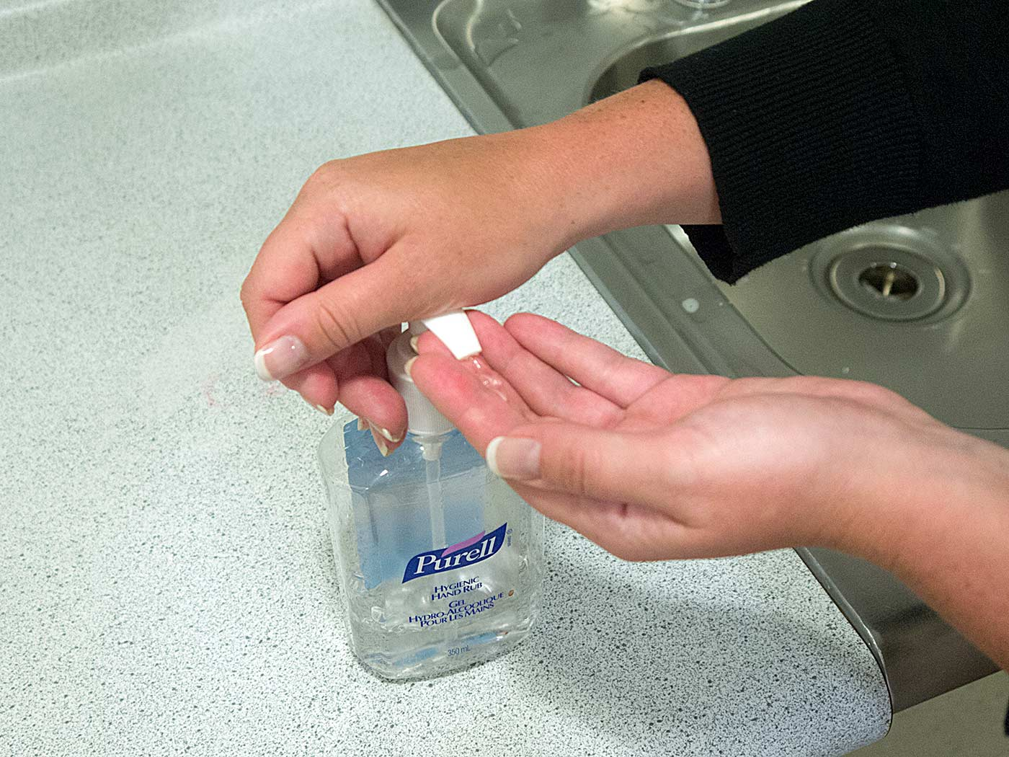
Venepuncture Cnt’d…
Step 03
Wash and sanitise your hands using alcohol cleanser.

Slide 24
Venepuncture Cnt’d…
Step 04
Place the patient’s arm in a comfortable position so that you can identify the veins. Select a vein, apply the tourniquet and re-check the vein making sure you are comfortable with its course.

Slide 25
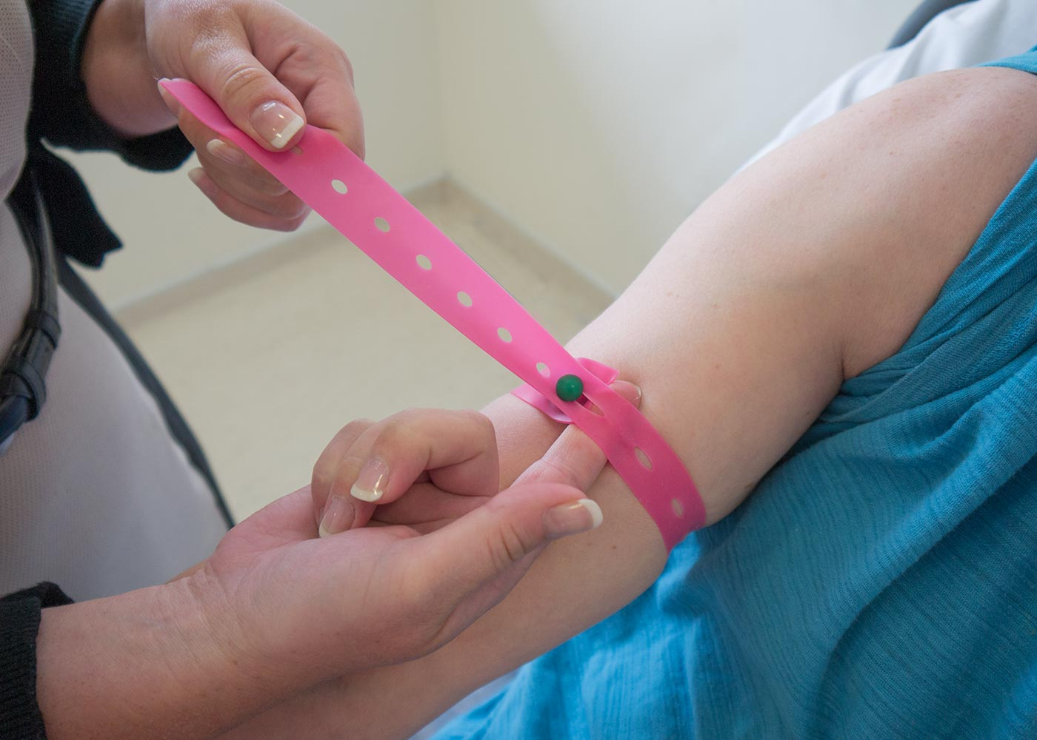
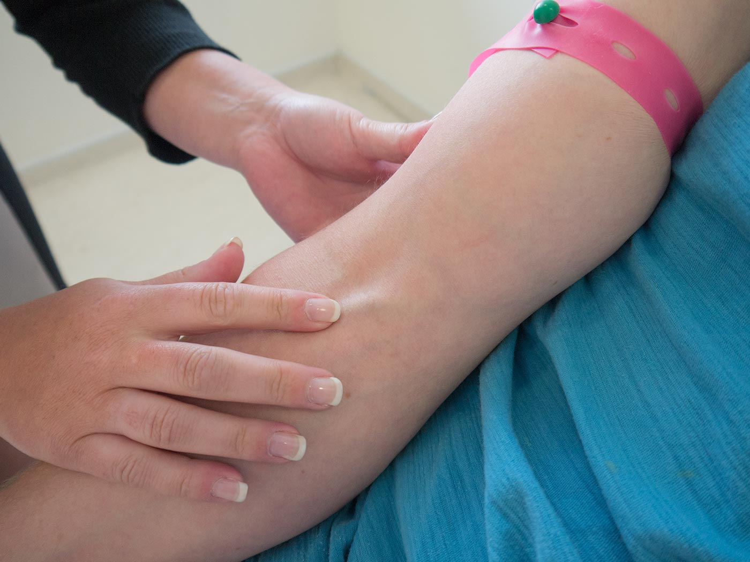
Venepuncture Cnt’d…
Applying the tourniquet
Re-check the vein

Slide 26
Venepuncture Cnt’d…
Step 05
Put on your gloves. This not only helps protect the patient but also yourself from any contact with blood should there be a spillage. It also reduces the risk of blood-borne virus transmission should you obtain a needle stick injury.

Slide 27
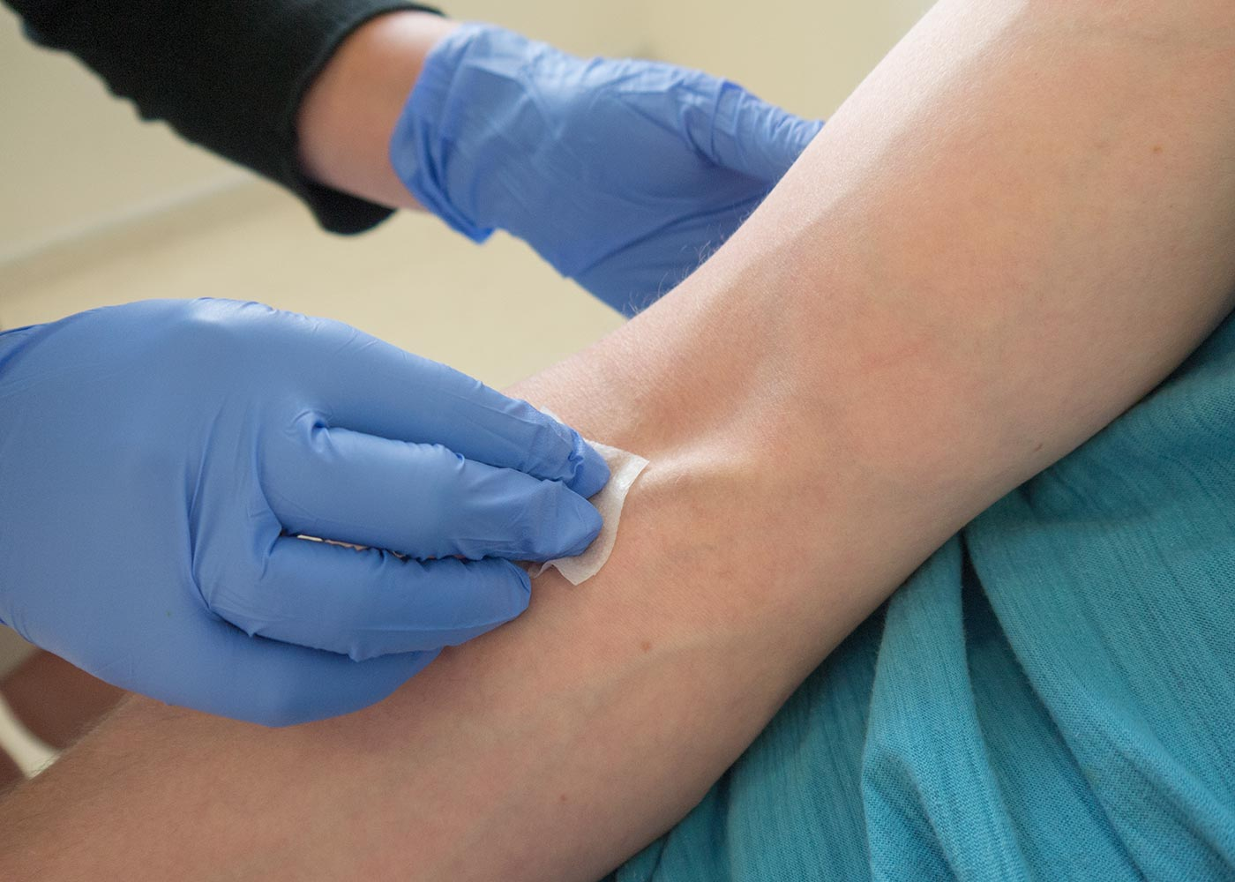
Venepuncture Cnt’d…
Step 06
Clean the venepuncture site using the alcohol wipe in downward strokes.

Slide 28
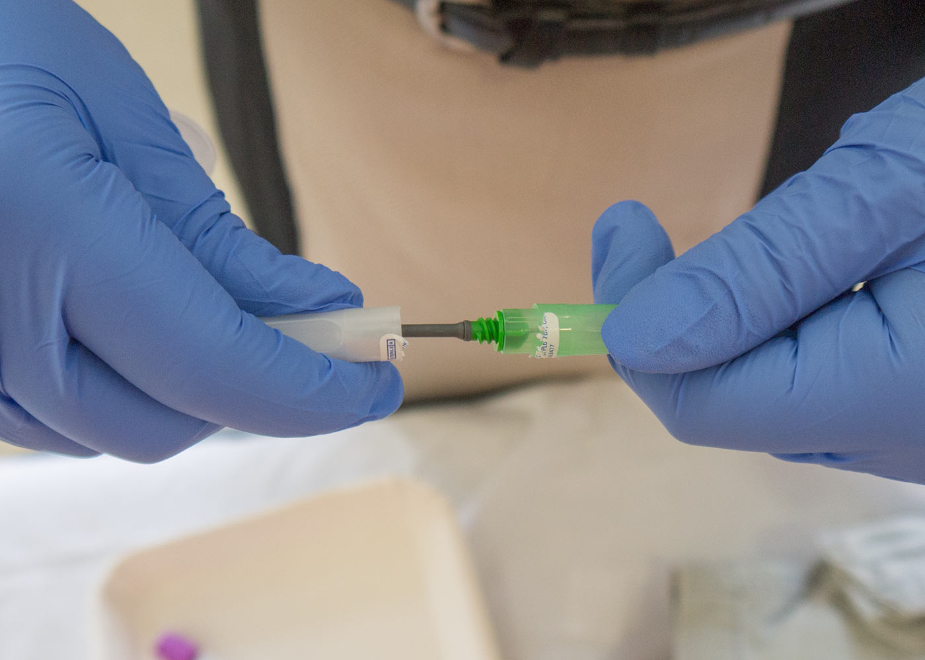
Venepuncture Cnt’d…
Step 07
Remove the grey cap from the needle, attach the needle to the needle holder, and remove the other cap to reveal the needle.
Remove the grey cap from the needle

Slide 29
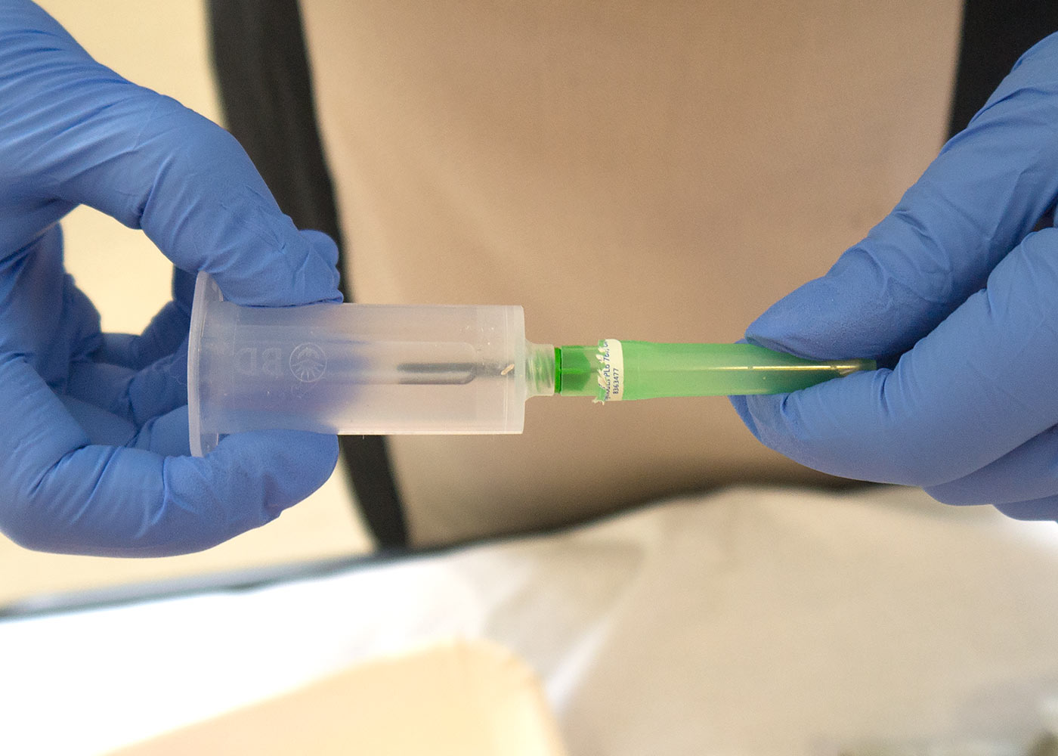
Venepuncture Cnt’d…
Attach the needle to the needle holder
Remove the other cap to reveal the needle

Slide 30
Venepuncture Cnt’d…
Step 08
Retract the skin distally, prepare the patient for a 'sharp scratch', and insert the needle into the vein bevel upwards.

Slide 31
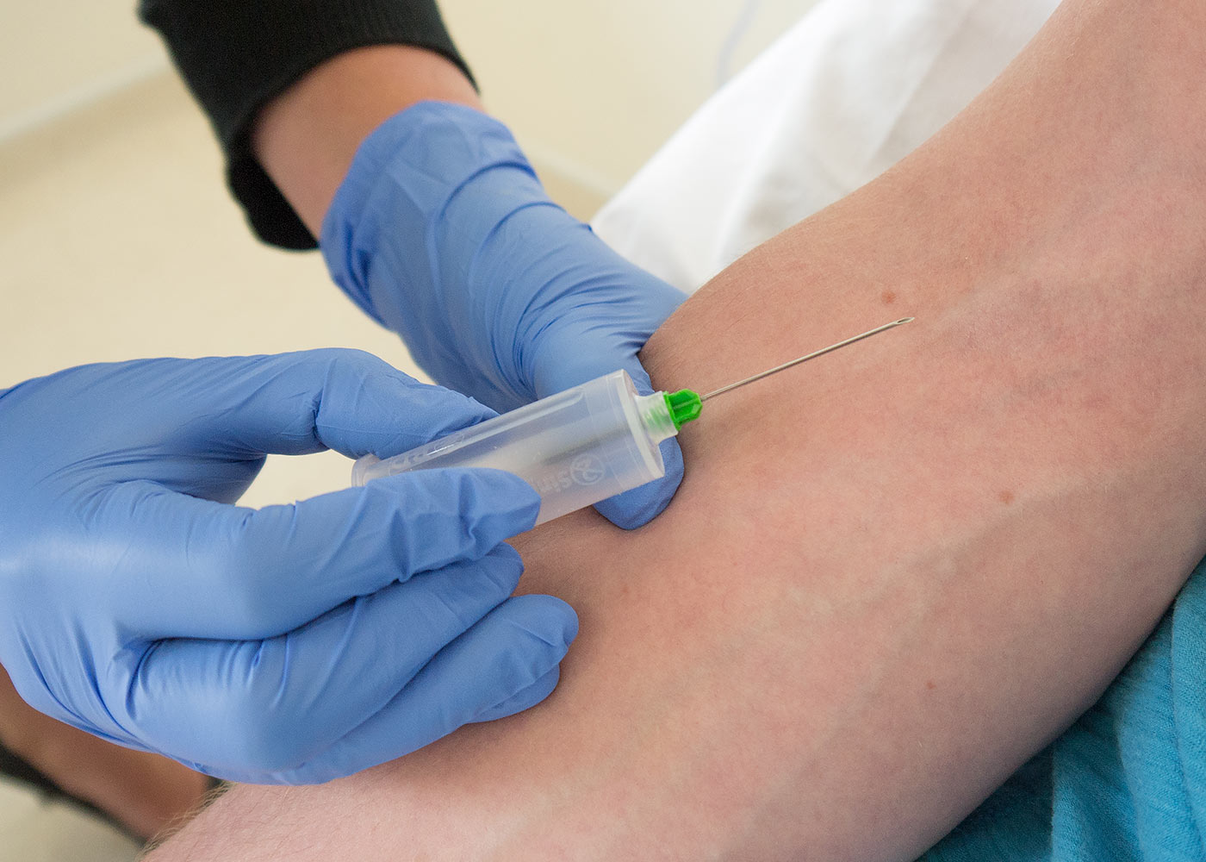
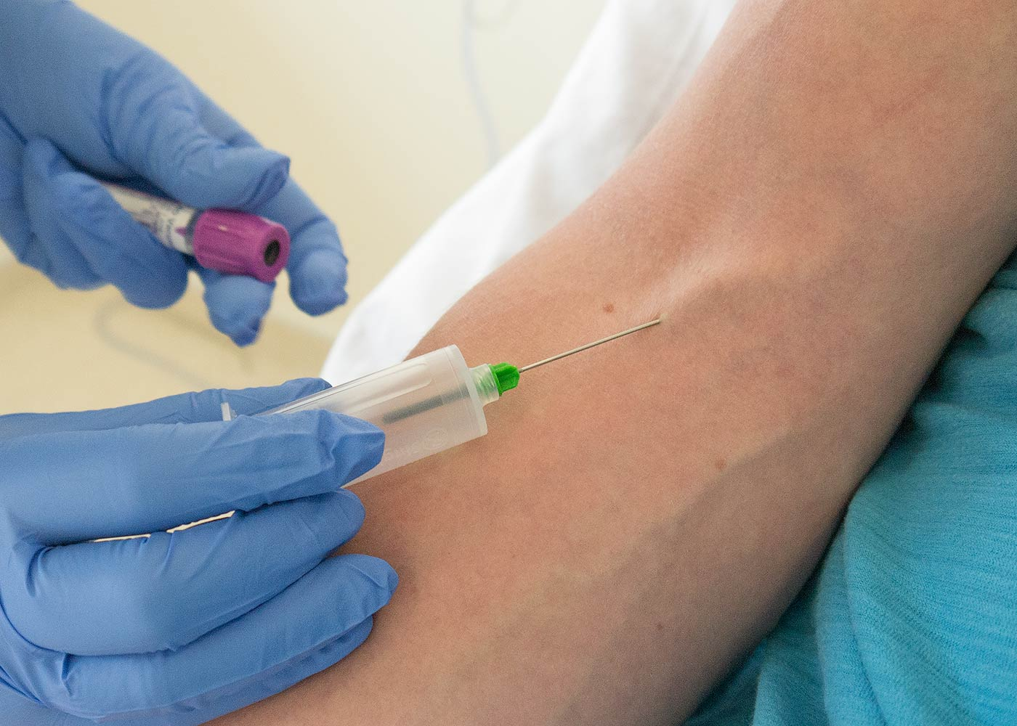
Venepuncture Cnt’d…
Retract the skin distally
Insert the needle into the vein bevel upwards

Slide 32
Venepuncture Cnt’d…
Step 09
Once in the vein, attach a bottle and let it fill, changing if more than one bottle is required. Whilst the last bottle is filling, loosen the tourniquet and when full, remove it from the needle holder.

Slide 33
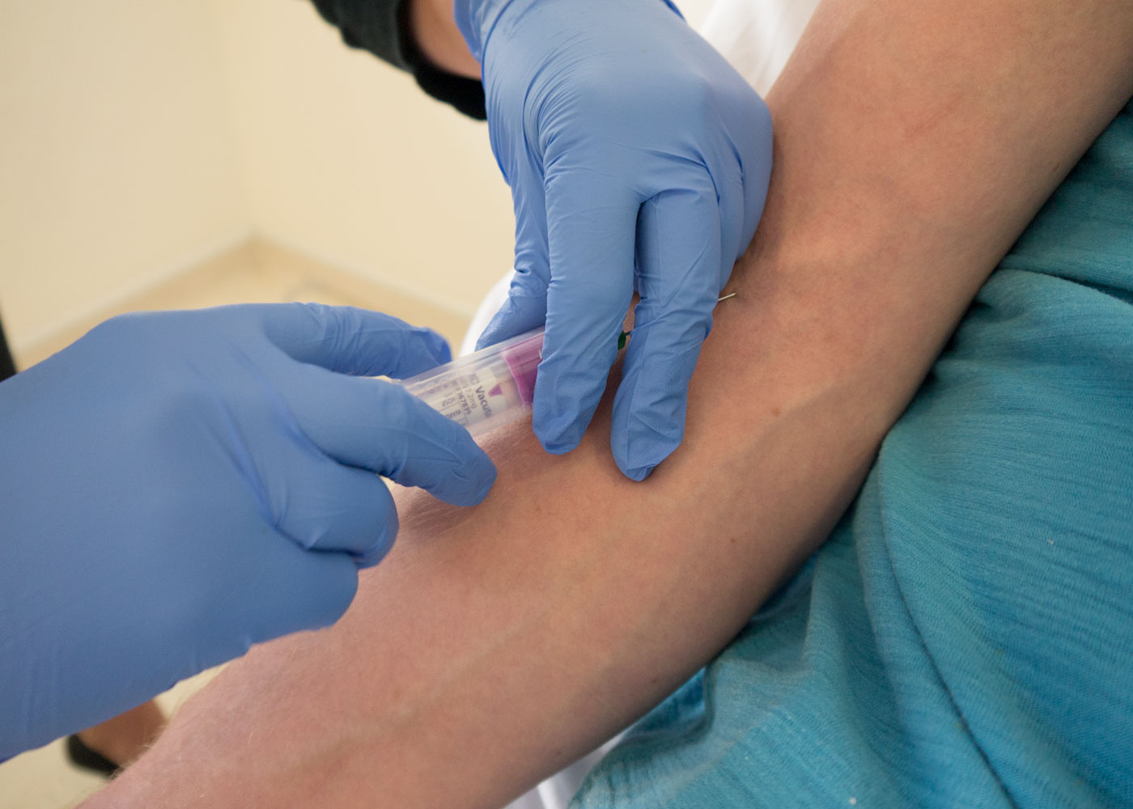
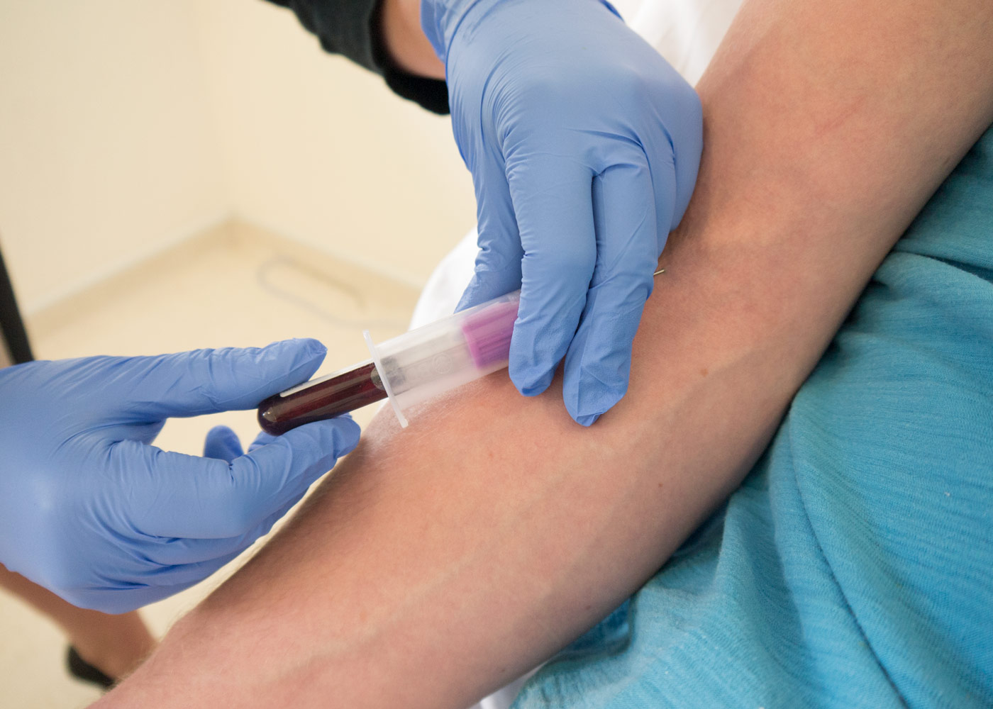
Venepuncture Cnt’d…
once-in-the-vein-attach-a-bottle-and-let-it-fill
Let the bottle fill

Slide 34
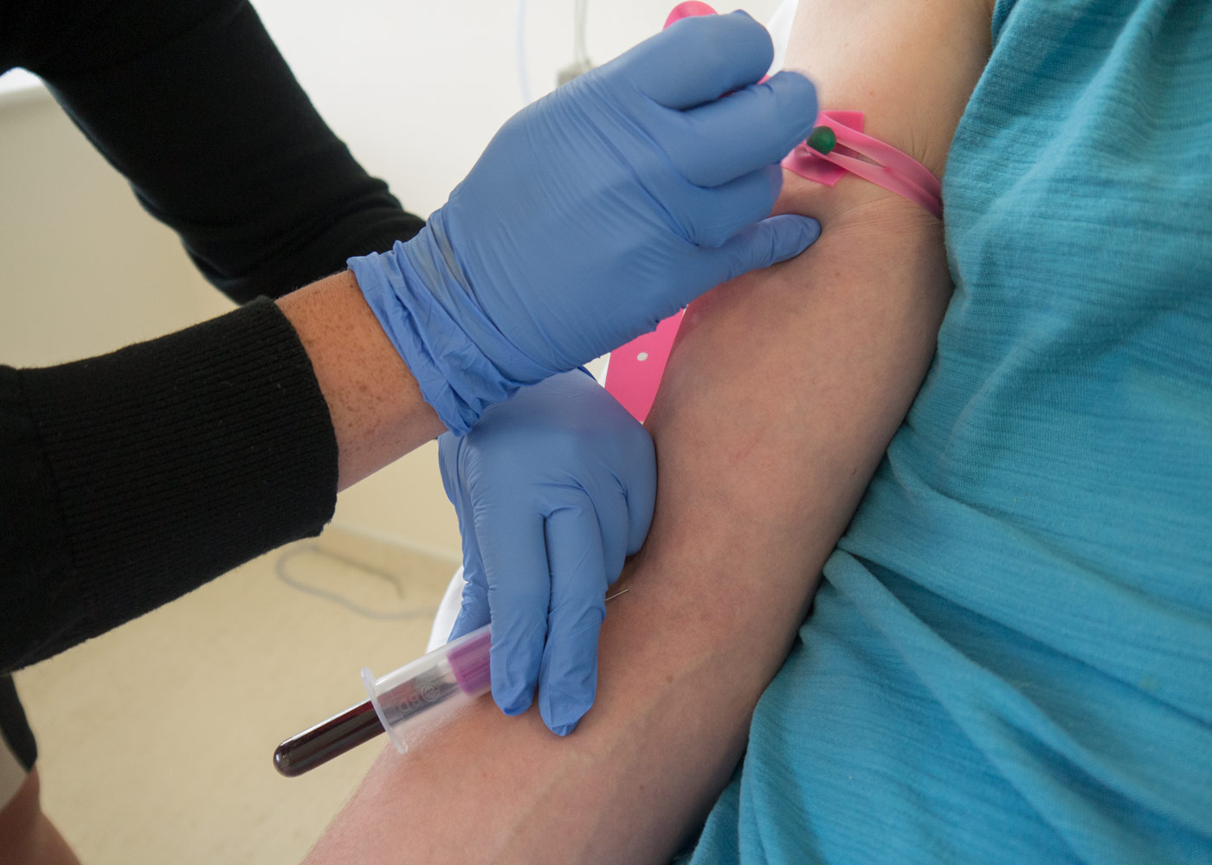
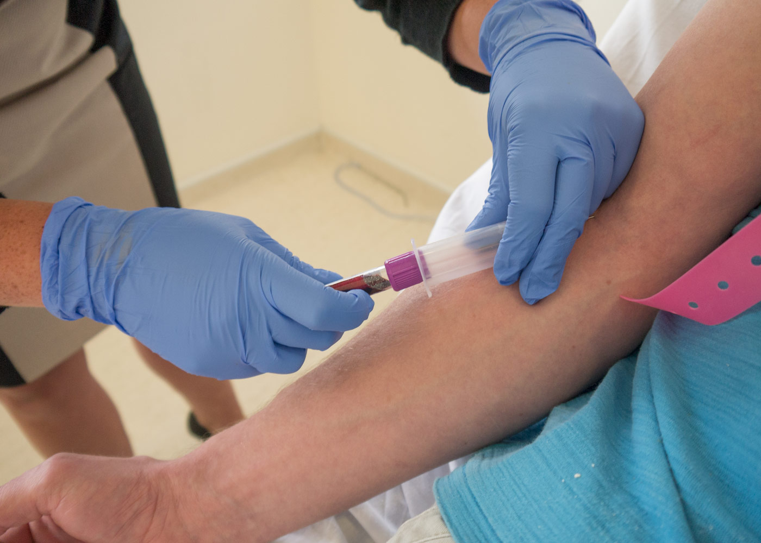
Venepuncture Cnt’d…
whilst-the-last-bottle-is-filling-loosen-the-tourniquet
When the bottle is full, remove it from the needle holder

Slide 35
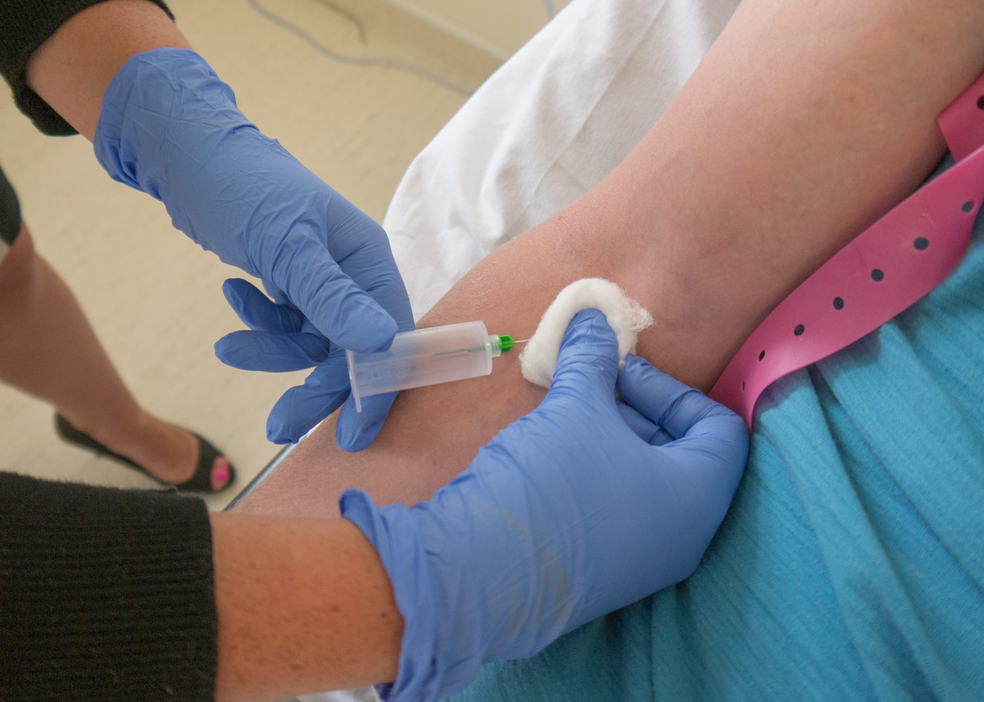
Venepuncture Cnt’d…
Step 10
Withdraw the needle, applying the gauze over the puncture site. Ask the patient to apply pressure with the gauze, keeping their arm straight as bending the arm may increase any bruising.
Withdraw the needle

Slide 36
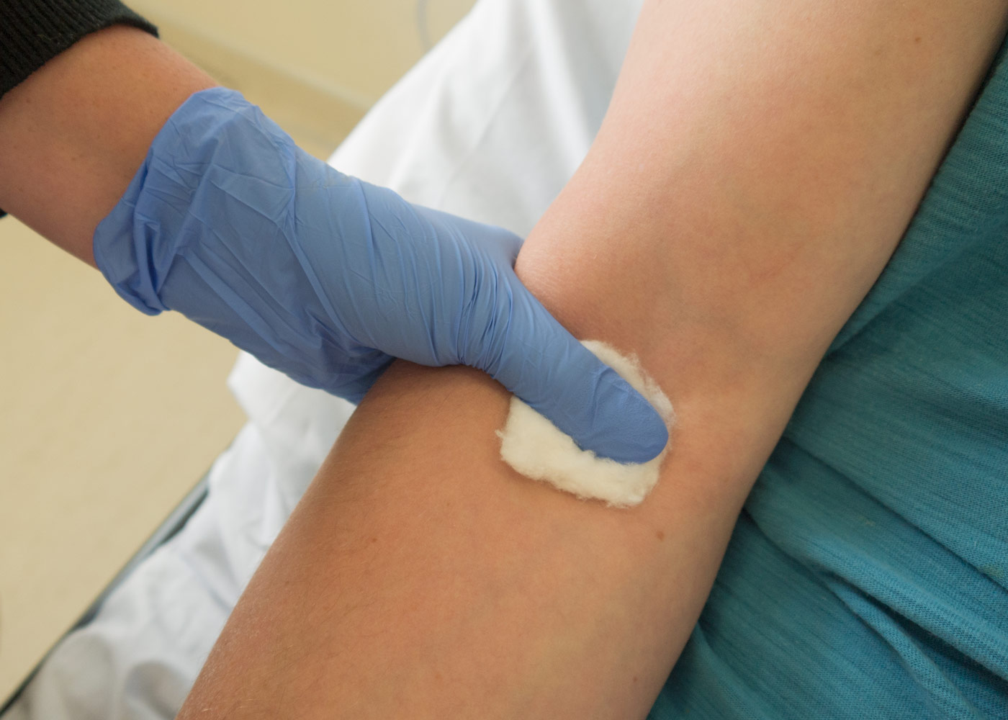
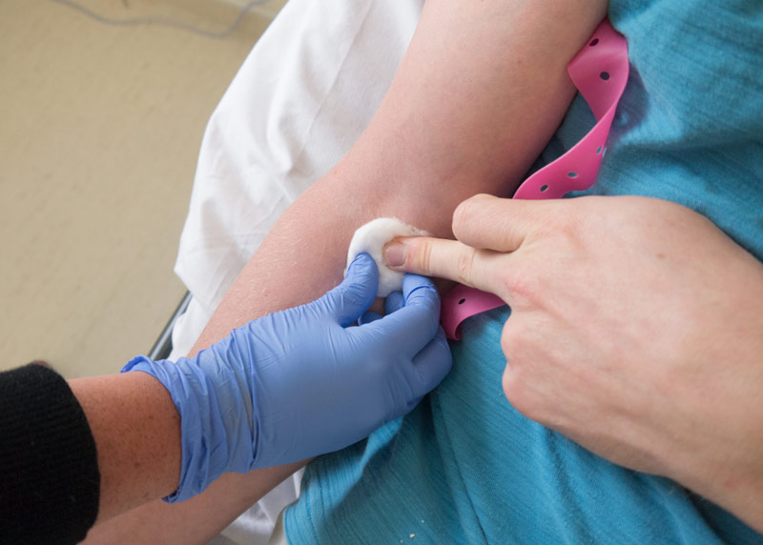
Venepuncture Cnt’d…
Apply the gauze over the puncture site
Ask the patient to apply pressure with the gauze

Slide 37
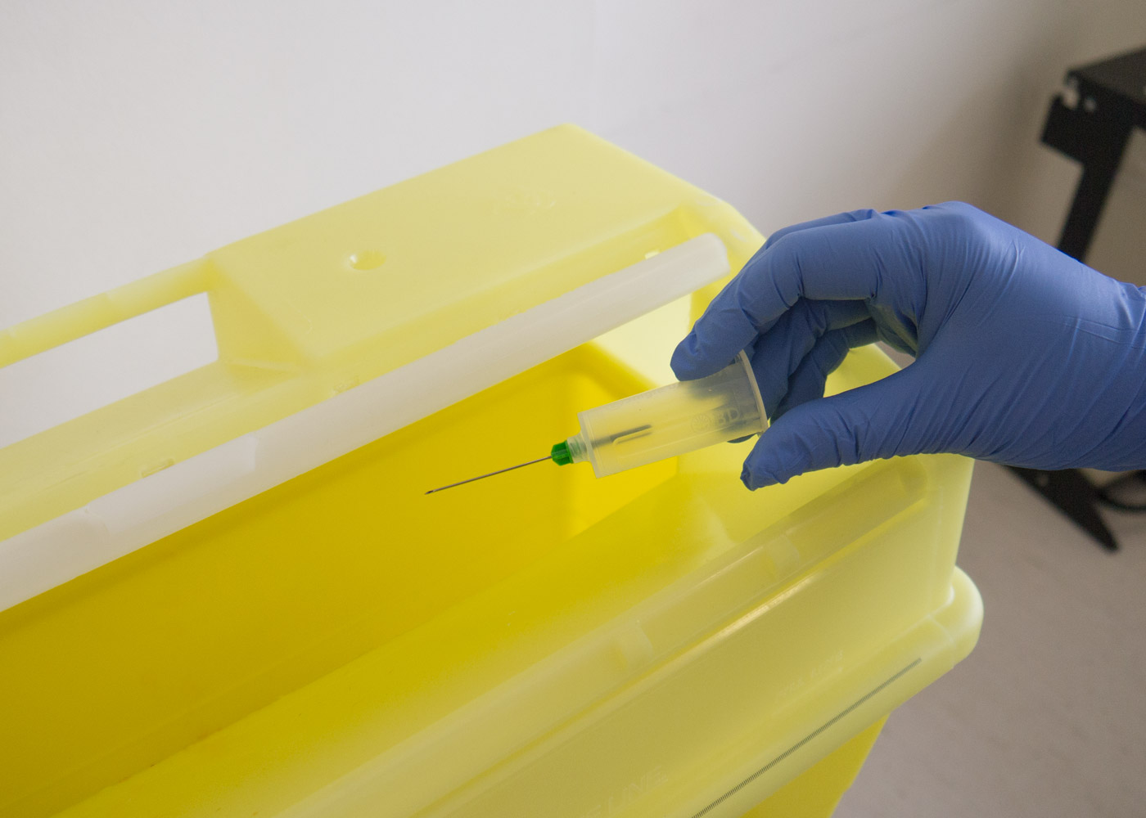
Venepuncture Cnt’d…
Step 11
Carefully dispose of the needle in the sharps bin.

Slide 38
Venepuncture Cnt’d…
Step 12
At this point, invert the tubes 3 times to ensure full mixing with any additives in the tubes such as heparin.
Step 13
Whilst still at the bedside, ensure that you complete all of the patient details required on the bottles.
Step 14
Ensure that any bleeding has stopped and if so, apply the plaster. Remove and dispose of your gloves, along with the remaining equipment in the clinical waste bin.
Thank the patient.

Slide 39
Throat Swab Culture
A throat culture is a lab test that clinicians use to find and identify germs in the back of a patient’s mouth that are making him/her sick.
A clinician will probably order this test if a patient complain of a sore throat and he/she thinks something other than a virus is to blame.
Some of the infections that can be identified on a throat culture are:
Strep throat
Scarlet and rheumatic fever
Gonorrhea (gonococcal pharyngitis)
Thrush
Diphtheria
Pertussis

Slide 40
Throat Swab Culture Cnt’d…
How It’s Done
You ask the patient to tilt their head back slightly, open their mouth, and say “Ahhhh.”
You quickly and gently move a cotton swab around the tonsil area in the back of the patient’s mouth.
You then place it in a germ-free container and send it to a lab for testing.
In the lab, the sample will be placed in a special container with other chemicals to make bacteria and fungi grow. The type of germs that grow, if any, shows your as a clinician what kind of infection the patient has. Then you will decide what medicine will work best for the patient.

Slide 41
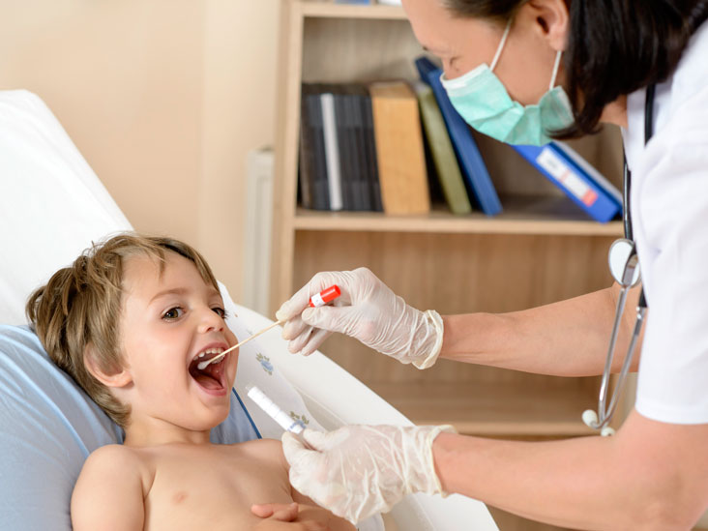

Slide 42
Endoscopy
Endoscopy is a nonsurgical procedure used to examine a person's digestive tract.
Using an endoscope, a flexible tube with a light and camera attached to it, a clinician can view pictures of the patient’s digestive tract on a color TV monitor.
During an upper endoscopy, an endoscope is easily passed through the mouth and throat and into the esophagus, allowing the clinician to view the esophagus, stomach, and upper part of the small intestine.

Slide 43
Endoscopy Cnt’d…
Similarly, endoscopes can be passed into the large intestine (colon) through the rectum to examine this area of the intestine. This procedure is called sigmoidoscopy or colonoscopy depending on how far up the colon is examined.
A special form of endoscopy called endoscopic retrograde cholangiopancreaticography, or ERCP, allows pictures of the pancreas, gallbladder, and related structures to be taken. ERCP is also used for stent placement and biopsies.
Endoscopic ultrasound or EUS combines upper endoscopy and ultrasound examination to obtain images and information about various parts of the digestive tract.
Notes:
A stent is a tiny tube that your doctor can insert into a blocked passageway to keep it open. The stent restores the flow of blood or other fluids, depending on where it's placed. Stents are made of either metal or plastic. Stent grafts are larger stents used for larger arteries.

Slide 44
Endoscopy Cnt’d…
Doctors will often recommend endoscopy to evaluate:
Stomach pain
Ulcers, gastritis, or difficulty swallowing
Digestive tract bleeding
Changes in bowel habits (chronic constipation or diarrhea)
Polyps or growths in the colon

Slide 45
Endoscopy Cnt’d…
In addition, your doctor may use an endoscope to take a biopsy (removal of tissue) to look for the presence of disease.
Endoscopy may also be used to treat a digestive tract problem. For example, the endoscope might not only detect active bleeding from an ulcer, but devices can be passed through the endoscope that can stop the bleeding. In the colon, polyps can be removed through the scope to prevent the development of colon cancer.
Also, using ERCP, gallstones that have passed outside the gallbladder and into the bile duct can often be removed.

Slide 46
Endoscopy Cnt’d…
Gut Preparation
Examining the upper digestive tract (upper endoscopy or ERCP) requires nothing more than fasting for 6-8 hours prior to the procedure.
To examine the colon, it must be cleared of stool. Therefore, a laxative( e.g. Bisacodyl, lactulose, liquid paraffin) or group of laxatives is given on the day before the procedure.

Slide 47
Endoscopy Cnt’d…
Sedation
For most examinations with an endoscope, a sedative is provided. This increases the comfort of the individual undergoing the examination. The sedative, which is administered via an injection into the vein, produces relaxation and light sleep.
Patients wake up within an hour, but the effects of the medicines are more prolonged.
General anesthesia (puts you totally asleep for a period of time) is given in only very special circumstances (in young children, and when very complex procedures are planned).

Slide 48
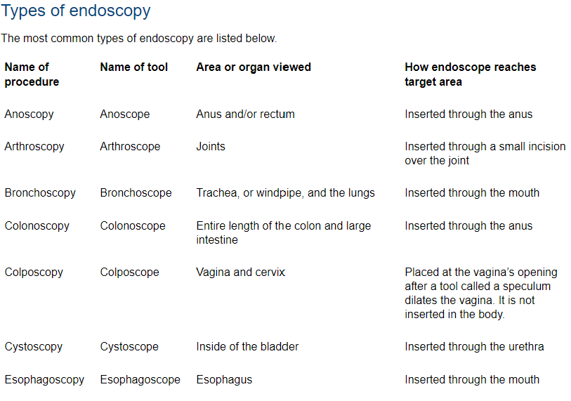

Slide 49
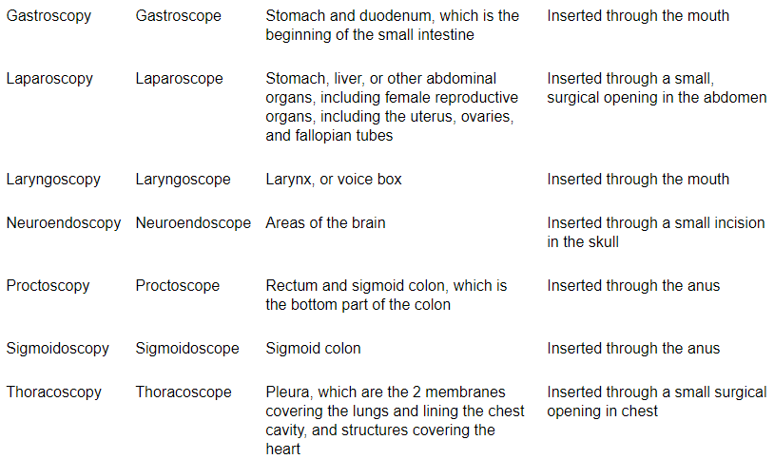

Slide 50
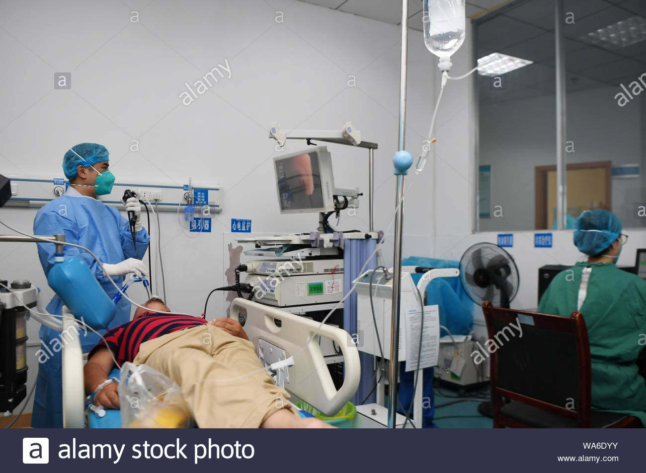
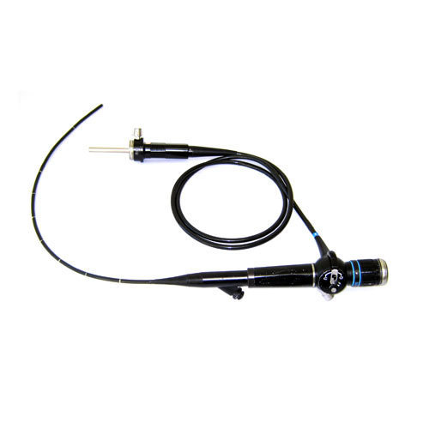

Slide 51
Paracentesis
Paracentesis is a procedure in which a needle or catheter is inserted into the peritoneal cavity to obtain ascitic fluid for diagnostic or therapeutic purposes.
Ascitic fluid may be used to help determine the etiology of ascites, as well as to evaluate for infection or presence of cancer.
Read the Light’s criteria of differentiating transudate and exudate.

Slide 52
Paracentesis Cnt’d…
Causes of transudative ascites include the following:
Hepatic cirrhosis
Alcoholic hepatitis
Heart failure
Fulminant hepatic failure
Nephrotic syndrome
Portal vein thrombosis
Causes of exudative ascites include the following:
Peritoneal carcinomatosis
Inflammation of the pancreas or biliary system
Peritonitis
Ischemic or obstructed bowel

Slide 53
Paracentesis Cnt’d…
Indications
Diagnostic tap is used for the following:
New-onset ascites - Fluid evaluation helps to determine etiology, differentiate transudate versus exudate, detect the presence of cancerous cells, or address other considerations
Suspected spontaneous or secondary bacterial peritonitis
Refractory ascites
Therapeutic tap is used for the following:
Respiratory compromise secondary to ascites
Abdominal pain or pressure secondary to ascites
Read the contraindications.

Slide 54
Paracentesis Cnt’d…
Procedure
Explain the purpose, risks, benefits and steps of the procedure.
a. Risks include perforation or laceration of abdominal/pelvic viscera, bleeding, infection, leak of ascitic fluid
b. Benefit includes relief of pain and yielding information, which may be useful in diagnosis and /or signifying of altering treatment
Obtain informed consent from the patient or appropriate legal designee.
Assemble materials and prepare sterile field.

Slide 55
Paracentesis Cnt’d…
Procedure Cnt’d…
Place the patient supine at the edge of the bed (right side of the bed if you are right handed), with the trunk elevated 45 degrees.
Access to the peritoneal space is usually midline 3 to 4 cm below the umbilicus, halfway between the symphysis pubis and the umbilicus. Alternatively, the entry site can be in the left or right lower quadrant between the umbilicus and the anterior superior iliac spine or the patient’s flank, depending on the location of the fluid as determined by percussion of fluid wave. Be sure to avoid old surgical scars since the bowel may be adherent to the abdominal wall.
Arrange equipment on a sterile field on a bedside stand.
Prep and drape the patient appropriately. Observe sterile technique.
Select the paracentesis site in the midline or lower quadrant.

Slide 56
Paracentesis Cnt’d…
Procedure Cnt’d…
Attach a 18-20 gauge 1½ inch needle (angiocath) to a 20-60 ml syringe. (In markedly obese patients a 3½ inch 20 or 22 gauge spinal needle may be needed).
With the catheter mounted to the syringe, puncture the anesthetized skin.
Keeping the needle perpendicular to the abdominal wall, advance the needle slowly until fluid flows freely into the syringe. You will meet some resistance as you enter the fascia. While advancing the syringe, maintain constant, gentle suction. When you get return of fluid, leave the catheter in place, remove the needle, and begin to aspirate, using a vacuum bottle. Sometimes it is necessary to reposition the catheter because of abutting bowel.

Slide 57
Paracentesis Cnt’d…
Procedure Cnt’d…
For diagnostic paracentesis, collect 50 ml of ascitic fluid.
For a therapeutic tap, do not remove more than 500ml per in ten minutes. One liter is the maximum that should be removed at one time; this voulme permits the fluids and electrolytes to equilibrate.
When enough fluid has been withdrawn, quickly withdraw the catheter. Cover the insertion site with a sterile pressure dressing. If leakage of ascitic fluid occurs, close the paracentesis with a mattress stitch.

Slide 58
Thoracocentesis / Thoracentesis
Thoracentesis is a procedure in which a needle is inserted into the pleural space between the lungs and the chest wall to remove excess fluid from the pleural space to help you breathe easier.
This procedure is done to remove excess fluid, known as a pleural effusion, from the pleural space to help you breathe easier. It may be done to determine the cause of your pleural effusion. Some conditions such as heart failure, lung infections, and tumors can cause pleural effusions.

Slide 59
Thoracocentesis cnt’d…
Indications
Primary spontaneous pneumothorax
Tension pneumothorax
Relative Contraindications
Thoracocentesis should be only considered after consultation in the following;
Spontaneous pneumothorax in patients with underlying lung disease
Traumatic pneumothorax without tension

Slide 60
Thoracocentesis cnt’d…
Analgesia, Anaesthesia
Analgesia and local anaesthesia are mandatory except with tension pneumothorax which is immediately life threatening
Use local anaesthesia
Consider oral or parenteral analgesia pre- and post-procedure.
  Placement and presence of an intercostal catheter device is painful.

Slide 61
Thoracocentesis cnt’d…
Procedure
Place patient on continuous cardiac monitoring and pulse oximetry
Patient position
  Place trauma patient in head-up, supine position
  All other patients should be placed in 45-degree, sitting position
Palpate landmark (2nd intercostal space, at the upper border of the 3rd rib in the midclavicular line) and antiseptically prepare the area
  Alternative landmark is the 4th or 5th intercostal space just anterior to mid-axillary line
Attach a 5ml syringe to the catheter device (cannula or CVC or pigtail)

Slide 62
Thoracocentesis cnt’d…
Procedure Cnt’d…
Insert the cannula vertically into the chest wall, just above the rib below, aspirating all the time²
In tension pneumothorax, often you will hear a pop or feel a change in resistance
Withdraw the needle while gently advancing the cannula downwards into position
Secure the cannula with tape/tegaderm
Attach 3 way tap and 20ml/50ml syringe
Drain until no further drainage to a maximum or 30ml/kg (max 2.5L)
Do not remove the aspiration device until decision made that the patient will not require further drainage

Slide 63
RADIOLOGICAL INVESTIGATIONS

Slide 64
X- RAYS/ PLAIN RADIOGRAPHY
X-rays are types of electromagnetic radiation probably most well-known for their ability to see through a person's skin and reveal images of the bones beneath it. Advances in technology have led to more powerful and focused X-ray beams as well as ever greater applications of these light waves, from imaging teensy biological cells and structural components of materials like cement to killing cancer cells.
The higher the frequency, the greater the penetration
X-ray source is x-ray tube: electrons are accelerated across a high potential difference between the Cathode(-) and anode (+)
The x-ray detector is either a Radiographic film or a Digital system
Darkroom processing—manual or automatic film processor. Being replaced by computed radiography (CR)and digital systems

Slide 65
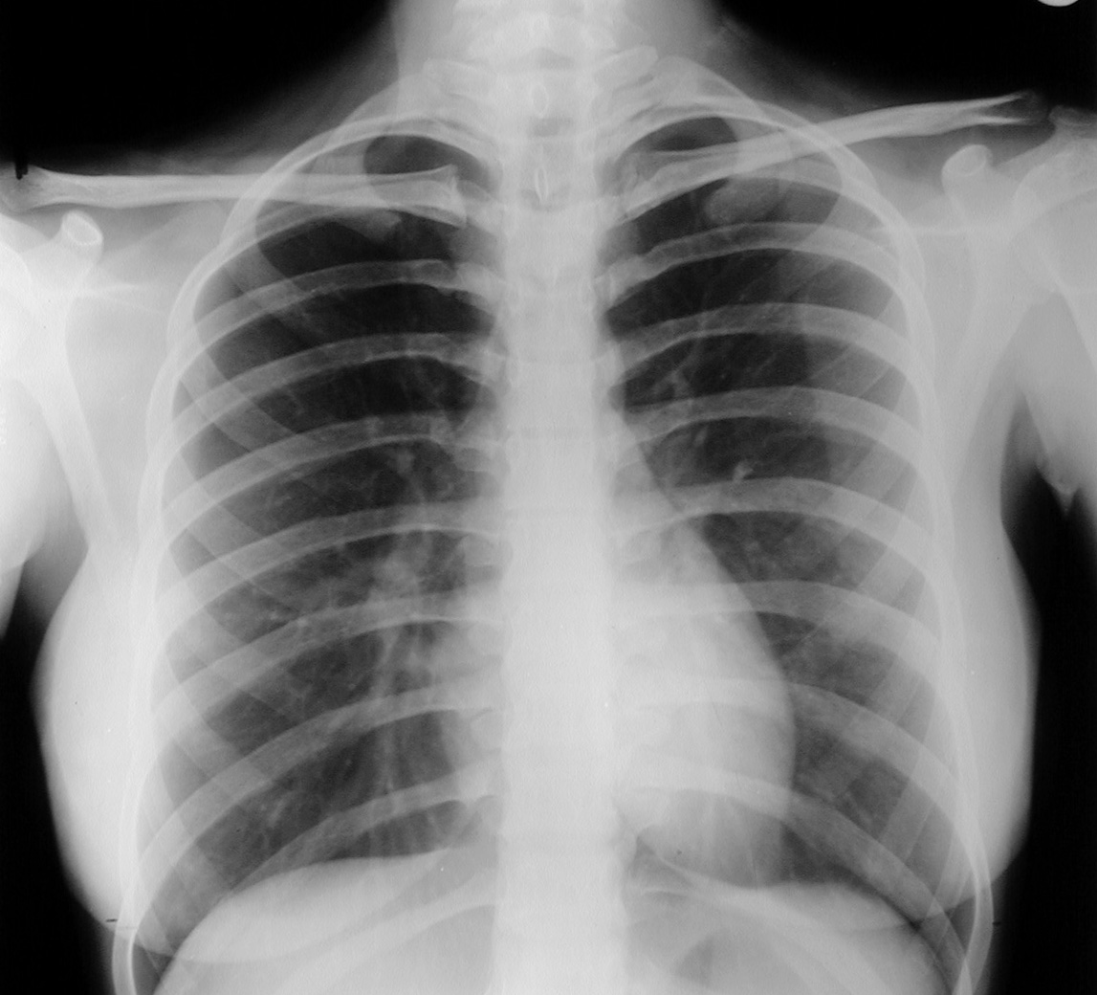
PLAIN RADIOGRAPHY

Slide 66
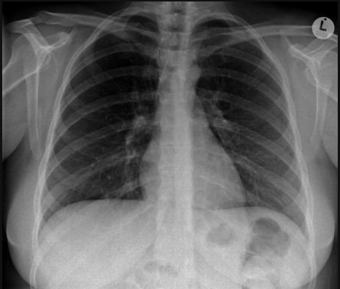
PLAIN RADIOGRAPHY

Slide 67
ULTRASOUND
Ultra means beyond ( i.e. for sound it means beyond human range of audibility)
It utilises piezo-electric effect
Transducer produces and detects U/S
Frequency range 3.0-9.5 MHZ
The higher the frequency, the less the penetration but the higher the resolution

Slide 68
ULTRASOUND Cnt’d...
Can be used to study:
uterus,ovaries
foetus,
kidneys,bladder, liver,etc
MSK
Neonate brain
It has no documented side effects within this range

Slide 69
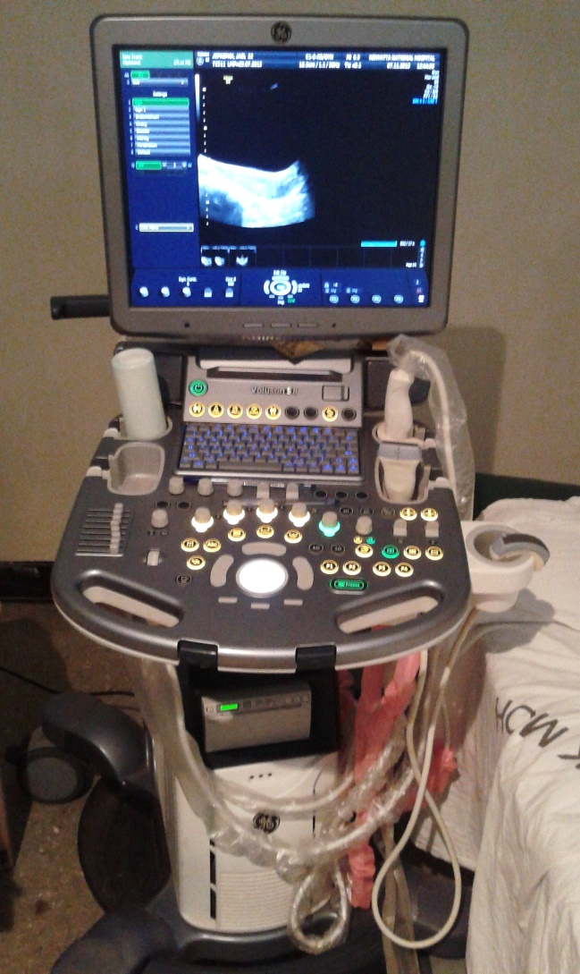
ULTRASOUND SYSTEM

Slide 70
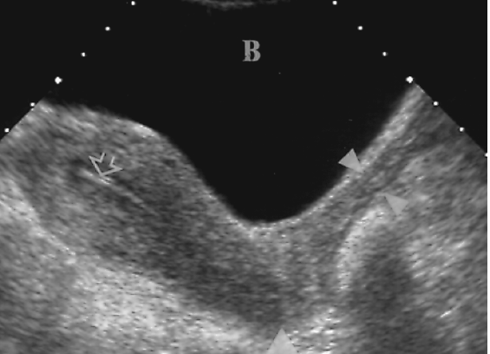
TRANSABDOMINAL PELVIC SCAN

Slide 71
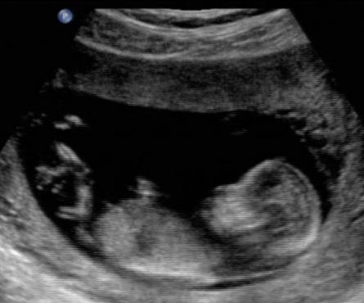
FETAL SCAN

Slide 72
COMPUTERIZED TOMOGRAPHY
Uses an X-ray source, narrow beam
The x-rays penetrate through an Object i.e. patient
They are detected by electronic detector array
Data is acquired in different projections
Data processed by computer into a cross-sectional image i.e. thin slices

Slide 73
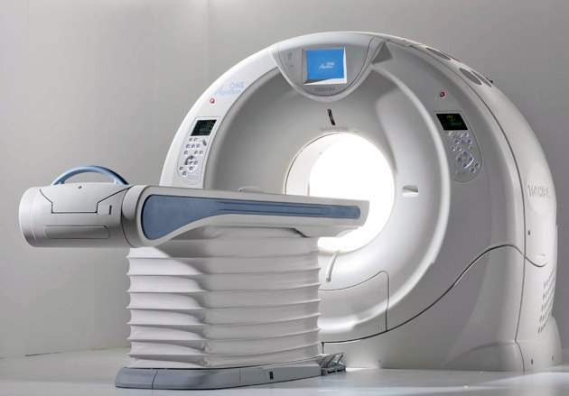
CT Machine

Slide 74
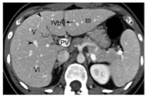

Slide 75
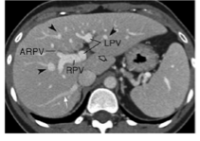

Slide 76
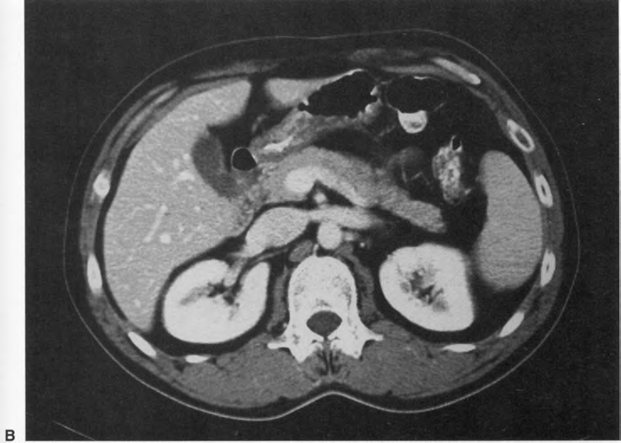

Slide 77
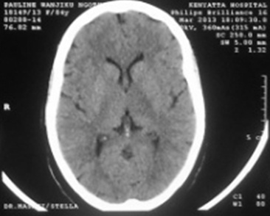

Slide 78
CLINICAL APPLICATION: ADVANTAGES
No ionizing radiation
It has multiplaner capability
CNS,MSK etc better definition of soft tissue anatomy
For certain lesions MRI is superior to CT

Slide 79
POTENTIAL PROBLEMS
Interference with procedure
Risks to the patient -pace-maker
-metallic heart valve
-prosthesis
-aneurysmal clip
Damage to electronic equipment
-mobile phone
-credit card
-flash disc, etc

Slide 81
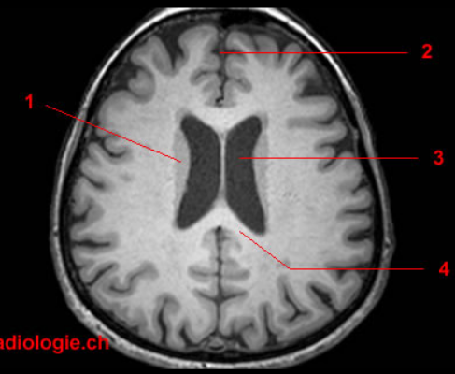

Slide 84
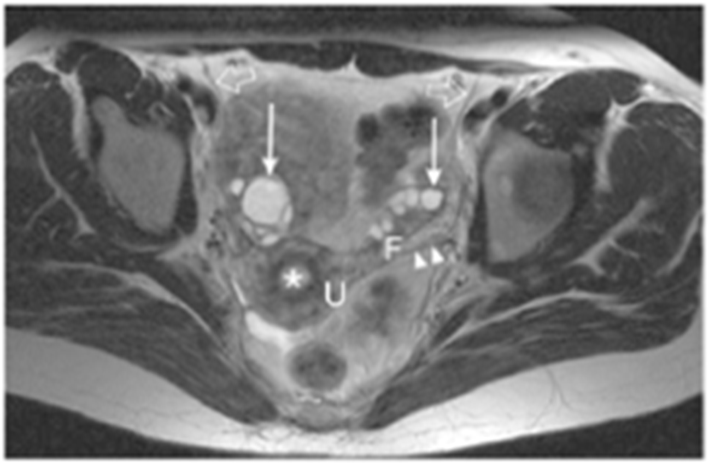

Slide 85
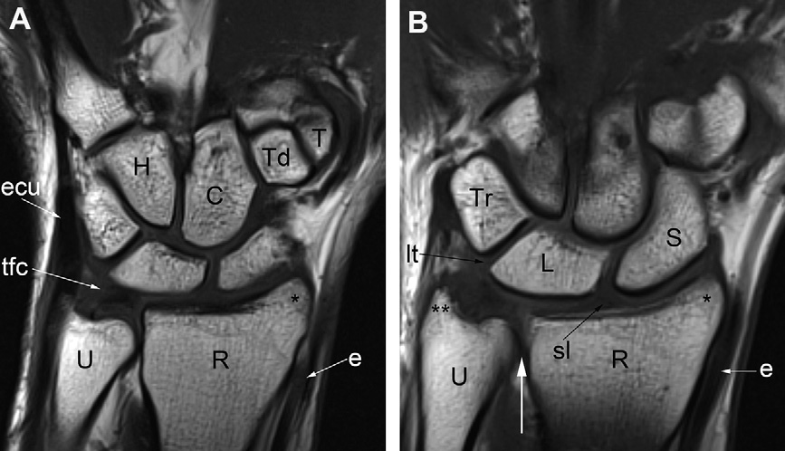

Slide 86
End of Presentation
Thank You

