Slide 1
DIALYSIS;
Dr.ouma k.o

Slide 2
Definition;
Also known as renal replacement therapy; it is Diffusion across a semipermeable membrane to remove excess water, solutes and toxins from blood in end stage kidney disease.
It can also be used as a temporary measure in acute Kidney Injury.

Slide 3
History and background;
A prototype was constructed by a Dutch physician in 1943 using improvised materials including (Sausage casing, beverage cans, washing machine and other available materials).
It was not until 1945 that the first succesfull dialysis was performed in a 67 year old woman.
Over the years, the dialysis machine has undergone modifications and improvements.

Slide 4
Indications for dialysis;
A- Acidosis/intractile acidosis.
E-Electrolyte imbalance (Hyperkalaemia, hupernatraemia, hypercalcaemia).
I-Intoxicants (Methanol, ethylene glycol, Lithium, ASA)
O-Overload/Intractable Fluid overfload.
U-Uremia/Uremic symptoms-nausea, seizure, pericarditis, bleeding.
Overall goal is to keep BUN<100mg/dl and creatinine levels <10mg/dl.
Generally, dialysis is indicated in CKD/end renal disease and some cases of AKI.

Slide 5
Principle of dialysis;
A dialysis machine works on the principle of osmosis and diffusion across a semipermeable membrane.
Blood flows on one side of the semipermeable membrane while the diasylate (dialysis fluid) flows on the opposite side.
The levels and components of the diasylate are typically prescribed by a nephrologist according to individual patient need.

Slide 6
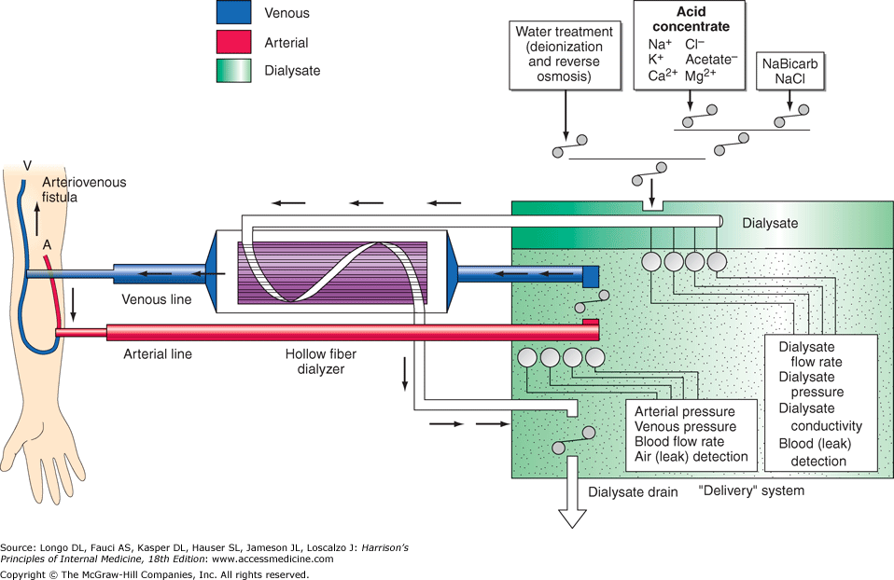

Slide 7
Dialysis membranes;
There are four categories of dialysis membranes:
Cellulose,
Substituted cellulose,
Cellulosynthetic,
Synthetic.
Over the past three decades, there has been a gradual switch from cellulose-derived to synthetic membranes, because the latter are more "biocompatible.“
Bioincompatibility is the ability of the membrane to activate the complement cascade

Slide 8
Dialysate;
Potassium concentration -may be varied from 0 to 4 mmol/L depending on the predialysis serum potassium concentration.
Calcium concentration -0.3-5 mmol/L (2.5 meq/L, although modification may be required in selected settings (e.g., higher dialysate calcium concentrations may be used in patients with hypocalcemia associated with secondary hyperparathyroidism or following parathyroidectomy).
Sodium concentration is 132-145 mmol/L. Lower dialysate sodium concentrations are associated with a higher frequency of hypotension, cramping, nausea, vomiting, fatigue, and dizziness in some patients, although may attenuate thirst. In patients who frequently develop hypotension during their dialysis run, "sodium modeling" to counterbalance urea-related osmolar gradients is often employed. With sodium modeling, the dialysate sodium concentration is gradually lowered from the range of 145–155 mmol/L to isotonic concentrations (140 mmol/L) near the end of the dialysis treatment, typically declining either in steps or in a linear or exponential fashion. Higher dialysate sodium concentrations and sodium modeling may predispose patients to positive sodium balance; thus, these strategies to ameliorate intradialytic hypotension may be undesirable in hypertensive patients or in patients with large interdialytic weight gains.
Chloride-103-110 meq/l.
Acetate- 2-37meq/l
Glucose- 0-200mg/dl
HCO3- 0-40 meq/l
Water- Approximately 120 L during each dialysis treatment, water used for the dialysate is subjected to filtration, softening, deionization, and, ultimately, reverse osmosis. During the reverse osmosis process, water is forced through a semipermeable membrane at very high pressure to remove microbiologic contaminants and >90% of dissolved ions.

Slide 9
Solutes in dialysate;
Sodium Chloride.
Sodium acetate or sodium bicarbonate.
Calcium chloride.
Potassium Chloride.
Magnesium Chloride.

Slide 10
Blood delivery system to dialysis;
The blood delivery system is composed of;
The extracorporeal circuit in the dialysis machine and
The dialysis access.
The dialysis machine consists of
A blood pump,
Dialysis solution
Delivery system,
Various safety monitors.
The blood pump moves blood from the access site, through the dialyzer, and back to the patient. The blood flow rate may range from 250–500 mL/min, depending largely on the type and integrity of the vascular access.
Negative hydrostatic pressure on the dialysate side can be manipulated to achieve desirable fluid removal or ultrafiltration. Dialysis membranes have different ultrafiltration coefficients (i.e., mL removed/min per mmHg) so that along with hydrostatic changes, fluid removal can be varied. The dialysis solution delivery system dilutes the concentrated dialysate with water and monitors the temperature, conductivity, and flow of dialysate.

Slide 11
Access for dialysis;
A native fistula created by the anastomosis of an artery to a vein (e.g., the Brescia-Cimino fistula, in which the cephalic vein is anastomosed end-to-side to the radial artery) results in arterialization of the vein.
A better one is brachiobasilic fistula.
This facilitates its subsequent use in the placement of large needles (typically 15 gauge) to access the circulation.
Although fistulas have the highest long-term patency rate of all dialysis access options, fistulas are created in a minority of patients.
Many patients undergo placement of an arteriovenous graft (i.e., the interposition of prosthetic material, usually polytetrafluoroethylene, between an artery and a vein) or a tunneled dialysis catheter.

Slide 12
Other Dialysis access;
Intravenous large bore catheter.
Tunneled catheter.
Catheters are usually placed in a large vein commonly superior vena cava by puncturing the internal jugular vein and then advancing towards the chest.
The femoral route is an inferior option and is prone to infection

Slide 13
Complications of dialysis catheters;
Thrombosis.
Higher infection rates in catheters than fistula/bacteremia/endocarditis.
Kinking.
Failure to locate the arterial wing of the catheter.

Slide 14
Haemodialysis;
Types of haemodialysis;
1.Conventional hemodialysis
2. Slow continuous ultrafiltration
3. Continuous arteriovenous hemodialysis (CAVHD)
4. Continuous venovenous hemodialysis (CVVHD)

Slide 15
Haemodialysis;
Complications:
1. Infection- most common organism is Staph. aureus
2. Hypotension
3. Dementia- long-term
4. Microcytic anemia secondary to-
5. Aluminium toxicity
6. Mechanical- blood leak.
7. Cardiovascular disease
8. Malnutrition

Slide 16
Peritoneal dialysis;
Access is usually via peritoneal catheter. The peritoneum acts as a SPM. It’s a cheaper option to hemodialysis.
Types:
1. Intermittent peritoneal dialysis (IPD)
2. Continuous ambulatory peritoneal dialysis (CAPD)
3. Continuous cyclic peritoneal dialysis (CCPD).
Advantage:
1. Avoidance of heparization and vascular surgery
2. Slower clearance (helpful in cardiovascular patients)
3. Self-amenable.

Slide 17
Peritoneal dialysis;
Disadvantage/complications:
1. Peritonitis- most common
2. Protein loss- malnutrition
3. Hypercholesterolemia and hypertriglyceridemia- obesity
Contraindications:
1. Pulmonary disease
2. Extensive abdominal adhesion
3. Scleroderma, vasculitis
4. Malignant hypertension

