Slide 1
Dorothea Orem’s Self-Care Deficit Theory

Slide 2
INTRODUCTION
There are instances where patients are encouraged to bring out the best in them despite being ill for a period of time.
This is very particular in rehabilitation settings, in which patients are entitled to be more independent after being cared for by physicians and nurses.

Slide 3
Through these, the Self-Care Nursing Theory or the Orem Model of Nursing was developed by Dorothea Orem between 1959 and 2001.
It is considered a grand nursing theory, which means the theory covers a broad scope with general concepts that can be applied to all instances of nursing

Slide 4
Description
Dorothea Orem’s Self-Care Deficit Theory defined Nursing as “The act of assisting others in the provision and management of self-care to maintain or improve human functioning at home level of effectiveness.”
It focuses on each individual’s ability to perform self-care, defined as “the practice of activities that individuals initiate and perform on their own behalf in maintaining life, health, and well-being.”

Slide 5
“The condition that validates the existence of a requirement for nursing in an adult is the absence of the ability to maintain continuously that amount and quality of self-care which is therapeutic in sustaining life and health, in recovering from disease or injury, or in coping with their effects.
With children, the condition is the inability of the parent (or guardian) to maintain continuously for the child the amount and quality of care that is therapeutic.” (Orem, 1991)

Slide 6
Assumptions of the Self-Care Deficit Theory
The assumptions of Dorothea Orem’s Self-Care Theory are:
(1) In order to stay alive and remain functional, humans engage in constant communication and connect among themselves and their environment.
(2) The power to act deliberately is exercised to identify needs and to make needed judgments.

Slide 7
(3) Mature human beings experience privations in the form of action in care of self and others involving making life-sustaining and function-regulating actions.
(4) Human agency is exercised in discovering, developing, and transmitting others ways and means to identify needs for, and make inputs into, self and others.
(5) Groups of human beings with structured relationships cluster tasks and allocate responsibilities for providing care to group members.

Slide 8
Major Concepts of the Self-Care Deficit Theory
In this section are the definitions of the major concepts of Dorothea Orem’s Self-Care Deficit Theory:
Nursing
Nursing is an art through which the practitioner of nursing gives specialized assistance to persons with disabilities which makes more than ordinary assistance necessary to meet needs for self-care.
The nurse also intelligently participates in the medical care the individual receives from the physician

Slide 9
Environment
The environment has physical, chemical and biological features. It includes the family, culture, and community.
Health
Health is “being structurally and functionally whole or sound.” Also, health is a state that encompasses both the health of individuals and of groups, and human health is the ability to reflect on one’s self, to symbolize experience, and to communicate with others.

Slide 10
Self-Care
Self-care is the performance or practice of activities that individuals initiate and perform on their own behalf to maintain life, health, and well-being

Slide 11
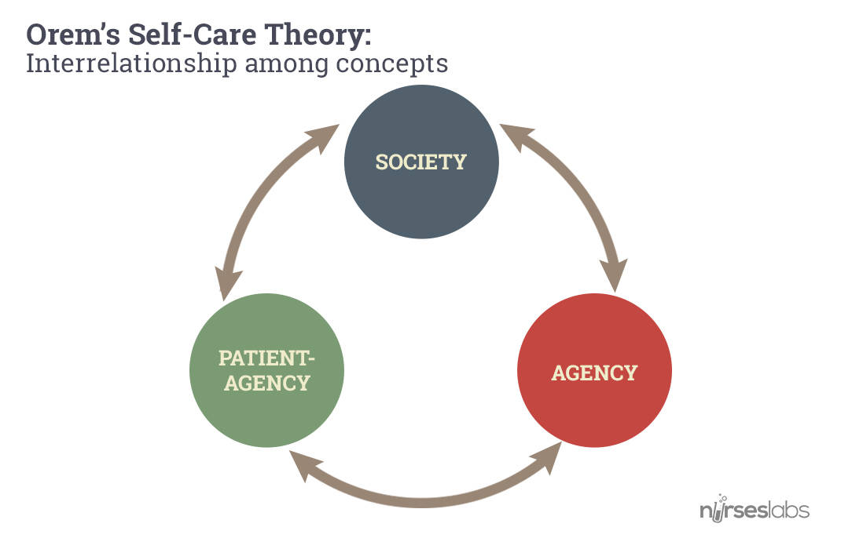

Slide 12
Self-care agency is the human’s ability or power to engage in self-care and is affected by basic conditioning factors.
Basic Conditioning Factors
Basic conditioning factors are age, gender, developmental state, health state, socio-cultural orientation, health care system factors, family system factors, patterns of living, environmental factors, and resource adequacy and availability

Slide 13
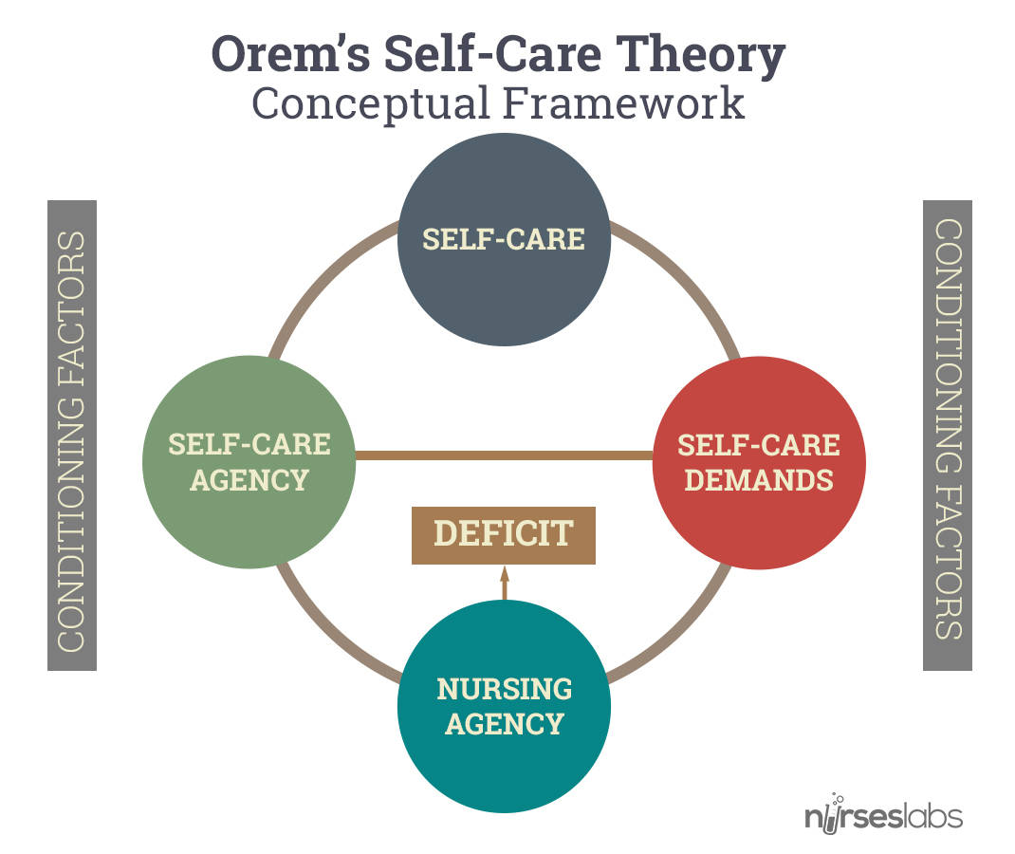

Slide 14
Therapeutic Self-care Demand is the totality of “self-care actions to be performed for some duration in order to meet known self-care requisites by using valid methods and related sets of actions and operations.”
Self-Care Deficit
Self-care Deficit delineates when nursing is needed. Nursing is required when an adult (or in the case of a dependent, the parent or guardian) is incapable of or limited in the provision of continuous effective self-care

Slide 15
Nursing Agency
Nursing Agency is a complex property or attribute of people educated and trained as nurses that enables them to act, to know, and to help others meet their therapeutic self-care demands by exercising or developing their own self-care agency.

Slide 16
Theories
The Self-Care or Self-Care Deficit Theory of Nursing is composed of three interrelated theories:
(1) the theory of self-care
(2) the self-care deficit theory, and
(3) the theory of nursing systems, which is further classified into wholly compensatory, partial compensatory and supportive-educative

Slide 17
Theory of Self-Care
This theory focuses on the performance or practice of activities that individuals initiate and perform on their own behalf to maintain life, health and well-being.
Self-Care Requisites
Self-care Requisites or requirements can be defined as actions directed toward the provision of self-care. It is presented in three categories:

Slide 18
Universal Self-Care Requisites
Universal self-care requisites are associated with life processes and the maintenance of the integrity of human structure and functioning.
The maintenance of a sufficient intake of air
The maintenance of a sufficient intake of water
The maintenance of a sufficient intake of food

Slide 19
The provision of care associated with elimination process and excrements
The maintenance of a balance between activity and rest
The maintenance of a balance between solitude and social interaction

Slide 20
The prevention of hazards to human life, human functioning, and human well-being
The promotion of human functioning and development within social groups in accord with human potential, known human limitations, and the human desire to be normal

Slide 21
Normalcy is used in the sense of that which is essentially human and that which is in accord with the genetic and constitutional characteristics and the talents of individuals.
Developmental self-care requisites
Developmental self-care requisites are “either specialized expressions of universal self-care requisites that have been particularized for developmental processes or they are new requisites derived from a condition or associated with an event.”

Slide 22
Health deviation self-care requisites
Health deviation self-care requisites are required in conditions of illness, injury, or disease or may result from medical measures required to diagnose and correct the condition.
Seeking and securing appropriate medical assistance
Being aware of and attending to the effects and results of pathologic conditions and states
Effectively carrying out medically prescribed diagnostic, therapeutic, and rehabilitative measures

Slide 23
Being aware of and attending to or regulating the discomforting or deleterious effects of prescribed medical measures
Modifying the self-concept (and self-image) in accepting oneself as being in a particular state of health and in need of specific forms of health care
Learning to live with the effects of pathologic conditions and states and the effects of medical diagnostic and treatment measures in a lifestyle that promotes continued personal development

Slide 24
Theory of Self-Care Deficit
This theory delineates when nursing is needed. Nursing is required when an adult (or in the case of a dependent, the parent or guardian) is incapable of or limited in the provision of continuous effective self-care.
Orem identified 5 methods of helping:

Slide 25
Acting for and doing for others
Guiding others
Supporting another
Providing an environment promoting personal development in relation to meet future demands
Teaching another

Slide 26
Theory of Nursing System
Theory of Nursing System
This theory is the product of a series of relations between the persons: legitimate nurse and legitimate client. This system is activated when the client’s therapeutic self-care demand exceeds available self-care agency, leading to the need for nursing

Slide 27
Wholly Compensatory Nursing System
This is represented by a situation in which the individual is unable “to engage in those self-care actions requiring self-directed and controlled ambulation and manipulative movement or the medical prescription to refrain from such activity… Persons with these limitations are socially dependent on others for their continued existence and well-being.”

Slide 28
Partial Compensatory Nursing System
This is represented by a situation in which “both nurse and perform care measures or other actions involving manipulative tasks or ambulation… [Either] the patient or the nurse may have a major role in the performance of care measures.”
Example: Nurse can assist postoperative client to ambulate, Nurse can bring a meal tray for client who can feed himself

Slide 29
Supportive-Educative System
This is also known as supportive-developmental system, the person “is able to perform or can and should learn to perform required measures of externally or internally oriented therapeutic self-care but cannot do so without assistance.”
Example: Nurse guides a mother how to breastfeed her baby, Counseling a psychiatric client on more adaptive coping strategies.

Slide 30
Strengths
A major strength of Dorothea Orem’s theory is that it is applicable for nursing by the beginning practitioner as well as the advanced clinicians.
Orem’s theory provides a comprehensive basis for nursing practice. It has utility for professional nursing in the areas of nursing practice, nursing education and administration.
The terms self-care, nursing systems, and self-care deficit are easily understood by the beginning student nurse and can be explored in greater depth as the nurse gains more knowledge and experience

Slide 31
She specifically defines when nursing is needed: Nursing is needed when the individual cannot maintain continuously that amount and quality of self-care necessary to sustain life and health, recover from disease or injury, or cope with their effects.
Her self-care approach is contemporary with the concepts of health promotion and health maintenance.
Three identifiable nursing systems were clearly delineated and are easily understood

Slide 32
Limitations
Orem’s theory, in general, is viewed as a single whole thing while Orem defines a system as a single whole thing.
Orem’s theory is simple yet complex. The use of self-care in multitudes of terms, such as self-care agency, self-care demand, self-care deficit, self-care requisites, and universal self-care, can be very confusing to the reader

Slide 33
Orem’s definition of health was confined in three static conditions which she refers to a “concrete nursing system,” which connotes rigidity.
Throughout her work, there is limited acknowledgement of the individual’s emotional needs.
Health is often viewed as dynamic and ever-changing

Slide 34
Conclusion
Orem’s theory is relatively simple, but generalizable to apply to a wide variety of patients. It explains the terms self-care, nursing systems, and self-care deficit which are very essential to students who plan to start their career in nursing.
Moreover, this theory signifies that all patients want to care for themselves, and they are able to recover more quickly and holistically by performing their own self-care as much as they’re able. This theory is particularly used in rehabilitation and primary care or other settings in which patients are encouraged to be independent

