Slide 1
EMBRYOLOGY
BY F.R.KURIA

Slide 2
Human embryology
EMBRYOLOGY is the study of embryos and fetuses.
is a continuous process that begins when an oocyte (ovum) from a female is fertilized by a sperm (spermatozoon) from a male.
.
This is followed by continuous Cell division, cell migration, programmed cell death, differentiation, growth, and cell rearrangement that transform the zygote, into a multicellular human being.
NB >Development does not stop at birth. Important changes, in addition to growth, occur after birth (e.g., development of teeth and female breasts).

Slide 3
Fertilization
Begins with a contact between the sperm & the ovum.
Ends up with intermingling of the maternal and paternal chromosomes.

Slide 5
Branches of embryology
Developmental anatomy is the field of embryology concerned with the changes that cells, tissues, organs, and the body as a whole undergo from a germ cell of each parent to the resulting adult.
Teratology (Gr. teratos, monster) is the division of embryology and pathology that deals with abnormal development (birth defects).

Slide 6
DEVELOPMENTAL PERIODS
Human development is usually divided into two broad periods:
1. prenatal development- (before birth):
- most visible advances occur during the third to eighth weeks a.k.a embryonic period.
- after 8th weeks the fetal period, is characterized with differentiation and growth of tissues and organs occur. The rate of body growth increases during this period
2. postnatal development- (after birth): further differentiation of organs and specializations of body tissues

Slide 7
Embryonic terminologies
Oocyte (L. ovum, egg). The female germ or sex cells which are produced in the ovaries.
Sperm (Gr. sperma, seed). The sperm, or spermatozoon, refers to the male germ cell produced in the testes (testicles)
Zygote. results of the union of an oocyte and a sperm during fertilization. A zygote or embryo is the beginning of a new human being.

Slide 8
Gestational Age. - it is the period from fertilization to birth: it is usually divided into three trimesters (I,II,III)
Cleavage. This is the series of mitotic cell divisions of the zygote that result in the formation of early embryonic cells, blastomeres.
Morula (L. morus, mulberry). This solid mass of 12 to approximately 32 blastomeres is formed by cleavage of a zygote(The morula stage occurs 3 to 4 days after fertilization)

Slide 9
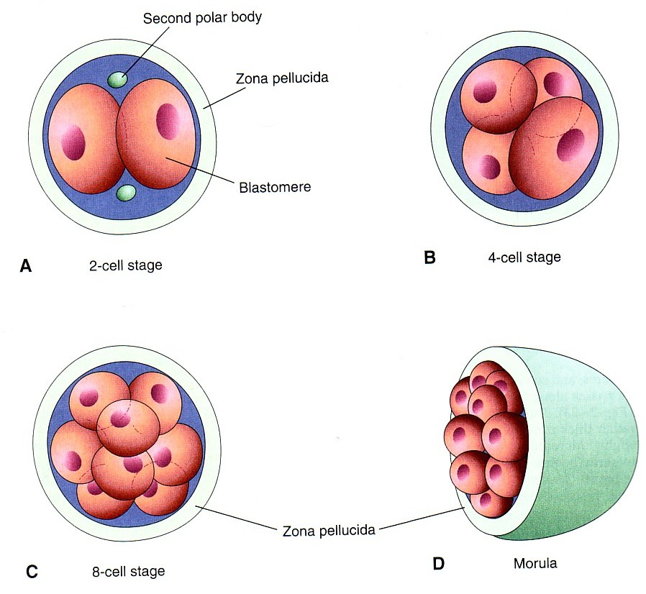
Cleavage of Zygote
It begins about 30 hours after fertilization.
Zygote divides into 2, then 4, then 8, then 16 cells.

Slide 10
Blastocyst (Gr. blastos, germ + kystis, bladder). After 2 to 3 days, the morula enters the uterus from the fallopian tube. Soon a fluid-filled cavity, the blastocystic cavity, develops inside it. This change converts the morula into a blastocyst. Its centrally located cells, the inner cell mass or embryoblast, is the embryonic part of the embryo.

Slide 11
Formation of blastocyst :
The Morula reaches the uterine cavity by the 3 day after fertilization, & remains free for one or two days.
Fluid passes from uterine cavity to the Morula.
Now the Morula is called Blastocyst, its cavity is called blastocystic cavity, its cells divided into Embryoblast & Trophoblast.

Slide 12
BLASTOCYST
It is formed of :
(1) Trophoblast .
(2) Inner cell mass.
(3) Blastocyst cavity.

Slide 13
Implantation.
It begins about the 6th day after fertilization.
It is completed by the 11th or 12th day
Its The process during which the blastocyst attaches to the endometrium, lining of uterus, and subsequently embeds in it.
normal site of implantation is the posterior wall of the uterus near the fundus.
The pre-implantation period of embryonic development is the time between fertilization and the beginning of implantation, a period of approximately 6 days

Slide 15
The embryoblast projects into the blastocystic cavity, while the trophoblast forms the wall of the blastocyst.
By 6th day the blastocyst adheres to the endometrium.
By 7th day, Trophoblast differentiates into 2 layers:
Cytotrophblast, inner layer, mononucleated mitotically active cells.
Syncytiotrophoblast (outer multinucleated mass, with indistinct cell boundary.
By 8th day the blastocyst is superficially embedded in the compact layer of the endometrium (by the end of 1st week,the blastocyst is superficially implanted in endometrium).

Slide 16
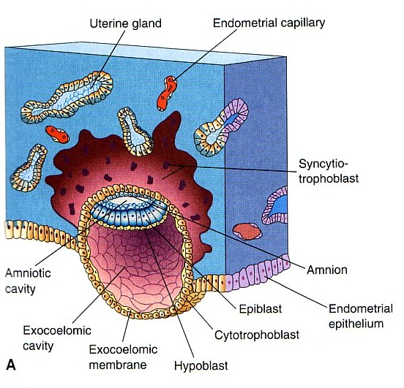
Blood-filled Lacunae appear in the Syncytiotrophoblast which communicate forming a network by the 10th day or 11th day.
Syncytiotrophoblast erodes the endothelial lining of the maternal capillaries which are known as sinusoids. Now blood of maternal capillaries reaches the lacunae so Uteroplacental circulation
is established by 11th or 12th day.

Slide 17
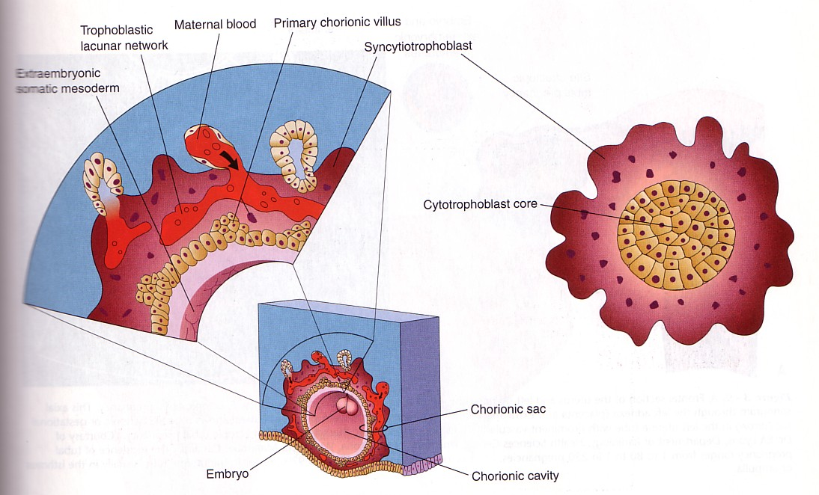
Formation of The Primary Chorionic villi
By the 13th day Proliferation of Cytotrophblast cells produce extension inside the Syncytiotropho-blast to form the primary chorionic villi.

Slide 18
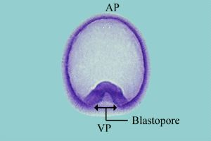
Differentation
Gastrulation: The process of differentiation in the embryo in which one side of the blastula invaginates (indents) forming a gastrula.
Three cell layers form.

Slide 19
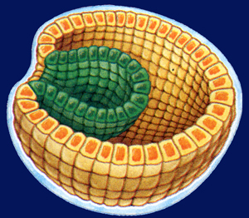
Embryonic Development
Gastrulation is the second major phase of embryonic development
The cells at one end of the blastula move inward,
It adds more cells to the embryo
It sorts all cells into three distinct cell layers
The embryo is transformed from the blastula into the gastrula

Slide 20
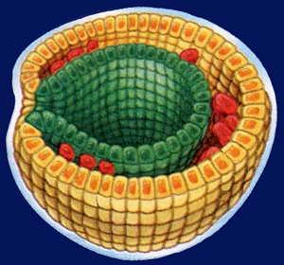
Embryonic Development
The three layers produced in gastrulation
Ectoderm, the outer layer
Endoderm, an embryonic digestive tract
Mesoderm, which partly fills the space between the ectoderm and endoderm

Slide 21
Gastrula (Gr. gaster, stomach). During gastrulation (transformation of a blastocyst into a gastrula), a three-layered embryonic disc forms (third week).
The three germ layers of the gastrula (ectoderm, mesoderm, and endoderm) subsequently differentiate into the tissues and organs of the embryo.
Neurula (Gr. neuron, nerve). The early embryo during the third and fourth weeks when the neural tube is developing from the neural plate .It is the first appearance of the nervous system and the next stage after the gastrula

Slide 22
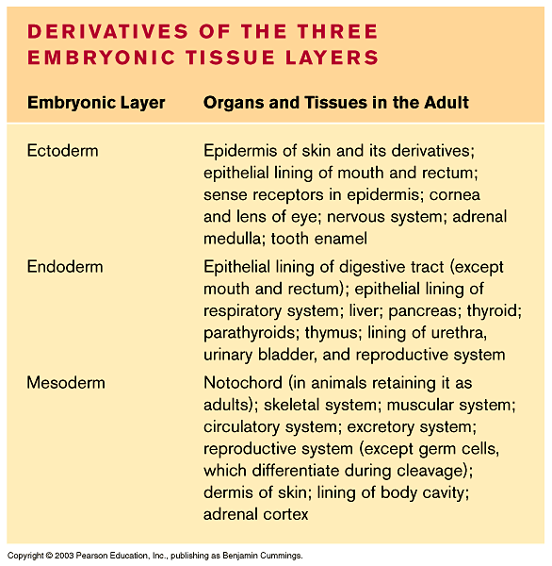
Embryonic Development
ectoderm cells~ eventually they develop into the skin and nervous tissue of the animal
endoderm cells ~develop into the lining of the animal’s digestive tract and into organs associated with digestion.
mesoderm cells ~develop into the muscles, circulatory system, excretory system, and, in some animals, the respiratory system.

Slide 23
Embryonic induction initiates organ formation
Induction is the mechanism by which one group of cells influences the development of tissues and organs from ectoderm, endoderm, and mesoderm
Adjacent cells and cell layers use chemical signals to influence differentiation

Slide 24
Pattern formation organizes the human body
Pattern formation is the emergence of a body form with structures in their correct relative positions
It involves the response of genes to spatial variations of chemicals in the embryo

Slide 25
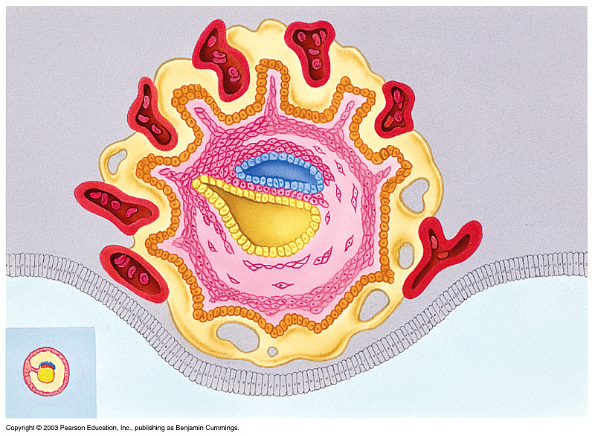
Meanwhile, the four embryonic membranes develop
Amnion~fluid filled sac for protection
Chorion ~ will form the embryo’s part of the placenta
Yolk sac ~ produces first blood cells &germ cells
Allantois ~ will form the umbilical cord (ropelike structure that attaches embryo to uterus)
Chorion
Amnion
Allantois
Yolk sac

Slide 26
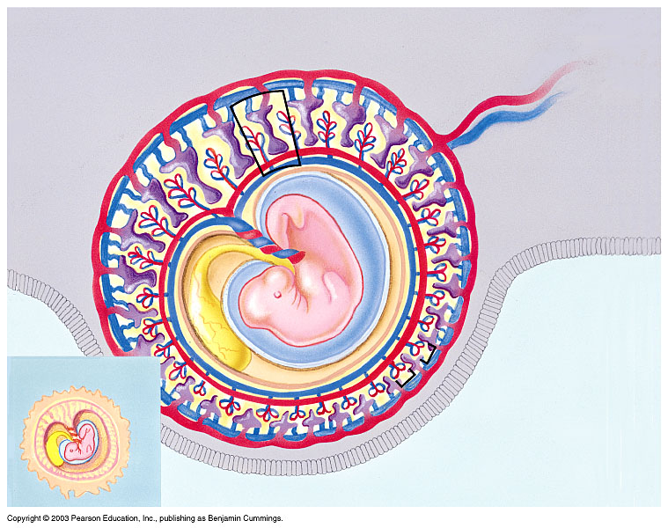
HUMAN DEVELOPMENT
The embryo floats in the fluid-filled amniotic cavity,
The placenta’s chorionic villi absorb food and oxygen from the mother’s blood
Mother’s blood vessels
Placenta
Yolk sac
Amniotic cavity
Amnion
Embryo
Chorion
Chorionic villi

Slide 27
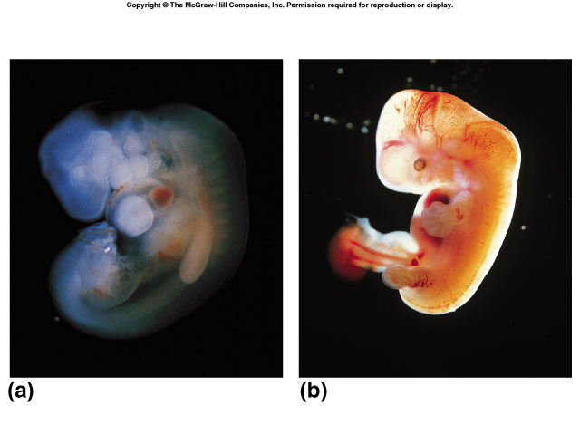
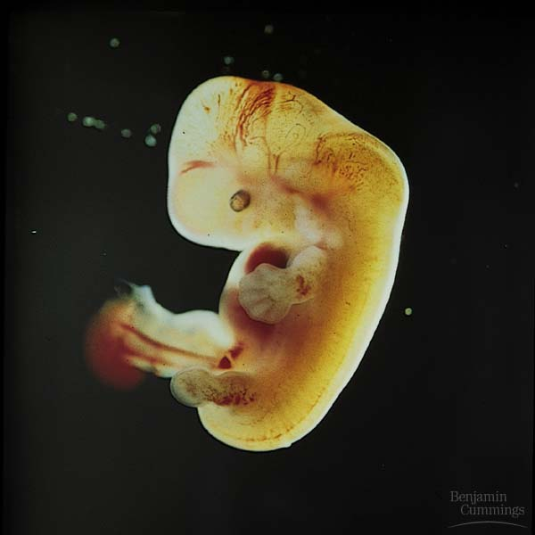
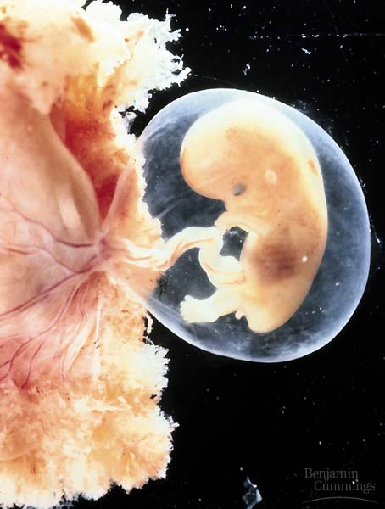
Human development from conception to birth is divided into three trimesters
First trimester
First three months
The most rapid changes occur during the first trimester
7 weeks 10 weeks
4 weeks

Slide 28
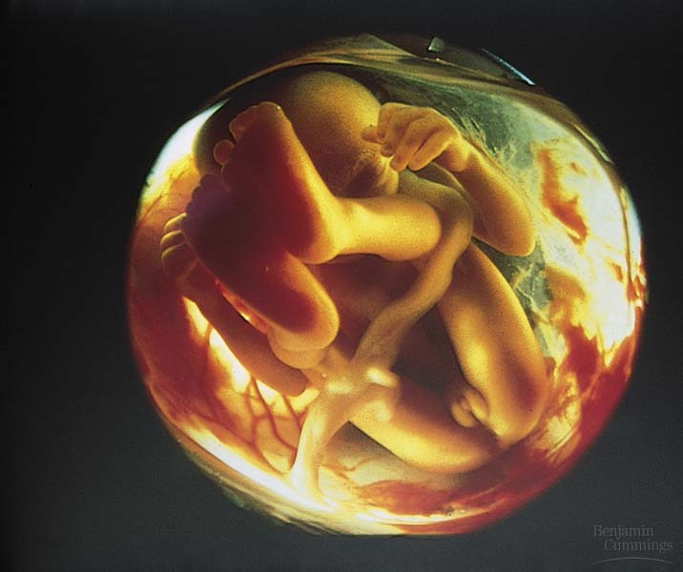
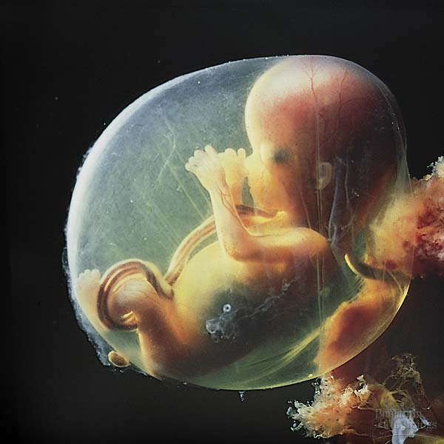
Human development from conception to birth is divided into three trimesters
Second trimester
Increase in size of fetus
General refinement of human features
12 weeks

Slide 29
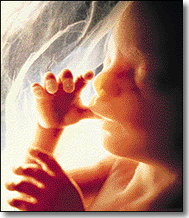
Human fetal development
The fetus just spends much of the 2nd & 3rd trimesters just growing
…and doing various flip-turns & kicks inside amniotic fluid
Week 20

Slide 30
SUMMARY

Slide 31
embryonic period:- it is the period that extends to the end of the eighth week (56 days), and marks the beginnings of all major organs
Stages of Prenatal Development. We shall study it in the following stages of development:
Stage 1:- embryonic stage its from fertilization and embryonic development up to day 56.
Stage 2:- the fetal stage: The fetal period begins on day 57 and ends when the fetus is completely outside the mother.

Slide 32
Conceptus :- The embryo and its or associated membranes. i.e amnion, chorionic (gestational) sac, and umbilical vesicle or yolk sac.
The conceptus includes all structures that develop from the zygote, both embryonic and extraembryonic.

Slide 33
Primordium -The beginning or first discernible indication of an organ or structure.
-Eg the primordium of the upper limb appears as a bud on day 26 .
Fetus (unborn offspring)- After the embryonic period (8 weeks) and until birth, the developing human is called a fetus.

Slide 34
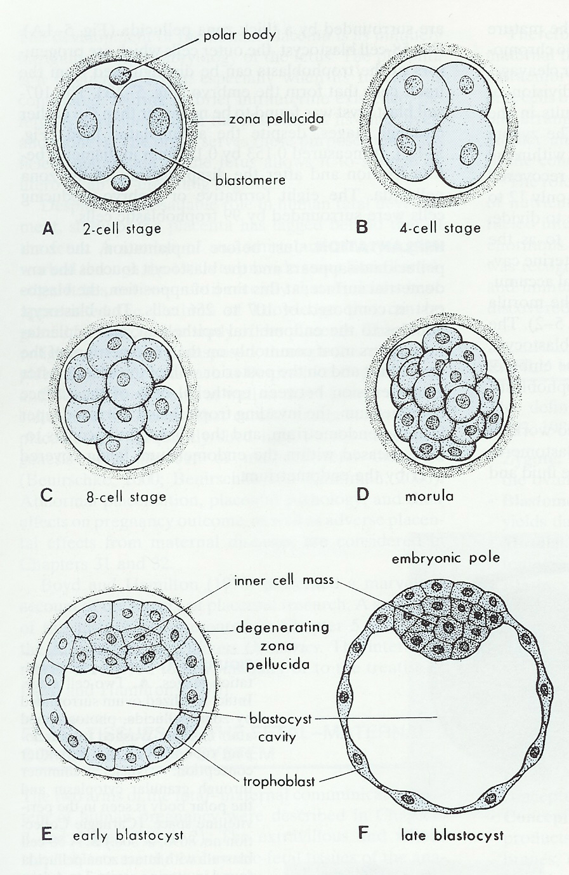
Early Human Development
Zygote
Blastomeres
Morula
Blastocyst
Embryo
Fetus
Conceptus

Slide 37
GOD BLESS YOU

