Slide 1
ENDOCRINE SYSTEM
Katua

Slide 2
.
The endocrine system controls body activities by releasing mediators, called
hormones.
A hormone (hormon to excite or get moving) is a mediator molecule that is released in one part of the body but regulates the activity of cells in other parts of the body.
Hormones regulate the activity of smooth muscle, cardiac muscle,
and some glands.

Slide 3
Endocrine Glands.
- Endocrine glands secrete hormones into interstitial fluid. Then, the hormones
diffuse into the blood.
- Exocrine glands (sebaceous, mucous, and digestive)secrete their
products through ducts into body cavities or onto body surfaces.

Slide 4
.
- The endocrine system consists of endocrine glands (pituitary, thyroid,
parathyroid, adrenal, and pineal glands).
Other hormone secreting tissues (hypothalamus, thymus, pancreas, ovaries,
testes, kidneys, stomach, liver, small intestine, skin, heart, adipose tissue, and
placenta).

Slide 5
Major Endocrine Organs.
Pituitary Gland (Hypophysis).
- Seated in sphenoid bone, pituitary gland, secretes at least nine hormones.
- Usually the size and shape of a pea,
- Its stalk, the funnel-shaped infundibulum, connects the gland to the
hypothalamus superiorly.

Slide 6
.
- Pituitary gland has two major lobes; one is neural tissue and the other glandular.
- The posterior pituitary (lobe) is composed largely of pituicytes (glia-like
supporting cells) and nerve fibers.
- It releases neurohormones (hormones secreted by neurons) received ready-
made from the hypothalamus.

Slide 7
.
- Thus, this lobe is a hormone-storage area and not a true endocrine gland in the
precise sense.
- The posterior lobe plus the infundibulum make up the region called the
neurohypophysis.

Slide 8
.
- The anterior pituitary (lobe), or adenohypophysis, is composed of glandular
tissue, and it manufactures and releases a number of hormones.

Slide 9
.
- The anterior pituitary consists of:-
Somatotrophs - produce human growth hormone (hGH);
Lactotrophs - produce prolactin (PRL);
Corticotrophs - secrete adrenocorticotropic hormone (ACTH)and melanocyte-
stimulating hormone (MSH);
Thyrotrophs - secrete thyroid-stimulating hormone (TSH);
Gonadotrophs - synthesize follicle-stimulating hormone (FSH) and luteinizing
hormone(LH).

Slide 10
.
The posterior pituitary contains axon terminals of neurosecretory
cells whose cell bodies are in the hypothalamus.
Hormones made by the hypothalamus and stored in the posterior
pituitary are:-
- Oxytocin, which stimulates contraction of the uterus and ejection of milk
from the breasts.
- Antidiuretic hormone(ADH), which stimulates water reabsorption by the
kidneys and constriction of arterioles.

Slide 11
.
The blood supply to the anterior pituitary is from the superior hypophyseal
arteries and venous drainage by hypophyseal portal veins.

Slide 12
Thyroid Gland
- The butterfly-shaped thyroid gland is located in anterior neck, on the trachea
just inferior to the larynx.
- Its two lateral lobes are connected by a median tissue mass called the isthmus.
- The thyroid gland is the largest pure endocrine gland in the body.
- Its blood supply is from the superior and inferior thyroid arteries.

Slide 13
.
- Internally, the gland is composed of hollow, spherical follicles.
- The walls of each follicle are formed largely by cuboidal or squamous epithelial
cells called follicle cells, which produce the glycoprotein thyroglobulin.
- The central cavity, or lumen, of the follicle stores colloid, an amber- colored,
sticky material consisting of thyroglobulin molecules with attached iodine atoms.

Slide 14
.
Thyroid hormone is derived from this iodinated thyroglobulin.
The parafollicular cells, another population of endocrine cells in the thyroid gland, produce calcitonin, an entirely different hormone.
- The parafollicular cells lie in the follicular epithelium but protrude into the soft
connective tissue that separates and surrounds the thyroid follicles.

Slide 15
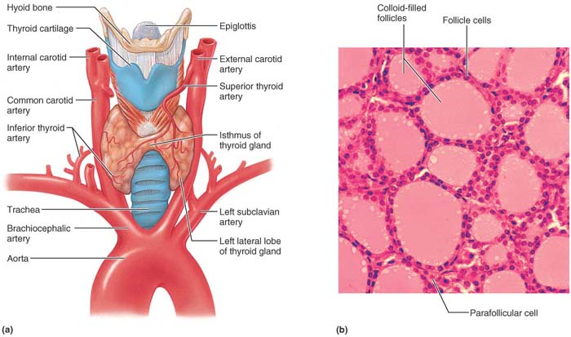
.

Slide 16
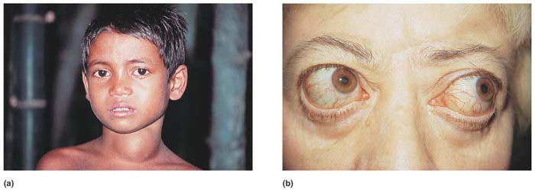

Slide 17
Parathyroid Glands.
- The tiny, yellow-brown parathyroid glands are nearly hidden from view in the
posterior aspect of the thyroid gland.
- There are usually four of these glands, but the precise number varies from one
individual to another.

Slide 18
.
- As many as eight have been reported, and some may be located in other regions
of the neck or even in the thorax.
- The parathyroid’s glandular cells are arranged in thick, branching cords
containing scattered oxyphil cells and large numbers of smaller chief cells.
- The chief cells secrete PTH.

Slide 19
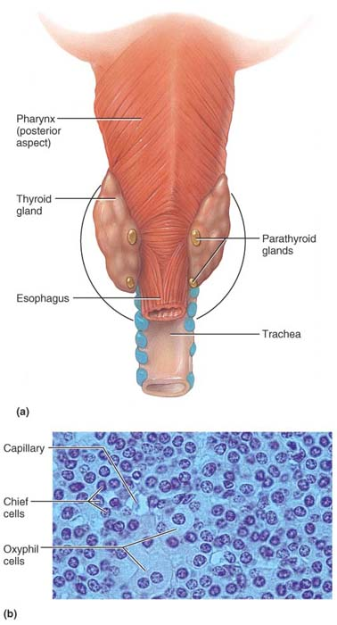
.

Slide 20
Adrenal (Suprarenal) Glands.
- The paired adrenal glands are pyramid-shaped organs perched atop the kidneys.
- They are enclosed in a fibrous capsule and a cushion of fat.
- They are also often referred to as the suprarenal glands.

Slide 21
.
- Each adrenal gland is structurally and functionally two endocrine glands.
- The inner adrenal medulla, more like a knot of nervous tissue than a gland, is
part of the sympathetic nervous system.

Slide 22
.
- The outer adrenal cortex, encapsulating the medullary region and forming the
bulk of the gland, is glandular tissue derived from embryonic mesoderm.
- Each region produces its own set of hormones, but all adrenal hormones help
cope with stressful situations.

Slide 23
Adrenal Cortex
- Steroid hormones, called corticosteroids, are synthesized from cholesterol by the
adrenal cortex.
- The pathway is multistep and involves varying intermediates depending on the
hormone being formed.
- Steroid hormones are not stored in cells, their rate of release in response to
stimulation depends on their rate of synthesis.

Slide 24
.
- The large, lipid-laden cortical cells are arranged in three layers or zones.
- The cell clusters forming the superficial zona glomerulosa produce
mineralocorticoids, hormones that help control the balance of minerals and
water in the blood.

Slide 25
.
The principal products of the middle zona fasciculata cells, arranged in more or
less linear cords, are the metabolic hormones called glucocorticoids.
- The cells of the innermost zona reticularis , abutting the adrenal medulla, have a
netlike arrangement.

Slide 26
.
These cells mainly produce small amounts of adrenal sex hormones, or
gonadocorticoids.
- The two innermost layers of the adrenal cortex share production of
glucocorticoids and gonadocorticoids, although each layer is the predominant
producer of one type.

Slide 27
Adrenal Medulla
- Its spherical chromaffin cells, crowd around blood-filled capillaries and sinusoids.
- Modified ganglionic sympathetic neurons synthesize catecholamines
epinephrine and norepinephrine (NE), via a molecular sequence from tyrosine to
dopamine to NE to epinephrine.

Slide 28
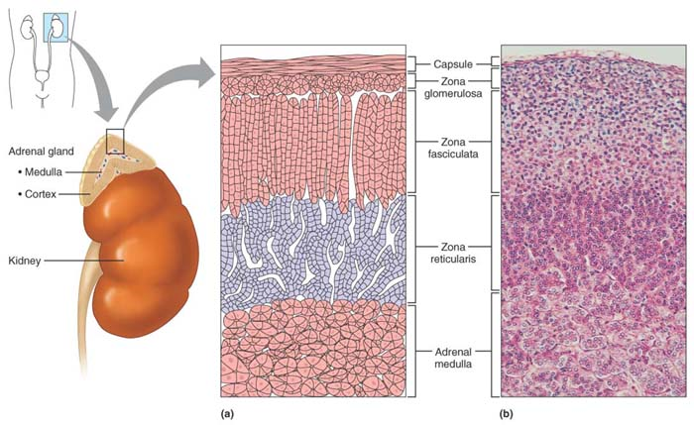
.

Slide 29
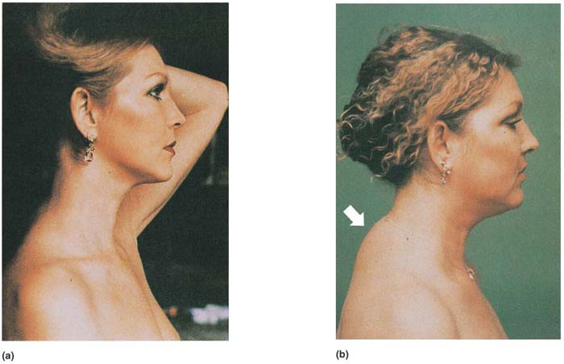
-(a) pt., (b) during Cushing’s disease, the characteristic “buffalo hump” of fat on the upper back is indicated by a white arrow..

Slide 30
The Pancrease
- Located partially behind stomach, the soft, triangular pancrease is a mixed gland
composed of both endocrine and exocrine gland cells.
- Along with the thyroid and parathyroids, it develops as an out pocketing of the
epithelial lining of the gastrointestinal tract.
- Acinar cells, forming the bulk of the gland, produce an enzyme-rich juice that is
ducted into the small intestine during food digestion.

Slide 31
.
- Among the acinar cells are pancreatic islets (also called islets of Langerhans),
tiny cell clusters that produce pancreatic hormones.
- The islets contain two major populations of hormone-producing cells, the
glucagon-synthesizing alpha (α) cells and the more numerous insulin-producing
beta (β) cells.

Slide 32
.
- These cells, secreting glucagon and insulin appropriately during the fasting and
fed states.
- Thus insulin and glucagon are intimately but independently involved in the
regulation of blood glucose levels.

Slide 33
.
- Their effects are antagonistic:-
1. Insulin is a hypoglycaemic hormone,
2. Glucagon is a hyperglycaemic hormone.
- Some islet cells also synthesize other peptides in small amounts. These include
somatostatin, pancreatic polypeptide (PP), and others.

Slide 34
Gonads.
- The male and female gonads produce steroid sex hormones, identical to those
produced by adrenal cortical cells.
- The major distinction is the source and relative amounts produced.
- The paired ovaries are small, oval organs located in the female’s abdominopelvic
cavity.

Slide 35
.
- Besides producing ova, or eggs, ovaries produce several hormones, most
importantly oestrogens and progesterone.
- Alone, the oestrogens are responsible for maturation of the reproductive organs
and the appearance of the secondary sex characteristics of females at puberty.

Slide 36
.
- Acting with progesterone, oestrogens promote breast development and cyclic
changes in the uterine mucosa (the menstrual cycle).
- The male testes, located in an extra-abdominal skin pouch called the scrotum,
produce sperm and male sex hormones, primarily testosterone.

Slide 37
Pineal Gland
- The tiny, pine cone–shaped pineal gland hangs from the roof of the third
ventricle in the diencephalon.
- Its secretory cells, called pinealocytes, are arranged in compact cords and
clusters.

Slide 38
.
- Lying between pinealocytes in adults are dense particles containing calcium salts.
- These salts are radiopaque; hence, the pineal gland is a handy landmark for
determining brain orientation in X rays.
- The endocrine function of the pineal gland is still somewhat of a mystery.

Slide 39
.
- Its only major secretory product is melatonin, a powerful antioxidant and amine
hormone derived from serotonin.
- Melatonin concentrations in the blood rise and fall in a diurnal (daily) cycle.
- Peak levels occur during the night and make us drowsy; lowest levels occur
around noon.

Slide 40
Thymus.
- Located deep to the sternum in the thorax is the lobulated thymus gland.
- Large and conspicuous in infants and children, the thymus diminishes in size
throughout adulthood.
- By old age, it is composed largely of adipose and fibrous connective tissues.

Slide 41
.
- The major hormonal product of thymic epithelial cells is peptide hormones,
including thymopoietins, thymic factor, and thymosins.
- They are essential for normal development of T lymphocytes and the immune
response.

Slide 42
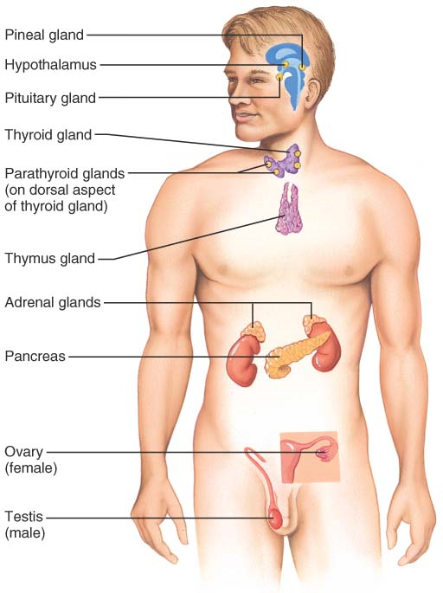
.

Slide 43
Goiter (enlargement of thyroid gland)

Slide 44
Exophthalmos (excess thyroid hormones, as in Graves’ disease)

