Slide 1
ENDOCRINE SYSTEM
SAMUEL NGIGI K.
KMTC

Slide 2
TWO MAIN CONTROL SYSTEMS
The Nervous System – Rapid control system
The Endocrine System – Slow control system

Slide 3
The Endocrine System

Slide 4
Introduction
The endocrine hormones are carried by the circulatory system to cells throughout the body, including the nervous system in some cases, where they bind with receptors and initiate many cell reactions.
Some endocrine hormones affect many different types of cells of the body; for example, growth hormone (from the anterior pituitary gland) causes growth in most parts of the body, and thyroxine (from the thyroid gland) increases the rate of many chemical reactions in almost all the body’s cells.

Slide 5
Classification of Hormones
1. According to their chemical nature.
A. Proteins and polypeptides, including hormones secreted by the anterior and posterior pituitary gland, the pancreas (insulin and glucagon), the parathyroid gland (parathyroid hormone), and many others.
B. Steroids secreted by the adrenal cortex (cortisol and aldosterone), the ovaries (estrogen and progesterone), the testes (testosterone), and the placenta (estrogen and progesterone).
C. Derivatives of the amino acid tyrosine, secreted by the thyroid (thyroxine and triiodothyronine) and the adrenal medullae (epinephrine and norepinephrine).

Slide 6
2. According to their origin
Hypophysiotropic hormones 1. Releasing H.
GHRH
Thyrotropin (TSH) RH (TRH)
Corticotropin RH
Gonadotropin RH
Hypothalamus
2. Inhibiting H.
Somatostatin (SS)
Prolactin inhibiting H.
Notes:
GHRH(Growth Hormone Releasing Hormone)

Slide 7
HORMONE SECRETION, TRANSPORT, AND CLEARANCE FROM THE BLOOD
Hormone Secretion After a Stimulus and Duration of Action of Different Hormones.
Some hormones, such as norepinephrine and epinephrine, are secreted within seconds after the gland is stimulated and may develop full action within another few seconds to minutes; the actions of other hormones, such as thyroxine or growth hormone, may require months for full effect.
Thus, each of the different hormones has its own characteristic onset and duration of action—each tailored to perform its specific control function.

Slide 8
HORMONE SECRETION, TRANSPORT, AND CLEARANCE FROM THE BLOOD
Concentrations of Hormones in the Circulating Blood and Hormonal Secretion Rates.
The concentrations of hormones required to control most metabolic and endocrine functions are incredibly small.
Their concentrations in the blood range from as little as 1 picogram (which is one millionth of one millionth of a gram) in each milliliter of blood up to at most a few micrograms (a few millionths of a gram) per milliliter of blood.
Similarly, the rates of secretion of the various hormones are extremely small, usually measured in micrograms or milligrams per day.

Slide 9
TRANSPORT OF HORMONES IN THE BLOOD
Water-soluble hormones (peptides and catecholamines) are dissolved in the plasma and transported from their sites of synthesis to target tissues, where they diffuse out of the capillaries, into the interstitial fluid, and ultimately to target cells.

Slide 10
TRANSPORT OF HORMONES IN THE BLOOD
Steroid and thyroid hormones, in contrast, circulate in the blood while being mainly bound to plasma proteins.
Usually less than 10 percent of steroid or thyroid hormones in the plasma exist free in solution.
For example, more than 99 percent of the thyroxine in the blood is bound to plasma proteins.
However, protein-bound hormones cannot easily diffuse across the capillaries and gain access to their target cells and are therefore biologically inactive until they dissociate from plasma proteins.

Slide 11
MECHANISMS OF ACTION OF HORMONES
HORMONE RECEPTORS AND THEIR ACTIVATION
The first step of a hormone’s action is to bind to specific receptors at the target cell.
Cells that lack receptors for the hormones do not respond.
Receptors for some hormones are located on the target cell membrane, whereas other hormone receptors are located in the cytoplasm or the nucleus.

Slide 12
MECHANISMS OF ACTION OF HORMONES CNT’D…
The locations for the different types of hormone receptors are generally the following:
1. In or on the surface of the cell membrane. The membrane receptors are specific mostly for the protein, peptide, and catecholamine hormones.
2. In the cell cytoplasm. The primary receptors for the different steroid hormones are found mainly in the cytoplasm.
3. In the cell nucleus. The receptors for the thyroid hormones are found in the nucleus and are believed to be located in direct association

Slide 13
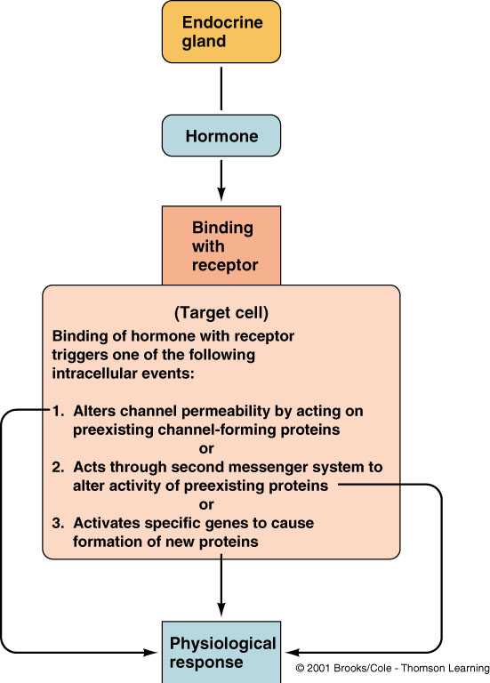

Slide 14
The Number and Sensitivity of Hormone Receptors Are Regulated
The number of receptors in a target cell usually does not remain constant from day to day or even from minute to minute.
Receptor proteins are often inactivated or destroyed during the course of their function, and at other times they are reactivated or new ones are manufactured by the cell.
For instance, increased hormone concentration and increased binding with its target cell receptors sometimes cause the number of active receptors to decrease.
This down-regulation of the receptors can occur as a result of
(1) inactivation of some of the receptor molecules;
(2) inactivation of some of the intracellular protein signaling molecules;
(3) temporary sequestration of the receptor to the inside of the cell, away from the site of action of hormones that interact with cell membrane receptors;

Slide 15
The Number and Sensitivity of Hormone Receptors Are Regulated
(4) destruction of the receptors by lysosomes after they are internalized; or
(5) decreased production of the receptors.
In each case, receptor downregulation decreases the target tissue’s responsiveness to the hormone.
Some hormones cause up-regulation of receptors and intracellular signaling proteins; that is, the stimulating hormone induces greater than normal formation of receptor or intracellular signaling molecules by the target cell or greater availability of the receptor for interaction with the hormone.
When up-regulation occurs, the target tissue becomes progressively more sensitive to the stimulating effects of the hormone.

Slide 16
INTRACELLULAR SIGNALING AFTER HORMONE RECEPTOR ACTIVATION
Almost without exception, a hormone affects its target tissues by first forming a hormone-receptor complex.
Formation of this complex alters the function of the receptor, and the activated receptor initiates the hormonal effects.
To explain this process, let us give a few examples of the different types of interactions.

Slide 17
Ion Channel–Linked Receptors
Virtually all the neurotransmitter substances, such as acetylcholine and norepinephrine, combine with receptors in the postsynaptic membrane.
This combination almost always causes a change in the structure of the receptor, usually opening or closing a channel for one or more ions.
Some of these ion channel–linked receptors open (or close) channels for sodium ions, others for potassium ions, others for calcium ions, and so forth.
The altered movement of these ions through the channels causes the subsequent effects on the postsynaptic cells.
Although a few hormones may exert some of their actions through activation of ion channel receptors, most hormones that open or close ions channels do this indirectly by coupling with G protein–linked or enzyme-linked receptors, as discussed next.

Slide 18
G Protein–Linked Hormone Receptors
Many hormones activate receptors that indirectly regulate the activity of target proteins (e.g., enzymes or ion channels) by coupling with groups of cell membrane proteins called heterotrimeric guanosine triphosphate (GTP)-binding proteins (G proteins) (Figure 75-4).
Of more than 1000 known G protein–coupled receptors, all have seven transmembrane segments that loop in and out of the cell membrane.
Some parts of the receptor that protrude into the cell cytoplasm (especially the cytoplasmic tail of the receptor) are coupled to G proteins that include three (i.e., trimeric) parts—the α, β, and γ subunits.
When the ligand (hormone) binds to the extracellular part of the receptor, a conformational change occurs in the receptor that activates the G proteins and induces intracellular signals that either:
open or close cell membrane ion channels,
(2) change the activity of an enzyme in the cytoplasm of the cell, or
(3) activate gene transcription.

Slide 19
G Protein–Linked Hormone Receptors
The trimeric G proteins are named for their ability to bind guanosine nucleotides. In their inactive state, the α, β, and γ subunits of G proteins form a complex that binds guanosine diphosphate (GDP) on the α subunit.
When the receptor is activated, it undergoes a conformational change that causes the GDP-bound trimeric G protein to associate with the cytoplasmic part of the receptor and to exchange GDP for GTP.
Displacement of GDP by GTP causes the α subunit to dissociate from the trimeric complex and to associate with other intracellular signaling proteins; these proteins, in turn, alter the activity of ion channels or intracellular enzymes such as adenylyl cyclase or phospholipase C, which alter cell function.
The signaling event is terminated when the hormone is removed and the α subunit inactivates itself by converting its bound GTP to GDP; then the α subunit once again combines with the β and γ subunits to form an inactive, membrane-bound trimeric G protein.

Slide 21
Enzyme-Linked Hormone Receptors
Some receptors, when activated, function directly as enzymes or are closely associated with enzymes that they activate.
These enzyme-linked receptors are proteins that pass through the membrane only once, in contrast to the seventransmembrane G protein–coupled receptors.
Enzyme linked receptors have their hormone-binding site on the outside of the cell membrane and their catalytic or enzyme-binding site on the inside.
When the hormone binds to the extracellular part of the receptor, an enzyme immediately inside the cell membrane is activated (or occasionally inactivated).

Slide 22
Table 75-2 lists a few of the many peptide growth factors, cytokines, and hormones that use the enzyme linked receptor tyrosine kinases for cell signaling.

Slide 23
Enzyme-Linked Hormone Receptors
One example that is widely used in hormonal control of cell function, is for the hormone to bind with a special transmembrane receptor, which then becomes the activated enzyme adenylyl cyclase at the end that protrudes to the interior of the cell.
This cyclase catalyzes the formation of cAMP, which has a multitude of effects inside the cell to control cell activity.
cAMP is called a second messenger because it is not the hormone itself that directly institutes the intracellular changes; instead, the cAMP serves as a second messenger to cause these effects.
For a few peptide hormones, such as atrial natriuretic peptide, cyclic guanosine monophosphate, which is only slightly different from cAMP, serves in a similar manner as a second messenger.
Notes:
Cyclic adenosine monophosphate (cAMP)

Slide 24
Intracellular Hormone Receptors and Activation of Genes
Several hormones, including adrenal and gonadal steroid hormones, thyroid hormones, retinoid hormones, and vitamin D, bind with protein receptors inside the cell rather than in the cell membrane.
Because these hormones are lipid soluble, they readily cross the cell membrane and interact with receptors in the cytoplasm or nucleus.
The activated hormone-receptor complex then binds with a specific regulatory (promoter) sequence of the DNA called the hormone response element, and in this manner either activates or represses transcription of specific genes and formation of messenger RNA (mRNA; Figure 75-6).

Slide 26
SECOND MESSENGER MECHANISMS FOR MEDIATING INTRACELLULAR HORMONAL FUNCTIONS
We noted earlier that one of the means by which hormones exert intracellular actions is to stimulate formation of the second messenger cAMP inside the cell membrane.
The cAMP then causes subsequent intracellular effects of the hormone.
Thus, the only direct effect that the hormone has on the cell is to activate a single type of membrane receptor.
The second messenger does the rest.
cAMP is not the only second messenger used by the different hormones.
Two other especially important ones are
calcium ions and associated calmodulin and
(2) products of membrane phospholipid breakdown.

Slide 28
Adenylyl Cyclase–cAMP Second Messenger System
Table 75-3 shows a few of the many hormones that use the adenylyl cyclase–cAMP mechanism to stimulate their target tissues.
Binding of the hormones with the receptor allows coupling of the receptor to a G protein.
If the G protein stimulates the adenylyl cyclase–cAMP system, it is called a Gs protein, denoting a stimulatory G protein.
Stimulation of adenylyl cyclase, a membrane-bound enzyme, by the Gs protein then catalyzes the conversion of a small amount of cytoplasmic adenosine triphosphate into cAMP inside the cell.
This then activates cAMP-dependent protein kinase, which phosphorylates specific cell proteins, triggering biochemical reactions that ultimately lead to the cell’s response to the hormone.
Once cAMP is formed inside the cell, it usually activates a cascade of enzymes.

Slide 29
Cell Membrane Phospholipid Second Messenger System
Some hormones activate transmembrane receptors that activate the enzyme phospholipase C attached to the inside projections of the receptors (Table 75-4).
This enzyme catalyzes the breakdown of some phospholipids in the cell membrane, especially phosphatidylinositol biphosphate (PIP2), into two different second messenger products: inositol triphosphate (IP3) and diacylglycerol (DAG).
The IP3 mobilizes calcium ions from mitochondria and the endoplasmic reticulum, and the calcium ions then have their own second messenger effects, such as smooth muscle contraction and changes in cell secretion.
DAG, the other lipid second messenger, activates the enzyme protein kinase C, which then phosphorylates a large number of proteins, leading to the cell’s response.

Slide 30
Calcium-Calmodulin Second Messenger System
Another second messenger system operates in response to the entry of calcium into the cells.
Calcium entry may be initiated by (1) changes in membrane potential that open calcium channels or (2) a hormone interacting with membrane receptors that open calcium channels.
Upon entering a cell, calcium ions bind with the protein calmodulin.
This protein has four calcium sites, and when three or four of these sites have become bound with calcium, the calmodulin changes its shape and initiates multiple effects inside the cell, including activation or inhibition of protein kinases.
Activation of calmodulin-dependent protein kinases causes, via phosphorylation, activation or inhibition of proteins involved in the cell’s response to the hormone.
For example, one specific function of calmodulin is to activate myosin light chain kinase, which acts directly on the myosin of smooth muscle to cause smooth muscle contraction.

Slide 31
HORMONES THAT ACT MAINLY ON THE GENETIC MACHINERY OF THE CELL
Steroid Hormones Increase Protein Synthesis
Another means by which hormones act, especially steroid hormones, is to cause synthesis of proteins in the target cells.
These proteins then function as enzymes, transport proteins, or structural proteins, which in turn provide other functions of the cells.

Slide 32
Steroid Hormones Increase Protein Synthesis
The sequence of events in steroid function is essentially the following:
The steroid hormone diffuses across the cell membrane and enters the cytoplasm of the cell, where it binds with a specific receptor protein.
2. The combined receptor protein–hormone then diffuses into or is transported into the nucleus.
3. The combination binds at specific points on the DNA strands in the chromosomes, which activates the transcription process of specific genes to form mRNA.
4. The mRNA diffuses into the cytoplasm, where it promotes the translation process at the ribosomes to form new proteins.

Slide 33
Thyroid Hormones Increase Gene Transcription in the Cell Nucleus
The thyroid hormones thyroxine and triiodothyronine cause increased transcription by specific genes in the nucleus.
To accomplish this increased transcription, these hormones first bind directly with receptor proteins in the nucleus, these receptors are activated transcription factors located within the chromosomal complex, and they control the function of the gene promoters.

Slide 34
Thyroid Hormones Increase Gene Transcription in the Cell Nucleus
The following two features of thyroid hormone function in the nucleus are important:
1. They activate the genetic mechanisms for the formation of many types of intracellular proteins— probably 100 or more. Many of these intracellular proteins are enzymes that promote enhanced intracellular metabolic activity in virtually all cells of the body.
2. Once bound to the intranuclear receptors, the thyroid hormones can continue to express their control functions for days or even weeks.

Slide 35
ENDOCRINE SYSTEM
General Principles of Endocrinology
Central Endocrine Glands
Pineal Gland
Hypothalamus
Hypophysis cerebri (Pituitary)
Peripheral Endocrine Glands
Thyroid
Parathyroids
Adrenal Glands
Pancreas
Gonads

Slide 36
Principles of Endocrinology
Endocrine Glands - Glands of internal secretion (products are emptied directly into the circulation)

Slide 37
Hormones
1. Definition - Chemical messengers (produced in one location and work somewhere else)
2. Types
Peptides
Amines
Catecholamines (epinephrine, nor-epinephrine)
Thyroxine
Steroids

Slide 38
Hormones
3. Chemical Properties
Hydrophilic and Lipophobic
Peptides -- work via a second messenger, cAMP
Adenylate Cyclase
ATP ___________________> cAMP
Catecholamines - via 2nd messengers
Hydrophobic and Lipophilic
Thyroxine - Activates genes
Steroids -- activate genes

Slide 39
Negative Feedback Loop
Major mechanism of hormone action
Mechanism:
A stimulus starts a process
Process causes release of a hormone
Either the hormone or a product of its effects causes the process to slow down or turn off.
Example: the regulation of the blood glucose level in the body

Slide 40
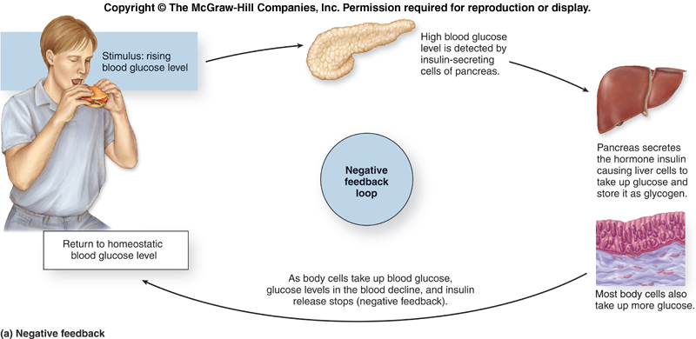

Slide 41
Positive Feedback Loop
Called positive because it accelerates the original process
can ensure that the pathway continues to run
can speed up its activities.
Few positive feedback loops in the human endocrine system.
Example: milk release from the mammary glands

Slide 42
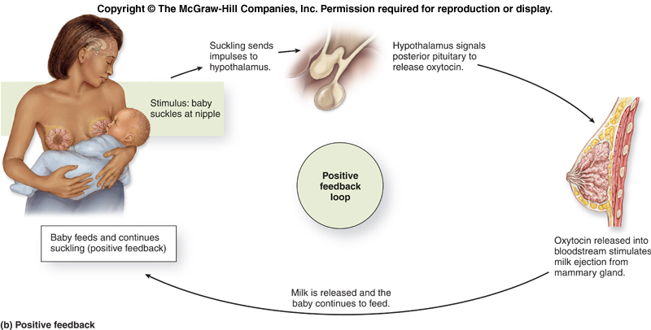

Slide 43
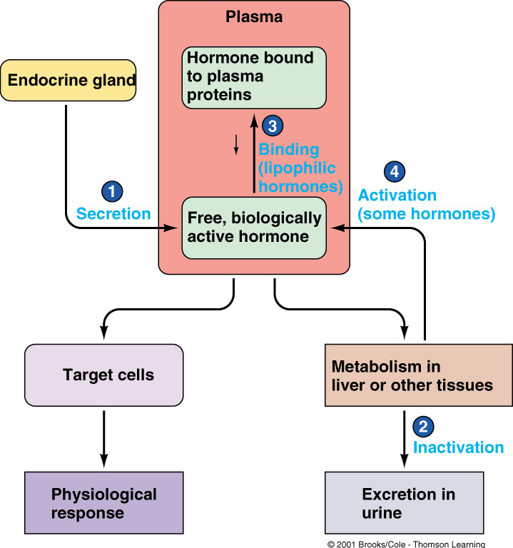

Slide 44
Central Endocrine Glands
Pineal Gland
Hypothalamus
Hypophysis cerebri (Pituitary)

Slide 45
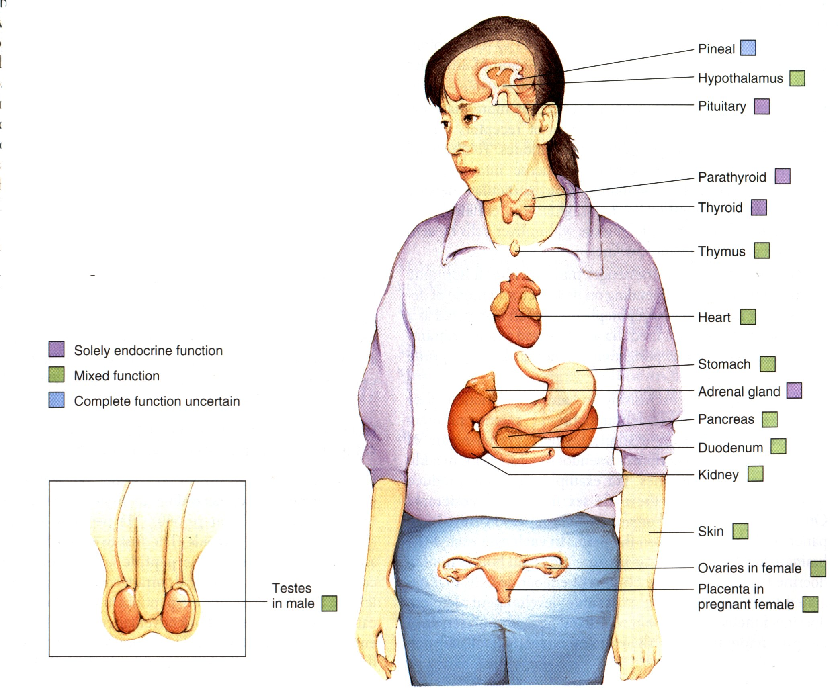
18-1

Slide 46
Pineal Gland
Melatonin - regulates circadian rhythms (increases in dark)
May induce sleep
May initiate puberty
May inhibit ovulation/spermatogenesis
May be antioxidant
May slow aging
May enhance immunity
Notes:
Circadian rhythms are physical, mental, and behavioral changes that follow a daily cycle. They respond primarily to light and darkness in an organism's environment. Sleeping at night and being awake during the day is an example of a light-related circadian rhythm.

Slide 48
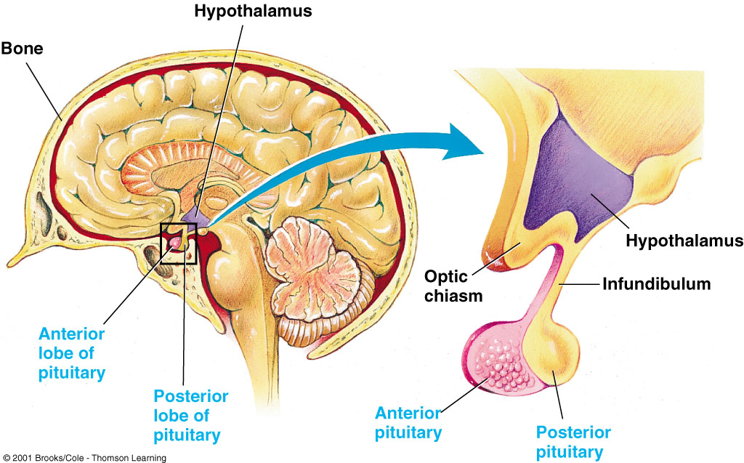
18-9

Slide 49
Hypothalamic Control of the Endocrine System
Master control center of the endocrine system
Hypothalamus oversees most endocrine activity:
special cells in the hypothalamus secrete hormones that influence the secretory activity of the anterior pituitary gland
called regulatory hormones
releasing hormones (RH)
inhibiting hormones (IH)
Hypothalamus has indirect control over these endocrine organs.

Slide 50
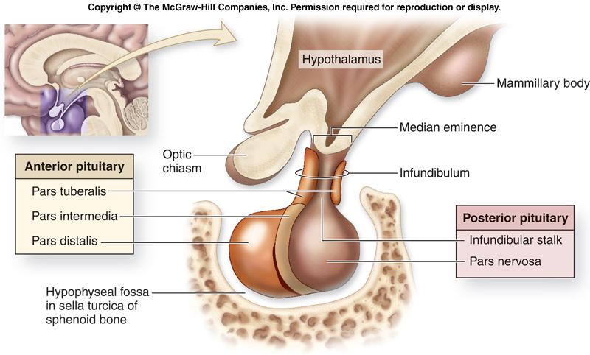

Slide 51
Hypothalamic Control of the Endocrine System
Hypothalamus produces two hormones that are transported to and stored in the posterior pituitary.
oxytocin (paraventicular nucleus)
antidiuretic hormone (ADH) (supraoptic nucleus)
Hypothalamus directly oversees the stimulation and hormone secretion of the adrenal medulla.
An endocrine structure that secretes its hormones in response to stimulation by the sympathetic nervous system.
Some endocrine cells are not under direct control of hypothalamus.

Slide 52
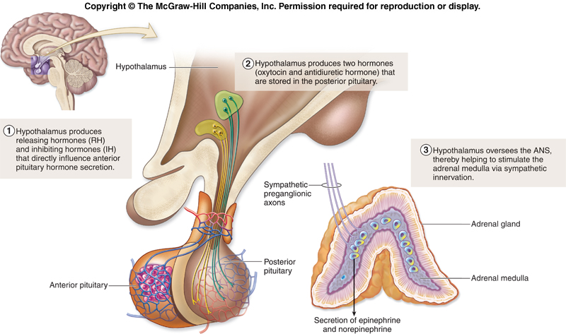

Slide 53
Pituitary Gland (Hypophysis)
lies inferior to the hypothalamus.
Small, slightly oval gland housed within the hypophyseal fossa of the sphenoid bone.
Connected to the hypothalamus by a thin stalk, the infundibulum.
Partitioned both structurally and functionally into an anterior pituitary and a posterior pituitary.
(called anterior lobes and posterior lobes)

Slide 54
Hypophysis cerebri
(= pituitary) - called the "master gland", because it regulates other glands.
Adenohypophysis (=anterior lobe)
Neurohypophysis (= Posterior Lobe)

Slide 56
Control of Anterior Pituitary Gland Secretions
Anterior pituitary gland is controlled by regulatory hormones secreted by the hypothalamus.
Hormones reach the anterior pituitary via hypothalamo- hypophyseal portal system.
essentially a “shunt”
takes venous blood carrying regulatory hormones from the hypothalamus directly to the anterior pituitary

Slide 57
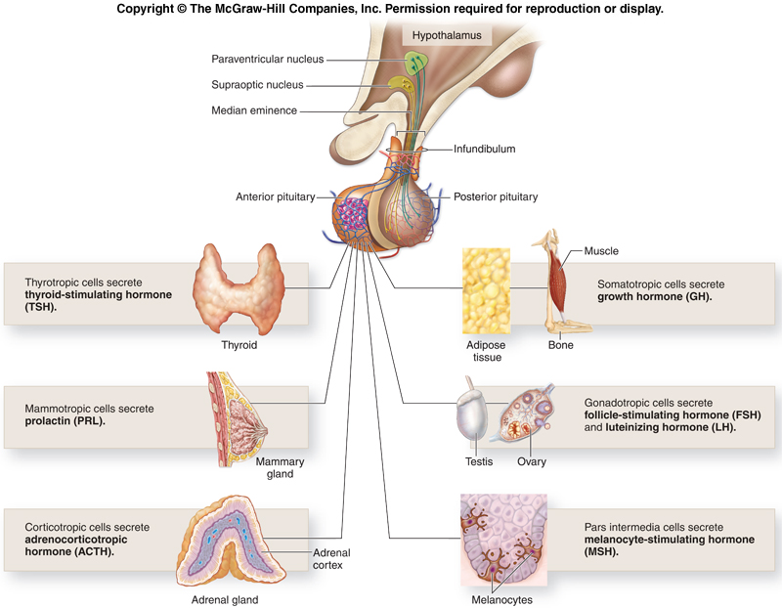

Slide 58
Neurohypophysis (=posterior lobe)
oxytocin - stimulates smooth muscle contraction --> childbirth & milk release.
Antidiuretic hormone (ADH) (=vasopressin) --> increased permeability of collecting tubules to water

Slide 59
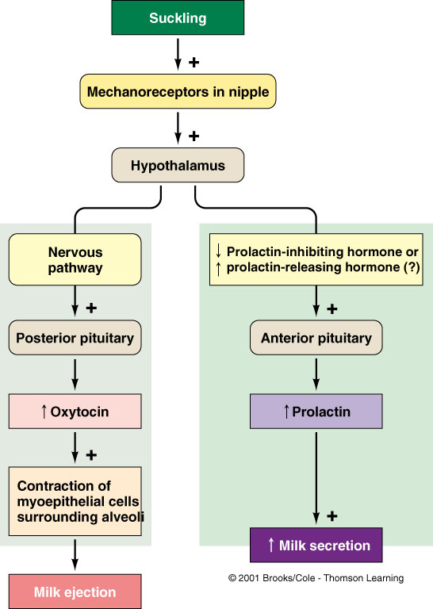

Slide 60
Adenophpophysis
Growth Hormone (GH) (= somatotropin) - regulates growth.
Prolactin (= Luteotropic hormone, LTH) - stimulates milk production; no known role in males.
Adrenocorticotropic hormone (ACTH) (= corticotropin) - stimulates adrenal cortex.
Thyroid Stimulating Hormone (TSH) (=Thyrotropin) - Stimulates thyroid gland to secrete thyroxine
Gonadotropins (Act on gonads)
Follicle Stimulating Hormone (FSH)
Luteinizing Hormone (LH)

Slide 61
Growth Hormone
Regulates growth
Overproduction in children ---> gigantism; in adults ---> acromegaly. Underproduction --> pituitary midget (dwarfism).
Notes:
Gigantism is a rare condition that causes abnormal growth in children. This change is most notable in terms of height, but girth is affected as well. It occurs when your child's pituitary gland makes too much growth hormone, which is also known as somatotropin. Early diagnosis is important.
Acromegaly is a disorder that results from excess growth hormone (GH) after the growth plates have closed. The initial symptom is typically enlargement of the hands and feet. There may also be enlargement of the forehead, jaw, and nose.

Slide 62
Peripheral Endocrine Glands
Thyroid Gland
Parathyroid Glands
Adrenal Glands
Pancreas

Slide 63
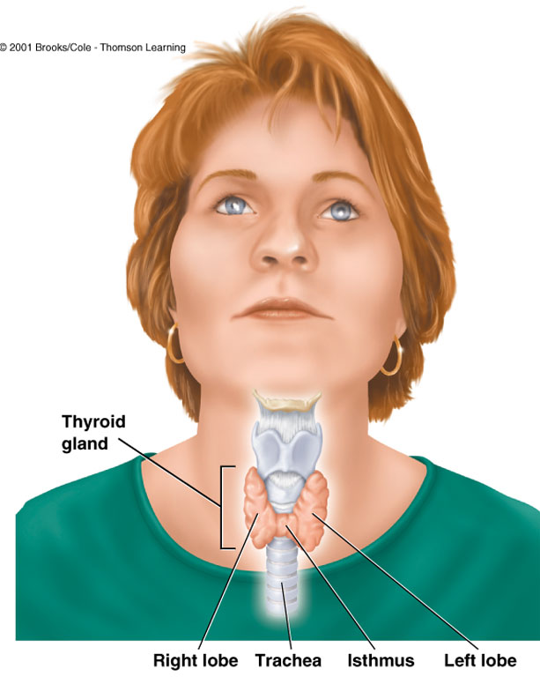
19-1a

Slide 64
Thyroid Gland
Located immediately inferior to the thyroid cartilage of the larynx and anterior to the trachea.
Distinctive “butterfly” shape due to its left and right lobes, which are connected at the anterior midline by a narrow isthmus.
Both lobes of the thyroid gland are highly vascularized, giving it an intense reddish coloration.
Regulation of thyroid hormone secretion depends upon a complex thyroid gland–pituitary gland negative feedback process.

Slide 65
Thyroid Gland
Follicle cells:
Produce and secrete thyroid hormone
Precursor is stored in colloid
Thyroid hormone
Increases metabolic rate
Important in growth and development.
Parafollicular cells
Produce and secrete calcitonin
Calcitonin
Secreted in response to elevated calcium levels
Reduces blood calcium levels
Acts on osteoblasts.

Slide 66
Thyroid Gland
-->Thyroxine - Regulates BMR
a. Hyperthyroidism --> high metabolic rate (extreme --> exophthalmos). Treated by propylthiouracil, thyroidectomy, or radioactive iodine.
b. Hypothyroidism --> cretinism in children & myxedema in adults
Notes:
Exophthalmos (also called exophthalmus, exophthalmia, proptosis, or exorbitism) is a bulging of the eye anteriorly out of the orbit.
Cretinism: Congenital hypothyroidism (underactivity of the thyroid gland at birth), which results in growth retardation, developmental delay, and other abnormal features.
Myxedema refers to a severe form of hypothyroidism than can occur when the condition is left untreated or is not treated sufficiently. The term also applies to the effects that hypothyroidism can have on the skin, making it appear swollen and puffy.

Slide 67
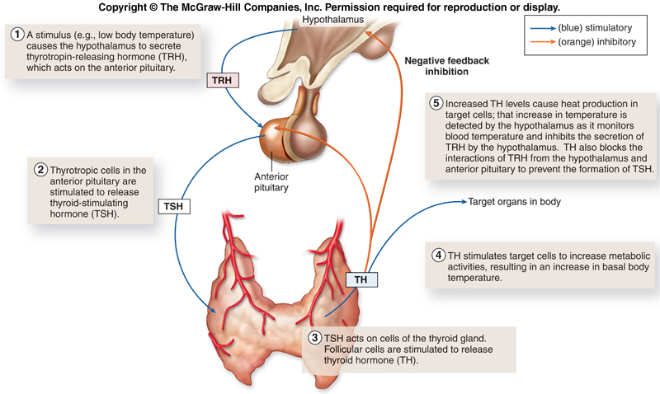

Slide 68
Parathyroid Glands
Small, brownish-red glands
located on the posterior surface of the thyroid gland
Usually four small nodules
may have as few as two or as many as six.
Two different types of cells in the parathyroid gland:
chief cells
oxyphil cells
Chief cells are the source of parathyroid hormone (PTH).
stimulates osteoclasts to resorb bone and release calcium ions from bone matrix into the bloodstream
stimulates calcitriol hormone synthesis in the kidney
promotes calcium absorption in the small intestine
prevents the loss of calcium ions during the formation of urine
The function of oxyphil cells is not known.

Slide 69
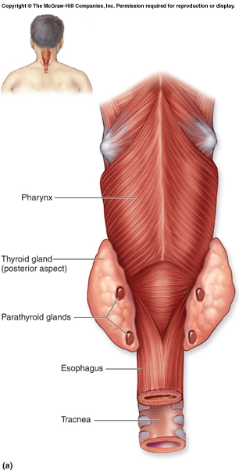

Slide 70
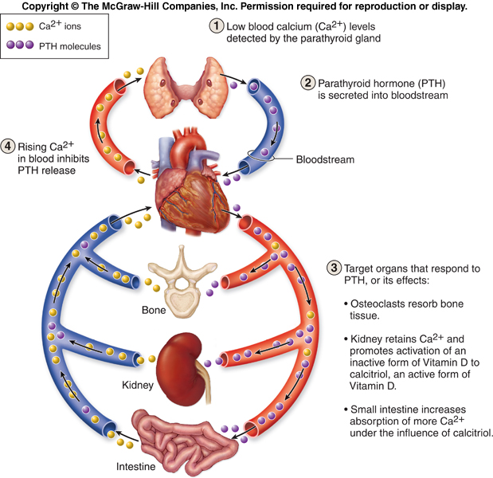

Slide 71
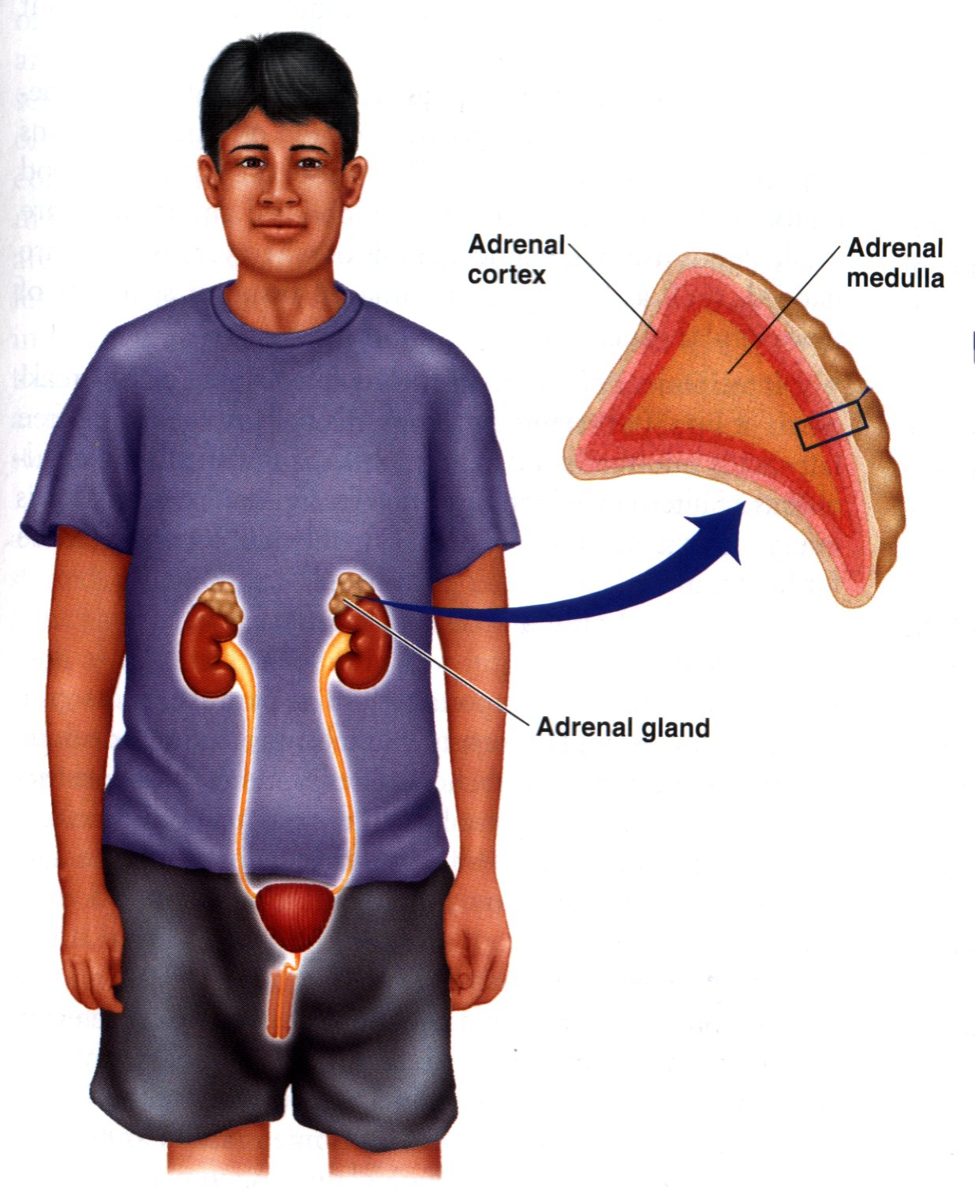

Slide 72
Adrenal Glands (suprarenal)
Paired, pyramid-shaped endocrine glands anchored on the superior surface of each kidney.
Retroperitoneal and embedded in fat and fascia to minimize their movement.
Outer adrenal cortex and an inner central core called the adrenal medulla.
secrete different types of hormones

Slide 73
Adrenal Gland
a. Adrenal Medulla --> epinephrine & norepinephrine
b. Adrenal Cortex --> numerous steroids (3 major groups)
i. Mineralocorticoids (e.g. aldosterone - regulates Na⁺ & K⁺ in blood).
ii. Glucocorticoids (e.g. cortisone - causes: gluconeogenesis, mobilization of amino acids, mobilization of fats. Anti-inflammatory agent released in response to stress)
iii. Androgens - Normally have no effect

Slide 74
Adrenal Cortex
Distinctive yellow color due to stored lipids in its cell.
Synthesize more than 25 different steroid hormones, collectively called corticosteroids.
corticosteroid synthesis is stimulated by the ACTH(adrenalcorticotropic hormone) produced by the anterior pituitary
corticosteroids are vital to our survival; trauma to or removal of the adrenal glands requires corticosteroid supplementation throughout life
Partitioned into the zona glomerulosa, the zona fasciculata, and the zona reticularis.
Different functional categories of steroid hormones are synthesized and secreted in the separate zones.
Regulates salt, sugar, and sex!

Slide 75
Adrenal Cortex
Partitioned into
zona glomerulosa
Mineralocordicoids
Aldosterone
Regulates ratio of sodium and potassium
zona fasciculata
Glucocorticoids
Cortisol and corticosterone
Stimulate metabolism of lipids, proteins, glucose
Resist stress, repair tissues
zona reticularis.
gonadocorticoids
androgens
Regulates salt, sugar, and sex!

Slide 77
Adrenal Medulla
Forms the inner core of each adrenal gland.
Pronounced red-brown color due to its extensive vascularization.
Primarily consists of clusters of large, spherical cells called chromaffin cells.
When innervated by the sympathetic division of the ANS, one population of cells secretes the hormone epinephrine (adrenaline).
The other population secretes the hormone norepinephrine (noradrenaline).
Hormones work with the sympathetic nervous system to prepare the body for an emergency or fight-or-flight situation.

Slide 79
Pancreas
Elongated, spongy, nodular organ
between the duodenum and the spleen
posterior to the stomach.
Both exocrine and endocrine
considered a heterocrine (mixed) gland.
Mostly composed of cells called pancreatic acini.
produce an alkaline pancreatic juice that aids digestion
Scattered among the pancreatic acini are small clusters of endocrine cells called pancreatic islets (islets of Langerhans) composed of four types of cells:
two major types (called alpha cells and beta cells)
two minor types (called delta cells and F cells)
each type produces its own hormone

Slide 80
Pancreas
Alpha cells secrete glucagon when blood glucose levels drop.
Beta cells secrete insulin when blood glucose levels are elevated.
Delta cells are stimulated by high levels of nutrients in the bloodstream.
synthesize somatostatin, also described as growth hormone-inhibiting hormone, or GHIH, which slows the release of insulin and glucagon and slows the rate of nutrient entry into the bloodstream
F cells are stimulated by protein digestion.
secrete pancreatic polypeptide to suppress and regulate somatostatin secretion from delta cells
Pancreatic hormones provide for orderly uptake and processing of nutrients.

Slide 81
Thymus
A bilobed structure located within the mediastinum superior to the heart and immediately posterior to the sternum.
Size of the thymus varies between individuals.
it is always relatively large in infants and children
as with the pineal gland, the thymus diminishes in size and activity with age, especially after puberty
Functions principally in association with the lymphatic system to regulate and maintain body immunity.
Produces complementary hormones thymopoietin and thymosins.
hormones act by stimulating and promoting the differentiation, growth, and maturation of a category of lymphocytes called T-lymphocytes (thymus-derived lymphocytes)

Slide 82
Gonads
Testes --> testosterone (Starts in fetus --> development of male sex organs & descent of testes. At puberty --> secondary male sexual characteristics.
Ovaries --> estrogens & progesterone --> secondary female sexual characteristics. Also play a role in the reproductive cycle.

Slide 83
Endocrine Functions of the Kidneys, Heart, GI Tract, and Gonads
Organs of the urinary, cardiovascular, digestive, and reproductive systems contain their own endocrine cells, which secrete their own hormones.
help regulate electrolyte levels in the blood
red blood cell production, blood volume, and blood pressure
digestive system activities
sexual maturation and activity

Slide 84
Aging and the Endocrine System
Secretory activity of endocrine glands wanes, especially secretion of growth hormone and sex hormones.
Reduction in GH levels leads to loss of weight and body mass.
Testosterone or estrogen levels decline

Slide 85
Chapter Summary
Endocrine Glands and Hormones
I. Hormones are chemicals that are secreted into the blood by endocrine glands.
A. The chemical classes of hormones include amines, polypeptides, glycoproteins and steroids.
B. Nonpolar hormones, which can pass through the cell membrane of their target cells, are called lipophilic hormones.
II. Precursors of active hormones may be classified as either prohormones or prehormones.
A. Prohormones are relatively inactive precursor molecules made in the endocrine cells.
B. Prehormones are the normal secretions of an endocrine gland that in order to be active must be converted to other derivatives by target cells.
III. Hormones can interact in permissive, synergistic, or antagonistic ways.
IV. The effects of a hormone in the body depend on its concentration.
A. Abnormally high amounts of a hormone can result in atypical effects.
B. Target tissues can become desensitized by high hormone concentrations.

Slide 86
Chapter Summary
Mechanisms of Hormone Action
I. The lipophilic hormones (steroids and thyroid hormones) bind to nuclear receptor proteins, which function as ligand-dependant transcription factors.
A. Some steroid hormones bind to cytoplasmic receptors, which then move into the nucleus. Other steroids and thyroxine bind to receptors already in the nucleus.
B. Each receptor binds to both the hormone and to a region of DNA called a hormone-response element.
C. Two units of the nuclear receptor are needed to bind to the hormone-response element to activate a gene; as a result, the gene is transcribed (makes mRNA).

Slide 87
Chapter Summary
Mechanisms of Hormone Action
II. The polar hormones bind to receptors located on the outer surface of the cell membrane. This activates enzymes that enlist second-messenger molecules.
A. Many hormones activate adenylate cyclase when they bind to their receptors. This enzyme produces cyclic AMP (cAMP), which activates protein kinase enzymes within the cell cytoplasm.
B. Other hormones may activate phospholipase C when they bind to their receptors. This leads to the release of inositol triphosphate (IP₃), which stimulates the endoplasmic reticulum to release Ca²⁺ into the cytoplasm, activating calmodulin.
C. The membrane receptors for insulin and various growth factors are tyrosine kinase enzymes that are activated by binding to the hormone. Once activated, the receptor kinase phosphorylates signaling molecules in the cytoplasm that can have many effects.

Slide 88
Chapter Summary
Pituitary Gland
I. The pituitary gland secretes eight hormones.
A. The anterior pituitary secretes growth hormone, thyroid-stimulating hormone, adrenocorticotropic hormone, follicle-stimulating hormone, luteinizing hormone, and prolactin.
B. The posterior pituitary releases antidiuretic hormone (also called vasopressin) and oxytocin, both of which are produced in the hypothalamus and transported to the posterior pituitary by the hypothalamo-hypophyseal nerve tract.
II. The release of posterior pituitary hormones is controlled by neuroendocrine reflexes.
III. Secretions of the anterior pituitary are controlled by hypothalamic hormones that stimulate or inhibit these secretions.
A. Hypothalamic hormones include TRH, CRH, GnRH, PIH, somatostatin, and a growth hormone-releasing-hormone.
B. These hormones are carried to the anterior pituitary by the hypothalamo-hypophyseal portal system.

Slide 89
Chapter Summary
Pituitary Gland
IV. Secretions of the anterior pituitary are also regulated by the feedback (usually negative feedback) exerted by target gland hormones.
V. Higher brain centers, acting through the hypothalamus, can influence pituitary secretion.

Slide 90
Chapter Summary
Adrenal Glands
I. The adrenal cortex secretes mineralocorticoids (mainly aldosterone), glucocorticoids (mainly cortisol), and sex steroids (primarily weak androgens).
A. The glucocorticoids help to regulate energy balance. They also can inhibit inflammation and suppress immune function.
B. The pituitary-adrenal axis is stimulated by stress as a part of the general adaptation syndrome.
II. The adrenal medulla secretes epinephrine and lesser amounts of norepinephrine. These hormones complement the action of the sympathetic nervous system.

Slide 91
Chapter Summary
Thyroid and Parathyroid Glands
I. The thyroid follicles secrete tetraiodothyronine (T₄, or thyroxine) and lesser amounts of triiodothyronine (T₃).
A. These hormones are formed within the colloid of the thyroid follicles.
B. The parafollicular cells of the thyroid secrete the hormone calcitonin, which may act to lower blood calcium levels.
II. The parathyroids are small structures embedded within the thyroid gland. They secrete a parathyroid hormone (PTH) which promotes a rise in blood calcium levels.

Slide 92
Chapter Summary
Pancreas and Other Endocrine Glands
I. Beta cells in the islets secrete insulin and alpha cells secrete glucagon.
A. Insulin lowers blood glucose and stimulates the production of glycogen, fat, and protein.
B. Glucagon raises blood glucose by stimulating the breakdown of liver glycogen. It also promotes lipolysis and the formation of ketone bodies.
C. The secretion of insulin is stimulated by a rise in blood glucose following meals. The secretion of glucagon is stimulated by a fall in blood glucose during periods of fasting.
II. The pineal gland, located on the roof of the third ventricle of the brain, secretes melatonin.
A. Melatonin secretion is regulated by the suprachiasmatic nucleus of the hypothalamus, which is the major center for the control of circadian rhythms.
B. Melatonin secretion is the highest at night, and this hormone has a sleep-promoting effect. In many species, it also has an antigonadotropic effect and may play a role in timing the onset of puberty in humans, although this is as yet unproven.

Slide 93
Chapter Summary
Pancreas and Other Endocrine Glands
III. The thymus is the site of T cell lymphocyte production and secretes a number of hormones that may play a role in regulating the immune system.
IV. The gastrointestinal tract secretes a number of hormones that help regulate digestive functions.
V. The gonads secrete sex steroid hormones.
A. Leydig cells in the interstitial tissue of the testes secrete testosterone and other androgens.
B. Granulosa cells of the ovarian follicles secrete estrogen.
C. The corpus luteum of the ovaries secretes progesterone, as well as estrogen.
VI. The placenta secretes estrogen, progesterone, and a variety of polypeptide hormones that have actions similar to some anterior pituitary hormones.

Slide 94
Chapter Summary
Autocrine and Paracrine Regulation
I. Autocrine regulators are produced and act within the same tissue of an organ, whereas paracrine regulators are produced within one tissue and regulate a different tissue of the same organ. Both types are local regulators, they do not travel in the blood..
II. Prostaglandins are special, twenty-carbon-long fatty acids produced by many different organs. They usually have regulatory functions within the organ in which they are produced.

Slide 95
End of Presentation
Thank You

