Slide 1
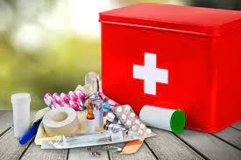
FIRST AID
12/2/2021
ABIRA DELILAH
MScN(CCN)
CLASS: MARCH 2021

Slide 2
OUTLINE
Objectives
Definition
First aid priorities
Principles and Aims of first aid
Responsibilities of a first aider
Qualities of a first aider
Priority of a casualty
First aid kit
Managing an incident
Assessing the sick/ injured
Adult chain of survival
Recovery position
Cardiopulmonary resuscitation
Managing different conditions

Slide 3
OBJECTIVES
By the end of this course you should be able to:
Be prepared psychologically and emotionally as a first aider in an emergency
Provide practical advice on what you should and should not do in an emergency situation.
To strengthen your skills and increase your confidence.

Slide 4
DEFINITION OF FIRST AID
First Aid is the initial assistance or treatment
given to a casualty for any injury or sudden
illness before the arrival of an ambulance,
doctor, or other qualified personnel.
Notes:
First aid is an emergency aid or treatment given to someone injured, suddenly ill, etc., before regular medical services arrive or can be reached.

Slide 5
CONT..
First aid is the provision of immediate care to a victim With an injury or illness, usually effected by a layperson, and performed within a limited skill range.
First aid is normally performed until the injury or illness is satisfactorily dealt with or until the next level of care, such as a paramedic or doctor, arrives.

Slide 6
FIRST AID PRIORITIES
■ To understand your own abilities and limitations.
■ To stay safe and calm at all times.
■ To assess a situation quickly and calmly and summon the appropriate help if necessary.
■ To assist the casualty and provide the necessary treatment, with the help of others if possible.
■ To pass on relevant information to the emergency services, or to the person who takes responsibility for the casualty.
■ To be aware of your own needs.

Slide 7
PURPOSES OF FIRST AID
The key guiding principles and purpose of first aid, is often given in the mnemonic "3 Ps".
1.Preserve life
  Life support (Airway, Breathing, and Circulation) are always the first priority.
  ● Airway must be open so that air containing oxygen enters the body.
  ● Breathing must take place so that oxygen passes through the lungs into the blood stream.
  ● The heart must circulate the oxygen carrying blood.

Slide 8
Aims of first aid….
2. Prevent the casualty’s condition from becoming worse
Act as quickly as possible.
      1) Dress wound to prevent infection
      2) Provide comfort to casualty
      3) Place casualty in a comfortable
      4) Try to stop the situation from becoming worse by removing any obvious dangers.
Notes:
Try to stop the situation from becoming worse by removing any obvious dangers like: stopping traffic ,clearing people away from the casualty, opening the window to clear any fumes

Slide 9
Aims of first aid….
3. Promote recovery
    1) Relieve casualty from anxiety
    2) Encourage confidence and trust
    3) Attempt to relieve pain and discomfort
    4) Handle casualty gently
    5) Protect casualty from cold and wet
    6) Prevent contamination
    7) Aid in safe transportation of the patient to a hospital

Slide 10
Basic principles of first aid include:
Safe response to emergencies for the benefit of casualties, bystanders and rescuers
Securing the emergency site to reduce further harm to the casualty
Using appropriate first aid procedures and techniques
Safely moving the casualty, minimizing pain and helping stabilize the condition

Slide 11
Basic principles…..
Providing reassurance and guidance to the casualty
Communication with bystanders and emergency services personnel
Acting in accord with first aid protocol and workplace guidelines

Slide 12
FIRST AID RULES
Do not get excited. First, check for danger and then check for responsiveness.
2. Do not move injured victim unless it is necessary.
3. Keep the victim lying down with his head level with his feet while being examined.
4. Keep the victim warm and comfortable. Remove enough clothing to get a clear idea to the extent of the injury.

Slide 13
FIRST AID RULES
5. Examined the victim gently. Treat the most urgent injuries first and then treat the other injuries to the best of your ability.
6. Avoid allowing the victim to see his own injury. Assure him that his condition is understood and that he will receive good care.
7. Do not try to give any solid or liquid substance by mouth to an unconscious victim.

Slide 14
FIRST AID RULES
8. Do not touch open wounds or burns with fingers or other objects except when sterile compresses or bandages are not available and it is absolutely necessary to stop bleeding.
9. Do not try to arouse an unconscious person.
10. Seek medical attention immediately.

Slide 15
PRIORITY OF TREATMENT
Some injuries are more serious than others and in general they should always be treated in the following order:
1. AIRWAY - Casualties with airway problems.
2. BREATHING - Casualties with difficulty in breathing or whose breathing has stopped
3 CIRCULATION - Casualties with bleeding wounds or are in shock.
4. DISABLITY - Casualties with other injuries, e.g. breaks and burns.

Slide 16
Initial assessment
Safety (yours and the victims),
Mechanism of the injury (how did it happen),
Medical information devices (“Medic Alert” tags)
Number of casualties
Bystanders
Always avoid contact with blood or other body fluids. Use latex gloves whenever possible.

Slide 17
Principle’s of first aid cont…
Three C’s of emergency:
1. Check
2. Call
3. Care

Slide 18
Three C’s
1. Check
Checking for anything unsafe. If the emergency is surrounded by danger, assistance may be needed.
Rushing into a scene without taking in present dangers may lead to more harm for yourself or others.
Check the scene before entering it.
Check if the victim is breathing. You may need to give specific care such as CPR.

Slide 19
Three C’S
2. Call
In emergency situations, it’s important to call 911 immediately.
As a first responder, act right away to get help from professionals.
Inspect the scene, gather needed information.
Provide correct information for local authorities and get them involved as soon as possible.

Slide 20
Three C’s
3. Care
Provide care until medical professionals arrive on the scene.
Monitor the victims breathing. You may need to stop bleeding or perform CPR.
Follow the circulation-airway-breathing of first aid.

Slide 21

RESPONSIBILITIES AS A FIRST AIDER
1. Assess the situation quickly and safely and summon appropriate help
2. Protect casualties and others at the scene from possible danger
3. To identify, as far as possible, the nature of illness or injury affecting casualty.
4. To give each casualty early and appropriate treatment, treating the most serious condition first.

Slide 22
RESPONSIBILITIES OF A FIRST AIDER
5. To arrange for the casualty’s removal to hospital or into the care of a doctor.
6. To remain with a casualty until appropriate care is available.
7. To report your observations to those taking care of the casualty, and to give further assistance if required.

Slide 23
Qualities of a first aide:
~ Calm
~ Confident
~ Willing to offer assistance whenever necessary
~ Patience
~ knowledgeable

Slide 24
PRIORITY OF CASUALTIES
Save the conscious casualties before the unconscious ones as they have a higher chance of recovery.
Save the young before the old.
Do not jeopardize your own life while rendering First Aid. In the event of immediate danger, get out of site immediately.

Slide 25
Remember: One of your aims is to preserve life, and not endanger your own in the process of rendering First Aid.
Casualties should always be treated in the order of priority, usually given by the “3 Bs”:
  Breathing
  Bleeding
  Bones

Slide 26
Essential to protect yourself from injury and infection
Ensure surroundings are safe
Protection from infection
  To prevent “cross infection”
  Wear gloves or wash hands before doing a dressing.

Slide 27
GETTING HELP FROM OTHERS
In an emergency situations, there are several tasks to be performed at once.
To maintain safety, call for help and start giving first aid. Ask people around the scene to help in activities that are not complex.
Make the area safe.
Call emergency services ie County ambulances, Redcross, St. John’s ambulance etc others like the policemen, fire brigade
Get first aid equipment ie the AED
Assess ABCs

Slide 28
Cont…
Control bleeding
Transport the casualty to a safe place if in immediate danger only if its safer to move him
Care for personal belongings
Keep a written record on the casualty ( What do you record?????)

Slide 29
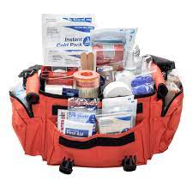
FIRST AID KIT

Slide 30
FIRST AID KIT
It is a collection of supplies and Equipments that is used to give medical treatment.
There is a wide variation in the contents of first aid kits based on the:
1. Knowledge and experience of those putting it together,
2. The differing first aid requirements of the area where it may be used 3. Variations in legislation or regulation in a given area
Every trained first aider should have access to a first aid kit.
First aid kits contain basic elements for dealing with common injuries, along with accessories to ensure both casualty and first aider are protected.

Slide 31
Content of the first aid kit:
The Red Cross recommends that all first aid kits for a family of four include the following:
Dressing:
• 2 absorbent compress dressings
• 25 adhesive bandages (assorted sizes)
• 1 adhesive cloth tape
• Sterile eye dressing
• Gauze pads

Slide 32
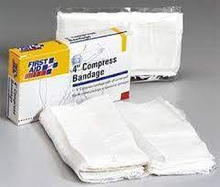
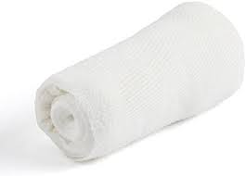
Absorbent dressings

Slide 33
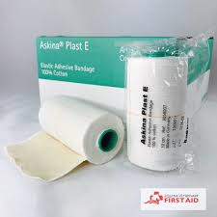
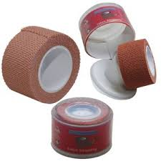
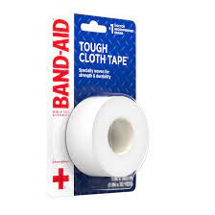
Adhesive bandages

Slide 34
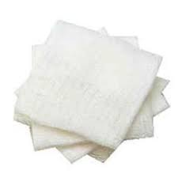
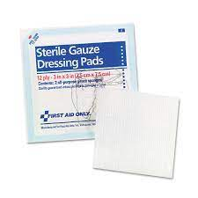
Gauze pads

Slide 35
Medications:
• 2 hydrocortisone ointment packets (approximately 1 gram each)
• 5 antibiotic ointment packets and burn cream
(approximately 1 gram)
• 5 antiseptic wipe packets/solution
• 2 packets of aspirin (81 mg each)
• Bandages:
• 2 roller bandages (different sizes)
• 5 sterile gauze pads (3 x 3
inches)
• 5 sterile gauze pads (4 x 4 inches)
• 2 triangular bandages

Slide 36
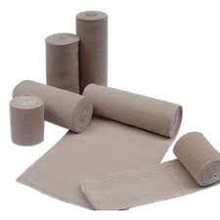
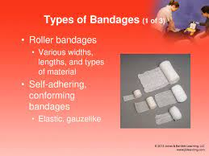
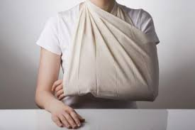
Roller bandages and a triangular bandage

Slide 37
Others:
• 1 blanket (space blanket)
• 1 breathing barrier (with one-way valve)
• 1 instant cold compress
• First aid instruction booklet
Eye pads and eye wash
Face shield for CPR
Equipment’s:
• Tweezers-to pull out stings
• Scissors-to cut dressing/bandage
• Oral thermometer (nonmercury/ nonglass)
• 2 pair of non latex gloves (size: large)
• Safety pin

Slide 38
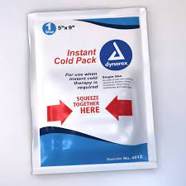
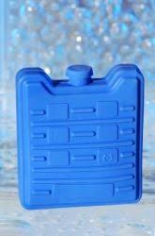
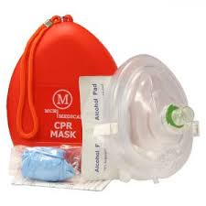
Breathing barrier and cold compress

Slide 39
Bandages can be used to:
Hold a dressing in place over an open wound
Apply direct pressure over a dressing to control bleeding
Prevent or reduce swelling
Provide support and stability for an extremity or joint
Bandage should be clean but need to be sterile

Slide 40
Managing an Incident (Action Plan) Principles
A.M.E.G.A
    Assess.
    Make safe.
    Emergency aid.
    Get help.
    After care.

Slide 41
Managing an incident …..
1. Assess Stop (only fools rush in). Look (use your eyes, ears and nose).
Think (who is involved, what happened, when did it happen, why did it happen and what resources have I got).
2. Make Safe Turn off. Engines, electric, gas, water, etc.
In case someone is on fire Stop, Drop, Wrap and Roll. For drowning reach and throw do not go. For electric shock disconnect at fuse board first. If in any doubt, get help first, better one casualty than two.

Slide 42
Managing an incident…
3. Emergency aid: is only given by someone that is qualified.
4. Getting Help. To fetch medical supplies. Control bleeding.
To maintain casualty privacy.
Help to put casualty into recovery position.
To move casualty away from danger, get help from the public e.g. crowd/traffic control, getting help…

Slide 43
Managing an incident..
5. After Care: Your job does not end when the ambulance arrives you need to pass on information:
-Name , address. History (what happened ). Brief description of injuries. Any unusual behavior.
After Care Any treatment given.
Observation made on breathing, pulse and levels of response. Minor cases arrange a lift home.

Slide 44
Managing an incident..
Some of the things a first aider sees or gets involved in, could cause shock and be upsetting. Speak too someone, don’t just suck it up.
First aiders may need to restock equipment or refill supplies.

Slide 45
ASSESSING THE SICK/INJURED
Tell those at the scene you are trained.
Remember:
1. Be calm
2. Be aware of risks
3. Build and maintain a casualty’s trust
4. Call appropriate help
5. Remember your own needs

Slide 46
METHODS OF ASSESSMENT
Deal with life threatening conditions first
Deal with conditions as you find them.
There are two methods;
a. Primary survey
b. secondary survey

Slide 47
PRIMARY SURVEY
This is the initial rapid assessment of a casualty to establish and treat conditions that are an immediate threat to life.
By following a methodical sequence using established techniques, each life threatening condition can be identified in a priority order and dealt with on a “find and treat basis”.
It should be applied to every casualty you attend.

Slide 48
Primary survey….
Response
Airway
Breathing
Circulation

Slide 49
Primary survey
1. Response
Do a quick assessment to check for the level of consciousness. If either conscious or unconscious.
Observe patient as you approach.
Introduce yourself. Ask questions: what happened?
Are you okay?
Open your eyes
If no response, gently shake the patient’s shoulders
If it’s a child- tap his/her shoulders, for an infant tap his foot, if there is no response take priority with this patients.

Slide 50
Primary survey
2. Airway
Is the airway open and clear.
If alert and talking to you ; then the airway is clear.
If unconscious - the airway may be obstructed.
Perform the head tilt chin lift maneuver.
  1. Put one hand on the patient’s forehead , gently tilt his head back.
  As you do this the mouth will fall open slightly.
  2. Place fingertips of your other hand on the point of the casualty’s chin and lift the chin.
  CHILD/INFANT
  Do not push on the soft tissues under the chin, since it may block the airways.

Slide 51
Airway..
If conscious:
Treat conditions like choking, suffocation that may be causing blockage.

Slide 52
Primary survey…
3. Breathing
Check if the patient is breathing normally; look, listen and feel for breaths. If no breaths;
a. Conscious
Treat any difficulty in breathing.
b. Unconscious
Call an ambulance
Begin chest compressions and rescue breaths.(CPR immediately)
If this happens deal with it first before moving to the next step.

Slide 53
Primary survey..
4. Circulation
Conditions that affect circulation could be life threatening.
Injuries lead to severe bleeding, hence blood loss from the circulatory system.
Treat immediately to minimize conditions like shock.
After stabilizing life threatening conditions then proceed to secondary survey.
Shock- treat the cause i.e. cuts, burns, antepartum hemorrhage or postpartum hemorrhage

Slide 54
SECONDARY SURVEY
A further assessment done on the patient after the primary survey.
It has two further checks:
1. Checks for disability; patient’s level of consciousness
2. Examination
Once you are done with primary survey start a methodical process of checking for other injuries/ illness by doing a head to toe examination. By performing:
a. Health history
b. Head to toe examination
c. Vital signs

Slide 55
Secondary survey
1. Health history
There are two important aspects: I. What happened / event history
II. Any medical history
I. Event history
Initial questions – help discover immediate events leading to the incident.
Either from the patient / relatives / bystanders.
Also use clues like impact on vehicle called mechanism of injury.
II. Previous medical history
It could have a clue to the cause.
At times it may have nothing to do with the present conditions.
Clues i.e. a medical bracelet
Medications in use

Slide 56
  QUICK REMINDER
  Use the mnemonic AMPLE as a reminder when assessing a casualty to ensure that you have covered all aspects of the examination. When the emergency services arrive they may ask.
  A - Allergy
  M - medications
  P - Previous medical history e.g pre existing conditions
  L – Last meal
  E – Event history

Slide 57
COMMON EMERGENCIES
Asphyxia
Drowning
shock
Hemorrhage
Fainting
Epistaxis
Spinal cord injuries
Head injuries
Fractures
Hyperthermia/ hypothermia
Soft tissue injuries
Seizures
Burns
Angina
Poisoning
Bites and stings
Concussion
Stroke
Heart attack
Foreign bodies
Wounds

Slide 58
Adult Chain of Survival
1.Early intervention
2.Immediate recognition of cardiac arrest and activation of the emergency response system (EMS)
3. Early CPR with an emphasis on chest compressions
4. Rapid defibrillation
5. Effective advanced life support
6. Integrated post–cardiac arrest care

Slide 59
Adult Chain of Survival
12/2/2021

Slide 60
RECOVERY POSITION
For people who are unconscious, or semiconscious, but are still breathing.
If there are spinal or neck injuries, do not attempt to place the casualty in the recovery position.
NOTE: Leaving the victim in this position for long periods may cause them to experience nerve compression.

Slide 61
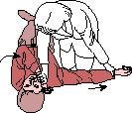
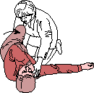
STEP 1: Kneel next to the person. Place the arm closest to you straight out from the body. Position the far arm with the back of the hand against the near cheek.
STEP 2: Grab and bend the person’s far knee.
http://www.health.harvard.edu/fhg/firstaid/recovery.shtml

Slide 62

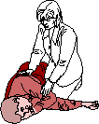
STEP 3: Protecting the head with one hand, gently roll the person toward you by pulling the far knee over and to the ground.
STEP 4: Tilt the head up slightly so that the airway is open. Make sure that the hand is under the cheek. Place a blanket or coat over the person (unless he/she has a heat illness or fever) and stay close until help arrives.
http://www.health.harvard.edu/fhg/firstaid/recovery.shtml

Slide 63
CARDIO-PULMONARY RESCUSCITATION- (CPR)
Cardiopulmonary resuscitation (CPR) is a lifesaving technique useful in many emergencies, including heart attack or near drowning, in which someone's breathing or heartbeat has stopped.

Slide 64
CPR..
Cardio Pulmonary Resuscitation is a technique of basic life support for oxygenating the brain and heart until appropriate, definitive medical treatment can restore normal heart and ventilatory action.

Slide 65
Purposes
To maintain an open and clear airway (A).
To maintain breathing by external ventilation (B).
To maintain Blood circulation by external cardiac massages (C).
To save life of the Patient.
To provide basic life support till medical and advanced life support arrives

Slide 66
Indications
Cardiac Arrest
Ventricular fibrillation (VF)
Ventricular tachycardia (VT)
Asystole
Pulse less electrical activity

Slide 67
Indications..
Respiratory Arrest
• This may be result of following:
        • Drowning
        • Stroke
        • Foreign body in throat
        • Smoke inhalation
        • Drug overdose
        • Suffocation
        • Accident, injury
        • Coma
        • Epiglottis paralysis.

Slide 68
Principles of CPR
To restore effective circulation and ventilation.
To prevent irreversible cerebral damage due to anoxia. When the heart fails to maintain the cerebral circulation for approximately four minutes the brain may suffer irreversible damage.

Slide 69
CPR PROCEDURE
Sequences of procedures performed to restore the circulation of oxygenated blood after a sudden pulmonary and/or cardiac arrest.
Chest compressions and pulmonary ventilation performed by anyone who knows how to do it, ANYWHERE, IMMEDIATELY, WITHOUT ANY OTHER EQUIPMENT.

Slide 70
Approach safely
Check response
Shout for help
Open airway
Check breathing
Call 911/EMS
30 chest compressions
2 rescue breaths

Slide 71
CHECK RESPONSE
Shake shoulders gently
Ask “Are you all right?”
If he responds.
• Find out what is wrong.
• Reassess regularly

Slide 72
SHOUT FOR HELP
SHOUT FOR HELP

Slide 73
OPEN AIRWAY
Head tilt and chin lift
- lay rescuers
non-healthcare rescuers
No need for finger sweep
unless solid material can be seen
in the airway

Slide 74
Jaw thrust.
The jaw-thrust maneuver is often used on patients with cervical neck problems or suspected cervical spine injury.
The maneuver is used on a supine patient.
It is performed by placing the index and middle fingers to physically push the posterior aspects of the lower jaw upwards while their thumbs push down on the chin to open the mouth.

Slide 75
CHECK BREATHING
• Look, listen and feel for NORMAL breathing
• Do not confuse
agonal breathing with
NORMAL breathing

Slide 76
CHEST COMPRESSIONS
• Place the heel of one hand in the centre of the chest
• Place other hand on top
• Interlock fingers
• Compress the chest
– Rate 100 b/ min
– Depth 4-5 cm (1.5 to 2 inch)
– Equal compression : relaxation

Slide 77
• When possible change CPR operator every 2 min
• Place the heel of one hand in the center of the chest
• Place other hand on top
• Interlock fingers
• Compress the chest
  – Rate 100 b/min
  – Depth 4-5 cm (1.5 to 2 inch)
  – Equal compression : relaxation

Slide 78
Rescue breathes
Pinch the nose
• Take a normal breath
• Place lips over mouth
• Blow until the chest rises
• Take about 1 second
• Allow chest to fall
• Repeat

Slide 79
RECOMMENDATIONS:
- Tidal volume
      500 – 600 ml
- Respiratory rate
    give each breaths over about 2s with enough volume to make the victim’s chest rise
- Chest-compression-only
    continuously at a rate of 100 b/min

Slide 80
CONTINUE CPR

Slide 81
Possible complications
Coronary vessel injury
Diaphragm injury
Hemopericardium
Hemothorax
Interference with ventilation

Slide 82
Possible complications…
• Liver injury
• Myocardial injury
• Pneumothorax
• Rib fractures
• Spleen injury
• Sternal fracture

Slide 83
MEDICATIONS
Adrenaline
• Adrenaline (epinephrine) is the main drug used during resuscitation from cardiac arrest.
Atropine
Asystole, symptomatic bradycardia
Amiodarone
• It is an antiarrhythmic drug.

Slide 84
Roles of the resuscitation team…
Maintain airway patency with use of airway adjuncts as required (suction, high flow oxygen with O2 or bag valve mask ventilation).
• Assist with intubation and securing of Endotracheal tube (ETT).
• Inserts gastric tube and/or facilitates gastric decompression post intubation as required.
• Assists with ongoing management of airway patency and adequate ventilation

Slide 85
• Supports less experienced staff by coaching/guidance e.g. drug preparation.
• If a shockable rhythm is present (VF/VT) ensure manual defibrillator pads are applied and connected.
• If CPR is in progress, prepare and independently double check and label 3 doses of adrenaline.
• Prepare and administer IV fluids.
• Document medications administered (including time)

Slide 86
QUESTIONS

Slide 87
FIRST AID- MANAGEMENT OF VARIOUS CONDITIONS
ABIRA DELILAH
MSN

Slide 88
OBJECTIVES
DEFINITION OF THE CONDITION/ DISEASE
CAUSES
SIGNS AND SYMPTOMS
MANAGEMENT- FIRST AID MANAGEMENT

Slide 89
HYPERVENTILATION
Hyperventilation, also known as excessive breathing, causes a reduction of carbon dioxide concentration (below normal) of the blood.
NORMAL blood carbon dioxide levels : 35 to 45 mmol/l

Slide 90
SYMPTOMS:
Unnaturally fast, deep breathing
Attention-seeking behaviors
Dizziness, faintness, trembling, or marked tingling in hands, feet and lips
Headache
Chest pain
Slurred speech
Cramps in the hands and feet

Slide 91
CAUSES
Many conditions and situations can bring on hyperventilation, including:
Anxiety disorder
Panic attack
Asthma
Stress
Hard exercise
Emphysema or another lung disease
Side effects from certain drugs
High altitude
Having a head injury
Shock

Slide 92
MANAGEMENT
CONTROLLED BREATHING METHODS:
Pursed lip breathing
Ask patient to put their lips into the same position that you’d use to blow out birthday candles.
Then to breathe in slowly through their nose, not mouth.
Then, they should breathe out slowly through the small opening between your lips.
Patient should take time to exhale, and don’t blow the air out with force.
Repeat these steps until they feel normal.

Slide 93
MANAGEMENT
2. Limit airflow.
Keep mouth closed, and press one nostril closed with their finger. Breathe in and out through the open nostril.
Tell them to inhale and exhale slowly too quickly, and don’t exhale too hard. Repeat several times.
Make sure that they inhale and exhale slowly, and coach them to repeat as long as needed, since you won’t see an instant change

Slide 94
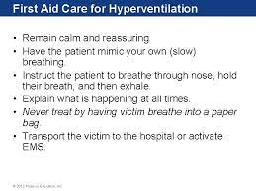
Management

Slide 95
FAINTING
Fainting is a brief loss of consciousness that is
caused by a temporary reduction of blood
flow to the brain.
SYMPTOMS:
A brief loss of consciousness causing the casualty to fall to the floor
A slow pulse
Pale, cold skin and sweating

Slide 96
FAINTING
CAUSES:
Taking in too little food and fluids (dehydration)
Low blood pressure
Lack of sleep
Over exhaustion
Stress
TREATMENT:
Lay casualty down, and slightly elevate legs
Make sure she has plenty of fresh air
As she recovers, reassure her and help her sit up gradually
Look for and treat any injury that has been sustained through falling

Slide 97
Shock
Shock is a condition where tissues in the body does not receive enough oxygen and nutrients to allow the cells to function well.
It occurs when the circulatory system fails, and insufficient oxygen reaches the tissues.
If the condition is not treated quickly, vital organs can fail ultimately causing death.
Shock is made worse by fear and pain.
This imbalance can occur for a variety of reasons and eventually results in cellular dysfunction and death.

Slide 98
Shock
CAUSES:
Shock can be divided into 4 types:
Hypovolemic shock
  Results from a loss of circulating or intravascular volume.
  Caused by the loss of blood volume (such as through bleeding) or profound dehydration

Slide 99
SHOCK…
2. Cardiogenic shock
  Results from the impaired ability of the heart to pump.
  A result of a weakened heart that is unable to pump blood as efficiently as it once did. Commonly occurs after a massive heart attack

Slide 100
CAUSES…
3. Distributive shock
  A result of the mal-distribution of circulating blood volume to the organs.
  Further classified as: Septic, anaphylactic and neurogenic.
Septic shock is the result of microorganisms entering the body.
Anaphylactic shock is the result of a severe antibody– antigen reaction. is an overwhelming allergic reaction to an antigen with a rapid onset which may lead to death without appropriate interventions.

Slide 101
SHOCK….
Neurogenic shock is the result of the loss of sympathetic tone in spinal cord injury patients.
This leads to immediate loss of autonomic ( vasodilation and redistribution of blood volume ) and motor reflexes below the level of injury.

Slide 102
SHOCK..
4. Obstructive shock
  Occurs as a result of impairment in cardiac ventricular filling or ventricular emptying.
Can result from etiologies like: Cardiac tamponade, tension pneumothorax and pulmonary embolism

Slide 103
CAUSES…
Cardiac tamponade occurs when fluid accumulates in the pericardium compressing the atrial and ventricular chambers preventing the filling of the chambers with blood.
This restriction to cardiac filling results in decreased CO, hypotension and reduced tissue perfusion.
Tension pneumothorax occurs when a unilateral pneumothorax becomes so large that it shifts the mediastinum and compresses the cardiac chambers.
This also results in impaired filling, decreased CO, hypotension and reduced tissue perfusion.
Massive pulmonary embolism which blocks blood flow through the pulmonary circulation.

Slide 104
Shock..
SIGNS & SYMPTOMS:
Cool and clammy skin (cool, pale and dump)
Low blood pressure
Restlessness and nervousness
Thirst
Loss of blood
Confusion
Rapid, shallow breathing
Weakness
Weak pulse
Profuse sweating
Dizziness
Unconsciousness
Nausea or vomiting
Cyanosis/ Blotched or bluish skin (especially around the mouth and lips)
Often perspires freely
May pass out.

Slide 105
Shock
TREATMENT:
“P.E.L.C.R.N.” (Pronounced Pell-Crin)
Position the casualty on their back
Elevate the Legs
Loosen clothing at neck waist or wherever it is binding
Climatize (prevent too hot or too cold)
Reassure (keep the casualty calm)
Notify medical personnel (Help, Get a medic!!)

Slide 106
MANAGEMENT
Call for emergency help
Safety
Response
Assess for ABCs
Control bleeding for hypovolemic shock
Have victim lie on their back and raise their legs
Loosen tight clothing
Continuous vital signs monitoring
Monitor urine output of the client
Be alert for vomiting, turn victim’s head to drain mouth
Maintain normal body temperature

Slide 107
BEE/HORNET STING
SYMPTOMS:
Redness and swelling in injured area
TREATMENT:
Remove stinger as fast as possible
Reduce pain and swelling with cold compress

Slide 108
BLEEDING
Control Methods For External Bleeding:
  Wear medical exam gloves
  Apply direct pressure this will stop most of the bleeding.
  Place a sterile gauze pad or a clean cloth over wound
  Elevation injured part to help reduce blood flow.
  Combine direct pressure over the wound with bandaging around the wound.

Slide 109
BLEEDING…
If bleeding continues, apply pressure at a pressure point to slow blood flow.
Pressure point locations:
  Brachial (Top of elbow)
  Femoral (Inside upper thigh)

Slide 110
BLEEDING…
Control Methods For Internal Bleeding:
  Signs of internal bleeding:
    Bruises or contusions of the skin
    Painful, tender, rigid, bruised abdomen
    Vomiting or coughing up blood
    Stools that are black or contain bright red blood

Slide 111
What to Do:
For severe internal bleeding, follow these steps:
Monitor ABC’s (Airway Breathing Circulation)
Keep the victim lying on his/her left side. (This will help prevent expulsion of vomit from stomach, or allow the vomit to drain and also prevent the victim from inhaling vomit).
Treat for shock by raising the victim’s legs.
Seek immediate medical attention

Slide 112
CHOKING
Choking is the mechanical obstruction of the flow of air from the environment into the lungs.
CAUSES:
Introduction of foreign object into airway, which becomes stuck
Respiratory diseases
Compression of airway (e.g. Strangling)

Slide 113
CHOKING
SYMPTOMS:
Unable to speak or cry out
Face turns blue from lack of oxygen
Victim grabbing at his/her throat
Weak coughing, labored breathing produces high-pitched noise
Unconsciousness

Slide 114
CHOCKING..
TREATMENT:
Encourage victim to cough
Back slaps: Use of hard blows with heel of the hand on the upper back of the victim
Abdominal thrusts: Standing behind the victim and using hands to exert pressure on bottom of the diaphragm (May result in injuries like bruises or fracture of ribs)

Slide 115
Perform Heimlich Maneuver if you are properly trained.
Conscious Victim:
Approach from behind and wrap arms around the victim’s waist.
Place one fist just above the victim’s navel with the thumb side against the abdomen.
Second hand over the fist.
Press into the victim’s abdomen with one upward thrust

Slide 116
CHOCKING……
Repeat thrust if necessary.
Try to pop the obstruction out with swift thrusts in and up.
Continue until the obstruction is relieved or victim collapses.
Have someone call for help.
Note: Always stay calm.

Slide 117
Unconscious Victim:
Ask someone to call 911/ems for help
Lower victim to floor on back or left side and perform Heimlich Maneuver
Open airway with tongue-jaw lift
Look inside mouth – if you cannot see anything, do not do a finger sweep
Try to give two full rescue breaths
If these do not go in, reposition the head and give another breath
Perform abdominal thrusts
Continue until successful or help arrives

Slide 118
Heart Attack
Heart Attack – Usually that happens when one of the coronary arteries is blocked by an obstruction or a spasm.
Signs and symptoms of a heart attack include:
Pressure in chest, fullness, squeezing, or pain that lasts more than a few minutes or that goes away and comes back.
Pain spreading to the shoulders, neck, or arms.
Chest discomfort with lightheadedness, fainting, sweating, nausea, or shortness of breath.

Slide 119
What to Do:
get to the nearest hospital
emergency department with 24-emergency cardiac care.
Monitor victim’s condition.
Help the victim to the least painful position, usually sitting with legs up and bent at the knees.
Loosen clothing around the neck and midriff.
Determine if the victim is known to have coronary heart disease and is using nitroglycerin.
If the victim is unresponsive, check ABCs and start CPR, if needed.

Slide 120
BURNS

Slide 121
Burns
Burns have been described as:
First-degree burns (Superficial)
Only the skin’s outer layer (epidermis) is damaged.
Symptoms include redness, mild swelling, tenderness, and pain.
Usually heals without scarring.
What to Do:
Immerse in cold water 10 to 45 minutes or use cold, wet cloths.
Cold stops burn progression
May use other liquids
Aloe, moisturizer lotion

Slide 123
BURNS…
Second-degree burns (Partial Thickness)
  Epidermis and upper regions of dermis are damaged.
  Symptoms include blisters, swelling, weeping of fluids, and severe pain.
What to Do:
  Immerse in cold water/wet pack
  Aspirin or ibuprofen
  Do not break blisters
  May seek medical attention

Slide 124
BURNS…
Third-degree burns (Full Thickness)
Severe burns that penetrate all the skin layers, into the underlying fat and muscle.
Symptoms include: the burned area appears gray-white, cherry red, or black; there is no initial edema or pain (since nerve endings are destroyed)

Slide 125
What to Do:
Usually not necessary to apply cold to areas of third degree
Do not apply ointments
Apply sterile, non-stick dressings (do not use plastic)
Check ABC’s
Treat for shock
Get medical help

Slide 126
Burn injuries can be classified as follow:
Thermal (heat) burns caused by:
Flames
Hot objects
Flammable vapor that ignites
Steam or hot liquid
What to Do:
Stop the burning
Remove victim from burn source
If open flame, smother with blanket, coat or similar item, or have the victim roll on ground.
Determine the depth (degree) of the burn

Slide 127
CHEMICAL BURNS
The result of a caustic or corrosive substance touching the skin caused by:
Acids (batteries)
Alkalis (drain cleaners- often more extensive)
Organic compounds (oil products)

Slide 128
What to Do:
Remove the chemical by flushing the area with water
Brush dry powder chemicals from the skin before flushing
Take precautions to protect yourself from exposure to the chemical
Remove the victim’s contaminated clothing and jewelry while flushing with water
Flush for 20 minutes all chemical burns (skin, eyes)
Cover the burned area with a dry, sterile dressing
Seek medical attention

Slide 129
MINOR BURNS
(FIRST DEGREE BURNS)
TREATMENT:
Rinse the injured part with cold water for at least 10 minutes to stop burning and relieve pain
Gently remove any jewelry, watches, belts or constricting clothing from injured area before it begins to swell
Cover area with sterile dressing, or any clean, non-fluffy material and bandage loosely in place.
NOTE: Cold burns should not be rinsed with cold water and cold water should never be applied to anyone with extensive burns.

Slide 130
SEVERE BURNS
(SECOND AND THIRD DEGREE BURNS)
TREATMENT:
Lay the casualty down and protect the burnt area from contact with the ground if possible
Rinse burn with plenty of cold water for at least 10 minutes or use burn-cooling gel
Arrange for casualty to be sent to the hospital
While cooling the burn, watch for signs of difficulty in breathing and be ready to resuscitate if necessary

Slide 131
SEVERE BURNS
(SECOND AND THIRD DEGREE BURNS)
Remove any rings, watches, belts, shoes or burning clothing from injured area before it begins to swell
Remove burnt clothing, unless it is sticking to the burn
Cover dressing with sterile dressing or some other suitable material to prevent infection and germs (this is not necessary if burn is on face)
Do NOT burst any blisters, touch infected area or apply any lotions to the injury as this will retain heat within the burn.
Notes:
Do NOT burst any blisters, touch infected area or apply any lotions to the injury as this will retain heat within the burn.

Slide 132
ELECTRIC SHOCKS
(LOW-VOLTAGE CURRENTS)
Break contact of electric source with casualty by switching off mains or meter point (Only if it is safe for you to do so)
If unable to reach cable, stand on insulating material e.g. plastic mat, wooden box and push casualty’s limbs away from source with a broom or stick
Do not touch the person until the power supply is turned off
Be careful in areas that are wet

Slide 133
FRACTURES
A fracture is a break or crack in the continuity of the bone.
SYMPTOMS:
Pain at or near fractured site
Tenderness on gentle pressure
Swelling over the fracture site
Deformity e.g. irregularity of bone, angulation or rotation of limb, depression of bone etc.
Loss of power
Signs and symptoms of shock

Slide 134
There are two categories of fractures:
1. Closed (Simple) fracture
  The skin is intact and no wound exists anywhere near the fracture site.
2. Open (Compound) fracture
  The skin over the fracture has been damaged or broken.
  The wound may result from bone protruding through the skin.
  The bone may not always be visible in the wound.

Slide 135
DISLOCATIONS
A dislocation is the displacement of one or more
bones at a joint. It usually occurs in the shoulders,
elbow, thumb, fingers and the lower jaw.
SYMPTOMS:
Pain at the site of injury
Limited movement at joint
Deformity
Swelling
Tenderness

Slide 136
FRACTURES AND DISLOCATIONS
TREATMENT:
Support and immobilize the injured limb
Use a splint (if possible) in order to prevent movement of the injured part
Arrange for casualty to be removed to hospital
In doubtful cases, always treat as for a fracture
Do not attempt to replace the bones

Slide 137
STRAINS
A strain is an injury to a muscle in which the Muscle fibers tear as a result of overstretching.
(Sprain – to a ligament)
SYMPTOMS:
Localized pain
Stiffness
Inflammation
Bruising

Slide 138
SPRAINS
A sprain occurs at a joint where there is
tearing or over-stretching of the ligaments
and tissues.
SYMPTOMS:
Pain at site of of injury
Swelling and later bruising
Pain on movement
Loss of function

Slide 139
SPRAINS
TREATMENT:
Support the joint in most comfortable position
P.R.I.C.E. (Protect, Rest, Ice, Compression, Elevation) treatment
When a sprained ankle occurs outdoors, do not remove the shoe
If unsure whether there is a fracture, always assume it is one

Slide 140
FOREIGN BODIES IN MINOR WOUNDS
TREATMENT:
Control bleeding by applying firm pressure on either side of the object and by raising wounded part
Cover the wound with gauze to minimize the risk of infection
Pad around the object until you can bandage over it without pressing down
Hold the padding in place while finishing the bandaging
If you cannot pad high enough, bandage around the object

Slide 141
DROWNING
Delilah abira
MSCN

Slide 142
INTRO..
Drowning:
Drowning is the result of complete immersion of the nose and mouth in water (or any other liquid).
Water enters the windpipe and lungs, clogging the lungs completely. near drowning: means patient nearly died from drowning. Survives for more than 24 hrs.

Slide 143
Causes:
• Suicide
• Seizures, unconscious near water
• Drowning in swimming pool
• Small children have drowning in bath tubs
• Fall during boating

Slide 144
Signs and symptoms
• Body is wet, cold hands and legs
• Bluish discoloration of body especially lips
• Shivering, restlessness, unconsciousness, confusion
• Frothy discharge from mouth, vomiting
• Increased / decreased rate of breathing/absent
breathing/gasping
• Abnormal sounds ( gurgling)
• Decreased heart rate

Slide 145
Algae, foreign materials attached in body
No breathing and no pulse( cardiac arrest)

Slide 146
Types
Wet drowning:
  • Water is inhaled inside lungs
  • Lungs cannot exchange gases properly
  • Breathing and circulation is stopped
Dry drowning:
  Water doesn’t enter the lungs due to immediate
  spasm of the upper airways
  No air entry from upper airways

Slide 147
First aid management
During drowning:
• Your safety first: don’t just jump in the water
• Throw a light object (life jacket, wooden piece
,rope) for the patient to catch
• Rescue the patient from under water
• Lie the patient in flat surface
• Remove all the wet clothes and make the patient warm

Slide 148
Management: The aim of first aid is to drain out water (or other matter) from lungs and to give artificial respiration.
• Act quickly. Remove seaweeds and mud from the nose and throat. Start artificial ventilation immediately.

Slide 149
Turn the victim face down with head to one side and arms stretched beyond his head. Infants or children could be help upside down for a short period.
• Raise the middle part of the body with your hands round the belly. This is to cause water to drain out of the lungs.

Slide 150
• Give artificial respiration until breathing comes back to normal. This may have to go on for as long as two hours.
• Remove wet clothing.
• Keep the body warm, cover with blankets.
• When victim becomes conscious, give hot drinks E.g coffee or tea.
• Do not allow him to sit up.
• After doing the above, transfer quickly to a hospital.

Slide 151
Assess the patient
LOOK: ALERTNESS(AVPU SCALE)
CHEST MOVEMENTS,
LISTEN ( HEART SOUNDS)
FEEL ( AIR PASSAGE THROUGH NOSTRILS

Slide 152
No pulse no respiration:
Start CPR
Patient breathing but has difficulty:
Maintain ABC
Manage if injuries

Slide 153
Maintain Airway Patency:
Left lateral position
Clear secretions, foreign bodies
Don’t insert anything in mouth(e.g spoon)
Head tilt, chin lift , jaw thrust to prevent tongue fall
Loosen tie ,clothing around the neck
Remove artificial dentures if possible

Slide 154
Remove excess water from lungs and abdomen:
By turning upside down
Or pressing over the abdomen
Reassure the patient
Immediately transfer to hospital

Slide 155
Complications:
• Cardiac arrest
• Pulmonary edema , pneumonia
• Stroke, cerebral edema
• Renal failure
• Metabolic changes
• infection

Slide 156
Prevention from drowning:
Brainstorming

Slide 157
EMERGENCY CHILDBIRTH
AND
SPINAL CORD INJURIES
Abira delilah

Slide 158
Emergency Child Birth
• Definition: Emergency child birth is defined as a situation where the expecting mother-to-be can not reach medical facilities in time and needs to give birth on the spot.
• Causes: Being away from medical facilities is the most common cause for this situation. Also, not having transportation.

Slide 159
Stages of child birth
First stage: This starts with contractions and your cervix dilating and ends when your cervix is fully open.
This stage is further broken down into latent phase and active phase.
In early labor, your contractions are regular, but still quite far apart. Cervical dilation in latent labor is from 0 to 3 centimeters and the dilation is gradual.
During the active phase of labor, your cervix will dilate more rapidly.

Slide 160
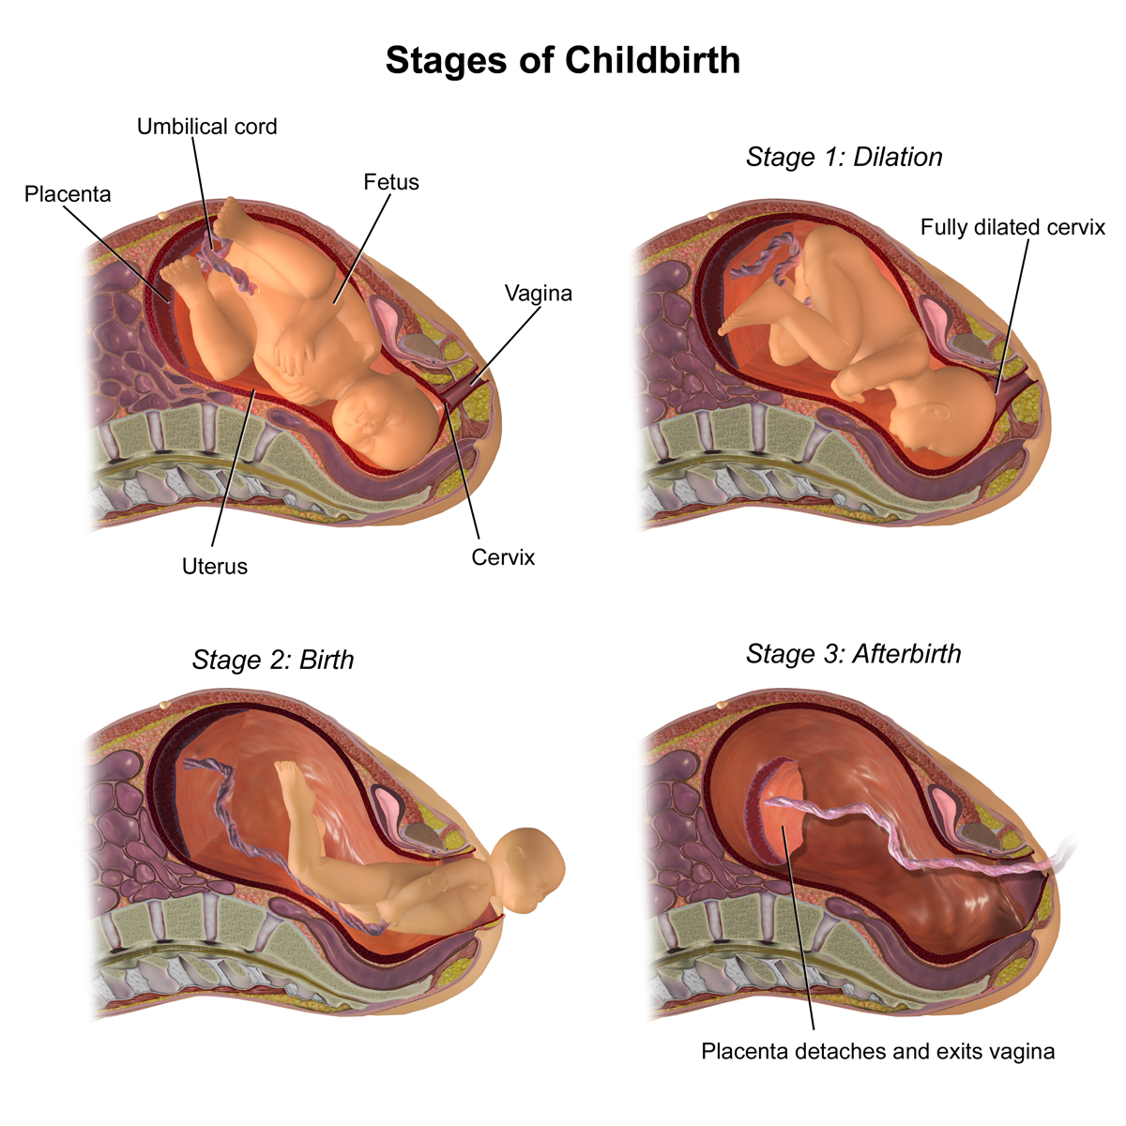

Slide 161
Second stage: This is when you push your baby through the birth canal.
Third stage: This ends with the delivery of the placenta, also called afterbirth.

Slide 162
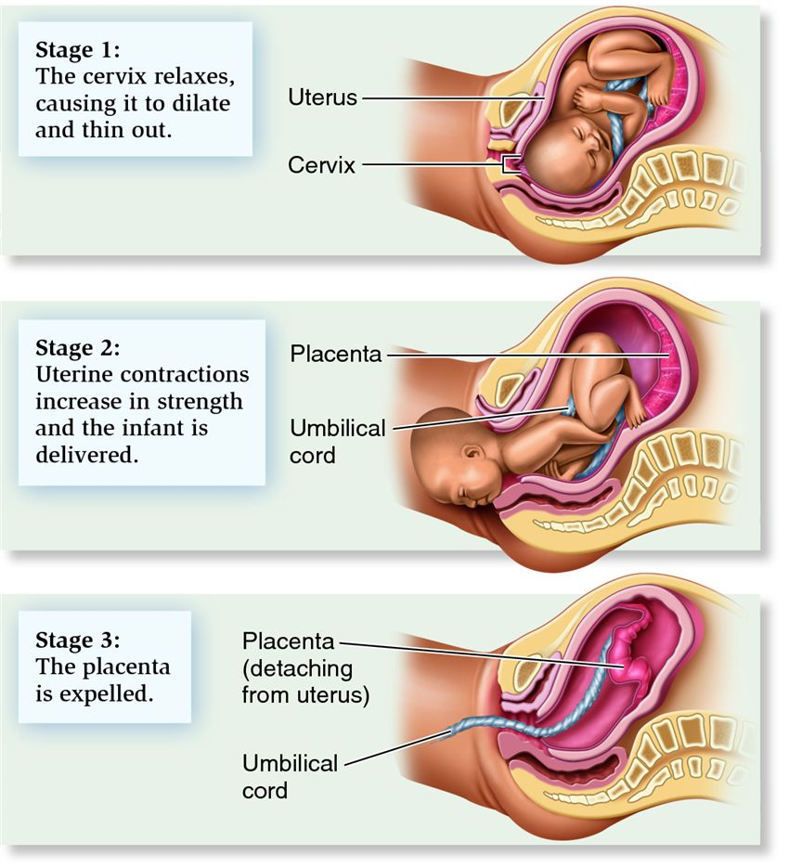

Slide 163
S/S OF CHILD BIRTH
Signs/Symptoms: If the mother says, “the baby is coming,” or the baby’s head is showing, or the contractions are less than two minutes apart, then it is time to deliver the baby on the spot.

Slide 164
Management:
Make sure the ambulance has been called.
Make the mother comfortable on her back. Remove any unnecessary clothing but keep her covered to protect her privacy.
Put some clean towels under her.

Slide 165
As a rescuer all you have to do is support the baby as it comes out. Hold the head as it is heavy compared to the rest of the baby.
As soon as you can see the baby’s throat make sure the umbilical cord is not wrapped around it. If it is use your finger to loosen it and pass it over the head.

Slide 166
Once the baby comes out wrap it in a clean towel.
Clean its mouth and nose.
If it is not breathing massage its back and tickly its feet. This should help stimulate the breathing mechanism.

Slide 167
If it is still not breathing begin rescue breathing and CPR.
Never hold the baby upside down and slap it. This is a TV thing, and if you should drop the baby you’ll be in trouble.

Slide 168
If the baby is fine give it to the mother to hold.
The other end of the umbilical cord will be attached to the placenta which will still be inside the mother. Do not pull, it will come out on its own in a few minutes in another set of contractions.

Slide 169
– Do not cut the cord. Simply wrap the placenta in a towel and keep with the baby.
– Never put the placenta lower than the baby as blood may drain from the baby back into the placenta.
If you wish you may tie something around the umbilical cord a few centimeters away from the baby and from the placenta. But do not cut it.

Slide 170
If the baby begins to come out feet first, it is a complication but there is nothing you can do.
Instruct the mother not to push. Do not try to push the baby back in. Simply support it any way it comes out.

Slide 171
SPINAL CORD INJURIES

Slide 172
SPINAL CORD INJURIES
It is the traumatic injury to the spinal cord.
Etiology of SCIs
1. Road traffic accident – 55%
2. Domestic/occupation – 22%
3. Sports – 18%
4. Assault – 15%

Slide 173
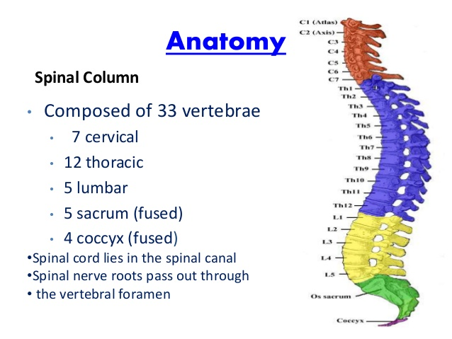
ANATOMY OF SPINAL CORD

Slide 174
MECHANISM OF INJURY
The type of primary injury sustained depends on the mechanism of injury. These include:
1. Hyper flexion – Sudden deceleration motion
ie head on collision – injury occurs from compression of the cord by fracture fragments or as a result of dislocation of vertebrae bodies. Instability of the spinal column occurs because of the rupture and tearing of posterior muscle ligaments.
2. Hyperextension – injuries involve backward and downward motion of the head. Often in rear end collisions or driving accidents. Spinal cord is stretched and distorted.

Slide 175
MECHANISM OF INJURY
3. Rotation - Rotation injuries often occur in conjunction with a flexion or extension injury
• Severe rotation of the neck or body results in tearing of the posterior ligaments and displacement (rotation) of the spinal column.
4. Axial loading/vertical compression - This is most commonly seen in a fall from a height in which the person lands on the feet or buttocks
• Compression injuries cause burst fractures of the vertebral body that often send bony fragments into the spinal canal or directly into the spinal cord.
5. Missile or penetrating injuries

Slide 176
Emergency S/S of SCIs
Extreme back pain or pressure in the neck, head or back.
Weakness, incoordination or paralysis in any part of the body.
Numbness, tingling or loss of sensation in the hands, fingers, feet or toes.
Loss of bladder or bowel control.

Slide 177
Management of Spinal Cord Injuries
• Immediate management at the scene is critical.
• Improper handling can cause further damage and loss of functioning
• Always assume there is a spinal cord injury until it is ruled out
– Immobilize
– Prevent flexion, rotation or extension of neck
– Avoid twisting patient
• If conscious, patients will usually complain of acute pain in back or neck which may radiate along the involved nerve

Slide 178
Management of SCIs
Management is aimed at preventing further injury and observing for progression of neuro deficits
Management involves:
– Primary and secondary survey;
Initial emergency treatment A-B-C-D-E sequence
– Medical management
– Surgical vs. non- surgical management
– Nursing management

Slide 179
Management of SCIs
A. Airway maintenance and Cervical Spine control
B. Breathing and Ventilation
C. Circulation and Hemorrhage Control
D. Disability [Neurological Evaluation]
E. Exposure and Environmental Control

Slide 180
A. Airway & Cervical Neck Control
• Ascertain patency- jaw thrust
• Foreign bodies, maxillofacial injuries, tracheal or laryngeal disruption
• Cervical collar/ Manual In-line immobilization

Slide 181
B. Breathing & Ventilation
Inspect, Palpate, Auscultate and Percuss
If the patient is not breathing, give breaths using a face mask.

Slide 182
C. Circulation & Hemorrhage Control
Check for bleeding and apply pressure at the site.
Circulation • Cardiac output is affected by external or internal hemorrhage and neurogenic shock.
To determine external bleeding, turn the patient in log-roll fashion and quickly note the site of injury.
Two signs of internal bleeding from abdominal trauma are abdominal pain and muscular rigidity.
Other usual signs of shock from internal bleeding are absence of urine and/or classic signs of shock (decreased BP and increased HR)

Slide 183
D- disability. Perform a neurological examination.
  Grade the level of consciousness using: AVPU
  The patient’s response to external stimuli, which can be:
  A- Alert
  V- Verbal
  P- pain
  U- unresponsive
  Do a Glasgow coma scale( Which assesses the patient in three different classes:
    Eye response (4)
    Verbal response (5)
    Motor response (6)

Slide 184
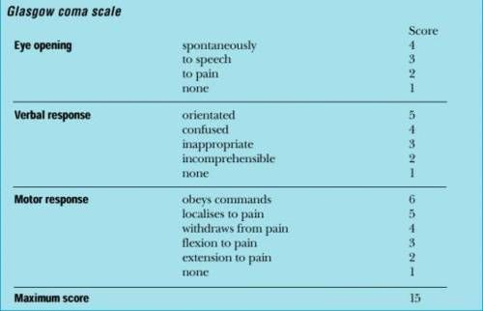
GLASGOW COMA SCALE
3

Slide 185
E- exposure and environmental control
Ensure your patient is kept warm
If they are hyperthermic expose them, and monitor their temperature.
Lastly get their history and most importantly their event history that led to the injury.
Await for their transport to the hospital.

Slide 186
TRANSPORTATION OF CASUALTY
With stretcher:
Keep the stretcher level to the ground
Carry the casualty with his feet facing the direction of move
Bring the stretcher to the casualty and not the casualty to the stretcher
Types of stretcher:
Wooden stretcher
Collapsible stretcher with telescopic handle
Improvised stretcher

Slide 187
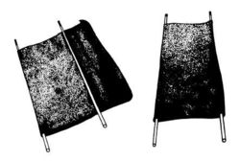
IMPROVISED STRETCHERS
Rolled blanket
Blanket with 2 poles
Chair method
Shirts/Gunnysacks with 2 poles
An improvised stretcher made from a blanket and two poles

Slide 188
EMERGENCY METHODS OF MOVING CASUALTIES
One Man Human Crutch
Conscious
Able to walk with some assistance
Pick-a-back
Conscious
Light weight
Able to hold on using arms
Cradle method
Light weight
A child

Slide 189
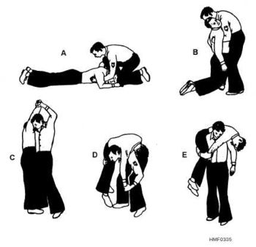
EMERGENCY METHODS OF MOVING CASUALTIES
Fore Method
When pick-a-back or fireman’s life method cannot be used to carry a heavy casualty down the staircase
Fireman’s Lift
Conscious
Unconscious
Light-weight
Double Human Crutch
Conscious
Able to walk with some assistance

Slide 190
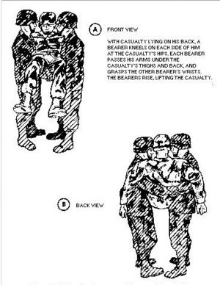
EMERGENCY METHODS OF MOVING CASUALTIES
Two-handed Seat
Unable to walk with assistance
Able to use his arms to support
Three-handed Seat
Unable to walk with assistance
Usually with injury on one leg
Able to use his arms to support

Slide 191
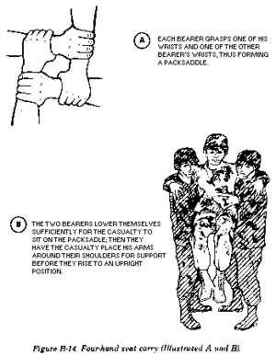
EMERGENCY METHODS OF MOVING CASUALTIES
Four-handed Seat
Unable to walk with assistance
Able to use his arms to support

Slide 192
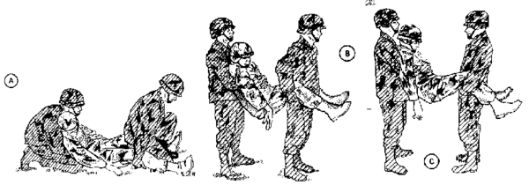
EMERGENCY METHODS OF MOVING CASUALTIES
Fore and Aft Method
Unconscious
Sustained abdominal injury

Slide 193
Questions?

Slide 194
END!!!!!!
Acknowledgements: http://en.wikipedia.org
http://www.health.harvard.edu/fhg/firstaid/recovery.shtml

