Slide 1
FIRST AID

Slide 2
INTRODUCTION
First aid is the assistance given to any person suffering a sudden illness or injury, with care provided to preserve life, prevent the condition from worsening, or to promote recovery.
It involves timely response to emergencies and immediate care of sick and injured people.
First aid is generally performed by someone with basic medical training.

Slide 3
Trained first aiders apply a range of procedures and techniques that offer care when accidents and injuries occur, often making the difference between life and death during high-risk, low-frequency emergencies.
More than ever, first aid intervention is a valuable link in the life saving chain, where casualties are addressed and monitored prior to the arrival of emergency services personnel.

Slide 4
The potential for first aid to save lives has improved dramatically during recent years.
It includes initial intervention in a serious condition prior to professional medical help being available, such as performing cardiopulmonary resuscitation (CPR) while awaiting an ambulance, as well as the complete treatment of minor conditions, such as applying a plaster to a cut.

Slide 5
Human Anatomy (remind/revise)
5
1. Trachea
2. Lungs
3. Heart
4. Liver
5. Stomach
6. Pancreas
7. Large intestine
8. Small intestine
1
2
3
4
5
6
7
8

Slide 6
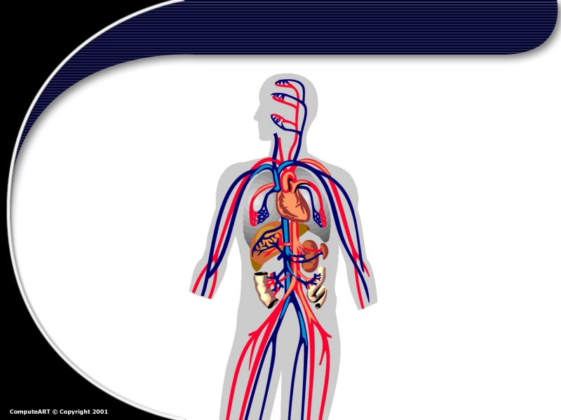
Circulatory System
6
Veins
Action of muscles around these thin walled vessels squeezes blood through them, and one-way valves keep it from flowing back towards the heart
Aorta
Largest artery in the body
Arteries
Strong muscular, elastic walls enable arteries to expand with each surge of blood away from the heart and towards tissues
© 2002 Abertay Nationwide Training

Slide 7
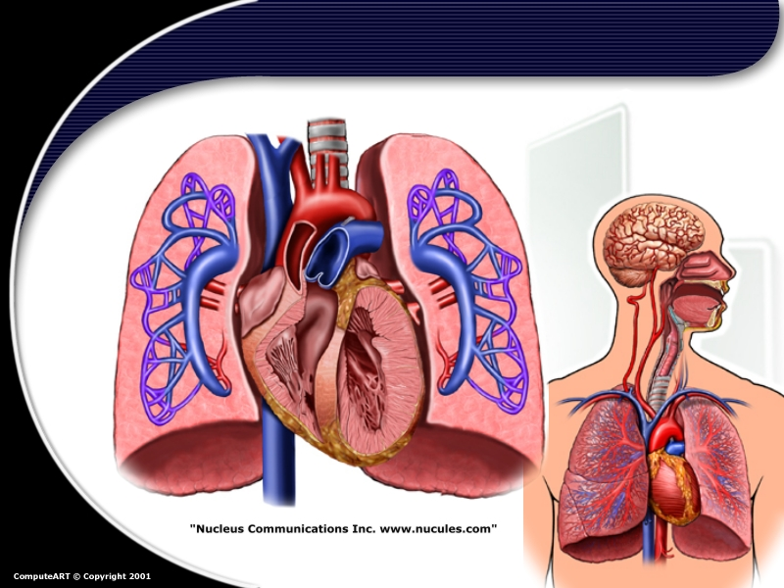
Circulatory System
7

Slide 8
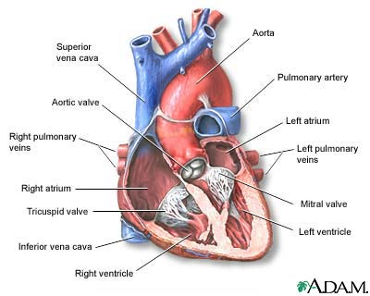
The Heart

Slide 9
Functions of the Blood
Transportation of gases
Nutrition
Regulation
Protection
Excretion

Slide 10
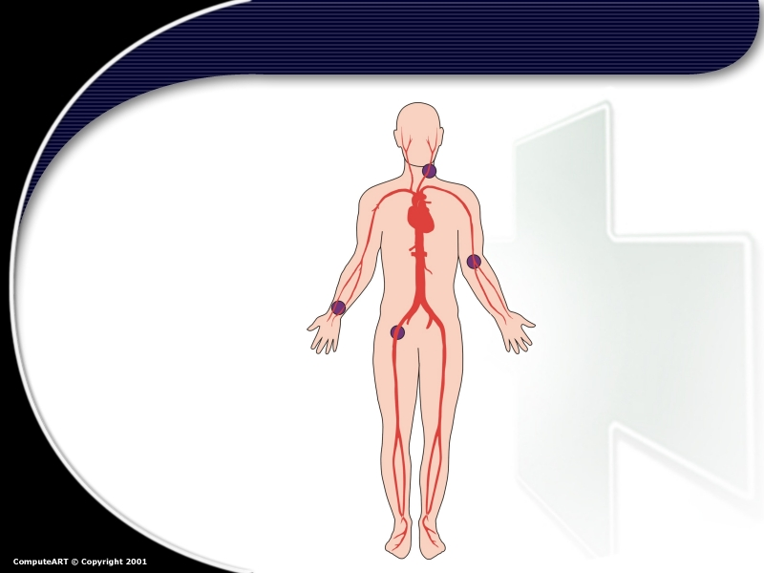
Pulse Points
Carotid
Brachial
Radial
Femoral

Slide 11
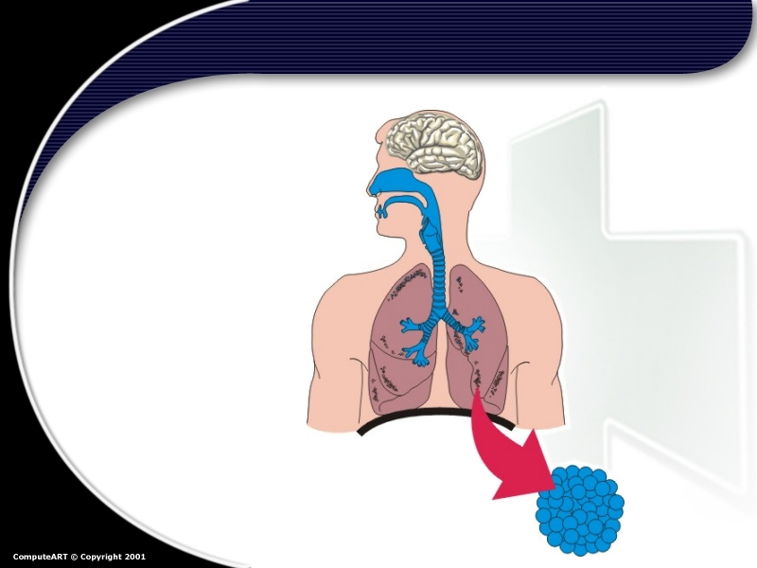
The Respiratory System
Respirtory
Centre
(Brain)
Tongue
Epiglottis
Trachea
Lung
Bronchioles
Diaphragm
Alveoli

Slide 12
FIRST AID AND BASIC LIFE SUPPORT
INTRODUCTION
This module is designed to enable the learner to gain skills, knowledge, initiate management following sudden trauma and in emergency situations.

Slide 13
COURSE OUTLINE
Concepts and principles of first aid; definition and objective of First Aid, principles and practice, purpose of first aid, responsibilities of a first aider, organization, assessment of situation, prioritization, methods of extinguishing fire.
Common emergencies; asphyxia, near drowning, wounds/hemorrhages, chock, convulsive disorders, fractures, injured ligaments and muscles, poisoning, bites and stings, burns and scalds, unconsciousness, foreign bodies,
First Aid kit: components of a First Aid kit; materials used for First Aid (bandages, slings, Thomas splint) bandaging techniques. Transportation of a casualty; lifting and carrying techniques.

Slide 14
FIRST AID
First Aid:
Def:
First aid is the initial assistance , or actions taken in response to someone who is injured or suddenly taken ill.
The immediate, temporary treatment carried out in cases of emergency, sudden illness or accident prior to the arrival of a doctor or transportation of the patient to a hospital, using resources available

Slide 15
First aider:
Def:
is a person who helps or takes actions while taking care to keep everyone safe and to cause no harm, while providing assistance to victim or casualty.
Casualty:
Def:
is a person or a victim who is affected injured or has sudden acute illness in an emergency situation.

Slide 16
Objectives/Aims/Reasons for carrying out First Aid
To save life i.e. make sure casualty has a clear airway, is breathing and has circulation.
To prevent further Injuries.
Promote recovery.
To send and transport the casualty to hospital for medical care.

Slide 17
3 Ps
Preserve /save life
Prevent the condition from worsening
Promote recovery

Slide 18
The Aims of First Aid
To Preserve life
The overriding aim of all medical care which includes first aid, is to save lives and minimize the threat of death

Slide 19
To Prevent the condition from getting worse
Prevent further harm also sometimes called prevent the condition from worsening, or danger of further injury,
This covers both external factors, such as moving a patient away from any cause of harm, and applying first aid techniques to prevent worsening of the condition, such as applying pressure to stop a bleed becoming dangerous.

Slide 20
To Promote recovery
First aid also involves trying to start the recovery process from the illness or injury, and in some cases might involve completing a treatment, such as in the case of applying a plaster to a small wound.

Slide 21
General principles of first aid
The general rules that govern 1st aid treatment in order of importance are:
Remove the patient from danger or remove further danger from the patient
Treat the most urgent condition 1st and in order of precedence:
Apparent cessation of breathing
Severe hemorrhage
Shock
Unconscious patients should be placed in prone, lateral or recumbent position

Slide 22
Principles cont’d…
Reassure patient
Medical aid should be sought by a written message
Organize unskilled onlookers or survivors to help in any way possible (e.g. messengers; call doctor)
Control bystanders & prevent them from exciting the patient
Proper handling of injured pt (e.g. if fracture, support area)

Slide 23
Philosophy of First Aid
In the pre-hospital setting, the key contributors to survival and recovery from illness and injury are prompt and effective maintenance of the body’s primary functions:
Airway
Breathing
Circulation
Bleeding control (life threatening)

Slide 24
Importance of first aid:
The importance of first aid is hard to overestimate.
Among the major benefits of first aid are the following:
Providing quick medical treatment until professional assistance arrives.
First aid helps ensure that the right methods of administering medical assistance are provided.
Knowledge in first aid also benefits the individuals themselves.
It affords people with the ability to provide help during various emergency situations.

Slide 25
Golden rule’s of first aid.
Do first things first quickly, quietly and without fuss or panic.
Give artificial respiration if breathing has stopped-every second
counts.
Stop any bleeding.
Guard against or treat for shock by moving the casualty as little as possible and handling him gently.
Do not attempt too much-do the minimum that is essential to save
life and prevent the condition from worsening.
Reassure the casualty and those around and so help to lessen anxiety.
Do not allow people to crowd round as fresh air is essential.
Do not remove clothes unnecessarily.
Arrange for the removal of the casualty to the care of a Doctor or hospitals soon as possible

Slide 26
First Aid priorities
Assess the situation and environment quickly.
Protect yourself and others from danger.
Prevent cross infection.
Comfort and reassure.
Give early treatment to casualties with serious life threatening condition and refer to hospital.

Slide 27
RESPONSIBLITIES OF A FIRST AIDER
To asses a situation quickly & safely, and summon appropriate help
To protect casualties and others at the scene from possible danger
To identify, as far as possible, the injury or nature of illness affecting a casualty.
To give each casualty early and appropriate treatment, treating the most serious conditions first

Slide 28
To arrange for removal of casualty to hospital, or to his or her home
To remain with a casualty until appropriate care is available.
To report your observations to those taking over care of the casualty, and to give further assistance if required
To prevent cross-infection between yourself and the casualty as much as possible.

Slide 29
QUALITIES OF A FIRST AIDER
Quick and smooth
First aid providers have to be very quick in their actions. As soon as some accident takes place, they have to be quick in response and take over the situation immediately, without any delay. Hesitation, doubts clouding the face and panic, these damage the already injured victim.

Slide 30
Controlled and calm
Without showing any panic, you should be able to perform in front of the people and the victim. Your actions should exhibit confidence, the only thing that can calm scared people. The first aid training you have undergone has given you the skills; there is no reason to panic.

Slide 31
Intelligent and decisive
You should be able to decide the course of treatment within seconds.
Depending on what is there in front of you, you should take an immediate yet a wise call, and keep the injured person stable till help arrives.
If there are more than one casualty, you must be quick to judge and must start working on the victim who needs attention the most.

Slide 32
Resourceful
Your first aid kit should, at all times, have the required material without fail.
In case you don't have it, you should make immediate arrangement or look for the right alternatives off what is available.
You should be able to use the people around you resourcefully, delegating responsibilities to people around.

Slide 33
Reassuring and sympathetic
It is your duty as a first aider is to reassure the victim that you are there to take care of him and that help is on its way.
You need to be calm, kind and sympathetic to the victim's calls.
The victim needs reassuring words. He needs to be told that everything will be alright and that he is in safe hands. This quality is the most important when it comes to dealing with small kids in schools and play schools.

Slide 34
Skilled
A first aider has the basic medical skills.
You are trained to perform these skills under pressure.
You should have the right skills to judge the problem depending on the symptoms and make quick calls.
If you require help, you should be able to garner some from the crowd and should be able to take charge and lead.

Slide 35
Efficient
You should be able to start the first aid without the victim feeling too much pain or without increasing his pain anymore.
There is never any time to waste when there is a medical emergency.
With the available resources, you need to attend to as many casualties are there, till help arrives.

Slide 36
Confident
As a first aid provider you must have faith in yourself and your actions before you start first aid on the victim.
The confidence which you would exhibit while performing would reassure the victim and the onlookers.

Slide 37
Sequence checks to be made in the assessment of a casualty
DRSABC
Danger to the casualty and first aider.
Response- Shake the victim, shout for help, command the victim.
Send/Shout for help.
Airway- Open the airway and clear the mouth and position the head tilt chin lift.
Breathing- Look , listen and feel. Look for chest movement, listen to airflow at the mouth and nose(+- additional noise) and feel for air flow at the mouth and nose.
6. Circulation – Take pulse rate.

Slide 38
Problems
Incident Problems
Casualty problems
Crowd
Hazardous material
Fire
Visibility
Falling objects
Smoke and fumes
Power lines
Bleeding
Unconsciousness
Fainting
Burns
Fractures
Asthma attack
Seizures

Slide 39
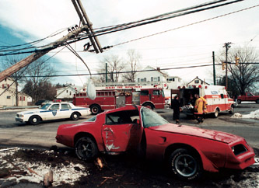
Incident management

Slide 40
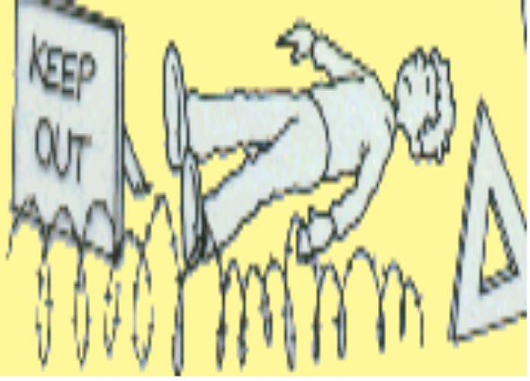
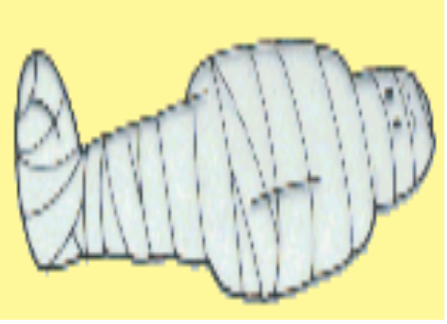
Incident Management
Assess the situation
Make the Area Safe
Emergency aid
Get Help
Aftermath

Slide 41
PRINCIPLES AND PRACTICES OF FIRST AID
Survey the scene (as expected under observation).
Do a primary survey of the victim.
Phone the emergency medical service (EMS) or look for help.
Do a secondary survey of the victim when appropriate.

Slide 42
SURVEY THE SCENE
In responding to an emergency situation, make a quick survey of the entire scene, look at the area around the victim, this should take only few seconds, then decide what to do next.
Consider the following as you do your survey and don’t forget the principle of DRABCD.

Slide 43
Is the scene safe?
You must not first decide if the situation is safe for you, also, you cannot help a victim by becoming a victim yourself.
You should know your abilities.
However, if you cannot get a victim because of extreme hazards, such as fire, toxic fumes, heavy traffic, electrical wires or deep swift moving water call emergency services or other services needed to handle the specific life-threatening hazard.

Slide 44
However, if you safely get to victim, decide if it is save to remain at the scene while you continue the steps of emergency action principle and care for the victim.
If it is not safe, you may need to make an immediate emergency rescue.

Slide 45
What happened?
If the victim is conscious, ask questions to what happened extent of victim’s illness or injury.
If victim is unconscious, ask bystanders or look for clues, the scene itself often gives the answer.

Slide 46
How many people are injured?
You should look beyond the victim you see at first glance. There may be other victims.

Slide 47
Are there bystanders who can help?
However, if there are bystanders, use them to help you find out what happened.
Although bystanders may not be trained in first aid, but they can help you in other important ways such as calling medical attention, by offering emotional support to the victim(s), their friends and their families and by keeping onlookers from crowding around the victim.

Slide 48
ASSESS THE SITUATION
Upon approaching the scene, quickly take in as much information as possible, and take into the consideration the principle of DRSABCD.
D -Danger – Always presume that there is some danger so check for and deal with any danger to yourself, the victim and bystanders e.g. traffic, electricity, infection from body fluid etc.
R -Response – Check for response by talking and asking the questions and shaking victim’s shoulders gently.
S -Shout – The first aider must shout for help when there is no response and he is alone with a the victim.

Slide 49
A - Airway – Casualty must have a clear and unobstructed airway to be able to survive. Maintain an open airway by tilting the head back while placing two fingers to life the chin. This head filth-chin position must be maintained to ensure the casualty airway remain open.
B - Breathing – check for up to 10 seconds for breathing, if breathing but unconscious place in the recovery position, this will help to maintain an open airway but if not breathing, start compression at once.

Slide 50
C - Compression – Commence chest compression immediately when casualty is not breathing at ratio of three degrees compression to two breaths (CPR).
D - Defibrillator – A medium used to bring back the heart to its normal rhythm.

Slide 51
DO A PRIMARY SURVEY OF THE VICTIM
The purpose of the primary survey is to check for the life threatening conditions and to give urgent first aid care

Slide 52
The primary survey (assessment for priorities)
Danger
Remove any dangers to you bystanders or casualty
Response
Question, command
& Shake.

Slide 53
Levels of response
Alert
Voice
Pain
Unresponsive
Question
Command
Shake or Pinch

Slide 54
If there is a response:
Summon help if needed.
Assess and Treat any condition or Injury found.
Monitor and record.
If there is no response:
Shout for help (if alone)
open the airway.

Slide 55
Primary survey ...
Airway
Open the airway by head tilt, chin lift maneuver.

Slide 56
Primary Survey…
Breathing
Look, Listen and Feel for 10secs

Slide 57
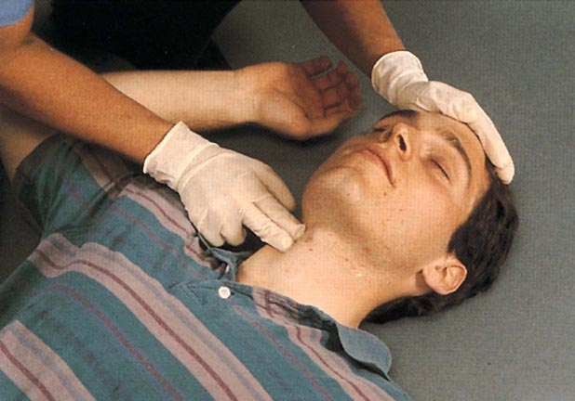
Primary Survey cont.…
Circulation:
Check for signs of life: normal skin color,
Temperature, movements or a pulse if you can(10 seconds)
Check for signs of severe
bleeding and stop it if you can

Slide 58
The Primary Survey summary
Danger
Response
Airway:
Breathing
Circulation

Slide 59
MAKING THE CALL
Make the call to medical yourself or give the responsibility to bystanders.
Make sure that adequate and precise information is passed on to the medicals.
This includes:
The location of the emergency (exact address, city or town, location, landmark name of he building, floor apartment or room number).

Slide 60
The telephone number of the phone being used.
The caller’s name.
What happened.
Number of victims.
The victim’s condition.
The help being given

Slide 61
DO A SECONDARY SURVEY OF THE VICTIM
The purpose of a secondary survey is to check the victim carefully and in an orderly way for injuries or other problems that are not an immediate threat to life but which could cause problems if not corrected. For example a broken bone.

Slide 62
Secondary survey (assessment for other injuries/medical conditions)
This includes the following:
Top-to-toe assessment
History
External clues
Signs & Symptoms

Slide 63
DECIDING TO TRANSPORT THE VICTIM
After completing the emergency action principle (EAPS) consider transporting the victim to the hospital yourself if the victim’s condition is not severe. This is an important decision.
Do not transport a victim with life threatening condition may develop. Moreover, there maybe some situations, when an ambulance is not readily available and you may have to weigh the risks and consider taking the victim to the hospital.
However, you must pay close attention to the victim and watch for any charges in his or her condition.

Slide 64
THE SCOPE OF FIRST AID
The scope of first aid includes the diagnosis, the treatment and the disposal of the case.
(a) For diagnosis, the first aider must first know how the accident or sudden injury has occurred.
This can be got from the victim if he can tell or from witnesses. This is called the history of the case.
The next step in diagnosis is to watch the symptoms like, thirst, pain or shivering.

Slide 65
Then the first aider looks at the signs, which are variations from normal conditions.
These may include swelling, congestion, paleness or deformity, which can be very easily observed by the first aider.
Signs are the most reliable indications on which diagnosis can be based.

Slide 66
(b) For treatment, the cause of the condition should be imme­diately removed, with a view to prevent the condition from becoming worse.
Special attention should be paid to cases of severe bleeding, shock, unconsciousness and failure of breathing.

Slide 67
(c) For quick disposal, the casualty or the victim should either be examined by the doctor on the spot or, if that is not possible, he should be immediately taken to his home or to a suitable place of shelter or to a hospital, according to circumstances.
The members of the victim's family or his relatives should be informed at once.

