Slide 1
FRACTURE AND ITS MANAGEMENT
KATUA.O.H.

Slide 2
DEFINITION OF FRACTURE
Fracture is the break in the normal continuity of the bone Fracture may be
Incomplete or complete
Un-displaced or displaced
Open or closed
Diaphyseal or Metaphyseal
Transverse, oblique, spiral, comminuted
Greenstick fractures
Traumatic or non traumatic

Slide 3
CAUSES OF FRACTURES
Automobile accidents major cause
Motor cycle injury common in young adults
Fall from height
Sports injury
Trivial injury fall at home
Machine injuries
Repetitive stress (stress fracture)
Gun shot injuries
Pathological problems of bone
Metabolic bone diseases
Defective collagen

Slide 4
Emergency management
At the spot of the accident
At tertiary care centre or hospital
Rescue teams reach at scene of accident
No rescue teams all over the country
Ambulance services are required
Patients either report at district level hospital or rural health centre or at tertiary centre directly

Slide 5
Ist priority is to save pts life
A,B,C
AIR WAY AND C-SPINE CARE
BREATHING AND BLEEDIND CONTROL
CIRCULATION TO PREVENT SHOCK

Slide 6
ATLS PROTOCOL FOR FRACTURE MANAGEMENT
Advance trauma life support is the most important protocol to save the life of the patients suffering from road traffic accidents
life saving measures
A-To maintain the air way and cervical spine care
B-Breathing problem is the next priority
C-Circulation to asses the shock and its treatment
D-Disability of the patient
E- Environments

Slide 7
Fracture classification
World wide acceptable classification is
A.O classification (Association of osteosynthesis)
Type A simple fractures
Type B 3 fragment with wedge piece
Type C comminuted with multi fragments
All these fracture types are again subdivided to
A1,A2 A3 OR B1,B2 B3 OR C1 C2 C3

Slide 8
TYPES OF FRACTURES ACCORDING TO REGION INVOLVED
Metaphyseal fractures
Diaphyseal fractures
Epiphyseal or intra-articular fractures

Slide 9
Emergency treatment at the scene of accident
At scene of accident save patients life clear the airway( rescue teams )ambulance service
Take care of cervical spine apply cervical collar
Assess breathing and bleeding
I/v line maintenance give fluids to avoid hypovolemia
Call the hospital administration
Shift the patient gently to the hospital
Pain killing agents coverage of open wound with antiseptic dressing and splint the fracture

Slide 10
Closed fractures and open fractures
Fracture in which the overlying soft tissues remain intact the fracture hematoma not communicates with exterior (skin barrier intact )
In open fractures the fractured bone is communicated with external environment chances of infection are high
Close fracture are treated either by plaster cast or internal fixation
Open fractures internal fixation is not indicated
Open fractures are mostly treated by the external fixation

Slide 11
Diagnosis of the fractures
Complete history
Mechanism of trauma
Pain and swelling at site of injury
Positive tenderness and crepitus at site
X-rays
Some times bone scan
CT scan or MRI

Slide 12
HOW TO ADVISE X-RAYS RULE OF 2
Always advise 02 views
Two times
Two sides
Two joints must be included

Slide 13
Fracture management
Resuscitate
Review
Radiographs
Reduce
Immobilization.
Rehabilitate

Slide 14
Four eras of open fracture treatment
OPEN FRACTURE IS THE ORTHOPAEDIC EMERGENY
Life preservation
Limb preservation
Infection avoidance
Functional preservation

Slide 15
Different types of treatments for fractures
Closed fractures
If undisplaced conservative or non operative treatment if displaced then operative type of treatment is advised
First aid includes
Assessment of the injured part ,pulses ,temperature at local area color of the skin , general condition must be checked
If there is wound over the fracture that means fracture is open
Open fracture require different type of treatment

Slide 16
Close and open fractures femur and tibia

Slide 17
Different modalities of fracture treatment
Plaster cast
Traction
skin/ skeletal traction
Functional braces
Internal fixation with plate screws ,Im nailing k-wires screw fixations ,rush nails ,flexible nails
External fixation

Slide 18
First aid measures at district level hospital
Support to the injured extremity by backslab or traction/ collar and cuff sling for upper limb or back slab for the tibia or knee fractures
Analgesics and i.v fluids
Open fractures with bleeding require blood transfusions
Anti-tatanus toxoid treatment
Prophylactic i/v antibiotics
Careful and gentle shifting of pateint is required

Slide 19
Femoral or hip fractures
Skin tractions
Long leg support
Skeletal tractions
Braces to immobilize the limb
Open fractures need wound debridements and external fixator applications
Dislocations are emergencies must be reduced as soon as possible

Slide 20
Rules for open fracture treatment
Wash the wound with antiseptic solutions podine and normal saline
Cover the wound after cleaning
Don’t put stitches on open fractures
Leave the wound open
Support the limb by the posterior slab
Elevate the limb to avoid the edema
Anti-tatanus toxoid

Slide 21
Indications of internal fixation of fractures
Displaced long bone fractures
Intra-articular fractures
Unstable fractures
Fractures with nerve injuries or vascular injuries
Fracture neck of femur in adults
Fractures with multiple fragments
Multiple fractures
Spinal fractures

Slide 22
Plaster cast

Slide 23
Femoral fractures fixed in nailing

Slide 24
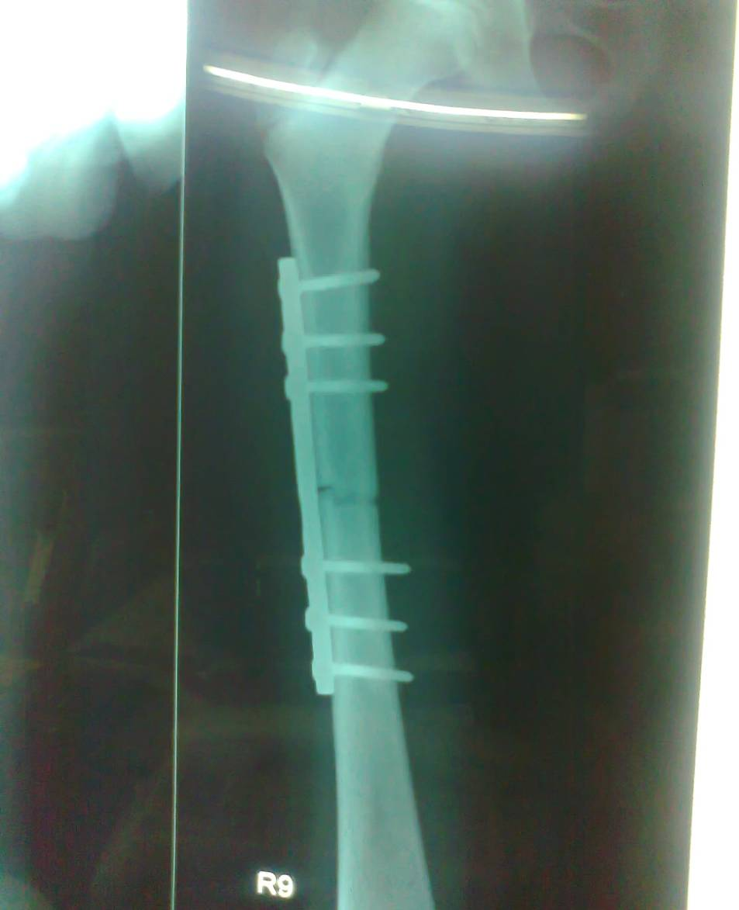
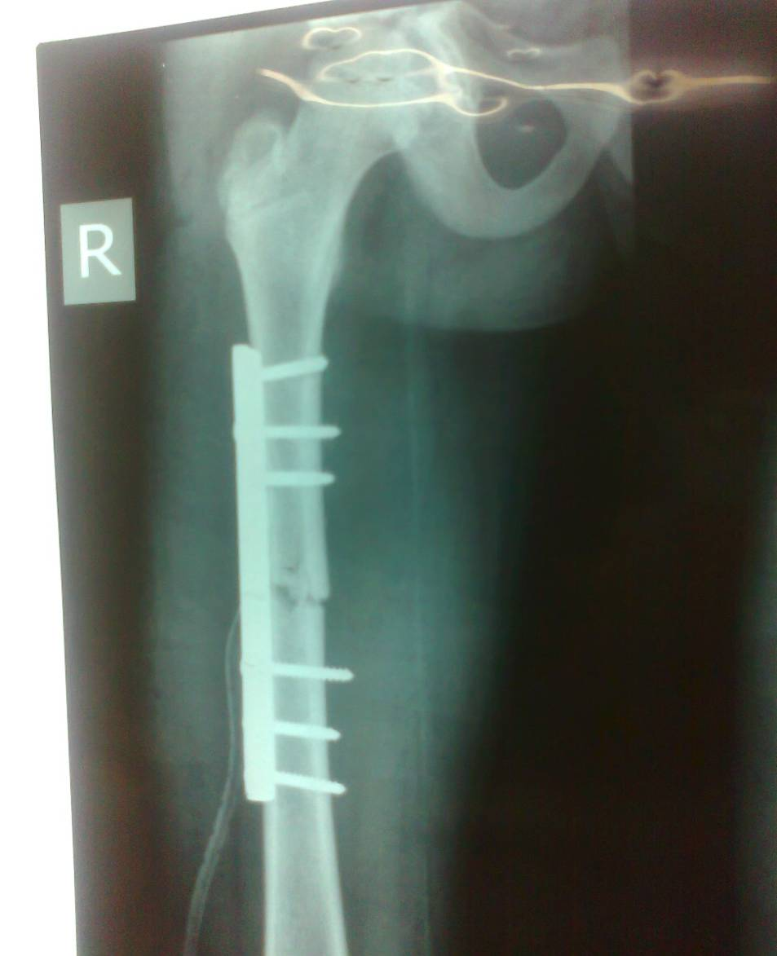
ORIF Femur with plate and screw

Slide 25
Fractures treated by plaster cast or traction followed by plaster cast
Femoral fractures in children
Undiplaced or minimally displaced fractures
Undisplaced intra-articular fracrures
Patients who are not medically fit
Fracture of tarsal or metatarsal bone with less displacement
Fractures of the metacarpal bones less displaced

Slide 26
General complications of fractures
Early Complications
Nerve injuries ,vessel injuries shock , pulmonary embolism , infections , septicemia , gas gangrene , crush syndrome , tetanus , multi-organ failure
Late complication
Non-union , Malunion , Stiffness of joints , limb shortening , growth arrest , osteoporosis

Slide 27
Close tibia fracture interlocking nail fixed

Slide 28
Tibia plateau fracture

Slide 29
External fixator tibia

Slide 30
Open fractures external fixation

Slide 31
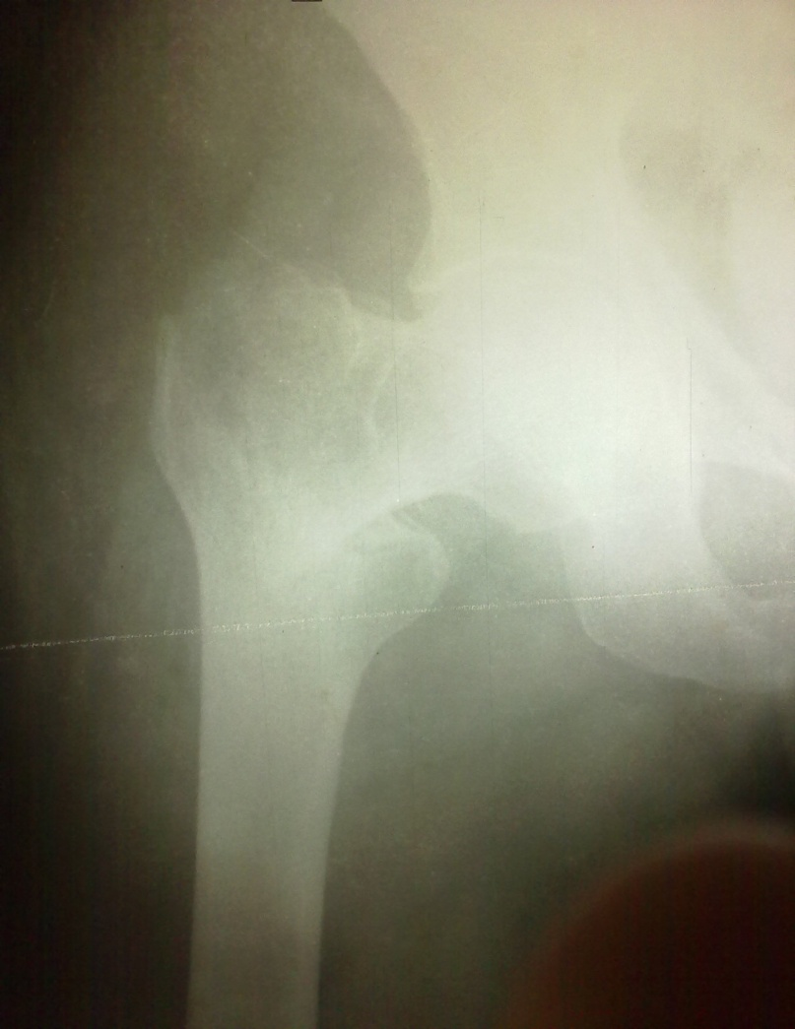
IT FRACTURES DHS FIXATION

Slide 32
Femoral diaphyseal fracture internal fixation indicated no good results with conservative

Slide 33
Radius ulna fracture

Slide 34
ORIF radius ulna

Slide 35
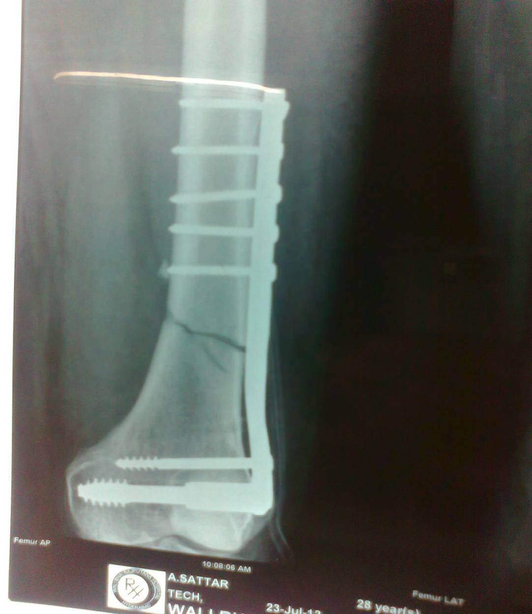
ORIF Femur
Supracondylar
femur fracture fixed
with DCS

Slide 36
Fracture neck femur

Slide 37
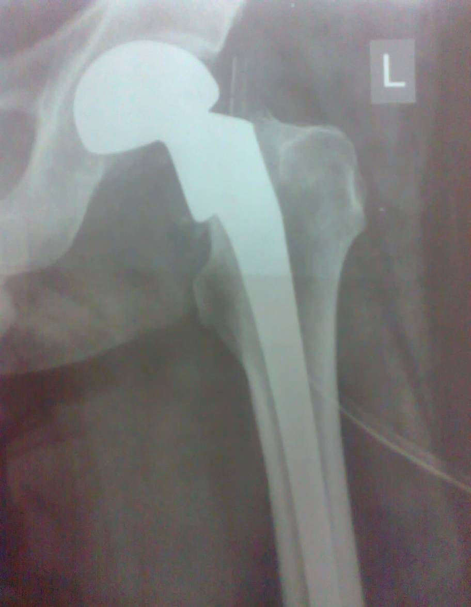
Fracture neck femur with prosthesis

Slide 38
ORTHOPAEDIC PROBLEMS CAN BE SOLVED BY
EMERGENY MEASURES AT THE DISTRICT LEVEL HOSPITALS
AWARENESS OF THE MEDICAL PRACTITIONERS
TIMELY REFFERAL AT TERTIARY CARE HOSPITALS WHEN IN STABLE STATE
OPEN FRACTURES MOSTLY COMPLICATE DUE TO DELAY

Slide 39
THANKS

