Slide 1
FRACTURES OF FOREARM BONES( ULNA & RADIUS)
G.M.Weru
Lecturer Clinical Medicine

Slide 2
CONTENTS
Monteggia fracture-dislocation
Galeazzi fracture-dislocation
Fractures shafts of radius and ulna
Colle’s fracture
Smith’s fracture

Slide 3
MONTEGGIA FRACTURE -DISLOCATION
It is fracture of proximal third of the ulna associated with dislocation of the radial head
It is named after Giovanni Battista Monteggia
MECHANISMS OF INJURY
Forced pronation of the forearm
Direct blow on the back of upper forearm, as a person warding off an assault
The radial head may dislocate anteriorly, laterally or posteriorly

Slide 4
Clinical features
Pain on the forearm
Swelling
Inability to supinate and pronate the foream
Deformity

Slide 5
Investigation
X-RAYS( A/P and lateral views)
Reveal the fracture of ulna and the dislocation of radial head

Slide 6
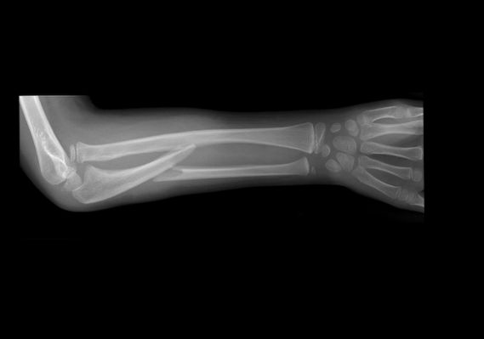
Monteggia fracture- dislocation

Slide 7
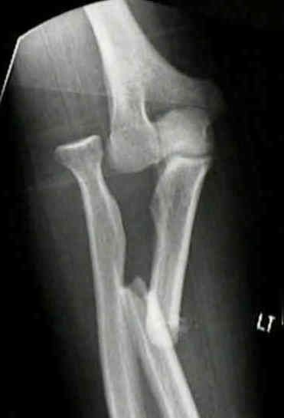
Monteggia fracture- dislocation

Slide 8
Treatment
Closed reduction by manipulation under G/A, then immobilize with an above elbow POP with the elbow joint at 90° for 6 weeks in adults and 4 weeks in children
Closed reduction succeeds in children but it’s liable to fail in adults
2. Open reduction with internal fixation using
plate and screws is the method of choice in
adults

Slide 9
Complications
Delayed union
Malunion
Non union
Stiffness of the elbow joint
Osteoarthritis of radio-humeral joint

Slide 10
GALEAZZI FRACTURE - DISLOCATION
It is fracture of shaft of radius(junction between mid and lower third) with dislocation of inferior radio-ulna joint
It is named after Ricardo Galeazzi
MECHANISM OF INJURY
Fall on outstretched hand with the elbow flexed
Direct blow
The head of ulna may be shifted medially, anteriorly or posteriorly

Slide 11
Clinical features
Pain on the forearm
Swelling
Inability to pronate and supinate the forearm due to pain at the inferior radio-ulna joint
Deformity
Tenderness

Slide 12
Investigation
X-RAY(A/P and lateral views)
Reveals the fracture of radius and dislocation of inferior radio-ulna joint

Slide 13
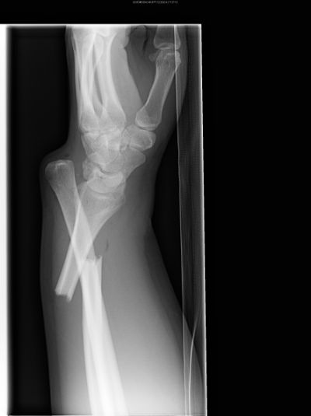
Galeazzi fracture- dislocation

Slide 14
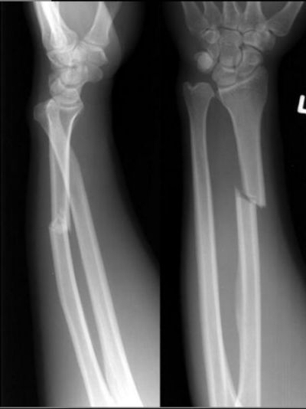
Galeazzi fracture- dislocation

Slide 15
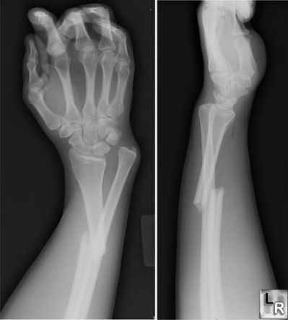
Galeazzi fracture- dislocation

Slide 16
Treatment
Closed reduction by manipulation under G/A, then immobilize with an above elbow POP with the elbow joint at 90° with the forearm supinated for 6 weeks in adults and 4 weeks in children
Closed reduction succeeds in children but is liable to fail in adults
2.Open reduction with internal fixation using
plate and screws- It is the method of choice in
adults

Slide 17
Complications
Delayed union
Non union- occurs due to inadequate reduction
Stiffness of wrist and elbow joints
Osteoarthritis of inferior radio-ulna joint

Slide 18
COLLE’S FRACTURE
It was described by Professor Abraham Colle’s in 1842
It is fracture of the lower end of radius, about 2cm above the wrist joint associated with the following features:
Impaction of fracture fragments
Dorsal displacement of distal fragment
Radial(lateral) displacement of distal fragment
Backward angulation of distal fragment
Supination of the forearm
± Avulsion fracture of Styloid process of the ulna

Slide 19
Cont.
INCIDENCE
It is rare below the age of 40 years
It’s common in elderly particularly in postmenopausal women, attributed to osteoporosis
MECHANISM OF INJURY
A fall on the palm of an outstretched hand

Slide 20
Clinical features
Pain on the wrist joint
Swelling on the wrist joint
Inability to move the wrist joint
Deformity near the wrist joint- Typical DINNER FORK DEFORMITY

Slide 21
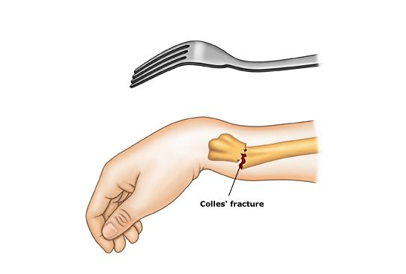
Dinner fork deformity

Slide 22
Investigation
X-RAYS(A/P and lateral views)
Reveals the fracture, type and extent of displacement

Slide 23
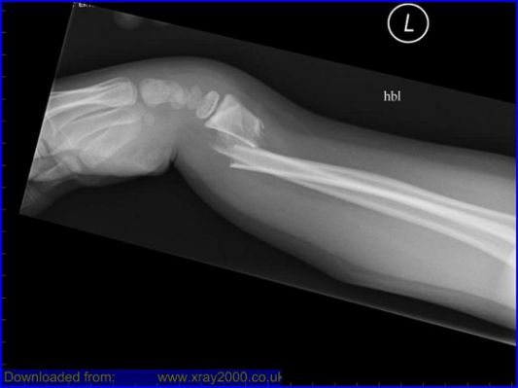
Colle’s fracture

Slide 24
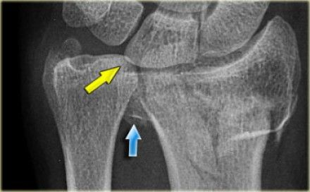
Colle’s fracture

Slide 25
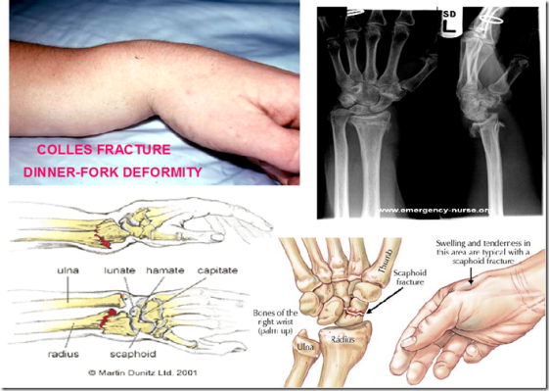
Colle’s fracture

Slide 26
Treatment
Closed reduction by manipulation under G/A
Technique
The hand and grasped and traction is applied in the length of the bone
The distal fragment is then pushed into place by pressing on the dorsum while manipulating the wrist into flexion, ulnar deviation and pronation
Request an check X-ray to confirm reduction
Apply a below elbow POP for 6 weeks

Slide 27
Cont.
2. Open reduction with internal fixation with plate and screws of percutaneous wires for:
Failure of closed reduction
Severely displaced fractures
3. External fixation it is rare; it’s indicated in:
Open fractures
Very unstable fractures

Slide 28
Complications
Compression of median nerve- presents with numbness of the fingers.
If symptoms are marked (Neuroplaxia); open reduction to free the nerve is indicated
2. Reflex sympathetic dystrophy/ Sudeck’s post
traumatic osteodystrophy
It is a poorly understood condition, thought to occur as result of disturbance of centrally mediated autonomic regulation with consequent increased stimulation of sympathetic and motor efferent fibres

Slide 29
Cont.
Presents with painful, swollen and stiff fingers
Treatment
Physiotherapy
Intravenous blockade with guanethidine sulphate for refractory symptoms
3. Malunion- due to inadequate reduction
4. Stiffness of the wrist and fingers
5. Weakness of the wrist joint

Slide 30
Cont.
6. Delayed rupture of extensor policis longus
tendon- Caused either by the fracture or POP.
Usual time between the time the fracture
occurred and the rupture is 4-8 weeks
Presents with inability to actively extend the thumb
Treatment is by tendon transfer of extensor indicis

Slide 31
Cont.
7. Subluxation of distal radio-ulna joint
Presents with impaired wrist movements especially adduction(ulna deviation) and rotation
Treatment
Minor cases- observation and follow up
Troublesome cases- Darroch’s operation i.e. excision of the lower end of the ulna

Slide 32
SMITH’S FRACTURE
It is a fracture of distal radius with features opposite those of Colle’s fracture i.e. the distal fragment is displaced forward and rotated forward
It a rare fracture
MECHANISMS OF INJURY
Backward fall of an outstretched hand
Fall on the dorsum of the hand in a flexed wrist joint

Slide 33
Clinical features
Pain on the wrist joint
Swelling around the wrist joint
Deformity- Which is the reverse of Colle’s fracture
Inability to move the wrist joint

Slide 35
Investigation
X-RAYS(A/P and lateral)
Reveals the fracture and the degree of displacement

Slide 36
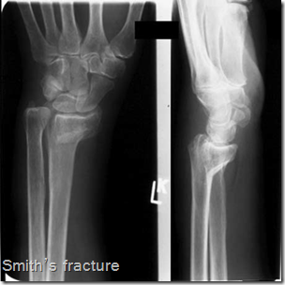
Smith’s fracture

Slide 37
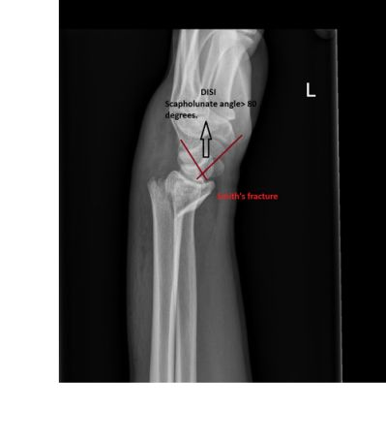
Smith’s fracture

Slide 38
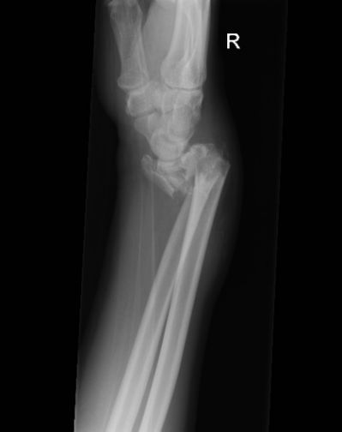
Smith’s fracture

Slide 39
Treatment
Closed reduction by manipulation under G/A
Technique is the reverse of that of Colle’s fracture
Then immobilize with a below elbow POP with the forearm in supination for 6 weeks
2) Open reduction with internal fixation using
a Buttress plate
Indications:
Severely displaced fractures
Pressure to radial artery

Slide 40
Complications
Pressure to radial artery
Malunion
Stiffness of the wrist and fingers
Weakness of the wrist joint

Slide 41
Assignment
Fractures shafts of ulna and radius

Slide 42
QUOTE!!

