Slide 1
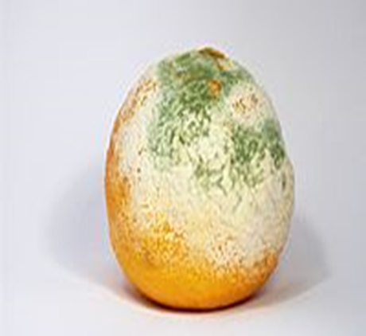
FUNGI
(Mycology)

Slide 2
FUNGI (Mycology)
The term "mycology" is derived from Greek word "mykes" meaning mushroom.
Mycology is the study of fungi.
The ability of fungi to invade plant and animal tissue was observed in early 19th century but the first documented animal infection by any fungus was made by Bassi, who in 1835 studied the muscardine disease of silkworm and proved the that the infection was caused by a fungus Beauveria bassiana.
In 1910 Raymond Sabouraud published his book Les Teignes, which was a comprehensive study of dermatophytic fungi.
He is also regarded as father of medical mycology.

Slide 3
TERMINOLOGY
Yeast: Unicellular growth form of fungi. These cells can appear spherical to ellipsoidal
Pseudohyphae: When buds of yeast cells do not separate, form long chains
Hyphae: Threadlike, branching, cylindrical, tubules composed of fungal cells attached end to end.
Molds (also called Mycelia): Multicellular colonies composed of clumps of intertwined branching hyphae.

Slide 4
TERMINOLOGY
Dimorphic fungi: Fungi that can grow as either a yeast or mold, depending on environmental conditions and temperature
Saprophytes: Fungi that live in and utilize organic matter (soil, rotten vegetation) as an energy source.
Spores: The reproducing bodies of molds.

Slide 5
FUNGI (Mycology)
All fungi are eukaryotic
Natural habitat- soil, water and decaying organic debris
Fungi - molds and yeasts
  Molds - exhibit filamentous type of growth
  Yeasts - pasty or mucoid form of fungal growth
50,000 + valid species; some have more than one name due to minor variations in size, color, host relationship, or geographic distribution

Slide 6
FUNGI (Mycology)
Diverse group of heterotrophs.
  Many are ecologically important saprophytes (consume dead and decaying matter)
  Others are parasites.
Most are multicellular, but yeasts are unicellular.
Most are aerobes or facultative anaerobes.
Cell walls are made up of chitin (polysaccharide).
Over 100,000 fungal species identified. Only about 100 are human or animal pathogens.
  Most human fungal infections are nosocomial and/or occur in immunocompromised individuals (opportunistic infections).

Slide 7
GENERAL PROPERTIES OF FUNGI
They are eukaryotic
cells contain membrane bound cell organelles including nuclei, mitochondria, golgi apparatus, endoplasmic reticulum, lysosomes etc.
They also exhibit mitosis.
2. Have ergosterols in their membranes and possesses 80S ribosomes.
3. Have a rigid cell wall and are therefore non-motile, a feature that separates them from animals.
All fungi possess cell wall made of chitin.

Slide 8
GENERAL PROPERTIES OF FUNGI
4. Are heterotrophic like animals and most bacteria; they require organic nutrients as a source of energy
5. Fungi are osmiotrophic; they obtain their nutrients by absorption.
6. They obtain nutrients as saprophytes (live off of decaying matter) or as parasites (live off of living matter).
7. All fungi require water and oxygen

Slide 9
GENERAL PROPERTIES OF FUNGI
8. Typically reproduce asexually and/or sexually by producing spores.
9. They grow either reproductively by budding or non-reproductively by hyphal tip elongation.
10. Food storage is generally in the form of lipids and glycogen.

Slide 10
BENEFICIAL EFFECTS OF FUNGI
1. Decomposition - nutrient and carbon recycling.
2. Biosynthetic factories. The fermentation property is used for the industrial production of alcohols, fats, citric, oxalic and gluconic acids.
3. Important sources of antibiotics, such as Penicillin.
4. Model organisms for biochemical and genetic studies. Eg: Neurospora crassa
5. Saccharomyces cerviciae is extensively used in recombinant DNA technology, which includes the Hepatitis B Vaccine.

Slide 11
BENEFICIAL EFFECTS OF FUNGI
6. Some fungi are edible (mushrooms).
7. Yeasts provide nutritional supplements such as vitamins and cofactors.
8. Penicillium is used to flavour Roquefort and Camembert cheeses.
9. Ergot produced by Claviceps purpurea contains medically important alkaloids that help in inducing uterine contractions, controlling bleeding and treating migraine.
10. Fungi (Leptolegnia caudate and Aphanomyces laevis) are used to trap mosquito larvae in paddy fields and thus help in malaria control.

Slide 12
HARMFUL EFFECTS OF FUNGI
1. Destruction of food, lumber, paper, and cloth.
2. Animal and human diseases, including allergies.
3. Toxins produced by poisonous mushrooms and within food (Mycetism and Mycotoxicosis).
4. Plant diseases.
5. Spoilage of agriculture produce such as vegetables and cereals in the go-down.
6. Damage the products such as magnetic tapes and disks, glass lenses, marble statues, bones and wax.

Slide 13
FUNGI (Mycology)
Fungi are eukaryotic protista; differ from bacteria and other prokaryotes.
1. Cell walls containing chitin (rigidity & support), mannan & other polysaccharides
2. Cytoplasmic membrane contains ergosterols
3. Possess true nuclei with nuclear membrane & paired chromosomes.
4. Divide asexually, sexually or by both
5. Unicellular or multicellular

Slide 14
FUNGI (Mycology)
Differences from bacteria
Posses rigid cell wall
Contain chitin, mannan and polysacharide
Cytopalsmic membrane contain sterols
True nuclei with Nuclear membrane, mitochondria and endoplasmic reticulum
Unicellular or multicellular
Divide by asexually, sexually or by both

Slide 15
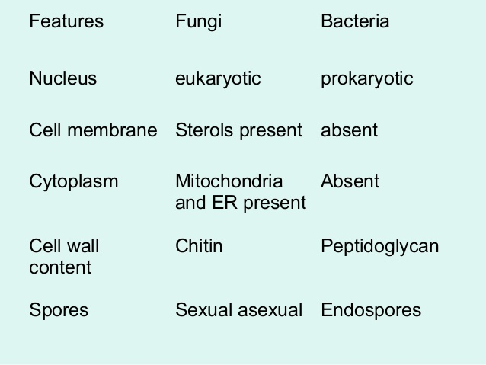

Slide 17
HOW THE FUNGUS ARE NOURISHED
All are chemo heterotrophs(require organic compounds for both carbon and energy sources)
Absorption of nutrients: powerful Exoenzyme to derive energy from organic substrates (living and dead)
Grow at lower pH-5 than bacteria
Grow in high salt and sugar
Metabolize complex CHO like lignin in wood-wood rot

Slide 18
THE STRUCTURE OF FUNGI
Yeasts and molds have different structural and reproductive characteristics
Yeast are unicellular, nucleated rounded fungi while molds are multicellular, filamentous fungi
Yeast reproduce by a process called budding while molds produce spores to reproduce
Some yeast are opportunistic pathogens in that they cause disease in immuno-compromised individuals
Yeast are used in the preparation in the variety of foods

Slide 19
CHARACTERISTICS OF FUNGI
eukaryotic, non- vascular organisms
reproduce by means of spores, usually wind-disseminated
both sexual (meiotic) and asexual (mitotic) spores may be produced, depending on the species and conditions
typically not motile, although a few (e.g. Chytrids) have a motile phase.
like plants, fungi have an alternation of generations

Slide 20
CLASSIFICATION
A. Taxonomic classification
Phyllum Thallophyta
Four classes of fungi
B. Morphological classification
Yeasts
Yeasts like fungi
Molds
Dimorphic fungi

Slide 21
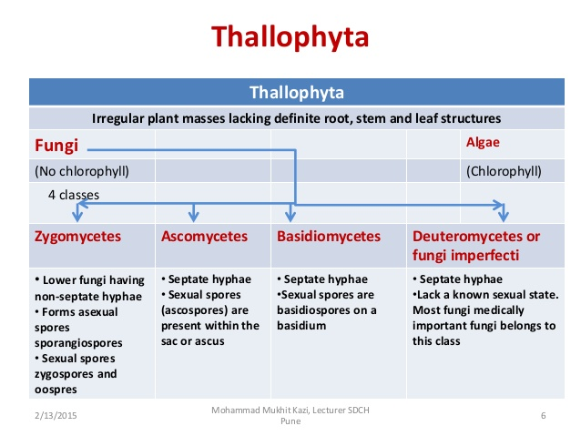

Slide 22
CLASSIFICATION
MORPHOLOGY OF FUNGI:
Fungi exist in two fundamental forms; the filamentous (hyphal) and single celled budding forms (yeast).
But, for the classification sake they are studied as:
  molds
  Yeasts
  yeast like fungi
  dimorphic fungi

Slide 23
MORPHOLOGY OF FUNGI
All fungi have typical eukaryotic morphology.
They have rigid cell wall composed of chitin, which may be layered with mannans, glucans and other polysaccharides in association with polypeptides.
Some lower fungi possess cellulose in their cell wall.
Some fungi such as Cryptococcus and yeast form of Histoplasma capsulatum possess polysaccharide capsules that help them to evade phagocytosis.

Slide 24
MORPHOLOGY OF FUNGI
Inner to the cell wall is the plasma membrane that is a typical bi-layered membrane in addition to the presence of sterols.
Fungal membranes possess ergosterol in contrast to cholesterol found in mammalian cells.
The cytoplasm consists of various organelles such as mitochondria, golgi apparatus, ribosomes, endoplasmic reticulum, lysosomes, microtubules and a membrane enclosed nucleus.

Slide 25
MORPHOLOGY OF FUNGI
A unique property of nuclear membrane is that it persists throughout the metaphase of mitosis unlike in plant and animal cells where it dissolves and re-forms.
The nucleus possesses paired chromosomes.
Classification depending on cell morphology
1. Yeasts
2. Yeast like fungi
3. Molds
4. Dimorphic fungi

Slide 26
Yeasts
Yeasts are unicellular spherical to ellipsoid cells.
They reproduce by budding, which result in blastospore (blastoconidia) formation.
In some cases, as the cells buds the buds fail to detach and elongate thus forming a chain of elongated hyphae like filament called pseudohyphae.
This property is seen in Candia albicans.

Slide 27
Yeasts
The same species also have the ability to produce true hypha, which is seen as germ tube.
The difference between the two is that there is a constriction in psueudohyphae at the point of budding, while the germ tube has no constriction.
Some yeast such as Cryptococcus and the yeast form of Blastomyces dermatatidis produce polysaccharide capsule.
Capsules can be demonstrated by negative staining methods using India ink or Nigrosin.
The capsule itself can be stained by Meyer Mucicarmine stain.

Slide 28
Yeasts
Some yeasts are pigmented.
Rhodotorula sps produces pink colonies due to carotenoid pigments while some yeasts such as Phaeoannellomyces werneckii and Piedraia hortae are dematiaceous, producing brown to olivaceous colonies.
True yeasts such as Saccharomyces cerviciae don't produce pseudohyphae.
On culture - produce smooth, creamy colonies e. g Cryptococcus Neoformans (capsulated yeast)

Slide 29
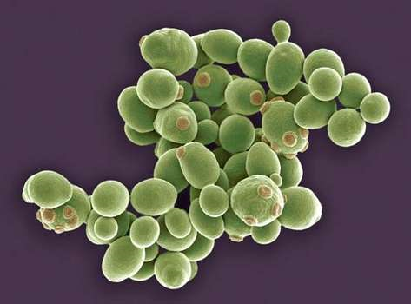
Yeasts

Slide 30
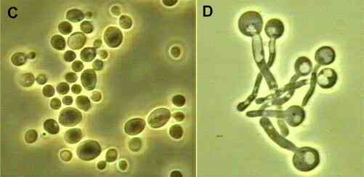
Yeast like fungi
Grow partly as yeasts and partly as elongated cells resembling hyphae which are called pseudo hyphae. e.g. Candida albicans

Slide 31
Molds
The thallus of mold is made of hyphae, which are cylindrical tube like structures that elongates by growth at tips.
A mass of hyphae is known as mycelium.
It is the hypha that is responsible for the filamentous nature of mold.
The hyphae may be branched or unbranched.
They may be septate or aseptate.
Hyphae usually have cross walls that divide them into numerous cells.

Slide 32
Molds
These cross walls, called septa have small pores through which cytoplasm is continuous throughout the hyphae.
All hyphal fungi tend to be coenocytic (multinucleate).
With exception of zygomycetes (Rhizopus, Mucor), all molds are septate.
Non-septate hyphae are considered to be more primitive because if a hyphal strand is damaged the entire strand dies.

Slide 33
Molds
When a septate hyphal strand is damaged, the pores between adjacent compartments can be plugged, thus preventing death of the whole hyphal strand.
Mycelium are of three kinds:
1. Vegetative mycelium are those that penetrates the surface of the medium and absorbs nutrients.
2. Aerial mycelium are those that grow above the agar surface
3. Fertile mycelium are aerial hyphae that bear reproductive structures such as conidia or sporangia.

Slide 34
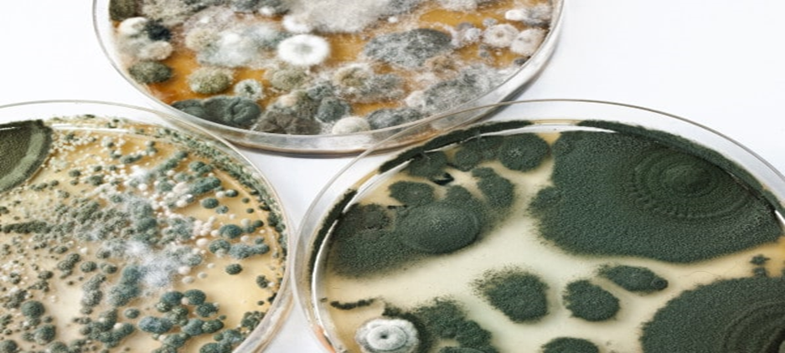

Slide 35
Molds
Spiral hyphae: These are spirally coiled hyphae commonly seen in Trichophyton mentagrophytes.
Pectinate body: These are short, unilateral projections from the hyphae that resemble a broken comb.
Commonly seen in Microsporum audouinii.
Favic chandelier: These are the group of hyphal tips that collectively resemble a chandelier or the antlers of the deer (antler hyphae).
They occur in Trichophyton schoenleinii and Trichophyton violaceum.

Slide 36
Molds
Nodular organ: This is an enlargement in the mycelium that consists of closely twisted hyphae.
Often seen in Trichophyton mentagrophytes and Microsporum canis.
Racquet hyphae: There is regular enlargement of one end of each segment with the opposing end remaining thin.
Seen in Epidermophyton floccosum, Trichophyton mentagrophytes.
Rhizoides: These are the root like structures seen in portions of vegetative hyphae in some members of zygomycetes.

Slide 38
Dimorphic fungi
Occur in 2 forms
  Molds (Filaments) – 25 C (soil)
  Yeasts – 37 C (in host tissue)
Most fungi causing systemic infections are dimorphic:
  Histoplasma capsulatum
  Blastomyces dermatidis
  Paracoccidioides brasiliensis
  Coccidioides immitis
  Penicillium marneffei
  Sporothrix schenkii

Slide 39
REPRODUCTION IN FUNGI
Fungi reproduce by asexual, sexual and parasexual means.
Asexual reproduction is the commonest mode in most fungi with fungi participating in sexual mode only under certain circumstances.
The form of fungus undergoing asexual reproduction is known as anamorph (or imperfect stage)
When the fungus is undergoing sexual reproduction, the form is said to be teleomorph (or perfect stage).
The whole fungus, including both the forms is referred as holomorph

Slide 40
REPRODUCTION IN FUNGI
Sexual - formation of Zygospore, ascospores or basidiospores
Asexual reproduction – budding or fission
Asexual spores are formed on or in specialized structures.
Vary in size, shape & colour but these characteristics are constant for a particular species.

Slide 41
ASEXUAL SPORES
Produced by aerial hyphae: adapted for dispersal
Progeny genetically identical to parent
Several types
Conidiospores
  not enclosed in a sac
  produced in a chain at end of a conidiophore
  Several types
Sporangiospores
  Within a sac, sporangium
  End of sporangiophore

Slide 42
REPRODUCTION IN FUNGI
Importance of Spores:
A. Biological
Allows for dissemination
Allows for reproduction
Allows the fungus to move to new food source.
Allows fungus to survive periods of adversity.
Means of introducing new genetic combinations into a population
B. Practical
Rapid identification (also helps with classification)
Source of inocula for human infection
Source of inocula for contamination

Slide 43
REPRODUCTION IN FUNGI
Asexual reproduction:
Asexual propagules are termed either spores or conidia depending on their mode of production.
Asexual spores are produced following mitosis where as sexual spores are produced following meiosis.
The asexual spores of zygomycetes, which are known as sporangiospores form within sac like structure known as sporangia.
The sporangiospores result from the mitotic cleavage of cytoplasm in the sporangium.

Slide 44
REPRODUCTION IN FUNGI
The sporangia are borne on special hyphae called sporangiophore.
This endogenous process of spore formation within a sac is known as sporogenesis.

Slide 45
REPRODUCTION IN FUNGI
Conidia arise either by budding off conidiogenous hyphae or by differentiation of preformed hyphae.
These develop following mitosis of a parent nucleus and are formed in any manner except involving cytoplasmic cleavage.
This exogenous process is known as conidiogenesis, a process that occurs both in yeasts and moulds.

Slide 46
REPRODUCTION IN FUNGI
Sexual Reproduction:
Sexual propagules are produced by the fusion of two nuclei that then generally undergo meiosis.
The first step in sexual methods of reproduction involves plasmogamy (cytoplasmic fusion of two cells).
The second step is karyogamy (fusion of two compatible nuclei), resulting in production of diploid or zygote nucleus.
This is followed by genetic recombination and meiosis.
The resulting four haploid spores are said to be sexual spores, e.g. zygospores, ascospores and basidiospores.

Slide 47
CLASSIFICATION
Based on sexual spore formation:
4 classes
1. Zygomycetes
2. Ascomycetes
3. Basidiomycetes
4. Deuteromycetes (fungi imperfectii)

Slide 48
ZYGOMYCETES
Commonly known as bread molds
These are fast growing, terrestrial, largely saprophytic fungi.
Hyphae are coenocytic and mostly aseptate.
Asexual spores include chlamydoconidia, conidia and sporangiospores.
Sporangiophores may be simple or branched.
Sexual reproduction involves producing a thick-walled sexual resting spore called a zygospore.

Slide 49
ZYGOMYCETES
Medically important orders and genera include:
Entomophthorales: Conidiobolus and Basidiobolus are involved in subcutaneous zygomycosis
Mucorales: Rhizopus, Mucor, Rhizomucor, Absidia and Cunninghamella are involved in subcutaneous and systemic zygomycosis (formerly called Mucormycosis)

Slide 51
ASCOMYCETES
Includes both yeasts & filamentous fungi
Narrow, septate hyphae
Asexual spores are called conidia borne on conidiophore

Slide 52
ASCOMYCETES
Sexual spores called ascospores are present within a sac like structure called Ascus.
Several asci may be seen within a fruiting body as seen in Penicillium, Aspergillus
Each ascus has 4 to 8 ascospores.

Slide 53
ASCOMYCETES
Medically important genera include the:
Teleomorphs of known pathogenic fungi e.g. Arthroderma (of Trichophyton and Microsporum), Ajellomyces dermatitidis (of Blastomyces dermatitidis), Pseudallescheria boydii (of Scedosporium apiospermum)
Agents of mycetoma, like Leptosphaeria
Agents of black piedra, like Piedraia hortae.

Slide 54
BASIDIOMYCETES
They exist as saprobes and parasites of plants.
Hyphae are dikaryotic and can often be distinguished by the presence of clamp connections over the septa.
Sexual reproduction is by the formation of exogenous basidiospores, typically four, on a basidium.

Slide 55
BASIDIOMYCETES
Sexual fusion results in the formation of a club shaped organ called base or basidium which bear spores called basidiospores

Slide 56
BASIDIOMYCETES
Occasional species produce conidia but most are sterile.
Genera of medical importance include:
Teleomorph of Cryptococcus neoformans, which is Filobasidiella neoformans
Agents of basidiomycosis such as Coprinus and Schizophyllium
Mushroom poisoning by Aminita, Lepiota, Coprinus and Psilocybe etc.

Slide 57
DEUTEROMYCETES
Deuteromycetes are also known as Fungi Imperfecti because of absence of sexually reproducing forms (teleomorph or perfect stage).
Group of fungi whose sexual phases are not identified.
Grow as molds as well as yeasts.
Asexual stage – conidia e.g. Candida, Cryptococcus

Slide 58
DEUTEROMYCETES
There are three classes of Fungi Imperfecti.
Blastomycetes
Hyphomycetes
Coelomycetes

Slide 59
FUNGAL DISEASES
Mycosis- fungal infection
  < 100 cause human disease
  Not highly contagious
  Humans acquire from nature
Groups based on degree on tissue involvement and mode of entry
Cutaneous mycoses-dermatophytes
  Epidermis, hair & nails
  Contagious-direct or indirect contact
  Secrete keratinase that degrades keratin

Slide 60
FUNGAL DISEASES
Infection in humans is a chance event, occurring only when conditions are favorable.
Except for few fungi such as the dimorphic fungi that cause systemic mycoses and dermatophytes, which are primary pathogens, the rest are only opportunistic pathogens.
Human body is a hostile environment and offers great resistance to fungal invasion.
The complex interplay between fungal virulence factors and host defence factors will determine if a fungal infection will cause a disease.
Infection depends on inoculum size and the general immunity of the host.

Slide 61
VIRULENCE FACTORS
Ability to adhere to host cells by way of cell wall glycoproteins
Production capsules allowing them to resist phagocytosis
Production of a cytokine called GM-CSF by Candida albicans that suppress the production of complement.
Ability to acquire iron from red blood cells as in Candida albicans
Ability to damage host by secreting enzymes such as keratinase, elastase, collagenase
Ability to resist killing by phagocytes as in dimorphic fungi
Ability to secrete mycotoxins
Having a unique enzymatic capacity
Ability to block the cell-mediated immune defenses of the host.

Slide 62
HOST DEFENSE FACTORS
Physical barriers, such as skin and mucus membranes
The fatty acid content of the skin
The pH of the skin, mucosal surfaces and body fluids
Epithelial cell turnover
Chemical barriers, such as secretions, serum factors
Natural Effector Cells (polymorphonuclear leucocytes) and the Professional Phagocytes (monocytes and macrophages)

Slide 63
PREDISPOSING FACTORS
Immunosuppressive conditions
Prolonged antibiotic therapy
Age
Surgical procedures
Immunosuppressive drugs
Irradiation therapy
Obesity
Drug addiction
Transplants
Occupation

Slide 65
Superficial: Surface mycoses
Live exclusively on dead surfaces of skin and its appendages
No contact with living tissue, hence no inflammatory response
Essentially no pathology; the disease is recognized purely on cosmetic basis.
1. Tinea versicolor: hypopigmented or hyperpigmented patches
on the skin.
2. Tinea nigra: superficial fungal infection that causes dark brown to black painless patches on the soles of the hands and feet.
3. black/white Piedra

Slide 66
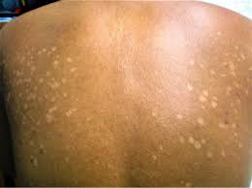
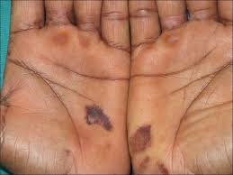

Slide 67
Cutaneous mycoses
Cornified layer of skin & its appendages
Contact with living tissue, hence inflammatory & allergic responses seen
Have particular affinity for the keratin of the skin, nails, and hair.
Most cutaneous infections are caused by a closely related group of fungi, called the dermatophytes.

Slide 68
Cutaneous mycoses
These keratinophilic prefer the non-living cornified layers.
The disease caused by these organisms is called Adermatophytosis or "dermatomycosis".
Host response is patchy scaling or eczema forming eruptions; inflammation may occur.
They are classified according to the area of the body that is involved.
Tinea corporis (body)
Tinea cruris (jock itch): Patients develop itchy red patches on the groin and scrotum

Slide 69
Cutaneous mycoses
Tinea pedis (athlete's foot): This infection commonly begins between the toes, and causes cracking and peeling of the skin. Infection requires warmth and moisture, so it only occurs in those wearing shoes
Tinea capitis (scalp): This condition primarily occurs in children. The infecting organisms grow in the hair and scalp, resulting in scaly red lesions with loss of hair. The infection appears as an expanding ring.
Tinea unguium (onychomycosis) (nails): The nails are thickened, discolored, and brittle.

Slide 70
Dermatophytes
They infect superficial keratinized tissue (skin, nail and hair) without involving tissue
They break down and utilizes keratin
In capable of penetrating subcutaneous tissue
Cause dermatomycoses also known as ringworm

Slide 71
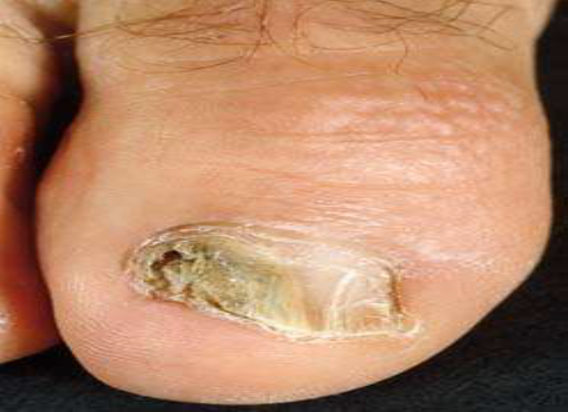
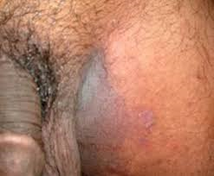
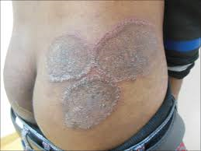

Slide 72
Dermatophytes
Classification
  Trichophyton - hair, skin and nail
  Microsporum – hair , skin
  Epidermophyton – skin and nail
Lab diagnosis:
Specimen: skin, hair or nail
Direct microscopy – LPCB mount
Culture

Slide 73
Subcutaneous mycosis
Involve the deeper layers of skin and often muscle tissue.
Man is an accidental host following inoculation of fungal spores via some form of trauma.
This type of fungal infection is often tentatively identified by the presence of a characteristic tissue reaction or granule.
Mycotic Mycetoma
Chromoblastomycoses
Sporotrichosis
Rhinosporidiosis

Slide 74
Subcutaneous Mycoses
Mycetoma : chronic granulomatous infection of subcutaneous tissue usually affects foot
Also known as Madura foot
Mainly in tropical countries
Caused by Actinomycetes and filamentous fungi
Enter through minor trauma
Diagnosis made by observing granules
Treatment- sulphonamides sometime amputation

Slide 75
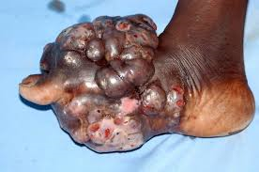
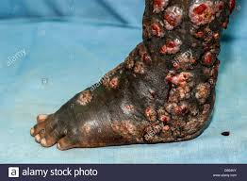

Slide 76
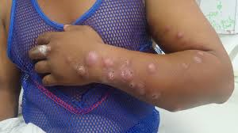
Sporotrichosis
Is nodular, ulcerating disease of skin and subcutaneous tissue
Access through thorn pricks or injuries
Spread through lymphatics up to regional lymph nodes
Sporothrix schenckii – dimorphic fungi
Lab diagnosis by culture

Slide 77
Rhinosporidiosis
Is a chronic granulomatous disease characterized by formation of friable polyps, usually confined to nose, mouth or eye
Causative agent Rhinosporidium seeberi
Mode of infection is not known
Lab diagnosis done by demonstration of sporangia

Slide 78
Systemic mycoses
Attack the deep tissues and organ systems; often create symptoms that resemble other diseases.
Two categories of systemic disease.
a. Those caused by truly pathogenic fungi with the ability to cause disease in the normal human host when the inoculum is of sufficient size.
  Histoplasma capsulatum
  Blastomyces dermatitidis
  Coccidioides immitis
  Paracoccidioides brasiliensis

Slide 79
Systemic mycoses
b. Opportunistic fungi, low virulence organisms, require the patient's defenses to be lowered before the infection is established.
  Aspergillus sp.
  Candida albicans
  Cryptococcus neoformans

Slide 80
Systemic mycoses
1. Histoplasmosis
  Histoplasma capsulatum
  Reticuloendothelial system
  Source – soil with excreta of birds
  Asymptomatic
  Sputum, bone marrow, blood, scrapings,
  biopsies
  Geimsa stain or Wright stain
  Culture- SDA
  Amphotericin B

Slide 81
Systemic mycoses
2. Blastomycosis
  Blastomyces dermatitidis- dimorphic fungi
  Infection mainly to skin, bone and genitourinary tract
  Inhalation of conidia
  Asymptomatic
  Sputum, pus or scrapings
  10% KOH, H&E stain and PAS stain
  Culture-SDA
  Amphotericin B

Slide 82
Histoplasma, Blastomyces, and
Coccidioides
Inhaled, primary infection in the lung.
Asymptomatic, mild, severe, or chronic lung infections.
Lung granulomas, calcifications, and/or cavitations.
Can disseminate hematogenously to distant sites.
Cause disease in the lungs, skin, bones, and meninges

Slide 83
Systemic mycoses
3. Paracoccidiomycosis
  Paracoccidioides brasilensis- dimorphic fungi
  Inhalation of spores
  Same
4. Cryptococcosis
  Crptococcus neoformans
  Inhalation of dust
  Seen in immunocompromised
  demosntration of capsule by india ink
5. Opportunistic mycoses- candiasis, aspergillosis, zygomycoses

Slide 85
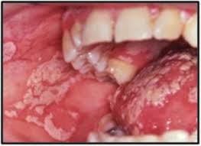
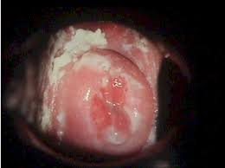
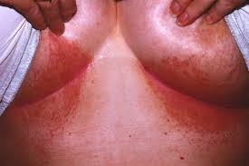
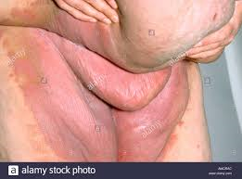

Slide 86
Laboratory Methods in Medical Mycology
Collection - usually by physician or nursing staff
Skin - cleaned with 70% alcohol to remove dirt, oil and surface saprophytes
Nails - cleaned same as for skin. Usually clipped; need to be finely minced before innoculating to media
Hair - obtained from edge of infected area of scalp,. Use a Wood's lamp to help locate infected hair. Hair can be obtained by plucking, brushing, or with a sticky tape.
Body fluids - normal sterile collection procedures

Slide 87
Laboratory Methods in Medical Mycology
Skin, nails, & hair - direct exam following KOH preparation
KOH prep - Potassium hydroxide; done on skin scrapings, hail, nails, sputum, vaginal specimens, etc. The KOH digests and clears the specimen’s tissue cells, mucous, etc., so fungal elements can be seen.
Wet mount prep - good for yeast; examination is done in natural environment, so loss of fragile structure is minimal.
Gram Stain - generally fungi are gram positive; Actinomyces and Nocardia are gram variable

Slide 88
Laboratory Methods in Medical Mycology
Giemsa’s stain: It is particularly useful in the detection of Histoplamsa capsulatum in the bone marrow smears.
India Ink - demonstrates the capsule of Cryptococcus neoformans in CSF specimens.
Culture: One of the most common media used to culture fungi in laboratory is Sabouraud’s Dextrose Agar (SDA).
It consists of peptone, dextrose and agar. High concentration of sugar and a low pH (4.5-5.5) prevents growth of most bacteria and makes it selective for fungi.

Slide 89
Take home message
Fungi are eukaryotes
Medically important fungi belongs to Fungi imperfecti or Deuteromycetes
Sabourauds dextrose agar is used to culture
Slide culture to demonstrate better morphological characters
KOH mount or LPCB mount for demonstration
Mainly opportunistic infections
E.g. Candidiasis, Cryptococcosis, Aspergillosis

