Slide 1

BY LOSIAMOI RHODAH
BScN,KRCHN,RH/FP.

Slide 2

By the end of this session the trainees will be able to effectively discuss methods of family planning.

Slide 3

To define family planning and contraception.
To review A/P of the reproductive system
To understand the principles of Fp
To understand Eligibility creteria.
To describe the various types of family planning methods.

Slide 4
6. To understand factors affecting family planning
7 .To manage logistics in FP

Slide 5

Family planning is defined as some thing that allows individuals and couples to anticipate and attain their desired number of children and spacing and timing of births. It is achieved through use of contraceptive methods and treatment of involuntary infertility.
Contraception is defined as : The process through which family planning methods are provided to prevent pregnancy.

Slide 6

In 1978, Kenya’s total fertility rate was about 8.3, the highest in the world
By the early 80s Kenya became one of the very few countries alongside Botswana and Zimbabwe to implement a national Family Planning (FP) programme

Slide 7

February 2013, AFIDEP sponsored a Science Café at Cedars Restaurant in Nairobi, Kenya, to discuss family planning in Kenya
The following were tasks to be active;
Division of Reproductive Health
National Council for Population and Development (NCPD)
Notes:
AFIDEP-African Institute for Development Policy is an African-led, non-profit policy think tank that enable utilization of research evidence in policy making.

Slide 8

As fertility begun to slowly drop in Kenya during the late 90s Kenya’s
current population, approximately 41 million people, is expected to more than double to 97 million by 2050.
a large majority of the Kenyan youth, making up about 65 percent of the Kenyan population, are not accessing or using contraceptives.

Slide 9

18 percent of pregnancies occur among girls 15-19 years old in Kenya. Unfortunately, many of these pregnancies contribute to maternal mortality as a result of, complications arising during pregnancies or at birth or from procuring of unsafe and consequently fatal abortions.

Slide 10

The highest cause of maternal deaths among girls 15-19 years is unsafe abortion.
Family planning, whilst politically and socially controversial.

Slide 11

FP can save 99 percent of all maternal mortality and offers, delayed child bearing in the youth, prolonged birth intervals that contributes to increased child survival as well as increased participation in the labour market that comes with families having less young dependants, a major contribution to an improved quality of life for the families and by extension the national economy.

Slide 12

Wajir county has the highest TFR at 7.8, followed by West Pokot at 7.2, Turkana at 6.9 and Samburu at 6.3, all of them the arid and semi-arid parts of northern Kenya.
The counties with the lowest total fertility rate (TFR) are Kirinyaga (2.3) followed by Nyeri, Kiambu and Nairobi, all with a TFR of 2.7.
Notes:
TRF Total Fertility Rate

Slide 13

Discuss socio economic impacts of high fertility rates in Kenya

Slide 14

External reproductive system
Internal reproductive system

Slide 15

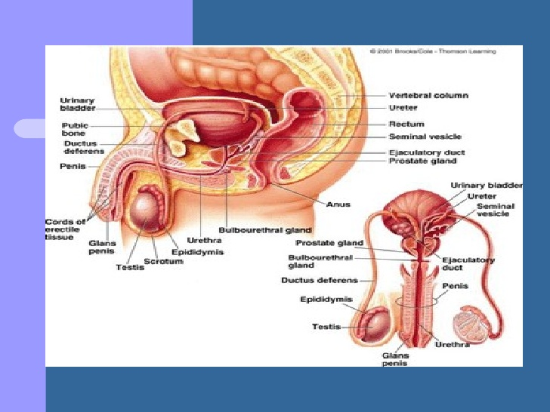

Slide 16

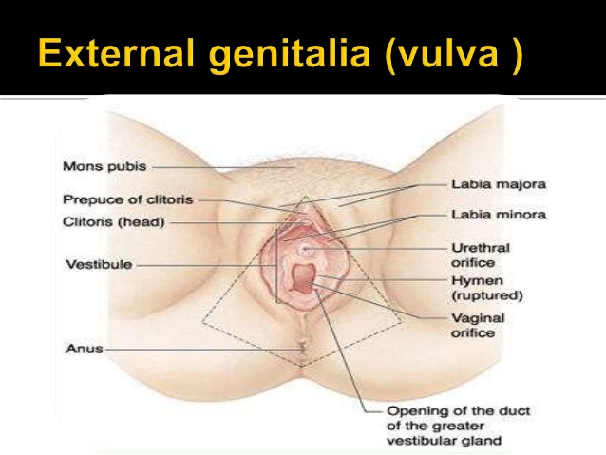

Slide 17
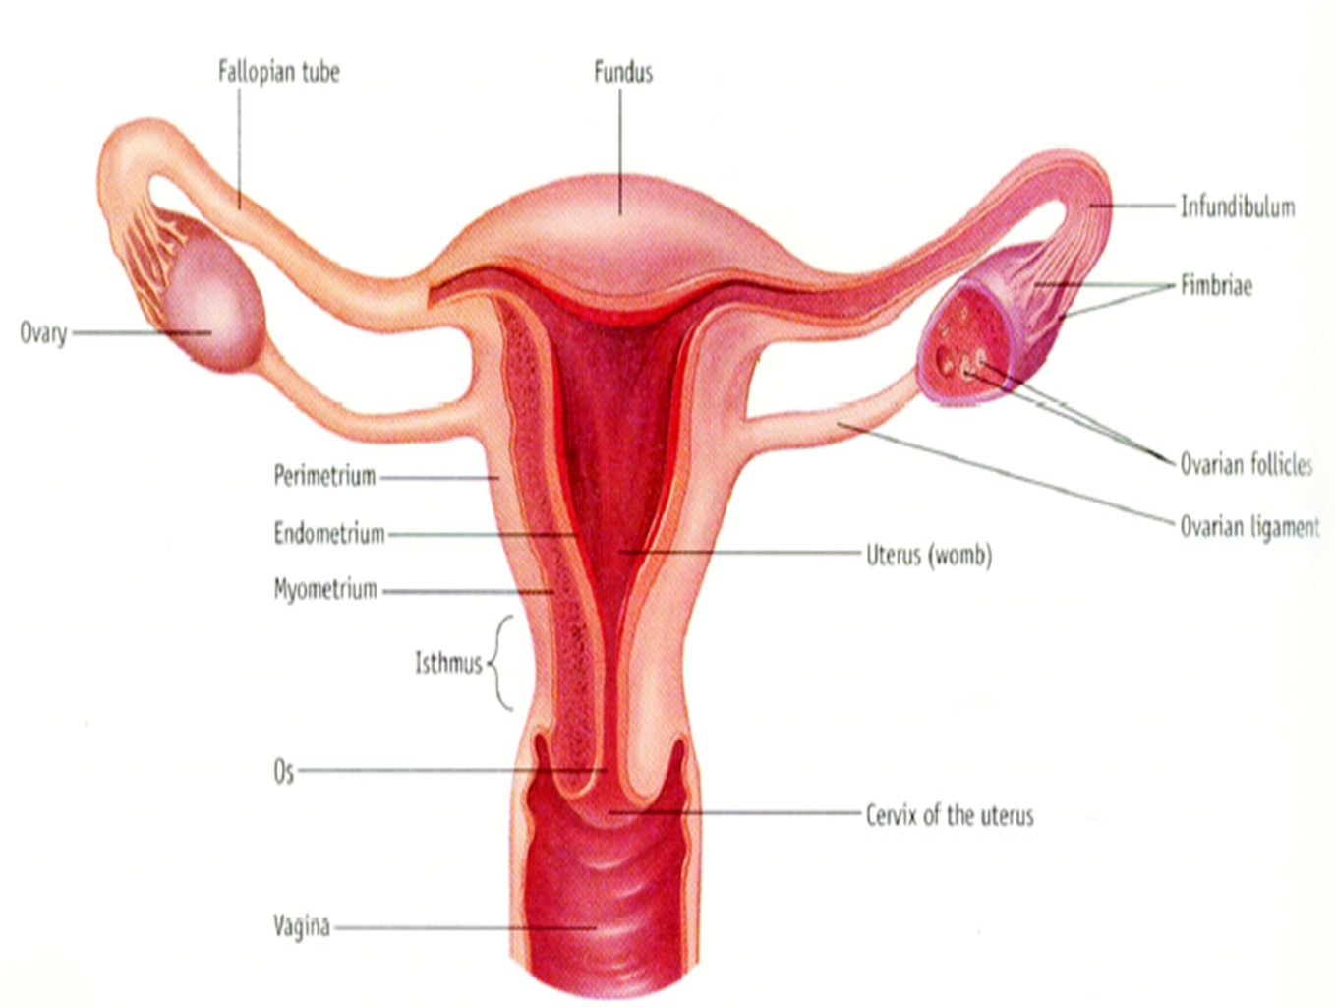

Slide 18

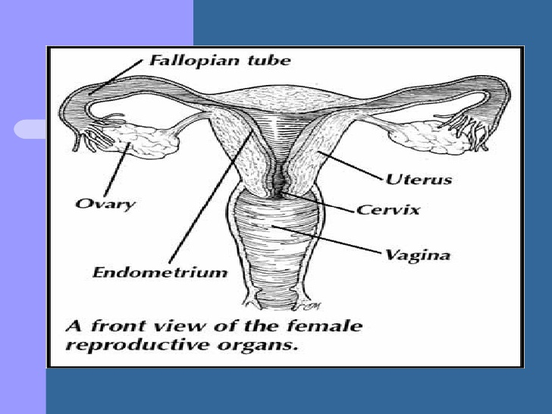

Slide 19
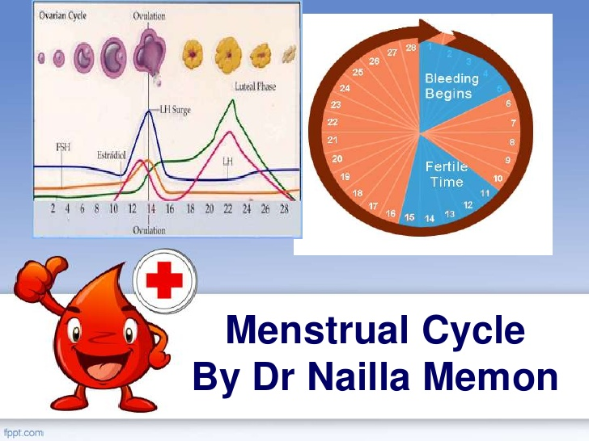

Slide 20
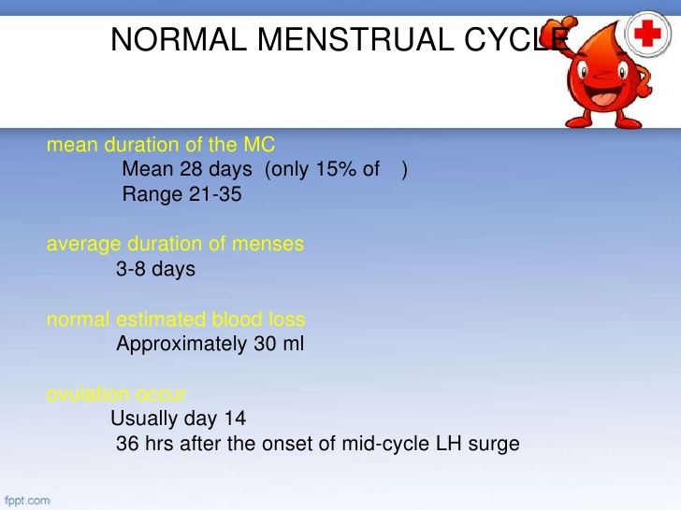

Slide 21
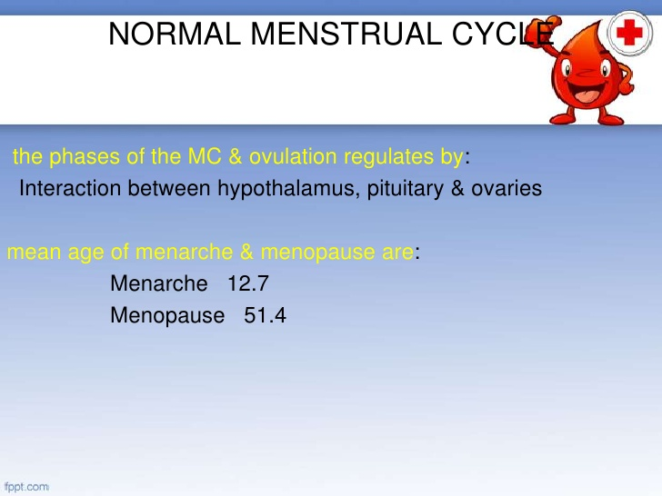

Slide 22
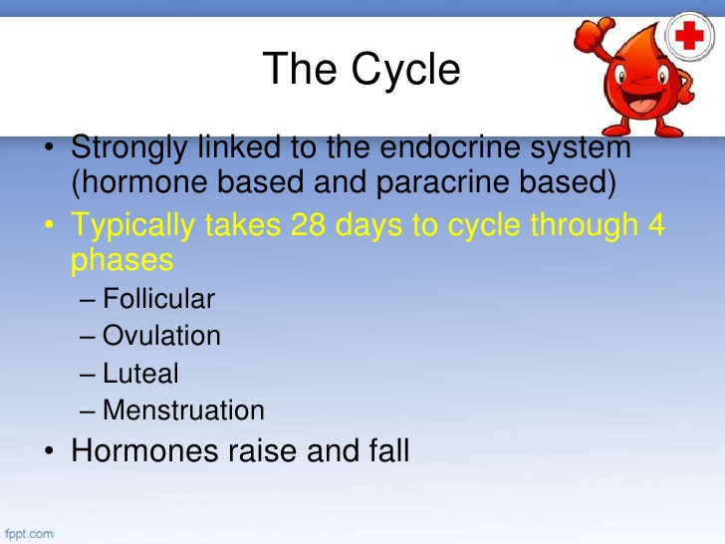

Slide 23
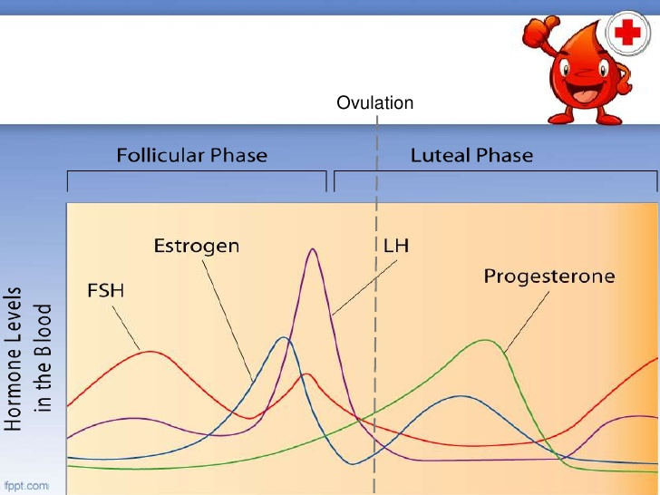

Slide 24
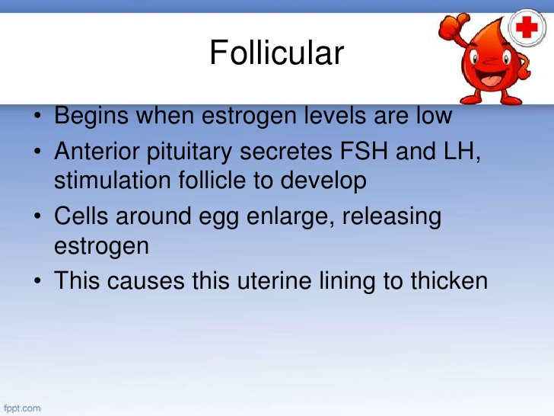

Slide 25
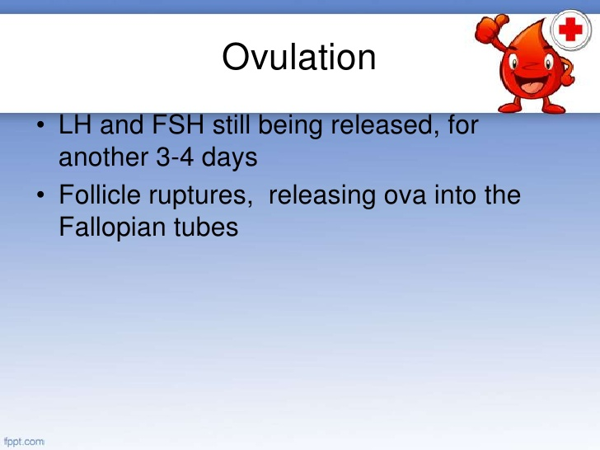

Slide 26
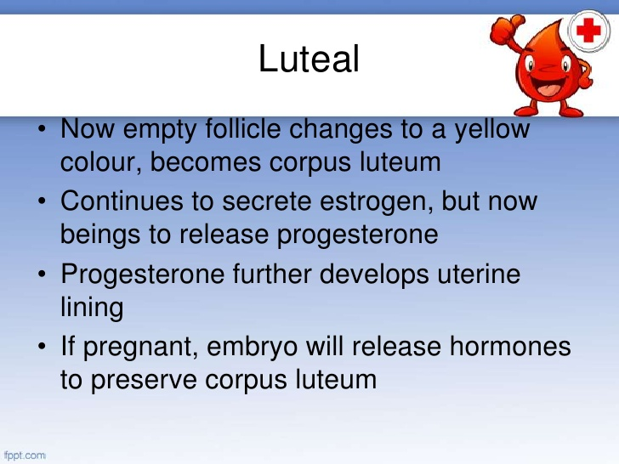

Slide 27
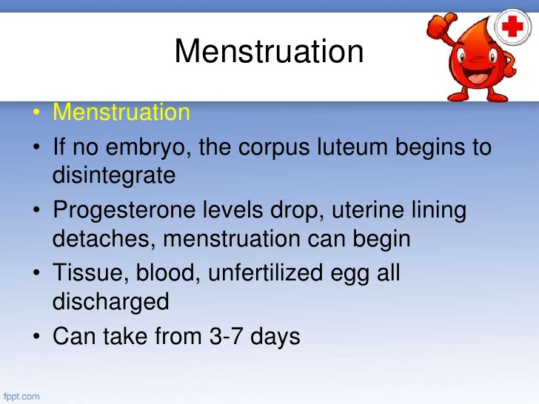

Slide 28
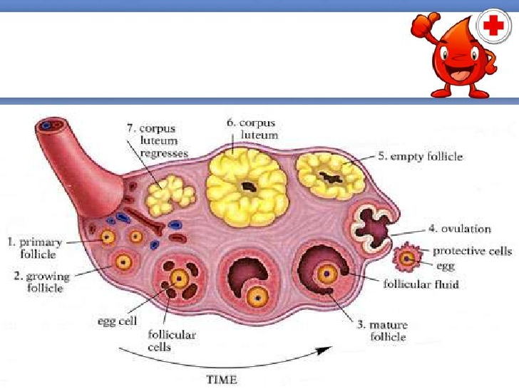

Slide 29
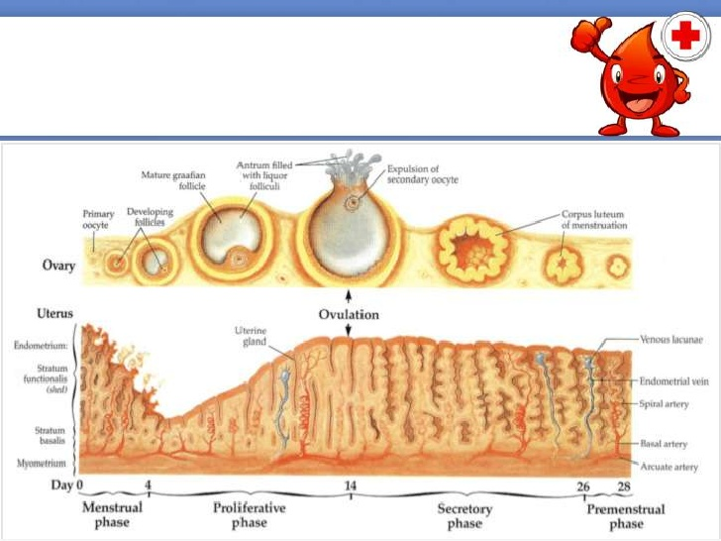

Slide 30
The Medical eligibility criteria (MEC)for contraceptive use
provides guidance regarding which clients can use contraceptive methods safely.
The goal is to improve access to, and quality of, family planning services by providing policy-makers, decision-makers and the scientific community with recommendations that can be used for developing or revising national guidelines on the MEC for the use of specific contraceptive methods.

Slide 31
CT…..The Medical eligibility criteria (MEC)
Methods covered by this guidance include all hormonal contraceptives, intrauterine devices, barrier methods, fertility awareness-based methods, coitus interruptus, lactational amenorrhoea(LAM) method, male and female sterilization, and emergency contraception.

Slide 32

used safely by people with certain health conditions (e.g. hypertension) or relevant characteristics (e.g. age).

Slide 33

Category 1 | A condition for which there is no restriction for the use of the contraceptive method
Category 2 | A condition where the advantages of using the method generally outweigh the theoretical or proven risks
Category 3 | A condition where the theoretical or proven risks usually outweigh the advantages of using the method
Category 4 | A condition which represents an unacceptable health risk if the contraceptive method is used

Slide 34
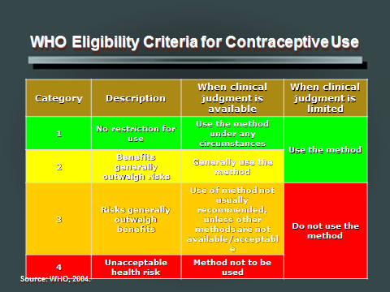

Slide 35
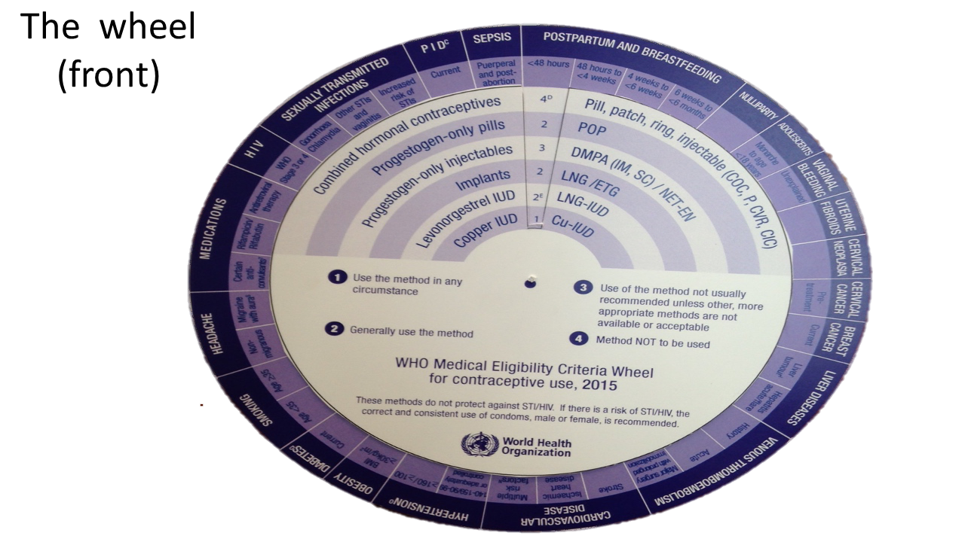

Slide 36
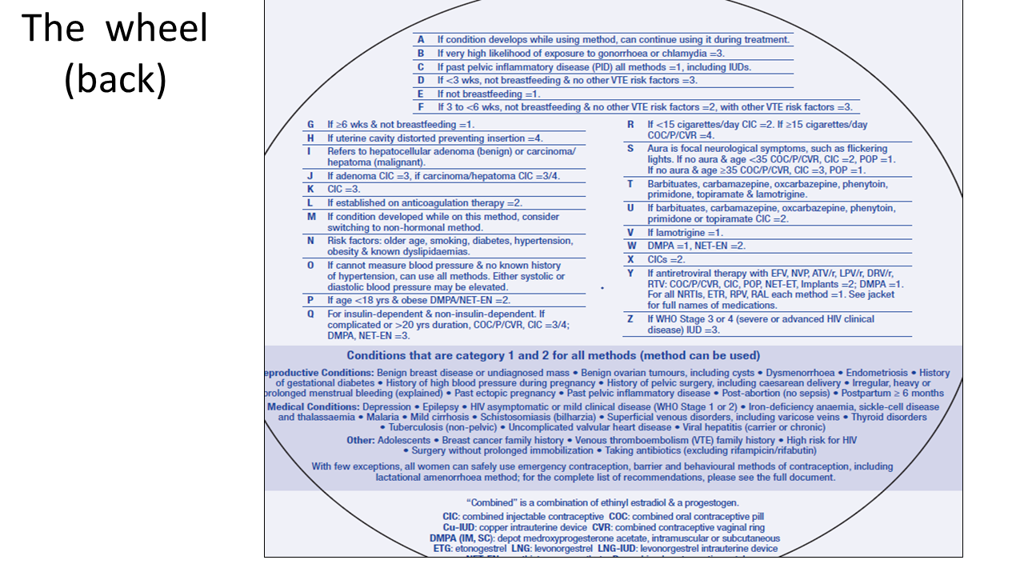


Slide 37

To describe the various types of family planning methods.
    What it is?
    MOA
    Effectiveness
    Advantages
    Disadvantages
    MEC
    Client instructions
    S/E, complication
    Common medical barriers to service provision
    Management of S/E and complications

Slide 38

Natural methods(fertility awareness)
  Abstinence
  Calendar based methods (moon beads)
  Billing’ s Method(Cervical mucus)
  Basal body temperature (BBT)
  Symptothermal(BBT+Cervical Mucus Method + Other fertility signs)
  Withdrawal
Lactational amenorrhea method (LAM)

Slide 39
Hormonal method
  Oral contraceptives – combined, progestin only, ECP
  Injectables- Progestin, Combined
  Contraceptive patches
  Vaginal rings
  Implants- Jadelle, norplant, implanon

Slide 40
4.Intrauterine devices
Copper T
Nova T
multiload
hormonal releasing (Mirena)
Plain (Lippes loop)

Slide 41

5.Barrier methods
Male condom
Female condom
Diaphragm
Cervical cap
Spermicides
6.Voluntary surgical contraception- BTL, Vasectomy

Slide 42
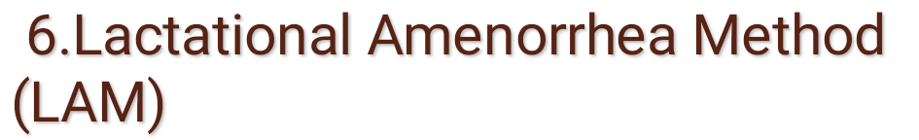
What is it?
This refers to the traditional method of breastfeeding with a natural effect of breastfeeding on fertility. “ Lactational” means related to breastfeeding and “amenorrhea” means not having monthly bleeding.

Slide 43

It is 98% effective in the first six months if the three conditions of who can use are met.

Slide 44

Women who:
Are fully or nearly fully breastfeeding
Have not had return of menses
Are less than 6 months postpartum¹
Note all these three conditions must be met
¹WHO recommends supplementation at 6 months. If begun earlier, LAM is not as effective.
44

Slide 45

Effective (1-2 pregnancies per 100 women during first 6 months of use)
Effective immediately
Does not interfere with sexual intercourse
No systemic side effects
No medical supervision necessary
No supplies required
No direct cost involved for family planning
45

Slide 46

For infant:
  Passive immunization and protection from other infectious diseases
  Best source of nutrition
  Decreased exposure to contaminants in water, other milk or formulas, or on utensils
For mother:
  Decreased postpartum bleeding
  Postpartum Uterine involution is facilitated
  Maternal bonding with the baby
46

Slide 47

User-dependent (requires following instructions regarding breastfeeding practices)
May be difficult to practice due to social circumstances
Highly effective only until menses return or up to 6 months
Does not protect against STIs (e.g., HBV, HIV and AIDS)
47

Slide 48

All breastfeeding mothers can safely use LAM but a woman in the following circumstances may want to consider other contraceptive method.
HIV /AIDS
Using medication during breastfeeding including mood altering drugs e.g. reserpine , ergotamine, anti-metabolites, cyclosporine.
The newborn who has a condition that makes it difficult to breastfeed e.g. preterm, cleft lip and palate

Slide 49

Women who are not breastfeeding at least nearly full.
Women with resumed menses.
Where the baby is more than 6 months old.
Couple who want highly effective protection against pregnancy where the woman has conditions that makes pregnancy dangerous.
Whose baby breastfeeds irregularly or longer than 6 hourly interval and sleeps throughout the night
Mothers breast milk flow is reduced for any reason

Slide 50

Breastfeed from both breasts on demand (about 6-10 times per day)
Breastfeed at least once during night (no more than 6 hours should pass between any two feedings)
Do not substitute other food or liquids for breast milk meal
If baby does not want to breastfeed 6-10 times per day or baby chooses to sleep through the night, LAM will be less effective as a contraceptive method
Once you substitute other food or drink for breastfeeding meals, the baby will suckle less, and LAM will no longer be an effective contraceptive method
50

Slide 51

Always keep a backup method of contraception, such as condoms, readily available. Use it if:
  your menses returns
  you begin supplementing your baby’s diet
  your baby reaches 6 months of age
Consult your healthcare provider or clinic before starting another contraceptive method
If you or your partner is at high risk for STIs, including the HIV, you should use condoms as well as LAM.
51

Slide 52

What are they?
These are methods containing female sex synthetic hormones (estrogen, progestin or a combination of both hormones).

Slide 53

Oral contraceptives
  Combined oral contraceptives (COC)
  Progestin only pill (POP)
Injectable Contraceptives
  Combined injectable
  Progestin only
Implants
  Norplant
  Jadelle
  Implanon
Contraceptive patches
Vaginal rings
Hormone releasing Intrauterine contraceptive device

Slide 54

What are they?
These are pills containing synthetic estrogen and progestins similar to the natural hormones in a woman's body. The amount of constituent hormones varies in different preparations.
Types of COCs include:

Slide 55

Surpress ovulation
Reduce sperm transport in upper genital tract (fallopian tubes)
Change endometrium making implantation less likely
Thicken cervical mucus (preventing sperm penetration)
55

Slide 56

Highly effective when taken daily
Effective immediately if started by day 7 of menstrual cycle
If taken consistently and correctly they are 99% effective.

Slide 57

Highly effective when taken daily
Effective immediately if started by day 7 of menstrual cycle
Do not need pelvic examination
Do not interfere with intercourse
Few side effects
Convenient and easy to use
Client can stop use
Can be provided by trained non-medical staff
57

Slide 58

Decrease menstrual flow (lighter, shorter periods)
Decrease menstrual cramps
May improve anemia
Protect against ovarian and endometrial cancer
Decrease benign breast disease and ovarian cysts
Prevent ectopic pregnancy
Protect against some causes of PID
58

Slide 59

Decrease menstrual blood loss (20 ml versus 35 ml)
Prevent iron deficiency anemia (50%)
Improve existing iron deficiency anemia
59

Slide 60

40-80% decrease in risk compared to non-users
Protection:
  Begins by 1 year of use
  Increases with duration of use
  Persists at least 10-15 years after COCs are stopped
  Is biologically possible
60
Notes:
There is a good deal of evidence to suggest that COCs reduce the risk of developing ovarian cancer. By suppressing ovulation or altering hormonal levels throughout the menstrual cycle, it appears that COCs alter the conditions that favor development of ovarian cancer. COCs may also reduce the opportunity for cells to mutate by decreasing the number of ovarian cell divisions. Finally, a 1998 animal study suggests that progestin may cause the death of damaged ovarian cells before they become cancerous.
The magnitude of the reduction in risk appears to depend on the duration of pill use—those women using the pill for a longer period of time (e.g., > 5 years) have a larger reduction in risk. Studies also suggest that the protective effect lasts for at least 10 to 15 years.
Source: Herbst AL. 1994. OCs and genital malignancies. Dialogues in Contraception 4(3):5-7.

Slide 61

There is no overall measurable increase of breast cancer risk except possibly among younger women
Breast cancer at a young age represents a very small proportion of all cases and may represent acceleration of pre-existing breast cancer or detection bias
COC use may provide protection against postmenopausal breast cancer.
61
Notes:
There is no evidence that COCs lead to a higher incidence of breast cancer. COC use has been related to a higher risk of being diagnosed with breast cancer and it is believed that this may be the result of acceleration of the cancer by the COCs. Cancers diagnosed in COC users are generally at an earlier stage than those diagnosed in non-COC users and are thus likely to have a better prognosis.

Slide 62
User-dependent (require continued motivation and daily use)
Some nausea, dizziness, mild breast tenderness, headaches or spotting may occur
Effectiveness may be lowered when certain drugs are taken
Forgetfulness increases method failure
Can delay return to fertility
Rare serious side effects possible
Re-supply must be readily and easily available
Do not protect against STIs (HBV, HIV and AIDS)
62

Slide 63

Women:
Of any reproductive age or parity who want highly effective protection against pregnancy
Who are breastfeeding (6 months or more postpartum)
Who are postpartum and are not breastfeeding (begin after third week)
Who are post abortion (start immediately or within 7 days)
63

Slide 64

Women:
With anemia
With severe menstrual cramping
With irregular menstrual cycles
With a history of ectopic pregnancy
In need of emergency contraception
64

Slide 65

Women who cannot remember to take a pill
every day
65
Notes:
Women who have had trouble remembering to take pills in the past should be counselled about the need to take the pill at the same time every day. The healthcare worker may want to suggest that the woman take the pills at meal time or just before going to bed. If she does not feel that she will be able to remember to take the pill each day, the client should be helped to choose a more appropriate method.

Slide 66

COCs should not be used in the presence of:
Breastfeeding and < 6 weeks postpartum
Current or history of ischemic heart disease
Smoking 15 or more cigarettes daily in women aged 35 years and more
Raised blood pressure (systolic > 160 or diastolic > 100 mmHG)
Hypertension with vascular disease
Migraine with aura
66

Slide 67

COCs should not be used in the presence of:
Diabetes (> 20 years duration)
Past or present evidence of DVT/PE
Major surgery with prolonged immobilization
Known thrombogenic mutations
Complicated valvular heart disease
Breast cancer within the past 5 years
Active viral hepatitis
Benign or malignant liver tumour
Severe (decompensated) cirrhosis
67

Slide 68

  Smoking up to 15 cigarettes daily in women aged 15 years or more
  Raised blood pressure (systolic 140-159 or diastolic 90-99 mmHG)
  History of hypertension (where blood pressure cannot be evaluated) or controlled hypertension
  Known hyperlipidaemia
  Migraine without aura in a woman aged 35 years or more
  Less than 21 days postpartum
  Breastfeeding from 6 weeks to less than 6 months postpartum
  History of breast cancer with no evidence of disease for the last 5 years
  Symptomatic gall bladder disease
  Drug treatment affecting liver enzymes: rifampicin and certain anticonvulsants
68

Slide 69

Anytime you can be reasonably sure the client is not pregnant
Days 1 to 5 of the menstrual cycle
Beyond the 5th day of menstrual cycle, make reasonably certain she is not pregnant and advise additional contraceptive protection for next 7 days
Postpartum:
  after 6 months if using LAM (recommend POP which can be started after the sixth week)
  after 3 weeks if not breastfeeding
Post abortion (immediately or within 7 days)
69

Slide 70

Amenorrhea
High blood pressure
Nausea/dizziness/vomiting
Bleeding/spotting
Acne
Breast fullness or tenderness (mastalgia)
Chest pain (especially if it occurs with exercise)
Depression (mood change or loss of libido)
70

Slide 71

Take 1 pill each day, preferably at same time of day.
Take first pill on first to fifth day (first day preferred) after beginning of your menstrual period.
Some pill packs have 28 pills. Others have 21 pills. When 28-day pack is empty, immediately start taking pills from a new pack. When 21-day pack is empty, wait 7 days and begin taking pills from new pack.
If you vomit within 30 minutes of taking pill, take another pill or use a backup method if you have sex during next 7 days.
71

Slide 72

With missed pills:
If you forget to take 1-2 pills, take it as soon as you remember, take the next pill at the usual time, even if it means taking 2 pills on one day. Keep taking active pills as usual.
If you forget to take 3 or more pills, take the pill as soon as possible and continue taking pills daily, one each day. Use a backup method (e.g., condoms) or do not have sex for 7 days until pills have been taken for 7 days in a row.
If you miss 2 or more menstrual periods, you should go to the clinic to check to see if you are pregnant.
72

Slide 73

Some nausea, dizziness, mild breast tenderness and headaches as well as spotting or light bleeding are common during menstrual cycle (usually disappear within 2 or 3 cycles)
Certain drugs (rifampin and most anti-epilepsy) may reduce effectiveness of COCs. Tell your provider if you start any new drugs.
Use a condom if at risk for STIs (ex: HBV, HIV and AIDS).
73

Slide 74

Contact healthcare provider or clinic if you develop any of the following problems:
  Severe abdominal pain
  Severe chest pain or shortness of breath
  Severe headaches or blurred vision
  Severe leg pain
  Absence of any bleeding or spotting during pill-free week (21-day pack) or while taking 7 inactive pills (28-day pack) may be a sign of pregnancy
74

Slide 75

Inappropriate contraindications (thyroid disease, fibroids, diabetes, etc.)
Age restrictions (young and old)
Parity criteria (less than two living children)
Who can provide (physicians or nurses only)
Number of pill packets given (less than three)
Process hurdles (lab tests, pelvic exams)
Provider bias (does not recommend, need for “rest period”)
Follow-up restrictions (BP required each visit)
75

Slide 76

What are they?
These are pills that have synthetic progesterone similar to the natural hormones in a woman's body.

Slide 77

35-pill pack: 300 mg levonorgestrel or 350 mg norethindrone 28-pill pack: 75 mg norgestrel
The table below summarizes the types of POPs
Progestin only pills | Progestin content | Amount (mg)
Microlut | Levonogesterel | 300
Micronor | Norethindrone | 350
Ovrette | Norgestrel | 75
77

Slide 78

Suppress ovulation
Reduce sperm transport in upper genital tract (fallopian tubes)
Change endometrium making implantation less likely
Thicken cervical mucus (preventing sperm penetration)
78

Slide 79

Effective when taken at the same time every day (0.05–5 pregnancies per 100 women during the first year of use)
If used correctly its 99% effective
Immediately effective (< 24 hours)
Less effective for non – breastfeeding women

Slide 80

Pelvic examination not required prior to use
Do not interfere with intercourse
Do not affect breastfeeding
Immediate return of fertility when stopped
80

Slide 81

Few side effects
Convenient and easy-to-use
Client can stop use
Can be provided by trained non-medical staff
Contain no estrogen
81

Slide 82

May decrease menstrual cramps
May decrease menstrual bleeding
May improve anemia
Protect against endometrial cancer
Decrease benign breast disease
Decrease ectopic pregnancy
Protect against some causes of PID
82

Slide 83

Cause changes in menstrual bleeding pattern
Some weight gain or loss may occur
User-dependent (require continued motivation and daily use)
Must be taken at the same time every day
Forgetfulness increases method failure
Re-supply must be available
Effectiveness may be lowered when certain drugs for epilepsy (phenytoin and barbiturates) or tuberculosis (rifampin) are taken
Do not protect against STIs (e.g., HBV, HIV and AIDS)
83

Slide 84
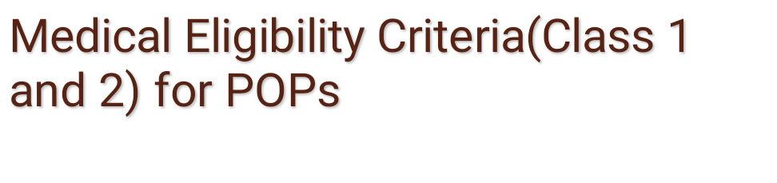
Women:
Of any reproductive age
Of any parity including nulliparous women
Who want effective protection against pregnancy
Who are breastfeeding (6 weeks or more postpartum) and need contraception
Who are postpartum and not breastfeeding
Who are post abortion
84

Slide 85

Women:
Who have blood pressure < 180/110, blood clotting problems or sickle cell disease
With moderate to severe menstrual cramping
Who smoke (any age, any amount)
Who prefer not to or should not use estrogen
Who want a progestin-only contraceptive but do not want injections or implants
Who should not use progestogen-only IUDs
85

Slide 86

Women:
Who cannot remember to take a pill every day at the same time.
Who cannot tolerate any changes in their menstrual bleeding pattern.
86

Slide 87

POPs should not be used if a woman:
  Is pregnant (known or suspected)
  Breast cancer within the past 5 years
Source: WHO 1996.
87

Slide 88

POPs are not recommended unless other methods are not available or acceptable if woman:
  Is breastfeeding and 6 weeks postpartum
  Current DVT /PE
  Active viral hepatitis
  Liver tumour (benign or malignant)
  Severe decompensated cirrhosis
  History of breast cancer with no evidence of disease in the last 5 years
  Drug treatment affecting liver enzymes: rifampicin and certain anticonvulsants
88

Slide 89

Blood pressure (< 180/110)
Diabetes (uncomplicated or < 20 years duration)
Pre-eclampsia (history of)
Smoking (any age, any amount)
Surgery (with or without prolonged bed rest)
Thromboembolic disorders
Valvular heart disease (symptomatic or asymptomatic)
89

Slide 90

Day 1 of the menstrual cycle
Anytime you can be reasonably sure the client is not pregnant (if it has been more than 5 days since menstrual bleeding started, she will need to abstain from sex who use another method for the next 2 days)
Postpartum:
  after 6 months if using lactational amenorrhea method (LAM)
  after 6 weeks if breastfeeding but not using LAM
  immediately or within 6 weeks if not breastfeeding
Post abortion (immediately)
90

Slide 91

Amenorrhea (absence of vaginal bleeding or spotting)
Bleeding or spotting
Heavy or prolonged bleeding
Lower abdominal/pelvic pain (with or without symptoms of pregnancy)
Weight gain or loss (change in appetite)
Headache
Nausea/dizziness/vomiting
91

Slide 92

Evaluate for pregnancy, especially if amenorrhea occurs after period of regular menstrual cycles
If not pregnant, counsel and reassure client
Do not attempt to induce bleeding with COCs
92

Slide 93

Prolonged spotting (> 8 days) or moderate
bleeding:
Reassurance
Check for gynecologic problem (e.g., cervicitis)
Short-term treatment:
  COCs (30-50 µg EE) for 1 cycle¹, or
  Ibuprofen (up to 800 mg 3 times daily x 5 days)
93

Slide 94

Bleeding twice as long or twice as much as
normal:
Carefully review history and check hemoglobin (if available)
Check for gynecologic problem
Short-term treatment:
  COCs (30-50 µg) for 1 cycle¹, or
  Ibuprofen (up to 800 mg 3 times daily) x 5 days
94

Slide 95

If bleeding not reduced in 3-5 days, give:
  2 COC pills per day for the remainder of her cycle followed by 1 pill per day from a new packet of pills, or
  High dose estrogen (50 µg EE COC, or 1.25 mg conjugated estrogen) for 14-21 days
95

Slide 96

Most interactions relate to increased liver metabolism of levonorgestrel:
  Rifampin (tuberculosis)
  Anti-epilepsy (seizures):
    Barbiturates, phenytoin, carbamzepine (but not valproic acid)
  Griseofulvin (long-term use only)
96

Slide 97

Take 1 pill at the same time each day.
Take first pill on first day of your menstrual period.
If you start POPs after the first day of your menstrual period, but before the seventh day, use a backup method for the next 48 hours.
Take all pills in pack. Start a new pack on the day after you take last pill.
If you vomit within 30 minutes of taking pill, take another pill or use a backup method if you have sex during the next 48 hours.
97

Slide 98

If you take a pill more than 3 hours late, take it as soon as you remember. Use a backup method if you have sex during the next 48 hours.
If you forget to take 1 or more pills, you should take the next pill when you remember. Use a backup method if you have sex during the next 48 hours.
If you miss 2 or more menstrual periods, you should go to the clinic to check to see if you are pregnant. Do not stop taking pills unless you know you are pregnant.
98

Slide 99

Changes in menstrual bleeding patterns are common, especially during the first 2 or 3 cycles. They are often temporary and rarely a risk to health.
Other minor side effects may include weight gain, mild headaches and breast tenderness. These symptoms are not dangerous and gradually disappear.
Certain drugs (rifampin and most anti-epilepsy drugs) may reduce the effectiveness of POPs. Tell your provider if you start any new drugs.
Use a condom if at risk for STIs (e.g., HBV, HIV and AIDS).
99

Slide 100

Return to clinic if any of the following occur:
  Delayed menstrual period after several months of regular cycles (may be sign of pregnancy)
  Severe lower abdominal pain
  Heavy or prolonged bleeding
  Migraine headaches
100

Slide 101

Age restrictions (young and old)
Parity criteria (less than two living children)
Who can provide (physicians or nurses only)
Process hurdles (lab tests, pelvic exams)
101

Slide 102

Number of pill packets given
Inappropriate precautions (diabetes, hypertension, smokers over age 35, etc.)
Poor management of side effects leading to discontinuation of method
Provider bias (does not recommend, need for “rest period”)
102

Slide 103


Slide 104

What it is?
Contraceptive methods used to prevent pregnancy after unprotected sex
Also known as:
Morning-After Pills
Postcoital Contraception
Secondary Contraception

Slide 105

Combined Oral Contraceptives (COCs):
  Low-dose (30–35 µg Ethinly Estradiol and 150 µg Levonogestrel), or
  High-dose (50 µg Ethinly Estradiol and 250 µg LNG)
Progestin-Only Pills (POPs):
  750 µg Levonogestrel (preferred e.g. Postinor 2)
  30 µg Levonogestrel
  37.5 µg Levonogestrel
  75 µg norgestrel
IUDs:
  TCu 380A, Multiload 375, Nova T

Slide 106

Mechanisms of action
  May alter endometrium (mixed proliferative/secretory pattern)
  May block ovulation
  May alter tubal motility inhibiting transportation of the egg /sperm.

Slide 107

All are very effective (failure rate less than 2% in women who use it correctly)

Slide 108

These methods have enormous potential for use as safe and effective postcoital contraceptives.
If integrated with ongoing family planning information and services, may encourage new clients to come to clinic.
Emergency contraception should be promoted to reduce unwanted pregnancies.

Slide 109

IUDs also provide long-term contraception
Notes:
Because emergency contraception is used only once or infequently, its effectiveness cannot be measured the way other contraceptive methods that are used more frequently are measured. A more accurate measurement of the efficacy of emergency contraception can be obtained by comparing the number of pregnancies in a study with the number of pregnancies that would have been expected without treatment. An analysis of data from 10 studies (Yuzpe regimen) showed that the weighted average of the effectiveness rates was 74%.
Hatcher et al 1998.

Slide 110

COCs are effective only if used within 120 hours of unprotected intercourse.
COCs cause nausea and vomiting.
POPs must be used within 120hours of unprotected intercourse but cause much less nausea than COCs.
IUDs are effective only if inserted within 5 days of unprotected intercourse.
IUD insertion requires minor procedure performed by a trained provider.
IUDs are not best choice for women at risk for STDs (e.g., HBV, HIV/AIDS).

Slide 111

Ensure that client does not want to become pregnant
Explain:
  Correct way to use
  Emergency contraception (EC) is not suitable for regular use
  Nausea and vomiting are common with COCs and POPs and cramping is common with IUDs
  EC pills do not provide protection following treatment
  EC pills will not cause menses to come immediately
  EC pills do not provide protection against STDs (e.g. HBV, HIV/AIDS).
Offer client regular contraceptive methods

Slide 112

Women who:
  Have unplanned, unprotected intercourse
  Used a condom that may have leaked or broken
  Missed multiple COC pills
  Waited > 16 weeks beyond last injection (DMPA)
  Failed in using withdrawal method of contraception (ejaculation in vagina or external genitalia)
  Failed to abstain when needed while using NFP
  Incorrectly used a diaphragm or the diaphragm or cervical cap dislodged, broke or tore, or was removed early
  Are rape victims

Slide 113

Although EC is intended for primary users, there may be other situations or circumstances when other users may need EC.The other users may be women who:
  Are sexually active adolescents in need of contraception
  Are currently not using a contraceptive
  Have intercourse infrequently
  Are postpartum (before menses returns)
  Are over age 35 (presumed decreased fertility)
  Are postabortion (before menses returns)

Slide 114

Women who are pregnant or suspected of being pregnant

Slide 115

Days Before and After Ovulation
.
Notes:
The risk of becoming pregnant depends on the day of the woman’s cycle in relation to ovulation. Calculating the exact risk is best done using data in which only a single act of intercourse potentially could have led to conception. On the basis of 129 such cycles in the Wilcox et al study, it was observed that the risk of pregnancy increased from 8% at 5 days before ovulation to 36% on the day of ovulation. These data indicate that the fertile period lasts only about 6 days, is clustered around a 2 to 3 day interval (days -2 and 0) and ends on the day of ovulation (i.e., cycle days 9 to 14 of a 28-day cycle). The decrease in fertility immediately following ovulation (day 0) suggests a short survival time for ova (less than 24 hours) as well as a rapid change in the cervical mucus that may prevent entry of new sperm.
Use of emergency contraception during the fertile period reduces the risk of pregnancy by at least 75%. For example, on day -2 a 36% risk might be reduced to about 9%.
For additional information, refer to: Blumenthal and McIntosh. 1996. PocketGuide for Family Planning Service Providers, 2nd ed. JHPIEGO Corporation: Baltimore, Maryland.

Slide 116

Safety
  No long-term problems in nearly all women
  Nausea (and vomiting) most common short-term side effect (due to estrogen)
Notes:
Although the exact mechanism of EC is not clear, several studies have shown that EC pills delay or inhibit ovulation and may prevent implantation.

Slide 117

Preferred:
Step 1: Take 4 tablets of a low-dose COC (30–35 µg EE) orally within 72 hours of unprotected intercourse.
Step 2: Take 4 more tablets in 12 hours.
  Total = 8 tablets
Step 3: If no menses (vaginal bleeding) within 3 weeks, the client should consult the clinic or service provider to check for possible pregnancy.

Slide 118

Alternative:
Step 1: Take 2 tablets of a high-dose COC (50 µg EE) orally within 72 hours of unprotected intercourse.
Step 2: Take 2 more tablets in 12 hours.
  Total = 4 tablets¹
Step 3: If no menses (vaginal bleeding) within 3 weeks, the client should consult the clinic or service provider to check for possible pregnancy.
¹ If available, high-dose estrogen can be substituted for COCs. The recommended dose of each medication (2.5 mg EE, 10 mg conjugated estrogens or 5 mg esterone) must be taken twice daily (e.g., 5 mg EE) for 5 consecutive days.
Notes:
In developing countries, high-dose COCs are often not available to use as emergency contraceptives. Therefore, low-dose COCs are generally used.

Slide 119

Mechanisms of action
  May alter endometrium (mixed proliferative/secretory pattern)
  May alter tubal motility
Effectiveness
  2% failure rate when used correctly¹
Safety
  No long-term problems in nearly all women
  Less nausea (and vomiting) than with COCs
Notes:
Although the exact mechanism of EC is not clear, several studies have shown that EC pills delay or inhibit ovulation and may prevent implantation.

Slide 120

Preferred:
Step 1: Take 1 tablet (750 µg of LNG) orally within 120 hours of unprotected intercourse.
Step 2: Take 1 more tablet in 12 hours.
  Total = 2 tablets
Step 3: If no menses (vaginal bleeding) within 3 weeks, the client should consult the clinic or service provider to check for possible pregnancy.

Slide 121

Alternative:
Step 1: Take 20 tablets (30 or 37.5 µg of LNG or 75 µg of norgestrel) orally within 72 hours of unprotected intercourse.
Step 2: Take 20 more tablets in 12 hours.
  Total = 40 tablets
Step 3: If no menses (vaginal bleeding) within 3 weeks, the client should consult the clinic or service provider to check for possible pregnancy.
Notes:
Because a woman has to take a total of 40 pills of low-dose POPs to use as emergency contraception as compared to only 2 pills of high-dose POPs, it may be more difficult for the woman to take the large number of pills. Therefore, high-dose POPs are generally preferred, if available.

Slide 122

Mechanisms of action
  May prevent fertilization by interfering with sperm transport or function
  May prevent implantation by altering tubal or endometrial environment
Effectiveness
  < 1% failure rate¹
Safety
  No adverse fetal effects (should be removed if pregnancy not prevented)
  Should not be inserted for women at risk for STDs (e.g., HBV, HIV/AIDS)

Slide 123

Step 1: Insert IUD within 5 days of unprotected intercourse.
Step 2: If no menses (vaginal bleeding) within 3 weeks, the client should consult the clinic or service provider to check for possible pregnancy.
Step 3: If pregnancy not prevented, counsel client regarding options.

Slide 124

What are they?
They can be progestin only injectables or contain estrogen and progesterone. They are injected into a womans body at a timed interval to prevent pregnancy.
The progestin only injectables are synthetic progesterone similar to the natural hormone in a woman’s body.
Types of Injectables:
Depot medroxyprogesterone acetate (DMPA)
Northisterone enanthate (NET-EN)

Slide 125

Progestin only injectable | Content per vial (mg)
Depo - provera | Medroxyprogesterone acetate 150
Noristerat | Norethidrone enenthate 200

Slide 126

Suppression of ovulation
Thickening of the cervical mucus
Thinning of the endometrium which interferes with implantation.

Slide 127

Name of the contraceptive method | Theoretical effectiveness (%) | User effectiveness (%) | Failure rate (%)
DMPA | 99.7 | 99.7 | 0.3
NET-EN | 99.7 | 99.7 | 0.3

Slide 128

Highly effective, reversible.
No pelvic examination required to initiate use.
They are long acting.
Do not contain estrogen therefore no cardiac and blood clot effects.
Decreases sickle cell crisis
Protects against endometrial cancer and possibly ovarian cancer.
Helps to prevent ectopic pregnancy.

Slide 129

Delay in return of fertility after discontinuation
Common side effects such as bleeding changes such as spotting, heavy and /or prolonged bleeding or amenorrhea.
Progestin injectables does not protect against STI/HIV individuals at risk should in addition use condoms.
Other side effects include nausea, headache, breast tenderness and mood swings.

Slide 130

Women of any parity including nulliparous with established menses.
Women who want highly effective long term protection against pregnancy.
Breastfeeding mothers after six weeks postpartum.
Immediate postpartum if not breastfeeding.
Women with fibroids or endometrial cancer.
Women with poor compliance to the Oral contraceptive pills.
Post abortal clients within 7 days
Clients with obesity, anemia, sickle cell disease, thyroid disease , complicated diabetes, hypertension(<160/100mmHg)
Women with STI/HIV and PID
Smokers regardless of age or number of cigarettes used.

Slide 131

Breastfeeding women less than six weeks
Women with active liver disease and severe cirrhosis.
Women with benign or malignant liver tumors.
Women with unexplained abnormal vagainal bleeding( before evaluation)
Women with breast cancer or history of breast cancer.
Women with blood pressure>160/100mmHg and vasculopathy.
Women with history of stroke or CVA.
Women with current DVT or pulmonary embolism
Women with multiple risk factors for arterial cardiovascular disease( smoking , vasculopathy associated with diabetes, old age)

Slide 132

Within seven days after the start of the monthly period.
If more than seven days after the start of her period she can commence injectables but will require a backup method for the first seven days post injection.
If she is switching from an IUD she can start injectables immediately.
If switching from an hormonal method used correctly no need to wait for the next monthly bleeding she can start immediately.
In breastfeeding mothers
Delay the first injection to at least 6 weeks of postpartum.

Slide 133

If her menses has not returned she can start injectables anytime between six weeks and six months.
If the mother is more than six months
If the menses are not returned he can commence at anytime after excluding pregnancy. A backup method will be required for the first seven days after the injection.
Mothers with resumed menses can start within the first seven days.
Women not breastfeeding
Less than four weeks post delivery can start at anytime and there is no need for backup.
If more than four weeks postpartum and the menses have not returned, rule out pregnancy, start injectables and give backup for the first seven days.
If the menses have returned she can start the injectables immediately.

Slide 134

If client has no menses(not related to childbirth or breastfeeding and not pregnant)
Commence injectables and issue backup for the first seven days.
After miscarriage or abortion
If within 7 days of 1st or 2nd trimester miscarriage start immediately. No need for backup.
If more than 7 days after 1st or 2nd trimester miscarriage start injectable and give backup method for the next seven days.
After taking emergency contraceptive pills
Clients can start injectables on the same day as the Emergency contraceptives. Or if preferred within seven days of starting her monthly period, this will require a backup method for the first seven days post injection. Be weary to look out for signs and symptoms of continued pregnancy.

Slide 135

Return to clinic after injection | Time period
Depo provera | 3 months
Noristerat | 2 months for 3 months, then 6 monthly

Slide 136

Aseptic technique with infection protocol to be observed.
Injection site deep into the hip ventro- gluteal muscle, upper arm deltoid muscle or the buttock upper outer portion.
Do not massage the injection site.

Slide 137
Side effects | Management
Bleeding between periods | Assess for pregnancy and other gynecological conditions if present refer. COCs one tablet per day for seven days
Heavy or prolonged bleeding | No obvious cause and <8nweeks do one or more of the following: COCs once daily upto 1-3 cycles Ethinyl estradiol 30-50mcg for 7-21 days Inject i.m Estradiol cypronate or combined injectable contraceaptive NSAIDS for 7-14 days
Weight gain | If weight unacceptable, instruct on diet or help client make an informed choice of a non- hormonal method.
Dizziness | Refer the client to be treated if slight. If severe may need to change the FP method to non- hormonal
Bloated abdomen | Counsel on diet, give MgSo4 for constipation or refer as appropriate
Breast tenderness | Counsel to wear supportive bra, hot or cold compress and NSAIDS

Slide 138

Side effects | Management
Amenorrhea with concerns to client | If pregnant stop the injection and refer to the antenatal clinic. If less than three months and no signs of pregnancy reassure. Client should be informed that amenorrhea can occur. If amenorrhea persists and no symptoms of pregnancy reassure and do PDT. Change to COCs if not C/I .If C/I then help her make informed choice for other method
Loss of libido | Give lubricant, counsel or refer
Headaches | Check the BP >140/90mmHg do not give the injection. If persistently greater refer and consider change of FP method. If client develops severe migraine with aura do not give the injection to use non- hormonal method
Acne | Counsel on hygiene and avoid use of heavy creams. If it worsens change to non- hormonal method
Lower abdominal pain | Refer for urgent evaluation and management
Thrombophlebitis | Refer for urgent evaluation and management

Slide 139

What are they?
These are monthly injectable that contain two hormones containing a progestin and estrogen like the natural hormone in a woman's body.
Types of CICs:
Cyclofem,
cycloprovera
Norigynon,
Mesigyna

Slide 140

Name of contraception | Estrogen content (mg) | Progestin content (mg)
Cyclofem, cyclopovera | Estradiol cypoionate 5 | Medroxyacetate progesterone 25
Norigynon, mesigyna | Estradiol valerate 5 | Norethinderone enanthate 50

Slide 141

Prevent the release of eggs from the ovaries.

Slide 142

Effectiveness > 99% if the client has the injection on time.
If the women are not consistent then it becomes 97% efffective.

Slide 143

If fully or nearly fully breastfeeding can start at 6 months postpartum.
If partially breastfeeding can start at 6 weeks.
If not breastfeeding can start at three weeks postpartum.
If the blood pressure is below 140/90mmHg the injectable can be adminstered

Slide 144

Diabetes for more than 20 years do not administer.
History of stroke, heart attack, DVT or other serious heart problems should not be given.
Breast cancer current or past do not give combined injectables.
Severe Migraine headache do not give this method.
Anticipated major surgery do not give this method.

Slide 145

Clients having menstrual cycle or switching from another hormonal method
The client can start within days after commencement of the menses no backup required.
If more than seven days post menses rule out pregnancy, commence injection and give backup method for seven days after injection.
If switching from an IUD can start immediately.
Switching from a hormonal method
Commenced immediately if the hormonal metrhod had been used correctly and consistently. There is no need for backup.
If switching from another injectable can start the combined injectable when the repeat injection was due. There is no need for backup.
Fully or nearly fully breastfeeding
Delay the first injection until 6 months or when breastfeeding is not the only baby’s main food.

Slide 146

More than six months and not bleeding rule out pregnancy start injection and backup method.
Partially breastfeeding
Less than six weeks delay until 6 weeks postpartum.
More than six weeks and no bleeding rule out pregnancy, commence injection and backup for seven days after the injection.
Not breastfeeding
Less than four weeks from delivery commence injection within 21-28 days. No backup required.
More than four weeks from delivery and not bleeding, rule out pregnancy, give injectable and backup for seven days after the injection.
Amenorrhea not related to childbirth or breastfeeding
Rule out pregnancy, commence injection and give backup for seven days after the injection.

Slide 147

After miscarriage or abortion
Commence the injectable immediately if within seven days after the 1st or 2nd trimester miscarriage or abortion. No backup method required.
If more than seven days after the 1st or 2nd trimester miscarriage or abortion rule out pregnancy, commence injectable and give a backup method for seven days after the injection.
After taking emergency contraceptive pills
Commence the injectable on the same day as the ECPs .No need to wait for the next period but a backup method is required for the first seven days after the injection.

Slide 148

Repeat injection visits
The standard is that the repeat injection is within four weeks. It is not based on the monthly period. However it can be given 7 days earlier or late.
If the client is less than 7 days late issue the injection no need for test or a backup method.
If more than 7 days late the injection can be given if
    She has used a backup method or taken ECP
    She has not had sex during the preceding seven days
Backup method will be required for the first seven days.

Slide 149

Refer to the table on injectable progestin side effects and management

Slide 150

What it is?
A small thin square of flexible plastic worn on the body. It continuously releases progestin and estrogen like the natural hormones in a woman’s body directly through the skin into the blood stream. It is worn every day and night for three weeks then no patch for the fourth week. Its during the fourth week the woman will get her menses.
Types
Ortho Evra
Evra

Slide 151
Mechanism of action:
Primarily inhibits ovulation
Effectiveness:
Research is ongoing.
Medical eligibility criteria:
Refer to COCs
Side effects and management:
Specific to the patch is skin irritation at site of application, flu symptoms and vaginitis. Other effects similar to COCs and are managed as stated above.

Slide 152

Client instructions for combined patch
Client can apply the patch to the upper outer arm, back, stomach or buttocks whenever its clean and dry. Do not apply on the breasts. Pressure for 10 sec to be applied on the adhesive side of the patch against the skin weekly and must be changed on the same day(patch change day) for three consecutive weeks.
After the patch free week a new patch must be applied.
Never go without wearing a patch for more than seven days.

Slide 153
Late removal or replacement
Apply a new patch as soon as possible. Record this day of the week as the new patch change day. Use a backup method for the next seven days of patch use.
If a new patch was applied three or more days late and the client had unprotected sex in the past five days give ECPs.
If the client forgot to change the patch by one or two days in the middle of the patch cycle(during week 2 or 3 ) apply a new patch as soon as you remember. No need for backup method.
If late by more than 2 days stop the current cycle and start a new four week cycle immediately. Record this day as the new patch change day and use a backup method for seven days.
Client forgot to remove at the end of four weeks. Remove the patch and start the next cycle on the usual patch change day. No need for backup.

Slide 154

What is it?
It is a flexible ring placed in the vagina and slowly releases a progestin and an estrogen similar to the natural hormones of a woman's body. The hormones are absorbed through the wall of the vagina directly into the bloodstream. The ring is kept in place for three weeks and removed on the fourth week and the woman will get her menses.
Type :
NuvaRing

Slide 155

Mechanism of action:
Primarily works by inhibiting ovulation
Effectiveness:
Research ongoing
Side effects and management:
Specific to the rings are irritation, vaginitis and vaginal discharges. The rest are similar to COCs and are managed appropriately.(Ref page)
Client instructions:
How to insert the ring .
The client assumes either a standing with one leg up, squating or lying down position. She compresses opposite side of the ring together and gently push the folded ring entirely deeply inside the vagina. The muscles of the vagina naturally keep the ring in place.

Slide 156

The ring must be kept in place day and night for three weeks. At the end of the third week the client removes the ring and disposes it.
To remove the ring the client should hook her index finger inside it or squeeze the ring between her index and middle fingers and pulls it out. She will probably have her menses during this week.
Is she forgets and extends the ring for more than four weeks, no special attention is required.
The ring can be removed for sex, cleaning or other reason but should not be left out more than three hours until the fourth week.
If the ring accidentally slips out, she should rinsed rinse it in clean water and immediately reinsert it.

Slide 157

If the ring is left out for more than three hours in the first and second week. It should be returned as soon as possible and a backup method given for the first seven days.
If the ring is kept out for more than three hours in the third week stop the current cycle and discard the ring. Insert a new ring and leave in place for three weeks. A backup method must be in place for the next seven days. (Alternatively if the ring had been used continuously and correctly for the past seven days, leave the ring out and make the next seven days the week with no ring. After these seven days insert a new ring and keep in place for the next three weeks. A backup method for the first seven days with the new ring to be given).

Slide 158

If client waited more than seven days before inserting a new ring or kept the ring in more than four weeks insert a new ring as soon as possible and use a backup method for the first seven days of ring use.
Also if a new ring was inserted three or more days late and client had unprotected sex in the past five days consider use of ECP.

Slide 159

What are they?
They are hormone bearing capsules or rods which when inserted under the skin of the womans upper arm release the progestin hormone slowly over a long period to prevent pregnancy

Slide 160

Name | Hormonal content (mg) | Number of rods | Effective period
Norplant | Levonogestrel 216 | 6 | 5 – 7 years
Jadelle | Levonogestrel 150 | 2 | 5 Years
Implanon | Levonogestrel 68 | 1 | 3 years

Slide 161

Suppress ovulation
Decrease tubal motility
Change endometrium
Thicken cervical mucus
161

Slide 162

Over 99% effective.
Effective contraceptive within <24 hours.

Slide 163

Highly effective (0.05–1 pregnancies per 100 women during the first year of use)
Rapidly effective (< 24 hours)
Long-term method
Pelvic examination not required prior to use
Do not interfere with intercourse
Do not affect breastfeeding
163

Slide 164

Immediate return of fertility on removal
Few side effects
Client needs to return to clinic only if problems
No supplies needed by client
Can be provided by trained non physician (nurse or midwife)
Contain no estrogen
164

Slide 165

Decrease ectopic pregnancy
May decrease menstrual cramps
May decrease menstrual bleeding
May improve anemia
Protect against endometrial cancer
Decrease benign breast disease
Protect against some causes of PID
165

Slide 166

Cause changes in menstrual bleeding pattern (irregular bleeding/spotting initially) in most women
Require trained provider for insertion and removal
Woman must return to healthcare provider or clinic for insertion of another set of capsules or removal
166

Slide 167

Woman cannot stop whenever she wants (provider dependent)
Effectiveness may be lowered when certain drugs for epilepsy (phenytoin and barbiturates) or tuberculosis (rifampin) are taken
Cost-effectiveness dependent on length of use
Do not protect against STIs (e.g., HBV, HIV and AIDS)
167

Slide 168

Women:
Of any reproductive age
Of any parity including nulliparous women
Who want highly effective, long-term protection against pregnancy
Who are breastfeeding (6 weeks or more postpartum) and need contraception
Who are postpartum and not breastfeeding
Who are post abortion
168

Slide 169

Women:
  With desired family size who do not want voluntary sterilization
  With histories of ectopic pregnancy
  Who have blood pressure < 160/110, blood clotting problems or sickle cell disease
  With moderate to severe menstrual cramping
  Who smoke (any age, any amount)
  Who prefer not to or should not use estrogen
  Who cannot remember to take a pill every day
169

Slide 170

May increase quantity of breast milk
Has no effect on:
  Initiation or duration of breastfeeding
  Quality of breast milk
  Long-term growth and development of infants
170

Slide 171

Implants should not be used if woman:
  Is pregnant (known or suspected)
  Has breast cancer within the past 5 years.
171

Slide 172
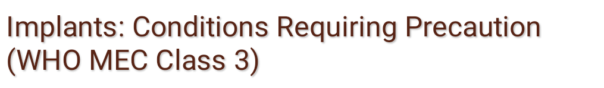
Implants are not recommended unless other methods are not available or acceptable if woman:
  Present evidence of DVT/PE
  Active viral hepatitis
  Severe decompensated cirrhosis
  Benign or malignant liver tumour
  History of breast cancer with no evidence of disease for the last 5 years
  Breast-feeding and less than 6 weeks postpartum
  Unexplained vaginal bleeding suggestive of a serious underlying condition (before investigation)
  Drug treatment affecting liver enzymes: rifampicin and certain antoconvulsants
172

Slide 173

Implants can be used safely in clients who:
  Raised blood pressure (> 160/100)
  Any history of hypertension where the blood pressure cannot be evaluated
  Hypertension with vascular disease
  Current or history of heart disease
  Diabetes with or without complications
  Migraine with or without aura
  Known hyperlipidaemia
  History of venous thromboembolic diseases (blood clotting
  Major surgery (with or without prolonged bed rest)
  Mild compensated cirrhosis
  Gallbladder disease
  Undiagnosed breast mass
  CIN
  Cervical cancer (awaiting treatment)
  ARV
173

Slide 174

Days 1 to 7 of the menstrual cycle
Anytime you can be reasonably sure the client is not pregnant
Postpartum:
  after 6 months if using lactational amenorrhea method (LAM)
  after 6 weeks if breastfeeding but not using LAM
  immediately or within 6 weeks if not breastfeeding
Post abortion (immediately or within the first 7 days)
174

Slide 175

Wash client’s entire arm and hand with soap and water prior to antiseptic prep.
Use sterile or high-level disinfected instruments, surgical gloves and other items.
After use, decontaminate all items.
Place disposables (needle and syringe) and waste items in a puncture-proof container prior to disposal.
Clean and final process reusable items by sterilization (or high-level disinfection).
175

Slide 176

Facts:
  Progestogens lead to lower tubal motility.
  Lower tubal motility may alter egg or zygote transport and lead to ectopic pregnancy.
Findings:
  No increased rate of ectopic pregnancy during effective life (5 years).
  Ectopic pregnancy is more likely (about 13%) if pregnancy occurs in Norplant implants users.
176

Slide 177

177

Slide 178

178
Notes:
Although nearly all users will experience side effects during 5 years of use, serious problems are rare and most can be alleviated with simple treatments. If side effects are not treated, however, they may prompt users to stop using implants. It is especially important to treat menstrual bleeding changesCwhich occur in most usersCbecause these changes are a common reason for discontinuation. This table shows treatments for the most common side effects.

Slide 179

Most interactions relate to increased liver metabolism of levonorgestrel:
  Rifampin (tuberculosis)
  Anti-epilepsy (seizures):
    Barbiturates, phenytoin, carbamzepine (but not valproic acid)
  Griseofulvin (long-term use only)
179

Slide 180

180

Slide 181

Keep incision area dry for 48 hours.
Keep pressure bandage on for 48 hours and leave bandange on until incision heals (3–5 days).
Bruising, swelling and tenderness at insertion site are common.
Routine work can be done immediately. Avoid bumping the area, carrying heavy loads or applying unusual pressure to incision site.
After healing, area can be touched and washed with normal pressure.
181

Slide 182

Contraceptive effectiveness begins 24 hours after insertion and stops soon after removal.
Changes in menstrual bleeding patterns are common.
Certain drugs may reduce effectiveness of implants. Tell your provider if you start any new drugs.
The removal of implants is necessary after effective period expires.
After removal, the fibrous sheath may be felt.
Reinsertion of another implant can be made immediately after removal of expired implant.
Use a condom if at risk for STIs (e.g., HBV, HIV and AIDS).
182

Slide 183

Return to clinic if any of the following occur:
  - Delayed menstrual period after several months of regular cycles (may be sign of pregnancy)
  Severe lower abdominal pain
  Heavy bleeding
  Pus or bleeding at insertion site
  Infection at insertion site
  Expulsion
  Migraine headaches
183

Slide 184

What are they?
These are small plastic device containing copper or steroid/ hormone that is placed high up in the uterus to prevent pregnancy.

Slide 185

Progestogen releasing:
  Progestasert
  LevoNova (LNG-20)
  Mirena
Copper-releasing:
  Copper T 380A
  Nova T
  Multiload 375
185

Slide 186
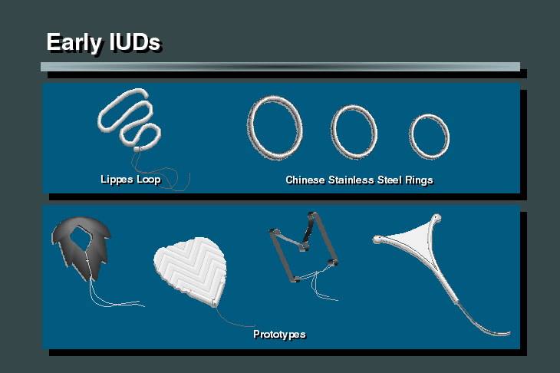

Slide 187
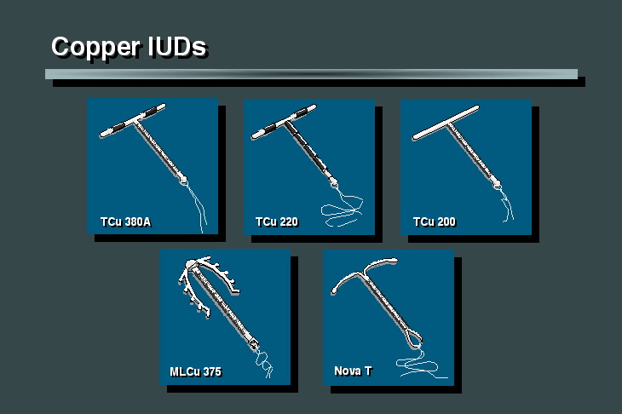

Slide 188
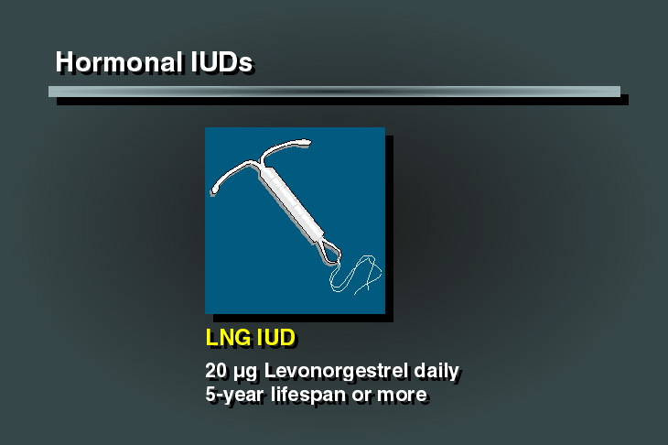

Slide 189

Interfere with reproductive process before ova reach uterine cavity (ova transportation acceleration)
Interfere with ability of sperm to pass through uterine cavity(sperm immobilisation)
Change endometrial lining (implantation prevention)
Thicken cervical mucus (fertilization interference)
189

Slide 190

This is 98% effective .
It is efffective immediately post insertion.
The levonorgestrel IUD has >99% effectiveness.

Slide 191

Highly effective (cumulative pregnancy rate of 2.2 per 100 women for Copper T 380A).
Effective immediately
Long-term method (up to 12 years protection with Copper T 380A)
Levonorgestrel IUD recommended for 5 years.
Do not interfere with intercourse
Immediate return to fertility upon removal
Do not affect breastfeeding
Can be used as an emergency contraceptive
191

Slide 192

Few side effects
After follow-up visit, client needs to return to clinic only if problems
No supplies needed by client
Can be provided by trained non-physician
Inexpensive (Copper T 380A)
192

Slide 193

Decrease menstrual cramps (progestogen-releasing only)
Decrease menstrual bleeding (progestogen-releasing only)
Decrease ectopic pregnancy (except Progestasert)
193

Slide 194

Pelvic examination MUST be performed
Requires trained provider for insertion and removal
Need to check for strings after menstrual period if cramping, spotting or pain
Woman cannot stop use whenever she wants (provider-dependent)
May cause changes in menstrual periods during the first few months and cramping (during the first 24-48 hours after insertion) (copper-releasing only)
May be spontaneously expelled
194

Slide 195

Rarely (< 1/1000 cases), perforation of the uterus may occur during insertion
May increase risk of PID where insertion has taken place under unsanitary conditions, or when the IUD is inserted in the presence of an undiagnosed STI
Levonogestrel- IUD may cause breast tenderness or pain, nausea and mood changes.
195

Slide 196

Women of any reproductive age or parity who:
  Want highly-effective, long-term contraception
  Are breastfeeding
  Are postpartum and not breastfeeding
  Are post abortion
  Are at low risk for STIs
  Cannot remember to take a pill every day
  Prefer not to use hormonal methods or
  should not use them
  Are in need of emergency contraception
196

Slide 197

Do not advise the use of any IUD or provide it to women with:
  Known or suspected pregnancy
  Puerperal or post-abortion sepsis current or within the last 3 months
  PID current
  STI current (STIs that may produce cervical infection, chlamydia or gonorrhea)
  Purulent cervicitis
  Confirmed or suspected malignancy of the genital tract
  Unexplained vaginal bleeding (suspicious for serious condition)
  Cervical cancer awaiting treatment; endometrial cancer
  Distorted uterine cavity
  Malignant gestational trophoblastic disease
  Known pelvic TB
197

Slide 198

IUDs are not recommended unless other methods are not available or acceptable if a woman has:
  Ovarian cancer
  Increased risk of STIs
  Initiation for women living with AIDS
  Benign trophoblastic disease
  From 48 hours to 4 weeks post-partum
198

Slide 199
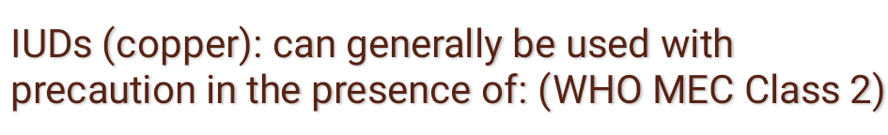
  Menarche to < 20 years of age
  Nulliparous
  < 48 hours post partum (copper IUD)
  Post abortion following second trimester abortion
  Cervical stenosis
  Complicated valvular heart disease
  Uterine fibroids without distortion of the uterine cavity
  PID without subsequent pregnancy
  Vaginitis without purulent
  Anemia (hemoglobin < 9 g/dl or hematocrit < 27)
  Painful menstrual periods
  Simple vaginal infection (candidiasis or bacterial vaginosis) without cervicitis
  Symptomatic valvular heart disease
199

Slide 200

STI/HIV/AIDS can affect IUD Eligibility
Category
Condition
 | Initiation | Continuation
Current STI, PID or purulent cervicitis | 4 | 2
High individual risk of STI | 3 | 2
AIDS | 3 | 2
AIDS and clinically well on ARV | 2 | 2
HIV positive | 2 | 2
Increased risk of STI | 2 | 2

Slide 201

Anytime during the menstrual cycle when you can be reasonably sure the client is not pregnant
Days 1 to 12 of the menstrual cycle
Postpartum insertion of IUD can be immediately following delivery, during the first 48 hours postpartum or after 4 weeks. Also levonorgestrel releasing IUD can be inserted after 4 weeks delivery
if the woman is breastfeeding or planning to breastfeed.
Post abortion (immediately or within the first 7 days) provided no evidence of pelvic infection
201

Slide 202

Pre-insertion:
  Wash hands before examining client.
  Wash genital area if hygiene poor.
Insertion:
  Put new or high-level disinfected gloves on both hands.
  Load IUD in sterile package.
  Clean cervical os (and vagina) thoroughly two times with antiseptic.
  Use “no touch” insertion technique.
202

Slide 203

Post insertion:
  Decontaminate all dirty items.
  Safely dispose of contaminated waste items.
  Wash hands after removing gloves.
203

Slide 204

(2)
Withdraw
inserter tube
(1)
Hold
plunger
204

Slide 205

Copper-releasing:
  Heavier menstrual bleeding
  Irregular or heavy vaginal bleeding
  Intermenstrual cramps
  Increased menstrual cramping or pain
  Vaginal discharge
Levonorgestrel releasing:
  Amenorrhea or very light menstrual bleeding/spotting
205

Slide 206

Missing strings
Slight increased risk of pelvic infection (up to 20 days after insertion)
Perforation of the uterus (rare)
Spontaneous expulsion
Ectopic pregnancy
Spontaneous abortion
Partner complaints about feeling strings
206

Slide 207

Special training for providers
Prenatal counselling for clients
No additional risk of infection, bleeding or perforation
Convenient for client
Cost effective
207

Slide 208

The IUD is effective immediately.
The IUD can come out of the uterus spontaneously, especially during the first few months.
Bleeding or spotting may occur during first few days.
Menstrual bleeding may change depending on type of IUD.
The IUD may be removed any time you wish. However, it is safe and effective for (x number of years) when using the (type of IUD).
IUDs do not provide protection against STIs, (e.g., HBV, HIV and AIDS.)
208

Slide 209

Return for a routine follow-up within 3 months, but not before the first menstrual period
During the first month after insertion, check the strings several times, particularly after your menstrual period.
Check strings after first month, only if you have:
  cramping in the lower part of the abdomen,
  spotting between periods or after intercourse, or
  pain after intercourse (or if your partner experiences discomfort during sex).
209

Slide 210

Client having menstrual cycle or switching from a non- hormonal method
Insert within seven days of menses and no need for backup.
If more than seven days after the menses rule out pregnancy, insert LNG-IUD and issue a backup method for the first seven days after insertion.
Client switching from a hormonal method if she had been using correctly and consistently insert immediately. No need to wait for menses or backup.
If switching from injectable LNG=IUD can be inserted when the repeat injection is due but will need a backup method for seven days after insertion.

Slide 211

Fully or nearly breastfeeding less than six months
Delay the insertion after 4 weeks post delivery
If the monthly period has not returned insert anytime between four weeks and six months. No need for backup method.
If more than six months after delivery and bleeding has not returned rule out pregnancy. Insert LNG-IUD and provide a backup method for seven days after insertion.
Partially breastfeeding or not breastfeeding
Delay insertion until the fourth week after delivery.
If more than four weeks after delivery and menses have not resumed insert LNG-IUD and provide a backup for the first seven days after insertion.
Amenorrhea not related to childbirth or breastfeeding rule out pregnancy, insert LNG-IUD and provide a backup for seven days after insertion.

Slide 212

Removal of the Copper T380A is necessary after 12 years but may be done sooner if you wish.
Return to your provider if you:
  cannot feel the strings,
  feel the hard part of the IUD,
  expel the IUD, or
  miss a period.
Use condoms if at risk for STIs.
212

Slide 213

Contact healthcare provider or clinic if you develop any of the following problems:
  Delayed menstrual period with pregnancy symptoms (nausea, breast tenderness, etc.)
  Persistent or crampy lower abdominal pain, especially if accompanied by not feeling well, fever or chills (symptoms suggest possible pelvic infection)
  Strings missing or the plastic tip of IUD can be felt when checking for strings
  Either you or your partner begin having sexual relations with more than one partner; IUDs do not protect women from STIs (e.g., HBV, HIV and AIDS)
213

Slide 214

Reassure client that menses generally are heavier with an IUD and bleeding/spotting may occur between periods, especially in first few months.
Evaluate for other cause(s) and treat if necessary.
If no other cause(s) found, treat with nonsteroidal anti-inflammatory agent (NSAID, such as ibuprofen) for 5-7 days.
Counsel on options and consider IUD removal if client requests.
214

Slide 215

Reassure client that cramping and menstrual pain (dysmenorrhea) may occur with an IUD, especially in first few months.
Evaluate for other cause(s) and treat if necessary.
If no other cause(s) found, consider treating with acetaminophen or ibuprofen daily with onset of menses.
Counsel on options and consider IUD removal if client requests.
215

Slide 216

Discuss client/couple's concerns, reassure it is not a serious problem and requires treatment only if really bothersome.
Check to be sure IUD is not partially expelled.
If IUD is in place, treatment options are:
  cut string, or
  remove IUD if client desires.
216

Slide 217

When cutting the string:
  Cut string so it does not protrude from cervical os.
  Explain that IUD string now is located at opening of cervical os, and she will not be able to feel it.
  Note in record that string has been cut flush with the cervix (important for follow-up and future removal).
217

Slide 218
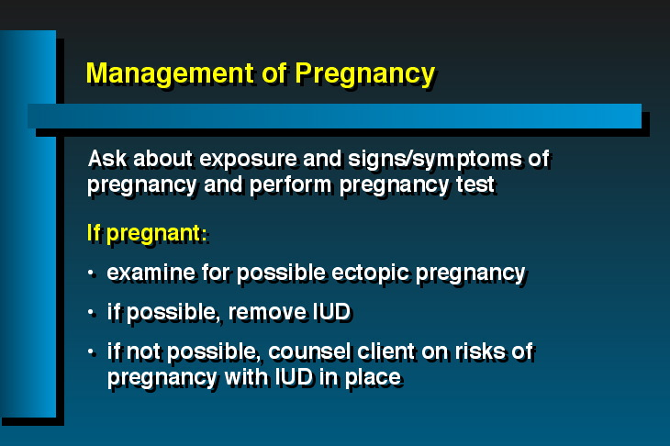

Slide 219
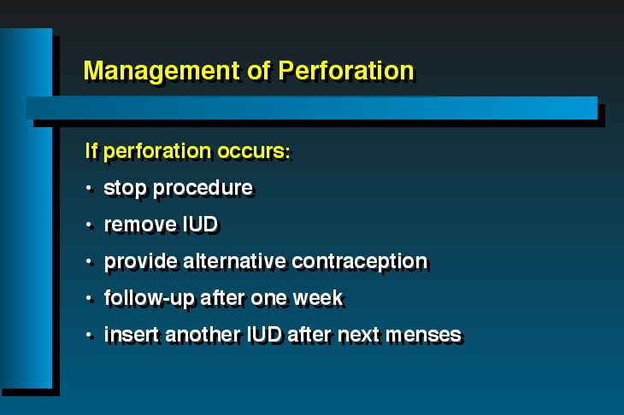

Slide 220

Anytime the client desires
At the end of effective life of the IUD
  TCu 380A = 12 years
If change in sexual practices (high risk behavior), consider adding barrier method (condoms) or removal.
If treated for STI or documented pelvic infection.
Menopause
220

Slide 221

Insertion only during menses
Age restrictions (young and old)
Parity criteria (less than 2 living children)
Marital status/spousal consent requirements
Inappropriate "contraindications" (immediate postpartum, valvular heart disease)
Process hurdles (too many pre- or followup visits)
Who can provide (physicians only)
Provider bias (provider does not recommend)
221

Slide 222

What are they?
These are ways by which a couple will learn to achieve or avoid a pregnancy by applying proper sexual behavior during the fertile and infertile phases of the menstrual cycle.

Slide 223

Calendar or rhythm Method (Ogino-Klaus)
Basal Body Temperature (BBT)
Cervical Mucus Method (Billings)
Sympto-thermal (BBT + cervical mucus)
Standard days method(cycle beads)
Coitus interruptus
223

Slide 224
For contraception:
  Avoid intercourse during the fertile phase of the menstrual cycle when conception is most likely.
For conception:
  Plan intercourse near mid-cycle (usually days 10-15) when conception is most likely.
224

Slide 225

Method | Theoretical (%) | Use (%)
Calendar/ rhythm method | 91-99 | 80
Basal body temperature | 93.4 - 97 | 90 - 94
Cervical mucus (Billings method) | 98 | 75 - 90
Symptothermal | 65.6- 95 | 90
Standard day method (cycle beads) | 95 | 88
Coitus interruptus | 91 | 81

Slide 226

Can be used to prevent or achieve pregnancy
No method-related health risks
No systemic side effects
Inexpensive
226

Slide 227

Improved knowledge of reproductive system
Possible closer relationship between couple
Increased male involvement in family planning
227

Slide 228
Moderately effective (1-25 pregnancies per 100 women during the first year of use)
Effectiveness depends on willingness to follow instructions
Considerable training required to use correctly
Requires trained provider (non-medical) to instruct about methods
Requires abstinence or use of another method (such as condoms) during fertile phase to avoid conception
228

Slide 229

Requires daily record keeping
Vaginal infections make cervical mucus difficult to interpret
Basal thermometer needed for some methods
Does not protect against STIs (e.g., HBV, HIV and AIDS)
229

Slide 230

Women/couples:
  Of any reproductive age
  Of any parity, including nulliparous women
  With religious or philosophical reasons for not using other methods
  Unable to use other methods
  Willing to abstain from intercourse for more than 1 week each cycle
  Willing and motivated to observe, record and interpret fertility signs
230

Slide 231

Women:
  Whose age, parity or health problems make pregnancy a high risk
  Without established menstrual cycles (breastfeeding, immediately post abortion)
  With irregular menstrual cycles (calendar method only)
  Whose partner will not cooperate (abstain) during certain times in the cycle
  Who dislike touching their genitals
231

Slide 232

Irregular menses
Persistent vaginal discharge
Breastfeeding
232

Slide 233

Monitor length of at least 6 menstrual cycles while abstaining or using another contraceptive method. Then calculate when fertile days occur following the instructions below.
From number of days in longest cycle, subtract 11. This identifies the last fertile day of cycle.
From number of days in shortest cycle, subtract 18. This identifies the first fertile day of your cycle.
For example, if the last 6 cycles were: 28, 26, 29, 27, 29, and 27 days long:
  The first day of the fertile phase = 26-18=8
  The last day of the fertile phase=29-11=18
Accordingly, sexual intercourse should be avoided from days 8-18 of the menstrual cycle (both days inclusive)
233

Slide 234

Infertile
Cover Line
234

Slide 235

Thermal Shift Rule:
Take temperature at about same time each morning (before rising) and record temperature on chart provided by NFP instructor.
Use temperatures recorded on chart for first 10 days of menstrual cycle to identify highest of “normal, low” temperatures (i.e., daily temperatures charted in typical pattern without any unusual conditions).
Disregard any temperatures that are abnormally high due to fever or other disruptions.
Draw a line 0.05-0.1°C above highest of these 10 temperatures. This line is called the cover line or temperature line.
235

Slide 236

The infertile phase begins on the evening of the third consecutive day that temperature stays above the cover line (Thermal Shift Rule).
Abstain from sexual intercourse from the beginning of menstrual period until beginning of infertile phase.
If any of 3 temperatures falls on or below cover line during 3-day count, this may be a sign that ovulation has not yet taken place. To avoid pregnancy, wait until 3 consecutive temperatures are recorded above cover line before resuming intercourse.
After infertile phase begins, you may stop taking temperature until next menstrual cycle begins and continue to have intercourse until first day of next menstrual period.
236

Slide 237

As mucus may changes during the day, observe it several times throughout the day. Every night before going to bed, determine highest level of fertility and mark chart with appropriate symbol.
Abstain from sexual intercourse for at least 1 cycle so that you will know the mucus days. Avoid intercourse during your menstrual period.
During dry days after period, it is safe to have intercourse.
As soon as any mucus or sensation of wetness appears, avoid intercourse or sexual contact.
237

Slide 238

Mark last day of clear, slippery, stretchy mucus with an X. This is the peak day, the most fertile time.
After the peak day, avoid intercourse for next 3 dry days and nights. These days are not safe.
Beginning on the morning of the fourth dry day, it is safe to have intercourse until your menstrual period begins again.
238

Slide 239

After menstrual bleeding stops, you may have intercourse on the evening of every dry day during infertile days before ovulation.
The fertile phase begins when wet vaginal sensations or any mucus appears. Abstain from intercourse until fertile phase ends.
Abstain from intercourse until both peak day and thermal shift rules have been applied.
When these rules do not identify the same day as being the end of the fertile phase, always follow rule that identifies the longest fertile phase.
239

Slide 240

To prevent pregnancy the couple abstains from sex, uses barrier method or withdraw on day 8 to 19 of the cycle formula based on computer analysis of thousands of menstrual cycles. The use of SDM is facilitated by cycle beads, a color coded strings of beads that represent the days of the cycle.
Important to note the is method works with women whose menstrual cycle is between 26 to 32 days.
Breastfeeding women or those who are using, or recently have used, contraceptive injectables need to wait a few cycles before they can use SDM.

Slide 241

What it is?
The man withdraws his penis from his partner’s vagina and ejaculates outside the vagina keeping his semen away from her external genitalia.

Slide 242

An alternative family planning method to be given until the man learns to use the withdrawal method correctly.
Note men who have difficulty with sensing ejaculation and those who get premature ejaculation this method may be unfavorable.
If ejaculation occurs before withdrawal the female client must be referred for emergency contraception.

Slide 243

What are they?
These are methods that prevents the sperms from gaining access to the upper reproductive tract thus preventing it from meeting the egg.

Slide 244

TYPES:
Male condom
Female condom
Diaphragm
Cervical cap
Spermicides: foaming tablets, creams, suppositories, jellies and film.

Slide 245

NO | METHOD | THEORETICAL | USE
1 | Male latex condom | 98% | 95-97%
2 | Female condom | 98% | 95-79%
3 | Diaphragm | 97% | 82%
4 | Spermicides | 97% | 79%

Slide 246

What is it?
Male condom is a thin latex rubber sheath which is put over the erect penis before sex and is removed immediately after ejaculation.

Slide 247

Types include;
  Plain Condoms
  Lubricated condoms
  Spermicide lubricated
  Flavored condoms

Slide 248

It is the only scientifically proven method that protects against HIV/STI transmission and pregnancy (Dual protection) with consistent and proper use.
Highly effective when used properly
Effective immediately
Do not affect breastfeeding
Do not interfere with intercourse
Can be used as backup to other methods
No method-related health risks
No systemic side effects
No prescription or medical assessment necessary

Slide 249

Varied effectiveness as contraceptives depends on willingness to follow instructions
User-dependent (require continued motivation and use with each act of intercourse)
It can be damaged by oil based lubricants, excessive heat, humidity and light

Slide 250

Men wishing to participate actively in family planning
Couples who have sexual intercourse infrequently
People in casual sexual relationships where pregnancy is not desired.
Couples needing a back up method wile waiting for another contraceptive method to become effective
Couple who need temporary method while waiting to receive another contraceptive method
Those who are at an increased risk of STIs
Couples where one or both of the partners are HIV/Positive

Slide 251

Individuals allergic to latex (material of which the male condom are made), should consider other contraceptive options. However, for those at risk for STI/HIV, condom use I still appropriate as there are no other methods that offer STI/HIV protection.
Couples who want highly effective protection against pregnancy E.g. where a woman has a condition that makes pregnancy an unacceptable risk and therefore needs to consider a more reliable method.

Slide 252

Ensure there is adequate lighting
Check expiry date – if date of manufacture is available, add 5 years to determine date of expiry
Press the condom pack to determine presence of air
Identify serrated edge and push condom downwards away from the cutting edge
Do not use teeth to cut open the condom pack
Insert condom on an erect penis, roll condom to the base of penis
Before insertion, press the tip of condom to expel air
Removal of condom after use should be done when penis is still partially erect

Slide 253

Thin sheath of polyurethane plastic with polyurethane rings at either end. They are inserted into the vagina before intercourse.
253

Slide 254

Prevent sperm from gaining access to female reproductive tract
Prevent microorganisms (ST1s) from passing from one partner to another
254

Slide 255

Effective immediately
Do not affect breastfeeding
Do not interfere with intercourse (may be inserted up to 8 hours before)
Can be used as backup to other methods
No method-related health risks
No systemic side effects
No prescription or medical assessment necessary
Controlled by the woman
255

Slide 256

Provides protection against STIs, including HIV with consistent and proper use.
May help prevent cervical cancer
Easy to use with little practice.
No health risks associated with the method
Can be used by almost every woman.
256

Slide 257

Cost
Varied effectiveness as contraceptives depends on willingness to follow instructions
User-dependent (require continued motivation and use with each act of intercourse)
257

Slide 258

Disposal of used condoms may be a problem
Adequate storage must be available at the client’s home
Supplies must be readily available before intercourse begins
Re-supply must be available
258

Slide 259

Women:
Who prefer not to use hormonal methods or cannot use them (e.g., smokers over 35 years of age)
Who prefer not to use IUDs
Who are breastfeeding and need contraception
Who want protection from STIs and whose partners will not use condoms
259

Slide 260

Couples:
Who need contraception immediately
Who need a temporary method while awaiting another method (e.g., implants, IUD or voluntary sterilization)
Who need a backup method
Who have intercourse infrequently
In which either partner has more than one sexual partner (at high risk for STIs, including HBV and HIV and AIDS), even if using another method
260

Slide 261

Couples:
In which pregnancy would pose a serious health risk to the woman
Who are allergic to polyurethane
Who need a highly effective method of contraception
Who want a long-term contraceptive method
Who want a method not related to intercourse
Not willing to use correctly and consistently with each act of intercourse
261

Slide 262

Use a new condom every time you have intercourse.
The female condom can be inserted up to 8 hours before intercourse.
Wash hands with soap and water.
Remove the condom from the package. Do not use teeth, knife, scissors or other sharp utensils to open package.
Hold the condom with the open end down.
Use the thumb and middle finger to squeeze the flexible ring at the closed end into a narrow oval.
262

Slide 263

With your other hand, spread the lips of your vagina.
Insert the ring and sheath into the vagina.
Use your index finger to push the ring as far as possible into the vagina.
Insert a finger into the condom until it touches the bottom of the ring.
Push the ring up past the pubic bone.
Make sure the outer ring and part of the sheath are outside the vagina over the vulva.
263

Slide 264
Take care to be sure the penis enters the sheath and stays within the sheath during intercourse.
Do not use the female condom with a male condom.
After withdrawal, twist the outer ring and gently pull out the condom. Remove the condom before you stand up.
Each condom should only be used once.
Dispose of used condoms by placing in a waste container, in latrine or burying. Do not flush the condom down the toilet.
264

Slide 265
Keep an extra supply of condoms available. Do not store them in a warm place or they will deteriorate and may leak during use.
Check date on condom package to ensure that it is not out of date.
Do not use a condom if the package is broken or the condom appears damaged or brittle.
265

Slide 266

If a client does not wish to be pregnant, and
she:
  did not use a condom properly
  forgot to use a condom when she had intercourse
  thinks the condom may have been broken
  thinks that condom had a tear
266

Slide 267

Dual protection is using male or female condoms to prevent both pregnancy and HIV/ STIs.
Dual method use is using two methods to prevent both pregnancy and infection.

Slide 268

Dual protection against pregnancy and infection is of major importance to prevent transmission of HIV, and infection with STIs. Providers of family planning services may overlook the importance of disease prevention in their attempt to provide the most effective method of contraception, just as providers working in HIV/AIDS may tend to overemphasize protection from infection and forget about the need for contraception.
For some men and women, it is easier to justify condom use when it is used for family planning, not disease prevention; for others who are aware of their individual infection risks, protection from disease is a main motivation for condom use.

Slide 269
Always consider the need for dual protection from pregnancy and STI/HIV when providing health services to people with HIV.
People living with HIV are often concerned about preventing infection (STI and HIV) and pregnancy at the same. Providers should be aware of these dual needs whenever they see people with HIV

Slide 270

Options for protection from infection and pregnancy :
Male and female condoms are the only contraceptive method that can protect against both at once. Some family planning providers may be biased against using condoms for contraception because they feel condoms are not as effective at preventing pregnancy as other methods.
Back-up method for condom failures, such as emergency contraception should be explained. Emergency contraceptive pills (ECPs) can be offered to minimize risk of pregnancy in case condom breaks or was not used, however in such cases women will still be exposed to STI/HIV risk.

Slide 271
Condoms plus any other method of contraception – male or female condoms can be used with most other methods - hormonal methods, the IUD, and sterilization - for maximum pregnancy prevention. However providers should be aware that when pregnancy prevention is the primary goal, couples may use condoms less when they have a second, highly effective contraceptive method – they will need strong motivation and support to keep using condoms
Family planning method without condoms - in mutually monogamous couples where both partners are HIV positive or negative. This is considered a safe strategy.
Other safer sex (non penetrative sex) - This includes any sexual activities during which there is no direct genital contact or exchange of bodily fluids (semen, blood, or other secretions) and which prevents infection (STI/HIV) and unwanted pregnancy.
Practice safer sex.

Slide 272

Effectiveness of methods for pregnancy prevention
High | Low | None
Implants Vasectomy Female Sterilization IUD Injectables The Pill Mini-Pills LAM Male condom Female Condom | Diaphragm Fertility awareness based methods Spermicides Withdrawal | No method

Slide 273

What it is?
VSC is a surgical means of permanently terminating fertility voluntarily.
This can be conducted on the male or female client.

Slide 274

Tubal Ligation (Female Volutary Sterilization
  Laparoscopy
  minilaparatomy
Vasectomy (Male voluntary sterilization)

Slide 275

Vasectomy: In men the tubes through which sperms travel from the testes to the penis(vas deferens) are tied and cut so that sperm can no longer enter the semen that is ejaculated
Tubal Ligation: In women both fallopian tubes are tied and cut using a modern operation Mini-Lap) so that the ovum cannot travel through them to meet the sperm and be fertilized

Slide 276

Tubal ligation |  | Vasectomy
Theoretical | Use effectiveness | Theoretical | Use effectiveness
99.8% | 99.6% | 99.9% | 99.85%

Slide 277

Surgery is relatively fast (usually less than 30 minutes);
Very appropriate for couples who already have the number of children they want;
Requires only a single procedure and therefore is inexpensive in the long term;
Procedures are very safe, and major complications are rare;
Does not require hospitalization;
Does not interrupt love-making

Slide 278

May cause pain and skin discoloration in area of incision (treatable)
May cause swelling and discoloration of scrotum (treatable)
Sexual relations must cease until 2 or 3 days after the procedure and can resume then only if there is no discomfort;
A condom or another method needs be used until after 20 ejaculations

Slide 279

Vasectomy offers no protection against STI/HIV

Slide 280
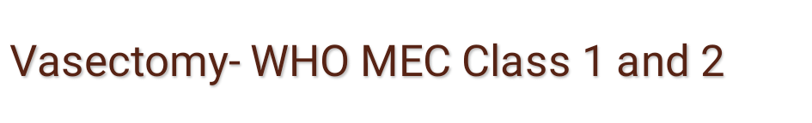
Who can have vasectomy?
In general, the majority of men who want vasectomy can have a safe and effective procedure in a routine setting, provided they have been counseled.
They should also be able to give informed/written consent. Men who may consider sterilization include:
Those who are certain that they have achieved their desired family size
Men who want a highly effective permanent contraceptive method
Men whose wives face unacceptable risk in pregnancy

Slide 281

Who should not have vasectomy?
There are no medical conditions that would absolutely restrict a man's eligibility for vasectomy. Some conditions and circumstances indicate that the procedure should be delayed, or that certain precautions be taken.
Local infections (scrotal skin infection, balanitits, epididymitis, or orchitis)
Current STI
Systemic infection or gastroenteritis
Men or couples who are not certain that they have completed their family size
Men making decision due to social problems:
Men or couple who have not understood that Vasectomy is permanent

Slide 282

Previous scrotal injury
Cryptorchidism (undescended testes)
Diabetes
Inguinal hernia

Slide 283

One week after the operation for semen analysis, or after 20 ejaculations
One week after the operation for removal of stitches

Slide 284

Bleeding at the incision site or internally.
Infection at the site of the incision or internally.
Injury to abdominal organs.
Blood clots in scrotum.

Slide 285

Types of Vasectomy Techniques
Scapel vasectomy
No – scapel vasectomy

Slide 286

Private;
Permanent
Very appropriate for couples who already have the number of children they want;
Requires only a single procedure and therefore is inexpensive in the long term;
Procedures are very safe and major complications are rare

Slide 287

Large studies indicate that less than 1% case experience serious complications, which may include: anesthesia-related problems (mostly related to over-sedation); hemorrhage uterine perforation; bowel/bladder injury; infection; and failure to occlude the tube (sterilization failure);
Ectopic pregnancy is a potential and serious long-term complication. Although pregnancy is a rare complication post-VSC. if a woman does become pregnant as a result of sterilization failure there is a significant chance that the pregnancy will be ectopic

Slide 288
Minor complications such as slight bleeding and wound infection occur in less than 5% of cases. Most complications can be avoided by provision of services which emphasize optimal infection practices thorough client screening and counseling; light sedation and local anaesthesia; careful monitoring of vital signs during and after the procedure (during recovery time); close attention to aseptic technique; and careful and gentle surgical technique.

Slide 289

Tubal ligation offers no protection against STI/HIV

Slide 290

Who can have tubal ligation?
In general, the majority of women who want tubal ligation can have a safe and effective procedure in a routine in a health facility equipped the service, provided they have been counseled. They should also be able to give informed consent. Women who may consider tubal ligation include:
Those who are certain that they have achieved their desired family size
Women who want a highly effective permanent method of contraception
Women for whom pregnancy presents unacceptable risk like:

Slide 291

women who have had four or more previous caesarean sections:
Women with medical conditions
Couples or women who understand and voluntarily give informed consent for the procedure.
Who should not have tubal ligation?
There are no medical conditions that would absolutely restrict a woman's eligibility for tubal ligation. Some conditions and circumstances indicate that the procedure should be delayed; or that certain precautions be taken.

Slide 292

Pregnancy
Postpartum (between day seven and six weeks)
Immediately/early postpartum if woman had severe pre-eclampsia, prolonged rupture of membranes (24 hours or more), sepsis, severe ante partum hemorrhage, or severe trauma to genital tract
Complicated abortion (infection, haemorrhage)
Current deep venous thrombosis
Current ischemic heart disease
Unexplained vaginal bleeding (before evaluation)

Slide 293

Malignant trophoblastic disease
Current PID or purulent cervicitis
Current gall bladder disease
Acute respiratory disease
Severe anaemia
Acute respiratory disease
Abdominal skin infection
Evidence of peritonitis
Women or couples who are not certain of their desired family size
Women requesting tubal ligation because of social problems

Slide 294

Immediately after childbirth or within first seven days (if she made voluntary informed choice in advance)
Six weeks or more after childbirth
Immediately after abortion (if she made voluntary informed choice in advance)
Any other time provided pregnancy is ruled out (but not between seven days and six weeks postpartum
During caesarean section

Slide 295

The client should be advised to come back one week after the operation for removal of stitches

Slide 296
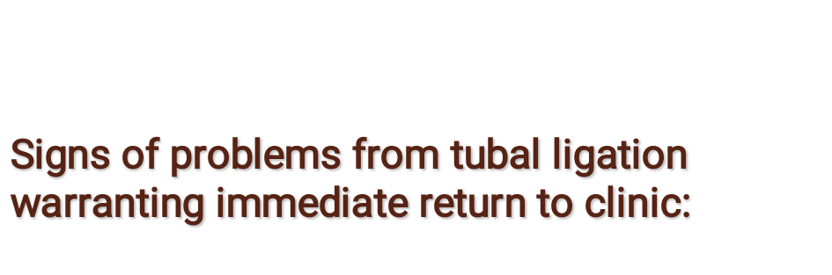
Severe bleeding at the incision site or internally
Infection at the incision site or internally
Injury to abdominal organs

Slide 297

During counseling using skills of interviewing and counseling BRAIDED methodology is used as below;
  Benefit: Permanent, Effective, No repeated decisions or expenses
  Risks: Not 100% operations are very difficult to reverse and may not be successful.
  Alternatives: All other reversible contraceptive methods available are explained
  Inquiries: Client is encouraged to ask questions, myths and misinformation should be cleared before hand.

Slide 298

  Decision: For the method can change. Client should feel free to change her/his mind. Decision is made on personal basis not because of your partner.
  Explanation: of the entire procedure, side effects and possible complications should be given in detail, including any medication which will be used.
  Documentation: of all personal particulars, method and timing of the sterilization.
Treatment and outcome of complications for future reference signing of consent forms.

Slide 299

Are there any situations in which you could imagine wanting a child later?
These may include:
  If you divorced.
  If your present relationship ended and you had a new partner who wanted to have a child with you.
  If one or more of your children died.
  If your financial situation improved significantly.
  If you wanted to fill the gap created when your children leave home.
  Consider alternative methods of birth control which are very effective.
  Discuss your decisions with your partner or talk to a friend or relative who has used the method. (optional)

Slide 300


