Slide 1
Florence Nightingale: Environmental Theory

Slide 2
Introduction
The Environmental Theory by Florence Nightingal defined Nursing
as “the act of utilizing the environment of the patient to assist him in his recovery.”
It involves the nurse’s initiative to configure environmental settings appropriate for the gradual restoration of the patient’s health, and that external factors associated with the patient’s surroundings affect life or biologic and physiologic processes, and his development.
Nightingale discussed the Environmental Theory in her book Notes on Nursing: What it is, What it is Not.

Slide 3
Major Concepts of Florence Nightingales Theory
Major Concepts of Florence Nightingales Theory
The major concepts of Florence Nightingale’s Theory are:
Nursing
“What nursing has to do… is to put the patient in the best condition for nature to act upon him” (Nightingale, 1859/1992)

Slide 4
Nightingale stated that nursing “ought to signify the proper use of fresh air, light, warmth, cleanliness, quiet, and the proper selection and administration of diet – all at the least expense of vital power to the patient.”
She reflected the art of nursing in her statement that, “the art of nursing, as now practiced, seems to be expressly constituted to unmake what God had made disease to be, viz., a reparative process.”

Slide 5
Human Beings
Human beings are not defined by Nightingale specifically. They are defined in relation to their environment and the impact of the environment upon them.
Environment
The physical environment is stressed by Nightingale in her writing. In her theory, Nightingale’s writings reflect a community health model in which all that surrounds human beings is considered in relation to their state of health.

Slide 6
Health
Nightingale (1859/1992) did not define health specifically. She stated, “We know nothing of health, the positive of which pathology is negative, except for the observation and experience. Given her definition that of the art of nursing is to “unmake what God had made disease,” then the goal of all nursing activities should be client health

Slide 7
Sub concepts of the Environmental Theory
The following are the sub concepts of Florence Nightingale’s theory:

Slide 8
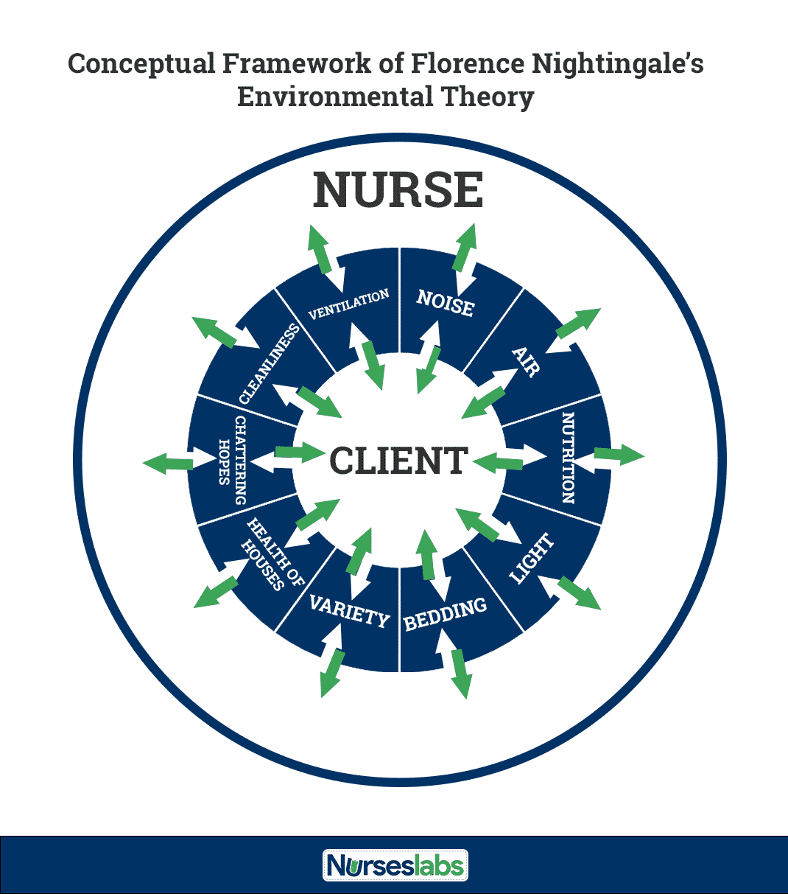

Slide 9
Health of Houses
“Badly constructed houses do for the healthy what badly constructed hospitals do for the sick. Once ensure that the air is stagnant and sickness is certain to follow.”
Ventilation and Warming
“Keep the air he breathes as pure as the external air, without chilling him.

Slide 10
Nightingale believed that the person who repeatedly breathed his or her own air would become sick or remain sick. She was very concerned about “noxious air” or “effluvia” and foul odors that came from excrement.
She also criticized “fumigations,” for she believed that the offensive source, not the smell, must be removed.

Slide 11
The importance of room temperature was also stressed by Nightingale. The patient should not be too warm or too cold.
The temperature could be controlled by an appropriate balance between burning fires and ventilation from windows.

Slide 12
Light
Nightingale believed that second to fresh air, the sick needed light. She noted that direct sunlight was what patients wanted.
Noise
She stated that patients should never be “waked intentionally” or accidentally during the first part of sleep. She asserted that whispered or long conversations about patients are thoughtless and cruel. She viewed unnecessary noise, including noise from female dress, as cruel and irritating to the patient.

Slide 13
Variety
She discussed the need for changes in color and form, including bringing the patient brightly colored flowers or plants.
She also advocated rotating 10 or 12 paintings and engravings each day, week, or month to provide variety for the patient.
Nightingale also advocated reading, needlework, writing, and cleaning as activities to relieve the sick of boredom

Slide 14
Bed and Bedding
Nightingale noted that an adult in health exhales about three pints of moisture through the lungs and skin in a 24-hour period. This organic matter enters the sheets and stays there unless the bedding is changed and aired frequently.
She believed that the bed should be placed in the lightest part of the room and placed so the patient could see out of a window. She also reminded the caregiver never to lean against, sit upon, or unnecessarily shake the bed of the patient

Slide 15
Personal Cleanliness
“Just as it is necessary to renew the air round a sick person frequently to carry off morbid effluvia from the lungs and skin, by maintaining free ventilation, so it is necessary to keep pores of the skin free from all obstructing excretions.”
“Every nurse ought to wash her hands very frequently during the day.”

Slide 16
Nutrition and Taking Food
Nightingale noted in her Environmental Theory that individuals desire different foods at different times of the day and that frequent small servings may be more beneficial to the patient than a large breakfast or dinner. She urged that no business be done with patients while they are eating because this was a distraction.

Slide 17
Chattering Hopes and Advice
Florence Nightingale wrote in her Environmental Theory that to falsely cheer the sick by making light of their illness and its danger is not helpful.
She encouraged the nurse to heed what is being said by visitors, believing that sick persons should hear the good news that would assist them in becoming healthier

Slide 18
Social Considerations
Nightingale supported the importance of looking beyond the individual to the social environment in which he or she lived

Slide 19
Environmental Factors
In Florence Nightingale’s Environmental Theory, she identified five (5) environmental factors: fresh air, pure water, efficient drainage, cleanliness or sanitation, and light or direct sunlight.
Pure fresh air – “to keep the air he breathes as pure as the external air without chilling him.”
Pure water – “well water of a very impure kind is used for domestic purposes. And when epidemic disease shows itself, persons using such water are almost sure to suffer.”

Slide 20
Effective drainage – “all the while the sewer maybe nothing but a laboratory from which epidemic disease and ill health is being installed into the house.”
Cleanliness – “the greater part of nursing consists in preserving cleanliness.”
Light (especially direct sunlight) – “the usefulness of light in treating disease is very important.”

Slide 21
Strengths
The language Florence Nightingale used to write her books was cultured and flowing, logical in format, and elegant in style.
Nightingale’s Environmental Theory has broad applicability to the practitioner.
Her model can be applied in most complex hospital intensive care environment, the home, a work site, or the community at large.
Reading Nightingale’s Environmental Theory raises consciousness in the nurse about how the environment influences client outcomes

Slide 22
Weaknesses
In Nightingale’s Environmental Theory, there is scant information on the psychosocial environment when compared to the physical environment. The application of her concepts in the twentieth century is in question

Slide 23
Conclusion
The Environmental Theory of Nursing is a patient-care theory. It focuses on the alteration of the patient’s environment in order to affect change in his or her health. Caring for the patient is of more importance rather than the nursing process, the relationship between patient and nurse, or the individual nurse

Slide 24
In this way, the model must be adapted to fit the needs of individual patients. The environmental factors affect different patients unique to their situations and illnesses, and the nurse must address these factors on a case-by-case basis in order to make sure the factors are altered in a way that best cares for an individual patient and his or her needs

Slide 25
THANKS A LOT FOR YOUR TIME & PARTICIPATION

