Slide 1
Formulations of drugs
Mr. Okoth

Slide 2
Learning objectives
Outline the types of drug formulations
Describe the types of solid formulations
Describe liquid formulations
State the types of topical preparations
Describe injectable formulations and their packages

Slide 3
Formulations of drugs
Drugs can be given to a person in a variety of formulations.
Formulation is a particular state in which the drug is supplied to the patient.
It can be either solid, semisolid or liquid formulation.

Slide 4
Formulations …
The type of formulation given to a patient depends upon the type of patient and the condition of the patient (such as age, sex, and health condition).
Also, the type of formulation is specific for particular routes of administration.

Slide 5
Solid Formulations
Solid formulations are generally given orally and are the most commonly used formulation.
Tablets
Solid drugs are mostly administered in the form of tablets.
The tablet is disc shaped and is made by compressing a granulated powder in a die of the suitable machinery.
It is made up of inert filler material since the drug may be required only in small quantities.

Slide 6
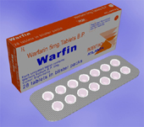
Tablets in Blister packs

Slide 7
Tablets
To help the tablet disintegrate in the GI tract it is coated with a substance like starch which swells up when in contact with fluid , such substances are called excipients.
Binding agent is added to hold the tablet together and finally lubricating material to prevent the tablet from sticking during manufacture.

Slide 8
Tablets
Tablets can be sugar coated or film coated.
Some are given as chewable tablets and flavourings can be added. These are called Dragees (``dra-jays``).

Slide 9
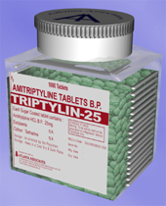
Loose tablets in a tin

Slide 10
Enteric Coated Tablets
Enteric coated tablets are coated with a material that does not disintegrate in the acidic medium of the stomach but disintegrates in the alkaline medium of the intestine.
These have ``EC`` written on their cover and it is essential that these drugs are not crushed and swallowed.

Slide 11
Enteric coated tablets …
Some of these preparations are made in such a way that small portions of the drugs are enteric coated into tiny balls and are enclosed in a capsule.
This can be opened and sprinkled on a suitable medium and then swallowed.

Slide 12
Sustained Release (SR) Preparations
SR drugs are formulated to be released slowly into the digestive tract.
This is useful of drugs that have a short half-life.
Also called slow release or retard release.
This is also done to improve the compliance to the drug.
The drug is embedded in a matrix of relatively inert material such that the drug release is slow.

Slide 13
SR Preparations
The drug can be prepared in layered tablets such that each layer of drug is coated by some inert material and hence once the layer disintegrates the drug is released. Until the next layer is disintegrated there is no further release of drugs.

Slide 14
SR preps…
SR drug can be made in the form of pellets which are coated by different thickness of the inert material and the one with the thinnest coating would disintegrate the fastest and the others would follow accordingly.
These pellets are then filled in capsules also called spansules and tablets called durules.

Slide 15
Controlled Release Tablet
In controlled release tablet the drug is covered with a semi permeable membrane and a hole is punctured through this membrane with the help of a laser.

Slide 16
Controlled release tablet
Once the tablet enters the GI tract the water seeps inside through the hole and the tablet swells and due to the difference in the osmotic pressure the drug is released.
These drugs would have CR or SR written on the cover.

Slide 17
Other tablet types
Dispersible or effervescent tablets
  These tablets are designed to be added to water just prior to swallowing.
Oro-dispersible tablets
  Oro-dispersible tablets are designed to disperse in the mouth and to be washed down with saliva. E.g. melts

Slide 18
Tablet types
Melts
  Melt tablets are placed on the tongue and are designed to dissolve directly in the mouth's saliva.
  The contents are then swallowed with saliva and consequently water does not have to be administered with these medicines.
  This is particularly useful in patients who are at risk of aspiration and therefore unable to swallow tablets with water concurrently.

Slide 19
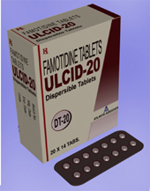
Dispersible tablets

Slide 20
Tablet types
Sub-lingual tablets
  These tablets are designed to be dissolved under the tongue, are rapidly absorbed through the tongue and therefore work quickly.

Slide 21
Capsules
Capsules are easier to swallow and are used by manufacturers when the drug can’t be compacted into a solid tablet.
They are also useful when the drug needs to be mixed with oil or other liquid to aid absorption in the body.
It is normally a shell or container made of gelatin that contains the drug.
There are two types of capsules, hard or soft.

Slide 22
Capsules
Hard capsules
Hard capsules contain the drug in solid form
Hard capsules, which are more commonly seen, are made up of a rigid shell in two pieces that fit together and is then filled with the drug.
This formulation is normally more suitable for drug powders and can only be used if the drug will be easily dissolved in the stomach.

Slide 23
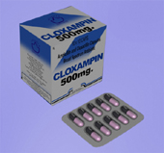
Capsules

Slide 24
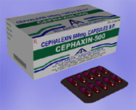
Capsules

Slide 25
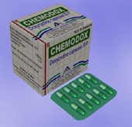
Capsules

Slide 26
Capsules
Soft capsules
Soft capsules contain the drug either in liquid or semi-solid form.
Soft capsules are useful for drugs that are hard to dissolve in water.
These are dissolved in liquids such as propylene or glycol and can be easily absorbed in the GI tract.

Slide 27
Capsules … soft
Soft capsules are formed in a single piece and are more suitable for oils e.g. fish oils, or drugs that need to be dissolved in oils or other liquids to aid the drug to be absorbed in the stomach.
In soft capsules the drug is combined with an appropriate solvent in the centre of the capsule and the capsule shell melts within minutes in the stomach.

Slide 28
Capsules … soft
Once the capsule shell melts, drugs are easily absorbed from the mixtures.
This offers two distinct advantages: -
  1) quicker effect, which is good for immediate pain relief
  2) Drug absorbed more effectively, so lower doses can be used which in turn means the soft capsules can be made smaller, making swallowing easier.

Slide 29
Liquid formulations
Pharmaceutically produced liquid medicines can either be called liquids, solutions, syrups or mixtures.
Liquid medicines are largely designed for patients who are unable to swallow tablets or capsules and therefore are prescribed mainly for children and the elderly.
They are designed to ensure that the drug is dispersed evenly throughout.
The taste of the drug is masked by sweeteners and flavourings.

Slide 30
Liquid formulations
Water is the most commonly used solvent.
However, due to drug Instability in water, some liquid medicines contain stabilizers.
Occasionally alternative liquid solvents such as glycerol or alcohol are used.
Where the drug doesn't dissolve in the liquid solvent manufacturers use suspending agents to ensure the even drug distribution.

Slide 31
Liquid formulations
A liquid medicine may contain:
  Stabilizer
  Colourant
  Flavouring
  Active drug
  Suspending agent or solvent
It is more complex than simply having a crushed tablet in water.

Slide 32
Oral Liquid Preparations
Such preparations are easier to swallow.
Flavourings can be added, but should not be given a lot of importance since drug abuse could occur.
Sugar is added in some cases but mostly sorbitol (a sugar alcohol) is now used.
Sorbitol is good since it acts as an osmotic laxative and can prevent drug abuse.

Slide 33
Oral liquid preparations
When the drug is insufficiently soluble in water then it is dissolved in alcohol. Such a drug is called an elixir.
In cases where the drug is used as a solid and alcohol is not used for dissolving, then such solutions are called suspension.
When liquid which is not soluble is used mixed with water then it is called emulsion. Such drugs should be well shaken before use.

Slide 34
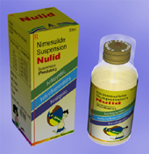
Oral liquid preparation

Slide 35
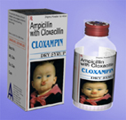
Dry powder for Oral suspension

Slide 36
Topical Preparations
The application of a drug to an area of the body for direct treatment is called topical application.
It is not restricted to the skin and hair but can be used in the mouth and entire GI tract during operations.
It is also used for the eyes, nose, ears and vagina.

Slide 37
Topical preparations
Drops: Eye and nose drops are made isotonic to avoid pain and discomfort on application.
The eye drops are either aqueous or oily suspensions to be put into the eye.
The nasal drops are aqueous since oily solution can hinder the ciliary action of the mucosa and also enter the trachea and lead to aspiration pneumonitis.
Ear drops are oily solutions that can adhere to the aural cavity.

Slide 38
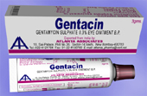
Eye ointment

Slide 39
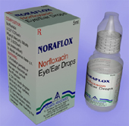
Eye/ear drops

Slide 40
Topical preparations
Creams and Ointments:
Mainly used for skin treatment.
Creams have an aqueous base such that the water evaporates quickly and the drug remains on the surface.
It remains on the superficial layer of the skin and very little is absorbed into the systemic circulation.
Ointments are lipid based. When they are applied on the body they shut off the skin from air and the sweating still occurs as a result of which the skin is softened and there is more penetration of the drug into the tissue. Absorption can be significant.

Slide 41
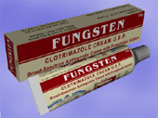
Topical cream

Slide 42
Topical preparations
Pastes: Pastes have powder and are water repellant and hence help in protecting the skin from moisture.
Gels and Lotions: are alcohol based and are useful in application where there is hair. Since the evaporation is fast very little of the drug penetrates.

Slide 43
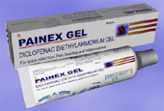
Topical gel

Slide 44
Suppositories
Suppositories:
Suppositories are designed for anal administration and usually consist of the active drug(s) and a base which is designed to melt at room temperature.
Once the suppository has been rectally administered the base will then break down and the drug will be released.

Slide 45
Enemas
are also preparations for rectal administration but are liquid.
These can be used for topical or systemic treatment and also for bowel movement.
For topical and systemic applications the solution is hypotonic such that fluid will be taken up by the body along with the active ingredient.
In case of bowel motion the solution is hypertonic to cause an outward flow of water from the body into the distal portion of the digestive system.

Slide 46
Vaginal pessaries
Pessaries are solid, bullet-shaped preparations designed for easy insertion into the vagina.
They can be inserted using fingers, or may come with an applicator.
Pessaries are normally made of a solid vegetable oil that contains the medicine.
The medicine is gradually released into the vagina as the pessary dissolves at body temperature.
The drug should coat all the vaginal mucosa and for this the drug should be entered as high as possible into the vagina.

Slide 47

Vaginal pessaries

Slide 48
Injectable preparations
Injectable preparations can be: -
In liquid form
In powder form for reconstitution before administration
Preparations can be in aqueous solution, oily solution, or suspensions.

Slide 49
Injectable preparations
Such injectable drugs can be packaged in special containers such as: -
Ampoules
Vials
Bottles for I.V. infusion

Slide 50

Ampoules of Digoxin

Slide 51

Vials

Slide 52

Bottle for I.V. infusion

Slide 53
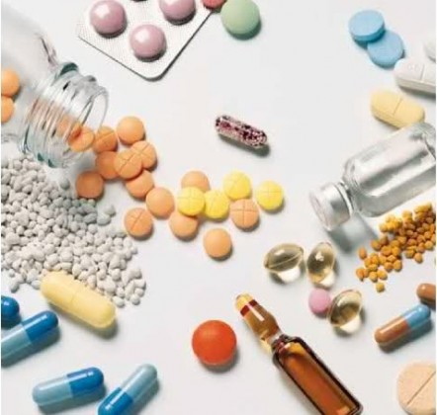
A picture showing different drug formulations
Can you name some of them?

Slide 54
Conclusion
What has been presented may not be all there is in the form of drug preparations!
Add to the list by doing further search!
THE END.

