Slide 1
Fractures of the clavicle
KELVIN

Slide 2
Introduction
incidence
  clavicle fractures make up ~4% of all fractures
demographics
  often seen in young active patients
  Associated with:
ipsilateral scapular fracture
scapulothoracic dissociation
  should be considered with significantly displaced fractures
rib fracture
pneumothorax
neurovascular injury

Slide 3
Mechanism of injury
  direct blow to lateral aspect of shoulder
  fall on an outstretched arm or direct trauma
pathoanatomy
  in displaced fractures, the sternocleidomastoid muscle pulls the medial fragment posterosuperiorly, while pectoralis and weight of arm pull the lateral fragment inferomedially
  open fractures buttonhole through platysma

Slide 4
Classification
Allman classification
Group I - Middle third (80-85%)
Group II - Neer Classification of Lateral third (10-15%)
Group III - Medial third (5-8%)

Slide 5
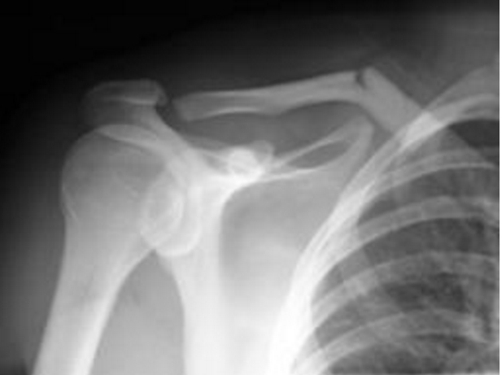
Image

Slide 6
Signs and symptoms
Symptoms
  shoulder pain
Physical exam
  deformity
  perform careful neurovascular exam
  tenting of skin (impending open fracture)

Slide 7
Imaging
Radiographs
  standard AP view of bilateral shoulders
    to measure clavicular shortening
  45° cephalic tilt determine superior/inferior displacement
  45° caudal tilt determines AP displacement
CT
  may help evaluate displacement, shortening, comminution, articular extension, and nonunion
  useful for medial physeal fractures and sternoclavicular injuries

Slide 8
Management
sling immobilization with gentle ROM exercises at 2-4 weeks and strengthening at 6-10 weeks
indications
  nondisplaced Group I (middle third)
  stable Group II fractures (Type I, III, IV)
  nondisplaced Group III (medial third)
  pediatric distal clavicle fractures (skeletally immature)

Slide 9
Sling Immobilization
technique
  sling or figure-of-eight (prospective studies have not shown difference between sling and figure-of-eight braces)
  after 2-4 weeks begin gentle range of motion exercises
  strengthening exercises begin at 6-10 weeks
  no attempt at reduction should be made

Slide 10
Management
open reduction internal fixation
indications
  absolute
    unstable Group II fractures (Type IIA, Type IIB, Type V)
    open fxs
    displaced fracture with skin tenting
    subclavian artery or vein injury
    floating shoulder (clavicle and scapula neck fx)
    symptomatic nonunion
    posteriorly displaced Group III fxs
    displaced Group I (middle third) with >2cm shortening

Slide 11
Complications
Nonoperative treatment
  nonunion (1-5%)
    treatment of nonunion
      if asymptomatic, no treatment necessary
      if symptomatic, ORIF with plate and bone graft (particularly atrophic nonunion)

Slide 12
Complications
Operative treatment
  hardware prominence
    ~30% of patient request plate removal
    superior plates associated with increased irritation
  neurovascular injury (3%)
    superior plates associated with increased risk of subclavian artery or vein penetration
    subclavian thrombosis
  nonunion (1-5%)
  infection (~4.8%)
  mechanical failure (~1.4%)
  pneumothorax
  adhesive capsulitis
    4% in surgical group develop adhesive capsulitis requiring surgical intervention

