Slide 1
ENVIRONMENTAL HEALTH NURSING
DIPLOMA IN COMMUNITY HEALTH NURSING
KMTC MWINGI CAMPUS
1ST YEARS, SEPTEMBER 2018
MODULE 11:
ENVIRONMENTAL HEALTH NURSING
Code: ENH 1103; Hours - 22; Credits - 3

Slide 2
Module Competence
This Module is designed to enable the learner promote health and prevent diseases

Slide 3
Module Units
Number Name Hours Theory Practical
1. Concepts of environmental health 12 0
2. Occupational health and safety 8 0
3. Educational visits 0 20

Slide 4
Module Outcomes
By the end of the module, the learner should: -
1. Apply basic knowledge to promote environmental Health
2. Prevent occupational related illnesses and hazards in work related environment
3. Observe environmental health activities that promote health

Slide 5
Module Content
Definitions
Types of environment and their effects
Food
Water
Housing
Excreta disposal
Air and ventilation
Pollution
Vectors and vermin control
Leadership and power structure
Rural and urban communities
Public health Act
Occupational health and safety Act
Educational field visits

Slide 6
Reference
1. Basavanthappa, B. (2013) Community Health Nursing 2nd Ed. New Delhi: Jaypee Brothers Medical Publishers.
2. Rukunga, G. (2010). Environmental Health for East Africa. 4th Ed. Nairobi
3. MOH, Kenya. (2012). Kenya Health Investment and Plan, 2012 – 2017
4. Wood, C. (2014), Community Health, Nairobi: AMREF

Slide 7
Mode of Learning
Interactive Lectures
Participatory learning
Group Discussions
Assignments

Slide 8
Definitions:
Environmental Health:
Comprises those aspects of human health, including quality of life, that are determined by physical, chemical, biological, social, and psychosocial factors in the natural environment. Or
It also refers to the theory and practice of assessing, correcting, controlling, and preventing those factors in the environment that can potentially affect adversely the health of present and future generations.
Community health
This is the science and art of preventing disease, prolonging life and health efficacy through organized community effort. Or
It’s the science and art of promoting health and preventing diseases through organized community participation.
Environment: The sum total of all surroundings of a living organism, including natural forces and other living things, which provide conditions for development and growth as well as of danger and damage.

Slide 9
Community health nursing
It’s a branch of nursing profession which deals with rendering nursing services within the community as opposed to the hospital setting.
It offers promotion, prevention and rehabilitation services in the community.
Community health nurse
This is a qualified KRCHN, who respects people’s cultures, maintain status congruence and ethics with all people at all times.
Nursing
Is a profession within the health care sector focused on the care of individuals, families, and communities so they may attain, maintain, or recover optimal health and quality of life.

Slide 10
Scope of practice of Environmental health.
The practice of environmental health by registered environmental health specialists in the public and private sector includes prevention of environmental health hazards and the promotion and protection of the public health and the environment in the following areas:-
Food protection.
Housing.
Institutional environmental health.
Land use.
Community noise control.
Recreational swimming areas and waters.
Electromagnetic radiation control.
Solid, liquid, and hazardous materials management.
Underground storage tank control.
Onsite septic systems.
Vector control.
Drinking water quality.
Environmental sanitation.
Emergency preparedness.
Milk and dairy products, etc.

Slide 11
Principles of environmental health
The maintenance and improvement of human condition is at the Centre of environmental health action.
The disadvantaged group within the society is often those that must live in the worst housing with poor environment conditions, work in most dangerous occupations, and that have limited access to a wholesome and varied food supply.
A range of governance issues that can be described as the conditions for civic engagement must be in place.

Slide 12
4. Cooperation and partnership - intersectoral approach.
5. Sustainable development and sustainability.
6. Environmental health issues are truly international in their character.

Slide 13
Types of environments
Physical environment (air, water, soil, whether)
Biological (plants, animals, micro-organisms)
Technological (internet, new technology)
Social/cultural (culture, family, religion, kinship)
Economic/Political (occupation, resources governance, infrastructure)

Slide 14
Water
Water quality
Properties of water
Water is a chemical compound consisting of two gases, hydrogen and oxygen in ratios 2;1 hence H2O.
Pure water should be, odourless, colourless, tasteless, and neutral ( PH7).
Water freezes at OC or 32 0 F and boils at 100C or 212 F.
Density of water is I gm/cc at 40 c ( max density )

Slide 15
5. Water is the greatest solvent known to science and due to this, it is never found pure in nature.
Temperature – the higher the temps of water the more it dissolves.
softness – the softer water is, the more soluble it becomes.
6. As water passes through the atmosphere, it absorbs CO2, forming carbonic acid which increases the solubility and enables water to dissolve lime and magnesium to form bicarbonates. Referred to as hard water.
7. Water is found in three forms in nature.
        solid – when frozen
        liquid – in aqueous form
        gaseous – in vapor form.

Slide 16
Physical characteristics of water.
Temperature
Pure water freezes atomic Oc and boils at 100 c.
2. Taste and odor.
Should be odorless and tasteless. But due to fact that, it dissolves impurities, organic in nature eg phenols and chloraphenols it may not be so.
3. Color
Even pure water is not colorless. It has a pale green – blue tint in large volumes. It is necessary to differentiate between true color due to material in solution and apparent color due to the suspended matter.

Slide 17
4. Turbidity – the presence of colloidal solids gives water cloud appearance which aesthetically unattractive and may be harmful.
5. Solids – these may be present in suspension or dissolved.
6. Electrical conductivity – the conductivity of solutions depends with TDS.

Slide 18
CHEMICAL CHARACTERISTICS OF WATER
PH: this measures the hydrogen ion concentration in water. Ranges in scale of 0 – 14 with 7 being neutral.
Hardness: this is the property of water being unable to form lather easily with soap and produces scale in hot water system.
Oxygen demand (OD): organic compounds are generally unstable and may be oxidised biologically or chemically to stable ,inert end product eg CO2, NO3, H2O.

Slide 19
4. Dissolved oxygen – this is most important element in water quality control. Its presence is essential to maintain the higher forms of biological life.
5. Biological oxygen Demand – this is the amount of water required by micro organisms to break down ( oxidize ) organic matter in given sample of water.
6. Chemical oxygen demand – sometimes chemical oxidizing agents are added to samples in attempt to oxidize chemically the material contained in the sample.

Slide 20
7. Total organic carbon (TOC) – this is equivalent to the total organic matter contend in water.
8. Total oxygen demand – this is amount of oxygen required to oxidize fully a sample of water.
9. Nitrogen – it has to be present for biological treatment of water to proceed.
10. Chlorides – they make water blackish and are an indication of sewage pollution because of the chloride content of urine.

Slide 21
Water sources
Rain water
surface water
Underground water
Sea water

Slide 22
Rain Water
Purest natural water if collected from clean iron sheets & stored well
Soft and effective in cleaning and washing
No micro-organisms if collected well

Slide 23
Rain water..
Disadvantages
Difficult to collect from some roofs (thatched)
Buildings require gutters & large tanks
Not tasty
Lacks essential minerals
Prone to atmospheric pollution

Slide 24
Underground water
Water found beneath the ground
Stored in porous rocks called acquifers
Will flow to the surface naturally at springs, seeps & wetlands
Wells can be contracted to tap it from the ground

Slide 25
Underground water cont….
Advantages
Usually clean
In plenty
Useful in times of draught
NOTE: may come from far away and may not dependent on local rain.

Slide 26
Underground water cont….
Disadvantages
Hard water due to the dissolved minerals.
Expensive to purify.
Costly in pumping from the ground to users

Slide 27
Surface water
Water in lakes, rivers, ponds, dams and shallow wells
Advantages
Commonest source of water
Easily accessible
Can be obtained by use of simple pumps.
Water in permanent lakes & rivers ensures.
constant supply all year

Slide 28
Surface water..
Disadvantages
Easily polluted(human, animal,industrial &agricultural waste)
Needs treatment before drinking

Slide 29
Sea water
Water collected in oceans
Very concentrated in salts(salty water)
Expensive to purify

Slide 30
Water Purification
There are 3 simple methods of purifying water are:
Storage
Filtration
Sterilization

Slide 31
Storage
Standing water kills many bacteria which are deprived of air
Suspended material settle(turbid water turns clear)
In small scale, can be done using the 3 pot system to stand water for 24 hours
In large scale, tanks can be used where the water stands for 3-7 days

Slide 32
Filtration
Can be done on small scale & large scale
Small scale –water filters can be used at home
In a large scale, sand filters are used
Layers of stone at the bottom, coarse sand, & fine sand at the top

Slide 33
Sterilization
In large scale done by chlorinating the filtered water.
Amount of chlorine proportionate to the volume.
Chlorine left for 30 minutes for it to be effective
In small scale done by boiling or adding chlorine or iodine.

Slide 34
Diseases associated with water
These can be classified as:
Water washed diseases
Water borne diseases
Water related diseases
Water based diseases

Slide 35
Water washed diseases
Diseases caused by lack of or inadequate water
Transmitted by fecal oral route due to lack of washing hands, dirty foods & utensils
Lack of personal hygiene (failure to wash hands, eyes, body)

Slide 36
Water washed diseases
Diarrhoea
Cholera
Bacillary dysentery
Skin diseases (e.g. scabies)
Eye diseases (e.g. trachoma
These diseases are prevented by increasing Quantity water available for use

Slide 37
Water borne diseases
They occur when the pathogen is in water , drunk by a person or animal eventually they become infected.
Water carries the organisms that cause these diseases.
Due to dirty water contaminated with the pathogen.
These diseases are prevented by increasing the Quality of water available for use.

Slide 38
Water borne diseases, cont..
Typhoid
Cholera
Poliomyelitis
Amoebiasis
Hepatitis A

Slide 39
Water related diseases
The final mechanism of water – related diseases is spread by insects which either breed in water or bite near water.
Water is essential in the life cycle of these organisms
  Malaria
  Schistosomiasis
  Onchocerciasis(river blindness)
  Dracunculosis(guinea worm)
  Trypanosomiasis(sleeping sickness)

Slide 40
Water based diseases
This is the one which the pathogen spends a part of its lifecycle or in an intermediate host which lives in water. Examples
Parasitic worms ( helminths ) e.g. shistomiasis which develop in snails until they are shed in to water as infective carcariae and reinfect man through the skin.
Guinea worm – its intermediate host is Cyclops, human infection occurs when following ingestion of water containing Cyclops.

Slide 41
Uses of Water
Human consumption for body needs
Animal watering
Industrial use for manufacturing
For recreational activities such as swimming
To produce electricity
Sustaining of aquatic life, for example, fish for consumption and export
Household purposes like washing and cooking

Slide 42
Water requirements
Every person requires about 2 litres of water a day for basic physiological needs
If water is fetched far, at least 1 KM away, people can manage with 6 litres per day
People who have a tap in the compound, use up to 25 litres a day
In houses with many taps & flush toilets, people will use 100 litres or more

Slide 43
NOTE:
Water washed diseases are the most common, the health of communities can be improved by increasing the quantities of water and then improving its quality
Water can have less minerals & lead to deficiency diseases (e.g. goitre) or excess minerals (e.g. fluorosis)

Slide 44
Water sampling & Testing
Used for large scale supplies of water
Mainly 2 methods
Bacteriological analysis
Chemical analysis

Slide 45
Bacteriological analysis
Water sample collected in 500 ml flask
Must be kept cold(4 C to 10 C)
Must be analysed in 30 minutes
Mainly done to detect E. Coli
Presence of E. Coli in large amounts indicates contamination by excreta

Slide 46
Chemical analysis
5 litres collected in a clean container
Water tested for various substances
Including
Ammonia
Softness & or hardness of water
Examination for cyanide & pesticides normally done within 24 hours

Slide 47
Pollution types
These include point and non- point source
Point source – from recognizable point e.g. effluent from industries
Non point source – pollutants diffusing to water sources from unidentified sources. E.g. agricultural sources.

Slide 48
Some water pollutants
Heavy metals – include lead, cadmium, manganese, copper, mercury etc. they have a tendency of being deposited on the surface of some soft and bone tissues and organs such as liver, kidney, lings etc.
Persistent organic pollutants – including poly – chloro – biphenyls ( PCBs) and organic pesticides such as chlorinated hydrocarbons e.g. dieldrins, DDT. They are cumulative in nature and can be passed from herbivores to secondary consumers.
Pathogens - biological pollutants e.g. E-coli counts exceeding WHO ranges. Others include streptococci, pseudomonas etc.

Slide 49
4. Decomposable organic matter - food remains and food processing effluents, rich in carbohydrates, as they decompose, they use dissolved oxygen from the water, causing a deficit in for the aquatic organisms hence creating oxygen demand.
5. Thermal pollutants – introduction to hot or cold effluents into a system causes changes in composition of aquatic organisms hence mesophils dominating.
6. Suspended matters – clay silt from soil erosion cause turbidity, reduce depth of sunlight penetration and thus affect photosynthesis.

Slide 50
7. Acids and bases – change the PH of the water body, thereby shifting the species composition within the system.
8. Oil pollution - block the air – water interaction hence interfering with gaseous exchange, reducing the amount of dissolved oxygen.
9. Nutrients – includes nitrates and phosphates which cause eutrophia.
10. helminthes/ worms – the infective stages of many parasitic roundworms and flat worms can be transmitted to man through drinking water.

Slide 51
SANITATION AND HEALTH

Slide 52
Defination:
Sanitation refers to all conditions that affect health, especially with regard to dirt and infection and especially to the drainage and disposal of sewage and refuse from houses.

Slide 53
Sanitation and disease transmission
Sources of disease
Inadequate and insanitary disposal of infected human faeces leads to the contamination of the ground and sources of water.

Slide 54
HOUSING
A combination of dampness, lack of light, poor ventilation and overcrowding will contribute to the spread of airborne and droplet infections.
Earth floors and walls permit the entry and breeding of flies and bedbugs, while unscreened windows permit entry of mosquitoes.
Cooking fires on the floor are hazards to small children. Inadequate space to talk and play, especially in town houses, is one of the reasons why fathers and children leave home thereby adding to social problems.

Slide 55
Types of Housing
Permanent Houses
Has a stone foundation
A cemented floor
Plastered walls.
The roof is covered with iron sheets, tiles or stones.
Is easy to keep the floor and walls clean.
The floor should be kept dry to avoid accidental falls.
Are not cheap to construct

Slide 56
Semi-Permanent Houses
The floor is usually cemented but does not necessarily have a stone foundation.
The walls are made of iron sheets or sometimes timber or mud bricks
The house is iron roofed.
Easy to keep clean.
Appropriate preservatives for timbers have to be used or else termites destroy it
It is less expensive than a permanent house.

Slide 57
Temporary Houses
The floor is earthen
the walls are made of cardboard, polythene paper, grass or mud.
The roof is thatched with the same material as the walls.
This type of a house does not provide for privacy
Can easily catch fire.
Are a health hazard and do not meet the requirements for good housing. They should be discouraged as much as possible.

Slide 58
Criteria for an Adequate House
Biological criteria
Physical criteria
Social criteria

Slide 59
Biological Criteria
Good housing minimizes the risk of transmission of diseases.
The spread of gastro-intestinal infections for instance is minimized by the following factors.
Good water supply
Good food storage, preservation and preparation
Adequate facilities for washing utensils and well designed kitchens
Adequate methods of refuse disposal

Slide 60
Physical Criteria
The house should be safe for every occupant.
This means that home accidents should be prevented.
It is, therefore, necessary that appropriate safety devices be provided for.
The house should also be free from air pollution.

Slide 61
Social Criteria
Good housing should be designed to enable the family function effectively in regard to its cultural background.
This means that the required privacy for adults should be catered for.
It should have a suitable setting for bringing
up children.

Slide 62
Characteristics of Adequate Housing
Good Lighting
Natural Light
The sun provides natural light, which is essential for physical growth, especially in young children.
Lighting is also essential for proper vision.
The presence of sunlight into the house kills some micro-organisms.
Some insects are also driven away by adequate lighting.
Artificial Lighting
This type of lighting is needed at night.
The sources are electricity, oil lamps and gas.
The type of lighting used should correspond to the purpose for which it is needed in the house

Slide 63
2. Ventilation
Fresh air is necessary for our health.
Ventilation of a house is the removal of impure air and pouring in pure air.
Good ventilation in the house is important, because it keeps the air on continuous movement without creating draught, cools the housing and maintains the room temperature at a constant.

Slide 64
3. Room Separation
The house should have adequate rooms to provide separate accommodation for adults and children.
The shelter for animals should be separate from the main house.
There should also be separate rooms for food storage and preparation.

Slide 65
others
4. Cemented floor and plastered walls to protect against insects and should be rodent-proof.
5. It should also have water supply in adequate and reliable quantity and quality.
6. Clean compound.
7. It should be equipped with proper methods of refuse and human waste disposal
8. The house should be dry.
9. The cooking arrangements should be satisfactory to avoid home accidents. Generally, there should be an effort to protect against all types of home accidents, for instance, those caused by fire, tools and chemicals.

Slide 66
Suitable Building Sites
The soil should be suitable for construction.
The site should be dry, sunny and exposed to free air.
The surroundings should be hygienic
and healthy.
The site should be away from noisy factories, cinema halls and heavy traffic.
It should be on high ground to avoid water from standing and stagnating. This will prevent breeding of mosquitoes.

Slide 67
Characteristics of poor housing
Dampness due to poor drainage.
Overcrowding
Earthen floors and unscreened windows
Unprotected fire places with poor cooking arrangements and improperly stored working tools.
Water supply and storage, which lacks hygiene.
Improper storage of clean utensils accompanied by poor personal hygiene in the preparation and serving of food.
The home environment may lack a good latrine, usually accompanied by improper excreta and inadequate refuse disposal.
Compounds with tall grass, pools of water and sprawling litter

Slide 68
FOOD HYGIENE

Slide 69
Food preservation
Purpose :
Increase its shelf-life, for example, canned foods
Render the food safe for consumption, for example, highly perishable foods like milk
Conserve the food for use during the periods of scarcity, for instance, dried cereals and vegetables
Avail seasonal foods, like fruits, throughout the year

Slide 70
Principles of Food Preservation
Destroy organisms responsible for spoilage through heat treatment.
Inhibit the micro-organisms through cold treatment

Slide 71
Micro-organisms that can cause food spoilage
Moulds: Affect the surfaces of foods containing high sugar and salt. They also affect dry foods that may become damp due to poor storage.
Yeasts :Affect foods that have acid or sugar in high concentration, for example, dried fruits, and concentrated fruit juices.
Bacteria: Affect foods under various conditions apart from dry food.

Slide 72
Heat Treatment
Cooking.
  Destroys or reduces micro-organisms and potential toxins in food.
  Inactivates undesirable enzymes in food.
  It alters the colour, texture and flavor of food.
  Improves the digestibility of food.
  Cause degradation of food nutrients

Slide 73
Blanching
  Vegetable foods are heat treated at 70 - 100°C for 2 - 10 minutes.
  This is done by immersing food in boiling water or exposing it to steam.
  Used before freezing, canning or drying.
  It inactivates enzymes,
  Drives out air bubbles trapped in food
  Enhances retention of green colours
  Reduces micro-organisms.

Slide 74
Heat treatment cont..
Smoking and Drying .
Makes food unsuitable for the bacteria to grow and multiply. E.g Fish and meat .
In smoking heat is used to dry the food, and the smoke gets inside the food to act as a preservative.
Green vegetables, cereals and legumes can be preserved by drying them in the sun.
If food is preserved by drying, it must be stored in a dry place until it is used.

Slide 75
Heat Treatment
Pasteurisation .
Partial sterilization of foods at a temperature that destroys harmful microorganisms without major changes in the chemistry of the food.
Generally carried out at a temperature of below 100°C.
This method reduces organisms that cause spoilage and eliminates pathogens.

Slide 76
Heat treatment cont…
Sterilisation.
Heat is used to kill all micro-organisms and their spores at a temperature of above 100°C.
The sterilized food is then stored in an airtight container to prevent the entry of and recontamination by micro-organisms.

Slide 77
Canning.
The food is first heated at a temperature that kills all bacteria
It is then sealed up in sterile cans or bottles.
This prevents bacteria from getting into it and enables it to remain safe for a long time at room temperature.

Slide 78
Cold treatment
Freezing
The most satisfactory method currently available for long-term preservation of food.
When properly done, freezing is effective for retaining the colour, texture, flavour and nutritive value.
Food must be deep-frozen at 0-4°C to remain palatable. This keeps food fresh for weeks or months.

Slide 79
Cold treatment cont..
Salting
This is the saturation of food with salt or sugar, for example, ham, jam and jelly.
The added solute reduces microbial activity due to its dehydrating effect.

Slide 80
Food Safety
Health: Individuals suffering from respiratory infections such as colds or sore throat as well as people with infected cuts, skin eruptions and diarrheal diseases like dysentery and typhoid should not work with food until they get well.
Clothing
Wear clean washable outer garments.
Every worker in the kitchen or washing dishes should wear a clean uniform or apron
Head Covering
To avoid hair from getting into food, hair bands, caps or nets should be used to cover the head when handling food.

Slide 81
Food Safety cont…
Personal Hygiene: Individuals handling food should:
Wash hands before handling the food
A daily bath
Use clean utensils
Avoid habits such as nose picking
Nails should be kept short and clean.

Slide 82
Food Safety cont…
Proper Food storage and preparation
Raw food should be separated from cooked food.
All vegetables should be cleaned thoroughly before preparation for cooking.
Fruits should be washed before eating.
The food should be hygienically prepared and cooked adequately.
All food utensils should be cleaned properly after use and left to dry before being stored in a clean place.

Slide 83
Food Safety cont…
Proper environment
The environment pertaining to the preparation of food should be clean throughout.
The area should be dust free.
The facility itself should be clean and with adequate ventilation and lighting.

Slide 84
Food Safety Regulations
Meat: it is important to inspect slaughterhouses and butcheries.
Milk:
Inspection of shops where milk is sold.
It should be obtained from healthy cows as it can transmit bovine tuberculosis among other diseases.
The room for handling milk should be clean, dustless and separate from the barn.
The pails, cans, bottles, coolers and other equipment, which comes into contact with the milk, should be thoroughly cleaned.

Slide 85
Food Safety Regulations cont…
Homes
These include maintenance of personal hygiene as covered earlier, that is cleaning the utensils, handling them with clean hands, and storing them in clean and dry cupboards or containers.

Slide 86
Food Safety Regulations cont…
Farms and food hygiene
The community should follow the regulations on the use of insecticides and pesticides in form of sprays and fertilizers.
Encourage the community to adhere to the instructions from the agricultural field educators.
Teach the community about regulations of food storage and preservation of different types of food.
The harvest should be carried out when the crops are completely ripe or ready to facilitate longer preservation.
Cereals and legumes should be dried properly before storage to avoid spoilage.
All perishable foods should be consumed at the right time.

Slide 87
Food Safety Regulations cont…
Markets and food hygiene
The markets should be designed in a manner that considers stations where similar types of food should be stored and sold, for example, vegetables of all kinds, dry foods like cereals, fruits and cooked foods.
The market should be kept clean and proper refuse disposal maintained.
The food sold should be clean and fit for human consumption.
Inspection of markets should be done by public health officers. These officers have the power to close markets and condemn foods to prevent disease outbreaks.

Slide 88
Food Safety Regulations cont…
Hotels
Hotels, restaurants and food shops should also be inspected under hygiene regulations.
They require regular inspection by the public health officers.
All the food handlers should be supervised and a regular medical examination is mandatory for them to prevent spread of diseases through food handling.
Licenses should only be given to hotel owners who have met the requirements.

Slide 89
Hotels cont…
Laboratory examinations may be necessary for food such as pre-cooked meat. The use of uniforms, aprons, head coverings, as described earlier, should be observed in the hotels.
Proper personal and environmental hygiene in the hotel premises should be maintained.
The hotel should store, preserve, prepare, cook and serve the food according to public health regulations.
The law a empowers closure of hotels which do not meet the regulations.

Slide 90
VECTOR AND VERMIN CONTROL
COMMON INSECTS OF PUBLIC HEALTH IMPORTANCE.
1. Housefly.
2. Mosquitoes.
3. Cockroaches.
4. Bed bugs.
5. Lice.
6. Tsetse fly.
7. Sand fly.
Vector control is any method to limit or eradicate the mammals, birds, insects or other arthropods (here collectively called "vectors") which transmit disease pathogens. The most frequent type of vector control is mosquito control using a variety of strategies. Several of the "neglected tropical diseases" are spread by such vectors.
Vector: is any agent (person, animal microorganism) that carries and transmits a disease.
Vermin: any of various small animals or insects that are pests e.g. cockroaches, rats
Pest: any unwanted and destructive insect or other animal that attacks food or crops or livestock, etc.

Slide 91
Methods of Control.
Vector control focuses on utilizing preventative methods to control or eliminate vector populations. Common preventative measures include:
Habitat / Environmental Control.
Removing or reducing areas where vectors can easily breed helps to limit population growth. For example, stagnant water removal, destruction of old tires and cans which serve as mosquito breeding environments and good management of used water can reduce areas of excessive vector incidence.
Reducing Contact.
Limiting exposure to insects or animals that are known disease vectors can reduce infection risks significantly. For example, bed nets, window screens on homes, or protective clothing can help reduce the likelihood contact with vectors. To be effective this requires education and promotion of methods among the population to raise the awareness of vector threats.

Slide 92
Chemical Control.
Insecticides, larvicides, rodenticides, traps and repellents can be used to control vectors. For example, larvicides can be used in mosquito breeding zones; insecticides can be applied to house walls or bed nets, and use of personal repellents can reduce incidence of insect bites and thus infection. The use of pesticides for vector control is promoted by the World Health Organization (WHO) and has proven to be highly effective.
Biological Control.
The use of natural vector predators, such as bacterial toxins or botanical compounds, can help control vector populations. Using fish that eat mosquito larvae or reducing breeding rates by introducing sterilized male tsetse flies have been shown to control vector populations and reduce infection risks.

Slide 93
Importance of vector control.
1. Some disasters give rise to increases in the populations of vector species, usually insects or rodents.
2. Floods may create new mosquito breeding sites in disaster rubble and stagnant pools.
3. A general breakdown of sanitation may favour the multipli-cation of houseflies and rodents.
4. People living in partially destroyed houses or primitive shelters may have lost the normal protection afforded by screened windows or mosquito nets.
5. Serious infection hazards may arise when massive migrations bring people of different origins together in temporary camps infested with disease vectors. Under such conditions, people who are relatively immune carriers of parasites can set off a disease transmission cycle to which weaker people who are not immune fall victim.
6. Fly control is likely to have a positive impact on health in most post disaster situations, particularly when sanitary conditions are poor and diarrhoea, dysentery, or typhoid prevalence are high.

Slide 94
7. Other vectors may be important in specific locations, depending on the prevalence of the vector and the disease before the disaster, and the susceptibility of the population.
8. Standing water rich in organic matter can produce massive numbers of biting midges which do not transmit any disease, but cause extreme nuisance and often trigger allergic reactions in sensitive people. Several mosquito species can also be a great nuisance without presenting a direct risk to health.
9. Some of the most serious disease vectors are hardly considered a nuisance in many areas as their bites are almost painless (e.g. Anopheles mosquitoes, the vectors of malaria).
10. When wild or domestic host animals have been killed or driven away by disaster, ectoparasites, such as ticks, bugs, lice and fleas, may invade a community and produce a serious additional risk of zoonotic vector-borne disease.
11. Another, related, vector-borne disease risk may arise when refugees enter territory formerly occupied only by wildlife and accompanying parasites. Examples of diseases that may then emerge include plague (from rats) and Lyme disease (from ticks)

Slide 95
Vector-borne diseases control.
The control of a vector-borne disease can be achieved by various means. In emergencies, these include, in order of priority:
1. Diagnosis and treatment.
2. Vector control.
3. Environmental hygiene.
4. Personal protection.
Vector Main diseases.
Mosquitoes - Malaria, yellow fever, dengue, viral encephalitis, filariasis.
Houseflies - Diarrhoea, dysentery, conjunctivitis, typhoid fever, trachoma, cholera etc.
Cockroaches - Diarrhoea, dysentery, salmonellosis, cholera.
Lice - Endemic typhus, pediculosis, relapsing fever, trench fever, skin irritation.
Bedbugs - Severe skin inflammation.
Ticks - Rickettsia fever, relapsing fever, viral encephalitis (brain inflammation).
Rodent (fleas) - Bubonic plague, endemic typhus.
Sand fly – Kalaazar.

Slide 96
Available control measures.
Although environmental management is the preferred strategy for reducing vector the use of insecticides for longevity reduction is often called for in emergencies, due to the urgent nature of the problem and the risk of epidemics of vector-borne disease among susceptible populations. Following control measures are applied:-
Insecticides for killing adult vectors must be applied in places where the vector will rest, such as the inside surfaces of houses in the case of mosquitoes.
In addition, the target species must be susceptible to the chemical and the chemical must not be a health hazard to the population or personnel carrying out the spraying.

Slide 97
Find out where the vector or rodent breeds.
Establish where the Vector/rodent feeds, what it feeds on and how.
How does the Vector/rodent transmit diseases.
Baits laced with chemicals can be applied to control rodents, e.g. rats. The design and implementation of these measures must be the responsibility of specialized personnel, to avoid poisoning of human food/water.

Slide 98
Excreta disposal
Excreta - Waste matter from the body: any waste matter discharged from the body, e.g. feces or urine.
Waste – Something no longer wanted in a given place & time and has no current value
♦Is any unwanted or useless material. Those materials no longer required by an individual, institution or industry.

Slide 99
Types of waste:
1. Solid waste
These are useless and unwanted substances discarded by human society. These include urban wastes, industrial wastes, agricultural wastes, biomedical wastes and radioactive wastes.
The term refuse is also used for solid waste.
2. Liquid waste
Wastes generated from washing, flushing or manufacturing processes of industries are called liquid wastes. Such a waste is called sewage. [Include Waste water and excreta]
3. Gaseous waste
These wastes are released in the form of gases from automobiles, factories, burning of fossil fuels etc. and get mixed in the atmosphere. These gases include carbon monoxide, CO2, Sulphur dioxide, nitrogen dioxide, ozone, methane, etc.

Slide 100
Human excreta are faeces and urine. They are a source of pathogenic organisms.
Excreta are offensive to both sight and smell and can also lead to the contamination of water and foods. Faecal organisms may infect people directly or indirectly.
Faeces should not be accessible to fingers, feet, flies and food. The fingers and flies transfer the faeces to the food through the faecal-oral route transmission, known as the 4F connection
Urine carries the infective ova of schistosoma heamatobium while faeces spread the schistosoma mansoni.

Slide 101
It is, therefore, necessary to help people understand the importance of proper excreta disposal by use of simple and cheap facilities.
As a nurse, you should be able to identify possible customs and beliefs, which hinder proper excreta disposal in the community and educate the people accordingly.

Slide 102
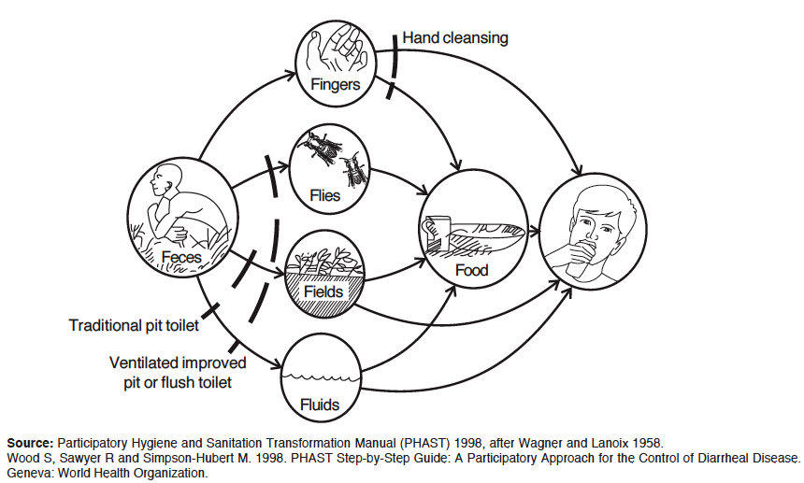
Faecal-oral transmission routes.

Slide 103
Diseases caused by poor excreta disposal
Human excreta may spread the following diseases:
Typhoid fever
Cholera
Intestinal worms
Poliomyelitis
Infective hepatitis A
Bacillary and amoebic dysentery

Slide 104
Factors that influence the types and construction methods of any sanitation system.
1. Social, cultural, beliefs, values and practices.
2. Religious customs.
3. Population density and settlement pattern.
4. Climatic conditions.
5. Topography and soil conditions.
6. Geological formations.
7. Abundance or scarcity of water.
8. Economic standards.
9. Political and social organizations.
10. Educational level of communities.
11. Level of health awareness.
12. Safety to users.
13. Availability of resources, and infrastructure that may support sanitation system (Skilled power, construction materials, on-going water or Hygiene programs etc.).

Slide 105
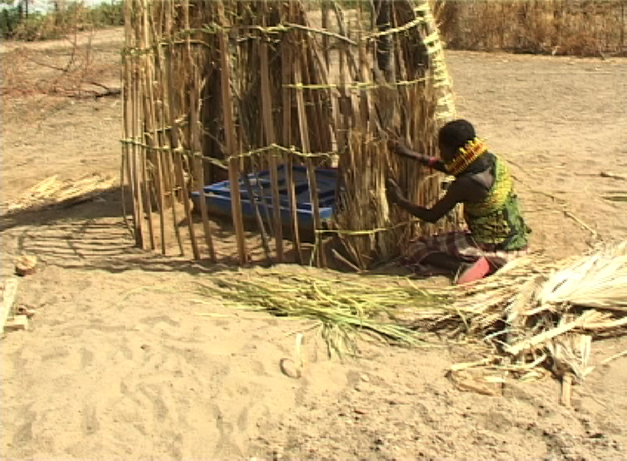
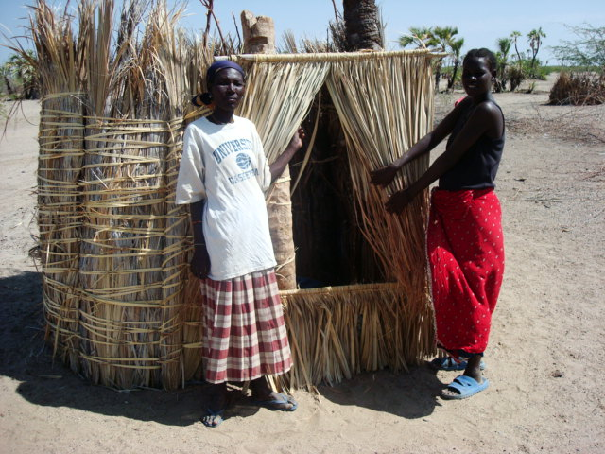
Latrines Constructed in Turkana: Latrines Constructed in Coast:

Slide 106
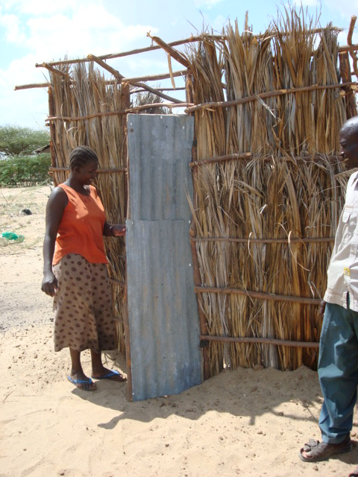
Latrine Construction in Tana River District: Bangladesh

Slide 107
SANITARY SYSTEM REQUIREMENTS.
Excreta disposal system should satisfy the following requirements as adapted from Ehlers and Steel.
1. The surface soil should not be contaminated because of the technology used.
2. There should be no contamination of ground water that may enter springs or wells.
3. There should be no contamination of surface water.
4. Excreta should not be accessible to flies or animals.
5. There should be no handling of fresh excreta or, when this is indispensable, it should be kept to a strict minimum.
6. There should be freedom from odours or unsightly conditions.
7. The method used should be simple and inexpensive in construction and operation.
8. Should serve at least 4 to five years to be cost effective.

Slide 108
TECHNOLOGIES.
The available technologies are grouped according to the technology involved and their overall function.
1. Drop-and-Store Systems.
  1.1 Pit latrines/pit privy.
  1.2 VIP latrines.
  1.3 Compost latrines.
  1.4 Aqua Privy.
  1.5 Bucket latrine.
  1.6 Trench latrine.
  1.7 Overhung latrine.
  1.8 Borehole latrine.

Slide 109
2. Drop-Flush-and-Discharge Systems.
  2.1 Water carriage (Water closet).
  2.2 Pour-flush latrine.
3. Individual containment and Treatment Systems.
  3.1 Cesspools.
  3.2 Septic tanks.
  3.3 Soak pits.
  3.4 Seepage pits.
4. Community Treatment Systems
  4.1 Waste water treatment process.

Slide 110
Pit Latrine:
This system is known as traditional pit latrine, pit privy, ordinary latrine or out-house.
Pit latrine is the cheapest type of excreta disposal system known. It is also considered the most common sanitation system in the world. It is based on containment and indefinite storage of human excreta. It is now given another name based on its function- “DROP-AND-STORE”.

Slide 111
Size Determination of a pit latrine.
How quickly the pit fills depends on many factors including the size, number of people using it, how much other material are added to it and what type of anal cleaning material is used.
In the African situation 0.025 to 0.040 M3 of waste will accumulate each year per user.
Depth of a pit required could be calculated using following formula;
Depth = (P x S x N) divide by A + 0.5 meter.
Where:
  P = average number of users.
  S = Solid accumulation rate in M3 per person per year (0.025M3 to 0.040M3).
  N = Minimum useful life required.
  A = Cross sectional area of the pit (based on the plot available)
  0.5 meter - This is added into the calculated depth for the service year required because the pit has to be filled with soil when the pit is full up to 0.5 meters from the top.

Slide 112
Pit latrine, a Drop and store requires for a hole to be dug in the ground. The excreta is deposited in the hole for until it is full after which the content will be pumped out or filled up by soil to remain underground forever. Pit Latrine among other things requires:-
A reasonable amount of open space.
Soil condition that can be dug easily.
A low ground water level.
Site that is never flooded.
Determinants of a pit latrine lifespan.
The lifespan of a pit latrine depends not only on the volume but also on:-
1. The maintenance and care taken.
2. How and where it is built (technology and soil).
3. The materials used in its construction.
4. The design period or the time required for the pit to fill.
5. The anal cleansing material used.

Slide 113
Advantages of a Pit Latrine.
Low cost.
Can be built easily.
Can use all type of anal cleansing materials (stone, corn cob, leaves, grass, mud, sticks etc.)
Minimal water requirement.
Disadvantage of a Pit Latrine.
Fly and mosquito nuisance.
Waste cannot be easily recycled.
Smell problem.
Lack of space for relocating new ones when full.
Potential for ground water pollution.
Difficulty to sink/dig in rocky or sandy soil.

Slide 114
Guidelines for a latrine site
Pit latrines should be at least 2-3m respectively above the water table.
Latrines should be located at least 6metres away from the buildings
Wells should be located upstream to avoid contamination of the well by ground water passing through the pit latrine.
Distance between the latrine and the water source should be at least 20 meters.

Slide 115
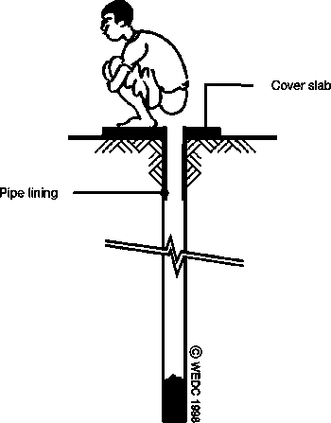
Borehole latrine :
About 18 inches in diameter and from 15 to 20 feet deep.
It has a smaller volume and fills up faster than a pit.
It is faster to install, and is appropriate following disasters
Advantages
Can be excavated easily if the boring equipment is available
Suitable for short term use, as in disaster situations.
Disadvantages
Sides liable to be fouled with consequent fly nuisance
Greater risk of ground water pollution owing to depth of hole.
Short life owing to small cross sectional area.

Slide 116
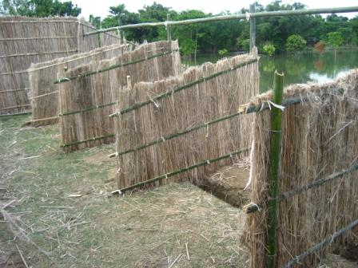
Trench latrine:
A trench is dug
A number of holes with dividing partitions constructed over it.
Used in temporary work camps.

Slide 117
Bucket latrines:
Also known as pail closets
Used where the water tables are high.
A squatting slab or seat is placed above the bucket.
Fills within a few days.
It is unpleasant to emptying it
Causes spillage which attracts flies
Advantages | Disadvantages
Low initial cost | Malodorous
 | Creates fly nuisance
 | Danger to health of those who collect or use the night soil.
 | Collection is environmentally and physically undesirable.

Slide 118
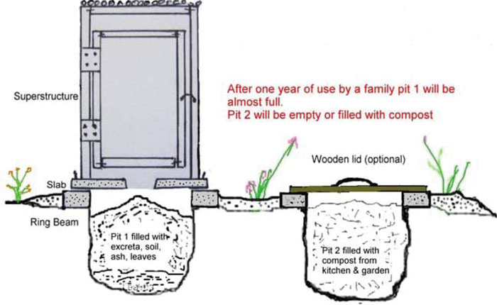
Composting pit latrine
It uses a predominantly aerobic processing system that treats excreta, typically with no water .
Suitable where the water table is too high.
Composting toilets may be used as an alternative to flush toilets in situations where there is no suitable water supply or waste treatment facility available or to capture nutrients in human excreta as human manure
Advantages | Disadvantages
Valuable humus is produced | Careful operation is essential
 | Urine has to be collected separately in the batch system
 | Ash or vegetable matter must be added regularly.

Slide 119
Ventilated pit latrine (VIP)
Fly and odor nuisance may be substantially reduced if the pit is ventilated by a pipe extending above the latrine roof, with fly proof netting across the top.
The inside of the superstructure is kept dark, hence VIP.
Advantages
Low cost
Can be built by householder
Does not need water for operation
Absence of smell in latrine and controlled flies
Disadvantages
Does not control mosquitoes
Extra cost of providing vent pipe.
Need to keep interior dark.

Slide 120
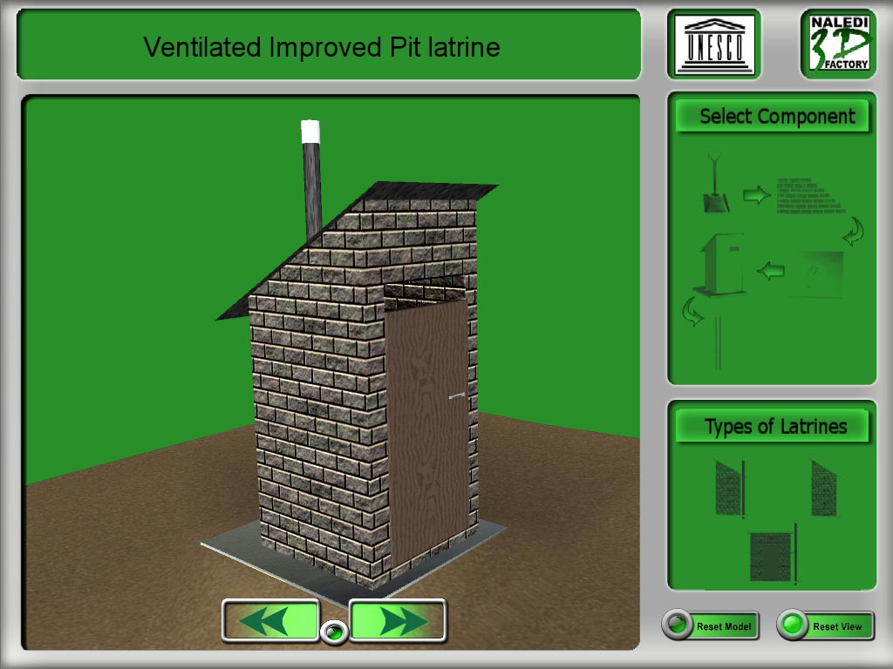
Ventilated improved pit latrines(VIP)
VIP LATRINE.
Ventilated Improved Pit (VIP) is a technical modification of simple pit latrine. It is also a drop-and-store technology.
Advantages
Eliminates fly breeding problem.
Reduces odour nuisance problem
Disadvantages
Costly to construct / maintain

Slide 121
The difference of VIP from the traditional one is the ventilation arrangement and a concrete slab cover. The pit is ventilated using a vent pipe extending above the roof of the VIP.
As a result of the vent technology added, VIP has advantages over the ordinary pit latrine by:
Eliminating fly breeding problem.
Reduction of odour nuisance problem.
But to control flies and reduce odor,
The vent pipe should be fitted with fly proof net (mesh).
The inside of the superstructure should be kept dark.
The door should face towards the prevailing wind and kept always closed to keep the inside area dark living space at floor level for air entrance.
It is not necessary to cover the squat hole.

Slide 122
Key Features of VIP Latrine
V.I.P smell control: One of the important features of a VIP latrine is its ventilation arrangement.
Fly Control: The inside of the superstructure should be relatively dark to discourage flies staying there.
VIP Latrine parts, which need periodic inspection;
Fly screen: [At the top the vent should be kept clear of Blockages and be quickly replaced if the screen has any holes in it]
Foundation: [any sign of erosion of the foundation around the edge of the slab should be filled immediately]
The Door: [should be self closing always]
Sunlight/heat: [Trees or any features which can block sunlight from reaching the vent pipe directly should be removed to facilitate heating of the air in the vent pipe.]

Slide 123
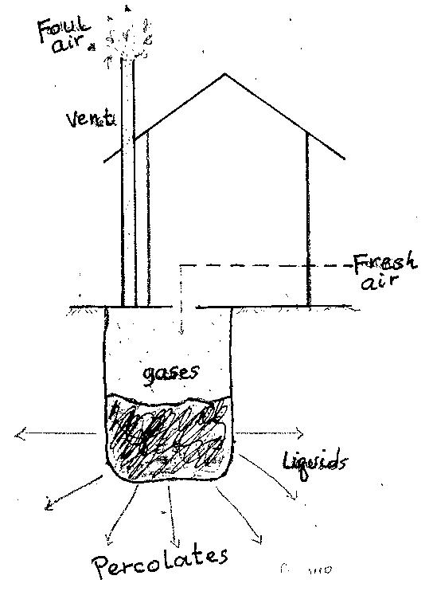
Parts of a VIP Latrine.

Slide 124
Pour – flush latrine
A latrine may be fitted with a trap providing a water seal, which is cleared of faeces by pouring in sufficient quantities of water to wash the solids into the pit and replenish the water seal.
Advantages | Disadvantages
Low cost | A reliable water supply must be available
Control of flies and mosquitoes | Unsuitable where solid anal cleaning material is used.
Absence of smell and latrine | Content of pit not visible.
Pan supported by ground | Can be upgraded by connection to sewer when sewerage becomes available.
Latrine can be in the house

Slide 125
Aqua - privy
An aqua – privy has a watertight tank immediately under the latrine floor.
Excreta drop directly into the tank through a pipe. The bottom of the pipe is submerged in the liquid in the tank, forming a water seal to prevent escape flies, mosquitos and smell. The tank functions like a septic tank.
Advantages | Disadvantages
Does not need piped water on site | Water must be available nearby
Less expensive than a septic tank | More expensive than VIP or pour flash
 | Fly mosquito and smell nuisance if seal is lost because insufficient water is added.
 | Regular desludging required and sludge needs careful handling.
 | Permeable soil required to dispose of effluent.

Slide 126
WATER CARRIAGE SYSTEM (WATER CLOSET).
The water carriage system is usually connected to a sewerage system. In order to carry the excreta to the sewers adequate water has to be used to flush it.
The water carriage system is a system where the user is not concerned about the waste once it is flushed away to the sewers. However, many installations depend on septic tank as receiver of the waste water.
A septic tank is a key component of the septic system, a small-scale sewage treatment system common in areas that lack connection to main sewage pipes provided by local governments or private corporations.
The term "septic" refers to the anaerobic bacterial environment that develops in the tank which decomposes or mineralizes the waste discharged into the tank.

Slide 127
Septic tank and septic drain field.
A septic tank consists of one or more concrete or plastic tanks of between 4000 and 7500 liters. One end is connected to an inlet waste water pipe and the other to a septic drain field. Generally these pipe connections are made with a T pipe, allowing liquid to enter and exit without disturbing any crust on the surface. The design of the tank usually incorporates two chambers; each equipped with a manhole cover, and separated by a dividing wall with openings located about midway between the floor and roof of the tank.
Wastewater enters the first chamber of the tank, allowing solids to settle and scum to float. The settled solids are anaerobically digested, reducing the volume of solids. The liquid component flows through the dividing wall into the second chamber, where further settlement takes place. The excess liquid, now in a relatively clear condition, then drains from the outlet into the cesspool or septic drain field, or seepage field, depending upon locality.

Slide 128
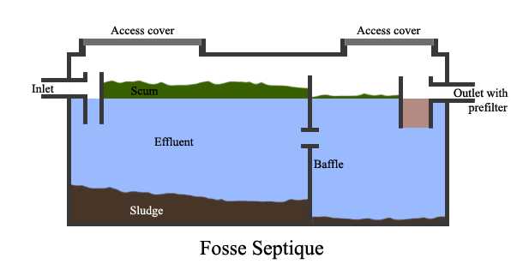
Septic Tank

Slide 129
WASTE WATER TREATMENT PROCESSES.
Sewage is generated by residential, institutional, commercial and industrial establishments. It includes household waste liquid from toilets, baths, showers, kitchens, and sinks draining into sewers.
Waste water (liquid waste) from flushing the toilet, bathing, washing sinks and general cleaning goes down the drain and into a pipe, which joins a larger sewer pipe under the road. The larger pipe also joins a major pipe that leads to the treatment center.
Stages: [Waste water treatment Stages]
Stage one: Screening.
Stage two: Primary treatment.
Stage Three: Secondary treatment.
Stage four: Tertiary treatment (final treatment).

Slide 130
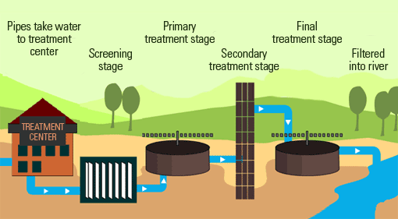
Waste water treatment Stages

Slide 131
Methods of solid waste disposal:
1.Dumping This can be in the sea or river or open dumping.
2.Burning by:
Simple open air burning
Burning in a trench
Using an incinerator
3.Composting.
Wet and dry refuse is heaped in alternative layers on to a plot about 2.5 square metres to a depth of about 1.5 metres.
The refuse is then covered with grass and earth. Compost is then turned frequently after 30 days then after 60 days.
This turning helps to distribute all parts of the heap to undergo the high temperature of the interior.
After 90 days the refuse is ready to be used as manure.
This method is, cheap, convenient and recommended especially in rural areas

Slide 132
4.Controlled Tipping
involves depositing refuse into depressions or large holes in the ground.
These tips should be situated at least half a Kilometre away from settlement, preferably out of sight and down wind.
5.Recycling
This is a method of re-using non-biodegradable refuse such as paper, bottles, plastics, metal cans and so on.
6.Burying

Slide 133
Refuse containers should be:-
Watertight plastic or metal with a tight-fitting lid or polythene bags;
Rust resistant
Easily filled, emptied and cleaned
Have side handles
Rest on a concrete slab to ensure cleanliness of adjacent ground
Disadvantages of Proper Waste Disposal
Breeding of pests and vectors
Foul smells
Contamination of water sources
Accidents from sharp objects
Overcrowding where space can be created for better utilization

Slide 134
Air and ventilation:
Ventilation - This is the intentional introduction of outside air into a space. Ventilation is mainly used to control indoor air quality by diluting and displacing indoor pollutants. It can also be used for purposes of thermal comfort or dehumidification.
It’s the process of supplying air to or removing it from any enclosed space by natural or mechanical means.
The consumption of oxygen in breathing, results in a reduction of the amount of oxygen in the atmosphere of a closed room and a proportional increase in the amount of Carbon dioxide (Co2).
In breathing, adults contribute about 0.67 cubic meter of carbon dioxide per hour to the atmosphere. Children contribute somewhat less. The average in mixed group is about 0.6 cubic meter per hour.
The reduction of oxygen and the increase of carbon dioxide may not be alarming except in tightly closed living or working environment.

Slide 135
Ventilation is aimed at removing the undesirable effects of poor ventilation from indoor environment.
The cooling power of air is mainly dependent upon its temperature and motion. Anemometers with rotating or deflecting vanes are used for rough measurements of air motion. The kata thermometer also known as comfort meter, is an instrument used to measure the cooling effect of the air in a given place.
The recommended velocity of air to attain comfort is 20 to 50 feet per minute (6.1 to 15.2 meter/ minute), with the lower values applying to heating systems and the higher to cooling.

Slide 136
Air composition.
Air is absolutely essential for sustainability of life. It is a mechanical mixture of gases and not a chemical compound. The pure ambient air that envelops the overlying earth’s surface is the composition of various elements.
Nitrogen----------------- 78.1%
Oxygen------------------20.9%
Carbon dioxide---------0.03%
Argon gas, Neon, Helium, Hydrogen, Krypton, are also present in the air with a very small proportion in the atmosphere.

Slide 137
Air space volume per person used as a general guideline in the estimation of dimensions of the buildings
A person requires generally 300 ft3 (8.49 m3) of air per hour.
 | Types of Building | Air space volume per person (m3)
1. | General Hospital | 34
2. | Infectious disease Hospital | 53
3. | Sleeping rooms | 14.2
4. | School class rooms | 3.54
5. | Dormitories | 8.49
6. | Cow sheds | 22.7

Slide 138
Methods of Ventilating a House
There are two means of ventilation: -
Natural ventilation
Artificial ventilation
Natural ventilation
It involves the use of natural forces of air diffusion and current by having properly built doors, windows e.g. fanlight, hopper or sliding sash windows.
Natural ventilation is an efficient, cheap and satisfactory form of effecting air movement in the house. Natural ventilation might not be used successfully in theaters, auditoriums, large schools, or large churches, but it is applicable in homes and small offices.

Slide 139
Such institutions require mechanical ventilation for efficient distribution and evacuation of contaminated air. It should be kept in mind that air movement into rooms through windows and a door depends up on winds and temperature differences between inside and outside air.
The disadvantages of natural ventilation are:
It is dependent upon wind direction
It does not control the possibility of entrance of smoky, dusty, and generally undesirable air.
Methods of natural ventilation.
Various methods of natural ventilation of houses.
a. Through ventilation - The windows are placed opposite to each other so that a current of air passes straight through the room.
b. Cross ventilation - The windows are placed diagonally on the two adjacent walls so that a current of air circulates and passes across the room.
c. Back to back ventilation – This is where the openings are placed on the same wall and air enters through one opening, circulates in the room goes out through the same wall on the same opening or the other opening, same direction.

Slide 140
Some means of natural ventilation:
Air Inlets and Outlets
Provision of windows
In houses built of mud and poles, the mud is omitted from the top most part of the eaves to ventilate and illuminate the house.
Air perforated bricks and chimney flues may be used to construct the house.
Simple wooden frame works also allow good fresh air circulation and adequate illumination.
Artificial (mechanical) Ventilation
It involves the use of mechanical apparatus such as fans and air conditioners. Such mechanical ventilators set air current in motion.
Fans are either the extraction type (exhaust vacuum system), propulsion (plenum) type, or the balance system that combines both systems.

Slide 141
a. Exhaust vacuum system of ventilation: is the type of ventilation in which the air is exhausted to the outside by fan or blower, thereby causing a lower pressure inside and a leakage inward through windows, doors, and walls. This method is largely used in kitchens to remove odors and smoke, in industrial plants and factories to remove dangerous dusts and fumes, the inlets to the ducts being placed near the point of their production, and in other circumstances where local ventilation is required.
b. The plenum system: is the type of ventilation which forces air into the room and cause a leakage outward, although exhaust ducts may also be provided. The forcing is accomplished by centrifugal fans, which operate in a manner similar to that of the centrifugal pump, or by impeller fans. The air in this method is introduced at a low level near the floors, so that the breathing line is completely bathed by the incoming air.
c. The balance system:- is a combination of the exhaust and plenum system. Air is drawn in through ducts by centrifugal fan and extracted at suitable points by exhaust fans. For the efficient working of this system, it is essential that there should be no leakage through windows or doors.

Slide 142
Advantages of artificial ventilation
❖ The air can be warmed, cooled, filtered, or humidified before allowing it to enter the building.
❖ It can also be supplied at any rate and at any level inside the room.
Disadvantages of artificial ventilation
➢ It is expensive to be used by the average population particularly in developing countries,
➢ Adopted rarely to the existing buildings, and
➢ Requires skilled persons for its application. Therefore, the environmental health professionals and other concerned bodies need to analyze these advantages and drawbacks before recommending certain types of artificial ventilation.

Slide 143
General and Specific Health Effects of Indoor Air Pollution
Indoor air pollution is the “The presence of one or more contaminants such as solid, liquid, or gases, in the indoor air in concentrations injurious to the inhabitants or which unreasonably interfere with comfort or enjoyment of humans”.
Indoor air pollutants are generally grouped into the following major sources:
1. Radon gas
2. Combustion products
3. Building materials and chemicals
4. Biological aerosols and house hold dusts
5. Decomposition processes
6. Respiration

Slide 144
General Health Effects
Burns and scalds are common
Initial heat damage to the conjunctiva and cornea
Prolonged exposure will lead to keratitis causing impaired vision, cataract and ultimately blindness.
Specific Health Effects of Indoor Air Pollution upon
Bronchitis, predisposing factor for tuberculosis and Asthma. Physiological and mental discomfort due to odor from skin and cloth of the occupants and increase in temperature as a result of heat generated from human body is significant.
Nitrogen Dioxide (NO2)
Cause respiratory tract irritation and inflammation.
Cause an increased air-flow resistance in respiratory tract.
Cause an increased risk of the respiratory infection.

Slide 145
Sulfur Dioxide (SO2)
Broncho-constriction, often associated with wheezing and respiratory distress.
Impairment of lung function
Increased asthmatic attack.
Carbon monoxide combines readily with blood hemoglobin to form carboxyl hemoglobin, thereby reducing the amount of hemoglobin available to carry oxygen to other parts of the body.
Formaldehyde: irritation of eyes and respiratory tract, cause bronchial asthma at higher doses. Cause occupational allergic contact dermatitis and skin irritation.
Tobacco smoke: Eye, nose, and throat irritation; Nasal congestion and rhinorrhea; Inflammation of the lower respiratory tract; Lung cancer
Fungi and Bacteria: Hypersensitivity pneumonitis, causing cough, dyspnea, and fatigue and allergic rhinitis. - Humidifier fever, causing flu-like illness with fever, chills, myalgia, and malaise.

Slide 146
Lighting of a House (Illumination)
Light is related to health in several ways:
Light (sunlight) helps in combating diseases and in promoting metabolism.
The ultraviolet rays have a beneficial effect in the health of the body as in the prevention of rickets by helping the body produce its own vitamin D.
The ultraviolet rays have also bactericidal effect, and thus, may kill pathogens that are sensitive to light.

Slide 147
Importance of proper lighting
Proper lighting is essential for cleanliness
Accident prevention i.e. reduces accident hazards
Reduce fatigue in the homes.
It also takes into consideration the task,
Spacing of light sources,
Elimination of shadows and glare,
Control of outside light and lightness of working surfaces, walls, ceilings, fixtures, trim and floors.
Good lighting safeguards the eyesight,
It saves the workers time, and thus economically profitable.
Good lighting is also conducive to rest, comfort, sleep, study and thinking.

Slide 148
Types (source) of Lighting
There are two types (source) of lighting:
1. Natural lighting
2. Artificial lighting
Natural Lighting: This is the natural day light from the sun. Light enters through doors and windows and is reflected from surfaces. Amount of daylight entering the house through windows or doors largely dependent upon the sky area visible at that point.
Artificial Lighting:
These are the systems of artificial (man-made) lighting. Artificial lighting can be sub-divided into five i.e.
Direct: the light passes through transparent material.
Direct indirect: is designed to provide generally diffused lighting, with nearly equal distribution in all directions (both up ward and down ward).
Semi-direct: 60 – 90 per cent of the light is directed downward to the work. The remaining percentage is directed upward.
Indirect. 90 – 100 per cent of the light is directed towards the ceiling and upper side walls from which it is reflected to all parts of room and 10% of the diffused light falls upon the working area.
Semi-indirect:

Slide 149
Pollution.
Pollution: This is the introduction of contaminants into the environment in such amount and duration that affect health or adverse change.
Pollutants: These are the components of pollution. They can be either foreign substances/energies or naturally occurring contaminants.
Contaminants: Biological, chemical, physical, or radiological substance (normally absent in the environment) which, in sufficient concentration, can adversely affect living organisms through air, water, soil, and/or food.
Ecosystem: Is a community of living organisms (plants, animals and microbes) in conjunction with the non living components of their environment (things like air, water and mineral soil), interacting as a system.

Slide 150
Sources of Pollution
There are six major sources of environmental pollution:
1. Industrial sources
2. Agricultural sources
3. Biogenic sources
4. Anthropogenic sources
5. Unnatural sources
6. Extra-terrestrial sources.
Types of Pollution
[Major types of pollution]
Air/ atmosphere pollution
Water pollution
Land / soil pollution

Slide 151
Others types of pollution
Noise pollution
Thermal pollution
Radioactive pollution
Visual pollution
Light pollution
Marine pollution
Air pollution - It is any contamination of the atmosphere that disturbs the natural composition and chemistry of the air.
It occurs when gases, dust particles, fumes (or smoke) or odour are introduced into the atmosphere in a way that makes it harmful to humans, animals and plant.
Common air pollutants - Carbon monoxide, Lead, Sulfur Dioxide, Particulate Matter, Nitrogen Dioxide, Ozone (Ground-level ozone).

Slide 152
SOIL POLLUTION - This is the contamination of soil causing adverse effects on living organisms in it.
It is the degradation of the earth's surface caused by a misuse of resources and improper disposal of waste.
The pollution of soil affects the entire ecosystem as it is the source of food/nutrition of all the living beings on earth.
Causes of soil pollution - Soil erosion, Industrial wastes, Urban wastes, Agricultural practice, Biological agents:
WATER POLLUTION - It is the contamination of water bodies (e.g. lakes, rivers, oceans, aquifers and groundwater).
Occurs when pollutants are discharged directly or indirectly into water bodies without adequate treatment to remove harmful compounds.
Any change or modification in the physical, chemical and biological properties of water that has a detrimental consequence on living things.
Sources and causes of water pollution – Microbial, Persistent organic chemicals, Solid waste, chemical, Oxygen demanding substances, Oil pollution, Plants Nutrients (Eutrophication), Suspended Matter.

Slide 153
NOISE POLLUTION - Sound becomes unwanted when it either interferes with normal activities such as sleeping, conversation, or disrupts or diminishes one’s quality of life.
Noise (or sound) is measured in the units of decibels and is denoted by the dB. Noise which is more than 115 dB is tolerant. The industrial limit of sound in the industries must be 75 dB according to the WHO
Sources of noise pollution - Household sources, Social events, Commercial and industrial activities, transportation
THERMAL POLLUTION - This is the rising air/water temperature so that it becomes harmful to human being and other organisms.
Sources of thermal pollution - Thermal power station, Nuclear power plants, Petroleum refiners, Domestic sewage.
Marine pollution – contamination of the sea.

Slide 154
Radioactive Pollution (Nuclear Hazards) - Radioactivity is produced by the spontaneous decay of the isotopes of some elements, whose nuclei are unstable.
Five types of radiation may occur: alpha, beta particles, neutrons, gamma rays and x-rays.
Sources of man-made Radiation - Nuclear reactors, Commercial and military reactors, Nuclear installations
Light pollution: Includes light trespass, over-illumination and astronomical interference.
Visual pollution: Which can refer to the presence of overhead power lines, motorway billboards, landforms, open storage of trash, municipal solid waste or space debris.

Slide 155
POLLUTION PREVENTION AND CONTROL STRATEGIES:
(A) Industrial prevention & control strategies
1. Waste minimization - Source reduction, Reuse, Recycling, Toxic chemical substitution, Production process modification, Production modernization
2. Cleaner production - It is a preventive, company-specific environmental protection initiative. It is intended to minimize waste and emissions maximizing product output.
3. Capacity training and development
4. Treatment of waste to an acceptable levels before discharging - Sewage treatment, Industrial wastewater treatment
5. Improvement in operation and maintenance of plants – use of pollution control devices, Dust collection systems, devices
6.Awareness
7. Environmental Statistics and Mapping
8. Enacting legislation to regulate various types of pollution

Slide 156
Pollution Prevention and Control Strategies at home
Purchase products with less packaging.
Recycle cardboard, glass, and plastic packaging.
Recycle aluminum, tin cans, and newspapers.
Purchase products made from recycled materials.
Properly dispose of waste oil and fluids from vehicles.
Maintain your septic tank in good condition.
Fix leaking faucets and toilets.
Run full loads of laundry. Install a low-flow shower head.
Mulch or compost your yard waste and vegetable scraps.
Apply herbicides and pesticides properly; more is not better.

Slide 157
Pollution prevention strategies in agricultural activities
Apply pesticides and herbicides at the proper concentrations.
Explore non-chemical methods of agricultural production.
Use alternative fuels when possible.
Maintain vehicles for maximum fuel efficiency.
Consider protecting sensitive environmental areas by planting "timber crops" or native grasses.
Mix and apply pesticides carefully, keeping in mind that they are potential contaminants.
Get involved in a pesticide container recycling program.
Manage animal wastes properly.
Apply nutrients and fertilizers with care since high concentrations can cause problems in ground water and streams.

Slide 158
Role of an individual in prevention of pollution
Reduce your dependency on fossil fuel especially coal or oil
Use eco-friendly products e.g. do not use polystyrene cups that has CFCs molecules as they destroy the ozone layer
Adopt and popularize renewable energy sources.
Promote reuse and recycling whatever possible and reduce the production of wastes.
Use mass transport system - decrease the use of automobiles.
Plant more trees as trees can absorb many toxic gases and can purify the air.
Use less hazardous chemicals wherever possible

Slide 159
Effects of pollution [Diseases caused by pollution]
Air pollution effects
Premature death in people with heart or lung disease, Nonfatal heart attacks, Irregular heartbeat, Aggravated asthma, Decreased lung function, and Increased respiratory symptoms, such as irritation of the airways, coughing or difficulty breathing
Flouride may lead skeletal flourisis to animals
Soil pollution effects
Hazardous chemicals enter into food chain from soil disturbing the biochemical process.
Nervous disorders, gastrointestinal disorder, joint pain, respiratory problems are the effects seen on human beings.
Lead and other heavy metals have been shown to cause neurological problems.
Mercury has been linked to developmental deficits in children and neurologic symptoms.

Slide 160
Water pollution effects
Water-borne disease outbreaks such as cholera and tuberculosis from drinking contaminated water
Taking toxins emitted by algae growth for instance can cause stomach aches and rashes.
Excess nitrogen in drinking water also pose serious risks to infants.
Noise pollution effects include stress related illnesses, speech interference, hearing loss, sleep disruption, and lost productivity.
Radiation effects - Disrupts molecules within cells, thus causing chemical changes. At high doses, radiation causes burning, nausea and other rapidly produced symptoms due to extensive, immediate death of body cells. At lower doses, radiation results in health problems such as cancer. Disruption of DNA, leading to the development of radionuclide exposure. Detrimental damage to cells

Slide 161
Effects of pollution [Effects to the Environment]
Air pollution effects - Acidification, Eutrophication, Ground-level Ozone, Aesthetic and Climatic effects
Soil pollution effects - Water logging and salinity makes soil infertile.
Water pollution effects - Death of aquatic (water) animals, Disruption of food-chains, Destruction of ecosystems
Thermal pollution effects - Species composition changes as species tolerant of warmer waters replace those unable to adapt e.g. algae, fish. Reduces dissolved oxygen (DO). The water properties changes. Toxic chemical becomes soluble at high temperatures. Disrupts natural reproductive cycle of water animals by premature hatching of eggs.
The emission of greenhouse gases leads to global warming which affects ecosystems in many ways.

Slide 162
Leadership and Power Structure
Leadership is a process by which a person influences others to accomplish an objective and directs the organization in away that makes it more cohesive and coherent.
Leaders carry out this process by applying their leadership attributes ,such as beliefs, values ethics character knowledge and skills.
It is about leading ,influencing ,commanding people.
Studying leadership is important because it enables us to understand how and why events and societal developments happened.
Having a strong Leadership was critical for survival of early civilizations, tribes etc.
Leadership as a function has existed since the beginning of mankind.

Slide 163
IMPORTANCE OF LEADERSHIP.
Initiates Action.
Provides motivation and building morale.
Provides confidence.
Builds work environment.
Coordination
CONCEPT OF LEADERSHIP.
Leadership occurs within a group context (process of influence and goal attainment).
Good leaders develop through a never ending process of self-study, education, training and experience.
Good leaders are made not born. If you have the desire and will power, you can become an effective leader

Slide 164
SOURCES OF LEADERSHIP POWER.
POWER - The capacity or potential to influence, it is the ability to affect others beliefs, attitudes and actions.
It is a relational concern for both leaders and followers.
5 BASES OF POWER.
1.Referent Power - based on followers identification and liking of the leader e.g. A school teacher who is adored by her students has referent power.
2. Expert Power - based on followers perception of leaders competence e.g. a tour guide who is knowledgeable about a foreign country has expert power.
3. Reward Power - derived from having the capacity to provide rewards to others

Slide 165
Legitimate Power - associated with having status or formal job authority – e.g. a judge who administers sentences in the court room exhibits legitimate power…
Coercive Power - derived from having capacity to penalize or punish others- e.g. a couch who sits a player on bench for being late for practice.
Coercion - use of force effect change and influencing others to do something through manipulation of rewards and penalties in the work environment, use of threats,
Punishment or negative rewards - example of coercive leaders-Adolf Hitler

Slide 166
THEORIES OF LEADERSHIP
ARE classified as follows.
Trait.
Contingency.
Invitational.
Transactional, etc.
TRAIT THEORY - States that there's a set of characteristics that determine a good leader i.e. personality, dominance (personal presence), charisma, self-confidence, achievement and ability to formulate vision.
CONTINGENCY THEORY- Views leadership as more flexible i.e. different styles can be used at different times depending on circumstances
Theory also suggests that leadership is not a fixed series of characteristics that can be transposed into different contexts.

Slide 167
BEHAVIORAL THEORY – Suggests that leaders can be trained and focuses on the way of doing things. Structures based on Behavioral theories focus on leader instituting structures i.e. he's task-oriented.
Relationships based on behavioral theories focus on the development and maintenance of relationships i.e. Process-Orientated.
TRANSFORMATIONAL THEORY - Involves widespread changes to the organization / business.
This type requires long-term Strategic Planning and clear objectives.
Requires clear vision.
Leadership by example and believes in efficiency of systems and processes.

Slide 168
TRANSACTIONAL THEORY - Focuses on management of the organization, also on procedures and efficiency.
Focuses on working to the rules and contracts.
Focus also on current issues and processes
INVITATIONAL THEORY - Focus on improving the atmosphere and messages sent out by the organization.
Focus on reducing negative messages sent out through every day actions of the organization both externally and crucially internally.
Reviews internal processes to reduce them
Builds relationship and sense of belonging and identity with the organization and get connected to customers.

Slide 169
Behavioral Theories - Suggests that successful leaders display particular behaviors which can be learned.
The social learning theory – states that individuals learn leadership by observing other who are leaders and copying their behavior and if rewarded then he is likely to repeat the same.

Slide 170
OTHER THEORIES
Big question are leaders born or made?
The great man theory (trait) suggests that all successful leaders have common characteristics or traits.
Proposes that a good leader in industry would also be a good captain in sport.
Research also suggests some common traits e.g. intelligence ,assertion and ambition.
However the above could possibly relate more to how leaders emerge rather than their effectiveness.

Slide 171
DEFINITIONS OF TERMS
[TASK AND PEOPLE ORIENTED] leadership
TASK-ORIENTED - Concerned with the demands of the task and focus on outcomes/results rather than peoples welfare.
It is good for really difficult tasks.
Popular - with Military
PEOPLE ORIENTED - Focus on interpersonal relationships within the organization.
Focus more on the journey i.e. the process by which we get there.
Good for personal development/nurturing, less concerned with results.
NB: A personal style of leadership can change depending on situations

Slide 172
Leadership Style
Leadership style is the manner and approach of providing direction, implementing plans and motivating people.
Autocratic leader - make all group decisions and assign tasks to members
Democratic / Participative leader - encourage group discussion and decision making through census building.
Delegative leader - minimally involved in decision making and encourage group members to make their own decisions.

Slide 173
Leadership Style
Autocratic
(Authoritarian)
Democratic
(Participative)
Delegative
Leader
Leader
Leader
Employees
Employees
Employees
Leader
Whole Group
Employees
EMPHASIS

Slide 174
Varying Leadership Style
While the proper leadership style depends on the situation, there are other factors that influence which style to use:
The leader’s personal background. What personality, knowledge, values, ethics does the leader have.
The leader’s preferred style.
The skill and experience of the subordinates.
The organization itself. The traditions, values, philosophy and concerns of the organization.
The organization environment – stable or suffering turbulent.

Slide 175
Effective Leader
someone who knows how to inspire and relate to subordinates; able to convince subordinates that the organisational vision is not only important but attainable; able to challenge them with goals, projects, tasks and responsibility that allow them to feel a sense of personal success, achievement, and accomplishment; rewards subordinates who perform well with recognition, money and promotions
Edwin A. Locke (1999)

Slide 176
CHARACTERISTICS OF AN EFFECTIVE LEADER
Effective leadership is putting first things first. Effective management is discipline, carrying it out”– Stephen Covey
Has a clear forward vision
Having Clear Values
Knowledgeable and intelligence
Able to Inspire
Able to Lead by Example
Take responsibility
Courageous
Able to create a spirit of collaboration and community
Continuously improve
Problem solving skills
Effective communication skills
Able to generate new ideas
Good learner and listener

Slide 177
Successful leaders get most out of their followers.
Leaders know how to lead and follow with the group.
They know how to make good decisions
He / She is a good teacher.
Does not put down those they work with.
A Leader is one who knows the way and shows the way(John Maxwell)
Effective leaders also know how not to be afraid to fail or make mistakes’
Effective leaders encourage people to be the best they can ever be.
They take responsibility for success as well as failure

Slide 178
NB:
Leadership is combination of Character and Competence of who you are and What you Can do.
Does leadership matter? Yes it does -it is crucial for survival of any organization
Types of Leadership
Formal leadership where an appointed leader is chosen by administration and given official or legitimate authority. This has the greatest impact when followers accept the leader.
Informal leadership. This type does not have official authority to direct activities of others. A leader is chosen by a group itself e.g. social group, church organization or work group. One may become a leader because the members of the group respect her /him due to age, seniority or special competencies or personality.

Slide 179
Types of Leaders
1.Charismatic Leader- This is the one who gains influence mainly from strength of personality and has exceptional qualities required to transform all those around into willing followers.
2.Traditional leader- A leader whose position is assured by birth e.g. kings or tribal chieftains. In this one few people can aspire to be leaders
3.Appointed leader – This is the one whose influence arises directly out of his position, e.g. a manager or supervisor
4.Situational leader – A leader whose influence is effective by being in the right place at the right time. The leader is looked at as someone who can assume leadership of a temporary measure over a specific period of time
5.Functional leader – This is a leader who gets into a leadership position because of what he or she does rather than what they are.

Slide 180
Rural and Urban Communities
Rural.
Means a reserve or hinterland. It is that interior and natural environment away from the urban.
Urban.
Is a relatively large dense and permanent settlement of individuals, groups or firms that are socially, economically and geographically heterogeneous.
Community
This is a group of people within the same area sharing the same utilities and interests.
Urbanization
An increase in capital investment and infrastructural improvements leading to better jobs and services.

Slide 181
RURAL – URBAN INTERDEPENDENCE.
What can the rural benefit from the urban?.
1. Job opportunities.
2. Market for products e.g. foodstuffs, building materials.
3. Banking and financial facilities.
4. Administrative services.
5. Manufactured goods.
6. Improved technologies e.g. solar technologies, energy jikos…
7. Educational facilities e.g. KMTCs, Teachers colleges, etc.
8. Easing of population pressure from farmlands.

Slide 182
WHAT CAN THE URBAN GAIN FROM THE RURAL?.
1. Foodstuffs.
2. Raw materials for industries.
3. Labor force.
4. Energy sources.
5. Markets for finished goods.
6. Land for expansion.
THE PUSH AND PULL PHENOMENA.
The rural push & the urban pull.
1. In search of (white collar) jobs.
2. Trade and business opportunities.
3. As prestige, to become civilized and sophisticated.
The city lights, city life & preference to town life.
To get away from notorious relatives

Slide 183
6. To join immediate relatives who live in towns.
7. To gain education and training.
8. Desire to travel and enjoy.
9. To get away from those problems of the village.
10. Land scarcity.
11. Poor rural facilities.
12. Village and family friends in urban places.
13. No network in rural home.
The Rural Pull.
1. Preference to village life.
2. Have a village job e.g. farming / care for the old / or working
3. Own immovable property.
4. Have family & village ties.
Difficulties in migrating; no money / no education /
Town life is very expensive.
7. Slow old and overwhelmed by the pace of town life.
Insecurity in towns
Poor sanitation in towns.

Slide 184
PROBLEMS ASSOCIATED WITH RAPID URBANIZATION.
1. High crime rate,- murders, muggings, robberies, rape, pick-pocketing.
2. Inadequate sanitation –disposal of solid waste, waste water, and human - waste. Pollution – noise, air, water, and grounds.
3. Inadequate planning and uncoordinated development.
4. Uncontrolled trades.
5. Over stretching infrastructure and services.
6. Development of slums & poor housing conditions / unplanned structures.
7. Inadequate social amenities.
8. Politicking.
9. Corruption and land grabbing.
10. Decay in moral standards.
11. Social diseases, - street children, prostitution.
12. Cultural conflicts and tensions.
13. Congestion and overcrowding / overloading the urban centers.
14. Rural-Urban development disparity.
15. Declining viability, profitability & revenues, security and economic base.
16. Unemployment.
17. Poor health standards and frequent outbreaks of disease.
18. Low quality of life.

Slide 185
RURAL SETTLEMENT.
Rural development Is a series of qualitative and quantitative changes happening in a rural set up.
THE UPSIDE OF VILLAGE LIFE.
1).Economic – Low cost of living, free or cheap accommodation, cheaper and fresher foodstuffs.
2). Way of life -That quiet life.
- Enjoy farming, rearing livestock, hunting - Mutual help from family and community.
- Traditional and family cultures.

Slide 186
THE DOWNSIDE OF VILLAGE LIFE.
1).Economic – No white collar jobs, crop failures.
2).Infrastructure – Few or no social amenities, Poor educational facilities , health facilitie, etc.
3).Recreations & entertainment – Life is ‘dull and uncivilized’, no color TVs, people are ‘backward.’, per say.
4).Social stress - Family and friends conflicts, conflicts over land and grazing rights, old fashioned practices (FGM), many other restrictions, etc.

Slide 187
Malpractices in the rural.
They may destroy or affect the quality of life. This includes;
1. Over subdivision of human land or fragmentation.
Deforestation and overgrazing.
3. Over cultivation.
4. Cultivation to river banks.
5. Excessive sand mining.
Malpractices in the urban.
1. Over-concentration of urban activities over a small area of land. This leads to many problems including traffic snarl-up.
2. Intruding on road reserves.
3. Pollution, Solid and liquid waste mismanaged.
4. Lack of zoning of e.g. industries, residential areas.
5. Lack of land allocation for essential services.

Slide 188
LAND ZONING. [some key concerns]
A. RESIDENTIAL COMPONENT.
INDUSTRIAL LOCATIONS.
C. THE RURAL VILLAGE.
D. OPEN AIR MARKET.
E. IDP CAMPS, EMERGENCY AND DISASTER RELIEF WORKS AND REFUGEE CAMPS.
G. DISPOSAL OF THE DEAD.
I. HOUSING ESTATE.

Slide 189
PUBLIC HEALTH ACT
DEFINITIONS.
Law.
This is the system of rules that a particular country or community recognizes as regulating the actions of its members and it is enforced by the imposition of penalties.
Rules.
These are accepted principles or instructions that states the way things are or should be done, and tells you what you are allowed or not allowed to do.
Regulations.
These are official or authoritative instructions. They are "moral and ethical directives, instruction, directions, command, order, charge, injunction, prescription, ruling, decree, formal ordinance, etc ".

Slide 190
By- laws.
The rules and regulations enacted by an association or a corporation to provide a framework for its operation and management.
By-laws may specify the qualifications, rights, and liabilities of membership, and the powers, duties, and grounds for the dissolution of an organization.
Orders.
The arrangement or disposition of people or things in relation to each other according to a particular sequence, pattern, or method, or a state in which the laws and rules regulating the behavior of members of a community are observed and authority is obeyed.
Declaration.
In law, a declaration refers to a judgment of the court, usually referred to as a declaratory judgment.

Slide 191
WHY LEARN LAW?
To know court procedures when prosecuting.
To avoid breaking the law.
To assist somebody in need.
To be aware of ones rights to avoid exploitation, harassment, intimidations etc.
To defend oneself in court of law.
For general knowledge.
To teach others.
PURPOSE OF LAW
To promote desired behavior of the community.
To protect the individual from outside aggression (robbery, assault, etc.) and vice versa.
Present uniformity of action in case of breach of law.
Prevents errors of judgement.
Accumulate experience for faster administration of justice.
To punish people who commit crimes.

Slide 192
CHARACTERISTICS OF LAW.
It represents the wish and desire of the community and commands and varies through time and space.
Are abiding in nature and affects all people uniformly.
Normally backed fully by government and state.
Provide the procedures of administration of justice.
SOURCES OF LAW
The Constitution.
Legislation.
Delegated Legislation.
Substance of Common Law and doctrines of equity.
African Customary Law.
Islamic Law.
Hindu Law.
Judicial Precedent (Case Law).

Slide 193
Key words in law,
Bill: - a draft law or legislation.
Delegated legislation: - law made by parliament indirectly.
Ultra vires: - Latin term which means “beyond the powers”.
Common law: - a branch of the law of England which was developed from customs, usages and practices of the English people.
Stare decisis; - Latin term which means “the decision stands”.
Precedent: - An earlier decision of a court e.g S.M. Otieno case.
Prima facie evidence - strength of evidence.
Inter alia - among other things.

Slide 194
FUNCTIONS OF ENVIRONMENTAL HEALTH LAW.
Ensure healthful living and working environment through;
1. Control of air and water quality.
2. By regulations of domestic, industrial waste and agricultural effluents.
3. Control of marine pollution.
4. Regulation of radiation emissions.
5. Control of toxic substances.
6. Noise reduction.
7. Conservation of natural environmental resources.
8. Land use control and regulation governing housing.

Slide 195
PUBLIC HEALTH PROSECUTION.
Crime scene.
This is the place of offence and it includes any place, land, building, where a certain Act of Kenyan law is being or has been violated by a known or unknown person who should be made to face the law. The Act enforcement officer ought to visit and take a legal action.
Purpose of scene visit.
You visit scene to:-
1. Confirm the situation.
2. Carry out enquiries.
3. If true, proceed with investigation.
4. Regulate, restrict or prohibit movements of person or criminals.

Slide 196
5. Impose requirements or conditions on entry of person or animals.
6. Perform medical examination, detention, quarantine, isolation of persons.
7. Summon the offender through notices.
8. Collect evidence or exhibits.
9. Take affected persons for treatment or places of safety.
10. Stop offence from continuing by condemning premises.
PROCEDURE FOR PROSECUTION.
1. Making a report.
2. Enclose the inspection report.
3. Enclose a copy of served notice.
4. Enclose any reply received.
5. Prepare and enclose charge sheet.
6. Consult the Public prosecutor.

Slide 197
7. Submit sermons for prosecution.
8. File the charge sheet in the court of law.
9. Prosecute.
10.Obtain the copy of judgment.
11.Review the judgment.
12. Renew action if further prosecution is necessary.
FACTORS INFLUENCING PROSECUTION.
Decision to prosecute or not to depends on;
1.Existence of prima facie evidence (strength of evidence) – are there weaknesses in the case.
2.Attitude of the complainant – Are there relatives involved in the case.
3.The health of the accused- Terminal or mental illness can weaken the case.
4.Humanitarian factors – Fair and not suppressive e.g. a Mother with a young child.
5.Public interest – To avoid public claim or reaction.
6.Gravity of the offence – Very minor offences may not need prosecution.
7.Impact on international relations – Involving two sovereign states.

Slide 198
CLASSES OF LAW.
Criminal law.
Substantive and procedural law.
Deals with the relationship between people and the society.
Deals with court cases that are between the government and the defendant.
Government prosecutes the offender.
The guilty defendant is jailed, fined or sentenced to death in exceptional cases.
Covers cases such as assault, homicide and sexual offences among others.

Slide 199
Civil law.
Deals with the relationship between an individual with the state.
Concerned with court cases that are between two private parties.
There is no execution of the defendant.
Losing defendant (accused) only reimburses the plaintiff (accuser) for losses.
Covers cases such as contract disputes, accidents and cases concerning will.
Why are people reluctant to take cases to court.
• Expensive.
• Time consuming.
• Ignorance.
• Social relationship.
• Injustice in court.
• Victimization fear.

Slide 200
THE CONSTITUTION.
This is a body of the basis of rules and principles by which a society has resolved to govern itself or regulate its affairs.
It contains the agreed contents of the political system.
It sets out the basic structure of Government.
It is the supreme law.
The Kenya Constitution is the supreme law of Kenya. It establishes the structure of the Kenyan government, and also defines the relationship between the government and the citizens of Kenya.
CONSTITUTION CHAPTERS.
The Kenyan Constitution is comprised of the following 18 Chapters:-
Chapter One: Sovereignty of the people and supremacy of the constitution.
Chapter Two: The republic.
Chapter Three: Citizenship.
Chapter Four: The bill of rights.
Chapter Five: Land and environment.

Slide 201
Chapter Six: Leadership and integrity.
Chapter Seven: Representation of the people.
Chapter Eight: The legislature.
Chapter Nine: The executive.
Chapter Ten: Judiciary.
Chapter Eleven: Devolved government.
Chapter Twelve: Public finance.
Chapter Thirteen: The public service.
Chapter Fourteen: National security.
Chapter Fifteen: Commissions and independent offices.
Chapter Sixteen: Amendment of the constitution.
Chapter Seventeen: General provisions.
Chapter Eighteen: Transitional and consequential provisions.
Kenya’s new constitution was enacted on 27th August 2010 replacing the old one that had been in place since Kenya’s Independence in 1963.

Slide 202
SUPREMACY OF THE CONSTITUTION.
The supremacy of the Constitution as source of law is manifested in various ways:-
1)All other laws derive their validity from the Constitution.
2)It proclaims its supremacy. Section 2 of the Constitution provides inter alia (among other things) “The Constitution is the Constitution of the Republic of Kenya and shall take the force of law throughout Kenya, if any other law is inconsistent with this Constitution, this Constitution will prevail and the other law shall to the extent of its inconsistency be void”.
The rights Guaranteed by the Constitution
Right to life.
Right to personal liberty.
Right to property.
Right to protection of law.

Slide 203
PUBLIC HEALTH ACT – CAP 242 LAWS OF KENYA.
PART III – NOTIFICATION OF INFECTIOUS DISEASES.
17. Application of Part.
18. Notification of infectious diseases.
17. Application of Part.
18. Notification of infectious diseases.
PART IV – PREVENTION AND SUPPRESSION OF INFECTIOUS DISEASES
21. Inspection of infected premises and examination of persons suspected to be suffering from infectious disease.
22. Health authority to cause premises to be cleansed and disinfected.
23. Destruction of infected bedding.
24. Provision of means of disinfection.
25. Provision of conveyance for infected persons.
26. Removal to hospital of infected persons.
27. Isolation of persons who have been exposed to infection.
28. Penalty for exposure of infected persons and things.
37. Health authority to see to execution of rules.
38. Power of entry.

Slide 204
PART V – VENEREAL DISEASES.
43. Venereal diseases.
44. Persons suffering from venereal disease to have themselves treated until cured.
45. Duties of medical practitioners.
46. Duties of parents or guardians of infected children.
PART VII – LEPROSY.
76. Interpretation of Part-
PART IX – SANITATION AND HOUSING.
PART X – PROTECTION OF FOODSTUFFS.
PART XI – PUBLIC WATER SUPPLIES, MEAT, MILK AND OTHER ARTICLES OF FOOD.
PART XII – PREVENTION AND DESTRUCTION OF MOSQUITOES.
PART XIII – CEMETERIES………………………………………….
PART XIV – GENERAL……………………………………………….
PART XV – MISCELLANEOUS PROVISIONS…………………….

Slide 205
Occupational health and safety:
Occupational health is the physical, mental and social wellbeing of a person in relation to their work and working environment, as well as their adjustment to work and the adjustment of work to them.
Occupational health hazard: An occupational health hazard is any condition of a job that can result in illness or injury, a source of danger, a possibility of incurring a loss or misfortune.
Hazard - Potential source of harm or adverse health effect on a person or persons
Exposure to a hazard may produce immediate (acute), medium or long- term (chronic) effects

Slide 206
Some occupational diseases may take long to manifest e.g. Mesothelioma due to asbestos
Risk is the probability of occurrence of an adverse event from a substance on a worker or the environment combined with the magnitude of the consequence of that adverse effect
Work areas - Office work, clinical areas, production processes, transportation and other specific work areas (e.g. kitchen, stores, workshops etc.).
Accident: An unforeseen and undesired event that results in harm to people, damage to property, loss to process or damage to the environment.
The scope of occupational health safety includes prevention and control of hazards, curative and rehabilitative programs.

Slide 207
According to WHO (1995), occupational safety and health can be defined as a multidisciplinary activity aiming at:
Protection and promotion of the health of workers by eliminating occupational factors and conditions hazardous to health and safety at work
Enhancement of physical, mental and social well-being of workers and support for the development and maintenance of their working capacity, as well as professional and social development at work
Development and promotion of sustainable work environments and work organizations

Slide 208
Justification of preventing Occupational Health Hazard (OHH) - [why we need to Control OHH]
1. At work, people often come together in large numbers that can be conveniently cared for at a single service point.
2. At work, healthy people can be exposed to health risks.
3. People may work in very isolated areas where no other health services are available.
4. Illness among workers creates a loss to both individual and national productivity.
5. When an employment group is considered as a unit, sickness caused by certain occupations can be identified and prevented.

Slide 209
Effect of work on health.
1. Physical Injuries.
2. Chemical Injuries.
Diseases. [e.g. skin, Lung, respiratory, poisoning, Physical disorders, Repetitive Trauma, etc.] –
some target organ – lung, blood, liver, Genitourinary system, Head / Brain, Body
4. Emotional Injuries.
Actors of preventing Occupational Health Hazard [OHH].
1. The health team.
2. Employers.
3. The employees.
4. The community’s formal and informal leaders.

Slide 210
Aims of Occupational health hazard prevention.
1. The promotion and maintenance of the highest degree of physical, mental and social wellbeing in all occupations.
2. The protection of workers in their employment, from any risk factors adverse to health.
3. The protection of workers in their employment from risk resulting from factors adverse to health.
4. The placing and maintenance of the worker in an occupational environment adapted to their physiological equipment.

Slide 211
Hazards.
Physical - Are conditions or situations that can cause the body physical harm or intense stress
Can either be natural and/or human made.
exposure to hot, cold, light, noise, vibration, ultra violet light, etc.
2. Biological Hazards -infective and parasitic agents
3. Mechanical and Electrical Hazards - is any hazard involving a machine or process.
Psychosocial Hazards - include but aren't limited to stress, violence and other workplace stressors, e.g. unsatisfactory work environment
Chemical - Are substances that can cause harm or damage to the body, property or the environment.
Ergonomic Hazard - An ergonomic hazard is a physical factor within the environment that harms the musculoskeletal system, e.g. include things such as repetitive movement, manual handling, workplace/job/task design, uncomfortable workstation height and poor body positioning.
Hazards occur through.
1. Contact.
2. Inhalation.

Slide 212
Common Methods of Dealing with Hazards.
1. Remove the Hazard or Toxic Substance from the Work Place.
2. Reducing Exposure to the Hazard.
3. General Ventilation.
4. General Cleanliness.
5. Personal Hygiene.
6. Protective and Safety Equipment.
Prevention of occupational hazards.
1. Primary Prevention.
2. Secondary Prevention.
3. Tertiary Prevention.

Slide 213
Primary prevention.
1. Good construction of machines and buildings.
2. Training of the workforce on how to work with machines.
3. Proper utilisation of protective, safety equipment and clothing, and cleanliness of workshop.
4. Good personal hygiene and health.
5. Adequate rest when working with machines.
Secondary prevention.
1. Screening of employees at risk of a particular hazard.
2. Regular screening for non-occupational illness during employment.
3. Screening of the working environment to check that recommended safety measures are put in place by employers, to be used by employees.
4. Maintaining a safe and healthy environment, through sampling and measuring exposure to physical or chemical agents.
5. Periodic medical examination to workers.

Slide 214
Tertiary Prevention.
Tertiary prevention includes the whole spectrum of healthcare from first-aid to treatment and rehabilitation
Whose roles.
1. Professional Role.
2. Environmental Role.
3. Managerial Role.
4. Educational Role.
5. Others: Advisors, counsellors, hygienist, rehabilitators, researchers, safety experts and supervisors.

Slide 215
FUNCTIONS AND RESPONSIBILITIES OF AN OCCUPATIONAL HEALTH NURSE.
Occupational health nurses work with employers and employees to identify health and safety needs in the workplace. To meet those needs, they should have knowledge on;
1. Physical and psychological assessment of workers.
2. Prevention of occupational and non-occupational illness.
3. Provisions of treatment and nursing care.
4. Keeping a continuous watch on working conditions, equipment and materials for safety precautions and possible dangers.
5. Counselling workers regarding personal and family health problem

Slide 216
6. Cooperating with management in the application, enforcement and training on the use of protective measures.
7. Giving advice on environmental sanitation.
8. Carrying out nursing administrative duties.
9. Maintaining simple records of case.
10. Evaluating health programme and activities.
11. Encouraging workers to take responsibility for their own health through health education such as smoking cessation, exercise/fitness, nutrition and weight control, stress management, control of chronic illnesses and effective use of medical services.
12. Monitor the health status of workers, worker populations and community groups.
13. Conduct research on the effects of workplace exposures, gathering health and hazard data.

Slide 217
PERSONAL PROTECTIVE EQUIPMENT (PPE)
Is a device that is worn by a worker in order to prevent any part of his body from coming into contact with hazards present at his/her place of work.
The material of PPE’s chosen must be able to withstand the specific hazard prevailing in a given work place. PPE is the last means of hazard control
TYPES OF P.P.E
P.P.E act as barriers between the worker and the hazard. They include:-
Head gear(helmets and caps)
Ear protectors or defenders (ear muffs and ear plugs)
Face shields
Goggles
Safety spectacles

Slide 218
Masks (dust, fluids)
Respirators
Safety shoes/boots
Gloves/Mittens
Aprons
Overalls
Dust coats
Safety harnesses
Safety belts
PROTECTION OF THE VARIOUS PARTS OF THE BODY
Head protection
Eye and face protection
Ear protection
Respiratory system Protection
Hand/Arm Protection
Foot protection
Main body protection

Slide 219
OCCUPATIONAL HEALTH AND SAFETY ACTS.
Occupational Health and Safety Act, 2007.
The Act applies to all workplaces where any person is at work, whether temporarily or permanently.
Duties of occupiers (employers/manager).
Ensure safety, health and welfare at work of all his employees.
Registration of workplaces.
Renewal of registration certificate.
Prepare a written safety and health policy statement.
Carry out risk assessments in relation to the safety and health of persons employed.
Not make any deduction from an employee’s salary or other benefits for anything provided under the Act.
Safety and health audits at least once every year by an approved safety and health adviser.

Slide 220
Duties of self-employed persons.
Take all necessary precautions to ensure his/her own safety and health and that of any other person who may be affected by his activities.
Duties of employees.
Take care of his own safety and health and that of other persons who may be affected by his acts or omissions at work.
Co-operate with his employer in discharge of any requirement imposed by the Act.
Use at all times protective equipment or clothing provided by the employer.
Report to the immediate supervisor any situation which he believes presents imminent danger to his safety.
No person shall willfully interfere with anything provided for safety, health and welfare.

Slide 221
Safety and health committees.
An employer with twenty or more regular employees shall establish a workplace safety and health committee whose membership shall comprise both the workers and management.
Accidents, diseases and dangerous occurrences notification.
Notice of accidents and dangerous occurrences: - Notify the nearest occupational safety and health office within 7 days.
In the case of a fatal accident the notice must be given within twenty-four hours.
Notification of occupational diseases seen by medical practitioner while attending a patient within 7 days.

Slide 222
Enforcement of the Act.
Inspections – Occupational Safety and Health Officers have powers to inspect every workplace by day or by night. Any person obstructing such an officer is liable to a penalty.
Improvement notices and prohibition notices, issued when contraventions recur and no action for improvement is taken.
Prosecution: for fresh and repetitive contraventions.
General Health Provisions.
Cleanliness: No accumulation of dirt.
Overcrowding: minimum 10m3 space for each person.
Ventilation: Adequate free flow of fresh air.
Lighting: Adequate & suitable for different occupations.
Drainage of Floors: well drained floors.
Sanitary Accommodation: sufficient for each gender.

Slide 223
General Safety Provisions.
Safe means of access: Floors, passages, gangways, steps, stairs and ladders must be soundly constructed and properly maintained, and handrails must be provided for stairs.
Removal of dust or fumes –workers must be protected against inhaling, and where practicable, localized exhaust ventilation must be provided and maintained.
Meals in Certain Dangerous Trades. - A person must not partake of food or drink in workrooms where there are hazardous dusts or fumes.
Protective Clothing and Appliances. – Suitable protective clothing and appliances must be provided and maintained for the use of workers.
Confined spaces. – Adequate precautions should be taken for work in confined spaces where persons are liable to be overcome by dangerous fumes.
Explosions of Inflammable Dust or Gas. – Precautions should be taken against explosions for welding or soldering on containers.
Protection of Eyes. – Goggles or effective screens must be provided in certain specified processes.

Slide 224
Training and Supervision of Inexperienced Workers. – A person must not work at any dangerous machine or process unless he has been fully instructed.
Fire. -Adequate and suitable means for extinguishing fire must be provided in every workplace.
Adequate fire exits must be provided and marked. All doors affording a means of exit from the workplace must be sliding doors or made to open outwards.
Fire Safety Audit: Every occupier shall carry out a fire audit of the work place once every twelve months.
Evacuation procedures: - Every occupier of a workplace shall design evacuation procedures to be used during any emergency.

Slide 225
Other Provisions:
Machinery safety.
Chemical safety.
Welfare Provisions.
Right to Compensation.
Other Related Legislation.
Public Health Act, Cap. 242.
Radiation Protection Act, Cap 243.
Pharmacy and Poisons Act, Cap 244.
Pest Control Products Act.
Environmental Management Coordination Act, 1999.
Waste management regulations 2006.

Slide 226
THANKS

