Slide 1
GAS EXCHANGE IN THE LUNGS
HENRY

Slide 2
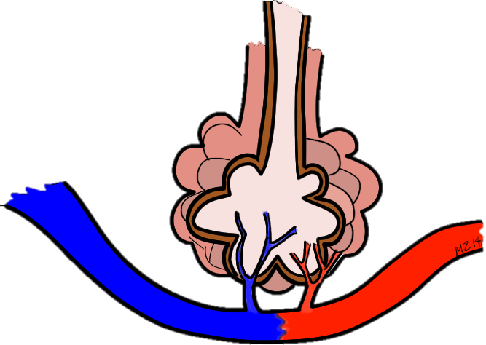
GAS EXCHANGE IN THE LUNGS
Mouth
Alveoli
6
CO₂ Blood from Body to Lungs
O₂ Blood Out from Lungs to Body
O₂ IN
CO₂ OUT
Red Blood Cell
Carbon Dioxide Molecule
Oxygen Molecule

Slide 3
introduction
Gas exchange between the alveolar air and the pulmonary capillaries results in an increased oxygen concentration and a decreased carbon dioxide concentration in the blood leaving the lungs

Slide 4
Blood Gases
Total pressure of a gas mixture is = to the sum of the independent, partial pressures of each gas (Dalton’s Law).
In sea level atmosphere:
P_{STP} = 760 mm Hg = PN₂ + P0₂ + PC0₂ + PH₂0

Slide 5
Dalton’s law
the total pressure of a gas mixture (such as air) is equal to the sum of the pressures that each gas in the mixture would exert independently.
The pressure that a particular gas in a mixture exerts independently is the partial pressure of that gas, which is equal to the product of the total pressure and the fraction of that gas in the mixture.

Slide 6
…
The total pressure of the gas mixture is equal to the sum of the partial pressures of the constituent gases.
Because oxygen constitutes about 21% of the atmosphere, eg, its partial pressure (abbreviated P O 2 ) is 21% of 760, or about 159 mmHg.
Nitrogen constitutes about 78% of the atmosphere, so its partial pressure is equal to 0.78 × 760 = 593 mmHg.

Slide 7
…
With increasing altitude, the total atmospheric pressure and the partial pressure of the constituent gases decrease.
At Denver (5,000 feet above sea level), eg, the atmospheric pressure is decreased to 619 mmHg and the P O 2 is therefore reduced to 619 × 0.21 = 130 mmHg.
At the peak of Mount Everest (at 29,000 feet) the P O 2 is only 42 mmHg.
As one descends below sea level, as in scuba diving, the total pressure increases by one atmosphere for every 33 feet.
At 33 feet therefore, the pressure equals 2 × 760 = 1,520 mmHg.
At 66 feet the pressure equals three atmospheres.

Slide 8
Effects of water on partial pressure
Inspired air contains variable amounts of moisture. By the time the air has passed into the respiratory zone of the lungs, however, it is normally saturated with water vapor (has a relative humidity of 100%).
The capacity of air to contain water vapor depends on its temperature; since the temperature of the respiratory zone is constant at 37 ° C, its water vapor pressure is also constant (at 47 mmHg).

Slide 9
The relationship between alveoli and blood vessels.

Slide 10
Partial Pressures of Gases in Blood
When a liquid and a gas, such as blood and alveolar air, are at equilibrium, the amount of gas dissolved in the fluid reaches a maximum value.
According to Henry’s law, this value depends on:
the solubility of the gas in the fluid, which is a physical constant;
the temperature of the fluid— more gas can be dissolved in cold water than warm water; and
the partial pressure of the gas.

Slide 11
…
Because solubility is a constant and the temperature of the blood does not vary significantly, the concentration of a gas dissolved in a fluid (such as plasma) depends directly on its partial pressure in the gas mixture.
When water—or plasma—is brought into equilibrium with air at a PO2 of 100 mmHg, for example, the fluid will contain 0.3 ml of O2 per 100 ml fluid at 37 ° C.
If the PO2 of the gas were reduced by half, the amount of dissolved oxygen would also be reduced by half.

Slide 12
Significance of Blood PO2 and PCO2 Measurements
Because blood P O 2 measurements are not directly affected by the oxygen in red blood cells, the P O 2 does not provide a measurement of the total oxygen content of whole blood.
It does, however, provide a good index of lung function.
If the inspired air has a normal P O 2 but the arterial P O 2 is below normal, for example, you could conclude that gas exchange in the lungs is impaired.

Slide 13
Pulmonary Circulation and Ventilation/Perfusion Ratios
the right ventricle (like the left) has a cardiac output of about 5.5 L per minute.
The rate of blood flow through the pulmonary circulation is thus equal to the flow rate through the systemic circulation.
Blood flow, is directly proportional to the pressure difference between the two ends of a vessel and inversely proportional to the vascular resistance.

Slide 14
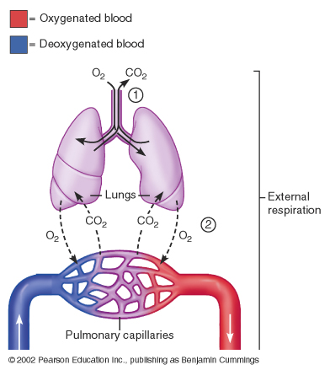
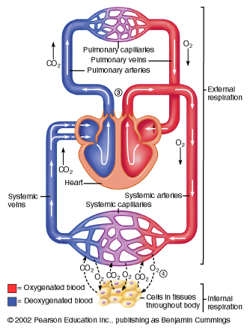
Circulation Overview

Slide 15
…
Because the driving pressure in the pulmonary circulation is only one-tenth that of the systemic circulation and yet the flow rates are equal, it follows that the pulmonary vascular resistance must be one-tenth that of the systemic vascular resistance.
The pulmonary circulation, in other words, is a low-resistance, low-pressure pathway.
The low pulmonary blood pressure produces less filtration pressure than systemic capillaries, and thus affords protection against pulmonary edema

Slide 16
..
Pulmonary arterioles constrict when the alveolar PO2 is low and dilate as the alveolar P O2 is raised.
This response is opposite to that of systemic arterioles, which dilate in response to low tissue PO2.
Dilation of the systemic arterioles when the P O 2 is low helps to supply more blood and oxygen to the tissues; constriction of the pulmonary arterioles when the alveolar P O 2 is low helps decrease blood flow to alveoli that are inadequately ventilated.
If this did not occur, blood from poorly ventilated alveoli would mix with blood from well ventilated alveoli, and the blood leaving the lungs would have a lowered P O 2 as a result of this dilution effect

Slide 17
Dilution of the PO2 of pulmonary vein blood actually does occur to some degree, despite these regulatory mechanisms.
When a person stands upright, the force of gravity causes a greater blood flow to the base of the lungs than to the apex (top).
Ventilation likewise increases from apex to base, because there is less lung tissue in the apex and less expansion of alveoli during inspiration.

Slide 18
…
However, the increase in ventilation from apex to base is not proportionate to the increase in blood perfusion.
The ventilation/perfusion ratio at the apex is thus high (0.24 L air divided by 0.07 L blood per minute gives a ratio of 3.4/1.0), while at the base of the lungs it is low (0.82 L air divided by 1.29 L blood per minute gives a ratio of 0.6/1.0).
Functionally, the alveoli at the apex of the lungs are thus overventilated (or underperfused), and they are larger than alveoli at the base.

Slide 19
Disorders Caused by High Partial Pressures of Gases

Slide 20
Oxygen Toxicity
higher partial oxygen pressures can be very dangerous.
Oxygen toxicity may develop rapidly when the P O 2 rises above about 2.5 atmospheres.
This is apparently caused by the oxidation of enzymes and other destructive changes that can damage the nervous system and lead to coma and death.
For these reasons, deep-sea divers commonly use gas mixtures in which oxygen is diluted with inert gases such as nitrogen (as in ordinary air) or helium.

Slide 21
Nitrogen Narcosis
Although at sea level nitrogen is physiologically inert, larger amounts of dissolved nitrogen under hyperbaric (highpressure) conditions have deleterious effects, possibly caused by the increased amounts of nitrogen dissolved in plasma membranes at the high partial pressures.
Nitrogen narcosis resembles alcohol intoxication; depending on the depth of the dive, the diver may experience what Jacques Cousteau termed “rapture of the deep.”
Dizziness and extreme drowsiness are other narcotizing effects.

Slide 22
Decompression Sickness
As the diver ascends to sea level, the amount of nitrogen dissolved in the plasma decreases as a result of the progressive decrease in the P N 2 .
If the diver surfaces slowly, a large amount of nitrogen can diffuse through the alveoli and be eliminated in the expired breath.
If decompression occurs too rapidly, however, bubbles of nitrogen gas (N 2 ) can form in the tissue fluids and enter the blood

Slide 23
…
The bubbles of N2 gas in the blood can block small blood channels, producing muscle and joint pain as well as more serious damage.
These effects are known as decompression sickness, commonly called “the bends.”
The primary treatment for decompression sickness is hyperbaric oxygen treatment.
Airplanes that fly long distances at high altitudes (30,000 to 40,000 ft) have pressurized cabins so that the passengers and crew do not experience the very low atmospheric pressures of these altitudes.

Slide 24
Thank you

