Slide 1
EARLY EMBRYOLOGICAL DEVELOPMENT
PREPARED BY:MADAM RUTH

Slide 2
Week 1-3:
Formation of:
Blastocyst
Bilaminar disc
Gastrulation
Trilaminar disc
Lateral body folding
Head and tail folding
Vertebrate body plan

Slide 3
Week 1:
4 cell stage
Late Day 2
Morula
Day 3
2 cell stage
Day 2
Blastocyst
Day 5
Implantation
Day 6 - 7
Fertilization
Day 1

Slide 4
Week 1
The blastocyst consists of :
Inner Cell Mass
(embryoblast)
Trophoblast
Blastocele

Slide 5
Week 1
Uterine Artery
Uterine Gland
Epithelium of Uterus
Inner Cell Mass
Trophoblast
Blastsocele

Slide 6
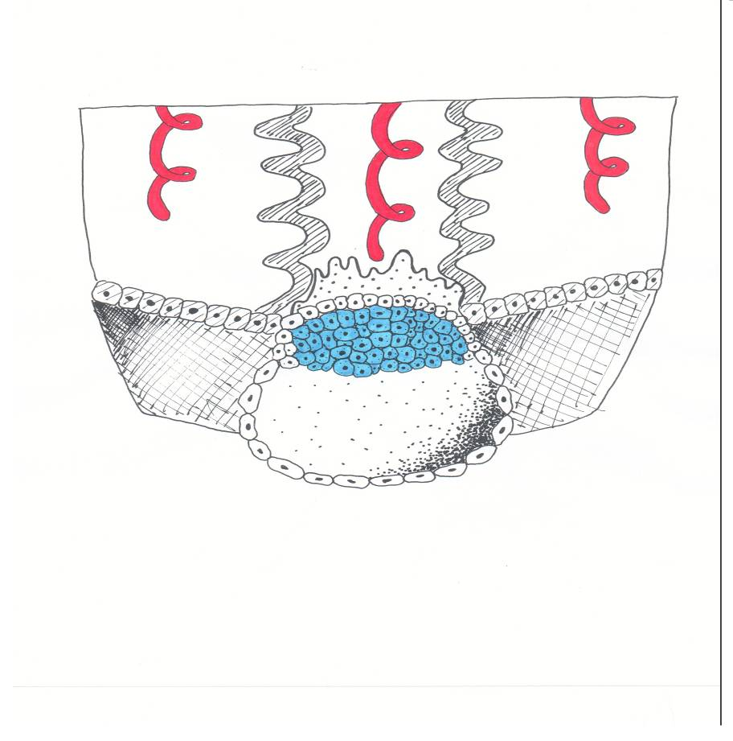
Week 2 Day 7.5
Inner Cell
Mass
Blastocyst
Cavity
Cytotrophoblast
Syncytiotrophoblast

Slide 7
Week 2: Early Development
Cytotrophoblast
Amniotic Cavity
Amnioblasts
Inner Cell Mass:
Epiblast
Hypoblast
Primary Yolk Sac
Exocoelomic Membrane

Slide 8
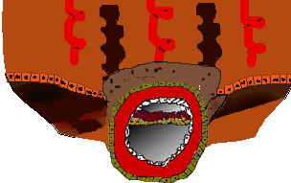
Early Development - Week 2 Day 10
Syncytiotrophoblast
Amniotic Cavity
Epiblast
Hypoblast
Primary yolk sac
Exocoelomic membrane
Cytotrophoblast
Extraembryonic mesoderm

Slide 9
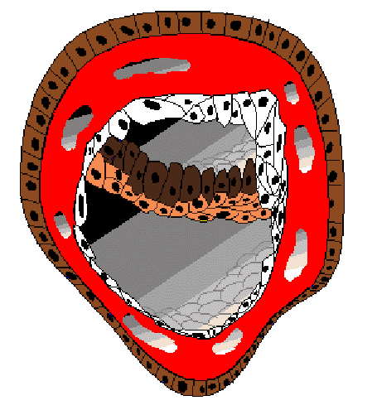
Week 2: Early Development
Lacunae
Amniotic Cavity
Epiblast
Hypoblast
Primary yolk sac
Exocoelomic membrane
Cytotrophoblast
Extraembryonic mesoderm

Slide 10
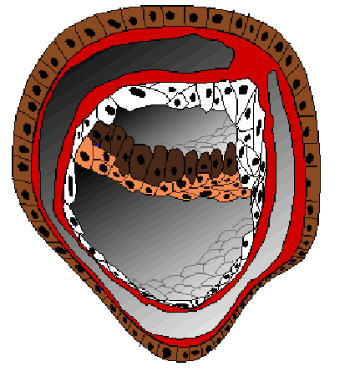
Week 2: Early Development
Connecting stalk
Cytotrophoblast
Epiblast
Hypoblast
Amniotic
Cavity
Extraembryonic
somatopleuric
mesoderm
Primary
Yolk
Sac
Extraembryonic
splanchnopleuric mesoderm
Extraembryonic Coelom

Slide 11
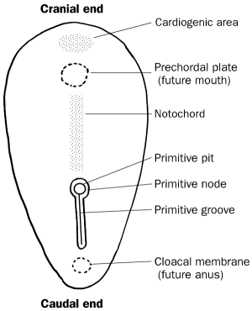
Third week of development (trilaminar disc)
Gastrulation: is the process of formation of the 3 germ layers (ectoderm, mesoderm & endoderm).
It begins by the formation of a mid line groove on the epiblast called primitive streak.
The cephalic end of this streak is called primitive node. In the center of this node there is primitive pit.
The epiblastic cells migrate & reach the primitive streak.
They slip under the primitive streak (invaginate) forming endoderm.
Some of invaginated epiblastic cells forms the intra-embryonic mesoderm.
Thus the epiblast is the source of the 3 germ layers, which are ectoderm (dorsally), endoderm (ventrally) and in-between these 2 layers is the mesoderm.
From these 3 germ layers arise all organs & tissues of the body.

Slide 12
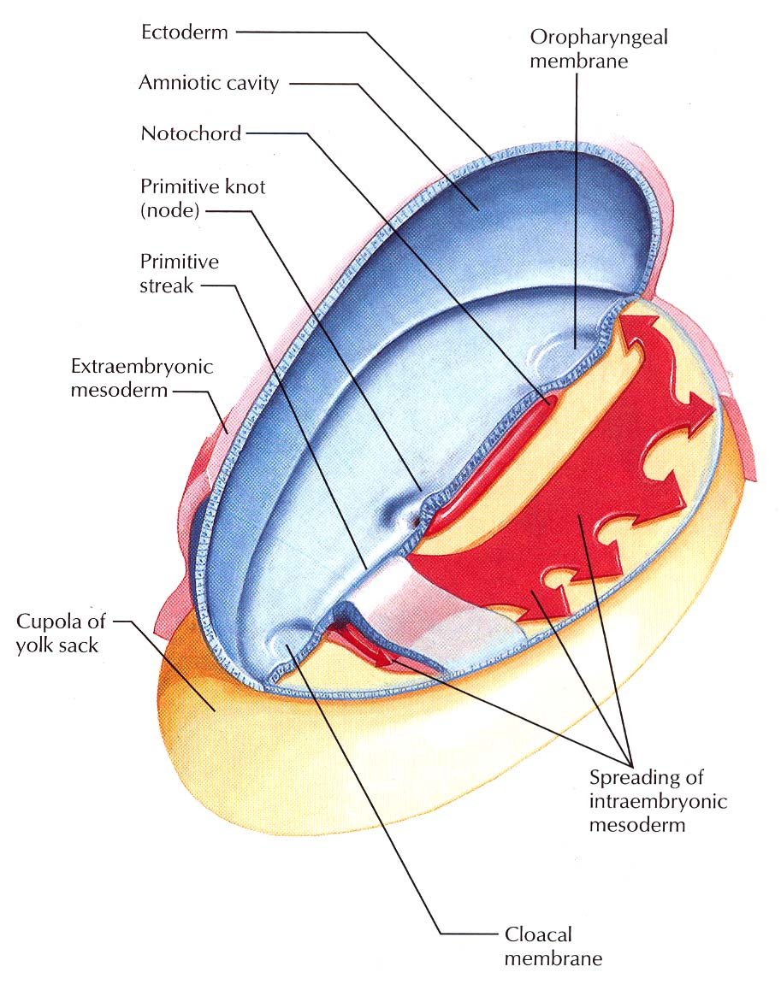
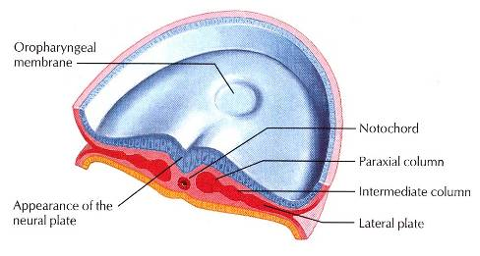
Trilaminar Embryonic Disc

Slide 13
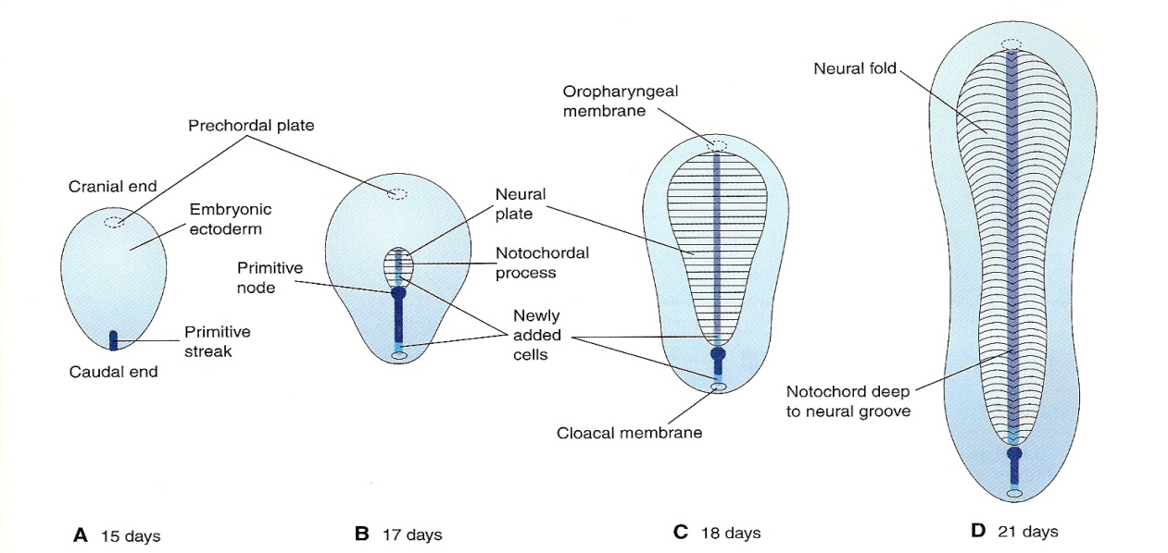
Gastrulation

Slide 14
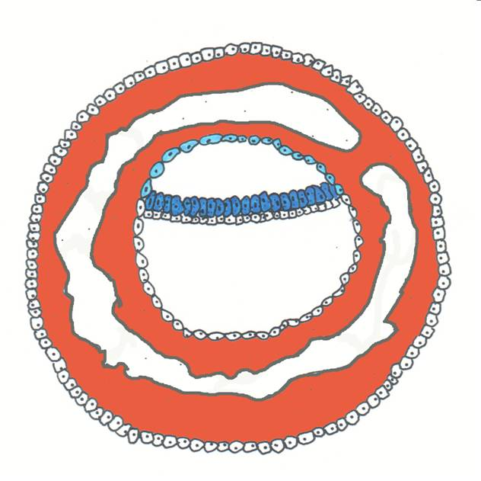
Third Week
Extraembryonic
Somatopleuric
Mesoderm
cytotrophoblast
Extraembryonic
Splanchnopleuric
Mesoderm
Epiblast
Hypoblast
Primitive
Yolk
Sac
Extraembryonic
Coelom

Slide 15
Gastrulation
Amnion
Hypoblast
Epiblast
Primary Yolk Sac
Extraembryonic
splanchnic mesoderm

Slide 16
Gastrulation
Amniotic Cavity
Epiblast
Primary Yolk Sac
Hypoblast

Slide 17
Gastrulation
Primitive Node
Primitive Pit

Slide 18
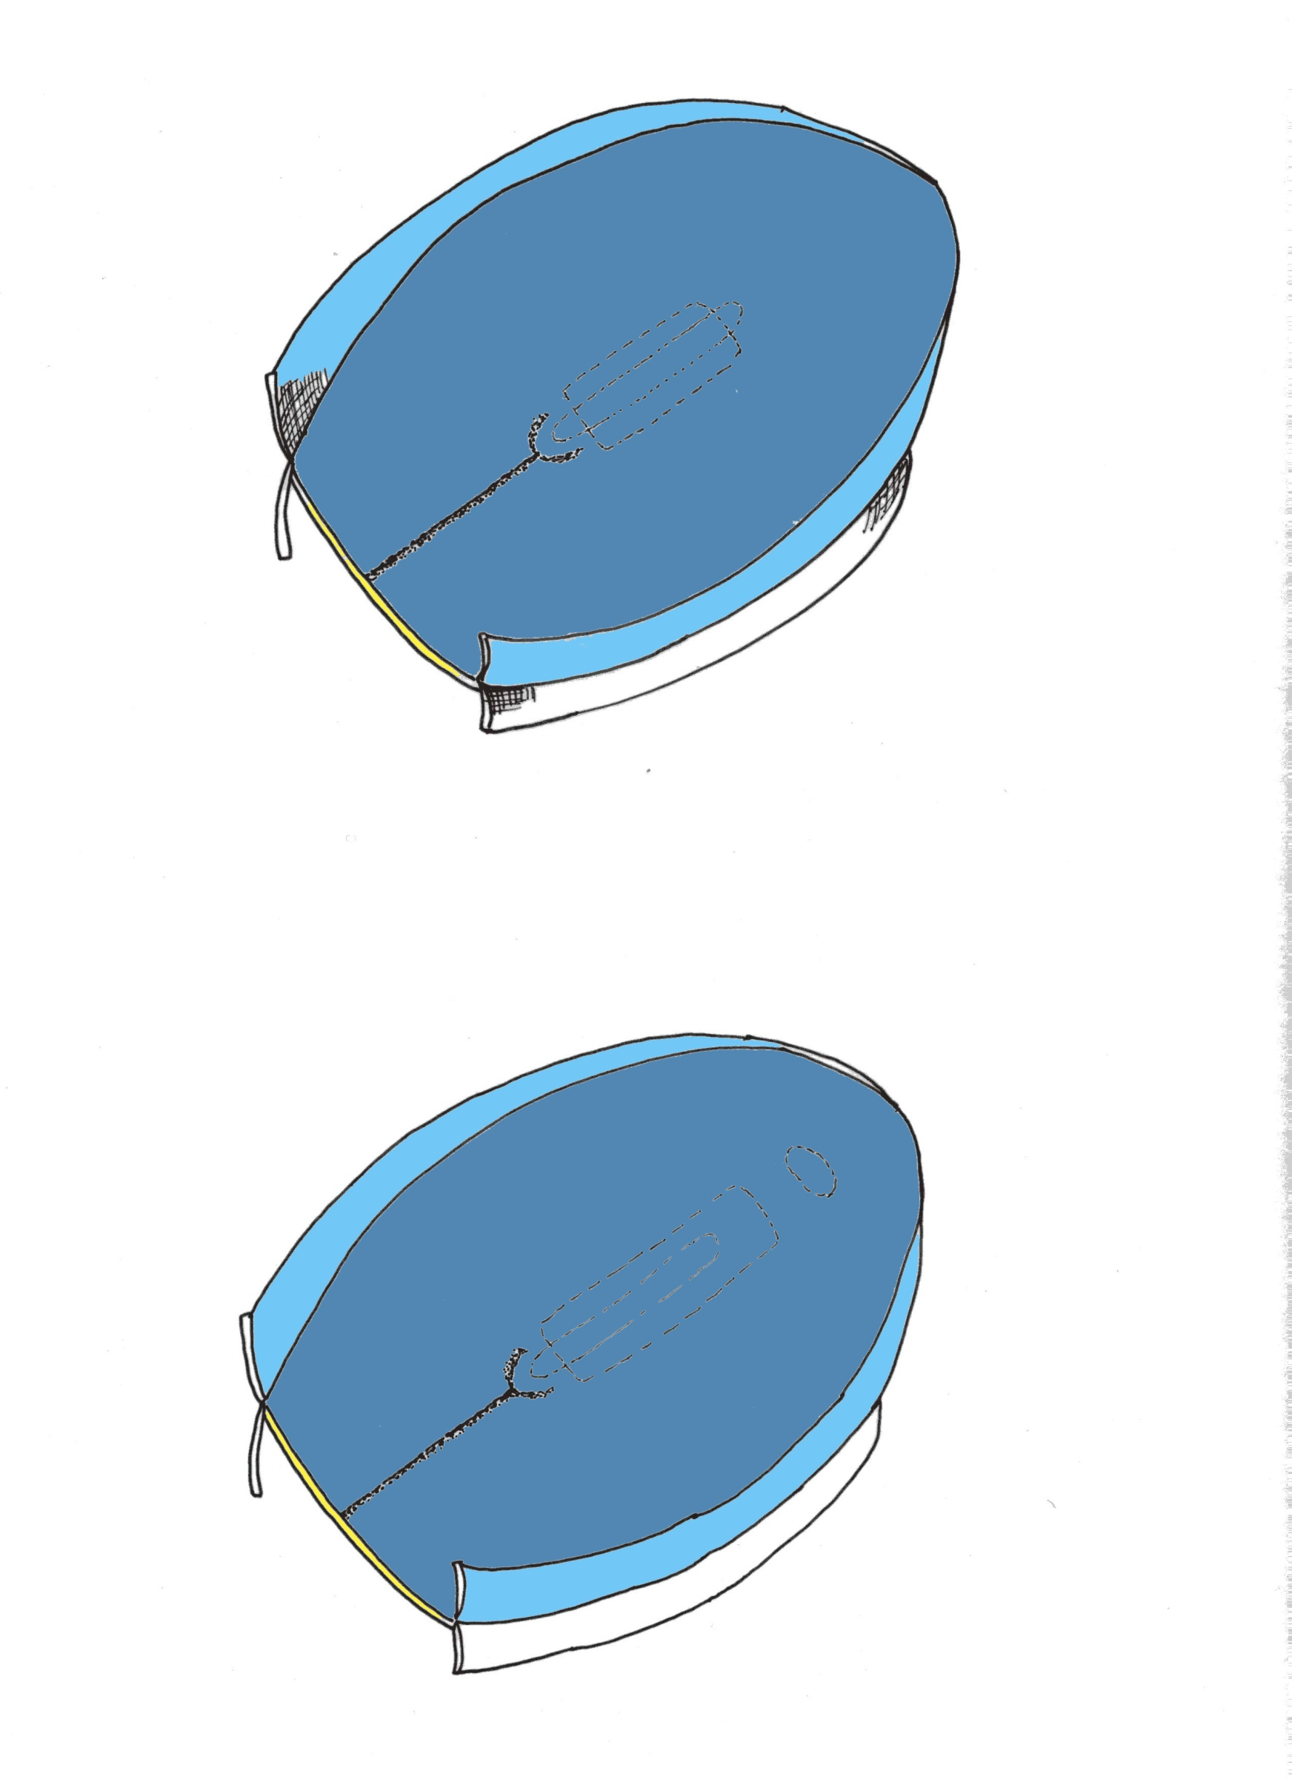

Slide 19
Gastrulation

Slide 20
Gastrulation
Primitive Node
Primitive Pit
Notochordal Process

Slide 21
Gastrulation

Slide 22
Formation of the notochord
- Epiblastic cells invaginate the primitive pit. They migrate cranially in the midline forming the notochordal plate. This plate lies between the endoderm & ectoderm. This plate will form solid cord called the notochord.
- The notochord is a solid mid line axis, so it forms fetal skeleton. Formation of the 3 germ layers occurred in a cephalocaudal direction, this means that the 3 germ layer are establish first in the head region then the tail region. Also tissues and organs develop in a cephalocaudal direction.

Slide 23
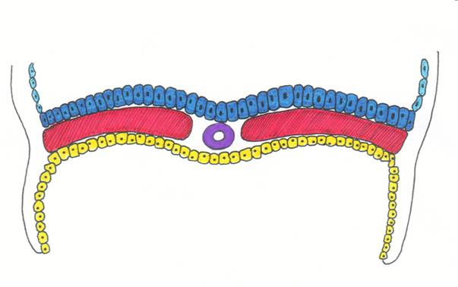
Gastrulation
ectoderm
mesoderm
notochordal
canal
endoderm
notochordal process

Slide 24
Gastrulation
Neurenteric Canal
Notochordal plate

Slide 25
Gastrulation
Notochordal Plate

Slide 26
Intraembryonic mesoderm
The cells of the primitive streak& notochordal process proliferate→2ry mesoderm → migrate laterally & cranially between ectoderm& endoderm except oral membrane ( cranially) & cloacal membrane (caudally).
The embryo now is called gastrula.
Dorsal aspect of pear shaped embryo

Slide 27
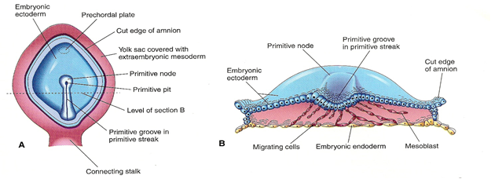

Slide 28
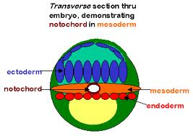

Slide 29
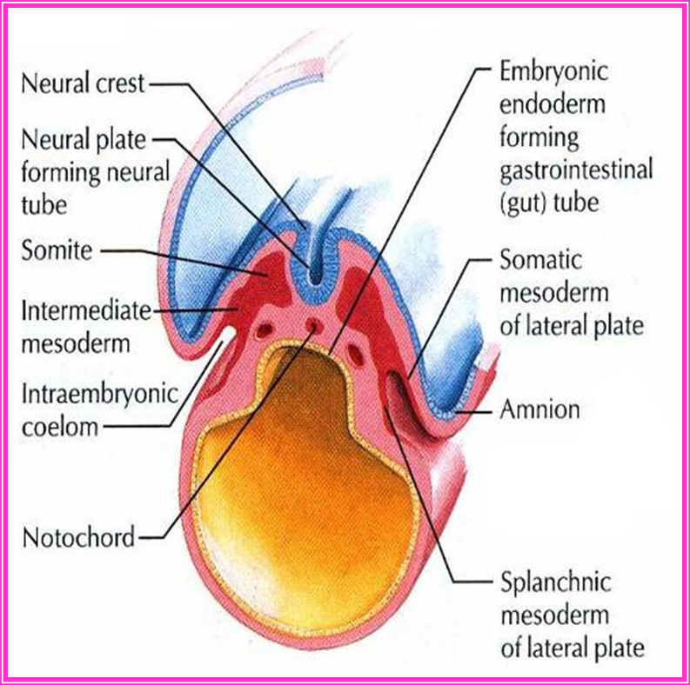
Functions of the notochord
1.It forms the basis of the
axial skeleton (bones of the head and vertebral column).
2. It induces the overlying ectoderm to thicken and form the neural plate; the primordium of the central nervous system (Notochord is the organizer for nervous system formation) .

Slide 30
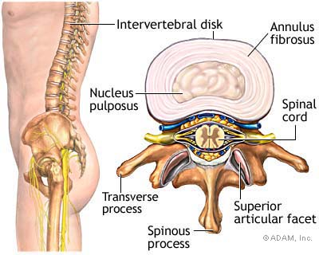
Functions of the notochord
3. The notochord degenerates and disappears as the bodies of the vertebrae form. Its remnant is the nucleus pulposus of the intervertebral discs.
4. It functions as the primary inducer in the early embryo i.e. it is a prime mover in a series of signal-calling episodes that ultimately transform unspecialized embryonic cells into definitive adult tissues and organs

Slide 31
Gastrulation
Ectoderm
Paraxial mesoderm
Intermediate mesoderm
Lateral plate mesoderm
Amniotic Cavity
Yolk Sac
Notochord
Endoderm

Slide 32
Formation of the Body Axis The cranial end of the embryo
Anterior visceral endoderm (AVE)
OTX, LIM1, HESX1 transcription factors
secreted factor ceberus

Slide 33
Formation of the Body Axis
BMP-4
FGF
BMP-4
FGF
Lateralize
Mesoderm:
Intermediate and
Lateral Plate mesoderm
BMP-4 – bone morphogenetic protein-4 with
FGF – Fibroblast growth factor

Slide 34
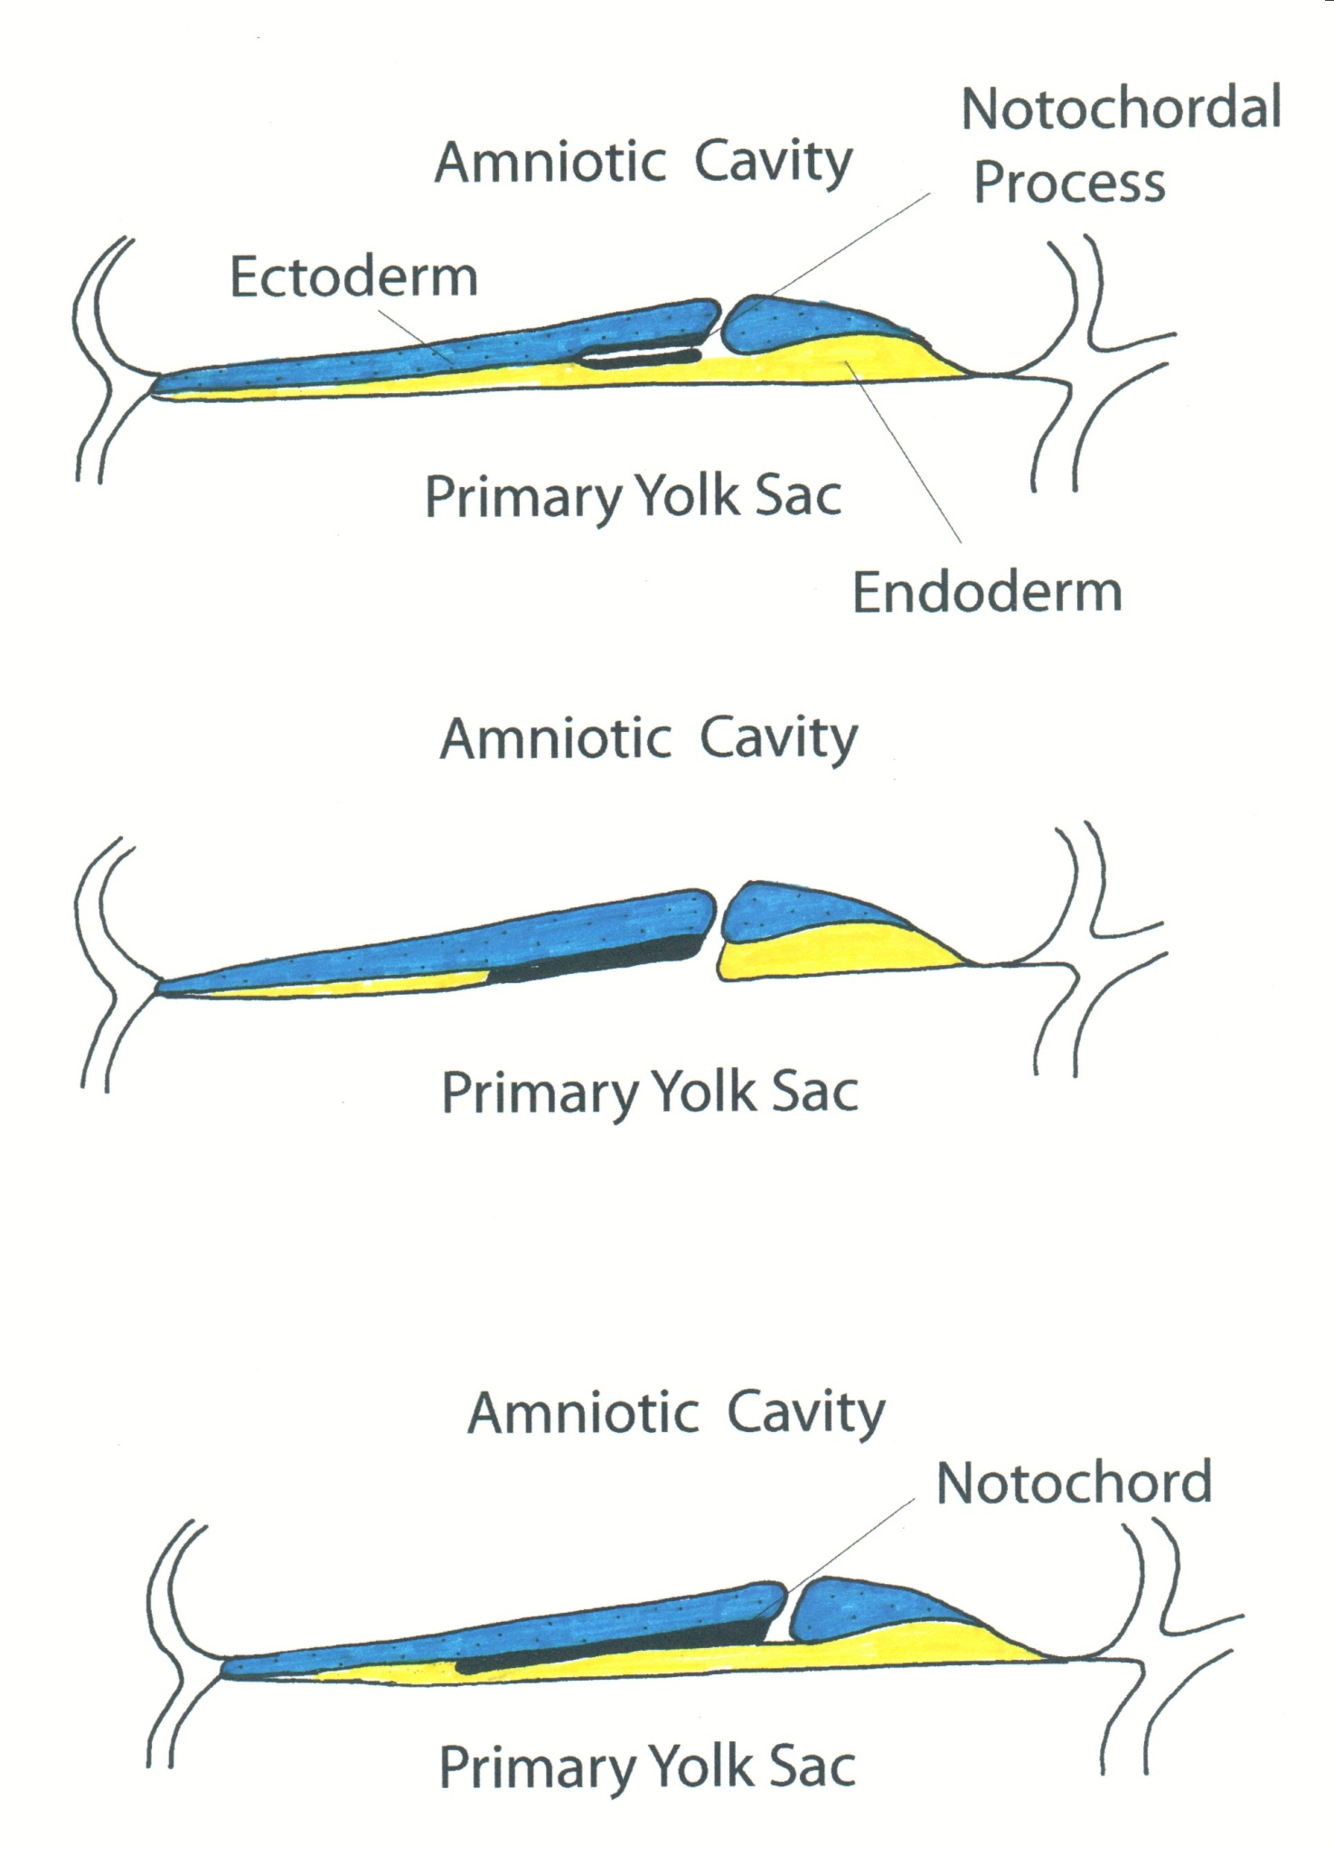
Formation of the Body Axis
Cranial Mesoderm
Notochord
Somites
Somitomeres
Goosecoid, chordin
Noggin and follistatin
Dorsalize mesoderm into
Notochord and Paraxial Mesoderm

Slide 35
Formation of the Body Axis
Nodal
HNF-3β
Brachyury (T) gene
Forebrain
Midbrain
Mid and caudal
midline mesoderm
development

Slide 36
Formation of the Body Axis Left – Right Sidedness
FGF8 Nodal Lefty PITX2

Slide 37
Cilia in Left – Right sidedness
Situs inversus
20% (Kartagener syndrome)
Dysfunctional cilia
Respiratory problems
Male fertility problems

Slide 38
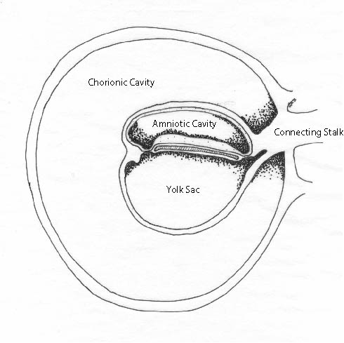
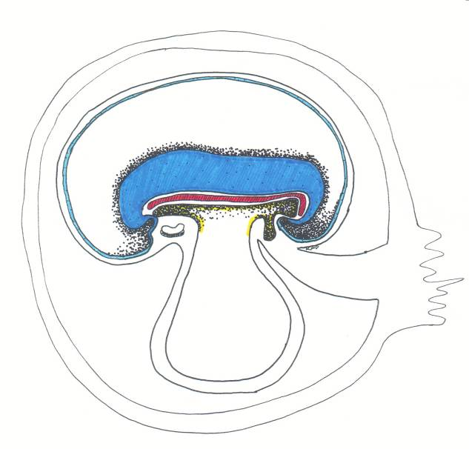

Slide 39
Clinical application
Third week of development is a very sensitive period in fetal development. Many factors such as drugs, alcohol or irradiation to the mother may cause congenital anomalies to her embryo.

Slide 40
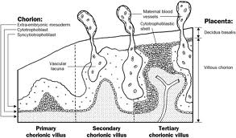
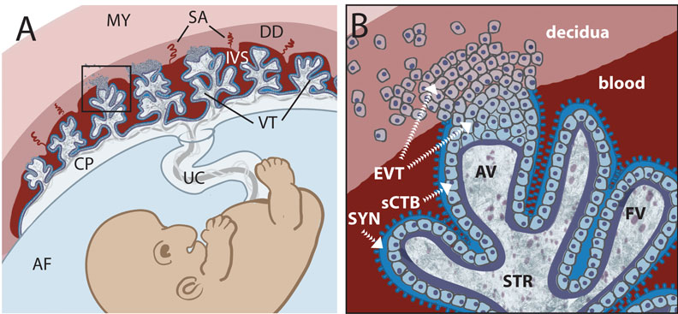
Development of trophoblast
1- At the beginning of the 3rd week, the trophoplast is characterized by primary villi.
It is formed by cytotrophoblast covered with syncytiotrophoblast.
They bathed in the intervillus spaces.
2- The mesodermal cells invade these villi. The newly formed villi are called secondary villi.
3- The mesodermal core inside the secondary villi form small blood vessels, the villi after the appearance of blood vessels are called tertiary villi.
The trophoblast after the formation of villi is called chorion.
The blood vessels in the villi are connected to the circulation of the embryo.

Slide 41
Function of the villi
Nutrition of the embryo (free villi).
Fixation of the embryo (anchoring villi).
Respiration of the embryo.
Excretion of the embryo.

Slide 42
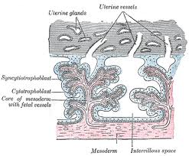
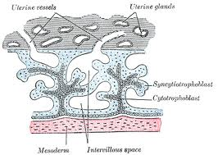
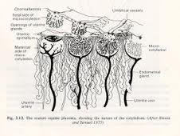
1ry villi
2ry villi
3ry villi

Slide 43
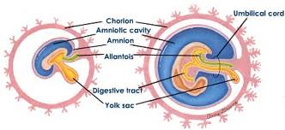
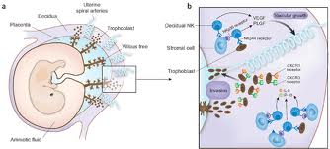
- With development of the embryo, the chorionic villi toward the decidua basalis grow and become well developed. So the chorion there is called chorion frondosum.
- While the villi toward the decidua capsularis become poorly developed, the chorion there is called chorion leava.
chorion frondosum
Chorion leava

Slide 44
Embryonic period (from 3rd to 8th week)
It is the period during which the 3 germ layers (ectoderm-endoderm-mesoderm) give the different tissues & organs.
Ectoderm gives:
Central and peripheral nervous system, skin & pituitary gland.
Endoderm gives:
Epithelial lining of the gastrointestinal tract, respiratory and part of urinary tracts.
Mesoderm:

Slide 45
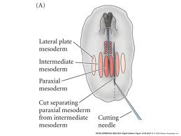
Mesoderm:
It differentiates into:
1-Axial mesoderm (primitive
streak, primitive node, notochord)
2-Paraxial mesoderm gives final count of approximately 35 pairs of somites. These somites further differentiate into 3 components:
a- Sclerotome (cartilage and bone)
b- Myotome (muscles)
c- Dermatome (dermis of skin)
3-Intermediate cell mass (gives kidneys& genital system)
4-Lateral plate of mesoderm.

Slide 46
4-Lateral plate of mesoderm
differentiates into:
a-somatopleure (gives the voluntary muscles of chest and abdomen and the parietal layer of pleura and peritoneum.
b- splanchnopleure (gives the involuntary muscles of heart, bronchial tree, and gut and the visceral layer of pleura and peritoneum).
The cavity between these two layers is the intraembryonic coelom.

Slide 47
Intraembryonic coelom
- It is inverted U shaped space. It will give rise to:
a. The future pericardial cavity: anterior transverse part lies anterior to the buccopharyngeal membrane.
b. The future peritoneal cavity: from its posterior part.
c. The future pleural cavity: between the above two cavities.

Slide 48
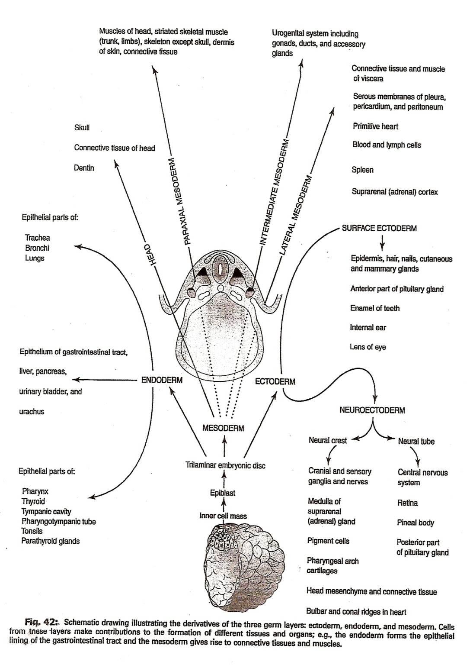

Slide 49
Fetal Period
it starts from the third month till birth. It is characterized by rapid growth of the body & tissue maturation.

