Slide 1
GENITAL URINARY SYSTEM ANATOMY

Slide 2
Function and components
The principal function of the urinary system is the maintenance of water, electrolyte and acid-base homeostasis
comprises of
-two kidneys,
-two ureters,
-a bladder and urethra.

Slide 3
Urine is produced in the kidneys and flows down the ureters to the bladder where it is stored until voided via the urethra.
NB> No further modification of the urine takes place after it leaves the kidneys.

Slide 4
:Location-The kidneys and ureters are found in the retroperitoneum while the urinary bladder is in the anterior part of the pelvis

Slide 5
Organs of the Urinary System
-Kidneys
-Ureters
-Urinary -bladder
-Urethra

Slide 6
Location and External Anatomy of Kidneys
Located retroperitoneally
Lateral to T₁₂–L₃ vertebrae
Average kidney
12 cm tall, 6 cm wide, 3 cm thick
Hilus
On concave surface
Vessels and nerves enter and exit
Renal capsule surrounds the kidney

Slide 7
Relationship of the Kidneys to Vertebra and Ribs

Slide 8
Internal Gross Anatomy of the Kidneys
Frontal section through the kidney
Renal cortex
Renal pyramids
Renal pelvis
Major calicies
Minor calicies
Gross vasculature
Renal arteries
Branch into segmental arteries

Slide 9
Summary of Blood Vessels Supplying the Kidney

Slide 10
Internal Gross Anatomy of the Kidneys
Nerve supply – renal plexus
A network of autonomic fibers
A branch of the celiac plexus

Slide 11
Internal Anatomy of the Kidneys

Slide 12
Microscopic Anatomy of the Kidneys
Uriniferous tubules
Composed of
Nephron
Renal corpuscle plus renal tubules
Collecting duct
Involved in concentrating urine

Slide 13
Mechanisms of Urine Production
Filtration
Filtrate of blood leaves kidney capillaries
Reabsorption
Most nutrients, water, and essential ions reclaimed

Slide 14
Secretion
Active process of removing undesirable molecules

Slide 15
Uriniferous Tubule

Slide 16
Renal corpuscle
Glomerulus and glomerular capsule
Glomerulus – tuft of capillaries
Capillaries of glomerulus are fenestrated
Glomerular (Bowman’s) capsule
Parietal layer – simple squamous epithelium
Visceral layer – consists of podocytes

Slide 17
Classes of Nephron
Cortical nephrons
85% of nephrons
Juxtamedullary nephrons
15% of nephrons

Slide 18
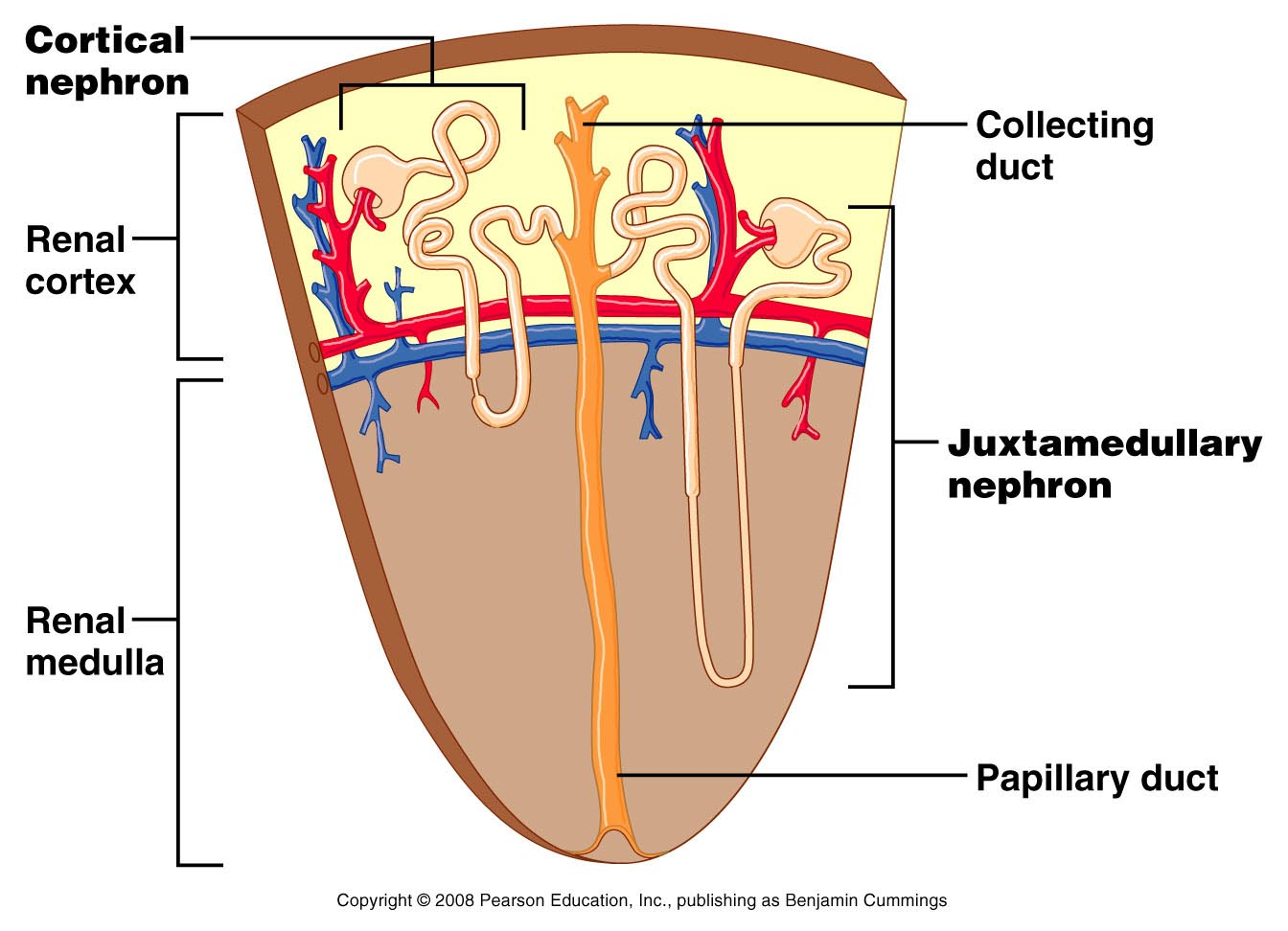
Collecting Tubules (Collecting duct)
Collecting tubules
Receive urine from distal convoluted tubules

Slide 20
Microscopic Anatomy of the Kidney
Juxtaglomerular apparatus
Functions in the regulation of blood pressure
Juxtaglomerular cells – secrete renin
Macula densa
A portion of distal convoluted tubule
Tall, closely packed epithelial cells
Act as chemoreceptors

Slide 21
The Ureters
The ureters are two thick tubes which act to transport urine from the kidney to the bladder.
They are approximately 25cm long and are situated bilaterally, with each ureter draining one kidney.

Slide 22
Anatomical Course
The ureters arise in the abdomen as a continuation of the renal pelvis, and terminate in the pelvic cavity – where they empty into the bladder.

Slide 23
The anatomical course of the ureters can therefore be divided into abdominal and pelvic components

Slide 25
Abdominal Part
The ureters arise from the renal pelvis – a funnel like structure located within the hilum of the kidney. The renal pelvis receives urine from the major calyces. The point at which the renal pelvis narrows to form the ureter is known as the ureteropelvic junction.

Slide 26
The ureters descend through the abdomen, along the anterior surface of the psoas major. Here, the ureters are a retroperitoneal structure (located behind the peritoneum).

Slide 27
At the area of the sacroiliac joints, the ureters cross the pelvic brim, thus entering the pelvic cavity. At this point, they also cross the bifurcation of the common iliac arteries.

Slide 28
Pelvic Part
Once within the pelvic cavity, the ureters travel down the lateral pelvic walls. At the level of the ischial spines, they turn anteromedially, moving in a transverse plane towards the bladder.

Slide 29
Upon reaching the bladder wall, the ureters pierce its lateral aspect in an oblique manner. This creates a one way valve, where high intramural pressure collapses the ureters – preventing the back-flow of urine.

Slide 30
Clinical Relevance - Vascular Relations of the Ureters
The anatomical course of the ureters is of surgical importance, as they travel close to other structures in the pelvis. They must be identified during pelvic surgery to ensure that they are not accidentally damaged.

Slide 31
Female
As they cross the pelvic brim, the ureters are in close proximity to the ovaries. Care must be taken not the damage the ureters during an oophorectomy, especially during the ligation of the ovarian arteries.

Slide 32
Approximately 2cm superior to the ischial spine, the ureters run underneath the uterine artery. During a hysterectomy, where the uterus and uterine artery are removed, the ureter is in danger of being accidentally damaged.

Slide 33
Relationship between the ureter and uterine artery

Slide 34
Male
In men, instead of the uterine arteries, the vas deferens cross the ureters anteriorly.

Slide 35
Neurovascular Supply
The ureter is a structure that has developed via the ureteric bud from the mesonephric duct, and then followed the kidney during its ascend to the final lumbar position in the retroperitoneum.

Slide 36
This long, ascending course has enabled the ureter to acquire vessels (arteries, veins and lymph vessels) of different origin during its route. The arterial supply to the ureters can be divided into abdominal and pelvic supply:

Slide 37
Abdominal – renal artery, testicular/ovarian artery, and ureteral branches directly from the abdominal aorta
Pelvic – superior and inferior vesical arteries.

Slide 38
Venous drainage is carried out by vessels that correspond to the above arteries.

Slide 39
Nervous supply to the ureters is delivered via the renal, testicular/ovarian and hypogastric plexuses. Sensory fibres from the ureters enter the spinal cord at T11-L2, with ureteric pain referred to those dermatomal areas.

Slide 41
Microscopic Structure of the Ureter

Slide 42
Clinical Relevance: Ureteric Calculus
A ureteric calculus (or kidney stone), is the presence of a solid stone in the urinary tract, formed from minerals within the urine. These can obstruct urinary flow, causing renal colic (an acute and severe loin pain) and haematuria (blood in the urine).

Slide 43
The Urinary Bladder
The bladder is an organ of the urinary system. It plays two main roles:
Temporary storage of urine – the bladder is a hollow organ with distensible walls. It has a folded internal lining (known as rugae), which allows it to accommodate up to 300-400ml of urine in healthy adults.

Slide 44
Assists in the expulsion of urine – the musculature of the bladder contracts during micturition, with concomitant relaxation of the sphincters

Slide 45
In the young child, the empty bladder projects above the pelvic inlet; later, when the pelvic cavity enlarges, the bladder sinks into the pelvis to take up the adult position

Slide 47
Shape of the Bladder
The appearance of the bladder varies depending on the amount of urine stored. When full, it exhibits an oval shape, and when empty it is flattened by the overlying bowel.
The external features of the bladder are:

Slide 48
Apex – located superiorly, pointing towards the pubic symphysis. It is connected to the umbilicus by the median umbilical ligament (a remnant of the urachus).
Body – main part of the bladder, located between the apex and the fundus

Slide 49
Fundus (or base) – located posteriorly. It is triangular-shaped, with the tip of the triangle pointing backwards.
Neck – formed by the convergence of the fundus and the two inferolateral surfaces. It is continuous with the urethra.

Slide 52
A collapsible muscular sac
Stores and expels urine
Full bladder – spherical
Expands into the abdominal cavity
Empty bladder – lies entirely within the pelvis

Slide 53
Structure of the Urinary Bladder and Urethra

Slide 55
Musculature
The musculature of the bladder plays a key role in the storage and emptying of urine.
In order to contract during micturition, the bladder wall contains specialised smooth muscle – known as detrusor muscle.

Slide 56
Its fibres are orientated in multiple directions, thus retaining structural integrity when stretched. It receives innervation from both the sympathetic and parasympathetic nervous systems.

Slide 57
The fibers of the detrusor muscle often become hypertrophic (presenting as prominent trabeculae) in order to compensate for increased workload of the bladder emptying. This is very common in conditions that obstruct the urine outflow such as benign prostatic hyperplasia.

Slide 58
There are also two muscular sphincters located in the urethra:
Internal urethral sphincter:
Male – consists of circular smooth fibres, which are under autonomic control. It is thought to prevent seminal regurgitation during ejaculation.

Slide 59
Females – thought to be a functional sphincter (i.e. no sphincteric muscle present). It is formed by the anatomy of the bladder neck and proximal urethra.

Slide 60
External urethral sphincter – has the same structure in both sexes. It is skeletal muscle, and under voluntary control. However, in males the external sphincteric mechanism is more complex, as it correlates with fibers of the rectourethralis muscle and the levator ani muscle

Slide 61
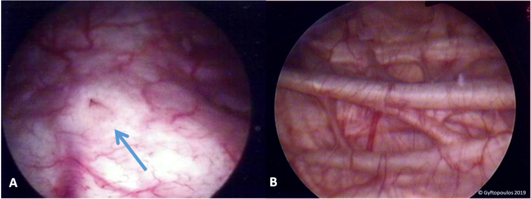
– Endoscopic view of the bladder. (A) The trigone and right ureteric orifice. (B) Prominent trabeculae of the bladder wall (hypertrophic fibers of the detrusor muscle).

Slide 62
Vasculature
The vasculature of the bladder is primarily derived from the internal iliac vessels.
Arterial supply is via the superior vesical branch of the internal iliac artery.

Slide 63
In males, this is supplemented by the inferior vesical artery, and in females by the vaginal arteries. In both sexes, the obturator and inferior gluteal arteries may also contribute small branches.

Slide 64
Venous drainage is achieved by the vesical venous plexus, which empties into the internal iliac veins. The vesical plexus in males is in continuity at the retropubic space with the prostate venous plexus (plexus of Santorini), which also receives blood from the dorsal vein of the penis

Slide 65
Arterial supply to the bladder via the superior vesical arteries.

Slide 66
Lymphatics
The superolateral aspect of the bladder drains into the external iliac lymph nodes. The neck and fundus drain into the internal iliac, sacral and common iliac nodes.

Slide 67
Nervous Supply
Neurological control is complex, with the bladder receiving input from both the autonomic (sympathetic and parasympathetic) and somatic arms of the nervous system:

Slide 68
Sympathetic – hypogastric nerve (T12 – L2). It causes relaxation of the detrusor muscle, promoting urine retention.

Slide 69
Parasympathetic – pelvic nerve (S2-S4). Increased signals from this nerve causes contraction of the detrusor muscle, stimulating micturition.
Somatic – pudendal nerve (S2-4). It innervates the external urethral sphincter, providing voluntary control over micturition.

Slide 70
In addition to the efferent nerves supplying the bladder, there are sensory (afferent) nerves that report to the brain. They are found in the bladder wall and signal the need to urinate when the bladder becomes full.

Slide 71
The Bladder Stretch Reflex
The bladder stretch reflex is a primitive spinal reflex, in which micturition is stimulated in response to stretch of the bladder wall.

Slide 72
The reflex arc:
Bladder fills with urine, and the bladder walls stretch. Sensory nerves detect stretch and transmit this information to the spinal cord.

Slide 73
Interneurons within the spinal cord relay the signal to the parasympathetic efferents (the pelvic nerve).
The pelvic nerve acts to contract the detrusor muscle, and stimulate micturition.

Slide 74
The Urethra
The urethra is the vessel responsible for transporting urine from the bladder to an external opening in the perineum.

Slide 75
It is lined by stratified columnar epithelium, which is protected from the corrosive urine by mucus secreting glands.

Slide 76
Male Urethra
The male urethra is approximately 15-20cm long. In addition to urine, the male urethra transports semen – a fluid containing spermatozoa and sex gland secretions.

Slide 77
Coronal section of the penis, showing the three parts of the urethra

Slide 78
According to the latest classification, the male urethra can be divided anatomically into three parts (proximal to distal):

Slide 79
Prostatic urethra:
Begins as a continuation of the bladder neck and passes through the prostate gland.
It is the widest and most dilatable portion of the urethra.

Slide 80
Receives the ejaculatory ducts (containing spermatozoa from the testes and seminal fluid from the seminal vesicle glands) and the prostatic ducts (containing alkaline fluid).

Slide 81
Membranous urethra:
Passes through the pelvic floor and the deep perineal pouch.
Surrounded by the external urethral sphincter – which provides voluntary control of micturition.
It is the narrowest and least dilatable portion of the urethra.

Slide 82
Penile (bulbous) urethra:
Passes through the bulb and corpus spongiosum of the penis, ending at the external urethral orifice (the meatus).
Receives the bulbourethral glands proximally.
In the glans (head) of the penis, the urethra dilates to form the navicular fossa.

Slide 83
Neurovascular Supply
The arterial supply to the male urethra is via several arteries:
Prostatic urethra – supplied by the inferior vesical artery (branch of the internal iliac artery which also supplies the lower part of the bladder).

Slide 84
Membranous urethra – supplied by the bulbourethral artery (branch of the internal pudendal artery)
Penile urethra – supplied directly by branches of the internal pudendal artery.

Slide 85
The nerve supply to the male urethra is derived from the prostatic plexus, which contains a mixture of sympathetic, parasympathetic and visceral afferent fibres

Slide 86
Lymphatic Drainage
Lymphatic drainage also varies according to the region of the urethra. The prostatic and membranous portions drain to the obturator and internal iliac nodes, while the penile urethra drains to the deep and superficial inguinal nodes.

Slide 87
Clinical Relevance: Male Catheterisation
Urinary catheterisation is the process of inserting a tube through the urethra and into the bladder. This is typically performed in situations where urine output needs to be monitored (such as sepsis), or when the patient is unable to pass urine (urinary retention).

Slide 88
Catheterisation is more complex in males, as there are two angles to consider – the infrapubic and prepubic angles. The prepubic angle can be diminished by holding the penis upwards during urinary catheterisation.

Slide 89
It is also important to note the three constrictions in the male urethra – the internal urethral sphincter, external urethral sphincter, and external urethral orifice.

Slide 90
The infrapubic and prepubic angles of the male urethra. The prepubic angle can be reduced by raising the penis during catheterisation.

Slide 91
Female Urethra
In females, the urethra is relatively short (approximately 4cm). It begins at the neck of the bladder, and passes inferiorly through the perineal membrane and muscular pelvic floor. The urethra opens directly onto the perineum, in an area between the labia minora, known as the vestibule.

Slide 92
Within the vestibule, the urethral orifice is located anteriorly to the vaginal opening, and 2-3cm posteriorly to the clitoris

Slide 93
The distal end of the urethra is marked by the presence of two mucous glands that lie either side of the urethra – Skene’s glands. They are homologous to the male prostate.

Slide 94
Neurovascular Supply
The arterial supply to the female urethra is via the internal pudendal arteries, vaginal arteries and inferior vesical branches of the vaginal arteries. Venous drainage is given by veins of the same names.

Slide 95
The nerve supply to the female urethra arises from the vesical plexus and the pudendal nerve. Visceral afferents from the urethra run in the pelvic splanchnic nerves.

Slide 96
Lymphatic Drainage
Lymphatic drainage of the proximal female urethra is to the internal iliac nodes, while the distal urethra drains to the superficial inguinal lymph nodes.

Slide 97
Location of the external urethral orifice in the vestibule

Slide 98
Clinical Relevance: Urinary Tract Infections
Due to the short length of the urethra, women are more susceptible to infections of the urinary tract. This usually manifests as cystitis, an infection of the bladder.

Slide 99
Common symptoms of cystitis are dysuria (pain upon urination), frequency, urgency, and haematuria (blood in the urine). A mid-stream urine sample can be tested for the presence of nitrites and leukocytes (both of which indicate infection).

Slide 100
Simple urinary tract infections are typically treated with a three-day course of antibiotics.

Slide 101
END

