Slide 1
GERIATRIC NURSING
BY
SALINE KERUBO

Slide 2
OBJECTIVES.
By the end of this module, the learner should:
Identify the health needs for the elderly persons.
Provide care for the elderly persons.
Identify social services available for the elderly.

Slide 3
INTRODUCTION TO GERIATRIC NURSING.
DEFINITIONS.
Gerontology- scientific study of aging process.
Aging – process of growing older, biologic and psychological changes.
Gerontologic Nursing – is the care and attention to individuals undergoing the aging process with emphasis on the developmental stages of aging.
Life span – maximum potential for survival (115y/o)
Life Expectancy – from birth to death.

Slide 4
Frial Old- > 75y/o , functional impairment to self care.
Centenarians-100y/o and above.
Geriatrics- the science and study of the physiologic and pathologic problems of individuals in their later maturity.
Geriatric Nursing – care of the elderly individual regardless of whether they are diseased or not.
Senescence- the normal aging process.
Senility- aging process characterized by severe mental deterioration.

Slide 5
Classification of aging.
Young Old : 65-75y/o
Old : 75-85y/o
Old Old : 85-100y/o
Elite Old : over 100

Slide 6
THEORIES OF AGING
PSYCHOSOCIAL – Describes the aging individual in terms of his /her social group or culture.
Disengagement theory: the basis of this theory arises from the fact that human beings are mortal and must eventually leave their place and role in society. Therefore ,it is their responsibility to look for suitable replacement.
Activity theory: assumes that the same norms exist for all mature individuals. The degree to which the individual “acts like” or “looks like” a middle aged is the determinant of aging process.
-One must constantly struggle to remain functional and take on new activities to replace lost one.

Slide 7
3.Continuity theory: accounts for the continuous flow of phases in the life cycle and does not limit itself to changes.
-It assumes that persons will remain the same unless there are factors that stimulate changes or necessitate adaptation.

Slide 8
B. BIOLOGICAL .
Immunological / Autoimmune theory: states that aging is caused by a change in the immune system.
There is a factor that initiates a change that causes the immune system to fail to recognize its own cell as they age.
2. Wear and Tear Theory: the body is like a machine. Parts wear out and the machine breaks down.
3. Rate of living theory: the body has a fixed rate of potential for living.

Slide 9
4.Waste theory: chemical wastes collect in the body and produce deterioration by interfering with cellular functioning.
5.Collagen theory: collagen stiffens with age, producing loss of elasticity in organs ,skin,tendons,blood vessels etc.
6.Endocrine theory: events occurring in the hypothalamus & pituitary are responsible for changes in the hormone production and response that result in the organism’s decline.
7.Genetic/Mutation theory: holds that changes in replication of DNA /RNA are the causes of aging.

Slide 11
AGING PROCESS.
The aging process is different for everyone , and there is no strict list of events that are guaranteed to happen. However , there are typical stages of aging that most adults will follow:
Stage 1 : Independence.
During this early stage, majority of older adults will stay in their own homes and look after all their needs like finances and health care. They may have experienced a minor decline in mental and physical ability , but not enough to have an impact on their life. An older adult is still in good health with high quality of life at this point.

Slide 12
Stage 2: Interdependence.
Older adults are likely to start finding everyday tasks more difficult. Physical and mental activity will both decline and they may start to forget things. They will be able to do many things on their own but not everything and as such, their quality of life is likely to suffer if they do not have assistance. A caregiver may be necessary to assist with one or more activities.
Stage 3: Dependency.
Age related changes are becoming more noticeable.

Slide 13
An older adult is likely to be experiencing difficulty doing a number of everyday tasks by themselves. Many more adults will be having more difficulty with physical and mental activity. The quality of life will be significantly impacted and as such , they will start to need notable caregiving assistance.
Stage 4 & 5: Crisis management and End of life.
If a senior reaches the point of crisis management and end of life care, they will typically need to be monitored round the clock , as well as having access to formal health care facilities.

Slide 14
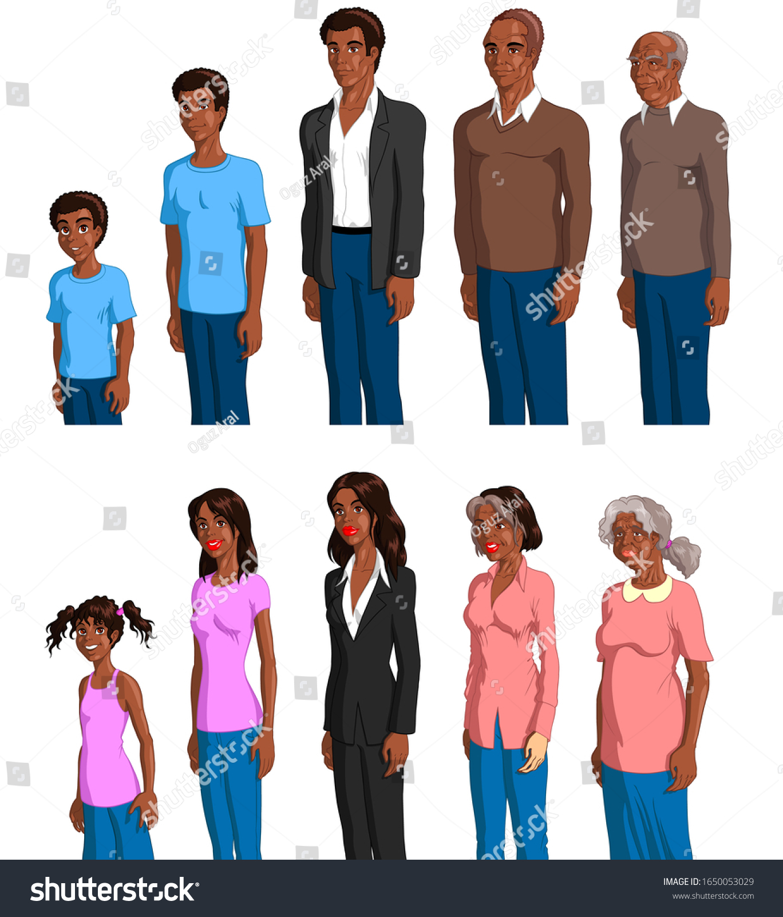

Slide 15
PROBLEMS FACED BY THE ELDERLY.
Dementia.
It is a common cognitive health condition that affects nearly 50 million seniors worldwide. Dementia caregivers are trained to placate seniors when dementia leads them to wander, experience paranoia or suffer fits of agitation.
Malnutrition.
Consuming inadequate nutrients may be the outcome of forgetfulness or depression in the senior. A limited income also prevent some seniors from enjoying nutrient-rich meals on a daily basis.

Slide 16
3. Falls.
Weakness predisposes seniors to injury. Falls are the most common type of injury experienced by older people. Aging bodies undergo the loss of muscle strength and flexibility, which introduces balance issues and the likelihood of bone fractures.
4. Depression.
Depression among the elderly is common and affects 7% of the aging population.

Slide 17
It may be a side effect of a chronic health condition. A healthy lifestyle and social support are instrumental in warding off depression.
Hearing and Vision loss.
Sensory impairments affect adults over the age of 70. Poor vision may result from conditions like cataracts, glaucoma or diabetic retinopathy. Hearing loss is a common occurrence among the aging population.

Slide 18
Incontinence.
Chronic health conditions and a poor diet are often responsible for bladder issues and constipation in the elderly. Urinary incontinence is also likely to occur in people in the late stages of Alzheimer’s disease.
Medication Noncompliance.
When older people are faced with taking multiple medicines at different times each day , they may become confused and consume the incorrect dosage.

Slide 19
Transportation.
The lack of reliable transportation can lead to isolation , poorer quality of life and an earlier death.

Slide 20
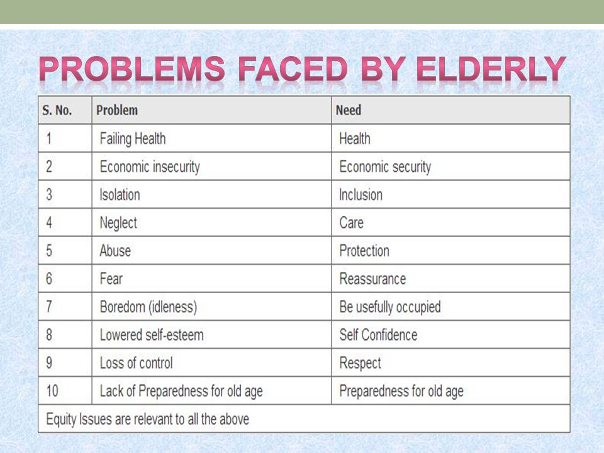

Slide 21
ASSIGNMENT
Read on trends in aging.

