Slide 1
GIT DISORDERS

Slide 2
Objectives
At the end of the module the student will be able to:-
1.Define terminologies used in GIT conditions
2.Recognize individuals with GIT conditions
3.Describe common GIT diseases
4.Demonstrate ability to care for individuals with GIT conditions

Slide 3
TERMS IN GIT
Constipation-fewer than three bowel movements a week, or hard, dry and small bowel movements that are painful and, or difficult to pass.
Obstruction-blockage within the G.I.T
Mal-absorption-inability of the small intestines to absorb certain essential substances

Slide 4
Odonophagia-pain on swallowing
Pyrosis-heartburn
Xerostomia –dry mouth
Stomatitis –inflammation of the oral cavity and lips mucosa
Dysphagia –difficulty in swallowing
Achlorhydria –lack of HCL in digestive secretions of the stomach
Stenosis –narrowing or tightening of an opening or passage in the body

Slide 5
COMMON TESTS
Radiographics
CT scan
MRI
X-rays
Liver enzyme tests
Stool tests
Gastric juice analysis
Endoscopies

Slide 6
DISORDERS OF THE ORAL CAVITY

Slide 7
ASSIGNMENT
Read on ;
Stomatitis
Oral Candidiasis

Slide 8
1. HALITOSIS
It is also known as bad breath or fetor oris (Breath malodor). Halitosis can cause significant worry, embarrassment, and anxiety .
Estimated to affect 1 in 4 people globally.
If particles of food are left in the mouth, their breakdown by bacteria produces sulfur compounds.
Keeping the mouth hydrated can reduce mouth odor. How to keep mouth hydrated?
The best treatment for bad breath is regular brushing

Slide 9
Causes
Tobacco: Tobacco products cause their own types of mouth odor. Additionally, they increase the chances of gum disease which can also cause bad breath.
Food: The breakdown of food particles stuck in the teeth can cause odors. Some foods such as onions and garlic can also cause bad breath. After they are digested, their breakdown products are carried in the blood to the lungs where they can affect the breath.

Slide 10
Dry mouth: Saliva naturally cleans the mouth. If the mouth is naturally dry or dry due to a specific disease, such as xerostomia, odors can build up.
Dental hygiene: particles of food build up and slowly break down, producing an odor. A film of bacteria (plaque) builds up if brushing is not regular. This plaque can irritate the gums and cause inflammation between the teeth and gums called periodontitis Dentures that are not cleaned regularly or properly can also harbor bacteria that cause halitosis.

Slide 11
Crash diets(a very restrictive meal plan that's unsustainable for the long term). Fasting and low-carbohydrate diet. This is due to the breakdown of reserve fats produces called ketones. that smell
Drugs: Examples include nitrates used to treat angina, some chemotherapy chemicals, and some tranquilizers, such as phenothiazines. Individuals who take vitamin supplements in large doses can also be prone to bad breath.

Slide 12
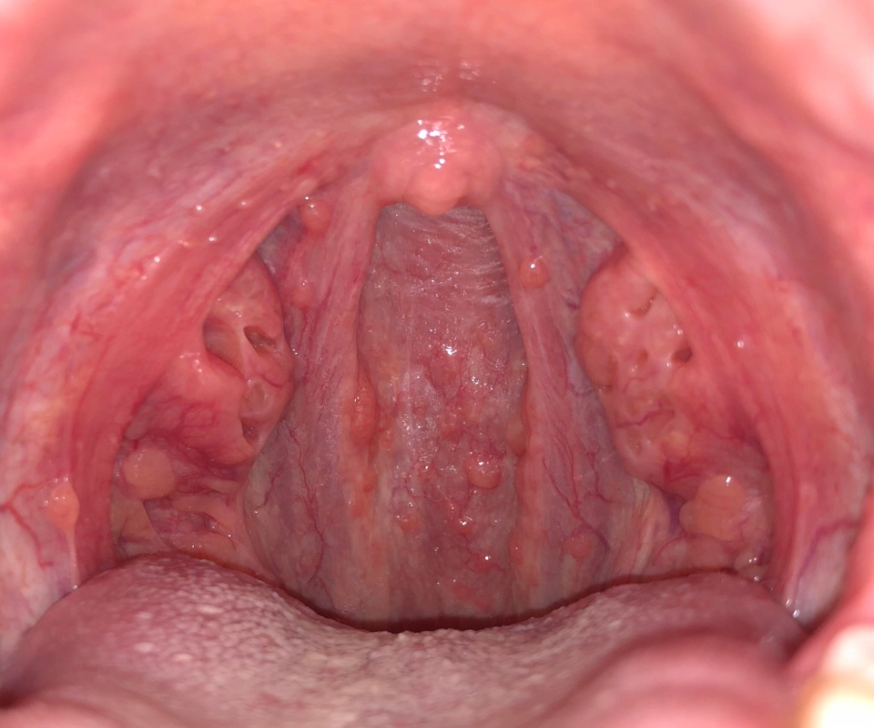
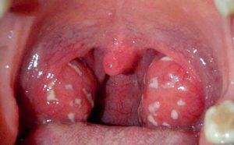
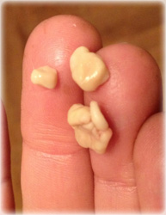
Mouth, nose, and throat conditions: Sometimes, small, bacteria-covered stones can form on the tonsils at the back of the throat and produce odor( tonsilolithiasis). Also, infections or inflammation in the nose, throat, or sinuses can cause halitosis.

Slide 13
Foreign body: Bad breath can be caused if they have a foreign body lodged in their nasal cavity, especially in children.
Diseases: Some cancers, liver failure, and other metabolic diseases can cause halitosis, due to the specific mixes of chemicals that they produce. Gastroesophageal reflux disease (GERD) can cause bad breath due to the regular reflux of stomach acids

Slide 14
Remedies
Suck sugar-free mints
Brush teeth, gums, tongue with fluoride toothpaste
Floss
Rinse with antiseptic (mouthwash)
Clean braces and retainers directly
Periodical tooth cleaning
Use of tongue scraper

Slide 15
HOME REMEDY FOR SMALL STONES
Cotton swab or finger. reach it with a finger or a cotton swab and scrape it off. Do this very carefully as it may cause additional infection if done aggressively or if the stone’s larger. Gargle with salt water immediately after you remove a tonsil stone this way. You shouldn’t do this unless the stone is easy to reach and small.
Coughing. Depending on the size of the stone, coughing could to dislodge a stone in some cases.

Slide 16
Apple cider vinegar or any vinegar. Dilute with water and gargle. Vinegar is supposed to be able to break down the stones because of its acidic content.
Garlic. Studies have shown that garlic has antibacterial, antifungal, and antiviral properties. It may combat bacterial growth and infection.
Salt water. One study shows that rinsing with salt water is an effective treatment of oral wounds.
Yogurt. Eating yogurt that contains probiotics may be able to counteract the bacteria causing tonsil stones.

Slide 17
Apples. The acidic content of apples may help combat the bacteria in a tonsil stone.
Carrots. Chewing carrots helps increase saliva and the production of natural antibacterial processes. This may help reduce or eliminate your tonsil stones.
Onions. Onions are believed to contain strong antibacterial properties. Including them in your diet may help prevent or eliminate tonsil stones.

Slide 18
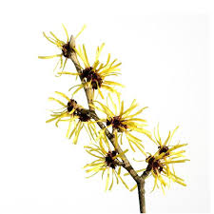
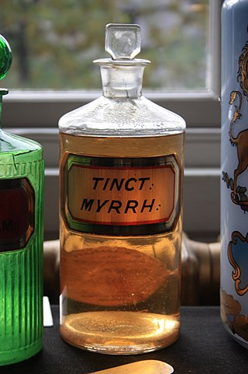
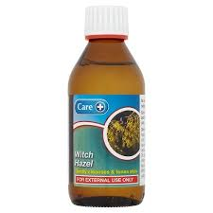
Essential oils. Some oils have anti-inflammatory or antibacterial properties. Examples are myrrh, thieves oil, and lemongrass. These may reduce or eliminate tonsil stones. Dilute the essential oil in a carrier oil and place one or two drops on a toothbrush before brushing the stones. Be sure to follow the directions for each specific oil. Because of the number of bacteria, it’s recommended that you don’t use this toothbrush afterwards

Slide 19
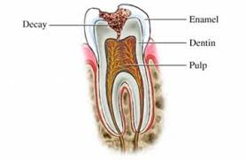
2. DENTAL CARIES
It is a local process manifesting with demineralization and progressive destruction of dental tissues with the formation of defect (cavity).
Affect enamel, dentin and pulp
decay
enamel
dentin
pulp

Slide 20
Types
Carious: Have caries(cavities), etiology: bacterial action
Non carious: No caries(no cavities), no bacteria action, just lesions: etiology: erosion, abrasion, fluorosis

Slide 21
Carious lesions: pathophysiology
Tooth surfaces are normally colonized by many microorganisms.
Unless the surface is cleaned thoroughly and frequently, bacterial colonies of majorly streptococcus mutans form a soft mass known as dental plaque on the teeth surface or in a fissure (a break in the tooth’s enamel) or in an area that is hard to clean.

Slide 22
Food residues accumulate and bacterial action produces acid that erodes the enamel. If no action is taken, the enamel is penetrated through into the dentin.
In the dentin, decay progresses more rapidly because the dentin is softer than the enamel and in time reaches the pulp. When the blood, lymph vessels, and nerves are exposed, they become infected and an abscess may form, either within the tooth or at the tip of the root.

Slide 23
Factors enhancing bacterial action
Xerostomia (chronic dryness of the mouth from lack of saliva)
Normally, saliva neutralizes microbially produced acids in the mouth.
It contains bacteriostatic factors
High-carbohydrate diet-more acids while roughage in raw and unrefined foods cleanses the teeth and necessitates more mastication, which further contributes to cleansing of the teeth.
Soft and refined foods tend to stick to the teeth and also require less chewing.
Others:– general state of the organism, – genetic predisposition, – age, –

Slide 25
Non carious lesions etiology
Erosion
Mechanical abrasion
Fluoride (excess)
Fluoride(deficient)

Slide 26
Non carious lesions
Erosion – irreversible loss of tooth structure due to chemical dissolution by acids not of bacterial origin.
Acids of 5.0 -5.7pH from food greatly responsible
Gastric acid(regurgitation)
Work in production of inorganic acids e.g diamond, table salt (professional pathology).

Slide 27
abrasion
loss of tooth structure by mechanical forces from a foreign element.
Possible sources of this wearing of tooth are toothbrushes, toothpicks, floss, and any dental appliance frequently set in and removed from the mouth.

Slide 28
Fluoride: Deficient
Fluoride protects against dental caries by being incorporated into the crystal lattice structure of enamel, where it forms fluorapatite, which is less acid soluble than is the apatite of enamel.
Fluoridation of drinking water leads to reductions in dental caries. Normal amount is 0.7-1.2 mg/l.

Slide 29
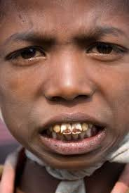
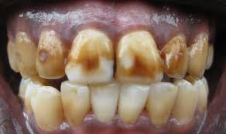
Fluoride: excess (fluorosis)
Dental fluorosis, aka. mottling of tooth enamel, is a developmental disturbance of dental enamel caused by excessive exposure to high concentrations of fluoride during tooth development.
Develops if fluoride concentration in food and water exceeds 2 mg/l
Critical period of exposure is between 1 and 4 years old, no longer at risk after 8 years of age.
Managed by microabrasion and bleaching.

Slide 30
Complications of dental caries
Destruction of enamel and dentin allows the bacteria to enter the pulp and extend into the bone at the tip of the tooth. Typical complications:
Acute pulpitis: infection in the central cavity of the tooth. • Apical abscess: Bacteria extend from the pulp into the bone surrounding the root of the tooth. Pus may drain into the mouth along the lateral sides of the infected tooth.
Periapical granuloma: granulation tissue that develops inside the healing periapical abscess.
Radicular cyst: If the pus from an abscess is resorbed, a cavity remains. This initial pseudocyst (no epithelial lining) may be partially covered by ingrowths of gingival epithelium.

Slide 31
General Symptoms of dental caries
Toothache
Sensitivity
Holes at the surface of the tooth
Jaw swelling.
Diagnosis
Oral examination-rays

Slide 32
Management
Fillings
Extractions
Dental implants
Drugs( antibiotics, analgesics)
Fluoridation of water
Good oral hygiene

Slide 33
Dentoalveolar abscess
Dfn-collection of pus in the apical dental periosteum (fibrous membrane supporting the tooth structure) and the tissue surrounding the apex of the tooth.
Clinical manifestations
Dull, gnawing continuous pain
Cellulitis and edema of the surrounding tissues
Mobility of the affected tooth
Fever
Malaise

Slide 34
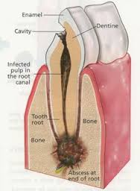
Management
Needle aspiration or drill an opening into the pulp cavity to relieve pressure and pain
Antibiotics
Later extraction or root canal of the affected tooth
Assess for bleeding
Gargle with saline
Giving of analgesics
Giving of soft or liquid diet

Slide 35
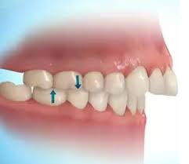
MALOCCLUSION
Misalignment of the teeth of the upper and lower dental arcs when the jaws are closed. It can be inherited or acquired( thumb sucking, trauma etc).
Malocclusion makes the teeth difficult to clean and can lead to decay, gum disease, and excess wear on supporting bone and gum tissues.
Management
Use of wires or braces-worn several hours in a day for the alignment to occur
Oral hygiene

Slide 36
TEMPOROMANDIBULAR DISORDERS
They are classified as:-
Myofascial pain-discomfort of the jaw, neck and shoulder muscles
Internal derangement of the joint-dislocated jaw, displaced disc or injured condyle
Degenerative joint disease-rheumatoid arthritis or osteoarthritis

Slide 37
Clinical manifestations
Pain( dull to throbbing)
Restricted jaw motion
Jaw locking
Difficult in chewing and swallowing
Others( headache, earache, dizziness, hearing problem)

Slide 38
Diagnosis
Based on clinical signs and symptoms
X-ray studies
MRI
Management
Use of analgesics
Use of muscle relaxants
Use of mild antidepressants
Surgical management-insertion of metal plates and screws to stabilize the jaw

Slide 39
Nursing management
Liquid diet for the first month of surgery
Food high in calories and proteins
Mouth care
Assess for signs of infection
Health education

Slide 40
GINGIVITIS
Dfn-inflammation of the gums.
Predisposing factors
Poor dental hygiene, trauma, infections, vitamin deficiency, hormonal effects, systemic diseases.
Etiology
Fusiform bacilli e.g boreliavincente

Slide 41
Signs &symptoms
Pain, bleeding, halitosis, fever, metallic taste, enlarged gum
Dx-physical exam
Management
Good oral hygiene
Antiseptic mouth wash
Analgesics
Antibiotics

Slide 42
PERIODONTITIS
Periodontitis is a chronic inflammatory disease of the gums resulting from an opportunistic infection of endogenous plaque biofilm.
It usually manifests as a worsening of gingivitis and then, if untreated, with loosening and loss of teeth.

Slide 43
Pathophysiology
Develops when gingivitis has not been adequately treated. In periodontitis, the deep pockets can harbor anaerobic organisms that do more damage than those usually present in simple gingivitis.
The organisms trigger chronic release of inflammatory mediators, including cytokines, prostaglandins, and enzymes from neutrophils and monocytes.
The resulting inflammation affects the periodontal ligament, gingiva, cementum, and alveolar bone.
The gingiva progressively loses its attachment to the teeth, bone loss begins, and periodontal pockets deepen. With progressive bone loss, teeth may loosen, and gingiva recedes. Tooth migration is common in later stages, and tooth loss can occur.

Slide 44
Modifiable risk factors that contribute to periodontitis include
Plaque
Smoking
Obesity
Diabetes (especially type 1)
Emotional stress
Vitamin C deficiency(scurvy

Slide 45
Symptoms and Signs
Impaction of food in the pockets can cause pain at meals.
Abundant(hyperplasia) plaque along with redness, swelling, and exudate
Gums may be tender and bleed easily, and breath may be foul.
As teeth loosen, particularly when only one third of the root is in the bone, chewing becomes painful.

Slide 46
Diagnosis
Clinical evaluation
Sometimes dental x-rays
Inspection of the teeth and gingiva combined with probing of the pockets and measurement of their depth are usually sufficient for diagnosis. Pockets deeper than 4 mm indicate periodontitis.
Dental x-rays reveal alveolar bone loss adjacent to the periodontal pockets.

Slide 47
Treatment
Treatment of risk factors
Scaling and root planing
Sometimes oral antibiotics, antibiotic packs, or both
Surgery or extraction
Treatment of modifiable risk factors such as poor oral hygiene, diabetes, and smoking improves outcomes.

Slide 48
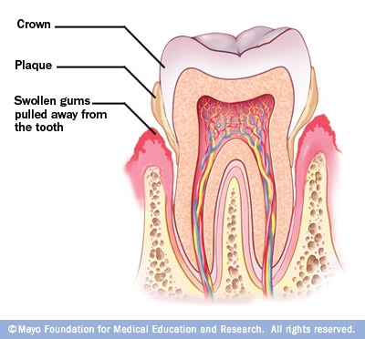

Slide 49
PAROTITIS
Dfn-inflammation of the parotid glands but can occur in other salivary glands.
Mumps( epidemic parotitis)-a communicable disease caused by a virus. It also affects the parotid glands and commonly in children.
Pathophysiology
Bacteria or virus in the mouth which travels through the salivary duct to the glands

Slide 50
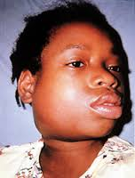
Clinical manifestations
Glands are swollen, tense and tender
Pain in the ear
Difficulty in swallowing
Fever
Irritability
Infant refuse to feed

Slide 51
Management
Antibiotics
Analgesics
Antipyretics
Maintaining adequate nutrition
Oral hygiene
Soft diet
Parotidectomy (surgical drainage of the glands)

Slide 52
Salivary calculus/ sialolithiasis
Dfn–calcified structure that may form inside a salivary gland or duct
Most affects the submandibular glands
Less common in the parotid and sublingual glands

Slide 53
Causes
Less saliva production
Thickened saliva
Pathophysiology
This is as a result of calcium crystals in the saliva when they clog ( calcium phosphate and calcium carbonate)

Slide 54
Risk factors
Dehydration –saliva concentration( statherins & proline rich proteins)
Reduced food intake –reduced saliva production
Medications e.g. antihistamines –reduced saliva production

Slide 55
Signs and symptoms
Pain in the face, mouth or neck-becomes worse just before or during meals
Tenderness and swelling around the cheeks
Redness in the affected area
Fever
Foul taste

Slide 56
Diagnosis
History taking
Physical exam
X-rays
Ultra sound
CT scan

Slide 57
Treatment
Hydration –increase saliva production
Apply heat and gently massage the affected area
Extracorporeal shock wave lithotripsy ( ESWL )
Antibiotics
Analgesics
Antipyretics
Soft/ blended food

Slide 58
Sialadenitis
Chronic inflammation of one or more salivary gland( acute, chronic and recurrent)
-Occurs when the rate of saliva is slowed or stopped causing the growth of micro-organisms ( bacteria )
-occurs in all of the salivary glands

Slide 59
Risk factors
Poor oral hygiene
Viral infections e.g mumps, herpes
Decreased flow of saliva –dehydration, post operative drugs
Sialolithiasis
Immunosuppression
Malnutrition
Dental procedures

Slide 60
Clinical features
Painful swelling
Reddened skin
Slow grade fever
Malaise
Raised leucocytes and ESR
Purulent exudate from the duct
Diagnosis
Culture
History and physical exam

Slide 61
Treatment
Hydration
Gland massage
Culture and antibiotics
Analgesics –NSAIDS
Incision and drainage
Nutrition care
Mouth care

Slide 62
Cancer of the oral cavity
Staging of cancers
Stage 0:carcinoma in situ( tissue of origin)
Stage I: cancers are localized to one part of the body.( Less than 2cm)
Stage II: cancers are locally advanced(no lymph node involvement)-2cm to 5 cm
Stage III: cancers are also locally advanced( further lymph nodes and structures)-more than 5 cm
Stage IV: cancers have often metastasized, or spread to other organs or throughout the body

Slide 63
Mouth cancer refers to cancer that develops in any of the parts that make up the mouth.
Mouth cancer can occur on the:
Lips
Gums
Tongue
Inside lining of the cheeks
Roof of the mouth
Floor of the mouth

Slide 64
Risk factors
Tobacco use of any kind, including cigarettes-has more than 400 carcinogens.
Heavy alcohol use (carcinogen-acetaldehyde )
Excessive sun exposure to lips
A sexually transmitted virus called human papillomavirus (HPV)
Family history
Exposure of radiation

Slide 65
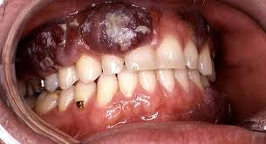
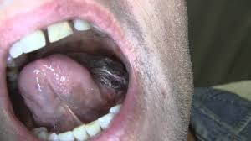
Types of oral cancers
Cancer that affects in the inside portion of the cheeks (buccal mucosa cancer)
Floor of mouth cancer
Gum cancer
Lip cancer
Roof of mouth (hard palate) cancer
Salivary gland cancer
Tongue cancer

Slide 66
Pathophysiology
Risk factor change in normal cell genetic factor abnormal cells forms a clone
Change occurs in surrounding tissues
Infiltration to other areas

Slide 67
Signs and symptoms
A sore that doesn't heal
A lump or thickening of the skin or lining of your mouth
A white or reddish patch on the inside of your mouth
Loose teeth
Poorly fitting dentures
Tongue pain
Jaw pain or stiffness
Difficult or painful chewing
Difficult or painful swallowing
Sore throat
Feeling of a mass in the throat

Slide 68
Diagnosis
Physical exam
Biopsy
Endoscopy
X-rays
CT scan
MRI

Slide 69
Treatment
Surgery to remove the tumor
Reconstructive surgery
Chemotherapy
Radiotherapy
Pain management
Antibiotics
Diet –soft, rich in both calories and proteins
Mouth care

Slide 70
Nursing Diagnosis
Impaired oral mucous membrane related to a pathologic condition, infection, or chemical or mechanical trauma (eg, medications, ill-fitting dentures)
Imbalanced nutrition, less than body requirements, related to inability to ingest adequate nutrients secondary to oral or dental conditions
Disturbed body image related to a physical change in appearance resulting from a disease condition or its treatment
Fear of pain and social isolation related to disease or change in physical appearance
Pain related to oral lesion or treatment
Impaired verbal communication related to treatment
Risk for infection related to disease or treatment
Deficient knowledge about disease process and treatment plan

Slide 71
Prevention
Stop tobacco use or don't start
Stop drinking alcohol
Eat a variety of fruits and vegetables –antioxidants
Avoid excessive sun exposure to lips.
See dentist regularly

