Slide 1
GLOBAL HEALTH POLICIES AND INITIATIVES.
By Mutai Kiprono

Slide 2
MODULE UNITS
Global and regional policies and initiatives
Country policies and initiatives.

Slide 3
Global and regional policies and initiatives
Definition of terms
Health-a state of complete physical, mental and social wellbeing, and not merely the absence of disease or infirmity.
Policies-a set of principles and directions that guide the decisions and actions of an organization.
Initiatives-a fresh approach to something or a new way of dealing with a problem.
Primary health care (PHC)- “ a whole of society approach to health that aims at ensuring the highest possible level of health and well being and their equitable distribution by focusing on peoples needs and as early as possible along the continuum from health promotion and disease prevention to treatment , rehabilitation and palliative care and as close as feasible to peoples everyday environment.” (WHO and UNICEF)

Slide 4
Global
Alma ata declaration (1978)
Sustainable development goals (SDGs)
Vision 2030
And others.

Slide 5
Alma-Ata declaration
A conference on phc held at alma attar in the year 1978 .
Expressed need for action by the world; governments, health workers, other sectors to protect and promote health.
Had 10 declarations:
Health is a primary human right and achieving its highest form is of most importance
Bridge the inequality in the status of peoples health
Economic and social development which in turn boost health sector
People have aright and duty to participate as whole or as one in planning and implementation of the health care

Slide 6
5. Government is responsible for health of the people
6 and 7. Primary health care
8. Formulation of national policies, strategies and plans of action to launch and sustain phc.
9. Cooperation between all countries (spirit of partnership)since there is a direct relation between all
10.Divertion of resources from armaments and military conflicts to health sectors. This is to ensure achievement of phc by 2000.

Slide 7
Global vision 2030 and Sustainable development goals (sdgs)
It was launched by UN in new York on September 2015 and is aimed at ending poverty in all its forms.
It sees a world oseef universal respect for all human rights and dignity.
It was in this time that the leaders agreed to develop the sdgs.
They are supposed to create a better world by 2030.

Slide 8
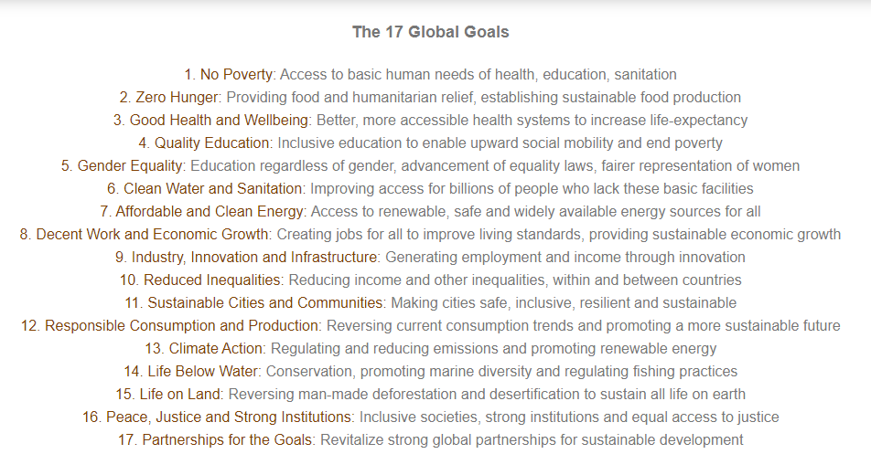

Slide 9
Abuja declaration (2001)
Made by members of the AU in 2001
Member states had two declarations;
Pledged to increase their budget to at least 15% of the states annual budget.
Requested western donor countries to increase their support.
By 2010 only one country had attained the target.

Slide 10
Paris declaration and Accra agenda for action
The paris declaration on aid effectiveness (2005)
An action-oriented guide to improve aid quality and its impact on development.
It ensures accountability between donors and recipients by providing a monitoring system to asses progress.
Five fundamentals of making aid effective:
Ownership- recipient set their own strategies for poverty eradication, improve their institutions and tackle corruption
Alignment-donor countries align behind this objectives and use local systems
Harmonization-donor countries coordinate, simplify procedures and share info to avoid duplication.

Slide 11
Results-both shift focus to development results and measure them
Mutual accountability-both parties are accountable for results.
Accra Agenda for Action (AAA 2008)
Deepen Paris declaration
Takes stock of progress and sets the agenda for accelerated advancement towards the Paris targets
Proposes 4 main areas for improvement;
Ownership-countries have more say over their development progress
Inclusive partnership-all partners participate fully
Delivering results-aid is focused on real and measurable impact on development
Capacity development-ability to manage their own future.

Slide 12
Country policies
National policies
The first health sector strategic plan which also acted as the first major policy was development in 1999 and was to work up to 2004.
From there several policies have been formulated over time with some short term and others long term.
Health sector strategic and investment plan (KHSSP)
Its objective is to attain universal coverage with critical services that positively contribute to the realization of the overall policy goal.
The policy framework outlines need of medium term(5years)strategic plan.

Slide 13
The policy objectives are aligned with the attainment of vision 2030
The six policy objectives are;
Eliminate communicable conditions: This it aims to achieve by forcing down the burden of communicable diseases, till they are not of major public health concern.
Halt, and reverse the rising burden of non communicable conditions. This it aims to achieve by ensuring clear strategies for implementation to address all the identified non communicable conditions in the country.
Reduce the burden of violence and injuries. This it aims to achieve by directly putting in place strategies that address each of the causes of injuries and violence at the time.

Slide 14
Provide essential health care. These shall be medical services that are affordable, equitable, accessible and responsive to client needs.
Minimize exposure to health risk factors. This it aims to achieve by strengthening the health promoting interventions, which address risk factors to health, plus facilitating use of products and services that lead to healthy behaviors in the population.
Strengthen collaboration with health related sectors. This it aims to achieve by adopting a ‘Health in all Policies’ approach, which ensures the Health Sector interacts with and influences design implementation and monitoring processes in all health related sector actions.
Assignment ;read about NHSSP1,NHSSP2 and KEPH.

Slide 15
Annual operational plans (AOPs)
A comprehensive document with goals, key performance indicators ad budgets to help a company or institution achieve clear objectives.
It can be made at any time of the year.
It is an important tool in translating government policies and strategic objectives into day to day management activities.
MOH adopted the medium term expenditure framework (MTEF) to help deal with misalignment between policy, planning and budgeting.

Slide 16
Universal health coverage (UHC)
It means that all people and communities receive the health services they need without suffering financially. (who)
Health ministry def; access to safe ,effective, quality essential care services including affordable essential medicines and vaccines for all without going into poverty.
Achieving uhc is one of targets set in the sdgs.
Improving health service coverage and health outcomes depends on availability, accessibility and capacity of health and care workers to deliver quality centered integrated care.

Slide 17
UHC emphasizes not only what services are covered, but also how they are funded, managed and delivered.
WHO uses 16 essential health services in 4 categories as indicators of the level and equity of coverage in countries:
Reproductive, maternal, newborn and child health;
Family planning
Antenatal and delivery care
Full child immunization
Health-seeking behavior for pneumonia

Slide 18
Infectious diseases:
Tuberculosis treatment
HIV antiretroviral treatment
Use of insecticide-treated bed nets for malaria prevention
Adequate sanitation
Non communicable diseases:
Prevention and treatment of raised blood pressure
Prevention and treatment of raised blood glucose
Cervical cancer screening
Tobacco (non-)smoking

Slide 19
Service capacity and access:
Basic hospital access
Health worker density
Access to essential medicines
Health security: compliance with the international health regulations

Slide 20
UHC in Kenya.
Launched by the president on 12 Dec 2018.
Part of big four agenda for national sustainable development.
Its aim: all Kenyans access essential health services the need by 2022
MOH development a department for strategic oversight and monitoring of uhc.
A pilot package of uhc was developed for trials in four counties
Selection was done to represent the diversity of health challenges in Kenya.

Slide 21
The four counties were: Kisumu, Nyeri, Isiolo and Machakos.
Pilot phase was to run up to October 2019.
Challenges towards achieving uhc
Shortage of government budgetary resources
Weak health systems
Misuse of resources
High poverty levels
Inability to reach vulnerable people
Difficulty selecting the right package of benefit
Integration of the informal sector
High dropout rate from insurance schemes

Slide 22
Vision 2030
Transforming Kenya into a newly industrialized middle income country to provide quality life in a clean and secure environment for the citizens.
Launched by president Mwai Kibaki in 2008.
Major pillars were: economic, social and political pillars

Slide 23
references
www.who.com
www.vision2030.go.ke
Challenges facing the attainment of uhc in Kenya by Dr. Wairimu and Dr Leon Ogoti
Oecd.org
Ministry of health online archives

