Slide 1
GYNAECOLOGY
By
Imelda Wamuta

Slide 2
REPRODUCTIVE SYSTEM & TRACT CANCERS
Pregnancy related neoplasm e.g hydatidform mole
Malignancies: cancer of cervix, endometrium, vulva, vagina, ovary, fallopian tube, ovary & breast cancer.
PREGNANY RELATED NEOPLASM
-Refers to all proliferative abnormalities that are associated with pregnancy
Examples- hydatidform mole,invasive mole,choriocarcinoma, placental site trophoblastic tumor

Slide 3
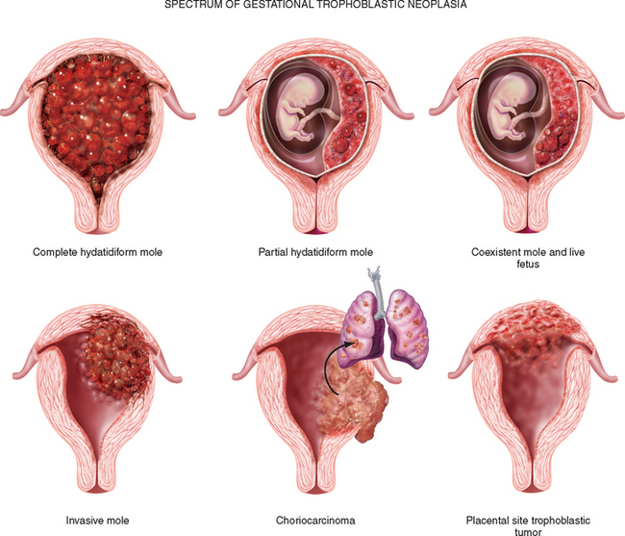

Slide 4
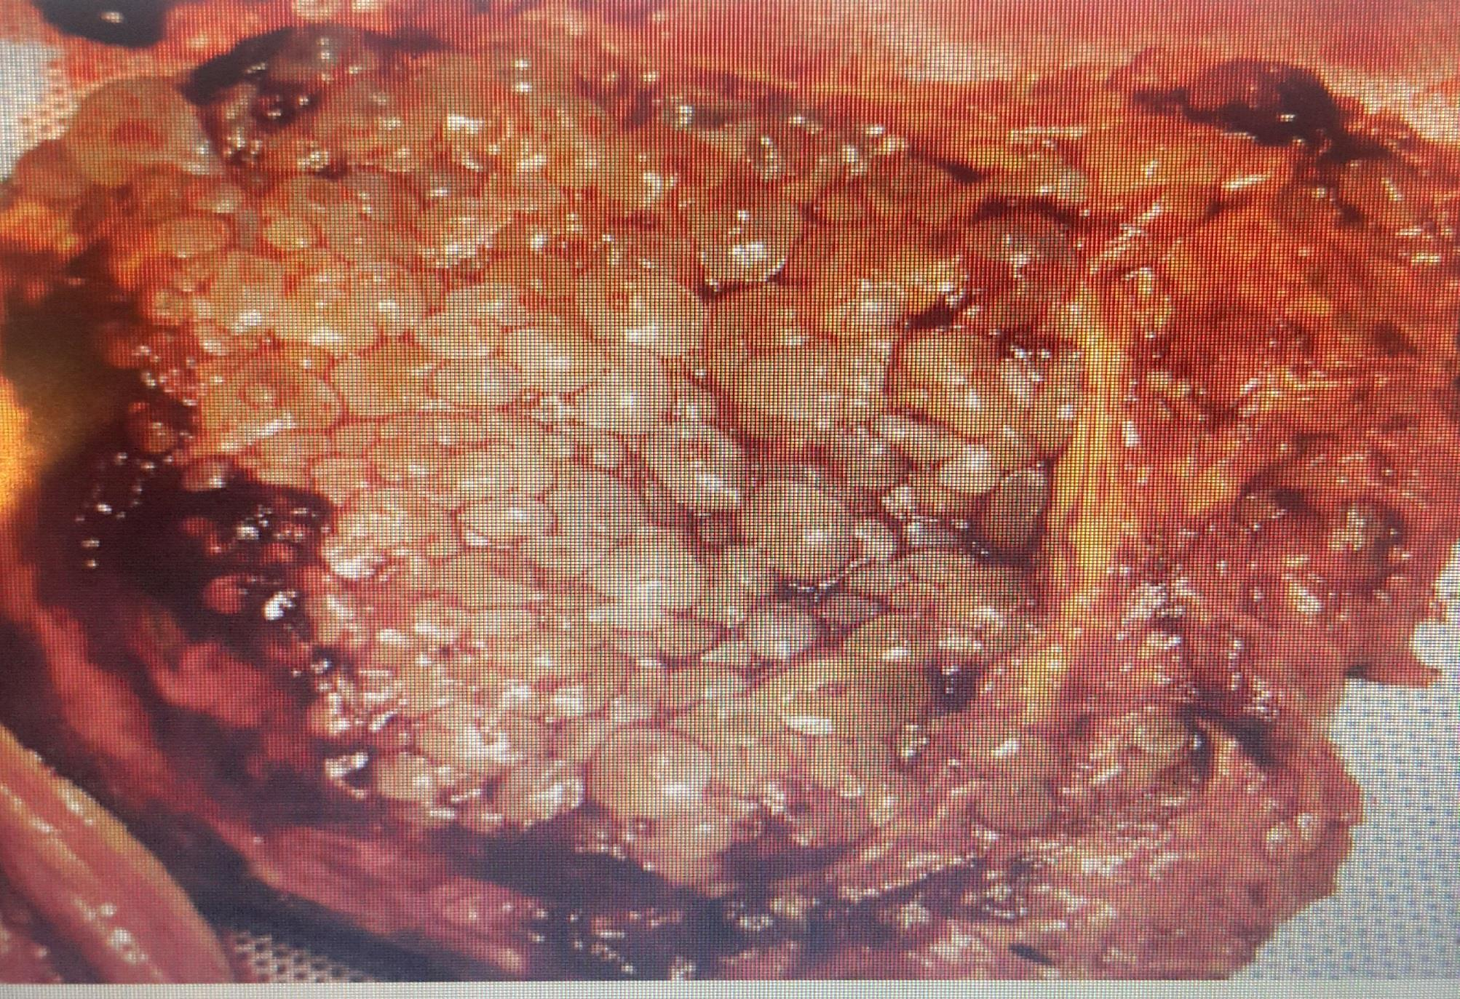
HYDATIDFORM MOLE/MOLAR PREGNACY
Its an abnormality of the placenta where there are partly degenerative and partly proliferative changes in the young chorionic villi resulting in formation of a cluster of cysts in varying sizes.
Its regarded as a benigh neoplasm of the chorion with malignant potential.

Slide 5
PATHOLOGY
The embryo dies and the chorionic villi undergoes incomplete development.
Are not become vascularized to form tertiary villi.
Secretions from the hyperplastic cells and transferred substances from maternal blood accumulate in the stoma of the villi which are devoid of blood vessels resulting in the distension of the degenerating villi to form cystic swellings resembling a bunch of grapes -hydatidiform moles-.

Slide 6
cont.....
The distension may also be due to oedema and liquefaction of the stroma
Vesicle fluid is interstitial fluid and is almost similar to ascitis or eodema fluid but rich in hcg
The moles exhibit variable degrees of trophoblastic proliferation and produce excessive amounts of human chorionic gonadotropin hormone

Slide 7
TYPES OF HYDATIDFORM MOLES
Complete mole (monospermic mole)
Results from fertilization of an oocyte in which the female pronucleus is absent or inactive-(an empty oocyte)
Contains no evidence of embryo, cord or membranes; death occurs prior to the development of placental circulation
Has high incidence of choriocarcinoma

Slide 8
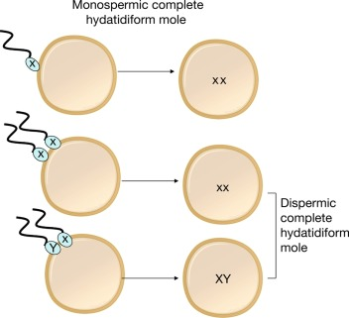
TYPES HYDATIDFORM MOLE
b) PARTIAL( dispermic) mole
usually results from fertilization of an oocyte by two sperms (dispermy)
There is evidence of an embryo,fetus and amniotic sac.
malignancy is less likely.

Slide 9
Risk factors
High in teenage pregnancy and over 45 years
High parity
Nutrition: inadequate intake of proteins and carotene
Previous history of mole pregnancy
Women with blood group A

Slide 10
Clinical features
Vaginal bleeding , grape like vesicles in vaginal discharge
Hypermesis gravidarum due to increase in HCG
Uterine enlargement greater than the expected at 14 weeks
High levels of HCG at 12 weeks >
Absent of foetal heart sounds and foetal parts
Uterus has a doughy feel
Signs and symptoms of preeclampsia
Rapture of vesicle result in light pink or brown discharge

Slide 11
Investigations
Ultrasound ‘‘snow stormy appearance’’
Urinary essay of HCG > 100,000miu/ml Normal preg value picks at 10-14wks & is rarely>100,000
Full Blood Count, GXM
MANAGEMENT
Vacuum aspiration
Dilatation and curettage
Follow up care for two years, avoid preg during this period
Hormonal contraceptive prescribed when HCG has returned to normal

Slide 12
COMPLICATIONS
1. Haemorrhage (concealed/revealed) and shock
-cause : Separation of vesicles from its attachment,
massive intraperitoneal hemorrhage(perforating mole)
atonic uterus or uterine injury durine mole evacuation
2. Choriocarcinoma development 2-10%
3. Sepsis- due to:
Entry of vaginal organisms into uterus due to lack of protective barrier,
Present degenerative vesicles & old blood mediate bacterial growth.
Increased operative interference

Slide 13
CONT...
4. Perforation of the uterus due to:
perforating mole;vaginal evacuation using sharp currettes or during currettage following sunction evacuation.
5. Pre-eclampsia with occasional convulsions
6.Acute pulmonary insufficiency due to pulmonary embolisation of trophoblastic cells with or without villi stroma
Symptoms begin within 4-6hrs following evacuation
7. Coagulation failure(DIC): Due to pulmonary embolism as it causes fibrin and platelet deposition within the vessles

Slide 14

.

Slide 15
Case analysis
Ayoung female patient came with a history of amenorrhoea for 4 months, small per vaginal bleeding for several days. Her urine for pregnancy tested +ve. On ultra sound, she had a bulky uterus with echogenic central mass having internal cystic areas forming Snowstorm appearance.
i) State the possible medical diagnosis
ii) State clinical features for suggestive of the condition
iii) Outline the management

