Slide 1
Galeazzi Fractures
KELVIN

Slide 2
Definition
distal 1/3 radius shaft fx AND
associated distal radioulnar joint (DRUJ) injury

Slide 3
Epidemiology
Incidence of DRUJ instability
  if radial fracture is <7.5 cm from articular surface
    unstable in 55%
  if radial fracture is >7.5 cm from articular surface
    unstable in 6%
Mechanism
  direct wrist trauma
    typically dorsolateral aspect
  fall onto outstretched hand with forearm in pronation

Slide 4
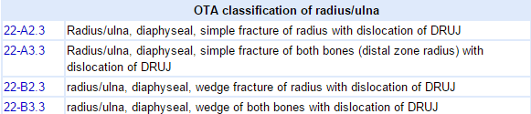
Classifications

Slide 5
Clinical presentation
Symptoms
  pain, swelling, deformity
Physical exam
  point tenderness over fracture site
  ROM
    test forearm supination and pronation for instability
  DRUJ stress
    causes wrist or midline forearm pain

Slide 6
Imaging
Radiographs
recommended views
  AP and lateral views of forearm, elbow, and wrist
findings
  signs of DRUJ injury
    ulnar styloid fx
    widening of joint on AP view
    dorsal or volar displacement on lateral view
    radial shortening (≥5mm)

Slide 7
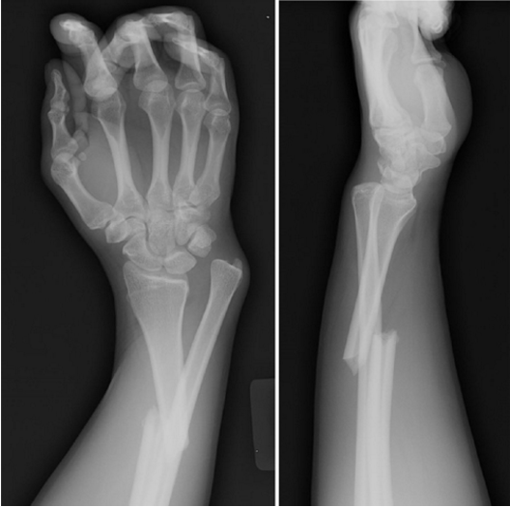
Image

Slide 8
Operative treatment
ORIF of radius with reduction and stabilization of DRUJ
  indications
    all cases, as anatomic reduction of DRUJ is required
    acute operative treatment far superior to late reconstruction

Slide 9
Complications
Compartment syndrome: high energy crush injury, open fractures, vascular injuries or coagulopathies
Neurovascular injury
Refracture: removing plate too early (minimum 18 months), large plates (4.5mm), comminuted fractures, persistent radiographic lucency
Nonunion
Malunion
DRUJ subluxation

