Slide 1
Genetic Control of Protein Synthesis
Samuel Ngigi Kiurire

Slide 2
Objectives
Discuss the genetic control and processes (transcription, translation) involved in protein synthesis
Discuss the genetic control and enzymatic mechanisms of regulating biochemical activities of the cell

Slide 3
Central Dogma of Molecular Biology
In the cell nucleus, large numbers of genes are attached end on end in extremely long double-stranded helical molecules of DNA having molecular weights measured in the billions.
A very short segment of such a molecule is shown in Figure 3–2.
Each gene, which is a nucleic acid called deoxyribonucleic acid (DNA), automatically controls the formation of another nucleic acid, ribonucleic acid (RNA); this RNA then spreads throughout the cell to control the formation of a specific protein.
Because there are more than 30,000 different genes in each cell, it is theoretically possible to form a very large number of different cellular proteins.

Slide 4
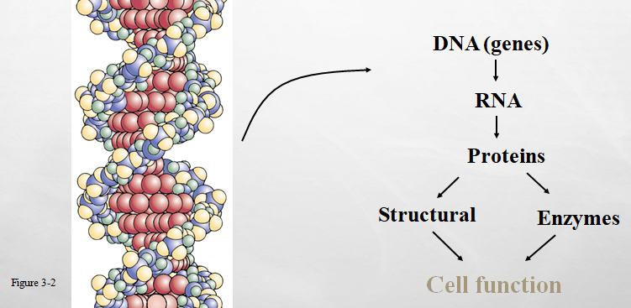
Central Dogma of Molecular Biology cnt’d…

Slide 5
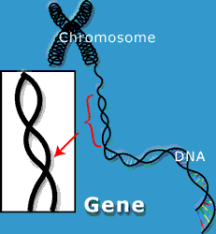
DNA
  Did you know that if you unwrap all of the DNA in all of your cells and lined it up end-to-end, you could reach the moon and back over 3000 times?
Only about 2-3% of all that DNA actually codes for traits inside our bodies. Those important parts are called GENES
Genes: a DNA segment sequences that code for many different traits
DNA has thousands of genes (estimated 20,000 to 25,000 genes in the human genome)

Slide 6
CHROMOSOME
Where to put all that DNA?
  Wondering how 5 ½ feet of DNA fit into each one of your tiny cell nuclei??
    They are packed neatly into structures called chromosomes
    CHROMOSOME: DNA and proteins coiled together

Slide 7
Genes
Nucleic acid (deoxyribonucleic acid) controls function of RNA
  (Ribonucleic acid)
RNA spreads throughout cell to control formation of specific protein
Genes controls heredity
Genes controls substances synthesized
  Structures
  Enzymes
  Chemicals

Slide 8
DNA
DNA is the most important molecule for life
  Controls all traits
  Cannot function without it
  Determines many
    Hair color
    Disease
  IMPORTANT: all cells in the body has the entire DNA code
  CSI: playing detective--- hair follicle, samples
Notes:
CSI: Crime Scene Investigation

Slide 9
DNA
The organization of the DNA
  Chromosomes
    Made up of DNA & protein
    In the nuclei, there are 46 chromosomes
      Has to be duplicated before division
    DNA is organized in chromosomes

Slide 10
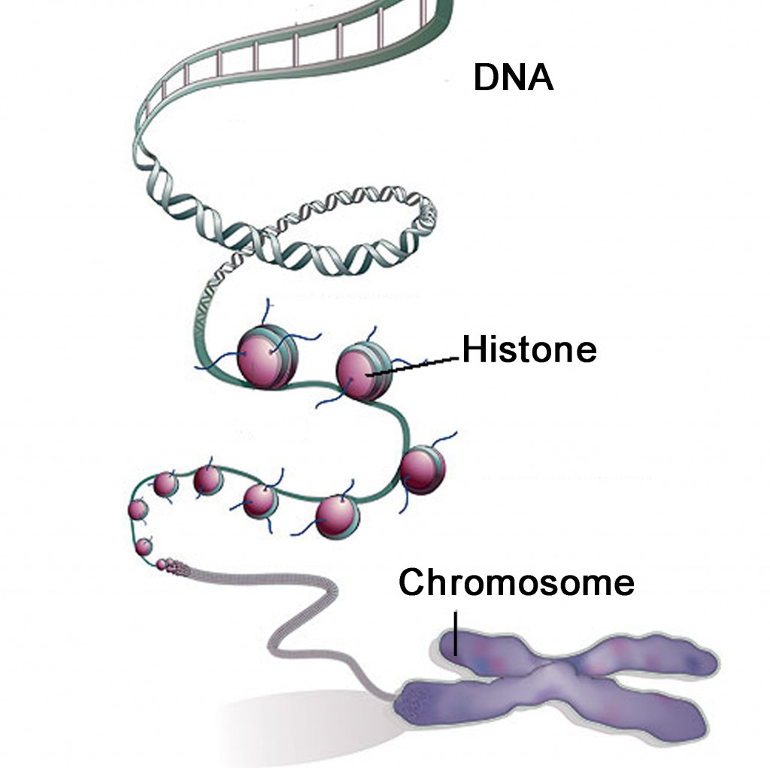
CHROMOSOME
Chromosome = DNA + histone
  Histones act as glue balls to hold the DNA tightly wound together

Slide 11
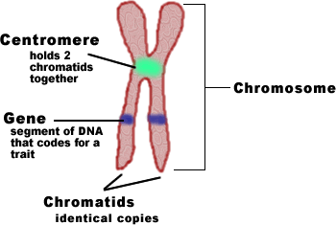
CHROMOSOME
Parts of a chromosome
  Chromatid: ½ of a chromosome– two chromatids make up a chromosome
    Chromatids are identical copies (original + copy)
  Centromere: attachment point of sister chromatids
Single chromosome: Each side is one stand of DNA coiled up around histones.
Only time to see the centromere will be during cellular division.

Slide 12
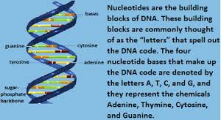

Slide 13
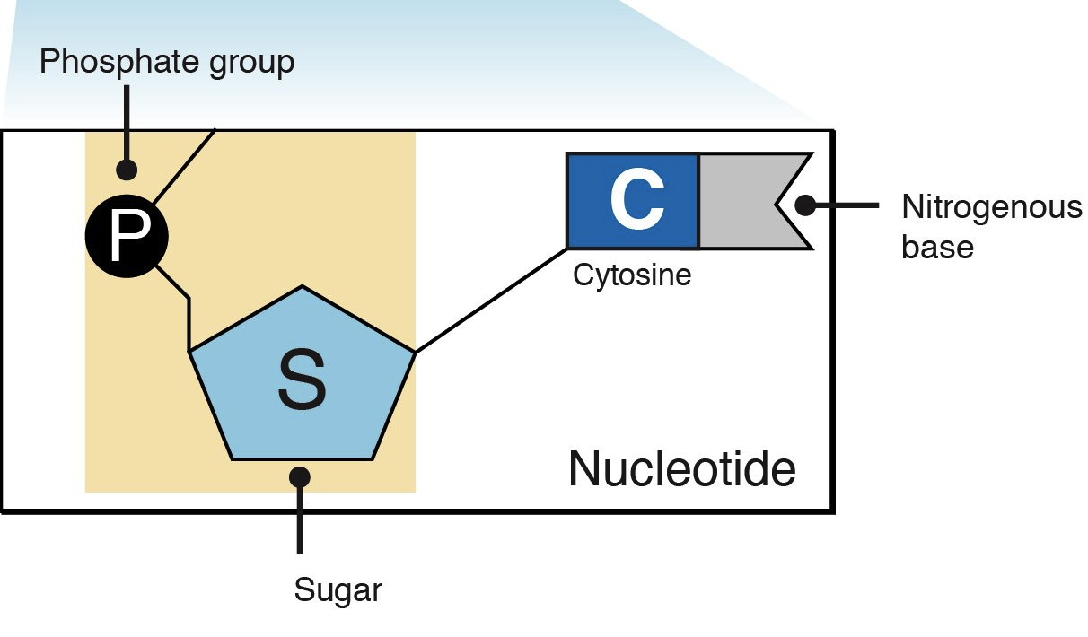
DNA
Nucleotide
  Smallest unit of DNA
  3 components
    Deoxyribose sugar
    Phosphate group
    4 nitrogenous bases
      Purines: Guanine & adenine
      Pyrimidines: thymine & cystosine

Slide 14
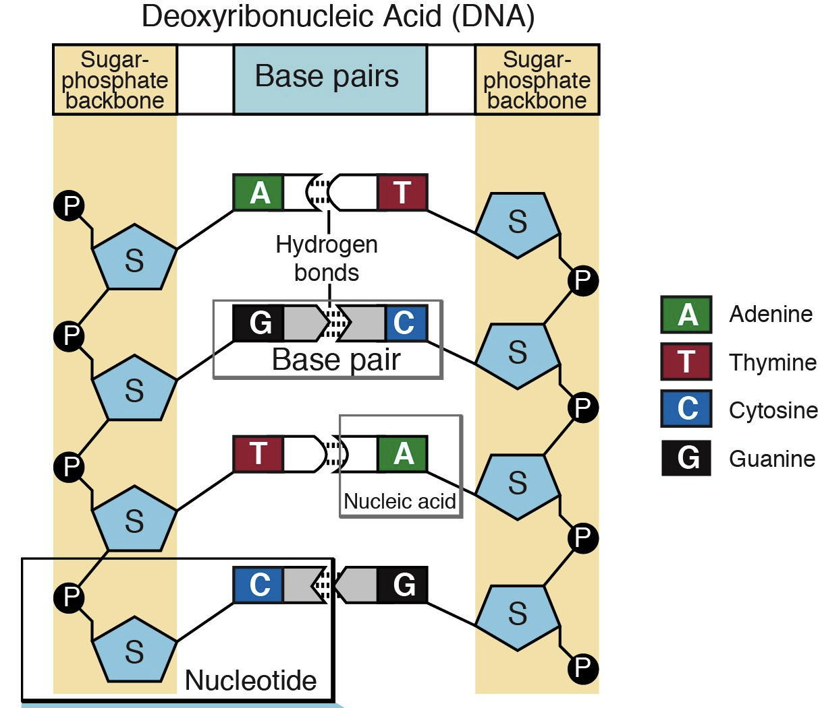
DNA
The bases are in each side of the helix
  ADENINE
  GUANINE
  THYMINE
  CYSTOSINE

Slide 15
Basic Building Blocks of DNA
Basic chemical compounds involved in the formation of DNA.
  (1) phosphoric acid
  (2) deoxyribose (a sugar)
  (3) four nitrogenous bases
    two purines, adenine and guanine,
    two pyrimidines, thymine and cytosine
The phosphoric acid and deoxyribose form the two helical strands that are the backbone of the DNA molecule, and the nitrogenous bases lie between the two strands and connect them

Slide 16
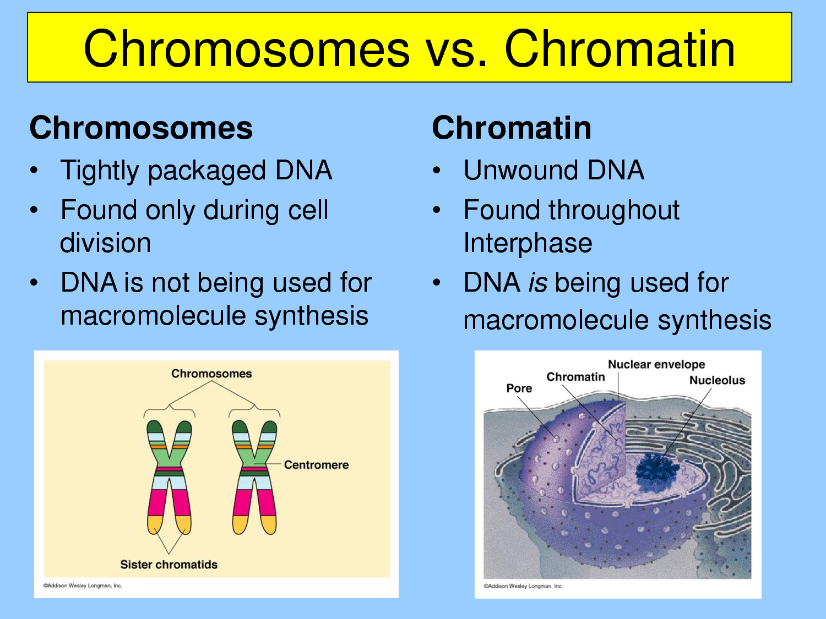
How the DNA Fits
DNA is folded and wrapped very tightly around protein called histones
As the DNA and proteins coil together, they form bead like structures called NUCLEOSOMES. They allow even more of the DNA to be wrapped and folded up
As the nucleosomes pack together, they form thick coiled fibers called CHROMATIN

Slide 17
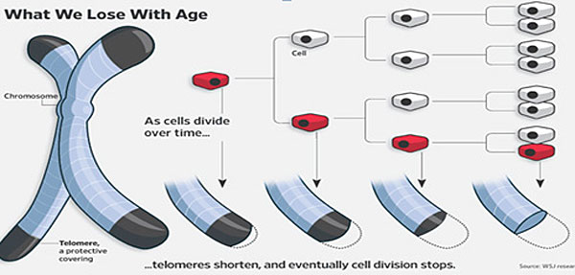
DNA
Every time the DNA is copied, telomeres (the ends of the DNA) get smaller, TELOMERASE keeps the telomeres on (prevents it from getting smaller)
If telomeres get too small, DNA cannot be copied anymore and the cell dies
Telomeres determines how many times a cell may divide

Slide 18
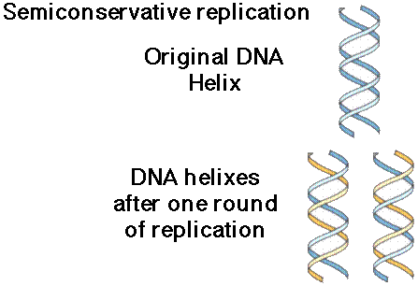
DNA Replication
Is the copying of DNA in preparation for cell division (mitosis)
Semi-conservative replication model
  One molecule will split in half, and each half will act as a template to build its complementary strand

Slide 19
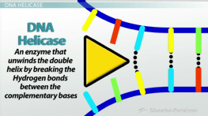
How DNA Replication Occurs
Uses a series of enzymes to start and run replication
DNA helicase unzips the molecule by breaking the hydrogen bonds between nitrogen bases
DNA Polymerase adds bases and then removes the RNA primers

Slide 20
Nucleotide
The first stage of DNA formation:
  Combine one molecule of phosphoric acid, one molecule of deoxyribose, and one of the four bases
    Base
      ADENINE
      THYMINE
      GUANINE
      CYTOSINE
    This forms the nucleotides (one for each of the four bases)

Slide 21
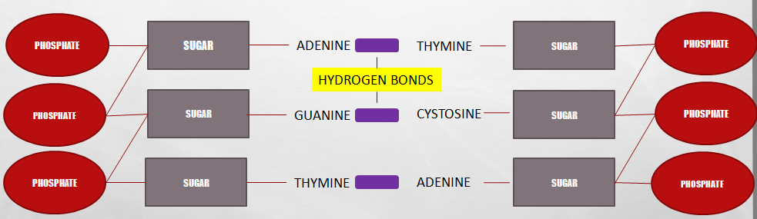
DNA Strand
The phosphoric acid and the deoxyribose form the two helical strands that are the backbone of the DNA molecule

Slide 22
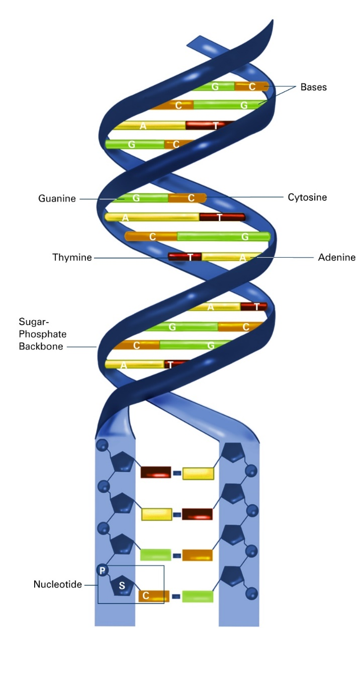
Bases
Bases have to be paired correctly
  If mismatched= mutation
  “Apples in the Tree, Car in the Garage”
    Adenine to Thymine
    Cystosine to Guanine
Notes:
A mutation is a change in a DNA sequence. Mutations can result from DNA copying mistakes made during cell division, exposure to ionizing radiation, exposure to chemicals called mutagens, or infection by viruses.

Slide 23
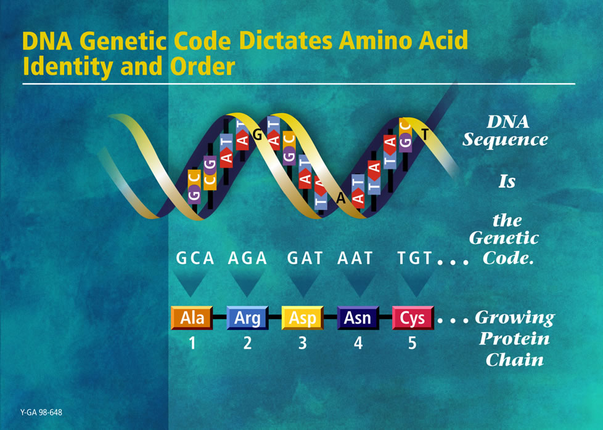
Genetic Code
Ability of the DNA to control the formation of proteins
Two strands of DNA molecule are split apart
  Purine and pyrimidine bases projecting to the side of each DNA are exposed
  These projecting bases form the genetic code

Slide 24
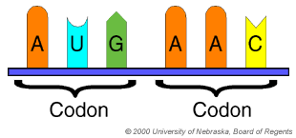
Genetic Code
DNA-controls formation of proteins by means of a genetic code
Code consists of triplets (codones) -code word
Codones will control the sequence of amino acids
Code transferred to the RNA in process called transcription

Slide 25
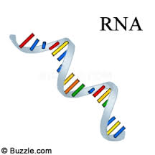
Transfer of Code to RNA
DNA is in nucleus
Code is transferred to another nucleic acid—RNA in process called transcription
Complimentary codones in the RNA

Slide 26
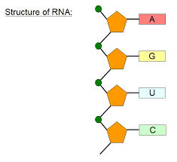
Formation of RNA Nucleotides
  RNA nucleotide Similar to nucleotides of DNA
    Four nucleotides
      Adenine
      Guanine
      Cytosine
      Uracil * (replaces thymine in DNA)
    Single stranded
    Sugar deoxyribose not used; instead RIBOSE

Slide 27
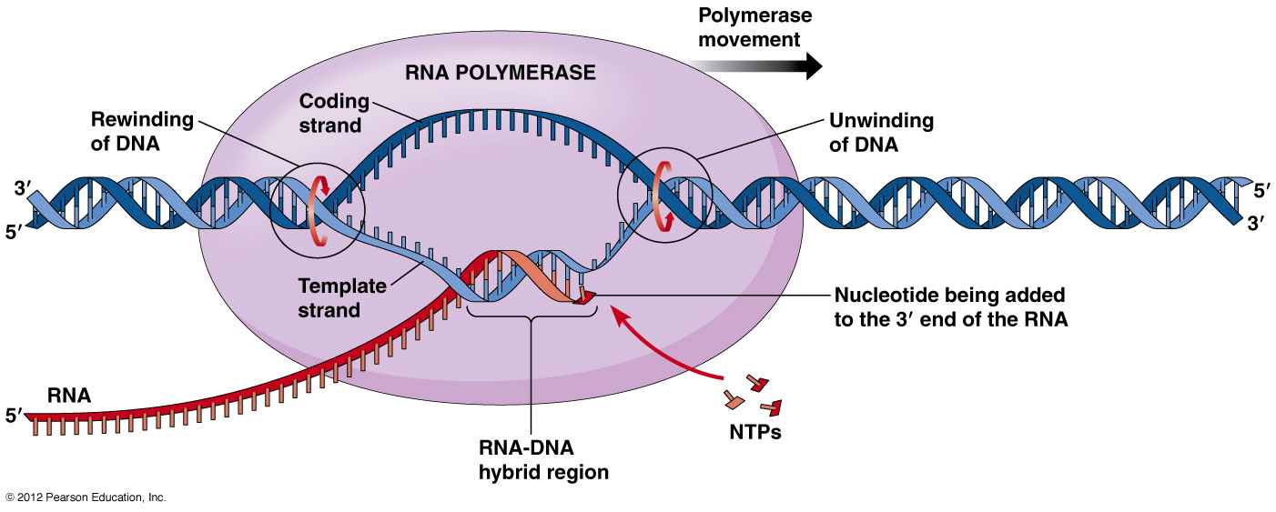
Activation of RNA Nucleotides
Activated by enzyme RNA polymerase
Begins the TRANSCRIPTION

Slide 28
Types of RNA
RNA
  mRNA- copy of DNA
  rRNA- along with proteins is what makes up the ribosomes (where proteins are made)
  tRNA- transfer RNA. Brings amino acids to the ribosome for protein assembly
  Others
    Precursor messenger RNA
    Small nuclear RNA (snRNA)
    MicroRNA (miRNA)

Slide 29
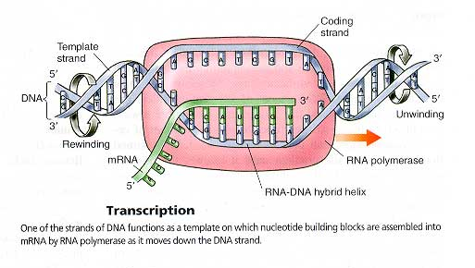
Transcription
  DNA & gene used as template to make messenger RNA with help of enzyme RNA polymerase
  Building blocks of RNA same as DNA except
    Sugar deoxyribose is not used
      Ribose is substituted
    Thymine is replaced by uracil (another pyrimidine)

Slide 30
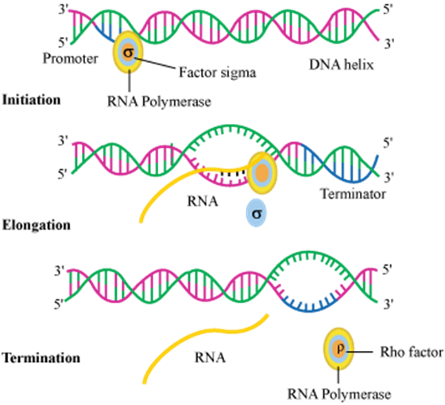
Transcription cnt’d…
3 Stages of Transcription
  Initiation
  Elongation
  Termination

Slide 31
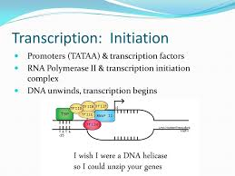
Initiation Stage
  Promoter region is signal site for RNA polymerase to bind
  This is where majority of trait expression is controlled
  Binding causes the double helix to unwind and open

Slide 32
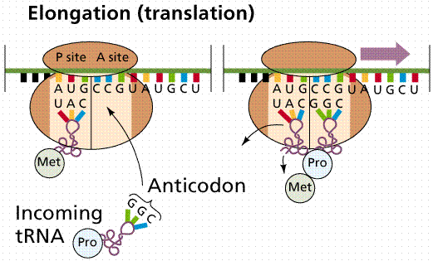
Transcription cnt’d…
Elongation Stage
  RNA polymerase slides through strand
  Complimentary bases pair up
Termination Stage
  Polymerase reaches terminator region of gene
  RNA transcription is complete
  RNA polymerase and strand separate

Slide 33
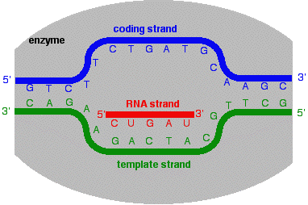
Transcription cnt’d…
How does a mature RNA transcribe protein?
  The nitrogenous bases grouped into 3 letter codes called CODONS
  The genetic code includes 64 codons
  Most codons code for specific amino acids

Slide 34
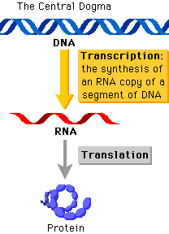
Translation Begins
DNA Transcription
  Unwinding of helix
  Copies of mRNA
  mRNA to nuclear pore
  Inside ribosome translation begins
  Chain of amino acids
  Packaged and transported

Slide 35
Further Reading
Read on:
Mitosis
Meiosis

Slide 36
End of Presentation
Thank You

