Slide 1
Gustation and Olfaction
SAMUEL NGIGI K.
KMTC

Slide 2
Overview
Sensory processes
Specific nature of energy transduction,
Relevant anatomical structures, and
Specialized pathways in the brain for taste and smell
Common sensory disorders in relation to smell and taste

Slide 3
Introduction
Taste and smell are discussed together
Sensory interaction:
the principle that one sense may influence another.
The senses of taste and smell have a very cooperative working relationship.
Many of the subtle distinctions you may think of as flavors really come from odors
Often, if you can’t smell the food, you can’t taste the food.
These are the principal systems for distinguishing flavours.

Slide 4
Gustation
Taste sensory cells (found in taste buds on papillae and on oral mucosa of palate and epiglottis).
Odor and food molecules activate membrane receptors
→Taste signals go to the limbic system and cerebral cortex
→ Patterns of nerve activity encode taste sensations
→ Sensory processing allows us to interpret flavors
Genes determine the kinds of taste receptors we have, and experiences shape our perceptions
Taste disorders may be genetic, or may result from illness or injury

Slide 5
Cont’d
Taste preference:
Infants have heightened taste sensitivity while elders have decreased ability to taste
Supertasters
More sensitive than average
People with taste buds for bitter flavors, experiences sense of taste with far greater intensity.
Aftertaste
Arise after swallowing
Maybe different from the food
Medicines
Acquired taste
Appreciation of food or beverage that’s unlikely to be enjoyed
Sensations of flavor and aroma often work together, especially during eating

Slide 6
Taste buds
Located in mucosa of
Epiglottis
Palate
Pharynx
Tongue papillae
Filiform (filum: rope)
Foliate (folio: leaf)
Fungiform (fungus-shaped)
Circumvallate (circum-; around + vallum; wall)

Slide 8
Papillae
Fungiform
5 taste buds
Located on top of papillae
Circumvallate and foliate
100 taste buds
Located on sides of papillae
Von Ebner’s glands
Secrete saliva
Cleanse mouth in preparation of new stimulant
Produces an odorant binding protein that interacts with bitter tasting hydrophobic solutes.

Slide 9
Taste buds
Each taste bud contains a pore that catches food particles
Each taste bud pore has 50-100 taste receptor cells with antenna like hairs (microvilli) that sense food molecules, at apical ends. These cells are;
Dark cells
Basal cells – migrate from adjacent lingual epithelium into the buds and differentiate into taste receptor cells.
Light cells
Intermediate cells
Taste receptors reproduce themselves every week or two (9-10 days).
It hardly matters if you burn your tongue with hot food
As you grow older, the number of taste buds decreases, as does taste sensitivity

Slide 11
Taste Receptors
Taste bud
Microvili
Receptors are
Modified epithelial cells
Each taste bud
Made up of 50 to 150 taste cells
Lifespan is 10 to 14 days
Microvili
Receptor cells
Transmitter

Slide 12
Taste Receptors
Taste bud
Microvili
One nerve innervates several receptors
One receptor may be innervated by several nerves
Trophic effect of nerves on receptors
Microvili
Receptor cells
Transmitter

Slide 13
Other Cells in Taste Buds
Taste bud
Microvilli
Sensory receptors
Contain microvilli
Contain sites for taste transduction
Supporting cells
Basal cells
Receptor cells
Microvilli
Transmitter

Slide 14
Taste
Sensory modality
Mediated by chemoreceptors of
Tongue, mouth, pharynx
Taste qualities
Sour taste
Associated with acids
Intensity is proportional to log [H⁺]

Slide 15
Taste
Salty taste
Elicited by ionized salts (Na⁺)
Cations mainly responsible for salty taste
But anions also contribute

Slide 16
Taste
Sweet taste
Associated with naturally occurring sugars
Sucrose, glucose
Glycol, aldehydes, ketones
Synthetic substances
Saccharin

Slide 17
Taste
Bitter taste
Associated with alkaloids, organic compounds
Quinine, caffeine, nicotine

Slide 18
Taste
Umami taste quality
New taste quality
Identified by Japanese in 1909
Meaty, savoury taste
Drive our appetite for amino acids

Slide 19
Importance of Taste
Taste
Drives appetite and
Protects us from poisons
We like taste of sugar
Because we require carbohydrate (sugars)

Slide 20
Importance of Taste
We get craving for salt
Because we must have sodium chloride in our diet
Bitter or sour
Cause avoidance reaction
Most poisons are bitter

Slide 21
Importance of Taste
Food which has turned bad
Is sour (acids)
Most medicines tastes bitter
Because most of them are poisons

Slide 22
Taste Transduction
Taste stimuli chemicals
Receptor protein
General
Taste substances
Bind to receptor protein on receptor cells
Change in membrane properties
Opening of ionic channels
Voltage gated Na⁺ channels
Na⁺
Ca⁺⁺
Voltage gated Ca⁺⁺ channels
Neurotransmitter release
AP

Slide 23
Taste Transduction
Taste stimuli chemicals
Receptor protein
This leads to depolarization
Followed by Ca⁺⁺ influx
Release of neurotransmitter
Excitation of sensory nerve
Voltage gated Na⁺ channels
Na⁺
Ca⁺⁺
Voltage gated Ca⁺⁺ channels
Neurotransmitter release
AP

Slide 24
Taste transduction
Taste bud
Microvili
Taste receptor proteins
Found on microvilli
Taste chemicals are soluble
Diffuse to bind to receptors
Microvili
Receptor cells
Different receptor cells: bitter, sour, sweet, salty, umami

Slide 25
Taste transduction
Taste bud
Microvili
Each taste bud
Made up of multiple taste cells
With different chemical sensitivity
Microvili
Receptor cells
Different receptor cells: bitter, sour, sweet, salty, umami

Slide 26
Taste transduction
Taste bud
Microvili
Within each taste bud
There are different taste cells
Can detect NaCl, sucrose, H⁺, quinine
Microvili
Receptor cells
Different receptor cells: bitter, sour, sweet, salty, umami

Slide 27
Taste transduction
Taste bud
Microvili
Each taste cell form
Chemical synapse with sensory nerve
Project to the brain
Microvili
Receptor cells
Different receptor cells: bitter, sour, sweet, salty, umami

Slide 28
Sweet Taste Transduction
Receptor protein
Sugar
Combination of sugar with receptor
Activate Gs protein
Leads to activation of
Adenyl cyclase
Formation of cAMP
K⁺ channels
K⁺
Neurotransmitter release
AP

Slide 29
Sweet Taste Transduction
Receptor protein
Sugar
Leads to activation of
Protein Kinase A (PKA)
This leads to
Phosphorylation of K⁺ channels
Closes the channels
Depolarization of cells
K⁺ channels
K⁺
Neurotransmitter release
AP

Slide 30
Sweet Taste Transduction
Receptor protein
Sugar
This leads to
Release of transmitter
↑ In firing of sensory nerve
K⁺ channels
K⁺
Neurotransmitter release
AP

Slide 31
Sour Taste Transduction
Receptor protein
H⁺
The H⁺ ions block K⁺ channels
K⁺ channels maintain membrane potential at about –85 mv
K⁺ equilibrium pot
When they are blocked
Membrane depolarizes
K⁺ channels
K⁺
Ca⁺⁺
Ca⁺⁺
Neurotransmitter release
AP

Slide 32
Sour Taste Transduction
Receptor protein
H⁺
Voltage gated ca⁺⁺ channels open
Ca⁺⁺ enters the cell
Release of transmitter
↑ In firing of AP in sensory nerve
K⁺ channels
K⁺
Ca⁺⁺
Ca⁺⁺
Neurotransmitter release
AP

Slide 33
Salty Taste Transduction
ENaC
Na⁺
The Na⁺ ions enter cell through epithelial sodium channels (ENaC)
Membrane depolarizes
Voltage gated ca⁺⁺ channels open
Ca⁺⁺ enters the cell
Release of transmitter
↑ In firing of AP in sensory nerve
Na⁺
Voltage gated Ca⁺⁺ channels
Ca⁺⁺
Ca⁺⁺
Neurotransmitter release
AP

Slide 34
Bitter Taste Transduction
Receptor
Chemical
Chemical combination with receptor
Activation of G protein
↑ In IP₃
Leads to release of Ca⁺⁺ from internal sources
Release of transmitter
↑ In firing of AP in sensory nerve
G_{S} protein
Ca⁺⁺
Neurotransmitter release
AP

Slide 35
Umami
Proteins to grow and repair tissue.
Interacts with ligand gated inotropic glutamate receptor coupled to gustducin and Ca2+ channel membrane proteins.

Slide 36
Receptors and transduction
Two types of receptors
Inotropic receptors
Salt: Na+ selective channel
Sour: H+ through ENaC
G-protein coupled receptors
G-protein – gustducin
Bitter, Umami and Sweet
Reduce cAMP (α-gustducin)
Increase IP₃ and DAG (βϒ-gustducin)

Slide 38
Gustatory pathways
1st order neurons
Chorda tympany (facial) nerve
Innervate taste buds in Anterior 2/3 of tongue and part of soft palate.
Glossopharyngeal nerve
Posterior 1/3 of tongue.
Pharynx and epiglottis.
Vagus nerve
Other parts including pharynx and epiglottis.
Project to nuclues of the tractus solitarius.
Terminate 2nd order neurons.
2nd order neurons
Travel through Ipsilateral medial lemniscus.
Project to posteromedial nucleus (thalamus) (VPM).
Terminate at the 3rd order sensory neuron in VPM.

Slide 39
Cont’d
3rd order neurons
Project to
Limbic System: hippocampus, hypothalamus and amygdala
Emotional tastes (pleasant, nostalgic, etc.) and memory function
Cerebral Cortex
Identification of tastes

Slide 42
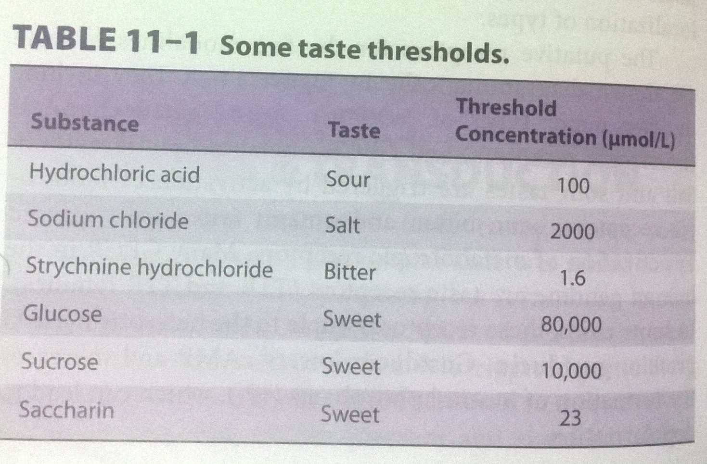
Taste threshold
Minimum concentration at which a substance can be perceived
Bitter: lowest threshold

Slide 43
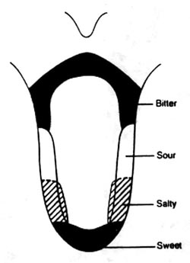
Theory debunked
Since 1942, tongue maps like this one were widely published and touted as an accurate portrayal of where certain taste receptors were located.
Wine glasses are even designed around this idea.
The notion that the tongue is mapped into four areas:
sweet,
Sour,
salty and
Bitter
Is wrong. There are five basic tastes identified so far, and the entire tongue can sense all of these tastes more or less equally.
Scientists never bothered to dispute this inconvenient truth until 1974, and even today, many textbooks still publish pictures of the tongue map.

Slide 44
Abnormalities
Ageusia
Absence of sense of taste
Hypogeusia
Diminished taste sensitivity
Dysgeusia
Disturbed sense of taste

Slide 45
Olfaction
The olfactory system is an extremely discriminative and sensitive chemosensory system.
Smell:
Chemical sense detected by sensory cells called chemoreceptors.
Odorant stimulates chemoreceptors in the nose that detect smell
→they pass on electrical impulses to the brain
→brain interprets patterns in electrical activity as specific odors and olfactory sensation becomes perception

Slide 46
The olfactory bulb in the brain, which sorts sensation into perception, is part of the limbic system. This link to brain's emotional center links smell to memories, feelings, and emotions
can bring on a flood of memories, influence people's moods and even affect their work performance.
Used as a form of communication:
Chemical signals released by organisms to communicate with other members of their species (pheromones)

Slide 47
Cont’d
Scent Marketing:
Sellers use scents to set a mood and sell their product.
Similar to Aromatherapy, which is the use of selected fragrances in lotions and inhalants to affect mood and promote health.
Odors are classified into 6 mjor groups: floral, fruit, spicy, resin, burnt and putrid.
Perception of odors begins with inhalation and transport of volatile aromas to the olfactory mucosa located on the dorsal posterior region of the nasal cavity.

Slide 48
Olfactory system
Olfactory mucosa
Consists of a layer of columnar epithelium.
Surround olfactory neurons.
Olfactory sensory neurons
Communicate with external environment.
Undergo constant replacement.
Bipolar neurons are supported by glial-like columnar cells which surround them. These have microvilli at their apex and secrete mucus which is layered on the surface of the olfactory mucosa.

Slide 49
Short single dendrites on bipolar neurons.
Terminal knob has cilia (unmyelinated, contain odorant receptors)
Each cilia may have 40 specific receptor membrane proteins for interaction with different odorant molecules.
Project into nasal cavity (towards apical mucosa).
Other cells
Sustentacular cells
Supportive
Stem cells
Generation of new olfactory cells

Slide 51
Olfactory pathways
Olfactory sensory receptors
G-protein coupled
Odorant molecules bind reversibly to receptor membrane proteins.
Adenylyl cyclase is actvated leading to formation of cAMP with the activation of Ca2+/Na+ channels. Influx of these ions leads to depolarization and the generation of a potential.

Slide 52
Generated ionic currents are graded in response to the flow rate of the odorant molecules and their concentration.
Sites of summated generator potentials occur across the olfactory mucosa to produce specific spatial pattern of activity for each stimulating odorant molecule.
This may contribute to neural coding of odors.
Have affinity for a wide range of odorants.

Slide 53
The depolarizing generator potential spreads through the axon hillock and action potentials are generated and propagated to the synaptic endings in the olfactory bulb.
The action potential frequency is proportional to the concentration of specific odorant molecules.
Action potential frequency is attenuated by adaptation or desensitization of the receptor and reduction in the production of cAMP.

Slide 54
Rapid adaptation and removal of the odorants permit continued recognition and discrimination of new aromas that are inhaled in the next respiratory cycle.
Action potentials generated in the axon terminals of activated neurons are propagated into the glomeruli within the olfactory bulb.

Slide 55
Neurons in olfactory bulb
These have laminar distribution.
On the ventral sie of the olfactory bulb is a layer of glomeruli where axon terminals of olfactory neurons synapse with numerous dendrites from large mitral cells (2nd order neurons) and tufted cells
1st order neurons (CN I)
Bipolar
Axons pass through cribriform plate
Terminate in olfactory bulbs

Slide 57
Synapse with 2nd order neurons in olfactory glomeruli
Periglomerular / tufted cells – inhibitory interneurons. Cause lateral inhibition that modulates activity in adjacent glomeruli innervated by other mitral and tuft cells.
Granule cells
Trigeminal nerve free endings

Slide 58
Cont’d
2nd order neurons
Mitral cells
Single dendrite into glomeruli
Bigger than tufted cells.
Tufted cells
Mutiple dendrites into glomeruli
Smaller

Slide 59
Pathway
Lateral olfactory tract
From the olfactory receptor neurons
ORN synapse with mitral cells
Olfactory glomerulus
Olfactory bulb
Mitral cells
Periglomerular cells
Olfactory glomerulus
Olfactory receptor neuron
Olfactory membrane (mucus)

Slide 60
Project into olfactory cortex
Through the lateral olfactory tract and ascend to olfactory cortex.
Cause a convergence/divergence (indicates a complex pattern of neuronal intergration for discrimination of various odorant molecules)between axons of olfactory neurons and specialized cells of olfactory bulb to generate EPSPs in dendrites of mitral cells.
Do not pass through the thalamus
Anterior olfactory nucleus
Olfactory tubercle
Piriform cortex
Amygdala
Entorhinal cortex

Slide 61
Neural pathway into olfactory cortex
Axons from mitral and tuft cells (2nd order neurons) project caudally into olfactory tract.
Fibres diverge and synapse with neurons of anterior olfactory nucleus (AON).
Axons from the AON cross to the opposite side of the hemisphere through the anterior commissure.
Most axons diverge laterally and form the lateral olfactory tract which synapse with nuclei of the olfactory cortex (piriform cortex, periamygdaloid cortex, part of amygdala and hippocampus.
There are no direct relays from the olfactory bulb into the thalamus.

Slide 63
Smell: behavior and memory
Pheromones
Vomeronasal organ (rodents)
Identification/choice of mate
Identification of the offspring
Circadian synchrony
Marking territory
Humans
Close relationship between smell and sexual function
Olfactory memory
Direct cortical connections
Unmyelinated fibres

Slide 64
Odor threshold
Minute quantity of stimulating agent in the air that can elicit a smell sensation.
For instance, the substance methylmercaptan can be smelled when only one 25 trillionth of a gram is present in each milliliter of air
Affective nature of smell
Pleasantness
Unpleasantness
Adaptation
Desensitization
After the onset of an olfactory stimulus, the CNS quickly develops strong feedback inhibition to suppress relay of the smell signals through the olfactory bulb.
Granule cells (GABA)

Slide 65
Common sensory disorders
Taste
Phantom Taste Perception: Most common, it’s a lingering, often unpleasant taste even though you have nothing in your mouth.
Hypogeusia: reduced ability to taste sweet, sour, bitter, salty, and umami
Ageusia: inability to detect any tastes (rare)
Dysgeusia: a foul, salty, rancid, or metallic taste sensation will persist in the mouth.
Most often, people are experiencing a loss of smell as opposed to a loss of taste.
Smell
Hyposmia: reduced ability to detect odors.
Anosmia: inability to detect odors at all.
People who experience smell disorders either have a loss in their ability to smell or changes in the way they perceive odors.

Slide 66
Thank YOU

