Slide 1
HEALTH ASSESSMENT
BSCN KU ,POLYNE ORANGI

Slide 2
OBJECTIVES :
By the end of the lesson students should be able to :
Define the terminologies
State the importance of history taking
State ways of establishing rapport during history taking
State the ideal setting of history taking
Describe the steps in taking a comprehensive nursing history

Slide 3
DEF.
Accurate diagnosis rests firmly upon the foundation of a thoughtful and inclusive history and a competently performed physical examination.

Slide 4
HISTORY TAKING
Systematic collection of subjective data which is stated by the client, and objective data which is observed by the nurse.
A process by which information is gained by a health care worker /nurse by asking specific questions to the patient with the aim of obtaining information useful in formulating a diagnosis and providing medical care to a patient.
Obtaining an accurate history is a critical first step in determining etiology of a patients illness.

Slide 5
IMPORTANCE OF HISTORY TAKING
History taking is a key component of patient assessment, enabling the delivery of high-quality care. You treat the patient not the condition.
Understanding the complexity and processes involved in history taking allows nurses to gain a better understanding of patients’ problems.
Care priorities can be identified and the most appropriate interventions commenced to optimize patient outcomes.

Slide 6
GUIDES FOR TAKING NURSING HISTORY
Private, comfortable, and quiet environment.
Allow the client to state problems and expectations for the interview.
Communicate and negotiate priorities with the client
Listen more than talk.
Observe non verbal communications e.g. "body language, voice tone, and appearance".
Orient the client with the expectations of the interview

Slide 7
The setting
The setting is important because it creates the environment in which you and the patient must interact.
The environment will greatly influence how comfortable the patient feels during the process and how complete and informative the patient’s answers will be. It is normal to expect patients to experience some degree of anxiety during an initial interview

Slide 8
The setting
Check your seating position – make sure your seating is no higher than eye level. Patients are very uncomfortable having to look up while talking and are actually most comfortable while looking slightly down.
Be aware of your body language – avoid body positions that are defensive or withdrawn.
Be aware of eye contact, too much and too little are both bad. Watch your vocabulary – don’t overwhelm the patient with highly technical terminology they don’t understand; at the same time, don’t talk down to the patient.
Lastly, a warm hand shake is a very comforting gesture towards a new patient and it’s also a nice way to conclude the visit.

Slide 9
Cont.
Respect for the patient as an individual is an important feature of assessment, and this includes consideration of beliefs and values and the ability to remain non-judgmental and professional.
Respect also involves maintenance of privacy and dignity; the environment should be private, quiet and ideally, there should be no interruptions. When this is not possible the nurse should do everything possible to ensure that patient confidentiality is maintained.

Slide 10
Introduction to history taking
Start by putting the patient at ease:
• Greet the patient by name: "Good morning, Mrs / Mr…….."
• Introduce yourself and explain that you are a nursing student.
• Shake the patient's hand, or if they are unwell rest your hand on theirs.
• Ensure that the patient is comfortable.
Gain consent to take history

Slide 11
Establishing rapport
Introduce yourself to the patient, shaking hands or offering a comforting touch will help build trust.
Use appropriate language.
When encountering communication barriers, try to enlist someone to help.
Actively listen.
One must learn to become comfortable dealing with sensitive topics.
It is important to earn a patient’s trust

Slide 12
THE COMPREHENSIVE HISTORY
W-wash hands
I-introduce yourself, check patient details
P-permission earning
E-expose patient(examination only)
R-right hand side of the bed(examination only)

Slide 13
Standard history taking
Personal history(first component)
a. Age
b. Occupation
c. Sex
d. Height / Weight
e. Marital / Family status
i. Children
2. Chief complaint (CC) or Presenting complaint
a. Why is the patient seeking care? Usually symptoms such as fever ,headache ,pain.
b. What other problems concern the patient?
Record in patient own words as described by them

Slide 14
Standard history
3.History of presenting illness
Elaborate on the chief complaint in detail
Ask any relevant associated symptoms
Gain as much information you can about the specific complaint
Lead the conversation by asking questions but not leading questions
Always start with an open ended question and take time to listen to patients story

Slide 15
TIPS TO GATHER INFO;
S-site
O-onset
C-character
R-radiation (of pain or discomfort)
A-alleviating factors
T-timing
E-exacerbating factors
S-severity

Slide 16
If the history of the presenting complaint includes pain, ask about it using the mnemonic SOCRATES
• Site - where exactly is this pain?
• Onset - when did the pain start, did it start suddenly or gradually?
• Character - describe the pain - sharp? knife-like? gripping? vice-like? burning? crushing?
• Radiation - does the pain spread anywhere? To the arm, groin etc?
• Associations - is the pain accompanied by any other features?
• Timing - does the pain vary in intensity during the day?
• Exacerbating and relieving factors - does anything make the pain better or worse?
• Severity - does the pain interfere with daily activities or with sleep?

Slide 17
4. Past medical history
Any history of similar problems patients has had in the past
Other medical problems
Past hospitalizations and past surgeries
Medication if any taken in the past (dosage and duration)
Allergies: sulphur
Gnae/obstetric history if female –birth control pregnancies
Immunizations
psychiatry

Slide 18
Past surgical history
• Have you had any operations in the past?

Slide 19
5.Family history
Are your father, mother, brothers, sisters alive? - If they have died, at what age did he/she/they die? What did he/she/they die of?
• Do they have any current illnesses?
• Do any illnesses run in your family?

Slide 20
6.Lifestyle (socio economic history)
Lifestyle (social history)
a. Alcohol-amount, duration,type
b. Smoking- amount ,duration,type
c. Recreational drug use
d. Sexual life style/orientation
e. Reproductive status
f. Occupational issues, social ,education background,financial

Slide 21
7.DRUG HISTORY
What drugs, homoeopathic and herbal medicines and/or health foods do you take? - and in what dose?
• What other therapies do you have? - Physiotherapy? Occupational therapy? Malaria prophylaxis?
• Do you have any allergies?
• Have any medicines ever upset you?

Slide 22
Current health status
Sleep patterns
Exercise and leisure activities
Environmental hazards
Use of safety measures
Family history
Home situation and significant others
Daily life

Slide 23
8.Review of systems
General health
Wellbeing
Energy
Appetite
Sleep
Weight change
Mood/anxiety/stress
Cardiovascular system
Chest pain
Breathlessness
Palpitations
Ankle swelling
Pain in lower leg when walking
Central nervous system
Headaches
Dizziness
Vertigo
Sensations
Fits/faints
Weakness
Twitches
Tinnitus
Visual disturbance
Memory and concentration changes
Endocrine
Excessive thirst
Tiredness
Heat intolerance
Hair distribution
Change in appearance of eyes
Gastrointestinal system
Dental/gum problems
Tongue
Difficulty in swallowing
Painful swallowing
Nausea
Vomiting
Heartburn
Colic
Abdominal pain
Change in bowel habit
Colour of stools

Slide 24
Review of systems
Genitourinary system
Pain on urinating
Blood in urine
Risk assessment for sexually
transmitted infections
Men
Hesitancy passing urine
Frequency of micturition
Poor urine flow
Incontinence
Urethral discharge
Erectile dysfunction
Change in libido
Musculoskeletal
Joint pain
Joint stiffness
Mobility
Gait
Falls
Time of day pain
Respiratory system
Shortness of breath
Cough
Wheeze
Sputum
Blood in sputum
Pain when breathing
Women
Onset of menstruation
Last menstrual period
Timing and regularity of periods
Length of periods
Type of flow
Vaginal discharge
Incontinence
Pain during sexual intercourse

Slide 25
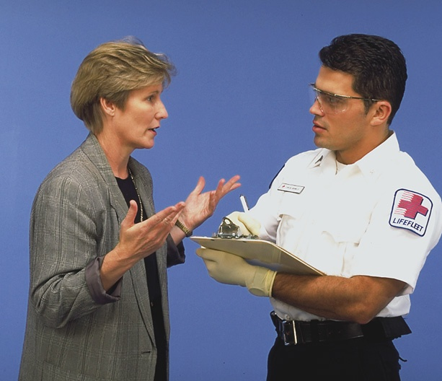
If the patient cannot provide useful information, gather it from family or bystanders.

Slide 26
Termination phase
Explain that the information required for the time being has been obtained ,however if more is required the patient will be informed.
Enquire if the patient or companion has any question to ask
Thank patient and companion and release them.
Keep patients notes and files in respective cabinets
Store unused stationery in the right place
Wash and dry hands.

Slide 27
Summary:
Students should be able to:
State Importance of history taking
Create a rapport/an approach with a patient
Arrange a comfortable setting for history taking
Explain each component of history taking conclusively

Slide 28
Take home assignment
What are the ways to establish a patient nurse relationship before history taking?
Which are the elements of the comprehensive history ?
State the 8 tips in gathering information about pain in history taking?

