Slide 1
Health Education
Outline: Definition, aims, objectives, principles, models (medical, motivation, social intervention) theory (behavioral, social learning, cognitive, humanist, approach to health education, steps in carrying out a health programme. Methods of health education, planning for a health education programme. Behavior change and communication, definition, behaviour change models (Health Belief Model), steps in behavior change, factors affecting behavior change, advocacy and networking, IEC.

Slide 2
Health Education
Definition
Combination of learning experiences designed to help individuals and communities improve their health by increasing their knowledge or influencing their attitudes(WHO)

Slide 3
Health Education
Health education is about providing health information and knowledge to individuals and communities and providing skills to enable individuals to adopt healthy behaviors voluntarily. It is a combination of learning experiences designed to help individuals and communities improve their health, by increasing their knowledge or influencing their attitudes

Slide 5
Health Education
Learning Objectives
To define health education
To state the aims of health education
To state the principles of health education
To describe the models of health education
To describe the theories of health education
To outline the steps in carrying out a health education programme

Slide 6
HEALTH EDUCATION
To state the health education methods
To describe how to plan for a health education programme
To define Behaviour Change Communication(BCC)
To describe the behaviour change models
To describe the steps in behaviour change

Slide 7
HEALTH EDUCATION
To describe the factors affecting behaviour change
To describe the role of advocacy in behaviour change
To describe the role of networking in behaviour change
To describe the role of IEC in behaviour change

Slide 8
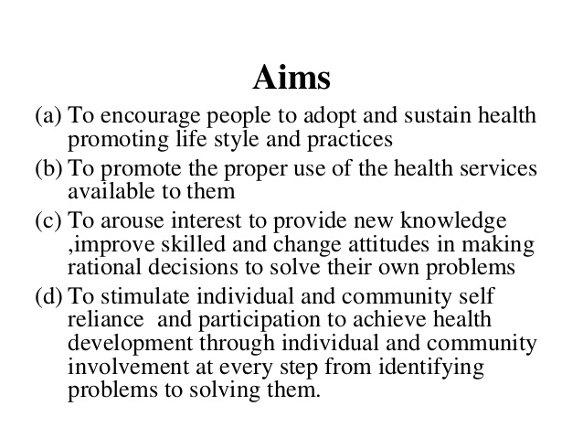
Health education

Slide 9
Objectives of health education
Informing People
Dissemination of information to the people regarding prevention of disease and promotion of health. This creates awareness of health needs, problems, take away the barrier of ignorance and misconceptions about health and Disease.
Motivating People
People should be motivated to change their ill habits, way of living as many diseases can be corrected by alteration of human behaviour or changes in health practices which are detrimental to health.
Guiding into action
People should be motivated, communicated, and educated, to adopt and maintain health practices and lifestyle practices.
Health Education should be made an integral part of Education, Which will enable to change their life styles

Slide 10
Principles of health education

Slide 11
Principles of health education

Slide 12
Principles of health education

Slide 13
Principles of health education

Slide 14
Principles of health education

Slide 15
Principles of health education

Slide 16
Principles of health education

Slide 17
Principles of health education

Slide 18
Principles of health education

Slide 19
Principles of health education

Slide 20
Principles of health education

Slide 21
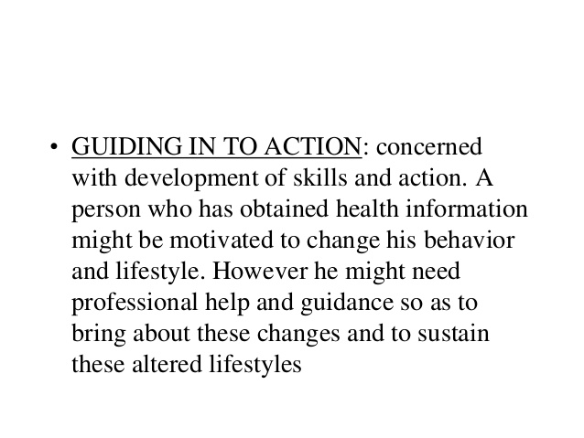
Principles of health education

Slide 22
Principles of health education

Slide 23
Principles of health education

Slide 24
Principles of health education

Slide 25
Principles of health education

Slide 26
Principles of health education

Slide 27
Principles of health education

Slide 28
Principles of health education

Slide 29
Aims of health education

Slide 30
Approaches to health education

Slide 31
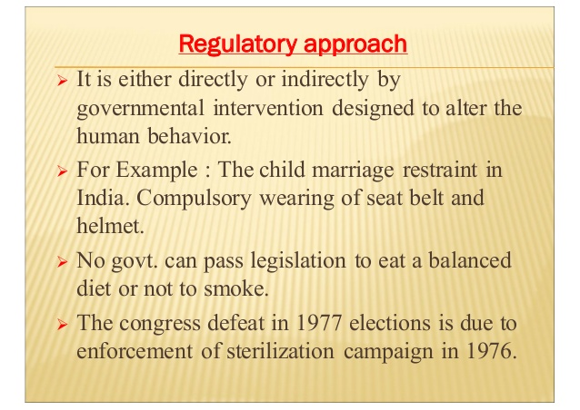
Approaches to health education

Slide 32
Approaches to health education

Slide 33
Approaches to health education

Slide 34
Approaches to health education

Slide 36
Models of health education

Slide 37
Models of health education

Slide 38
Models of health education

Slide 40
Health Education Theories

Slide 41
Health Education Theories

Slide 42
Health Education Theories

Slide 43
Health Education Theories

Slide 44
Health Education Theories

Slide 45
Health Education Theories

Slide 46
Health Education Theories

Slide 47
Health Education Theories

Slide 48
Health Education Theories

Slide 49
Diffusion and Innovation

Slide 50
Health Education Theories

Slide 51
Steps in planning health education programmes
Careful planning is essential to the success of all health education activities.
All health education messages require a lot of planning before they are delivered.
Before you can begin planning your health education activities, you need to have a clear understanding of what planning means. Planning is the process of making thoughtful and systematic decisions about what needs to be done, how it has to be done, by whom, and with what resources. Planning is central to health education and health promotion activities.

Slide 52
Key questions to ask when planning
What will be done?
When will it be done?
Where will it be done?
Who will do it?
What resources are required?

Slide 53
The purpose of planning in health education
Planning enables you to match your resources to the problem you intend to solve.
Planning helps you to use resources more efficiently so you can ensure the best use of scarce resources. Planning can help avoid duplication of activities. Planning helps you prioritize needs and activities. This is useful because your community may have a lot of problems, but not the resources or the capacity to solve all these problems at the same time.
Planning enables you to think about how to develop the best methods with which to solve a problem.

Slide 54
Principles of planning in health education
It is important that plans are made with the needs and context of the community in mind. You should try to understand what is currently happening in the community you work in.
Consider the basic needs and interests of the community. If you do not consider the local needs and interests, your plans will not be effective.
Plan with the people involved in the implementation of an activity. If you include people they will be more likely to participate, and the plan will be more likely to succeed.
Identify and use all relevant community resources.
Planning should be flexible, not rigid. You can modify your plans when necessary. For example, you would have to change your priorities if a new problem, needing an urgent response, arose.
The planned activity should be achievable, and take into consideration the financial, personnel, and time constraints on the resources you have available. You should not plan unachievable activities.

Slide 55
Steps involved in planning health education activities
Planning is a continuous process. It doesn’t just happen at the start of a project. If you are involved in improving and promoting individual, family and community health, you should make sure that you plan your activities. Planning can be thought of as a cycle that has six steps

Slide 56
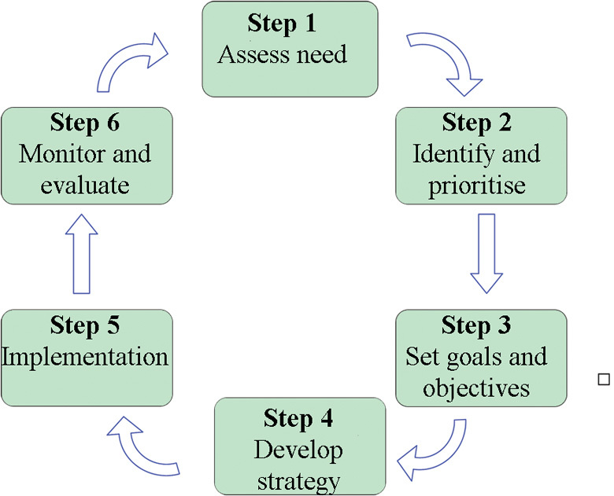

Slide 57
Needs assessment
Conducting a needs assessment is the first, and probably the most important, step in any successful planning process. Sufficient time should be given for each needs assessment. The amount of time required for a needs assessment will depend on the time you have available to address the problem, and the nature and urgency of the problem being assessed.
Needs assessment is the process of identifying and understanding the health problems of the community, and their possible causes. The problems are then analysed so that priorities can be set for any necessary interventions. The information you collect during a needs assessment will serve as a baseline for monitoring and evaluation at a later stage.

Slide 58
Needs assessment
Before you begin a needs assessment, it is important to become familiar with the community you are working in. This involves identifying and talking with the key community members such as the leaders, as well as religious and leaders. Ideally, you would involve key community members throughout the planning process, and in the implementation and evaluation of your health education activities.
There are various categories of needs assessment. In order to develop a workable and appropriate plan, several types of needs should be identified, including health needs and resource needs, which are outlined below.

Slide 59
Health needs assessment
In a health needs assessment, you identify health problems prevalent in your community. In other words, you look into any local health conditions which are associated with morbidity, mortality and disability. The local problems may include malaria, TB, HIV/AIDS, diarrhoea, or other conditions arising from the local context, such as goitre caused by lack of iodine in the diet.
Having identified the problems, you need to think about the extent to which local health conditions are a result of insufficient education. For example, are people lacking in knowledge about malaria, or HIV, or diarrhoe. Are they aware that some of their behaviours may be part of the problem?

Slide 60
Resource needs assessment
A resource needs assessment identifies the resources needed to tackle the identified health problems in your community. You should consider whether there is a lack of resources or materials that is preventing the community from practicing healthy behaviours. For example, a mother may have good knowledge about malaria and its prevention methods, and want to use Insecticide Treated Bed Nets (ITNs). However, if ITNs are not available, it may not be possible for her to avoid malaria. Therefore, a bed net is a resource which is required to bring about behaviour change. Similarly, a woman may intend to use contraception. However, if contraceptive services are not available in her locality, she remains at risk of unplanned pregnancies. In order to facilitate behaviour change, you should identify ways of addressing this lack of contraceptive resources.
Be aware too that education is in itself one of the great resources you can call on. An education needs assessment should also be part of your plan.

Slide 61
Resource needs assessment
Data related to the health needs of the community can be obtained from two main sources — these are called primary and secondary sources.
Primary sources are data which you collect during a needs assessment, using techniques such as observation, in-depth interviews, key informant interviews, and focus group discussions.

Slide 62
Resource needs assessment
Secondary sources are data that were collected and documented for other purposes, including health centre and health post records, activity reports, and research reports. You may also be able to review data which has already been collected by other people to identify local health problems.

Slide 63
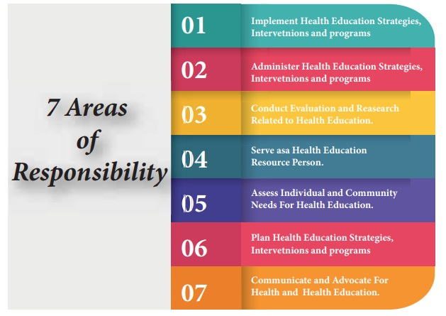
Responsibilities of a health Educator

Slide 64
Responsibilities of a health Educator
· Assessing Individual and Community needs for Health education
Provides the foundation for program planning
· Determines what health problems might exist in any given groups
· Includes determination of community resources available to address the problem
· Community Empowerment encourages the population to take ownership of their health problems
· Includes careful data collection and analysis
· It is essential for healthy life
· Find out the vital health statistics in community

Slide 65
Responsibilities of a health Educator
· Plan Health education Strategies, Interventions, and Programs
Actions are based on the needs assessment done for the community (see Responsibility I)
· Involves the development of goals and objectives which are specific and measurable
· Interventions are developed that will meet the goals and objectives
· According to Rule of Sufficiency, strategies are implemented which are sufficiently robust, effective enough, and have a reasonable chance of meeting stated objectives

Slide 66
Responsibilities of a health Educator
Implement Health education Strategies, Interventions, and Programs
· Implementation is based on a thorough understanding of the priority population
· Utilize a wide range of educational methods and techniques

Slide 67
Responsibilities of a health Educator
Conduct valuation and Research Related to Health education
Depending on the setting, utilize tests, surveys, observations, tracking epidemiological data, or other methods of data collection
· Health Educators make use of research to improve their practices.

Slide 68
Responsibilities of a health Educator
· Administer Health education Strategies, Interventions, and Programs
Administration is generally a function of the more experienced practitioner
· Involves facilitating cooperation among personnel, both within and between programs

Slide 69
Responsibilities of a health Educator
· Serve as a Health education resource Person
Involves skills to access needed resources, and establish effective consultative relationships.

Slide 70
Responsibilities of a health Educator
· Communicate and Advocate for Health and Health education
Address diverse audience in diverse settings
· Translates scientific language into understandable information
· Formulates and support rules, policies and legislation
· Advocate for the profession of health education

Slide 72
Behavior change communication
Behaviour change communication is an interactive process for developing messages and approaches using a mix of communication channels in order to encourage and sustain positive and appropriate behaviour

Slide 73
BCC

Slide 74
Principles of BCC

Slide 76
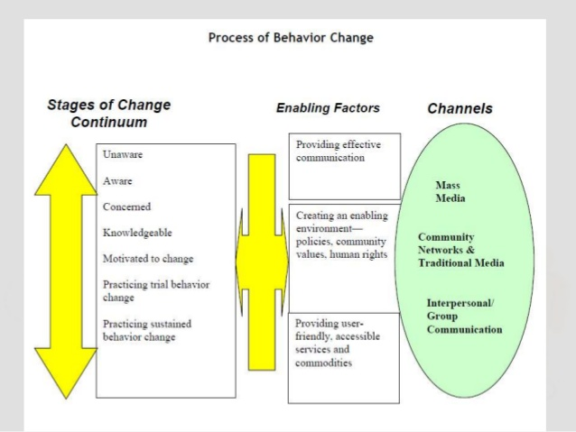
Process of behaviour change

Slide 77
Steps for a BCC Programme

Slide 78
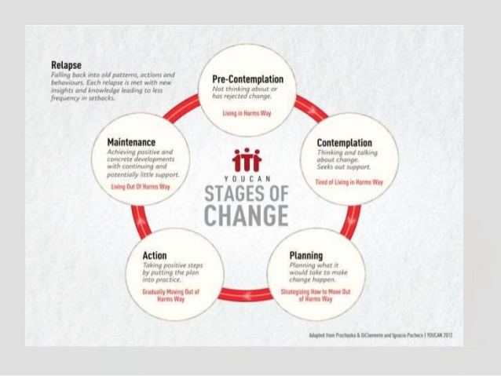
Stages of change

Slide 79
The Health Belief Model
Perceived benefits - This refers to a person's perception of the effectiveness of various actions available to reduce the threat of illness or disease (or to cure illness or disease). The course of action a person takes in preventing (or curing) illness or disease relies on consideration and evaluation of both perceived susceptibility and perceived benefit, such that the person would accept the recommended health action if it was perceived as beneficial.
Perceived barriers - This refers to a person's feelings on the obstacles to performing a recommended health action. There is wide variation in a person's feelings of barriers, or impediments, which lead to a cost/benefit analysis. The person weighs the effectiveness of the actions against the perceptions that it may be expensive, dangerous (e.g., side effects), unpleasant (e.g., painful), time-consuming, or inconvenient.
Cue to action - This is the stimulus needed to trigger the decision-making process to accept a recommended health action. These cues can be internal (e.g., chest pains, wheezing, etc.) or external (e.g., advice from others, illness of family member, newspaper article, etc.).
Self-efficacy - This refers to the level of a person's confidence in his or her ability to successfully perform a behavior. This construct was added to the model most recently in mid-1980. Self-efficacy is a construct in many behavioral theories as it directly relates to whether a person performs the desired behavior.
Limitations of Health Belief Model

Slide 80
Limitation of health belief model
It does not account for a person's attitudes, beliefs, or other individual determinants that dictate a person's acceptance of a health behavior.
It does not take into account behaviors that are habitual and thus may inform the decision-making process to accept a recommended action (e.g., smoking).
It does not take into account behaviors that are performed for non-health related reasons such as social acceptability.
It does not account for environmental or economic factors that may prohibit or promote the recommended action.
It assumes that everyone has access to equal amounts of information on the illness or disease.
It assumes that cues to action are widely prevalent in encouraging people to act and that "health" actions are the main goal in the decision-making process.

Slide 81
Theory of Planned Behavior
The Theory of Planned Behavior (TPB) started as the Theory of Reasoned Action in 1980 to predict an individual's intention to engage in a behavior at a specific time and place. The theory was intended to explain all behaviors over which people have the ability to exert self-control. The key component to this model is behavioral intent; behavioral intentions are influenced by the attitude about the likelihood that the behavior will have the expected outcome and the subjective evaluation of the risks and benefits of that outcome.
The TPB has been used successfully to predict and explain a wide range of health behaviors and intentions including smoking, drinking, health services utilization, breastfeeding, and substance use, among others. The TPB states that behavioral achievement depends on both motivation (intention) and ability (behavioral control). It distinguishes between three types of beliefs - behavioral, normative, and control. The TPB is comprised of six constructs that collectively represent a person's actual control over the behavior.

Slide 82
Six constructs of Theory of planned behavior that collectively represent a person's actual control over the behavior.
Attitudes - This refers to the degree to which a person has a favorable or unfavorable evaluation of the behavior of interest. It entails a consideration of the outcomes of performing the behavior.
Behavioral intention - This refers to the motivational factors that influence a given behavior where the stronger the intention to perform the behavior, the more likely the behavior will be performed.
Subjective norms - This refers to the belief about whether most people approve or disapprove of the behavior. It relates to a person's beliefs about whether peers and people of importance to the person think he or she should engage in the behavior.

Slide 83
Six constructs of Theory of planned behavior that collectively represent a person's actual control over the behavior.
Social norms - This refers to the customary codes of behavior in a group or people or larger cultural context. Social norms are considered normative, or standard, in a group of people.
Perceived power - This refers to the perceived presence of factors that may facilitate or impede performance of a behavior. Perceived power contributes to a person's perceived behavioral control over each of those factors.
Perceived behavioral control - This refers to a person's perception of the ease or difficulty of performing the behavior of interest. Perceived behavioral control varies across situations and actions, which results in a person having varying perceptions of behavioral control depending on the situation. This construct of the theory was added later, and created the shift from the Theory of Reasoned Action to the Theory of Planned Behavior.

Slide 85
Stage 1: Precontemplation
Characteristics
Denial
Ignorance of the problem
StrategiesRethink your behavior
Analyze yourself and your actions
Assess risks of current behavior
The earliest stage of change is known as precontemplation. During the precontemplation stage, people are not considering a change. People in this stage are often described as "in denial," because they claim that their behavior is not a problem. In some cases, people in this stage do not understand that their behavior is damaging, or they are under-informed about the consequences of their actions.
If you are in this stage, you may feel resigned to your current state or believe that you have no control over your behavior.
If you are in this stage, begin by asking yourself some questions. Have you ever tried to change this behavior in the past? How do you recognize that you have a problem? What would have to happen for you to consider your behavior a problem?

Slide 86
Stage 2: Contemplation
Characteristics
Ambivalence
Conflicted emotions
Strategies Weigh pros and cons of behavior change
Confirm readiness and ability to change
Identify barriers to change
During this stage, people become more and more aware of the potential benefits of making a change, but the costs tend to stand out even more. This conflict creates a strong sense of ambivalence about changing. Because of this uncertainty, the contemplation stage of change can last months or even years.¹﻿
Many people never make it past the contemplation phase.

Slide 87
Stage 2: Contemplation
You may view change as a process of giving something up rather than a means of gaining emotional, mental, or physical benefits. If you are contemplating a behavior change, there are some important questions to ask yourself: Why do you want to change? Is there anything preventing you from changing? What are some things that could help you make this change?

Slide 88
Stage 3: Preparation
Characteristics
Experimenting with small changes
Collecting information about change
StrategiesWrite down your goals
Prepare a plan of action
Make a list of motivating statements

Slide 89
Stage 3: Preparation
During the preparation stage, you might begin making small changes to prepare for a larger life change. For example, if losing weight is your goal, you might switch to lower-fat foods.²﻿ If your goal is to quit smoking, you might switch brands or smoke less each day. You might also take some sort of direct action such as consulting a therapist, joining a health club, or reading self-help books.
If you are in the preparation stage, there are some steps you can take to improve your chances of successfully making a lasting life change. Gather as much information as you can about ways to change your behavior. Prepare a list of motivating statements. Write down your goals. Find resources such as support groups, counselors, or friends who can offer advice and encouragement.

Slide 90
Stage 4: Action
Characteristics
Direct action toward a goal
StrategiesReward your successes
Seek out social support
During the fourth stage of change, people begin taking direct action in order to accomplish their goals.¹﻿ Oftentimes, resolutions fail because the previous steps have not been given enough thought or time.

Slide 91
Stage 4: Action
For example, many people make a New Year's resolution to lose weight and immediately start a new exercise regimen, embark on a healthier diet, and cut back on snacks. These definitive steps are vital to success, but these efforts are often abandoned in a matter of weeks because the previous steps have been overlooked.
If you are currently taking action towards achieving a goal, congratulate and reward yourself for any positive steps you take. Reinforcement and support are extremely important in helping maintain positive steps toward change.
Take the time to periodically review your motivations, resources, and progress in order to refresh your commitment and belief in your abilities.

Slide 92
Stage 6: Relapse
Characteristics
Disappointment
Frustration
Feelings of failure
StrategiesIdentify triggers that lead to relapse
Recognize barriers to success
Reaffirm your goal and commitment to change
In any behavior change, relapses are a common occurrence.³﻿ When you go through a relapse, you might experience feelings of failure, disappointment, and frustration.

Slide 93
Stage 6: Relapse
The key to success is to not let these setbacks undermine your self-confidence. If you lapse back to an old behavior, take a hard look at why it happened. What triggered the relapse? What can you do to avoid these triggers in the future?
While relapses can be difficult, the best solution is to start again with the preparation, action, or maintenance stages of behavior change.
You might want to reassess your resources and techniques. Reaffirm your motivation, plan of action, and commitment to your goals. Also, make plans for how you will deal with any future temptations.
Resolutions fail when the proper preparation and actions are not taken. By approaching a goal with an understanding of how to best prepare, act, and maintain a new behavior, you will be more likely to succeed.

Slide 94
Community resources
During a needs assessment, you also need to identify the resources available in the community, such as labour power. This would include finding out about the help that community leaders and volunteers could give, and the local materials and spaces in which to conduct health education sessions. When looking at community resources, you should include local information such as the number of people in each household, their ages and their economic characteristics. You would also include information on community groups and their impact on local health activities and communication networks.

Slide 105
Commonly used in family planning

Slide 107
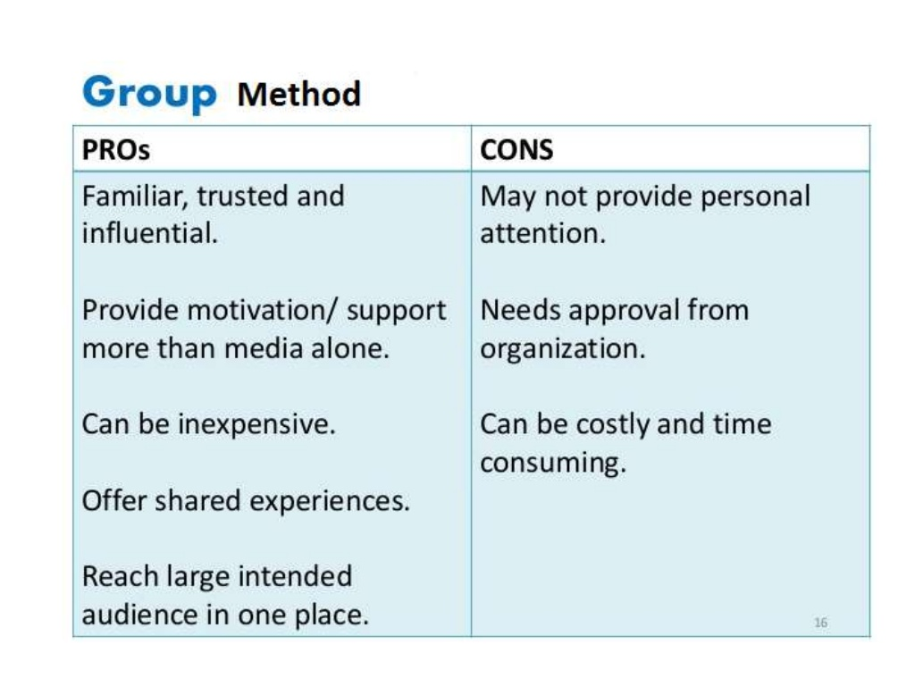

Slide 108
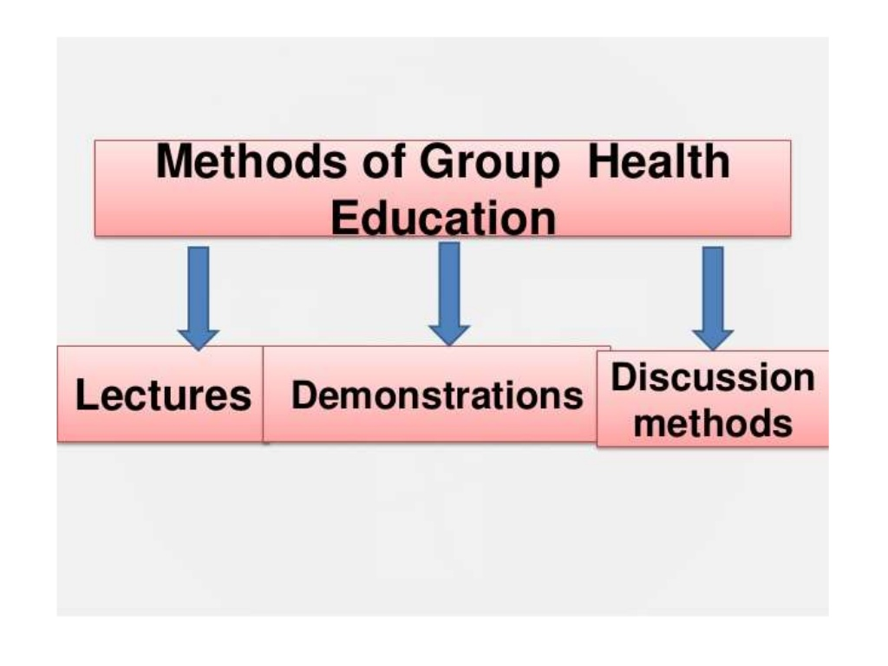

Slide 137
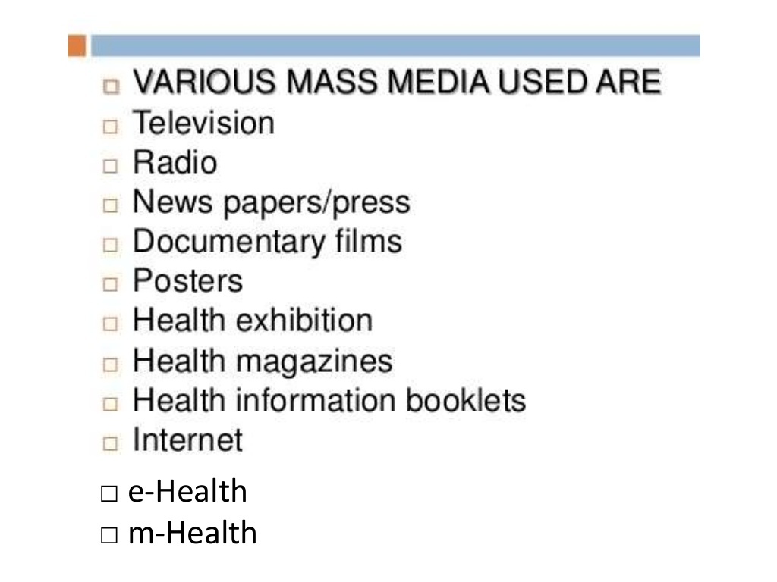

Slide 138
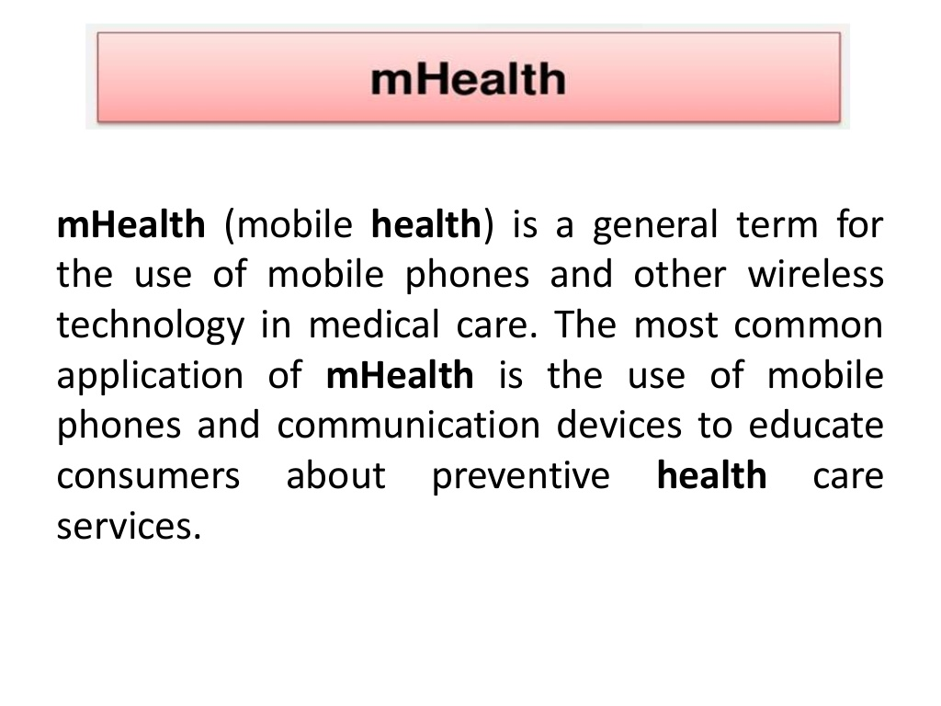

Slide 141
Factors influencing behaviour change
Abilities
Gender
Race and culture
Attribution
Perception
Attitude

Slide 142
Factors influencing behaviour change
Abilities are the traits a person learns from the environment around as well as the traits a person is gifted with by birth. These traits are broadly classified as −
Intellectual abilities
Physical abilities
Self-awareness abilities
In order to understand how these affect a person’s behavior, we need to know what these abilities are.
Intellectual abilities − It personifies a person’s intelligence, verbal and analytical reasoning abilities, memory as well as verbal comprehension.

Slide 143
Factors influencing behaviour change
Physical abilities
− It personifies a person’s physical strength, stamina, body coordination as well as motor skills.
Self-awareness abilities − It symbolizes how a person feels about the task, while a manager’s perception of his abilities decides the kind of work that needs to be allotted to an individual.
Thus the psychological, physical, self-assurance traits owned by a person defines the behavior of a person in social and personal life.

Slide 144
Factors influencing behaviour change
Gender
Research proves that men and women both stand equal in terms of job performance and mental abilities; however, society still emphasizes differences between the two genders. Absenteeism is one area in an organization where differences are found as women are considered to be the primary caregiver for children. A factor that might influence work allocation and evaluation in an organization is the manager’s perception and personal values.
For example − An organization encourages both genders to work efficiently towards the company’s goal and no special promotion or demotion is given or tolerated for any specific gender.

Slide 145
Race & Culture
Race is a group of people sharing similar physical features. It is used to define types of persons according to perceived traits. For example − Indian, African. On the other hand, culture can be defined as the traits, ideas, customs and traditions one follows either as a person or in a group. For example − Celebrating a festival.
Race & culture have always exerted an important influence both at the workplace as well as in the society. The common mistakes such as attributing behavior and stereotyping according to individual’s race & culture basically influences an individual’s behavior.
In today’s diverse work culture, the management as well as staff should learn and accept different cultures, values, and common protocols to create more comfortable corporate culture.

Slide 146
Perception
Perception is an intellectual process of transforming sensory stimuli into meaningful information. It is the process of interpreting something that we see or hear in our mind and use it later to judge and give a verdict on a situation, person, group, etc.
It can be divided into six types namely −
Of sound − The ability to receive sound by identifying vibrations.
Of speech − The competence of interpreting and understanding the sounds of language heard.
Touch − Identifying objects through patterns of its surface by touching it.
Taste − The ability to detect flavor of substances by tasting it through sensory organs known as taste buds.
Other senses − Other senses include balance, acceleration, pain, time, sensation felt in throat and lungs etc.

Slide 147
Attribution
Attribution is the course of observing behavior followed by determining its cause based on individual’s personality or situation.
Attribution framework uses the following three criteria −
Consensus − The extent to which people in the same situation might react similarly.
Distinctiveness − The extent to which a person’s behavior can be associated to situations or personality.
Consistency − The frequency measurement of the observed behavior, that is, how often does this behavior occur.
The framework mentioned says it is all about how an individual behaves in different situations.

Slide 148
Attitude
Attitude is the abstract learnt reaction or say response of a person’s entire cognitive process over a time span.
For example − A person who has worked with different companies might develop an attitude of indifference towards organizational citizenship.
Now we have a clear idea about what are the factors responsible for the way we behave. We never think about these elements and how they affect our daily life but we can’t ignore the fact that they are responsible for the way we walk, talk, eat, socialize, etc.

Slide 149
Methods of health communication

Slide 150
Knowledge and awareness
Providing information is therefore a first step towards influencing behaviour change rather than an end point

Slide 151
Habit and routine
Habit or routine can be a key factor in influencing frequent behaviours. In recent years, it has become an emerging area of study in social psychology and in fields such as neuroscience. Here, experiments on animals have given insights into the dual process cognitive system10 whereby the automatic mind handles most of our day-to-day functioning while the executive mind both monitors the automatic mind and takes on focused mental tasks. The more we repeat a particular behaviour, the more automatic it becomes. As time passes and the behaviour is undertaken more and more frequently, habit can therefore become the key factor driving behaviour.

Slide 152
Emotions
Emotions may be triggered without our knowing and can have a strong influence on our behaviour, both conscious and unconscious. While most models see emotion as influencing behaviour change indirectly (by altering attitude, habit or agency), there are occasionally situations where behaviour is driven by emotion alone. For example, a phobia or fear can determine how an individual behaves in certain situations.

Slide 153
Social motivation
Other people’s values, attitudes, beliefs and behaviour can have a strong social influence on our own behaviour, a phenomenon that has been widely discussed in recent years. Social norms are the group ‘rules’ that determine what is deemed ‘acceptable’ behaviour. Social norms can have a huge influence on our thoughts and behaviours and therefore appear in many different social psychological models

Slide 154
Social motivation
. Social norms vary by group, so what the norm is for one group of young people may well be different from that adopted by another group living in different circumstances. Failure to act in accordance with these ‘rules’ can lead to exclusion from the group.

Slide 155
Communications and social norms
Communications can be effective in highlighting social norms and prompting pe
For the young people in that group, the views and behaviour of their peers will be a more powerful influence than information provided by other sources.

Slide 156
Environmental factors
Environmental factors can be hugely significant in determining how an individual will behave. Before behaviour change can occur.

Slide 157
Environmental factors
The local (exo) environment However motivated we are to behave in a certain way, if our local environment puts barriers in the way of that behaviour it is unlikely that we will succeed. For example, an individual may be strongly motivated to use public transport instead of a car, but if there is little access to public transport in their area, it will be difficult if not impossible for them to change their behaviour.

Slide 158
Macro environment
Factors that operate at a national or even international level can also have a huge influence on individual behaviour. Wider or macro environmental factors can include technology, the economy, taxation and legislation.

Slide 159
Communication
Communications can provide vital support for policy interventions, for example by providing information about new legislation (such as the reclassification of cannabis) or promoting local services. In such cases, more traditional forms of advertising may be appropriate.

Slide 160
Communication
Communications can also influence environmental factors by helping to frame the discourse on particular issues. While this may challenge ‘traditional’ definitions of the role of communications, it is an important point to consider, particularly where government is seeking to influence behaviours that are deepseated and difficult to change.

Slide 161
Communication
Participative approaches such as citizens’ summits, workshops or online dialogue draw on theories of learning and change which argue that sustainable change cannot be imposed. Rather, people need to play an active role in the change process. Communications could be used, for example, to recruit people into programmes that empower them to change the environment themselves or to highlight local problems, thus creating the momentum for change.

Slide 162
Adoption of new ideas

Slide 163
Methods of health communication

Slide 164
Methods of health communication

Slide 165
Methods of health communication

Slide 166
Methods of health communication

Slide 167
Methods of health communication

Slide 168
Advocacy in health education

Slide 169
Advocacy in health education
Advocacy is an activity by an individual or group that aims to influence decisions within political, economic, and social institutions. ... Lobbying (often by lobby groups) is a form of advocacy where a direct approach is made to legislators on a specific issue or specific piece of legislation.

Slide 170
Advocacy
Advocacy simply means actively supporting a cause, and trying to get others to support it as well.
Advocacy is speaking up, drawing attention to an important issue and directing decision makers towards a solution.

Slide 171
Purpose of advocacy
The purpose of advocacy as defined by UNFPA is to promote or reinforce a change in policy, programme or legislation.
Rather than providing support directly to clients or users of services, advocacy aims at winning support from others, i.e. creating a supportive environment

Slide 172
Techniques of advocacy
Sensitizing
Mobilizing
Dialoguing
Negotiating
Lobbying
Petitioning
Pressuring
Informing

Slide 173
Importance of advocacy

Slide 174
How advocacy is done
Lobbying or direct communication: involves influencing through direct, private communications with decision-makers. Lobbying, particularly through personal meetings with decision-makers, can be a powerful and cost-effective advocacy tool.
Campaigning: involves speaking publicly on an issue with a view to generating a response from the wider public and using a variety of techniques such as:
chain e-mail or letter
opinion pieces and letters to the editor in newspapers
newsletters
celebrity endorsements
media partnerships with newspapers, journalists and film-makers
web-based bulletins and online discussions
public events
large-scale advertising campaigns.
The choice of method will very much depend on the target audience, the message to be conveyed, the resources available, and the cultural and socioeconomic context.

Slide 175
Process of advocacy
The effectiveness and success of any advocacy process depends, amongst other factors, on how well the following steps are implemented:
• Identifying and stating the issue
• Collecting the relevant information
• Mobilising interested people
• Raising and managing the necessary resources
• Networking
Forming alliances
• Forming and sustaining coalitions
• Involving media
• Establishing contacts with government

Slide 176
The steps in planning for advocacy
• Know your issue
• Establish your objective(s)
• Conduct a stakeholder analysis
• Develop a strategy
• Plan the activities
• Identify and mobilise the required resources
• Monitor and evaluate the campaign’s progress.
It may well be necessary to revisit and revise several of these steps throughout the implementation of your advocacy campaign. Successful advocacy does not proceed in a straight line and rarely unfolds exactly according to plan. Be prepared for unforeseen events and consequences. Be flexible.

Slide 177
Stakeholders and their sources of power
Government -Election mandate, political authority, access to state resources, access to civil service, access to business, access to donors, access to other governments, membership of international organizations, influence over provincial and local government
Civil society -organizations Constituency / membership base, information drawn from development work, expertise, credibility, access to international networks / sector organizations
Union federation -Membership, money, access to union media, mobilization skills
Business -Money, capacity to buy intellectual power, access to officials, access to media, power as employers
Religious organizations- Membership, moral authority, outreach
Media Access to the public, variety of sources of information, communication skills, captive audiences

Slide 178
Why information is a source of power
• Information drawn from advocacy groups' own work can provide them with credibility and with the basis for alternative analysis to counter positions.
• Information or data, which is only available to government institutions can be used by government to influence arguments in favour of their own positions.
• Information provided by advocacy groups to communities regarding their constitutional rights empowers the people in those communities to assert their rights.
• Information collected by advocacy groups from other advocacy groups in regional, national, or international organisations about experiences and policies elsewhere, and used in an advocacy campaign, can help to influence local or national policy decisions

Slide 179
Advocacy
In summary, Advocacy begins with a problem or with a perception that there is a better alternative to a current condition and seeks to solve that problem and/or implement the selected alternative. Advocacy is both an art and a science. There are no strict rules for advocacy work. Its approaches must be culturally, socially and politically specific

Slide 180
Advocacy
. Widespread participation in an advocacy campaign is generally a precondition for success. Planning an advocacy campaign is a dynamic process. It involves identifying the issue, developing solutions, building support, and bringing issues, solutions, and political will together to ensure that the desired change takes place. Finally, it involves monitoring and evaluating the entire process.

Slide 181
Information,Education,Communication(IEC)

Slide 182
Concept of IEC

Slide 183
Aims of IEC

Slide 184
Types of communication

Slide 185
Communication Barriers

Slide 186
Functions of communication

Slide 187
Health communication methods

Slide 188
Health communication methods

Slide 189
Health communication methods

Slide 190
Health promotion
Outline:
Concepts, The Ottawa Charter for Health Promotion, principles, aims,
Elements ( good governance for health, healthy cities, health literacy), methods of health promotion (audio visual aids, role plays, songs, barazas, schools, women and men groups, youth groups), steps of an organized community dialogue, community empowerment in health promotion.

Slide 191
Health promotion
Definition
Heath promotion is a process of enabling people to increase control over and improve their health.
NB
It’s a positive concept emphasizing on personal, social, political and institutional resources as well as physical capabilities

Slide 192
Health promotion
NB
Any combination of health, political, spiritual or organizational initiation to bring about poisitive attidudinal behavioural, social and environmental changes conducive to improving the health of a population. It is directed towards action or the determinants of health

Slide 193
Health promotion
NB
Government at both county and National level has a responsibility to ensure that the environment which is beyond the control of individuals and groups is conducive to health

Slide 194
History of Health Promotion
The first International Conference on Health Promotion was held in Ottawa in 1986, and was primarily a response to growing expectations for a new public health movement around the world. It launched a series of actions among international organizations, national governments and local communities to achieve the goal of "Health For All" by the year 2000 and beyond.

Slide 195
History of Health Promotion
Since then, the WHO Global Health Promotion Conferences have established and developed the global principles and action areas for health promotion. Most recently, the 9th global conference (Shanghai 2016), titled ‘Promoting health in the Sustainable Development Goals: Health for all and all for health’, highlighted the critical links between promoting health and the 2030 Agenda for Sustainable Development.

Slide 196
History of Health Promotion
Whilst calling for bold political interventions to accelerate country action on the SDGs, the Shanghai Declaration provides a framework through which governments can utilize the transformational potential of health promotion.

Slide 197
History of Health Promotion
First International Conference on Health Promotion, Ottawa, 21 November 1986
Call for International Action
The Conference calls on the World Health Organization and other international organizations to advocate the promotion of health in all appropriate forums and to support countries in setting up strategies and programmes for health promotion.

Slide 198
History of Health Promotion
The Conference was firmly convinced that if people in all walks of life, nongovernmental and voluntary organizations, governments, the World Health Organization and all other bodies concerned join forces in introducing strategies for health promotion, in line with the moral and social values that form the basis of this CHARTER, Health For All by the year 2000 would become a reality

Slide 199
History of Health Promotion
The CHARTER was adopted at an INTERNATIONAL CONFERENCE ON HEALTH PROMOTION, the move towards a new public health, 17th-21st November 1986 Ottawa, Ontario, Canada.
Co-sponsored by the Canadian Public Health Association, Health and Welfare Canada, and the World Health Organization.

Slide 200
History of Health Promotion
The three basic strategies for health promotion identified in the Ottawa Charter:
Advocacy for health to create the essential conditions for health(to boost the factors which encourage health)
Enabling all people to achieve their full health potential (allowing all people to achieve health equity)
Mediating between the different interests in society in the pursuit of health( collaboration across all sectors).

Slide 201
History of Health Promotion
These strategies are supported by five priority action areas as outlined in the Ottawa Charter for health promotion as indicated below

Slide 202
History of Health Promotion
The World Health Organization took a leading role in action for health promotion. It suggested that health promotion happens at five key levels/priority areas.
Developing Personal Skills
Creating Supportive Environments for health
Strengthening Community Action
Build a healthy Public Policy
Re- orient the Health Services.

Slide 203
The five priority action areas/components of health promotion
Create supportive environments for health: The protection of the natural and built environments and conservation of natural resources must be addressed in any health promotion strategy.

Slide 204
The five priority action areas/components of health promotion
• Strengthen community action for health: Community development draws on existing human and material resources to enhance self-help and social support, and to develop flexible systems for strengthening public participation in, and direction of, health matters. This requires full and continuous access to information and learning opportunities for health, as well as funding support.

Slide 205
The five priority action areas/components of health promotion
DEVELOPING PERSONAL SKILLS
Youth organisations, through the broad range of programmes and activites delivered to young people, including health education and health information, positivelly influence the development of personal skills, for example self esteem, self efficacy, communication, negotation, life skills and motivation. The development of these skills has a positive impact on health.

Slide 206
Developing personal skills creating supportive environments
Through creating safe and secure physical and social environments, youth organisations provide young people and staff with opportunities to discuss and explore health issues and practice health-enhancing behaviours, thus supporting health education and ‘making the healthier choice the easier choice’; for example providing healthy food options in the tuck shop; providing healthy snacks for after schools clubs; providing a smoke free environment, implementing an anti-bullying policy, providing an adolescent friendly health service.

Slide 207
STRENGTHEN COMMUNITY ACTION
Through developing partnerships and alliances with other organisations and sectors in the community, youth organisations can build capacity and positively influence health within the wider community, which in turn, can continue to support the health of their target groups who live in the community, for example delivering parent programmes, working in partnership with healthy towns initatives.

Slide 208
The five priority action areas/components of health promotion
Build/delivering health public policy
Through the development of health-related policy internally, youth organisations demonstrate evidence-based practice indicating the importance of having policy in place to support practice, for example sexual health policy; substance use policy. Additionally, youth organisations have a key role to play in raising awareness and advocating for public policy development and change in order to support their health-related work and the health of their target groups, for example national alcohol policy.

Slide 209
Public policies
Examples of public policies
Policies which provide for a physical and social environment conducive to health, such as town planning, pollution control and tax incentives for lead-free petrol
Educational policies which ensure that all children have good education for health and nutritious school meals
Food and nutrition policies which provide physical and economic access to a healthy diet for all groups

Slide 210
Public policies
Transport policies which include legislative and educational measures pertaining to, for example, the use of seat-belts and reduced speed limits, better road design, traffic control and equality of access to public services, e.g. subsidised fares
Policies relating to tobacco products and alcohol, which combine public and educational measures to reduce supply and demand

Slide 211
Public policies
Employment policies which enhance workers' participation, job creation, and job satisfaction, and provide for statutory health-based regulations at work. Work should be considered as a source of health
Health services policies which specifically seek to reduce inequity between social or gender groups in their productive or reproductive roles, and legal provisions which allow for maternity and/or paternity leave.

Slide 212
Reorient the health services
Advocating for the development and provision of health services that can respond to the health needs of young people is a key role of youth organizations, for example youth organisations have a role in creating awareness and advocating for the provision of an adolescent friendly health service for young people.

Slide 213
The five priority action areas/components of health promotion
• Develop personal skills: Enabling people to learn (throughout life) to prepare themselves for all stages and to cope with chronic illness and injuries is essential. This has to be facilitated in school, home, work and community settings.

Slide 214
The five priority action areas/components of health promotion
Re-orient health services: the role of the health sector must move increasingly in a health promotion direction, beyond its responsibility for providing clinical and curative services. Reorientation of health services also requires stronger attention to health research, as well as changes in professional education and training.

Slide 215
Aims of health promotion
Achieve equity in health by:
Reduce differences in current health status
Ensure equal opportunities and resources to enable all people to achieve their fullest health potential
Strengthen skills and capabilities of individuals
Embrace action towards changing social,

Slide 216
Aims of health promotion
environmental and economic conditions so as to alleviate their impact on public and individual health
Create participation in individuals, communities and families in actions that are essential to sustaining health promotion

Slide 217
Principles of health promotion
Empowerment – a way of working to enable people to gain greater control over decisions and actions affecting their health.
Participative – where people take an active part in decision making.
Holistic – taking account of the separate influences on health and the interaction of these dimensions.

Slide 218
Principles of health promotion
Equitable – ensuring fairness of outcomes for service users.
Intersectoral – working in partnership with other relevant agencies/organisations.
Sustainable – ensuring that the outcomes of health promotion activities are sustainable in the long term.
Multi Strategy – working on a number of strategy areas such as programmes, policy.

Slide 219
Elements/Pillars of health promotion
Good governance for health
Health promotion requires policy makers across all government departments to make health a central line of government policy. This means they must factor health implications into all the decisions they take, and prioritize policies that prevent people from becoming ill and protect them from injuries.

Slide 220
Good governance for health
These policies must be supported by regulations that match private sector incentives with public health goals. For example, by aligning tax policies on unhealthy or harmful products such as alcohol, tobacco, and food products which are high in salt, sugars and fat with measures to boost trade in other areas. And through legislation that supports healthy urbanization by creating workable cities, reducing air and water pollution, enforcing the wearing of seat belts and helmets.

Slide 221
Health literacy
People need to acquire the knowledge, skills and information to make healthy choices, for example about the food they eat and healthcare services that they need. They need to have opportunities to make those choices. And they need to be assured of an environment in which people can demand further policy actions to further improve their health.

Slide 222
Healthy cities
Cities have a key role to play in promoting good health. Strong leadership and commitment at the municipal level is essential to healthy urban planning and to build up preventive measures in communities and primary health care facilities. From healthy cities evolve healthy countries and, ultimately, a healthier world.

Slide 223
Methods & Approaches of Health Education

Slide 224
Methods of health education
Health education is carried out at 3 main levels;
· Individual Approach.
· Group Approach.
· General Approach/Mass.

Slide 225
Individual Health Education:
Doctors and nurses, who are in direct contact with patients and their relatives, have opportunities for much individual health education. The topic selected should be relevant to the situation. For instance, a mother who has come for delivery should be told about child birth-not about malaria eradication.
The biggest advantage of individual health teaching is that we can discuss, argue and persuade the individual to change his behaviour. The disadvantage is that the numbers we reach are small.

Slide 226
Group Health Education:
The groups are many eg mothers, school children, patients, industrial workers to whom we can direct health teaching. The choice of subject in group health teaching is very important; it must relate directly to the interest of the group. For instance, mothers may be taught about baby care; school children about oral hygiene; a group of TB patients about tuberculosis, and industrial workers about accidents.

Slide 227
Methods of Group Teaching
One – way or didactic methods:
· Lecture
· Films
· Charts
· Flannel graph
· Exhibits
· Flashcards

Slide 228
1. Lectures:
Lectures are the most popular method of health teaching. In this, communication is mostly one-way, i.e., the people are only passive listeners; there is no active participation on their part in learning. How impressive and effective the lecture is, depends upon the personality and reputation of the speaker. A lecture does provide basic information on the subject, but it may fail to change the health behaviour of the people. Nevertheless lectures have an important place in the health education of small groups

Slide 229
Methods of health education
2. Films, charts & Puppets:
These are mass media of communica-tion. They can be of value in educat-ing small groups.
Suspense Charts:
Each section of the charts is covered and is exposed one by one to reveal the story or ideas without exposing the whole chart at a time.
Puppets:
Puppets are dolls made by hand and a story can be narrated using them it is a popular teaching aid to health teaching.

Slide 230
Methods of health education
3. Flannel graph:
A flannel graph consists of a wooden board over which is pasted or fixed a piece of rough flannel cloth or khadi. It provides an excellent background for displaying cut out pictures and other illustrations. These illustrations and cut out pictures are provided with a rough surface at the back by pasting pieces of sand-paper, felt or rough cloth, and they adhere at once, put on the flannel. Flannel graph is a very chief medium, easy to transport and promotes thought and criticism. The pictures must be arranged in proper sequence based on the talk to be given

Slide 231
Methods of health education
4. Exhibits:
These consist of objects, models, specimens, etc. They convey a specific message to the observer. They are essentially mass media of communication.
5. Flash Cards:
They consist of a series of cards, approximately 10 x 12 inches – each with an illustration pertaining to a story or talk to be given. Each card is “flashed” or displayed before a group as the talk is in progress. The message on the cards must be brief and to the point.
They are pictures arranged in sequence, which illustrate a story support the cards in front of the chest and practice in order to make the teaching effective. Use a Pointer so that the picture is not covered by your hand.

Slide 232
Two-way or Socratic Methods:
· Group discussion
· Panel Discussion
· Symposium
· Workshop
· Role playing
· Demonstration

Slide 233
Methods of health education
Group Discussion:
Group discussion is considered a very effective method of health teaching. It is a tow-way teaching method. People learn by exchanging their views and experiences.
· To be effective, the group should comprise not less than 6, and not more than 12 people.
· There should be a group leader who initiates the subject, helps the discussion in the proper manner, prevents side-conversations, encourages everyone to participate and sums up the discussion in the end.
· The proceedings of the group discussion are recorded by a “recorder”, who prepares a report on the subject and agreements reached.

Slide 234
2. Panel Discussion:
Panel discussion is a novel method of health education. The success of the panel depends upon the Chairman.
· The Panel consists of a Chairman or Moderator, and 4 to 8 speakers.
· The Panel sits and discusses a given problem in front of a group or audience.
· The Chairman opens the meeting, welcomes the group and introduces the panel speakers who are experts on the subject.

Slide 235
Panel Discussion:
· He introduces the topic briefly and invites the panel speakers to present their points of view. There are no set speeches, but only informal discussion among the panel speakers.
· It is said that the discussion should be spontaneous and natural.
· After the subject has been discussed by the panel speakers, the audience is invited to take part. If properly planned and guided, panel discussion can be an effective method of health education.

Slide 236
3. Symposium:
A Symposium is a series of speeches on the selected subject by experts. There is no discussion on the subject by the experts. In the end, the audience may raise questions and contribute to the Symposium.

Slide 237
4. Workshop:
The Workshop consists of a series of meetings. The total workshop is divided into small groups, and each group will choose a Chairman and a recorder. Each group solves a part of the problem with the help of consultants and resource personnel. Learning takes place in a friendly, happy and democratic atmosphere under expert guidance.

Slide 238
5. Role Play:
Role Play or socio-drama is a particularly useful device for putting up problems of human relationship. The group members enact the roles as they have observed or experienced them, e.g. the expectant mother in an antenatal clinic, the public health nurse on a home visit, etc. The size of the group should not be more than 25. Role play is followed by a discussion of the problem.

Slide 239
Demonstration
Practical demonstration is an important technique of health. We show people how a particular thing is done. Demonstration leaves a visual impression in the minds of people

Slide 240
Education of the general public(Mass Approach) :
For the education of the general public, we employ “mass media of communication’ – Posters, health magazines, films, radio, television, health exhibitions and health museums. Mass media are generally less effective in changing human behaviour than individual or group methods. But however, they are very useful in reaching large numbers of people with whom otherwise there could be no contact. For effective health education mass media should be used in combination with other methods.

Slide 241
Individual Approach

Slide 242
Group Approach

Slide 243
Mass media

Slide 244
Mass media

Slide 245
APPROACHES IN HEALTH PROMOTION
• Medical or Preventive
• Behaviour Change
• Educational
• Empowerment
• Social Change

Slide 246
Medical or Preventive
Aim
Reducing morbidity or mortality, by targeting risk groups or risk behaviours with medical interventions.
Objectives
Detection and prevention to avoid of mitigate disease
Process
Concepts of primary, secondary and tertiary prevention. Through immunisation, screening, surgery, medication
Application of Medical knowledge (evidenced based practice) Expertise: technical, professional authority of professionals important. Compliance/concordance by patients required

Slide 247
Levels of Prevention
Primary Aims to prevent or delay the onset of disease in those at risk but who do not currently have the disease
Secondary Aims to prevent or delay further progression or complications in people known to have the disease
Tertiary Aims to reduce long-term disability that would otherwise result from the disease

Slide 248
Educational
Aim
To provide knowledge and information and develop necessary skills so that people can make an informed choice about their health behaviour.
Objectives
To enable personal choice Process Giving knowledge, information and skills development to make an informed choice. It does not set out to persuade or motivate change in a particular direction. Psychological theories; Cognitive, Affective and behavioural. Provision of leaflets, booklets

Slide 249
Behaviuor
Aim
To increase individuals' knowledge about the causes of health and illness.
Objective
To bring about changes in individual behaviour through changes in individuals' cognitions.
Process Provision of information about health risks and hazards. Conceptually under-pinned by psychological theory. Most commonly top-down expert-led. (targeted/population)

Slide 250
Stages of Change Model
Pre-contemplation
Contemplation
Planning
Action
Maintenance
Termination

Slide 251
Empowerment
Aim
To increase control over one's physical, social and internal environments.
Objective
To empower individuals to make healthy choices. “Health promotion is the process of enabling people to increase control over, and to improve their health” WHO (1984).
Process Participatory learning techniques

Slide 252
Social change
Aim
To modify social, economic and physical structures which generate ill health.
Objective
To improve health by addressing socio-economic and environmental causes of ill health.
Process
Individuals organize and act collectively in order to change their physical and social environments. Lobbying, change within organisations.

Slide 253
Responsibility of health promotion

Slide 254
Responsibility of health promotion

Slide 255
Responsibility of health promotion

Slide 256
Responsibility of health promotion

Slide 257
Responsibility of health promotion

Slide 258
Responsibility of health promotion

Slide 259
Responsibility of health promotion

Slide 260
Health promotion
AIM
APPROPRIATE METHOD
Health awareness goal
Raising awareness, or consciousness, of health issues.
Talks, group work, mass media, displays and exhibitions, campaign.
Improving knowledge
Providing information.
One-to-one teaching, displays and exhibitions, written materials, mass media, campaigns, group teaching.
Self-empowering
Improving self-awareness, elf-esteem, decision making.
Group work, practising decision-making, values clarification, social skills training, simulation, gaming and role play, assertiveness training, counselling.
Changing attitudes and behaviour
Changing the lifestyles of individuals.
Group work, skills training, self-help groups, one-to-one instruction, group or individual therapy, written material, advice.
Societal/environmental change
Changing the physical or social environment.
Positive action for under-served groups, lobbying, pressure groups, community-based work, advocacy schemes, environmental measures, planning and policy making, organisational change, enforcement of laws and regulations.

Slide 261
Health promotion

Slide 262
Responsibility of health promotion

Slide 263
Community dialogue
A dialogue is a forum that draws participants from as many parts of the community as possible to exchange information face-to-face, share personal stories and experiences, honestly express perspectives, clarify viewpoints, and develop solutions to community concerns.
Dialogue emphasizes listening to deepen understanding Dialogue invites discovery It develops common values and allows participants to express their own interests. It expects that participants will grow in understanding and may decide to act together with common goals. In dialogue, participants can question and reevaluate their assumptions. Through this process, people are learning to work together to improve race relations.

Slide 264
Effective dialogues do the following:
Move towards solutions rather than continue to express or analyze the problem. An emphasis on personal responsibility moves the discussion away from finger-pointing or naming enemies and towards constructive common action.
Reach beyond the usual boundaries. When fully developed, dialogues can involve the entire community, offering opportunities for new, unexpected partnerships. New partnerships can develop when participants listen carefully and respectfully to each other. A search for solutions focuses on the common good as participants are encouraged to broaden their horizons and build relationships outside their comfort zones.

Slide 265
Effective dialogues do the following:
Unite divided communities through a respectful, informed sharing of local racial history and its consequences for different people in today's society. The experience of "walking through history" together can lead to healing.
Aim for a change of heart, not just a change of mind. Dialogues go beyond sharing and understanding to transforming participants. While the process begins with the individual, it eventually involves groups and institutions. Ultimately, dialogues can affect how policies are made.

Slide 266
Principles of community dialogue
• Mutual Trust – community dialogue should promote common understanding and honesty among individuals.
• Respect – the parties involved will be encouraged to be open-minded and respect diversity of thought.
• Participation and inclusion – the approach used should give room for sharing of opinions, listening, and the inclusion of all groups represented; all persons must be included in the dialogue regardless of their sex, age, religion, disability, ethnicity and social economic status.

Slide 267
Principles of community dialogue
• Cultural Sensitivity – there should be understanding and respect for culture, beliefs and experiences of the community without violation of human rights.
• Mutual gain of knowledge by all participants - there should be an effective means of knowledge exchange where all parties benefit from the dialogue.
• Confidentiality – the dialogue should promote free expression for individuals without fear and ensure protection of private information within the community dialogue sessions.

Slide 268
Benefits of conducting a community dialogue
• It creates a deeper understanding of communities, their situation, current practices, interests, existing opportunities and challenges and helps devise mitigating strategies for sustainable behaviour change
• It enhances accountability and stimulates action and a sense of ownership of agreed interventions by the community
• It enables identification of key persons in the community in order to build networks and partnerships to ensure sustainability

Slide 269
Benefits of conducting a community dialogue
• It enhances the capacity of the facilitators to develop effective and adaptable skills in inclusive decision-making for attitude and behaviour change
• A community dialogue is effective if there is active participation of community members where individual members of target communities attend at least 80% of the planned regular sessions over a period of at least six months

Slide 270
Steps in organizing a community dialogue
Training of community facilitators: This is a crucial step whereby organizations and implementers should invest in training of community facilitators as a first step. • Stakeholders’ mapping and engagement: Stakeholders’ engagement is the backbone of a successful dialogue. Therefore, initial engagement with key stakeholders is necessary for buy-in and effective community-led dialogue preparation.

Slide 271
Steps in organizing a community dialogue
• Participant identification: Facilitators and organizers need to properly understand the purpose of the dialogue and who should be involved. This process will help the facilitator plan for diversity of the target group, approaches to use and other logistics. Among the target participants should be those who have accepted that the practice of FGM should be abandoned as they will play a role in shaping the discussion..

Slide 272
Steps in organizing a community dialogue
• Develop leading questions: Develop a list of leading questions that will trigger conversations. The questions should be framed to provoke response and discussion among participants. The questions should start from general to specific.
• Venue selection: The community should identify a convenient venue for the target group where they will be free to articulate their issues and engage. The organizer should consider safety and security of participants and the facilitator.

Slide 273
Steps in organizing a community dialogue
• Timing of the dialogue: The community should decide the appropriate time and day for the dialogue.
• Participant mobilization: Communities have existing structures of leadership which should be given the task of mobilization for the event. It is also important to consider other channels for mobilization. A maximum of 45 participants is advisable for one facilitator

Slide 274
Conducting community dialogue
Effective dialogue leads to change in knowledge, attitude and beliefs which prepared the ground for the community to accept abandonment of FGM. It is therefore important to understand how to conduct such effective dialogue to bring about the desired change.

Slide 275
Conducting community dialogue
i) Introduce the purpose of the dialogue: The aim of the dialogue is to enable participants to share their opinions, experiences, views, stereotypes, narratives, norms and values in an interactive and participatory manner. The sessions should allow ease of expression without fear of judgment and intimidation.
ii) Language of the dialogue: Conduct the dialogue in a language that is easily understood by all. It is advisable to use the local dialect of the participants.

Slide 276
Conducting community dialogue
iii) Rules of engagement:
a) Ensure an appropriate climate setting that creates rapport and a conducive environment for the dialogue.
b) The facilitator should pick norms, values and stereotypes from proponents to stimulate further discussion.
c) The dialogue should not be conducted in a hurry.
d) The facilitator should guide the discussions and ensure mutual respect among participants.
e) The facilitator should gauge when to end the dialogue based on time,issue under discussion and progress.
f) The dialogue should be conducted for in a consistent manner

Slide 277
Conducting community dialogue
iv) Community resolve and action plan: The dialogue should be geared towards attainment of a commitment or resolution by the participants . This will happen when participants undergo change in attitude and beliefs. It may also bring about additional information, issues, and ideas that the community may wish to act on. The facilitator will gauge whether the action can be done during that session or develop an action plan for it. The process is most effective when the participants are actively involved in the resolution that may eventually lead to a community declaration, in accordance with the values.

Slide 278
Conducting community dialogue
v) Evaluating the dialogue There is need to evaluate the dialogue in terms of what was successful, what was not and what needs to be improved in the future. This should be done using appropriate feedback collection tools. There needs to be proper documentation of the process, change, best practice and lessons learnt.

Slide 279
Conducting community dialogue
vi) Concluding the Dialogue After successfully conducting a dialogue session and the evaluation, the facilitator should express appreciation to all participants for their time, contribution and resolve. This should be done regardless of the dialogue outcome.

Slide 280
Conducting community dialogue
Facilitation plays a significant role in community dialogue as it ensures that the objectives are met. It is thus imperative to have a qualified individual who will understand the qualities, roles and responsibilities of facilitation to effectively moderate the conversation.

Slide 281
Qualities of an effective facilitator
The four major qualities of a facilitator include:
• Skills: Ability to sustain and focus the dialogue, be a good orator, a good listener, negotiator, analytical, moderator; having a sense of humour, being innovative and creative, and having advocacy skills.
• Knowledgeable: Conversant with the issues at hand.
• Behaviour: Non-judgmental, confident, empathetic, passionate, honest and trusted by the community.
• Cultural sensitivity: A good understanding of the local culture in general and specifically on the community’s view of the issue eg FGM.

Slide 282
The role of a facilitator
Identifies the agenda or objectives to be discussed in the dialogue.
• Ensures the purpose is clear and agreed upon by the participants.
•Sets the climate/mood for the dialogue. • guides the participants to set ground rules for the dialogue.
• Identifies the local champions/role models who will positively influence the dialogue on the abandonment of issue in discussion eg FGM.
• Ensures dialogue is interactive and participatory.

Slide 283
The role of the facilitator
Moderates and ensures the dialogue remains focused.
• Knows when to draw an agreeable conclusion around an issue.
• Assists in resolving issues during the dialogue and when necessary make referrals.
• Guides the participants to agree on a possible action plan after the dialogue.
• Lists stereotypes, narratives or norms used to propagate FGM and from this develops leading questions for the dialogue.
• Documents and follows up, using the monitoring and evaluation framework

Slide 284
Monitoring and evaluation
The monitoring and evaluation component will help the organizations, partners or facilitators engaging in community dialogue to track their achievements through a regular collection of information. This will assist in timely decision-making, ensure accountability amongst stakeholders and the coordinating unit, and provide the basis for participatory evaluation and learning.

Slide 285
monitoring and evaluation
The monitoring and evaluation tool within the context of community dialogue should: • be specific to the target group in matters of gender, , age group, or people with disabilities • be qualitative and quantitative • document the community dialogue process, best practices, and challenges • have effective mechanisms of providing feedback • ensure adequate participation of the community members in the monitoring and evaluation processes

Slide 286
monitoring and evaluation
A good monitoring & evaluation tool will help answer the following questions:
• Are planned activities being implemented?
• Are the activities being implemented correctly and according to schedule?
• Are the messages reaching the intended audience?
Is there a change in knowledge, attitude, beliefs and practices?
• Are the interventions sustainable?
• Are girls and women given an equal opportunity to participate in the community dialogue?

Slide 287
Five steps in Monitoring:
i. Establish performance indicators that should be in line with objectives of the community dialogue
ii. Set performance baselines and targets
iii. Collecting, reporting & sharing data is essential for documentation. The implementation team should keep records of proceedings to track progress.
iv. Consider the monitoring risk and assumptions during design process
v. Select appropriate data collection tools, e.g. questionnaires, interviews, focus group discussions, and a registry of the participants

Slide 288
Three steps in Evaluation:
i. Planning for evaluation should be done during the design process.
ii. Assess effectiveness of the community dialogue by considering community expectations and the long-term outcome.
iii. Assess the impact of the community dialogue and go beyond the outcome to include change in knowledge, attitude and practice of the target groups. After monitoring and evaluation, the data and information collected needs to be documented, shared and integrated into future designs

Slide 289
NB
Health promotion is the process of enabling people to increase control over, and to improve, their health. To reach a state of complete physical, mental and social well-being, an individual or group must be able to identify and to realize aspirations, to satisfy needs, and to change or cope with the environment. Health is, therefore, seen as a resource for everyday life, not the objective of living. Health is a positive concept emphasizing social and personal resources, as well as physical capacities. Therefore, health promotion is not just the responsibility of the health sector, but goes beyond healthy life-styles to well-being.

Slide 290
Prerequisites for Health
The fundamental conditions and resources for health are:
peace,
shelter,
education,
food,
income,
a stable eco-system,
sustainable resources,
social justice, and equity.

Slide 291
The three basic strategies for health promotion
Advocate
Good health is a major resource for social, economic and personal development and an important dimension of quality of life. Political, economic, social, cultural, environmental, behavioural and biological factors can all favour health or be harmful to it. Health promotion action aims at making these conditions favourable through advocacy for health.
Enable
Health promotion focuses on achieving equity in health. Health promotion action aims at reducing differences in current health status and ensuring equal opportunities and resources to enable all people to achieve their fullest health potential. This includes a secure foundation in a supportive environment, access to information, life skills and opportunities for making healthy choices. People cannot achieve their fullest health potential unless they are able to take control of those things which determine their health. This must apply equally to women and men.

Slide 292
The three basic strategies for health promotion
Mediate
The prerequisites and prospects for health cannot be ensured by the health sector alone. More importantly, health promotion demands coordinated action by all concerned: by governments, by health and other social and economic sectors, by nongovernmental and voluntary organization, by local authorities, by industry and by the media. People in all walks of life are involved as individuals, families and communities. Professional and social groups and health personnel have a major responsibility to mediate between differing interests in society for the pursuit of health.
Health promotion strategies and programmes should be adapted to the local needs and possibilities of individual countries and regions to take into account differing social, cultural and economic systems.

Slide 293
Ottawa charter prority action areas
Build Healthy Public Policy
Health promotion goes beyond health care. It puts health on the agenda of policy makers in all sectors and at all levels, directing them to be aware of the health consequences of their decisions and to accept their responsibilities for health.
Health promotion policy combines diverse but complementary approaches including legislation, fiscal measures, taxation and organizational change. It is coordinated action that leads to health, income and social policies that foster greater equity. Joint action contributes to ensuring safer and healthier goods and services, healthier public services, and cleaner, more enjoyable environments.
Health promotion policy requires the identification of obstacles to the adoption of healthy public policies in non-health sectors, and ways of removing them. The aim must be to make the healthier choice the easier choice for policy makers as well.

Slide 294
Ottawa charter action areas
Create Supportive Environments
Our societies are complex and interrelated. Health cannot be separated from other goals. The inextricable links between people and their environment constitutes the basis for a socioecological approach to health. The overall guiding principle for the world, nations, regions and communities alike, is the need to encourage reciprocal maintenance - to take care of each other, our communities and our natural environment. The conservation of natural resources throughout the world should be emphasized as a global responsibility.
Changing patterns of life, work and leisure have a significant impact on health. Work and leisure should be a source of health for people. The way society organizes work should help create a healthy society. Health promotion generates living and working conditions that are safe, stimulating, satisfying and enjoyable.

Slide 295
Ottawa charter action areas
Systematic assessment of the health impact of a rapidly changing environment - particularly in areas of technology, work, energy production and urbanization - is essential and must be followed by action to ensure positive benefit to the health of the public. The protection of the natural and built environments and the conservation of natural resources must be addressed in any health promotion strategy.

Slide 296
Ottawa charter action areas
Strengthen Community Actions
Health promotion works through concrete and effective community action in setting priorities, making decisions, planning strategies and implementing them to achieve better health. At the heart of this process is the empowerment of communities - their ownership and control of their own endeavours and destinies.
Community development draws on existing human and material resources in the community to enhance self-help and social support, and to develop flexible systems for strengthening public participation in and direction of health matters. This requires full and continuous access to information, learning opportunities for health, as well as funding support.

Slide 297
Ottawa charter action areas
Develop Personal Skills
Health promotion supports personal and social development through providing information, education for health, and enhancing life skills. By so doing, it increases the options available to people to exercise more control over their own health and over their environments, and to make choices conducive to health.
Enabling people to learn, throughout life, to prepare themselves for all of its stages and to cope with chronic illness and injuries is essential. This has to be facilitated in school, home, work and community settings. Action is required through educational, professional, commercial and voluntary bodies, and within the institutions themselves.

Slide 298
Ottawa charter action areas
To acknowledge people as the main health resource; to support and enable them to keep themselves, their families and friends healthy through financial and other means, and to accept the community as the essential voice in matters of its health, living conditions and well-being;
To reorient health services and their resources towards the promotion of health; and to share power with other sectors, other disciplines and, most importantly, with people themselves;
To recognize health and its maintenance as a major social investment and challenge; and to address the overall ecological issue of our ways of living.
The Conference urges all concerned to join them in their commitment to a strong public health alliance.

Slide 299
Emblem used by WHO during Ottawa charter

Slide 300
Ottawa charter action areas
Reorient Health Services
The responsibility for health promotion in health services is shared among individuals, community groups, health professionals, health service institutions and governments.
They must work together towards a health care system which contributes to the pursuit of health. The role of the health sector must move increasingly in a health promotion direction, beyond its responsibility for providing clinical and curative services. Health services need to embrace an expanded mandate which is sensitive and respects cultural needs. This mandate should support the needs of individuals and communities for a healthier life, and open channels between the health sector and broader social, political, economic and physical environmental components

Slide 301
Ottawa charter action areas
Reorienting health services also requires stronger attention to health research as well as changes in professional education and training. This must lead to a change of attitude and organization of health services which refocuses on the total needs of the individual as a whole person.
Moving into the Future
Health is created and lived by people within the settings of their everyday life; where they learn, work, play and love. Health is created by caring for oneself and others, by being able to take decisions and have control over one's life circumstances, and by ensuring that the society one lives in creates conditions that allow the attainment of health by all its members.

Slide 302
Ottawa charter action areas
Caring, holism and ecology are essential issues in developing strategies for health promotion. Therefore, those involved should take as a guiding principle that, in each phase of planning, implementation and evaluation of health promotion activities, women and men should become equal partners.

Slide 303
Commitment to Health Promotion
The participants in this Conference pledge:
to move into the arena of healthy public policy, and to advocate a clear political commitment to health and equity in all sectors;
to counteract the pressures towards harmful products, resource depletion, unhealthy living conditions and environments, and bad nutrition; and to focus attention on public health issues such as pollution, occupational hazards, housing and settlements;
to respond to the health gap within and between societies, and to tackle the inequities in health produced by the rules and practices of these societies;

Slide 304
Ottawa charter action areas
To acknowledge people as the main health resource; to support and enable them to keep themselves, their families and friends healthy through financial and other means, and to accept the community as the essential voice in matters of its health, living conditions and well-being;
To reorient health services and their resources towards the promotion of health; and to share power with other sectors, other disciplines and, most importantly, with people themselves;
To recognize health and its maintenance as a major social investment and challenge; and to address the overall ecological issue of our ways of living.
The Conference urges all concerned to join them in their commitment to a strong public health alliance.

Slide 305
Elements of health
Good Governance
Strengthening policy-makers across all governmental departments to make decisions and to create sustainable systems which promote the health and well-being of all.
Health promotion requires policy makers across all government departments to make health a central line of government policy. This means they must factor health implications into all the decisions they take, and prioritize policies that prevent people from becoming ill and protect them from injuries.

Slide 306
Elements of health
These policies must be supported by regulations that match private sector incentives with public health goals. For example, by aligning tax policies on unhealthy or harmful products such as alcohol, tobacco, and food products which are high in salt, sugars and fat with measures to boost trade in other areas. Legislation can also support healthy urbanization by creating walkable cities, reducing air and water pollution, and enforcing the wearing of seat belts and helmets

Slide 307
Elements of health
Health Literacy
Increasing the degree to which individuals and communities have the capacity to obtain, process and understand the basic health information and services needed to make appropriate health decisions.
People need to acquire the knowledge, skills and information to make healthy choices, for example about the food they eat and healthcare services that they need. They need to have opportunities to make those choices. And they need to be assured of an environment in which people can demand further policy actions to further improve their health.

Slide 308
Elements of health
Healthy Cities
Promoting well-being and multi-disciplinary approaches to health within the setting of everyday urban life.
The Healthy Cities programme is the best-known example of a successful Healthy Settings approach. Cities have a key role to play in promoting good health. Strong leadership and commitment at the municipal level is essential to healthy urban planning and to build up preventive measures in communities and primary health care facilities. From healthy cities evolve healthy countries and, ultimately, a healthier world.

Slide 309
Elements of health
Health Promoting Schools
Strengthening the capacity of schools to be healthy settings for living, learning and working.
WHO promotes school health programs as a strategic means to prevent important health risks among youth and to engage the education sector in efforts to change the educational, social, economic and political conditions that affect risk.

Slide 310
Elements of health
Social Mobilization
Engaging and galvanizing people, whether at a national or local level, to take action towards the achievement of good health and well-being in a way that gives ownership to the community as a whole.
Social mobilization is the process of bringing together all societal and personal influences to raise awareness of and demand for health care, assist in the delivery of resources and services, and cultivate sustainable individual and community involvement. In order to employ social mobilization, members of institutions, community partners and organizations, and others collaborate to reach specific groups of people for intentional dialogue. Social mobilization aims to facilitate change through an interdisciplinary approach.

Slide 311
This conference was primarily a response to growing expectations for a new public health movement around the world. Discussions focused on the needs in industrialized countries, but took into account similar concerns in all other regions. It built on the progress made through the Declaration on Primary Health Care at Alma-Ata, the World Health Organization's Targets for Health for All document, and the recent debate at the World Health Assembly on intersectoral action for health.

Slide 312
Community empowerment
Community empowerment refers to the process of enabling communities to increase control over their lives. "Communities" are groups of people that may or may not be spatially connected, but who share common interests, concerns or identities. These communities could be local, national or international, with specific or broad interests.

Slide 313
Empowerment
'Empowerment' refers to the process by which people gain control over the factors and decisions that shape their lives. It is the process by which they increase their assets and attributes and build capacities to gain access, partners, networks and/or a voice, in order to gain control. "Enabling" implies that people cannot "be empowered" by others; they can only empower themselves by acquiring more of power's different forms (Laverack, 2008). It assumes that people are their own assets, and the role of the external agent is to catalyse, facilitate or "accompany" the community in acquiring power.

Slide 314
Note
Community empowerment necessarily addresses the social, cultural, political and economic determinants that underpin health, and seeks to build partnerships with other sectors in finding solutions.
Globalization adds another dimension to the process of community empowerment. In today’s world, the local and global are inextricably linked. Action on one cannot ignore the influence of or impact on the other. Community empowerment recognizes and strategically acts upon this inter-linkage and ensures that power is shared at both local and global levels.

Slide 315
Empowerment
Community empowerment, therefore, is more than the involvement, participation or engagement of communities. It implies community ownership and action that explicitly aims at social and political change. Community empowerment is a process of re-negotiating power in order to gain more control. It recognizes that if some people are going to be empowered, then others will be sharing their existing power and giving some of it up (Baum, 2008). Power is a central concept in community empowerment and health promotion invariably operates within the arena of a power struggle.

Slide 316
Empowerment
Communication plays a vital role in ensuring community empowerment. Participatory approaches in communication that encourage discussion and debate result in increased knowledge and awareness, and a higher level of critical thinking. Critical thinking enables communities to understand the interplay of forces operating on their lives, and helps them take their own decisions.

