Slide 1
HEALTH PROMOTION MATERIALS
BY MADAM FLORENCE

Slide 2
Introduction
Health Promotion - The process of enabling people to increase control over and improve their health. It involves the population as a whole in the context of their everyday lives, rather than focusing on people at risk for specific diseases, and is directed toward action on the determinants or causes of health.
Universal child and family health services have the opportunity to conduct a range of evidence-based health promotion strategies that aim to encourage families to create attitudes, behaviours and environments to promote optimal health for children.

Slide 3
Cont…
There are many ways in which health promotion is delivered in a universal child and family health service and these may include:
the provision of information to parents through written or audio-visual resources;
a discussion between the worker and the family, or demonstration of a health- promoting behaviour;
role modelling through specifically set up groups and through experiences of other parents; and
community awareness activities.

Slide 4
SERVICE ELEMENTS
There are four core service elements related to health promotion:
1. prevention of disease, injury and illness;
2. health education, anticipatory guidance and parenting skill development;
3. support that builds confidence and is reassuring for mothers, fathers and carers; and
4. community capacity building.

Slide 5
Health education, anticipatory guidance and parenting skill development
Health education, anticipatory guidance and parenting skill development are interrelated components of health promotion. These components may occur during individual contact with parents and careres, or in a group setting .The benefits of a group delivery include peer support and cost-effective use of resources.
The World Health Organization (1998) defines health education as ‘consciously constructed opportunities for learning, involving some form of communication designed to improve health literacy, including improving knowledge, and developing life skills which are conductive to individual and community health’.

Slide 6
Health education and anticipatory guidance topics
physical needs of the infant/young child information and skills development – feeding, bathing, clothing, skin care
normal infant and child sleep expectations and settling management
nutrition – breastfeeding, introducing a healthy diet, weaning
oral health education
emotional needs of the infant – mother/child interaction, attachment, early brain development

Slide 7
CONT..
normal behaviour and behaviour management – tantrums, self-comforting behaviour, separation anxiety, toilet training
activities to support development – speech and language, early introduction to books, movement and activity developmentally appropriate play activities
child safety
preparing for preschool and school

Slide 8
Community capacity building
Community capacity building is an essential health promotion activity crucial to the achievement of the objectives of the Framework. Capacity building has been broadly defined as encompassing:
empowerment of individuals and groups within defined ‘communities’;
development of skills, knowledge, and confidence;
increased social connections and relationships;
responsive service delivery and policy based in community-identified needs and solutions;

Slide 9
CONT..
audible community voices;
community involvement;
responsive and accountable decision makers;
resource mobilization for communities in need; and
community acceptance of programs because they have been involved in development

Slide 10
MATERIALS FOR HEALTH PROMOTION

Slide 11

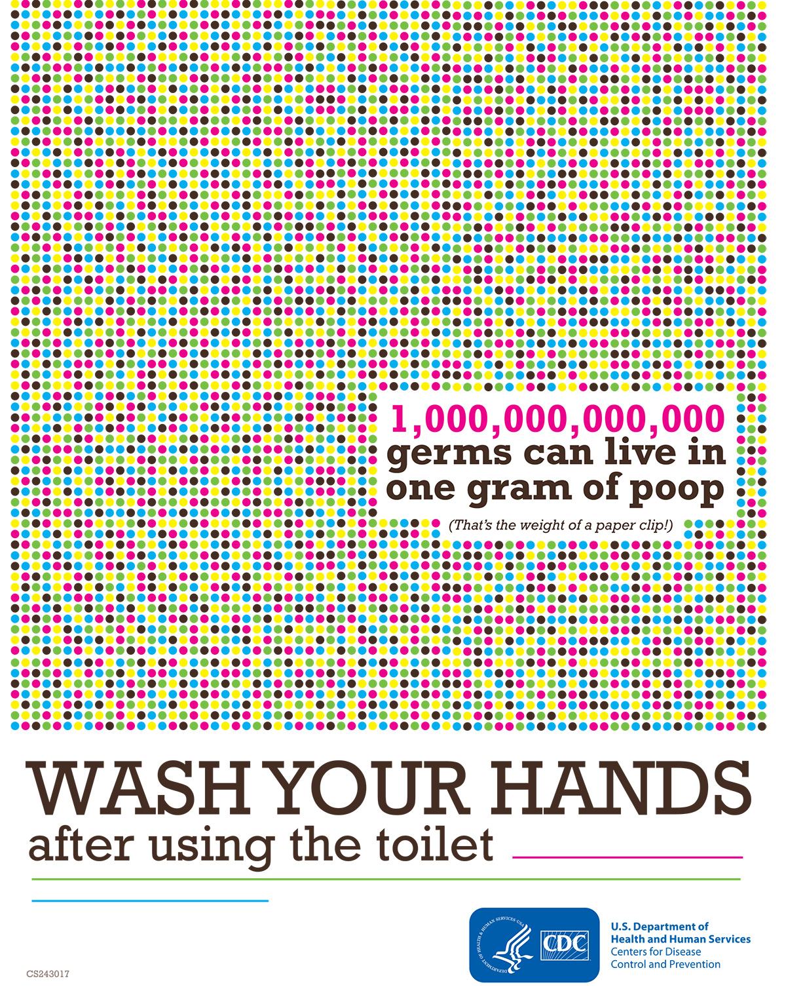
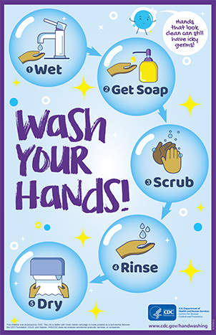
POSTERS

Slide 12
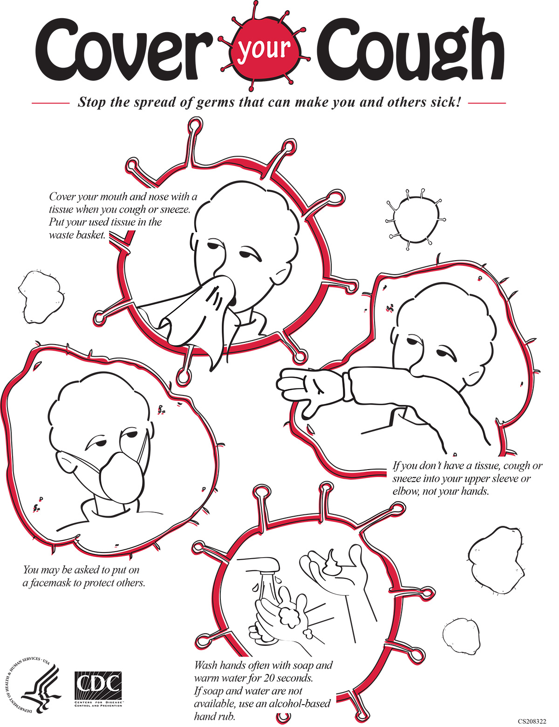
CONT..

Slide 13
How to Keep Your Breast Pump Kit Clean
New Guidance on Cleaning Breast Pumps fact sheet
Message: Learn how to keep your pump parts clean to help prevent Cronobacter infection.
Audience: Mothers of infants.
Fact Sheet: How to Keep Your Breast Pump Kit Clean: The Essentials

Slide 14
Safe and Healthy Diapering in the Home
Diapering in childcare settings
Message: Protect yourself and your children from germs by following these diapering steps.
Audience: Parents/guardians of diapered children.
Fact Sheet: Safe & Healthy Diapering in the Home

Slide 15

"I washed my hands!" Printable Sticker Sheet

Slide 16
Health Promotion Materials
Campaigns and Projects. Health campaigns and projects related to hygiene promotion.
Fact Sheets. Printable fact sheets related to handwashing.
Podcasts. Audio podcasts about practicing improved hygiene in different settings.
Posters. ...
Presentations. ...
Social Media. ...
Stickers. ...
Videos/TV.

