Slide 1
HEALTH SYSTEM MANAGEMENT
BY Abednego Mutuku

Slide 2
Module units
Introduction to leadership and management
Organization of health care services
Human resource management
Communication and networking
Commodity and supplies management

Slide 3
MODULE COMPETENCY
MODULE COMPETENCY
This module is designed to develop learners competency strengthening health care system at their level within health care system at their level within the health sector

Slide 4
LEARNING OUTCOMES
Describe the concepts ,principles ,roles and function of leadership and management
Explain the organization and coordination of health sector

Slide 5
Describe principles for effective leadership and management of human resources
Demonstrate effective communication within health care organization
Describe principles of commodity and supplies management

Slide 6
module content
Introduction to leadership and management
Definitions – management, leadership
Importance of studying management,
Historical development of management and concepts
Theories, Principles and Function of management ,

Slide 7
Differentiate between leadership and management
Qualities of a leader and styles of leadership ,
Organization behavior and group dynamics ,
Definition of mission ,vision ,
Importance of personal and organizational mission and vision statement

Slide 8
Organization of healthcare services –
Organization structure, purpose, types ,function,
Organizational structure of healthcare system, structures, functions
Health service delivery, levels of service ,health service at each level, actors ,cadre ,referral system in Kenya

Slide 9
Human resource management
Human Resource Management ,Concepts ,Principles ,Practices in resource management ,Recruitment ,Orientation ,Deployment ,Performance management ,Counselling and Coaching ,Motivation ,Work climate ,Resolution ,Grievances
Code of regulation ,Managing change ,

Slide 10
Human resource development – cycle ,continuous profession development , job description ,job analysis, professionalism and work ethics
Medico-legal issues – occupational hazards ,work man compensation act ,disciplinary process ,decision making planning meeting

Slide 11
Communication and networking
basics of effective communication, effective communication skills, public speaking ,report writing, networking advocacy ,negotiation ,partnership ,inter/intra-sectoral collaboration ,conducting meeting

Slide 12
Commodity and supplies management
commodity management cycle- selection ,procurement ,distribution ,use and disposal ,inventory management procedures, procurement procedures ,ethical and legal implications in commodity and supplies management

Slide 13
References
1. Barton E. et al (1980) On Being InCharge.
Geneva: World Health Organization.
2.Basavanthappa, B. P. (2000). Nursing Administration.
New Delhi, Jaypee Brothers Medical Publishers Ltd.
3. Bennet, R. (2004) Management. Essex: Pearson Education Ltd.
4. Cole, G. A. (1996) Management - Theory and Practice. London:
Martins the Printers.
5. Tappen, R. M. (2001) Nursing Leadership and Management 4th F.A Davis, Philadelphia.

Slide 14
LEADERSHIP AND MANAGEMENT
OBJECTIVES
by end of lesson students should be able to:-
Define management and leadership
Explain levels of management
Explain neoclassical and classical theories of management
Explain functions of management
Explain difference between leadership and management
Explain qualities of a leader and styles of leadership

Slide 15
management
What is management?
Management is the art of getting things done through people in order to achieve stated organizational objectives.
Management is also the systematic process involving planning, organizing, staffing, leading and controlling the efforts of organizational members and using all other resources to achieve stated organizational objectives.

Slide 16
There are six main resources in an organization (6M)
1. Money
2. Manpower
3. Machines
4. Materials
5. Management (methods)
6. Minutes (time

Slide 17
Management is also defined as the process by which resources are mobilized, combined and coordinated to effectively to achieve organizational objectives.
It is a process that utilizes organizational resources in the most effective and efficient manner, in order to attain stated organizational objectives.

Slide 18
Efficiency and Effectiveness
Efficiency in management refers to optimal utilization of organization resources with minimal wastage. It is also the relationship between achieving objectives and consumption of resources.

Slide 19
Effectiveness refers to attaining specific organizational goals that are timely and challenging. It is also an outcome measure of the interventions that improve peoples health under ordinary circumstances and in ordinary settings.

Slide 20
Management versus Administration
Administration is part of management work but more concerned with execution.
A manager is said to be performing administrative work when he/she is involved in interpreting policies of the organization and putting into plans and having those plans implemented.

Slide 21
At every level of management, managers perform some work which involves execution or “doing” which is one that completes the administrative process.
Therefore administration is the total of planning, organizing, controlling, coordinating and also operating work.

Slide 22
Who is a manager
This is an individual employed by an organization who is responsible and accountable for efficiently accomplishing the goals of the organization.
Managers focus on coordinating and integrating resources using the functions of planning, organizing, supervising, staffing, evaluating, negotiating and representing

Slide 23
Characteristics of a manager
Managers have assigned positions within a formal organization.
They have legitimate source of power due to delegated authority that accompanies their position.
They direct willing and unwilling subordinates.

Slide 24
characteristics cont.……….
Since managers work in a formal organization, they have a greater formal responsibility and accountability for rationality and control than leaders.
They are also expected to carry out specific functions, and responsibilities.
Managers also manipulate people, the environment, money, time, and other resources to achieve organizational goals

Slide 25
Cont. ………….
Managers work at various levels in an organization. The number of levels will depend on the size of the organization. Generally three levels of management are used.

Slide 26
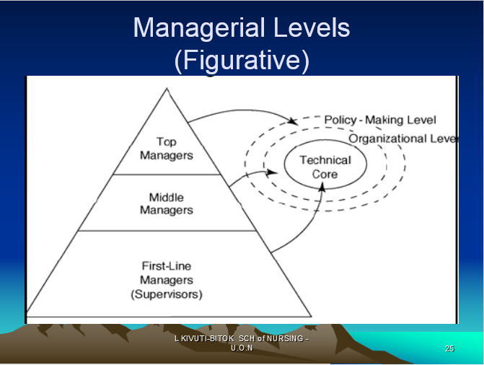
Levels of management

Slide 27
Levels of management
1. First level management:
The first level managers are also referred as first line managers they are responsible for supervising the work of non-managerial personnel and the day to day activities of a specific work units or ward.
They are the lowest level. In a hospital, setting these would include, ward In-charge. They are responsible for clinical practice, assigning staff to patients, interfacing with the public, patient care delivery

Slide 28
Personnel development, ensuring compliance with regulatory and professional standards, maintaining discipline and motivating staff to achieve the organizational goals.
First level managers are also responsible for fostering inter-disciplinary, collaborative and strategic planning.

Slide 29
2. Middle level Management:
The middle level managers supervise a number of first level managers usually with related specialties or in a given geographical area.
They have a 24hr responsibility for their defined area.
Typically middle level managers act as liaison between upper management and first level managers.

Slide 30
They are responsible for implementing the policies and plans developed by top managers. They also supervising and coordinate the activities of first line managers
A middle level manager maybe referred as a supervisor, director or assistant director. This group constitutes the largest group of managers

Slide 31
3. Upper level management (top managers):
This refers to top executives (such as Chief Nurse,rco) to whom the middle managers report.
They are responsible for establishing organizational goals and strategic plans for the entire organization and operating policies for the entire division

Slide 32
They also ensure integration of work units to achieve the organization mission and buffering the effects of the external environment on workers within the organization.
Top managers are relatively a small group

Slide 33
Managerial Skills
Different types of skills are required to manage an organization effectively .
These skills have been classified into three categories namely:
Technical skills
human /interpersonal skills
conceptual skills.

Slide 34
Though the above skills are necessary at all levels of management, their importance vary according to ranks. Technical skills are important at lower level whereas conceptual skills are important at top levels
Technical skills:
Technical skills refer to the ability and knowledge in using the equipment, technique and procedures involved in performing specific tasks in a specialized field. Technical skills are important in order to accomplish or understand the specific kind of work being done in the organization.

Slide 35
Interpersonal/human skills:
Human skills consist of the ability to work effectively with other people both as individuals and as members of a group. These are required to win cooperation of others and to build effective teams. Such skills require a sense of feeling for others and capacity to look at things from others point of view. Managers interact with people within and outside the organization and therefore require these skills to assist them communicate with, understand and motivate individuals and groups

Slide 36
Conceptual skills:
This is the ability to see the organization as a whole, to recognize significant elements in a situation and to understand the relationships among elements. It is a cognitive ability to coordinate and integrate all of an organization’s activities. They allow managers to think in the abstract and strategically so as to see the big picture and to make broad based decisions that serve the overall organization. Conceptual skills also include the competence to understand a problem in all its aspects and to use creative thinking in solving the problem

Slide 37
MANAGEMENT ROLES:
Henry Mintzberg (1973) identified ten management roles which he placed in three categories: Interpersonal role, informational roles and decisional roles.

Slide 38
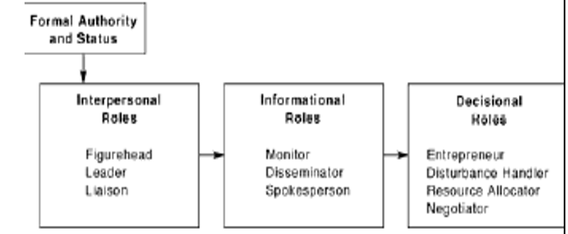

Slide 39
Interpersonal roles:
1.Figure head role: symbolizes the organization or department and performs ceremonial duties
2. Leader: determines the Mission and Objectives of the organization and sees that they are accomplished effectively. He hires, trains and motivates employees and encourages them to do better
3. Liaison role: Involves networking with outside organizations, expanding information sources, like conferences, professional meetings etc. Acts as a link between people, groups or organizations within and without the organization

Slide 40
Informational role:
4. Monitor: As a monitor, the manager informally seeks information about the organization through internal networks, gossips, and observations. (Get information useful to organization). He/she tours of the organization and holds formal and informal meetings to provide information about the needs of the organization
5.Disseminator: A manager is a link in the organization chain of command. He shares information from outside the organization and between work units (sharing information improves job satisfaction)

Slide 41
6. Spokes person: The manager shares information with individuals outside the organization, attends meetings, offering continuing education and participates in professional organizations
Decisional Roles:
7. The entrepreneur: The manager looks for profitable investments for the organization to improve its performance (start a school of nursing)

Slide 42
8. Resource allocator; Managers schedule their own time (work plan). They decide how resources are distributed and with whom he will work most closely with
9. Negotiator; Enters into negotiation with other parties e.g. to enter into a long term relationship with a supplier
10. Disturbance handler: Responds to unforeseen circumstances eg. Replacement of a sick staff, missing equipment, disease outbreaks (shift staffs)

Slide 43
ATTRIBUTES & QUALITIES OF A MANAGER
Technical competence
Social & human skills
Conceptual ability

Slide 44
HISTORICAL DEVELOPMENT OF MANAGEMENT
Management has been developed through the following periods:
i) The classical theories
ii) Neo classical theories

Slide 45
SCIENTIFIC / CLASSICAL APPROACH =1910’s
Described management as a science
– Focused on formal structure, technical requirements of the organisation and general sets of principles
-Listed duties of a manager

Slide 46
HUMAN RELATIONS APPROACH
– Focused on the informal organisation and the psychological & social needs of people at work

Slide 47
Classical theories:
The exponents of classical theories were principally concerned with the structure and mechanics of organizations. They included the following
1. Henri Fayol (French Industrialist 1841-1925) – Administrative theory (search for principles of Management
2. Fredrick W. Taylor (1856-1915) – A Mechanical Engineer in the USA (The Scientific Management Theory)
3. Max Weber (1864-1920) – A German Sociologist. The Theory of Bureaucracy

Slide 48
NB. Classical/scientific managers relied on their experience. They advocated for what worked.

Slide 49
Scientific Management Theory
was developed by Fredrick Taylor (1900-1930) (A mechanical Engineer) in 1911
Taylor conducted research on methods of training workers for increased productivity. He advocated that work be studied scientifically to determine the one best way to perform each task.
Taylor postulated that if workers could be taught the “one best way to accomplish a task,” productivity would increase. He came up with the basic principles of scientific management:

Slide 50
FREDERIC WINSLOW TAYLOR(1856-1915)-cont’d
Systematically analyzed human behavior at work
His model was machine with cheap , interchangeable parts @ doing a specific function
Reduce complex organizations into machine like
Make individuals into equivalent machine parts.

Slide 51
He studied;
Interaction of human xtics
Social environment
Tasks
Physical environment
Capacity
Speed
Durability cost

Slide 52
FAYOL’S 6 ACTIVITIES OF INDUSTRIAL UNDERTAKING
Technical e.g. production
Commercial e.g. buying and selling
Financial activities e.g. securing capital
Security e.g. safeguarding property
Accounting e.g. providing financial information

Slide 53
Principles of scientific management
1. Observing the workers’ performance through time and motion study to determine the one best way to carry out each task (develop a science for each element of man’s work to maximize organization output)
2. Scientifically selecting the best worker to perform each job, that is the person with characters and abilities needed to carry out job tasks in the most efficient manner.
3. Training the selected worker to perform tasks in the most efficient manner

Slide 54
4.Paying the worker a differential piece rate to motivate them to perform the tasks in prescribed, efficient fashion
5. Appointing a few highly skilled workers to managerial positions and giving each manager responsibility for planning tasks for subordinate workers
6. Appointing a foreman for each aspect of the work and instructing the production worker to report to a different functional foreman for each aspect of the job

Slide 55
F. W TAYLOR’S ACHIEVEMENTS
Raised productivity of shovellers from 16 to 59 tons/day i.e. 4 fold
Reduced no. of yard laborers from 500- 140
Revolutionarised the art of cutting metals
Doubled speed at which fine steelwork was done
Increased production I one instance by 369% and increased the wages by 60%%= extra profit!!!
was nicknamed "Speedy" Taylor for his reputation as an efficiency expert.

Slide 56
FAILURES OF F. W TAYLOR’S
He dehumanized management theory
The aspect of mgt which the laws of science did not as yet apply were to be subject to collective bargaining e.g. class interests
Taylor was hate by unions
Laws were passed to keep his methods out of military arsenal . The federal government (the military, actually) thought his ideas were dangerous, and scientific management was banned by federal law from ever being implemented in that sector

Slide 57
Administrative theory
Administrative theory of management was developed by (Henri Fayol 1841-1925)
While the scientific management focused on the tasks to be performed by the worker, administrative management focused on the development of broad administrative principles applicable to general and higher managerial level.
Henri Fayol (1925) also was the first person to identify the management functions of planning, organization, command, coordination, and control. Fayol also described fourteen management principles as follows.

Slide 58
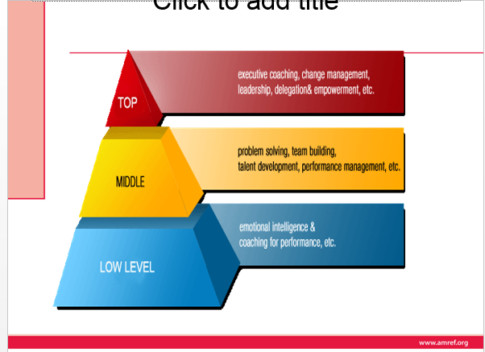
PRINCIPLES OF MANAGEMENT

Slide 59
H. FAYOL’S 14 PRINCIPLES OF MANAGEMENT
1. Specialization or division of labor )
- reduces span of attention or effort for any one person or group.
-develops practice and familiarity
-Specializing encourages continuous improvement in skills and the development of improvements in methods.

Slide 60
2. AUTHORITY
rights to give order
should be accompanied by responsibility
- The right to give orders and the power to exact obedience.

Slide 61
3.Discipline. This is defined as respect for agreements which are directed at achieving obedience. Obedience must prevail throughout the organization as its essential for smooth running of an enterprise.
outward mark of respect accordance with formal
informal agreement between firm and employees
No slacking, bending of rules.

Slide 62
4. Unity of command. Every subordinate should receive orders and be accountable to only one supervisor. Dual or multiple commands is a perpetual source of conflict. Unity of command avoids conflicting orders and ensures order stability in the organization
one man, one superior
-Each employee has one and only one boss.

Slide 63
5.Unity of direction. According to this principle, each ground of activities having the same objective must have one head and one plan.
- one head, one person (director) and one plan for a group of activities with one objective.
A single mind generates a single plan and all play their part in that plan.

Slide 64
6. Subordination of Individual Interests to general interests. Efforts should be made to reconcile individual interests with common interests. When there is conflict between the two, the interests of organization should prevail over individual interests.
interest of one individual or one group should be subordinate( not prevail over the general good (total workgroup)
When at work, only work things should be pursued or thought about.

Slide 65
7. Remuneration of personnel. The amount of remuneration and the methods of payment should be just and fair and should provide maximum possible satisfaction to both employees and employers
pay should be fair to both employee and the firm
Employees receive fair payment for services, not what the company can get away with.

Slide 66
8.Centralization; The degree of concentration of authority should be based upon optimum utilization of all faculties of the personnel.
depending on size of company and quality of managers.
Consolidation of management functions.
Decisions are made from the top.

Slide 67
9. Scalar Chain (line of authority). There should be a clear line of authority ranging from top to down of the organization. All upward and down ward communication should flow through each position of authority along the scalar chain
There should be an unbroken chain of authority extending from top executive to lowest level worker.
Formal chain of command running from top to bottom of the organization, like military

Slide 68
10.Order. All materials and personnel have a prescribed place, and they must remain there. The right man should be in the right place
A place for everything &everything in its own place,
the right man in the right place
All materials and personnel have a prescribed place, and they must remain there.

Slide 69
11.Equity. This means that employees should be treated with justice and kindness. Managers should be fair and impartial in their dealings with subordinates Treat every employee with equity &justice.
-A combination of justice and kindliness towards employees.
-Equality of treatment (but not necessarily identical treatment)

Slide 70
12. Stability of tenure of personnel. Employees cannot work efficiently unless job security is assured of them.
    employees need time to settle into their jobs,
    this may be lengthy times.
    Limited turnover of personnel.
    Lifetime employment for good workers.

Slide 71
13. Initiative. Employees at all levels should be given the opportunity to take initiative and exercise judgment in the formulation and execution of plans. Initiative refers to the freedom to think for oneself and use discretion in doing work. It develops the interest of employees in their jobs and provides job satisfaction to them.

Slide 72
Thinking out a plan and do what it takes to make it happen
-Within levels of authority and responsibility all staff should be encouraged to show initiative i.e. new ways of doing things.

Slide 73
14.Esprit de corps. This refers to harmony and mutual understanding among members of the organization. Unity among the staff is the foundation of success in any organization
Harmony is a great strength to organizations
team work should be encouraged.

Slide 74
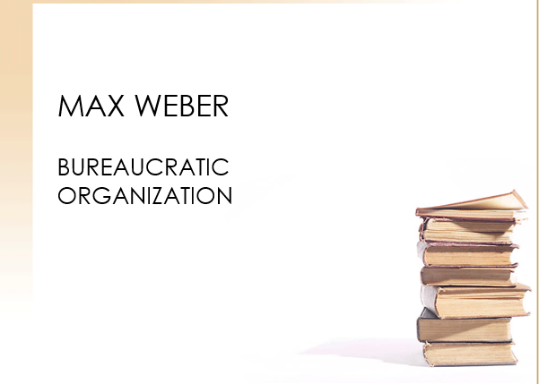
MAX WEBER

Slide 75
''Bureau' (French, borrowed into German) is a desk, or by extension an office (as in 'I will be at the office tomorrow'; 'I work at the Bureau of Statistics').
'Bureaucracy' is rule conducted from a desk or office, i.e. by the preparation and dispatch of written documents - or, these days, their electronic equivalent.

Slide 76
a sociologist who began to study the new forms of organization being developed for managing large numbers of people in far-flung and complex activities.
Germany had been an early leader in developing a civil service. At the same time, German industry was beginning to adopt the organizational methods developed in the United States.
Surveying this scene, Weber attempted to isolate the elements common to all of these new organizations.

Slide 77
Weber concluded that all these new large-scale organizations were similar.
Each was a bureaucracy.
Today many of us regard bureaucracy as a dirty word, suggesting red tape, inefficiency, and officiousness

Slide 78
The theory was developed by Max Weber (1864-1920). Webber’s rational bureaucracy states that employees performing a large variety of tasks in an organization must follow established rules and regulations in order to ensure uniformity and rationality of output. The following are the characteristics of an ideal organization as described by Weber

Slide 79
Characteristics of an ideal organization by Weber
I. Division of labor: there should be clearly defined authority and responsibility given as official duties
II. Hierarchy of authority: Positions should be organized in a hierarchical manner resulting in scalar chain
III. Formal selection: Employees should be selected on the basis of technical skill, formal examinations or by education or training
IV. Formal rules: There must be formal rules and controls regarding the conduct of official duties and administrations

Slide 80
FEATURES DEVELOPED TO MAKE BUREAUCRACIES RATIONAL
(1) functional specialization
(2) clear lines of hierarchical authority,
(3) expert training of managers,
(4) decision making based on rules and tactics developed to guarantee consistent and effective pursuit of organizational goals.

Slide 81
RATIONAL BUREAUCRACY
Weber noted additional features of rational bureaucracies that are simple extensions of the four just outlined,
1. To ensure expert management, appointment and promotion are based on merit rather than favoritism, and those appointed treat their positions as full-time, primary careers.
2. To ensure order in decision making, business is conducted primarily through written rules records, and communications.

Slide 82
CONCLUSION & NOTE ON Scientific management
There is a best machine for each job, so there is a best working method by which people should undertake their jobs
All job processes should be analysed into discrete tasks & via this management find the ‘one best’ way to perform each task

Slide 83
Neoclassical theorist/ motivational theories
Neoclassical theorists also referred as human relation or motivational theorists were concerned with the human factor at work place. They were concerned with motivation, group relationships and leadership. They wanted to discover what it is that triggers and sustains human behavior. The major assumption of this theory is that people desire social relationships, respond to group pressures, and search for personal fulfillment.

Slide 84
Definitions of Motivation
“Motivation takes place when people expect that a course of action is likely to lead to the attainment of a goal - a valued reward that satisfies their particular needs”. (Armstrong:1997).
“The willingness to exert high levels of effort toward organizational goals, conditioned by the effort’s ability to satisfy some individual needs”. (Robbins:1998).

Slide 85
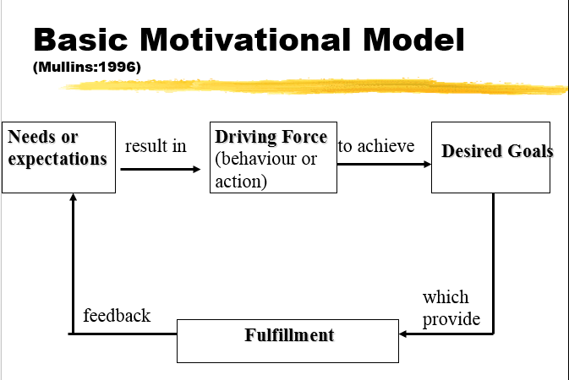

Slide 86
Concept of Motivation
The underlying concept of motivation is some driving force within individuals by which they attempt to achieve some goal in order to fulfil some need or expectation.
Peoples behaviour is determined by what motivates them. Their performance is a product of both ability level and motivation.
  Performance = function (ability X motivation)

Slide 87
Types of Motivation Theories
Content Theories
Process Theories

Slide 88
Content Theories
These theories attempt to explain those specific things which actually motivate the individual at work.
These theories are concerned with identifying peoples needs and their relative strengths, and the goals they pursue in order to satisfy these needs.
Content theories place emphasis on what motivates human behavior i.e. the wants and needs that people are trying to satisfy

Slide 89
Process Theories
Process theories- These seek to explain specific actions focusing on the thought process that people experience prior to behaving in a particular manner e.g H. Vroom

Slide 90
Content Models
The Hierarchy of Needs Theory (Maslow:1943).
The ERG Theory (Alderfer:1972).
The Acquired Needs Theory/Achievement Motivation Theory(McClelland:1961).
The Dual-Factor Theory (Herzberg:1968

Slide 91
Process Models
Theory X, Theory Y (McGregor:1960)
Expectancy Theory (Vroom:1964 and Porter & Lawler:1968)
Equity Theory (Adams:1965)

Slide 92
Professor Elton Mayo (1880-1849 Hawthorne studies
Prof. Elton Mayo (Australian) (1880-1949) Psychologist, Carried research at the Western Electric Company in the USA (1.1 1927-1932). He was concerned about studying people, in terms of their social relationships at work. He carried out a study at the Hawthorne plant of the Western Electric Company with emphasis on the worker rather than the work

Slide 93
Conclusions from Hawthorne Theory (Elton Mayo)
I. Individuals cannot be treated in isolation, but must be members of a group
II. The need to belong to a group and have status within it is more important than monetary incentives or good physical working conditions
III. Informal (or unofficial) groups at work exercise strong influence over the behavior of workers

Slide 94
IV. Supervisors and managers need to be aware of these social needs and cater for them if workers are to collaborate with the official organization rather than work against it.

Slide 95
MASLOW HIERARCHY OF NEEDS (Theory of Motivation)
Maslow’s studies into human behavior led him to propose a theory of needs based on hierarchical model with the basic needs at the bottom and higher needs at the top as shown in

Slide 96
Basic proposition is that people are wanting beings, they always want more, and what they want depends on what they already have.
Hierarchy ranges through 5 levels and is displayed in the form of a pyramid implying a thinning out of needs as people progress up the hierarchy.
Ascending order implies that it is the next unachieved level that acts as the motivator.

Slide 97
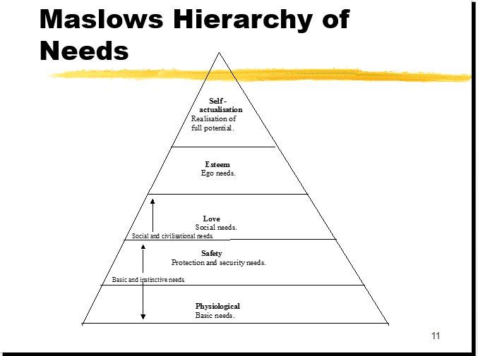

Slide 98
Maslow’s Hierarchy of needs
1. Physiological needs- These are the basic needs of air, water, food, clothing and shelter. In other words, physiological needs are the needs for basic amenities of life.
2. Safety needs- Safety needs include physical, environmental and emotional safety and protection. For instance- Job security, financial security, protection from animals, family security, health security, etc.
3. Social needs- Social needs include the need for love, affection, care, belongingness, and friendship.

Slide 99
4. Esteem needs- Esteem needs are of two types: internal esteem needs (self- respect, confidence, competence, achievement and freedom) and external esteem needs (recognition, power, status, attention and admiration).
5. Self-actualization need- This include the urge to become what you are capable of becoming / what you have the potential to become. It includes the need for growth and self-contentment. It also includes desire for gaining more knowledge, social- service, creativity and being aesthetic. The self- actualization needs are never fully satiable. As an individual grows psychologically, opportunities keep cropping up to continue growing

Slide 100
Central points in Maslow’s hierarchy of needs
People tend to meet their needs systematically, starting with physiological needs then moving up the hierarchy.
Until a particular group or needs is satisfied, a person’s behavior will be dominated by them

Slide 101
Herzberg’s Dual-Factor Theory
Herzberg’s original study consisted of interviews with 203 accountants and engineers.
The object of the research being to design jobs that provided job satisfaction, thereby encouraging higher levels of performance.
This process developed into job enrichment.

Slide 102
Herzberg’s two factor theory:
He concentrated on satisfaction as work. From the study he came to conclude that certain factors tend to lead to job satisfaction while others frequently led to dissatisfaction. Factors giving rise to satisfaction were called motivators. Those leading to dissatisfaction were called hygiene factors.

Slide 103
Important motivators (satisfiers)
Achievement for performing a task
Recognition and praise
Work itself
Responsibility for one’s work
Advancement: through promotion

Slide 104
Hygiene factors/dissatisfiers (Extrinsic to the job)/MANTAINANCE FATOTS
I. Company policy and administration
II. Supervision – the technical aspects
III. Salary
IV. Interpersonal relationships – supervision
V. Working conditions

Slide 105
Hygiene or Maintenance Factors (Herzberg
These are the factors, which if absent, cause dissatisfaction.
They are related to the job context and concerned with the job environment.
They serve to prevent dissatisfaction.
They act as a ‘platform’ upon with the satisfaction factors can be built.

Slide 106
Motivators or Growth Factors (Herzberg
These factors, if present, serve to motivate the individual to superior effort and performance.
These factors are related to the job content of the work itself.
The strength of these factors will affect feelings of satisfaction or no satisfaction, but not dissatisfaction.

Slide 107
Unsatisfactory hygiene factors lead to dissatisfaction which lead to increased absences, grievances or resignations. He likens hygiene factors to water filtration pump. Not having one will likely result to illness, but drinking purified water will not necessarily keep one from becoming sick

Slide 108
McGregor’s Theory X, Theory Y
McGregor put forward two suppositions about human nature and behaviour at work.
He argues that the style of management adopted is a function of the managers attitudes towards people and assumptions about human nature and behaviour.

Slide 109
McGregor –theory X and theory Y are essentially sets of assumption s about behavior. He saw two different sets of assumptions made by managers about their employees, one which is negative ,theory X and the other positive, theory Y

Slide 110
Theory X (McGregor)
Theory X represents the assumptions on which traditional organizations are based, and was widely accepted and practiced before the development of the human relations approach.
The central principle is direction and control through a centralized system of organization and the exercise of authority

Slide 111
Theory X assumptions
I. Human beings are lazy, dislike work and avoid it as far as possible
II. Since human beings dislike work they must be coerced, controlled or threatened with punishment to achieve goals
III. Human beings will avoid responsibility, and want to be directed whenever possible
IV. Human beings place security above all other factors associated with work and will display little ambition

Slide 112
Theory Y (McGregor)
Theory Y represents the assumptions consistent with current research knowledge.
The central principle is the integration of the individual and organization goals.
It is recognized as the best way to elicit co-operation from workers

Slide 113
Theory y assumptions
1. For most people work is as natural as play or rest.
People will exercise self-direction and self-control in the service of objectives to which they are committed.
Commitment to objectives is a function of rewards associated with their achievement.

Slide 114
Given the right conditions the average worker can learn to accept and to seek responsibility.
The capacity for creativity in solving organizational problems is distributed.
The intellectual potential of the average person is only partially utilized.
Motivation occurs at all of Maslow’s levels

Slide 115
Expectancy Theory
Vroom’s expectancy theory(1964) maintains that employees behave in ways they expect will produce positive outcomes.
The model suggest that the persons level of effort or force (motivation) is not simply a function of rewards.
It is a measure of the strength of a particular outcome has for the individual

Slide 116
Vrooms expectancy theory is:
  F = Sum (E * V) where,
    F = Force - the motivation or the force used to achieve it.
    E = Expectancy - the possibility of achieving a certain outcome through certain actions.
    V = Vacancy - the preference an individual has for a particular outcome, the worth placed on a particular result.

Slide 117
Porter and Lawler (1968) develop Vroom’s expectancy theory by suggesting that there are two factors determining the effort people put into their jobs.
  The value of the reward to individuals in so far as they satisfy their need for security, social esteem, autonomy and self- actualisation.

Slide 118
  The probability that reward depends on effort, as perceived by individuals - in other words their expectations of the relationship between effort and reward.
Thus the greater the value of a set of rewards and the higher the probability that receiving each of these rewards depends upon effort, the greater the effort that will be made in a given situation.

Slide 119
Adams Equity Theory
Equity theory focuses on peoples feelings of how fairly they feel they have been treated in comparison with the treatment received by others.
It is based on exchange theory.
People expect certain outcomes in exchange for certain inputs or contributions.

Slide 120
Adams states that people will be better motivated if they are treated equitably.
The exchange variables are:
  Inputs - what the individual brings to their employment in terms of effort, experience and skills.
  Outcomes - the range of factors the employee receives in return for their inputs i.e. all the financial and non-financial rewards.

Slide 121
Alderfer’s ERG Theory
This is a modified need hierarchy model and it condenses Maslows five levels of need into only three levels based on the core needs of:
  Existence
  Relatedness
  Growth

Slide 122
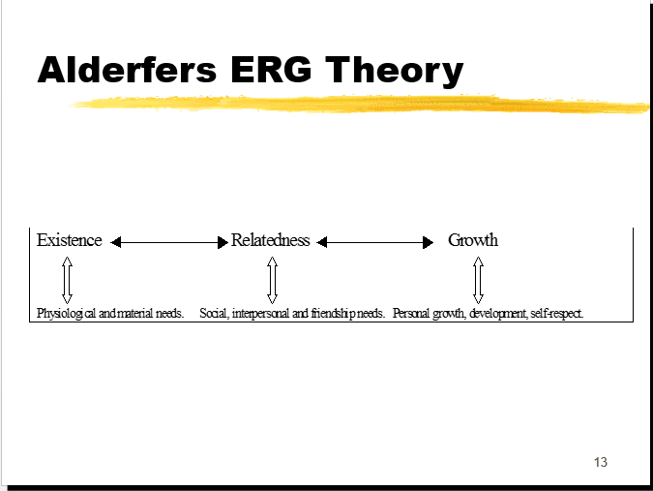

Slide 123
Existence needs are concerned with sustaining human existence and survival and cover physiological and safety needs of a material nature.
Relatedness needs are concerned with relationships to the social environment and cover love or belonging, affiliation and meaningful interpersonal relations of a safety or esteem nature.

Slide 124
Growth needs are concerned with the development of potential and cover self-esteem and self- actualisation.
More than one need can be activated at the same time - a frustration-regression process e.g. if an individual is continually frustrated in an attempt to satisfy growth needs, relatedness needs may reassume most importance.

Slide 125
ERG theory states that an individual is motivated to satisfy one or more basic sets of needs.
If a persons needs at a particular level are blocked then attention should be focused on the satisfaction of needs at the other levels.

Slide 126
LYNDALL URWICK’S 10 PRINCIPLES OF ORGANISATION
Objective- every org or part must have an expression of purpose, otherwise it is meaningless and therefore redundant.
Specialization-activities confined to a single function.
Co-ordination- facilitate co-ordination: unity of effort
Authority-a supreme authority must rest somewhere, a clear line of authority to every individual in a group.
Responsibility-of superior for acts of subordinates is absolute

Slide 127
Definition-content of @position, duties involved, authority, responsibilities and relationship with others must be clearly defined in writing and published to all concerned!!
Correspondence- in every position, responsibility and authority should correspond.

Slide 128
Span of control-no persons should supervise more than 5 or at most 6 direct subordinates whose work interlocks!!
Balance- various units of org’n must be kept in balance.
Continuity-re0organization is a continuous process, in every undertaking specific provision should be made.

Slide 129
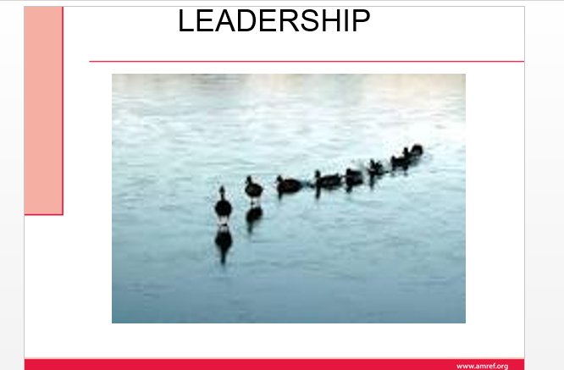

Slide 130
LEADERSHIP
Definition of Leadership
Leadership as the art of motivating a group of people to act towards achieving a common goal, It is also the process of persuading and influencing others towards a goal.
Definition of a leader
A leader is the person who influences and guides direction, opinion, and course of action. Also a leader is anyone who uses interpersonal skills to influence others to accomplish a specific goal (good or bad)

Slide 131
Characteristics of a leader
Leaders often do not have delegated authority but obtain their power through other means, such as influence.
I. Leaders may or may not be part of the formal organization.
II. Leaders focus on group process, information gathering, feedback, and empowering others.

Slide 132
III. Leaders emphasize interpersonal relationships.
IV. Leaders direct willing followers.
V. Leaders have goals that may or may not reflect those of the organization.
VI. Often do not have delegated authority

Slide 133
There are two types of leadership
Formal leadership – Is practiced by a person with legitimate authority conferred by the organization and described in a job description who is a manager.
Informal leadership – Is exercised by a staff member who does not have a specified management role. Informal leadership depends on one’s knowledge, status and personal skills in persuading and guiding others

Slide 134
This implies that, all managers are formal leaders while not all leaders are manager because we have seen that there is informal type of leadership and managers work in a formal organization
ASSIGNMENT
List five differences between the characteristics of a leader and a manager (10marks)

Slide 135
Evolution of leadership theories
Leadership has evolved over period of time as you are going to learn in the following discussion
a. The Great man Theory (Trait Theories):
These were basis of leadership research until 1940’s. The great man theory asserts that some people are born to lead whereas others are born to be led. Trait theory assumes that some people have certain characteristics or personality traits that make them better leaders than others.

Slide 136
b. Behavioral Theories and leadership styles:
During human relations era, many behavioral and social scientists studying management also studied leadership. Emphasis was on what the leader did or the behaviors of leaders. The behavioral view of leadership, personal traits only provide a foundation for leadership; effective leaders acquire a pattern of learned behaviors.
The behavioral theories includes the leadership styles, system 4 management, the managerial grid and the continuum of leadership behavior

Slide 137
Leadership styles: Lewin, Lippitt and White studied leadership styles. They identified three leadership styles which are authoritarian, democratic and Leissez-faire
Authoritarian leader exhibits the following behaviors
i) Strong control is maintained over the work group.
ii) Others are motivated by coercion.
iii) Others are directed with commands

Slide 138
Iv)Communication flows downwards.
v) Decision making does not involve others.
vi) Emphasis is on difference in status (“I” and “you”).
vii) Criticism is punitive (should be constructive)
Democratic leader exhibits the following behaviors
I. Less control is maintained.
II. Economic and ego awards are used to motivate

Slide 139
III. Others are directed thorough suggestions and guidance.
IV. Communication flows up and down.
V. Decision making involves others.
VI. Emphasis is on “we” rather than “I” and “you”.
VII. Criticism is constructive.
A Leissez-faire leader is characterized by the following behaviors
I. Is permissive with little or no control.

Slide 140
II. Motivate by support when requested by the group or individual
III. Provides little or no direction.
IV. Uses upward and downward communication
V. Places emphasis on the group and does not criticize.
VI. Laissez-faire leadership is appropriate when problems are poorly defined and brainstorming is needed to generate alternative solutions.

Slide 141
System 4 management: This theory was developed by Likert. It is based on the premise that involving employees in decisions about work is central to effective leadership. It has four dimensions based on increasing levels of employee’s involvement in decision making
I. Autocratic leaders – have little trust in employees and exclude them in decision making.
II. Benevolent leaders – Are kind to employees but still do not involve them in decision making.

Slide 142
III. Consultative leaders – Seek employee’s advice about decisions.
IV. Participative or democratic leaders – they value employees involvement, team work and team building. They also have high levels of confidence in employees and seek consensus in decision making
The managerial grid: Another model of depicting leadership along a continuum is the managerial grid. Five leadership styles are plotted in four quadrants of a two dimensional grid. The grid depicts various degrees of leader concern for production (structure) and concern for people. These are

Slide 143
1. Impoverished – Low concern for both production and people.
2. Authority compliance – high concern for production and low concern for people.
3. Middle of the road – moderate concern for production and people.
4. Country club – High concern for people and low concern for production.
5. Team – High concern for both production and people.

Slide 144
c. Situational and contingency theory:
This combines traits and situation. The contingency theories suggest that the most effective leadership style is the one that best compliments the organizational environment, the task to be accomplished and the personal characteristic of the people involved in each situation. People become leaders because of their responsibility and situational factors.

Slide 145
d. Contemporary Theories of Leadership
Leadership theory has continued to evolve. Contemporary approaches to leadership are underpinned by the belief that information power that was previously restricted to the professionals or managers is now available to all.
The contemporary leadership theories includes
I. The quantum leadership: A leadership style based on the concept of chaos theory

Slide 146
II. Shared leadership, an organizational structure in which several individuals share the responsibility for achieving the organization’s goals.
III. Servant leadership; the premise that leadership originates from a desire to serve; a leader emerges when others’ needs take priority.
IV. Transformational leadership; A leadership style focused on effecting revolutionary change in organizations through a commitment the organizations vision

Slide 147
Burns (1978) suggested that both leaders and followers have the ability to raise each other to higher levels of motivation and morality. He identified this concept as transformational leadership.
He maintained that there are two types of leaders in management.
I. The traditional manager, concerned with the day to day operations was termed as Transactional Leader.
II. The manager who is committed, has a vision and is able to empower others with this vision was termed as Transformational leader.

Slide 148
Transactional Leader Transformational
Focuses on management tasks. Identifies common values.
Is caretaker (takes care of tasks Is committed (extra mile).
Uses tradeoffs to meet goals. Inspires others with
Shared values not identified. Has long term vision
Examiner causes. Looks at effects.
Uses contingency rewards. Empowers others.

Slide 149
LEADERSHIP FUNCTIONS
Supervision (overseeing)
Supervision is another leadership behavior.
It includes inspecting another’s work, evaluating his/her performance and approving or correcting performance.
Good supervision is facilitative because a good supervisor inspects work in progress and can remedy inadequate performance before serious consequences develop.
The intensity of supervision should match situational requirements, employees needs and managers leadership skills

Slide 150
Supervision must be appropriate in type and intensity for work groups members to interact effectively e.g. technical workers need closer supervision than professional workers
A manager can effectively supervise a large number of subordinates when they are confined in a small area, perform similar jobs and are fairly educated.

Slide 151
Intensity of supervision should also depend on manger-caregiver ration.
The purpose of supervision is to inspect, evaluate and improve worker performance. Therefore a criteria is needed for judging the quality of work processes and outcomes.
Job description and associated performance standards provide such evaluation criteria.

Slide 152
The following performance elements should be appraised during supervision
I. Quantity of work output
II. Quality of output
III. Time use
IV. Conservation of resources
V. Assistance to co-workers
VI. Support of administrator

Slide 153
Co-ordination
This is another leadership activity. It includes all activities that enable work group members to work together harmoniously.
Co-ordination ensures that everything that needs to be done is done and that no two people are doing the same thing (or duplication of activity).
Coordinating means distributing authority, providing channels of communication and arranging work so that the right things are done, at the right time, in the right place, in the right way and by the right people

Slide 154
The overall results of coordination should be orderly work, harmonious, efficient and successful activities
MOTIVATION
Motivation describes the factors that initiate and direct behavior.
Therefore a manager’s most important leadership task is to maximize subordinates work motivation because employees bring to the organization different needs and goals, the type and intensity of motivators vary among employees

Slide 155
Therefore the manager must know which needs the employee expects to satisfy through employment and should be able to predict, which needs will be satisfied through the job duties and positions
Motivated employees are more likely to be productive than non-motivated employees and hence motivation is an important aspect of enhancing employee performance.

Slide 156
How leaders influence others
Leadership, the foundation of the management function of leading, and a critical element of the health systems management building blocks is the process of influencing others toward the achievement of health care organizational goals (better health outcomes).

Slide 157
Power is the capacity to affect the behavior of others.
Effective leaders develop and use power, or the ability to influence others.
Legitimate, reward, and coercive are all forms of power used by managers to change employee behavior.

Slide 158
Legitimate power
Legitimate power stems from a formal management position in an organization and the authority granted to it. Subordinates accept this as a legitimate source of power and comply with it.
Reward power
Reward power stems from the authority to reward others. Managers can give formal rewards, such as pay increases or promotions, and may also use praise, attention, and recognition to influence behavior.

Slide 159
Coercive power
Coercive power is the opposite of reward power and stems from the authority to punish or to recommend punishment. Managers have coercive power when they have the right to fire or demote employees, criticize them, withhold pay increases, give reprimands, make negative entries in employee files, and so on.

Slide 160
Expert power
Expert power results from a leader's special knowledge or skills regarding the tasks performed by followers. When a leader is a true expert, subordinates tend to go along quickly with his or her recommendations.

Slide 161
Referent power
Referent power results from leadership characteristics that command identification, respect, and admiration from subordinates who then desire to emulate the leader. When workers admire a supervisor because of the way he or she deals with them, the influence is based on referent power. Referent power depends on a leader's personal characteristics rather than on his or her formal title or position, and is most visible in the area of charismatic leadership

Slide 162
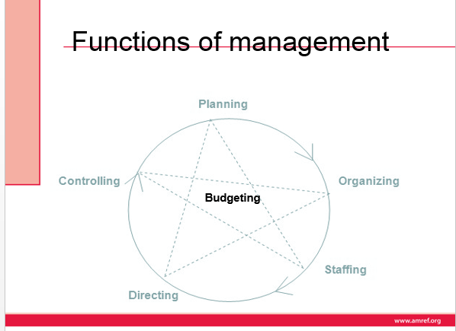

Slide 163
FUNCTIONS OF MANAGEMENT
Management has been described as a social process involving responsibility for economical and effective planning and regulation of operation of an enterprise in the fulfilment of given purposes
Remember in the definition of management we stated that it is a process. The core functions of management were identified by Henry Fayol as we have already seen in the management theories. The functions are planning, organizing, staffing, directing, coordinating and budgeting—as denoted by the mnemonic POSDCORB

Slide 164
Where
P – planning
O – organizing
S – staffing
D – directing
Co – coordinating
R – reporting
B – budgeting

Slide 165
Planning - best management function . planning is deciding in advance what to do ,when to do and how to do.
it bridges the gap from where we are and we want to be. A plan is future course of action.
It is an exercise in problem solving and decision making .planning is determination of course of action to achieve desired goals .
planning is important to ensure proper utilization of human and non human resources

Slide 166
2. organizing – it is the process of bringing together physical ,financial and human resources and developing productive relationship amongst them for achievement of organizational goals.
According to henry fayol to organize a business is to provide it with everything useful or its functioning i.e. raw materials tools capital and personnel
organization involves
identification of activities
Classification of grouping of activities

Slide 167
Assignment of duties
Delegation of duties and creation of responsibilities
coordinating authority and responsibilityrelationship

Slide 168
3. staffing – it’s the function of maintaining the organization structure and keeping it manned .staffing has assumed greater importance in the recent years due to advancement of technology and increase in business
The main purpose of staffing is to put the right man on the right job
Management is manning of the organizational structure through proper and effective selection appraisal and development of personnel to fill the roles

Slide 169
Staffing involves
manpower planning
Recruitment ,selection and placement
Training and development
Performance appraisal
Promotion and transfer

Slide 170
4. directing
Is the part of managerial function which directs the organizational to work efficiently for achievement of organizational purposes
It sets in the motion of action
Direction is the interpersonal aspect of management which deals directly with influencing ,guiding ,supervising ,motivating subordinates for the achievement of organizational goals

Slide 171
Directing has the following elements
Supervision
Motivating
Leadership
Communication
supervision – implies overseeing the work of subordinates by their superiors .it is the act of watching and directing work and workers

Slide 172
Motivation – means inspiring ,stimulating or encouraging the subordinates with zeal to work .positive ,negative ,monetary ,non monetary incentives may be used
Leadership – is a process by which manager guides and influences the work of the subordinates in desired direction
Communication – is the process of passing information ,experience opinion from one person to another .it is a bridge of understanding

Slide 173
5. controlling – it implies measurement of accomplishment against the standards and correction of deviation if any to ensure achievement of organizational goal
The purpose is to ensure that everything occurs in conformity with the standards
Controlling is the measurement and correction of performance activities of subordinates in order to make sure that the goals and objectives are achieved

Slide 174
controlling has the following steps
establishment of standard performance
Measurement of actual performance
Comparison of actual performance with standards
Corrective action

Slide 175
Coordination
This is the unification integration synchronization of the efforts of the group of members so as to provide unity of action in pursuit of common goals
It is the hidden force which binds all the other functions of management
Is the integration of several parts in to orderly hole to achieve the purpose of understanding

Slide 176
Management achieves coordination through basic functions of management like planning ,organizing, staffing directing and controlling
Controlling is integral element through
coordinating through planning
Coordinating through organizing
Coordinating through staffing
Coordinating through directing
Coordinating through controlling

Slide 177
1. PLANNING
OBJECTIVES
By the end of this lecture, you should be able to
Explain planning and planning process.
Describe the purposes of planning.
Describe strategic planning and its importance in organizations
In our day to day living, we are involved in planning activities and programs. What plans did you make today before commencing work?

Slide 178
1. PLANNING
Planning is a management decision making process by which an organization decides what it wants to achieve, how it intends to achieve, in what manner
It is the process of deciding in advance what to do, who is to do it and where it is to be done. Therefore all planning involves choice; a necessity to choose from among alternatives. Planning is a proactive and deliberate process.

Slide 179
It is a function required of all managers so that personal as well as organizational needs and objectives can be met. This cyclic process allows for unity of goals, continuity of energy expenditure (human and fiscal resources) and an opportunity to minimize uncertainty and chance. The process also directs attention to the objectives of the organization and provides the manager with a means of control. Planning precedes all other management functions and without adequate planning the management process will fail

Slide 180
TERMINOLOGIES USED IN PLANNING
Philosophy
It is a statement of beliefs based on core values – inner forces that give us purpose. Philosophy states the values and beliefs held about the nature of work required to accomplish the mission and the nature and rights of both the people being served and those providing the service.

Slide 181
Mission - It is a broad general statement of the organization reason for existence. It states where the organization is now, where it wants to go and how it intends to get there. The mission identifies the organization customers and the type of services offered
Vision - A vision statement describes the goal to which the organization aspires. It delineates the set of values and beliefs that guide all actions of the organization. Vision statements are future oriented purposeful statements designed to identify the desired future of an organization. Within this context, mission and philosophy statements are crafted.

Slide 182
The goal: May be defined as the desired result towards which effort are directed. This is a specific aim or target that the unit wishes to attain within a time span e.g. of 1 year. They are measurable and precise. Goals like values and philosophies change with time and require periodic re-evaluation
Objectives : An objective is the desired end results of any activity. They specify what an organization is meant to accomplish

Slide 183
Policy : Statements of conduct, principles designed to influence decisions and actions). They make managers take action in a certain way. These are plans reduced to statements or instructions that direct organization in decision making.
Procedure: A procedure is a series of steps for the accomplishment of some specific project or endeavor. It is a chronological sequence of steps to be undertaken to attain an objective.
Rules and Regulations : Are plans that define specific action or non-action. Rules describe situations that allow only one choice of action.

Slide 184
TYPES OF PLANNING
Planning can be classified on the basis of time, nature and use of plans
Based on time
We have the following types based on time
Long period planning
This normally covers a period of more than five years though it can extend up to 20years or so. They are developed to guide the future efforts of an organization. Long term planning is mainly the responsibility of the top management

Slide 185
Short period planning
This refers to determination of courses of action for the time period extending up to one to three years. In short term planning the structure is fixed and specific activities required to achieve goals are developed. Its formulated by lower level management
Based on nature
We have the following types based on nature

Slide 186
Strategic planning
Strategic planning is a process that is designed to achieve goals in dynamic competitive environment through the allocation of resources. Drucker (1973 defines strategic planning as a continuous systematic process of making risk-taking decisions today with the greatest possible knowledge of their effects on the future

Slide 187
Planning Process
The process of planning is comprised of four stages. These are :-
- Assessment
- Setting goals
- Implementation
- Evaluation

Slide 188
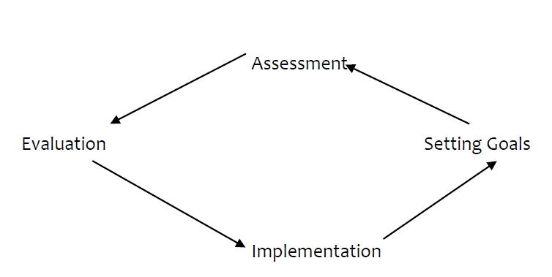

Slide 189
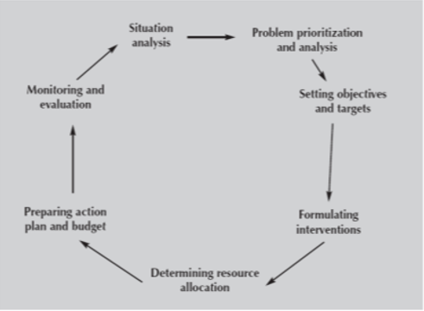

Slide 190
Steps in strategic planning process/planning cycle
1: Environmental scanning/
This involves assessment of the External an Internal-environment
The economic, demographic, technological, social, educational and political factors are assessed in terms of their impact on opportunities and threats within the environment
Internal environment assessment (SW) includes review of the effectiveness of the structure size, programmes, financial resources, human resources, information system, research and development capabilities of the organization

Slide 191
2: Strategy formulation
This includes the development of the mission, specifying objectives, developing strategies and setting policy guidelines.
Mission: The development of the mission statement provides a sense of direction and focus and draws the organization together. The purpose of the mission statement is to communicate what the organization stands for and where it is heading. Mission statement answers the question, why do we exist. Everyone should participate in deciding of the mission statement.

Slide 192
Goal Setting: This is the process of developing, negotiating and formalizing the targets or objectives that an employee s responsible for accomplishing (performance standards). Goals assist the managers to focus attention on what is relevant and to develop strategies and actions to achieve the goal.
Objectives: Objectives should be challenging, measurable, consistent, achievable, reasonable and clear. Smart – outcome oriented

Slide 193
3: Identification of strategies: Strategy determines how the organization will go about attaining their vision i.e. how it will exploit the external opportunities and internal strengths and counter external threats and internal weaknesses. This involves preparing a detailed plan of action, either short-term and long-term objectives. Formulation of annual departmental objectives, resource allocation and preparation of budgets is also done at this stage. Strategies may include; retrenchment, expansion, recruitment etc

Slide 194
4: Strategy Implementation
This is the action stage. The specific plans for action are implemented in order of priority. It entails open communication with staff in regard to priorities and formulation of area and individual objectives related to the plan. Resource allocation (human/non human allows for strategy execution. Resources are allocated in order of priority i.e. established by annual objectives.

Slide 195
5: Strategy Evaluation
At set periods, the strategic plan is reviewed at all levels to determine if the goals, objectives and activities are on target. Monitors the results of formulation and implementation of activities and includes measuring individual and organizational performance and taking corrective actions when necessary

Slide 196
Operational planning/tactical planning
This is tactical planning and a short term exercise designed to implement the strategies formulated under strategic planning. It is based on strategic plans.

Slide 197
Purposes of Planning (Significance)
Planning has many important purposes which include some of the following:
Contributes to a purposeful organization.
Reduces costs. Efforts will be better directed toward desired results
Provides for integration and coordination of activities.
Haphazard approaches can be minimized and duplications avoided.
Provides for consistency of action which is necessary so that both internal and external people can anticipate the organizations

Slide 198
Difficulties Encountered In Planning
Plans tend to be slow when joint efforts of several individuals are needed.
There is friction as people bring together their ideas to make a decision.
Differences in perception of objectives.
Communication problems.
Persuasive ability of the impressive individual.

Slide 199
ACTIVITY: Find out the vision, mission and philosophy of your institution. To what extent does the institution subscribe to them?

Slide 200
ORGANIZING
This lecture focuses on Organizing as an important function of management. You will learn about the meaning of organizing, organizations and organizational structure and communication in organizations.
HCW are expected to organize their work activities based on the staffing patterns

Slide 201
OBJECTIVES
By the end of this lecture, you should be able to:
1. Explain the importance of organizing.
2.Describe organization and organizational structure
3.Explain organizational communication

Slide 202
Definition of Organizing
It is the process of grouping the necessary responsibilities and activities into workable units, determining the lines of authority, communication, developing patterns of coordinating and giving feedback.
By organizing we are attempting to answer the question: How will the work be divided and accomplished? To answer the question the manager must define, group and assign duties

Slide 203
There are certain basic issues to consider. These include:
• Setting up structure – structured aspects of the organization must be sure up which indicate the activities to be performed and lines of responsibility and authority.
• Developing procedures and policies.
• Determining organizational requirements and deciding how duties will be performed

Slide 204
Types of Organizations
Formal – Those organizations whose membership and activities are governed by certain specified rules and procedures which determine the degree of authority and behavior of each participating member e.g government ministries, non-profit making organization, business companies.
When designing the departmental organizational structure, the manager should plan for an ideal organization

Slide 205
Types of formal organization structures
Line Organizations
It is the oldest and simplest type of formal organization structure. Pure line structure is straight forward and has direct chain of command pattern that emphasizes superior subordinate relationships
Functional Structures
Employees are grouped in departments by specialty with similar tasks being performed by the same group. Similar departments reporting to the same manager are grouped together

Slide 206
Service integrated structure/product line
All functions need to produce a product or services are grouped together, in self contained units. units are based on product, service, geographical location, or type of customer.
Hybrid Structure
As organization grows it typically organizes both self-contained units and functional units resulting into a hybrid structure

Slide 207
Matrix
Integrates both product and functional structures into one overlapping structure. Different managers are responsible for function and product

Slide 208
Informal – These are social groups or “cliques” which develop within formal organizations in order to fulfill individual social needs e.g according to social interests like welfare society.
No formal organization will operate efficiently without an accompanying informal organization

Slide 209
Organizational Structure
Organizational structure refers to how work is organized, where decisions are made and the authority and responsibility of workers. Structure is a map of communication and decision making paths. Organization structure is an important tool through which managers can increase organization efficiency

Slide 210
It depicts the expression of responsibility relationships among people and jobs. The organizational structure is graphically portrayed by the organizational chart. This is a pattern to show how parts are put together to accomplish a particular purpose.
Individual positions are shown as rectangular boxes each representing a job. The chart shows:
Areas of responsibility.
To whom and for whom each person is accountable.
Major channels of formal communication.
Interdepartmental relationships.

Slide 211
ELEMENTS OF AN ORGANIZATIONAL STRUCTURE
In drawing up an organizational chart determine the purpose of the plan considering administrative control, Planning and policy making and relationships with other departments and agencies.
Review departmental functions and determine what activities are needed in order to carry out the functions. Avoid duplication of activities and include all-important ones.

Slide 212
Classify the functions and activities and draw up job specifications and descriptions. Find out where the responsibility for decision making should be placed and allow for delegation.
Review relationship with other departments in the hospital or organization.

Slide 213
Purposes of Organizational Structure
The following are the main purposes of organizational structure are:
To have the right people taking right decision at the right time.
To establish who is accountable for what and who reports to whom.
To facilitate easy flow of information -channels of communication.
To depict interdepartmental relationships.
To integrate and coordinate activities.

Slide 214
HEALTH CARE ORGANIZATIONS
The health care organizations make up the health care system which provides total services offered by all health disciplines. Today many types of health care organizations exist. These differ in terms of: Ownership, Role or services offered, activity and size

Slide 215
TYPES OF HEALTH CARE ORGANIZATIONS
1. Hospitals: These are institutions whose purpose is to serve the whole community, sick or well. Hospitals play a significant role and the services provided include:- preventive, curative, rehabilitative, promotive, education and research.
Hospitals are classified into:-
- Acute care: This is a facility in which average length of stay is less than 30 days.
- Chronic or long term hospitals: These are designated to care for patients whose average length of stay is longer than 30 days.

Slide 216
2. Ambulatory-based organization
This is the second type of health care organization. Many health services are provided on ambulatory basis. It is the care mainly given by private physicians or in hospitals as out-patient care. The goal is to focus on out of hospital preventive care and illness follow up care. It also reduces the cost of expensive acute hospital care.

Slide 217
3. Health Managed Organization (HMO)
The other type of health care organizations are the HMO's. This is a newer concept in our country which is catching up quickly. This is where an organization gets people to enroll and pay a fixed periodic fee to the organization which determines the amount of services used. The HMO company offers hospital and outpatient services. Examples of these include insurance companies who cover medical expenses.

Slide 218
4. Home Health Care Organization
The last type of health care organizations is home-based.
The services in this case are offered at home. The care is given by professional with expert skills in assessing patients self-care abilities and identifying resources to overcome problems and meet patients needs. These include patients' requiring palliative care, chronically ill, disabled or elderly.

Slide 219
The Kenya National Health System
The health system in Kenya include the
National system and the County Health System,
national and county governments institutions engaged in health service delivery,
research for health, health financing institution,

Slide 220
health regulations,
all health workers both in the public and private sectors, traditional,
complementary and alternative health care providers, and all institutions

Slide 221
Professional societies ( like the Kenya Medical Association) who are involved in ensuring the promotion,
-prevention, control and treatment of illness,
-care and or rehabilitation of health.

Slide 222
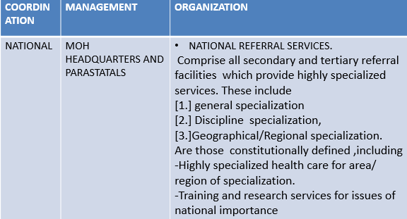
Structure of the health care system in kenya

Slide 223
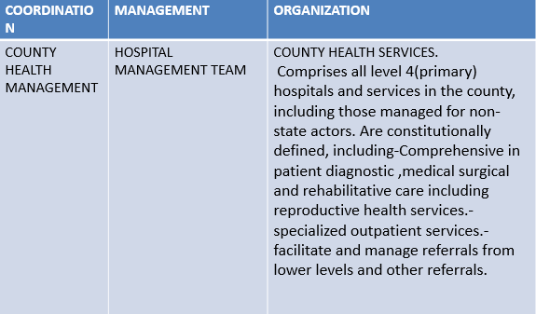

Slide 224
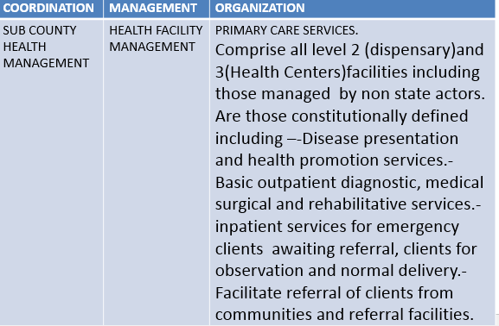

Slide 225
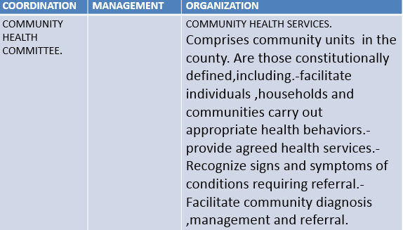

Slide 226
Public sector health service Delivery
The health sector comprises the public system, with major players including the MOH, Parastatal organization and the private sector, which includes private for –profit, non-governmental organization (NGOs) and faith-based organization(FBO) facilities.
Health services are provided through a network of health facilities countrywide, with the public sector system accounting for about 50 percent of these facilities.

Slide 227
The public sector health service delivery is organized on a six level tier system as outlined below.

Slide 228
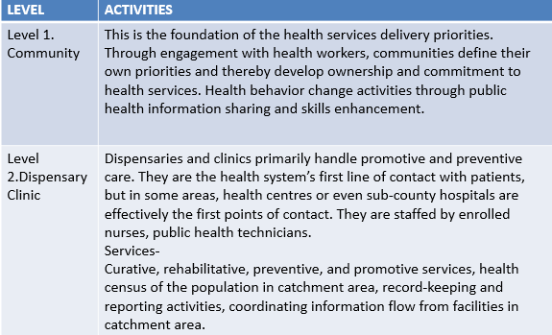
Public Sector Health Service Delivery System

Slide 229
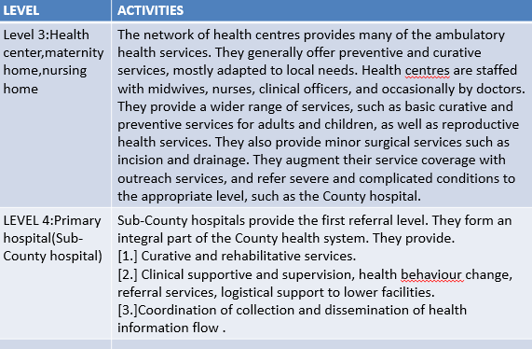

Slide 230
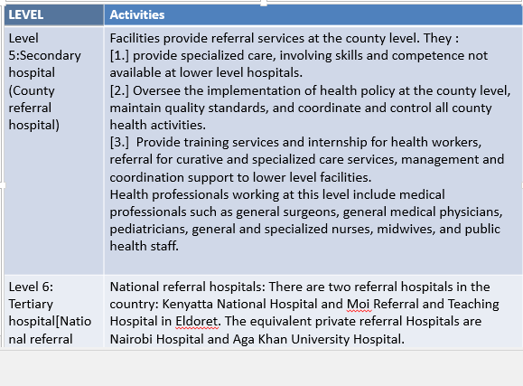

Slide 231
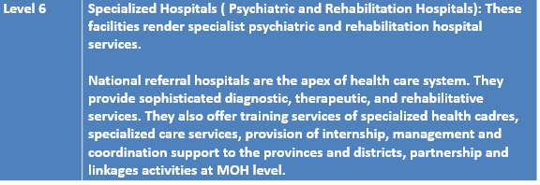

Slide 232
Linkages and responsibilities in the health care system
The constitution of Kenya (2010) assigns the larger potion of delivery of health services to the counties with the exception being the national referral services.
Counties bear overall responsibilities for planning, financing, coordinating delivery and monitoring of health services towards the fulfillment or right to ‘the highest attainable standard of health’.

Slide 233
Responsibilities for health services are exercised at three levels
1. The Ministry of Health ( National Directorate for health)
2. County Health Management Teams(CHMT)
3. County Health Facility Management Teams

Slide 234
The Ministry of Health
Under the devolved system of government, the National Government through the Ministry of Health is responsible for provision of overall direction through
-policy formulation,
-national strategic planning,
-priority setting,

Slide 235
-budgeting and resource mobilization,
-regulating,
-setting standards
-formulating guidelines,
-monitoring and evaluation,
-and provision of technical backup to the county level

Slide 236
Key mandates of the MOH:
1.Development of national policy.
2.Provision of technical support at all levels.
3. Monitoring quality and standards in health services provision;
4.Provision of guidelines on tariffs for health services;
5. Conducting studies required for administrative or management purposes

Slide 237
The chief Technical Officer of the Ministry of Health is the Director of Medical Services (DMS).The role of the MOH is to provide strategic direction through national health planning, development of services and quality standards, health financing, HRH planning, monitoring and evaluation.

Slide 238
These national functions are distributed amongst six directorates namely
1.Administrative Services;
2. Health Standards ,Quality Assurance and Regulations;
3.Curative and Rehabilitative Services;
4.Policy Planning and Health Care Financing;
5. Preventive and Promotive Services;
6.National Quality Control Laboratory.

Slide 239
The role of the National Directorates for Health is to provide overall direction- policy formulation, national strategic planning, priority setting, budgeting and resource mobilization, regulating, setting standards, formulating guidelines monitoring and evaluation and provision of technical backup to the county level.

Slide 240
COUNTY GOVERNMENT
At county level ,the Kenya Health Policy 2012-2030 proposes the formation of county health departments whose role will be to create and provide an enabling institutional and management structure responsible for ‘coordinating and managing the delivery of health care

Slide 241
mandates and services at the county level’. In addition to the county health departments, the policy calls for the formation of county health management teams. These will provide ‘professional and technical management structure’’ in each county to coordinate the delivery of health services through health facilities available in each county.

Slide 242
The role of the county government is to provide strategic and operational leadership and stewardship for overall health management in the county, including provision of health services, resource mobilization, creation of linkages with national level referral health services, monitoring and evaluation, coordination and collaboration with state and non-state and non-state stakeholders at the county level.

Slide 243
Within each county, the Health Facility Management Teams are charged with the responsibility of providing health services, developing and implementing facility health plans, coordinating and collaborating with stakeholders through county Health Stakeholder Forums, supervising,continuosly monitoring and evaluating health services provision and implementing health policies

Slide 244
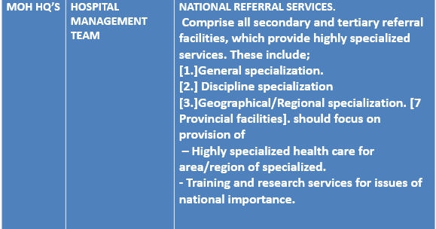
SERVICES PROVIDED IN VARIOUS LEVELS OF HEALTH FACILITIES

Slide 245
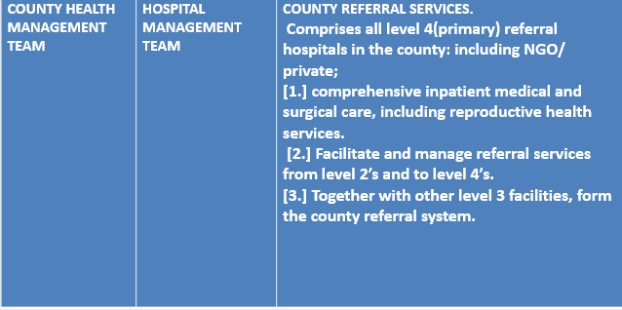

Slide 246
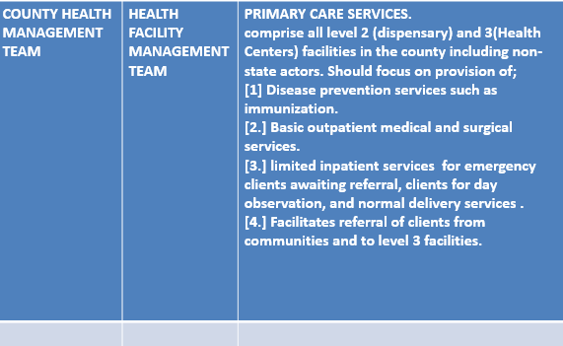

Slide 247
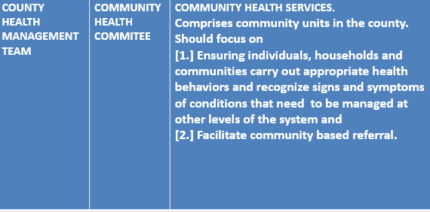

Slide 248
Job Descriptions and Specifications
Job descriptions
Job descriptions state the principal duties and responsibilities of the various jobs and the scope of authority. They may be based on information obtained from employees who hold positions and supervisors, as they perceive the jobs.
Generally they describe function elements of a position in relation to duties and responsibilities.

Slide 249
Job Specifications
This refers to human qualities or personal specifications which are necessary to perform a job adequately.
It includes the details of the knowledge, skills and abilities and behavior required to perform a job.
Most organization manuals combine jobs specifications as part of each job description.

Slide 250
Tools Used By Manager
1. Organizational manuals
These provide in comprehensive written form, the decisions which have been made concerning the organizational structure.
The manual should clearly specify: The responsibilities of each supervisory position and how they are related to other positions.
They should state the objectives of the organization and each department.
Manuals should have major policies of the organization particularly relating to personnel e.g Human resource issues, disciplinary policy, terms and conditions of service, training and development, leave.

Slide 251
Policy
A policy is a guide which clearly spells out responsibilities and prescribes actions to be taken under a given set of circumstances.
It provides general direction for decision making so that action can be taken within the framework of organizations beliefs and principles.

Slide 252
Procedure
This prescribes steps that should be followed in order to conform or carry out a policy.
Standards
These coordinate and articulate the operations of organizations.

Slide 253
ORGANIZATIONAL COMMUNICATION
In your communication course, you discussed the principles and importance of communication.
There is no organization that can exist without communication. Communication is referred to as the lifeblood of an organization.
Communication is the need of creating common understanding. It is therefore the process of transmitting ideas and information from one person (sender) to another or group of people (receivers).

Slide 254
Organizational communication is the exchange of information within the organization. While employees’ communications are the responsibilities of the managers, the managers work may be supplemented through already established means of communication within an organization. In any organization, there exists both formal and informal communication

Slide 255
The formal communication system mainly used is based on the chain of command from the top of the organization to the bottom. This is used for all official messages including directives, procedures, policies, job instructions etc.
The informal communication – System is usually oral and not crucial to the functioning of the organization. It generates from informal groupings e.g associations or welfare. In most cases, messages are transmitted through “grapevine” or rumors and sometimes the communication is distorted or groundless. Since it can cause fear and anxiety among staff, the manager should be aware of them to reinforce the formal system.

Slide 256
The role of the manager is to use positive informal communication to the maximum for the benefit of organization. He/she must discourage any which may not work in the interest of organization success. There is need to establish proper formal channels and use them for all information that employees need to know

Slide 257
Flow of Communication in an Organization
The Manager is responsible for passing information through vertical channels of communication which includes both downward and upward flow of communication.
I. Vertical Flow:
The Manager is responsible for passing information through vertical channels of communication which includes both downward and upward flow of communication

Slide 258
a) Downward Communication:
Most information within organizations move from top downward, that is, top management to employees. This may be through face to face, written materials e.g memos or circulars. The purpose is mainly to inform employees of their job responsibilities, commitment to the objectives and any other relevant information.

Slide 259
Some barriers to this include:
- Manager may withhold information.
- The employee may fail to understand the message.
- Employee may get information not relevant to their needs and do not get information they need.

Slide 260
b) Upward Communication:
This is the flow of information from bottom – up or subordinates to supervisor. Ideally information should pass freely up the chain of command so that management gets the feedback needed to evaluate results and initiate improvements.

Slide 261
Barriers to upward communication may include:
- If employees feel management is not interested in their ideas, they will not offer them.
- Sometimes, bad news get blocked and is not communicated to the top management.
- Delays in relying messages.

Slide 262
2. Horizontal Flow
This is the flow of information where managers communicate with each other at a professional level or employees of equal rank exchange information including opinions or news.
Write down the principles of communication and list five (5) barriers to effective communication

Slide 263
In this lecture, we have defined organizing as the process of grouping responsibilities and activities into workable units, determining lines of authority and developing patterns of coordinating and giving feedback. Types of organizations were discussed as well as elements of organizational structure

Slide 264
STAFFING
Allocating human resources is one of the many responsibilities and a challenge to the manager.
This lecture will introduce you to the managerial function of staffing including staffing process, scheduling and factors affecting staffing

Slide 265
OBJECTIVES
By the end of this lecture, you should be able to:
1. Explain staffing process
2. Describe factors affecting staffing
3. Describe scheduling and different types of scheduling

Slide 266
Definition of Staffing
This is the process of balancing the quantity of staff available with the quantity and mix of staff needed by the organization.

Slide 267
Objectives of Staffing
The following are the main objectives of staffing:
1. To provide appropriate numbers and mix of staff to meet patient needs
2. To provide continuous quality care to patients
3. To periodically evaluate staffing practices in order to determine the scope of staffing problems.
4. To utilize the talents and skills of each level of STAFF to their fullest

Slide 268
5. To provide new employees with an adequate orientation period.
6. To establish staff conditions of employment and adjust as needed to current practices.
7. To utilize centralized or decentralized staffing as means of scheduling
8. To establish a master-staffing plan for allocating personnel based on assessment of patients needs.
9. To maintain records pertinent to staff data.

Slide 269
STAFFING PROCESS
The process of staffing involves: Recruitment, Selection, Induction and Scheduling
Let us examine the meaning of each of the above terms:
Recruitment
This is the first part of the process and it involves filling a vacancy. It is the drafting or revision of the job specification for the vacant position, outlining the qualifications, experience, skills and the responsibilities involved.
The vacancy is then advertised to source suitable candidates. The sources could be internal, that is, from within the organization or external.

Slide 270
Selection
Selecting is the next stage which involves matching the requirements of the job with the attributes of the candidate. The process includes assessing the candidate by various means eg. Interviewing and screening. The purpose of this is to obtain information. Selection testing including achievement, aptitude, intelligence and personality may also be used. These are followed by offer of employment

Slide 271
Induction
This is the process of receiving employees when they begin work, introducing them to the organization and to their colleagues and informing them of the activities, and the culture of the organization. This may be regarded as the orientation or beginning of training

Slide 272
Scheduling(Duty Roster)
After induction is given, the employee is assigned the tasks to be performed. The schedules for work and time off should meet organizational goals with fairness and equality among personnel. A schedule should adhere to following:
• Policies, standards and practices of the organization on the use of professional and paraprofessional personnel (Supportive staff).

Slide 273
Appropriate ratio or balance between professional and supportive staff. This is in order to deliver continuity of services nursing care.
• Approved budget. The manager should consider the financial resources within the organization.
• Consideration of vacations and consideration of allowance of adjustment in case of illness, emergencies or changes in patient care needs.

Slide 274
Factors Affecting Staffing
Patient factors e.g Unpredictability of the patient census, variety of patient conditions, patient population, and care needs.
- Staff factors including, experiences and expectations of the organization, job descriptions, education level and personnel requirements.
- Health care organization factors e.g. policies and procedures, resources available and number of beds per unit

Slide 275
Since each setting is unique, there is no guide that can stipulate the correct number of personnel needed to provide quality care but systems have been developed for guidance e.g.. patient classification system which is a method of grouping patients according to the amount and complexity of their nursing care requirements. In this case patients are grouped according to the nursing time, effort and ability required to provide care.

Slide 276
HUMAN RESOURCE FOR HEALTH MANAGEMENT
OBJECTIVES
By the end of this lecture you should be able to:-
1. Describe the importance of human resource management.
2. Explain human resource planning
3. Describe motivation at work
4. Explain conflict and conflict resolution
5. Describe collective bargaining
6. Describe performance appraisal

Slide 277
HUMAN RESOURCE FOR HEALTH MANAGEMENT
Introduction
The greatest asset of health care organizations is the collective and individual knowledge and intelligence of their employees and nurses/clinical are among the health care providers called “ Knowledge workers” because the services they provide is based on specialized expertise and complex decision making hence the importance of investing in human resource.

Slide 278
HUMAN RESOURCE MANAGEMENT CONCEPTS
Human Resource Management
Human resource management (HRM) is the strategic and coherent approach to the management of an organization's most valued assets - the people working there who individually and collectively contribute to the achievement of the objectives
Human Resource: This is any individual employed by the organization

Slide 279
Performance management: All that mediates the interactive process between work motivation of the individual the performance rewards and development opportunities provided by the organization (Frank 1998).
Staff development It’s the process of orientation, in-service education, and continuing education to promote the development of personnel within any employment setting consistent with the goals and responsibility of the employer ( Refers to both professional and non- professional staff

Slide 280
Orientation: Introducing new staff members to the philosophy goals, policies, procedures role expectations, physical facilities, and special services in a work setting
In-service education: Learning of experiences provided in the work setting to assist staff in performing their assigned functions
Continuing education: Educational programmes that consists the concepts, principles, research or theories related to proffrssion that build on previously acquired knowledge, skills and attitudes

Slide 281
Strategic Human Resource Management: This is the linking of HRM strategic goals and objectives in order to improve business strategy. That strategy then provides the framework that guides the design of specific HR activities such as recruiting and training

Slide 282
OBJECTVES OF HUMAN RESOURCE MANAGEMENT
According to Basavanthappa (2002) the main objectives of human resources management are the following:-
- Effective utilization of human resources to the achievement of organizational goals.
- Establishment and maintenance of an adequate organizational structure and desirable working relationship among staff.
- Securing integration of the individual and informal groups with the organization ad thereby ensuring their commitment, involvement and loyalty.

Slide 283
Recognition and satisfaction of individual needs and group goals.
- Provision of maximum opportunities for individual development and advancement.
- Maintenance of high morals in organizations

Slide 284
Main Responsibilities in Management of Human Resources

Slide 285
HUMAN RESOURCE MANAGEMENT PROCESS
The following are the techniques required for Human Resource Management
1. Conducting a Job analysis determining the nature of each employees Job
2. Planning labor needs (HR Planning) and recruiting Job candidates
3. Selecting Job candidates

Slide 286
HUMAN RESOURCE MANAGEMENT PROCESS
The following are the techniques required for Human Resource Management
1. Conducting a Job analysis determining the nature of each employees Job
2. Planning labor needs (HR Planning) and recruiting Job candidates
3. Selecting Job candidates

Slide 287
4. Orienting and training new employees
5. Managing wages and salaries ( compensating employees)
6. Providing incentive sand benefits
7. Appraising performance
8. Communicating ( interviewing, counseling, disciplining)
9. Training and development

Slide 288
Human Resource planning
Human resource planning is the process of identifying the member’s skills, occupational categories, and performance and development needs of personnel in an organization.
This identification has to be linked to the strategic plan of the organization. While the strategic plan of the organization is to identify the future direction

Slide 289
in the organization, the objective of human resource planning is to ensure that the organization will always have the right people in the right places to do the work required by the organization.

Slide 290
Human Resource Planning
Forecasting future manpower requirements: Estimating the institutions demand for labor, matching this with what is available and identifying whether there are shortfalls or more than required. Such planning is accomplished through analysis of current and expected skill needs, vacancies and department expansions and reductions.

Slide 291
Formulating and proposing policies: Policy formulation is carried out in Human Resources Department. The policies have to be agreed by the top management team. The key areas of personnel policy include recruitment and selection; terms and conditions of employment, training and development. These personnel policies are guidelines for behavior stating what the organization will do or will not do in relation to employees and employee affairs.

Slide 292
Recruitment: This involves preparing job descriptions and specifications, drafting job advertisements, interviewing candidates and assessing appropriate salary levels for new employees. As discussed earlier a job description states the principal duties, responsibilities and the scope of authority while A job specification refers to human quality or personnel. Specifications which are necessary to perform a job adequately e.g. The knowledge details, skills, ability and behavior

Slide 293
Training and Development: Once the employees join the organization, they require training. Induction or orientation of new employees is an integral part of training
Training and Development of human resources is the most dynamic of all the organization's resources. The process aims at increasing the ability of employees to contribute to organizational effectiveness. Training and development is important in order to maintain the key skills within the organization and motivate the staff. This is to enable them to realize their full potential in their work. The human resource department has the responsibility of assessing the training needs, designing methods of training needs, designing methods of training to be employed and evaluating the training to determine how effective it was.

Slide 294
In planning, consideration must be given to:
I. The type of patient care management used
II. The education and knowledge level of staff to be recruited
III. Budget constraints
1V. The historical background of staffing needs
V. The diversity of the client population to be served

Slide 295
Principles of effective human resource plan
I. The plan should be as detailed as possible
II. Plans should not extend too far into the future, as accurate prediction of the distant future is not always possible
III. All alternative courses of action should be considered
IV. Implications of the actions envisaged should be assessed
V. Instructions to individuals and departments must be incorporated into the plans
VI. Plans should be concise and easy to understand

Slide 296
Reasons for Training and Development
A change in working methods
- Realization that performance is poor, inadequate and not up to the standards.
- Manpower shortage necessitating the upgrading of some employees to new positions.
- Desire to improve the quality

Slide 297
Recruitment process
1: Defining requirements:
Categories and number of people required should be specified in the recruitment programme derived from human resource plan.
The department in which the recruit will work must draft or revise a comprehensive job specification and job description (from job analysis) for the vacant position, outlining its major and minor responsibilities; the skills, experience and qualifications needed; grade and level of pay and particulars of any special conditions attached to the job (temporary, permanent, contract, shift duty).

Slide 298
2. Attracting candidates: After defining requirements then the job is advertised. This involves reviewing and evaluating alternative sources of applicants inside and outside the company. First consideration should be given to internal candidates, then advertising and outsourcing
3. Selection of candidates: This is the assessment of candidates and choice of the one who best meets the criteria for the available position. It involves matching job requirements with the attributes of the candidates. Normally involves the following steps

Slide 299
a) Short listing: List applications on a control sheet and comparing the applications with the key criterion in the job specification and sort them into three categories.
i) Possible
ii) Marginal
iii) Unsuitable
Scrutinize the possible again to draw up a short –list for interview. Ideally should be 4-8 candidates per position

Slide 300
b) Interviewing; An interview may be defined as a verbal interaction between individuals for a particular purpose. The goals of the selection interview are;
The interviewer seeks to obtain enough information to determine the applicant’s suitability for the available position
The applicant obtains adequate information to make an intelligent decision about accepting the job should it be offered
The interviewer seeks to conduct the interview in such a manner that, regardless of the interview’s results, the applicant will continue to have respect for and good will towards the organization.

Slide 301
Types of interviews
There are many types of interviews and formats for conducting them.
The unstructured interview
The interviewer asks whatever seems appropriate and adapts the discussion to the response. This requires little planning because the goals for hiring may be unclear, questions are not prepared in advance, and often the interviewer does more talking than the applicant.

Slide 302
Semi structured interview
Only the major questions to be asked are prepared in advance and the interviewer may ask other questions that open up areas of discussion during the interview session.
They require some planning since the flow is focused and directed at major topic areas although there is flexibility in the approach.

Slide 303
The structured interview
The interviewer uses a prepared list of questions and does not deviate from them.
This type of interview requires greater planning time yet because questions must be developed in advance that address the specific job requirements.
Information must be offered about the skills and qualities being sought, examples of the applicant’s experience must be received, and the willingness or motivation of the applicant to do the job must be determined. The interviewer who uses a structured format would ask the same essential questions of all applicants

Slide 304
Other formats of conducting interviews
Individual interviews
Interviewing panels
Selection boards

Slide 305
4. References: This is to obtain in confidence factual information about a prospective employee and opinions about his or her character and suitability for a job
5. Physical examination: The examination determines if the applicant can meet the requirements for a specific job and provides a record of the physical condition of the applicants at the time of hire. Also helps to identify applicants who will potentially have unfavorable attendance records or may file excessive future claims against the organization’s health insurance

Slide 306
6. Confirming the offer
Confirm offer of appointment after satisfactory references have been made and applicants have passed medical exam. Contracts of employment should be written. Applicants offered a position should confirm their acceptance in writing
After the employee has been given the appointment and have reported to work they have to understand the work environment and adjust effectively to the job. This is done through the indoctrination process

Slide 307
Indoctrination Process
As a management function, this refers to the planned, guided adjustment of an employee to the organization and the work environment. The process includes; induction, orientation and socialization.
Induction: This includes all activities that educate the new employee about the organization and employment and personnel policies and procedures. This takes place before the employee starts performing the job. A handbook can be given and a form signed to verify that it was given. The form should be placed in the employee’s personal file.

Slide 308
Orientation: Induction provides the employee with general information about the organization whereas orientation activities are more specific to the position. Orientation is the process of
assisting new employees to adjust to new roles and responsibilities within the organization. It is the process of introducing new employees to the organization and to their superior, their juniors, colleagues and to their tasks.Recruiting and selecting high potential employees does not guarantee they will perform effectively. People who do not know what to do or how to do it can’t perform effectively even if they want to.

Slide 309
Socialization: Socialization involves inducting new employees to the expectations and behaviors of the organization. This is a sharing of the values and attitudes of the organization by the use of role models, myths and legends. The leader introduces the employees to unit values and culture and molds them to fit in the unit by introducing them to norms of the group. Role models, preceptors and mentors can be used to clarify role expectations.

Slide 310
Role models are examples of experienced, competent employees. The employee sees the role models are skilled and tries to emulate them.
A preceptor is an experienced nurse who provides emotional support and is a strong clinical role model to the new nurse. (Preceptors are usually assigned and have a short relationship with the person assigned while a mentor has a long term relationship with the mentee)
Mentoring is a supportive and nurturing relationship between an expert and a novice. The mentor makes a conscious decision to assist the mentee in his or her career development

Slide 311
Approaches to training and development
On The –Job-Training
This is informal training which employees, receive while performing the job.
Off –the –Job Training
This is internal training by other personnel. It is done through coordination of human resources department or a trainer in the organization with expertise in the subject
Internal Training by External Consultants
The Organization may lack expertise and therefore has to source elsewhere. The training is held either inside or outside the organization and facilitated by external consultants. The course(s) are tailored to specific needs of the organization.

Slide 312
Assignment
Read and make notes on deployment

Slide 313
Performance management
Performance management: All that mediates the interactive process between work motivation of the individual the performance rewards and development opportunities provided by the organization (Frank 1998).

Slide 314
Managers exist to achieve results
Managing performance = improvement of theperformance of the organization by getting better result from team and individuals
The process should encourage dialogue
Should not be see as an end it self but as one of the process for improving performance

Slide 315
Performance management should address the needs of the individuals within the organization as well as the needs of an organization
Performance management should not be a controlling process but ,an enabling process concerning on how to help an individual to realize their potential
Performance management requires coaching individual hence managers require to invest time in the process

Slide 316
Performance management should occur as natural process to all managers ,not one imposed by the personnel department or top management

Slide 317
Managing expectations
Managing performance is corned about managing expectations
Organization develops purpose objectives and have strategic plans to meet the expectations
Organization also defines value as guiding principles in achieving their purposes
The expectation of an organization determines its functions

Slide 318
Departmental and team expectations are then translated into what individuals are suppose to do in terms achieving targets and standards of performance
The organization defines core competency

Slide 319
Intergration
This takes care of coporate ,team and individual objectives ,intergration of core valus and competency requirement
Intergration is important in managing performance to ensure that the expectations are shared and understood
This makes every one move in the same direction of achieving goals

Slide 320
Cascading
this corporates objectives to individual objectives often take the form of bottom approach
but a bottom up approach should be encouraged to ensure that there is ownership of the process and the expectations developed

Slide 321
Managing performance cycle
PLAN ACT
REVIEW MEASURE

Slide 322
PLAN – agreement of objectives targets and needs for the development of competencies or capabilities and the preparation of the plans to achieve the objectives ,improve performance and develop capabilities
Act – the implementation of the plan in the normal course of work and through special improvement and developmental programmes

Slide 323
Measure – monitor performance (actions )by reference to performance measures (outcome )with what should have been achieved (plans )
Review – take stock at regular interviews but not once a year ,of achievements in relation to plans as established by measuring outcomes

Slide 324
PERFORMANCE APPRAISAL
Managing the performance of people is a fundamental organizational strategy to gain competitive advantage through mobilization of human resources. An important part of a manager’s job is to define performance in advance and to state desired results

Slide 325
Definition of performance appraisal
Performance appraisal means evaluating an employee’s current or past performance relative to the person’s performance standards
Also known as employee appraisal, it is a method by which the job performance of an employee is evaluated (generally in terms of quality, quantity, cost and time).
Performance appraisal is a part of career development. Performance appraisals are regular reviews of employee performance within organizations and begin when an employee is hired and stops when he/she leaves

Slide 326
Purpose of performance appraisal are
I. To identify an individual’s current job performance and give feedback on performance to employees.
II. Identify the strength and weaknesses of the employees
III. Identify employee training and development needs
IV. To motivate the employee.
V. Document criteria used to allocate organizational rewards.

Slide 327
VI. Form a basis for personnel decisions: salary increases, promotions, transfers, disciplinary actions, etc.
VII. Provide the opportunity for organizational diagnosis and development.
VIII. Facilitate communication between employee and administration
IX. Validate selection techniques and human resource policies
X. Provide information for succession planning

Slide 328
Types of appraisal
Formal – This Involves written documentation according to specific organizational guidelines.
Informal – It involves e.g. praising the individual for good performance in a job or a compliment from a supervisor, customer /patient.
The key is that the praise or corrections be made as close to time to the episode as possible.

Slide 329
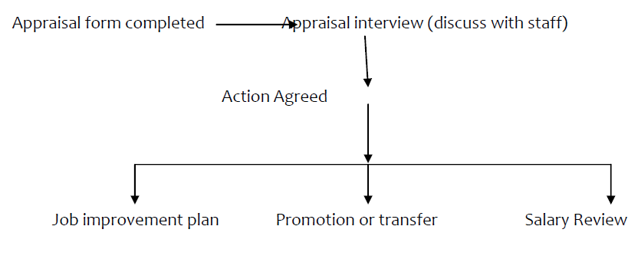
Appraisal Process

Slide 330
The appraisal process
I. The management needs define the appraisal: This involves establishing the performance standards/objectives/expectations and Communicating the expectations to the employee
II. Allow the employees some period to work
III. Appraisal: Assess and measure the actual performance of the work
IV. Compare actual with the expected performance
V. Complete the appraisal
VI. Conduct the appraisal interview and provide feedback

Slide 331
Appraisal Methods
1. Rating Scale
A common method which consists of a list of personal characteristics or factors against each of which is a scale. This focuses on attributes and not targets or job. One of the weaknesses is that there is an element of subjectivity. It is usually on a 5- point scale where 1 is the lowest and 5 the highest score. The following is example of assessing Initiative on an employee:
- -Requires detailed supervision - 1
- -Requires frequent supervision - 2

Slide 332
-Requires occasional supervision - 3
-Rarely requires supervision - 4
-Never requires supervision - 5

Slide 333
Performance Management
This method encompasses objective setting for individuals and departments and performance related pay and training programs. The duties and responsibilities focus on results or targets which are set by individual employees in consultation with their supervisors. The objectives set must be measurable.

Slide 334
Appraisal problems
1. Unclear standards: This is where the performance standards have not been clearly defined
2: Halo and horns effect: The halo effect occurs when the appraiser lets one or two positive aspects of the assessment or behavior of the employee unduly influence all other aspects of the employee’s performance. The horns effect occurs when the appraiser allows some negative aspects of the employee’s performance to influence the assessment to such an extent that other levels of job performance are not accurately recorded.

Slide 335
3. Central tendency: This is where the appraisers stick to the middle when filling rating scales by avoiding high or very low marks and hence cannot be used for promotions or salary increase since everybody is average.
4.Leniency or strictness: This is where rating an appraiser rates employees consistently high (leniency) or low (strictness)

Slide 336
5.Personal bias: The tendency to allow individual differences such as age, race and sex affect performance appraisal ratings employees receive. How employees performed in the past can affect current appraisal
6.Recency and primacy effects: This occurs when the a superior (appraiser) places to much weight on factors that occurred recently (recency) or in the beginning (primacy
6.Matthew effect: The Matthew Effect is said to occur when employees receive the same appraisal results, year after year. Those who performed well early in their employment are likely to do well. Those who struggled will continue to struggle.

Slide 337
Assignment
Read and make notes on appraisal methods /tools of appraisal

Slide 338
Human resource management functions
1. Staff discipline
Some of the very challenging problems for managers is what to do when an employee fail to perform as per their expectations
Discipline is the action taken when a regulation has been violated. Discipline can be defined as the process by which an employee brings her or his behavior into agreement with the agency’s official behavior codes. It can also be a managerial action to enforce employee compliance with agency rules and regulations.

Slide 339
Purpose of discipline
The purpose of discipline is to encourage employees to behave sensibly at work or adhere to rules and regulations.
Discipline is called for when rules and regulations are violated.
The purpose of rules is to inform employees ahead of time what is and is not acceptable behavior
Insubordination e.g. lack of respecting authority

Slide 340
factors that must be present to foster a climate of self discipline.
Employee awareness and understanding of rules and regulations that govern behaviour. These must be clearly written and communicated to subordinates.
• There must exist an atmosphere of mutual trust. The managers must believe that employees are capable of and actively seeking self discipline. Conversely, the employees must perceive the manager as honest and trustworthy.
• Employees should identify with the goals of the organization. When this happens, they are more likely to accept the standards of conduct deemed acceptable by the organization.

Slide 341
The disciplinary process
The purpose of a disciplinary action should be to correct rather than to punish a wayward employee. Discipline should be administered promptly, privately thoughtfully and consistently. Discipline should also be progressive and preceded by counseling

Slide 342
Disciplinary Process
1. Preliminary investigation.
2. A discussion (cordial) with the offender and a brief warning as to why further violations will not be tolerated.
3. A stronger verbal warning after a further violation of regulation.

Slide 343
4. A formal written warning.
5. A written warning accompanied by suspension from the job for a prescribed number of days.
6. Suspension from the job for a longer period of time.
7. Discharge with opportunity to appeal

Slide 344
2. STAFF COACHING
This is the day today process of helping employees improve performance. Coaching also should be used when performance meets the standards but improvement can still be obtained. Before entering into a coaching session the coach should prepare for the interaction. The goal of the meeting is to eliminate or improve performance problems

Slide 345
Cont.………………..
Performance Deficiency Coaching
Performance deficiency coaching is another strategy that the manager can use to create a disciplined work environment. This type of coaching may be ongoing or problem-centered. Problem-centered coaching is less spontaneous and requires more managerial planning than ongoing coaching

Slide 346
Cont.………………………
In performance deficiency coaching, the manager actively brings areas of unacceptable behavior or performance to the attention of the employee and works with him or her to establish a plan to correct deficiencies. Because the role of a coach is less threatening than that of an enforcer, the manager becomes a supporter and helper. Performance deficiency coaching helps employees, over time, to improve their performance to the highest level of which they are capable. As such, the development, use, and mastery of performance deficiency coaching should result in improved performance for all

Slide 347
3. STAFF MOTIVATION
Motivation describes the factors that initiate and direct behavior.
manager’s most important leadership task is to maximize subordinates work motivation because employees bring to the organization different needs and goals, the type and intensity of motivators vary among employees.
Therefore the manager must know which needs the employee expects to satisfy through employment and should be able to predict, which needs will be satisfied through the job duties of each employee position.

Slide 348
Definition
Motivation : Those processes both instinctive and rational by which people seek to satisfy the basic drives, perceived needs and personal goals which trigger human behavior. They are the entire class of wants, drives, desires, needs, wishes which people strive to satisfy

Slide 349
Motive: Inner state which energizes, activates, moves and directs human behavior toward fulfillment of the desire etc.
Motivator: Something which influences body’s behavior to perform a task with a certain degree of enthusiasm e.g. rewards or penalties

Slide 350
Motivation theories are classified into two:
i. Content theories- these focus on the needs that motivate people to behave in certain ways e.g Maslows and McGregors theories (Topic 1)
ii. Process theories- These seek to explain specific actions focusing on the thought process that people experience prior to behaving in a particular manner e.g H. Vroom ( Topic 1)

Slide 351
Practical Steps in Motivation
i. Make people feel valued by:
- Regularly monitoring and appreciating each employee’s work.
- Showing an interest in whatever they hold important.
- Creating a good working environment by being approachable.
- Ensuring everyone understands the importance of their contribution to the team’s objectives.
- Ensuring everyone understands the objectives of the organization

Slide 352
ii. Provide a challenge and scope for development by:
- Setting targets, after consulting, and review at regular intervals.
- Providing relevant training- where appropriate by using people to train others, in the specialty skills they may have.
- Restructuring or grouping tasks to use people’s skills to the fullest.
- Rotating jobs to broaden experience.
- Providing scope for individuals to take greater responsibility.
- Training at least one deputy- succession planning
- Encouraging ideas and suggestions and listening.
- Delegating and allowing staff to take decisions and to implement them.

Slide 353
iii. Recognize achievements by:
- Praising and communicating individual successes,
- Reporting regularly to the team on its progress.
- Holding regular meetings with each individual to monitor progress and give feedback

Slide 354
iv. Communicate by:
- Explaining the organisation’s results and achievements.
- Setting and communicating the team’s objectives and regularly appraising them of its progress.
- Ensuring the team knows how the organization is doing and commutating any changes taking place in the organization.
- Explaining decisions made to assist people to accept them

Slide 355
4. SUPPORTIVE SUPERVISION
Supportive Supervision refers to an activity of more experienced or higher positioned personnel whereby they support the work of their juniors so that it meets set standards. It means assisting health, workers in achieving work outcomes, finding out work problems and challenges and together finding solutions to the problems. Supportive supervision should aim at encouraging team members to apply their ability and energy to work. It also means understanding what makes people dissatisfied at work.

Slide 356
CONFLICTS AND CONFLICT RESOLUTION
Introduction
Conflicts are generally defined as the internal or external disorder that results from differences in ideas, values, or feelings between or more people. Because managers have interpersonal relationships with people having a variety of different values beliefs and backgrounds and goals conflict is an expected outcome. The Managers role is to create a work environment where conflict may be used as a consult for growth, innovation and productivity

Slide 357
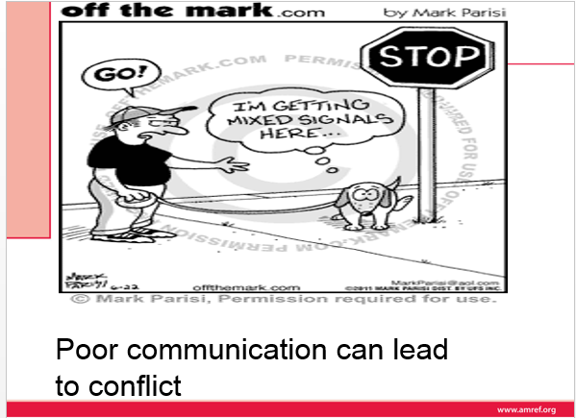

Slide 358
Types of Conflict
1. Intrapersonal – within a person. E.g. personal and professional priorities
2. Interpersonal – among people e.g. best way to ……., information giving.
3. Organizational –e.g. role differentiation, communication, policies and practice, new system or change.

Slide 359
In organizations conflict may be caused by the following:
- Unclear authority structures
- Personal disputes
- Conflicts of interest
- Competition of resources
- Poor coordination of activities
- Incompatibility of group and organizational goals

Slide 360
Conflict resolution methods (strategies)
Avoiding/Avoidance: This method/strategy attempts to keep the conflict from surfacing at all e.g. ignore the conflict or impose a solution (especially where concern for people and production is low.
Important if in conflict a quick action is needed to prevent the conflict from occurring.

Slide 361
Accommodating: This is also known as smoothing or co-operating. It is used when a person ignores his or her own feelings about an issue in order to agree with (accommodate) the other side.
NB: Parties that consistently ignore feelings and give in can end up feeling frustrated or used and may be less willing to co-operate in future.
More conflict can ensue if parties disagree about importance of the issues being accommodated

Slide 362
Competing: One side wins the conflict and the other side loses. It is also called forcing because the winner forces the loser to accept his or her perspective on the conflict.
This can cause anger and resentment to increase withdrawal/avoidance.
The method is useful when an issue is critical or time to resolve it is limited. Can also help move a critical but unpopular decision quickly through an origin

Slide 363
Compromising: Each side gives up something as well as gets something. Used when both sides have a reasonable, important goal and losing is not required.
Negotiation: This is an extension of compromise with higher stakes and more deliberate techniques to bargain for each side’s give and take. It is useful for high stake issues and solutions are seen as formal and more permanent than compromise. Conflicts tend not to recur once the negotiations are finished

Slide 364
Collaborating: In this method both sides in a conflict work to develop the outcome that is best for both sides.
The emphasis is on creative problem solving so that each side meets its key goals.
Confronting: This method attempts to block the conflict from the start. The method brings the parties together, clarifies issues and achieves an outcome.

Slide 365
Causes of conflicts
differences in information ,values ,beliefs ,and interest
Competition for resources,eg money skilled manpower
Inter group rivalry for rewards
Take difficulties
Skill differences
Pressure to avoid failures
Unworkable organization structure

Slide 366
Effects of conflict
Advantages
Prevents intellectual stagnation
Decreases likelihood of group think
stimulates employees curiosity
Facilities employees change
Disadvantages
disputes puts others in to conflict
Unresolved causes violence
Spread from peripheral to other issues

Slide 367
Managing Conflict
Communicating to self and others that conflict is a necessary process.
- Determining similarities and differences in facts, goals, methods and values.
- Assessing the degree of conflict – ask questions about quality of decisions.
- Assessing each situation and matching the best approach regardless of which is your favourite.
- Assisting others in assessing conflict and seeing how best they can approach.

Slide 368
The manager may also overcome organizational conflict through the following:
Improving team spirit
Enhancing effective communication
Regular job rotation
Employee counseling services

Slide 369
Grievances
Grievance Process = When a union member believes that management has failed to meet the terms of the contract or labor agreement and communicates this to management. This process is called grievance!
The grievance process steps
1. The employee informs the employer about the nature of the grievance
2. The employer arranges for a formal meeting to be held without unreasonable delay after a grievance is received

Slide 370
3. The meeting is held and the employee should be accompanied at the meeting. Following the meeting a decision is made on what action if any to take. Decision should be communicated to the employee in writing without unreasonable delay.
4. The employee is allowed to take the grievance further (appeal) if not resolved)
5. The appeal should be dealt with impartially
6. The outcome of the appeal should be communicated to the employee in writing without unreasonable delay
NB: Grievance procedures differ from union to union.

Slide 371
Change and change management
OBJECTIVES
By the end of this lecture you should be able to:-
1. Explain the concept of change
2. Analyze the process of managing change.
3. Identify reasons for resistance to change and how to overcome it

Slide 372
Change is fundamental in order to guarantee long term success in the organization. Some organizations change in response to external circumstances (reactive change) and others change because they have decided to change (proactive change)
a. Definition of change -To change something implies altering it, varying or modifying it in some way. It is also the process of moving from one system to another. It is also the process of making something different from what it was. Also change is any shift in status from an undesirable current status to a desirable future status.

Slide 373
b. Types of change
Planned change: Results from deliberative, collaborative effort to improve system operations and facilitate acceptance of the improvement by involved parties
Unplanned /accidental change: Accidental or reactive change is an adaptive response to an outside stimulus that is directed toward re-establishing balance between system and environment.

Slide 374
c. The change process (planned change)
Change is a continual unfolding process rather than an event. The process begins with the present state, moves through a transition period then comes to a desired state once the desired state has been reached the process begins again. The change process is very similar to the problem solving process and involves :-
Assessment At this stage problem or opportunity for change is identified. Data about change is collected from both internal and external sources and then analyzed. Data analysis should support both the need for change and the potential action selected

Slide 375
Planning: During planning the change agent determines who will be affected by change and when change will occur. Also all potential actions are examined which should include how change will be implemented. An evaluation component to assess if the change met the organizational goals for the change is also constructed
Implement the change: The plans are put into motion. Interventions are designed to gain the necessary compliance. The change agent creates a supportive climate, obtains and provides feedback and overcomes resistance to change.

Slide 376
Evaluation: Determine whether change is effective based on outcomes (goals) identified during assessment and using the evaluation method established during planning. The change agent determines whether presumed benefits were achieved from a financial as well as qualitative perspective
Stabilization: This is achieved by using policies or procedures to make change the norm rather than the innovation. Should occur as soon as possible to complete the change process

Slide 377
d. Change theories
There are several theories that have been developed concerning the change process. These theories are
I. Lewis force field theory
II. Lippitt’s phases of change
III. Rogers diffusions of innovations
IV. Bridges’ model of managing transitions
In this session we are going to review the Lewins’ force field model while you can read about the other theories

Slide 378
Overcoming Resistance to Change
Lewin’s force-field model -Lewin provides a social psychological view of the change process. He sees behavior as a dynamic balance of forces working in opposing directions within a field (e.g. an organization) He suggested that there is need to do an analysis of change situations (which he referred as force field analysis). This includes identifying the following
(i) Driving forces (behaviors’ that facilitate change because they push participants in the desired direction)
(ii) Restraining forces (behaviors that impede change by discouraging participants from making specified changes

Slide 379
Overcoming Resistance to Change
Therefore for change to be effective driving forces must exceed restraining forces. To plan change one must analyze these forces and shift the balance in the direction of change through the following three step process:-
Steps of change according to Lewin
Unfreezing the existing equilibrium: Refers to the awareness of an opportunity, need or problem for which some action is necessary. To unfreeze a status quo, a change agent must increase driving forces or decreases restraining forces in the situation. According to Lewin it involves motivating the participants by getting them ready for change, building trust and recognition for the need to change To their attitudes, actively involve the participants in identifying problems and generating solutions.

Slide 380
Move the target system to a new level of equilibrium (moving)/change This is done by getting the participants to agree that the status quo is not beneficial to them, encouraging them to view the problem from a new perspective and helping them scan the environment to search for relevant information

Slide 381
Refreeze the system at the new level of equilibrium: This involves reinforcing the new patterns of behavior (e.g. rewarding for desired behavior or research on new system).Reinforcement can also be done through formal and informal mechanism (e.g. formulating policies, establishing communication channels

Slide 382
To implement the above process the following approaches will be necessary:-
Education and Communication
This is to make employees fully aware of all aspects of the situation and convince them that change is essential.
- Participation and Involvement
The employees should actively participate and get involved from the beginning so as to stimulate commitment.
- Patience and Tolerance
Give support and assistance needed.

Slide 383
Resistance to change
Response to change varies from ready acceptance to full blown resistance. Forces that oppose change are labelled resistance. Resistance is anything that leads to delay or additional costs to a change Programme. This could be an extreme delay (non-starter) or mild (a few months)
Reasons why people resist change
There are several reasons why people resist change. Among them are the following
I. Fear of unknown: This is where the participants wants the status quo because they are not sure of what will happen when change has occurred
II. When people do not know what is expected of them either during the change process or after change has occurred

Slide 384
II. When people do not know what is expected of them either during the change process or after change has occurred
III. Parochial self-interests: This is where people resist change because of personal interest is expense of organizational interests. May be they fear that they might loose their position if change occurs.
IV. lack of information about what the change entails and the implication of change
V. Mistrust: This occurs especially when people don’t trust the leaders. They might assume that their leaders could be having a hidden agenda e.g. layoff of employees.

Slide 385
Measures of dealing with resistance to change
I. Communication with employees; Speak in person and privately with those who oppose the change. Get to the root of their reasons for the opposition
II. Educate the people; emphasize the goals of change and how the individual or groups will benefit. Clarify information and provide accurate feedback
III. Facilitation: This can be done by providing the resources required. The change agent should also maintain a climate of support and confidence

Slide 386
IV. Involve people affected by change: The change agent should be open to suggestions but clear about the overall purpose and goals. Do not compromise on the intended outcome
V. Negotiation; It is also important to discuss the consequences of resistance e.g. compromised patient care or closure of the organization so that the participants can see the importance of change
VI. Manipulation: This method can be used by rewarding those who have accepted change so that those who are resisting can see there are some benefits and comply
VII. Coercion: This by threatening people who resist change and therefore they comply out of fear

Slide 387
TEAM LEADERSHIP
a. Differentiating groups from teams
A group is an aggregate of individual who interact and mutually influence each other. Both formal and informal groups exist in an organization
Formal Groups: These are clusters of individuals designated by an organization to perform specified organizational tasks. These may include task forces and committees.
Informal Groups: These evolve naturally from social interactions that are not defined by an organizational structure e.g. People who take lunch together who convene spontaneously to discuss a clinical dilemma.

Slide 388
Teams: Teams are real groups in which individuals must work cooperatively with each other in order to achieve some goals. They demonstrate healthy interdependence. A team is composed of a small number of people with complementary skills who are committed to a common purpose, set of performance goals and approach for which they hold themselves mutually accountable. Teams have command or line of authority to perform tasks and membership is based on the specific skills required to accomplish the task.

Slide 389
. Group and team processes
Groups whether formal or informal typically through the following phases
Forming: This is the initial stage of group development in which individual members assemble into a well-defined cluster ( members get to know each other, and very are cautious..
Storming: The second stage of group development where members wrestle with roles and relationships. Conflict dissatisfaction and competition arise on important issues related to procedures and behavior. Members often compete for power and status and informal leadership emerges.
Norming: This is the third phase of Group development. The Group defines its goals and rules of behavior. They also define acceptable and unacceptable behaviors and attitudes. The group structures, roles and relationships become clearer. Cohesiveness also developes.

Slide 390
Performing: This is the fourth stage. The group members agree on basic purposes and activities and came out the work. Cooperation improves and emotional issues subside. Members communicate effectively and interact in a relaxed atmosphere of sharing.
Adjourning: This is the final stage of group development, in which a group dissolves after achieving its objectives or reforming with some major changes takes place in the environment

Slide 391
c. Team building/team development
This is a group development technique that focuses on task and relationship aspects of group functioning in order to build team cohesiveness.
Team building involves
a) Gathering data through individual interviews, questioners and or group meetings about the team and its functioning.
b) Diagnosing the team strengths and arcsine need of development.
c) Holding semi- structured retreat sessions usually directed by an experienced facilitator aimed at addressing priority team problem

Slide 392
Characteristics of effective teams
I. Clear objectives and agreed goals
II. Openness and confrontation
III. Support and trust
IV. Co-operation and conflict
V. Sound procedures
VI. Appropriate leadership
VII. Regular review
VIII. Individual development
IX. Sound intergroup relations

Slide 393
COLLABORATION
Effective teams are characterized by trust, respect and collaboration. Collaboration in health care is defined as health care professional assuming complementary roles and cooperatively working together, sharing responsibility for problem-solving and making decisions to formulate and carry out for patients care

Slide 394
Collaboration between physicians, nurses and other healthcare professionals increases team members awareness of each others type of knowledge and skills, leading to continued improvement in decision making (o’ Daniel and rosentein,2008

Slide 395
When considering a teamwork model in health care, an interdisciplinary approach should be applied. Unlike a multidisciplinary approach, in which each team member is responsible only for the activities related to his or her own discipline and formulates separate goals

Slide 396
for the patient, an interdisciplinary approach coalesces a joint effort on behalf of the patient with a common goal from all discipline involved in the care plan. The plan of care takes into account the multiple assessments and treatment regiments, and it packages these services to create an individualized care program me that best addresses the needs of the patient

Slide 397
COMPONENTS OF SUCCESSFUL TEAMWORK
Open communication
Non-punitive environment
Clear direction ;
Clear and known roles and tasks for team members
Respectful atmosphere
Shared responsibility for team success
Appropriate balance of member participation for the task at hand

Slide 398
COMMON BARRIERS TO INTER-PROFESSINAL COLLABORATION
Personal values and expectations
Personality differences
Hierarchy
Disruptive behavior
Culture and ethnicity
Generation differences
Gender;
Historical inter-professional

Slide 399
Generational differences
Differences in language and jargon
Differences in schedules and professional routines
Varying levels of preparation,qualifications,and status.
Fear of diluted professional identity
Differences in accountability,remuneration,and rewards
Concerns regarding clinical responsibility.
Emphasis on rapid decision making
Complexity of care

Slide 400
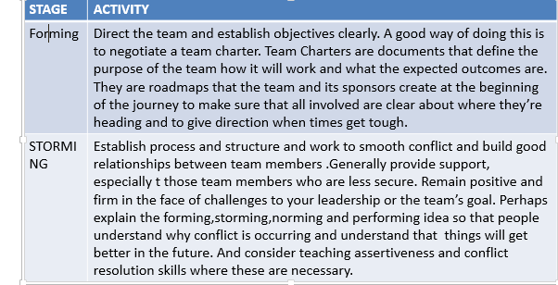
LEADERSHIP ACTIVITIES AT DIFFERENT GROUP FORMATION STAGES

Slide 401
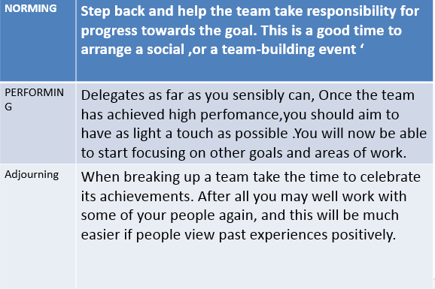

Slide 402
Barriers to effective teamwork.
changing roles-There are currently considerable change and overlap in the roles played by different health-care professionals. Example include radiographers reading plain film x-rays, nurses performing colonoscopies and nurse practitioners having prescribing rights .These changing roles can present challenges to teams in terms of role allocation and acknowledgement.

Slide 403
changing settings - The of health care is changing including increased delivery of care for chronic conditions into community care and many surgical procedures to day-care centers. These changes require the development of new teams and the modification of existing ones

Slide 404
3.medical hierarchies. Medicine is strongly hierarchical in nature and this counter productive in terms of establishing and effectively running teams where all members views are accepted and the team leader is not always a doctor. While these has been a growing acknowledgement that teamwork is important in heath care, this has not necessarily been translated into change practises,especially in environment where cultural norms of communication may mitigate against teamwork

Slide 405
4.Individualistic nature of medicine - The practice of medicine is based on the autonomous one-on-one relation between the doctor and patient. While this relationship remains a core value, it is challenged by many concepts of teamwork, and shared care. This can be at many levels including doctors being unwilling to share the care of their patients through to medico-legal implications of teams-based care.

Slide 406
5.Instability of teams = As already indicated, health-care teams are often transitory in nature, coming together for a specific task or event(such as cardiac arrest teams).The transitory nature of these teams places great emphasis on the quality of training is often relegated at the expenses of services delivery

Slide 407
TYPES OF MEDICAL TEAMS
There are many types of teams in health care. They include labour and delivery units, icus,medical wards, primary care teams in the community, teams assembled for specific task such as emergency response team or multi-professional teams such as multidisciplinary cancer care teams that come together to plan and coordinate patient's care.

Slide 408
CORE TEAMS
Core teams consist of team members who are involved in the direct care of the patient.
Core team members include direct care providers (from the home base of the operation for each unit) and continuity providers (those who manage the patient from the assessment to disposition, for example, case managers). The core team, such as a unit-based team (physician,nurses,physiotherapist,and pharmacist.

Slide 409
2. COORDINATING TEAMS.
A coordinating team is group responsible for:
Day-to-day operational management;
Coordination functions.
Resource management for core teams.

Slide 410
CONTIGENCY TEAMS.
Contingency teams are:
Formed for emergent or specific events;
Time-limited events (e.g.cardiac arrest teams, disaster responsible teams, rapid response teams)
Composed of teams members drawn from a variety of core teams.

Slide 411
ANCILLARY SERVICES.
Ancillary services consist of individual such as catering, cleaners, and other support staff who:
Provide direct, task-specific, time-limited care to patients;
Support services that facilitate care of patients;
Are often not located where patients receive routine care.

Slide 412
Ancillary services are primarily a service delivery team whose mission is to support the core team. This does not mean that they should not share the same goals. The successful outcome of a patient undergoing surgery requires accurate information on catering and instructions

Slide 413
SUPPORT SERVICES
Support services consist of individuals who:
Provide indirect, task-specific services in a health-care facility;
Are services-focused on integral members of the team, helping to facilitate the optimal health care experience for patients and their families

Slide 414
ADMINISTRATION.
Administration includes the executive leadership of a unit or facility, and has 24-hour accountability for the overall function and management of organization. Administration shapes the climate and culture for a teamwork system to flourish by

Slide 415
Establishing and communicating vision;
Developing and enforcing policies;
Setting expectation for staff;
Providing necessary resources for successful implementation
Defining the culture of the organization.

Slide 416
Problem solving
a. Definition of problem solving
Problem solving is a systematic process that focuses on analyzing a difficult situation. Problem solving is also an active process that starts with a problem and ends with a solution.
Problem solving always includes a decision-making step. Managers are constantly faced with problems to solve in an organization.

Slide 417
b. Scientific Problem Solving
Most problems are solved using step by step problem solving process. Problem solving uses critical thinking to gather and analyze data/information, creative thinking to come up with solutions and decision making at key steps on the process.
c. Steps of the scientific problem solving process
Problem solving process has the following seven steps

Slide 418
Define the problem, Issue or Situation: The most common cause of failure in problem solving is improper identification of the problem. In work settings problems fall under certain categories e.g. Manpower, methods, machines and material The definition of the problem should be a descriptive statement of the state of affairs but not a judgmental or a conclusion.
Gather information/Data: Collect the facts that can provide the clues to the scope and solution of the problem. Obtain relevant, valid accurate and detailed descriptions from appropriate people or sources and put the information in writing

Slide 419
Analyze the information/data: Categorize information in order of reliability. List information from most important to least important and set information into a time sequence Information can also be categorized in terms of cause and effect e.g. is A causing B. The information can also Classified into categories e.g. human factors, technical factors rules/procedures, legal and ethical issues.
Develop Solutions: As the information is being analyzed numerous solutions will come up and should be written down and plans made to immediately start developing the best of them. Develop alternative solutions, in case the first order solution proves impossible.

Slide 420
Make a Decision: Select one solution that is most feasible and satisfactory and has the fewest consequences.
Implement the decision: The manager implements the decision after selecting the best cause of action.
Evaluate the solution: Review the plan instituted and compare the actual results and benefits to those of the idealized solutions. The Manager should ask herself or himself: Is the solution being implemented?, are the results better or worse than expected and how can he/she ensure that the solution continues to be used and to work?

Slide 421
Problem Solving Principles
To be able to solve problems effectively it is important to apply the following principles
I. Separate large problems from small ones, and rely on policy for small problems while conserving managerial time for solving major problems.
II. Delegate smaller problems to subordinates trained to handle them.
III. Seek information for problem solving from internal and external experts so that the solution will be based on current knowledge

Slide 422
IV. Approach problems in relaxed fashion and avoid solving problems under stress.
V. After appropriate consideration, select and implement the best solutions without rumination. (do not agonize over selecting a solution) it is impossible to expect 100% accuracy in diagnosing and resolving problems

Slide 423
DELEGATING AND DECISION MAKING
OBJECTIVES
By the end of this lecture, you should be able to:
1. Define delegation and decision making.
2. Explain delegating and the process of delegating
3. Describe the difficulties of delegating and how to overcome them
4. Discuss decision making process

Slide 424
Decision making
Definition:
Decision making is a complex, cognitive process often defined as choosing a particular course of action.
“the process of making choices or reaching conclusions
Choice made from at least two alternatives

Slide 425
Types of Decisions
Strategic Decisions – Long term decisions based on principal goals and objectives eg. Major policy statements
Operating Decisions – Short term decisions routine and repetitive – e.g. schedules or inventory levels.
Administrative Decisions – Concerned with organization structure eg. Communication.

Slide 426
Rational decision making process
The primary steps of decision making process are similar to those of problem solving.
I. Define the problem/issue and diagnose the problem.
II. Collect relevant data
III. Develop alternative solutions
IV. Assess consequences
V. Select optimum solution
VI. Implement solution
VII. Measure and monitor

Slide 427
1. Gather information
- Identify signs and symptoms of dissatisfaction – there must be a problem.
- Gather data – what contributed to the problem.
- Isolate facts, ideas, information clues in terms of what is relevant, valid, accurate.
- Put down in writing

Slide 428
2. Analyze data
- Categorize in order of reliability.
- Compile and rank order information.
- Identify pointers to problem.
- Set in time sequence.

Slide 429
3. Select the cause and define the problem
- Select the most probable cause of the problem.
- Clearly state the problem based on available data.
- Use all available resources.
- Classify the problem in terms of e.g personal, educational or technical skills

Slide 430
4. Develop alternatives or solutions
- Brainstorm
- Explore and list alternative ways.
- Discuss advantages and disadvantages of each of the alternatives

Slide 431
5. Choose or decide
- Actual deciding
- Choose the best alternative – most cost effective or advantageous, feasible or satisfactory. If it involves change – involve those to be affected.
It should have few undesirable consequences.

Slide 432
6. Implement
- Draw a plan of action for the choice made and objectives to be met. Identify tasks to the goal or objectives stating :
➢ What is to be done.
➢ Who is to do it.
➢ When it should be done
➢ Monitoring process – by who - Set timelines

Slide 433
7. Evaluate
- Finding out if goals/objectives were met and to what extent.
- Evaluation will be ongoing (formative ) and the end (summative)
- Are the results as expected

Slide 434
Delegation
DEFINITION
Delegation is defined as the purpose by which responsibility and authority for performing a task (function, activity or decision) is transferred to another individual who accepts that authority and responsibility (Sullivan and Decker, 1992, pg 216).
Although the delegator remains accountable for the task, the delegate is also accountable to the delegator for responsibilities assumed.

Slide 435
Delegation is a dynamic process which involves 3 factors:-
1. Responsibility for work delegated - willingness to do the assigned work or an obligation to accomplish a task.
2. Accountability - obligation to carry out the responsibility or authority or act of accepting ownership for the results or lack thereof.
3. Authority - the right to act or empower.

Slide 436
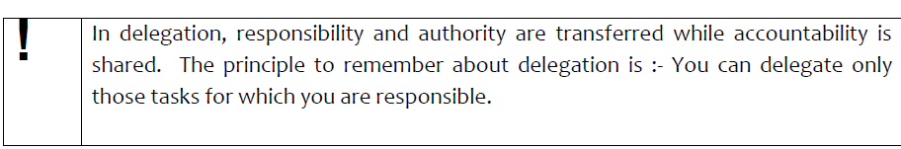

Slide 437
To clearly understand who is responsible, the manager must consider the following;
Practice acts – These determine the scope of nursing practice.
- Policy statements regarding the quality of care and the standards of care
- Job descriptions for various positions- This is to enable delegate specific responsibilities

Slide 438
Principles for effective delegation:
I. Grant proper amount of authority: Responsibility should not be less than authority delegated.
II. Define the results expected: Delegation must define results expected (don’t give ambiguous instructions).
III. Consider the capabilities of the subordinates: While delegating consider the background, experience, intelligence, training and the limitations of the delegate

Slide 439
IV. Make sure authority is clearly stated: Authority relationships should be clearly defined not only to the subordinate but also to others concerned as well. Everyone must know who is in charge and where authority rests.
V. Modify authority whenever necessary: Authority is always revocable or subject to modification and can be increased or decreased or even withdrawn altogether (depending on situations and also environment).
VI. Follow unit of command/chain of command: Authority should flow from the highest manager to all subordinates (each individual reports to one superior except in matrix organizations (according to functional areas).

Slide 440
VII. Develop a willingness to delegate: Managers lack confidence in their staff, fear to loose control. Let go and let others make mistakes if delegation is to work.
VIII. Create a supportive climate. Give moral and material support. Provide advice and encouragement continuously

Slide 441
IX. Develop effective communication system. There should be free flow of communication between superior and subordinates for subordinates to seek clarification and guidance from superior.
X. Establish an effective control system: Controls consent that authority delegated is used properly. Superior should set performance standards and evaluate subordinate periodically and help them improve.
XI. Appropriate incentives: Suitable financial and non-financial incentives should be provided to reward subordinates for successful assumption of authority and completion of responsibility

Slide 442
Delegation process
i. Defining the task – The manager should first determine what can and should be delegated eg.
- Routine tasks
- Tasks for which you do not have time
- Tasks that have moved down in priority
- Problem solving issues
- Staff development

Slide 443
2. Decide on the delegate: Match tasks to the individual. Analyze the person’s abilities to perform various tasks to be delegated and determine . Delegate to the person next in the hierarchy who has the requisite capabilities and who is legally allowed to do the task and also by organizational policy.
3. Define the task : Clearly define your expectations to the delegate. Plan your meeting with the delegate .Provide enough time to describe the task and your expectations and to entertain questions.

Slide 444
4. Providing clear communication about expectations regarding the task.
It is important to communicate effectively with the delegate. To do this the manager must:
- Plan a meeting with the delegate
- Describe the task
- Give reasons for the task
- Inform the delegate by what standard the task will be evaluated
- Identify any constraints for completing the tasks

Slide 445
5. Reach agreement: After outline your expectation you must be sure that the delegate agrees to accept responsibility and authority for the task.
6. Monitor performance and provide feedback: monitoring performance provides mechanism for feedback and control that ensures that delegated tasks are carried out as agreed

Slide 446
Benefits of Delegation:
To the delegator
devote more time to these tasks that cannot be delegated. With more time,
develop more skills and abilities facilitating the opportunity for career advancement.
Improve interpersonal relationship with subordinates,
Provides continuity of work in the delegator’s absence and offers ready replacement.

Slide 447
To the delegatee,
gains new skills and abilities that can facilitate upward mobility.
Delegation also brings trust and support thereby building self-esteem and confidence.
Job satisfaction and motivation are also enhanced as individuals feel stimulated by new challenges.
Morale improves a sense of pride, develops greater awareness of responsibility and individuals feel more appreciated and learn to appreciate the roles and responsibilities of others

Slide 448
To the Organization:
organization is able to achieve its goals more efficiently due to team work,
overtime and absences decrease and productivity increases and at the same time organization’s financial position may improve.
As delegation increases efficiency, the quality of care improves and hence patient’s satisfaction

Slide 449
Some Problems That Hinder Delegation
Manager is reluctant to delegate adequately to his/her subordinates. In some cases some will delegate responsibility and not authority.
- A manager will fail to delegate because she can do a better job.
- A manager may lack the ability to communicate to people what is to be done.

Slide 450
On the other hand, the subordinate or delegate may:
Not accept delegated tasks because it is easier to ask the manager than to decide for themselves how to deal with a problem.
- Fear criticism for mistakes made. This keeps subordinates from accepting responsibility.
- Lack necessary information and resources or non-supportive environment which creates an attitude that might make a person reject further assignments).
Lack self confidence.
- Fear liability - some individuals do not like to take risks

Slide 451
Centralization and decentralization
Centralization is the degree to which authority is retained by higher level managers with an organization rather than being delegated. If a limited amount of authority is delegated , the
organization is usually characterized as being centralized. If significant amount of authority is delegated to lower managers, the organization is described as being decentralized.
Assignment
Read and make notes on advantages of centralization and decentralization

Slide 452
MANAGING MATERIALS AND TIME
OBJECTIVES
By the end of this lecture you should be able to:-
1. Explain demand estimation and procurement.
2. Describe the role of the nurse manager in inventory control
3. Identify time wasters
4. Describe the principles of time management

Slide 453
Managing Materials
Materials are essential resources to achieve the objectives of the health care institution. For quality and efficient services, the materials must be in the right place, at the right time when needed and in right quantity

Slide 454
Activities Which Pertain to Materials Management
i. Demand estimation
Since a large quantity of materials are used in hospitals and in specific units/wards, you need to identify your requirements or needs.
ii. Procurement
Having come up with your list the next step is procurement or ordering. Some institutions have laid rules and regulations regarding procurement. This is aimed at reducing wastage and maximizing the value of money

Slide 455
iii. Receipt and Inspection
The materials received should be subjected to either physical or chemical inspection. This ensures that you receive the right quality of material supplied to the organization.
iv. Storage
The materials should be in a store within or near the institution. The store should be of adequate size to accommodate the materials required for different types of usages eg. Fridges, shelves, cupboards

Slide 456
v. Inventory Control (Issue and use)
This means stocking adequate numbers so that materials are available whenever required. Close supervision of movement of materials or consumption rate is a good tool for proper control

Slide 457
Time management
Def. :- act or process of exercising conscious control over amount of time spent on specific activities in order to increase efficiency and effectiveness
Time management skills
Set goals – realistic and achievable
Prioritize work – make a list of task
Delegate task – to your subordinates as per their skills
Avoid distractors - i.e. email face book politics
Organize your time - identify when you waste time and reduce

Slide 458
Break down tasks – so as to accomplish one step at a time
Set deadlines – set realistic deadlines for task and stick to it
challenge your self and meet the deadline ,reward your self for meeting difficult tasks
Avoid stress – stress occurs when we accept more than our abilities resulting into tiredness and loss of productivity ,delegate tasks and leave time for relaxation

Slide 459
1. Tasks which have to be done. These relate to key responsibilities eg. Clinical or administrative duties.
2. Tasks into which you are pressurized by other people.
Some of these are important and must be done while others you do because you do not want to say no.
3. Tasks which you do because you want to.
These are usually your own choices and include tasks which someone else could do well eg. attending a association meeting

Slide 460
Time Wasters
• Interruptions such as telephone calls and drop-in visitors.
• Lack of clear cut goals, objectives and priorities.
• Meetings both scheduled and unscheduled.
• Lack of daily and/or weekly plans.
• Lack of self discipline.
• Failure to delegate.
• Ineffective communication.
• Inability to say no.

Slide 461
Principles of Time Management
1. Goal Setting
The nurse manager sets both organizational and personal goals. The goals are either short or long term and provide direction and vision for actions as well as time frames in which activities will be accomplished.
2. Time Analysis
The manager should conduct a survey of how she/he spends a day. Reviewing the daily schedule and keeping it accurate may demonstrate how time is used.

Slide 462
3. Priority Setting
Time frames for achievement of goals are identified by the nurse manager. The "to do" list should be prioritized by classifying activities as e.g. "1" for urgent or "2" not urgent but important and "3" less important.
4. Delegation
A number of activities may be delegated by the nurse manager

Slide 463
5. Controlling Interruptions
Identify causes of interruptions and plan to reduce them. Some could become a planned and scheduled activity.

Slide 464
HUMAN RESOURCE DEVELOPMENT
Training: Training is the planned process of modifying employee behavior, attitude, and skill through learning in order to increase the probability of goal achievement.
Development
This usually suggests a broader view of knowledge and skills acquisition than training. It is less job oriented than career oriented. It is concerned more with employee potential than with immediate skills. It sees the employees as adaptable resources

Slide 465
Training and development cycle
The primary objective of training is to reduce the gap between what employees know and what they should know. Systematic training is initiated by the organization’s policy and sustained by its training organization

Slide 466
Training involves five steps
Needs analysis/identifying training needs: The first priority is to establish what the training and development needs of the organization are. A training need is any shortfall terms of employee knowledge, understanding, skill, and attitudes against what is required by the job or the demands of organizational change. This will involve use of job descriptions, employee’s appraisal records and any other data that may indicate such needs.
Plan training required; The next step is to plan the training required to the needs identified. This involves such matters as setting budgets and timetables, and deciding on the objectives, content and methods of training to be employed

Slide 467
Implementation/carry out the training: This is training the targeted employee/ group. The implementation of plan is a joint affair between the training specialist and their line and functional colleagues.
Evaluation and follow up: Management assesses the programme success. This is by evaluating the results so that subsequent changes can be made if necessary. Then the cycle starts again.
NB: Read and draw the systematic training basic cycle

Slide 468
Methods of training
1. On the job training
2. Apprenticeship training ( combination of classroom ,institutions and on the job training
3. Vestibule training: This is an internal off the job training method in which the environment of the actual work place is simulated. Used by organizations where specific skills are needed before actual job performance

Slide 469
4. Job Rotation; In this training method the employee is moved from one job to another. It gives the employee a chance to use a variety of skills and abilities.
5. In coaching/mentoring: A senior experienced manager takes charge of training and development of a new incumbent. The mentor/trainer helps the employee to adjust both to the organizational culture and work setting

Slide 470
JOB ANALYSIS
Job analysis is the procedure through which you determine the duties of positions to be staffed in an organization and the characteristics of the people to hire for them.
Job analysis produces information used for writing Job descriptions (a list of what the Job entails) and Job specification ( what kind of people to hire for the Job). The following types of information is gathered during Job analysis

Slide 471
1.Work activities: identifying the tasks involved in the Job e.g giving medications, monitoring vital sign etc.
2. Human behavior: Included here is information regarding Job demands such as lifting weights or walking long distances
3. Machines, tool equipment's and work aids:
4. Performance standards: This is the Jobs performance standards in terms of quality or quantity level of each Job duty. (The standards will be used to appraise the employees

Slide 472
5. Job context: This includes physical working conditions, work schedule number of people with whom the employee wound normally interact, information about incentives etc.
6. Human requirements: This is the job related knowledge or skills (education, training, work experience) and the required personal attribute (attitudes, physical characteristics personality interest)

Slide 473
Job description
This is a written statement of what the worker actually does, how he or she does it, and what the jobs working conditions are.
A job description set out the purpose of the job, where it fits in the organization structure, the context within which the job holder functions and the principal accountabilities of job holder(s) or the main tasks they have to carry out.

Slide 474
Sections of job description
A job description mainly contains the following sections.
Job identification; This contains the job title e.g. manager, etc. It also contains the date that the job description was written, who prepared it, who approval the job description and the location of the job e.g. hospital in charge
Job summary: This describes the general nature of the job and includes only it major functions or activities e.g. plan, directs, co-ordinates hospital activities.
Relationships: This shows the job holders relationship with others inside and outside the organization e.g. reports to, supervises who? Works with etc.

Slide 475
Responsibilities and duties: This section presents the jobs main responsibilities and duties. e.g. conducting performance appraisal, giving medication to patients etc.
Standards of performance and working conditions: This lists the standards the employee is expected to achieve under each of the job description duties and responsibilities.
Job specifications: It shows what kind of a person to and for what qualities that person should be tested e.g. the skills, knowledge, experience, attitudes etc.

Slide 476
COMMODITY AND SUPPLIES MANAGEMENT
Commodity management is a set of activities and procedures that ensure that health commodities are available, accessible and of high quality.
Importance of commodity management
This is to ensure consistent availability of and access to medicines, laboratory reagents and other medical supplies.
Some of the supplies also have a short shelf-life and are costly and hence needs to management effectively.
The other importance is to improve quality of life patients and to increase the consumer confidence in the healthcare system

Slide 477
Commodity management cycle
Commodity management can be described as a cycle made up of various components. These components are product selection, procurement, inventory management (with storage & distribution) and use

Slide 478
Product Selection: Selection is the process of identifying which commodity should be made available as per the national guidelines. Appropriate selection ensures that the effective medicines and related commodities for are selected. It also ensures that right dose, dosage form, preparation are selected and the most affordable commodities are made available

Slide 479
Procurement: This is the process of obtaining the required medicines and supplies through purchase, donations or manufacturing. Key components of procurement includes quantification which is the need to know how much to buy. It also includes supplier selection where who to buy from and how to buy is identified. In procurement also quality assurance in order to ensure quality of the products you buy

Slide 480
Distribution: This is transferring commodities from a storage facility/supplier to a point of use or from one point of use to another, including appropriate storage and inventory control. It involves moving stocks from national stores, to district stores or central sites. It also includes distribution from District stores or central sites to facilities and finally from the facility store to user points.

Slide 481
Use: Refers to practices that include dispensing the prescribed medicines to patients, patient adherence and follow up and also issuing other commodities to points of use.

Slide 482
Types of Records used in commodity management
Stock keeping cards: These keep information about commodities in storage at the facility
Transaction records: Keep information about commodities being moved from one facility to another or within a facility.
Consumption records: Keep information about quantities of each commodity dispensed on daily basis to patients

Slide 483
The Procurement
Procurement means the purchasing, hiring or obtaining by any other contractual goods, construction and services. Public Procurement means procuring by public funds. Procurement also means acquiring affordable commodities of good quality, either by purchase or from donations

Slide 484
Procurement cycle
Procurement follows a series of steps
Select the commodity / Review the selection
Forecast & quantify the quantities needed
Reconcile the needs and the funds available
Choose the procurement method
Locate and select suppliers

Slide 485
Specify terms of supply
Monitor supply order progress
Receive and check supplies
Make payment to suppliers
Distribute the commodities
Collect consumption data

Slide 486
Procurement Methods
In Kenya, procurement in the public sector is governed by the Public Procurement Act. Let us briefly look at the methods used in procuring health commodities:
Open tender: This is a formal procurement process in which local or international suppliers (or their representatives) are invited to submit bids for the supply of commodities under the terms and conditions stipulated in the tender. This method allows for the widest selection of potential suppliers. However it is a time-consuming and bureaucratic method

Slide 487
Closed or Restricted tender: Similar to open tender but here the bidding is limited to suppliers meeting certain conditions, e.g. suppliers of a certain financial capacity, suppliers producing drugs of a certified quality. These suppliers are short-listed using a pre-qualification procedure. It assists by reducing the potentially large number of suppliers who may bid, as compared to the open tender.

Slide 488
Competitive negotiation: Here, the buyer selects a small number of suppliers and negotiates prices with them directly. It is useful for bulk procurements or for emergency supplies.
Direct purchase: The product is purchased directly from one supplier. This is the simplest method but usually very expensive since the buyer does not seek better value by checking out other suppliers. It’s useful for small procurements or for emergency supplies

Slide 489
Ethical and legal implications in commodity and supplies management
Public procurement in Kenya should be based on core principles and pillars. Some of these principles include:
Transparency and Accountability: Procuring entities should ensure there is openness and clarity on procurement policy and its delivery.
Efficiency: This encompasses the performance of the procurement process as cost effectively as possible and in a timely manner.

Slide 490
Consistency: The application of the procurement process should be the same across all procuring entities.
Open and Effective Competition: Provision of ample and equal opportunities for participation by interested and qualified suppliers of goods, works or services.
Ethics and Fair Dealing: Under the Public Officers and Ethics Act (2003), it is an offence for those employed by contracting authorities in their official capacity to accept any gift or consideration as an incentive or reward for acting in a manner showing favor or disfavor for any person or entity

Slide 491
Legal Framework The legal framework for public procurement includes:
I. Public Procurement and Disposal Act, 2005
II. Public Procurement and Disposal Regulations 2006 and 2009
III. Public Procurement and Disposal Regulations (Public Private Partnerships) 2009
IV. Supplies Practitioners Management Act, 2007.

Slide 492
