Slide 1
HIV/AIDS
DR. NJAU.N.N.

Slide 2
Historical background
1981 - doctors in US recognized PCP in homosexual males, a condition previously unreported in healthy adults
  Later recognized that patients all were immunosuppressed
1983/4 - scientist described the cause of the syndrome as a retrovirus
    Lymphadenopathy Associated Virus (LAV)
    AIDs Associated Retrovirus (ARV)
    Human T-lymphotrophic Virus Ш (HTLV-Ш)
In Kenya the first case described in 1984
1986 - Human Immunodeficiency Virus (HIV) accepted as international designation for the retrovirus in a WHO consultative meeting

Slide 3
Global picture
Fourth biggest killer in the world
About one-third of PLHA are between 15-24 years
Most people are still unaware they are infected
Young women are more vulnerable

Slide 5
HIV Life Cycle
Attachment to CD4 receptor site (and co-receptor)
Capsid released into lymphocyte
Fusion
Reverse
Transcriptase
Mature virus
Transcription using RT to create dsDNA copy
Protease
New virions budding from cell
Integrase
Manufacture and assembly of new viral proteins
Integration of viral DNA into human genome
New viral RNA
Notes:
Activation of the host cells results in the transcription of viral DNA into messenger RNA (mRNA), which is then translated into viral proteins. The new viral RNA forms the genetic material of the next generation of viruses. The viral RNA and viral proteins assemble at the cell membrane into a new virus. Amongst the viral proteins is HIV protease, which is required to process other HIV proteins into their functional forms. The viral RNA and viral proteins assemble at the cell membrane into a new virus. Following assembly at the cell surface, the virus then buds forth from the cell and is released to infect another cell. CD4 cells are destroyed in this process

Slide 6
Stages of the life cycle
Binding, Fusion and Entry
Transcription
Integration & Replication
Budding
Maturation

Slide 7
BINDING:
For successful entry into cells the HIV envelope glycoprotein GP 120 binds to the host receptor CD4 molecule
  co-receptors are necessary (CCR5/CXCR4).
i.e (Following gp120-CD4 binding, a conformational change occurs in gp120. It then binds a co-receptor on the cell surface: a chemokine receptor, either CCR5 or CXCR4. This is thought to result in further conformational changes in gp120 that expose the gp41 protein. This protein mediates fusion of the viral and cell membranes.)

Slide 8
FUSION and ENTRY:
Viral binding to host cell triggers fusion of the viral and host cell membranes
  Mediated by gp41
Allows entry of virus core into host cell cytoplasm
Core protein dissolved by host enzymes releasing viral RNA and enzymes

Slide 9
INTEGRATION
Reverse transcriptase enzyme converts the viral RNA into a DNA molecule
The DNA enters the host cell nucleus
Integrase enzyme catalyses the process of integration of the viral DNA into the host cell’s DNA

Slide 10
REPLICATION
Integrated viral DNA turns the host cell into a "factory" for manufacturing more virus.
Viral proteins are produced as a single multi-protein molecule
Viral proteins are cleaved by protease enzyme

Slide 11
BUDDING AND MATURATION
Viral proteins together with RNA gather at the membrane of the CD4+ cells
Viral particles are formed which bud off the cell and enter the bloodstream
The CD4 cells are often destroyed by HIV virus infection and replication resulting in profound immunodeficiency.

Slide 12
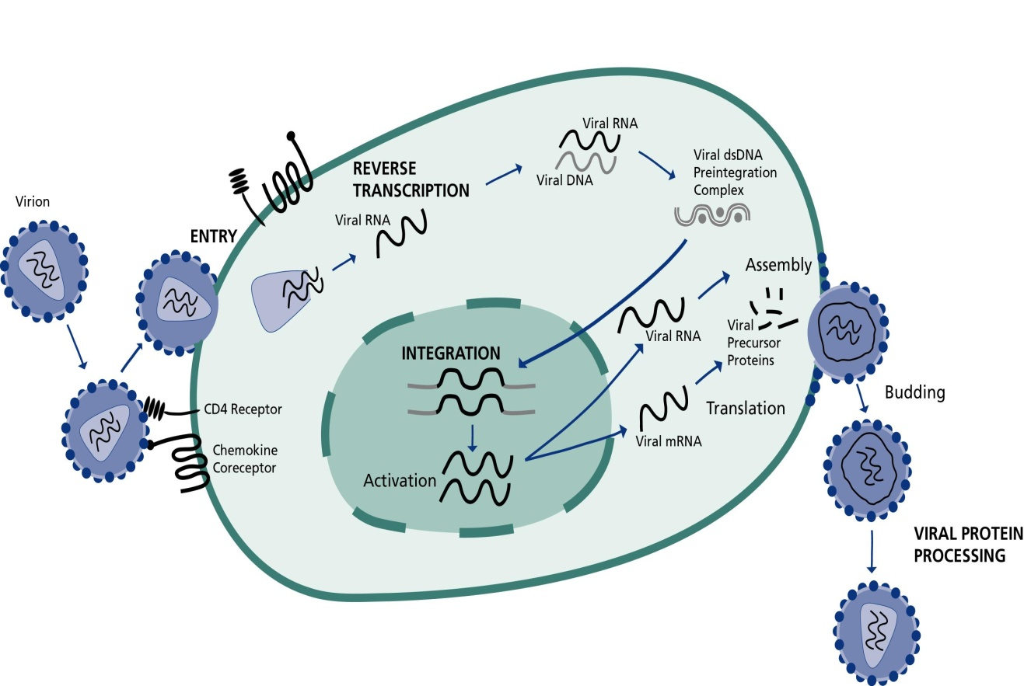
HIV LIFE CYCLE: Enzymes
Transcription:
  Activation of host cell results in transcription of viral DNA into mRNA.
  mRNA translated into viral precursor proteins
Assembly & Budding
Viral precursor proteins processed by protease enzyme into usable forms
  Proteins assembled with RNA to form viral particles which then bud
Reverse Transcription
  The viral enzyme reverse transcriptase converts the single stranded viral RNA into double strand DNA
Integration:
  The viral enzyme integrase inserts the viral DNA (viral genetic material) into the host DNA.
Notes:
Activation of the host cells results in the transcription of viral DNA into messenger RNA (mRNA), which is then translated into viral proteins. The new viral RNA forms the genetic material of the next generation of viruses. The viral RNA and viral proteins assemble at the cell membrane into a new virus. Amongst the viral proteins is HIV protease, which is required to process other HIV proteins into their functional forms. The viral RNA and viral proteins assemble at the cell membrane into a new virus. Following assembly at the cell surface, the virus then buds forth from the cell and is released to infect another cell. CD4 cells are destroyed in this process

Slide 13
How HIV affects the immune system
HIV attaches to cells of the immune system through special surface markers called CD4 receptors
The following immune cells have CD4 receptors
    T-Lymphocytes – CD4+ Cells
    Macrophages
    Monocytes
    Dendritic cells
HIV infection of CD4 cells causes cell dysfunction and death

Slide 14
The hallmark of HIV/AIDS is a profound immunodeficiency as a result depletion of CD4+ T lymphocytes.
The CD4+ T cell depletion is two fold
  Reduction in numbers
  Impairment in function
Reduction in the CD4 cell number and the effects on their function reduces the capacity of the body to fight infectious diseases

Slide 15
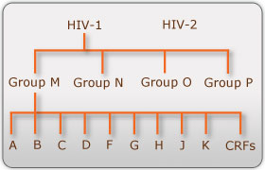
Phylogeny of HIV
Implications
  1. Virulence
    Subtype B >A?
  2. Transmission
    Differences in efficiency
  3. Diagnostic testing
  HIV RNA testing
    No FDA-approved test for HIV-2
  4. Treatment
    HIV-2 with natural resistance to NNRTIs
Notes:
Phylogeny: the development over time of a species, genus, or group, as contrasted with the development of an individual ontogeny

Slide 16
In addition to the classic AIDS virus (HIV-1), a group of related viruses, HIV-2, have been isolated in West African patients.
HIV-2 has the same genetic organization as HIV-1, but there are significant differences in the envelope glycoproteins.
Some infected individuals exhibit AIDS-like illnesses, but most West Africans infected with HIV-2 are asymptomatic
Notes:
HIV-2 is less easily transmitted, and the period between initial infection and illness is longer in the case of HIV-2.

Slide 17
People with HIV/AIDS are susceptible to other infections
    Due to lowered immunity
Other infectious conditions within such a population find a highly susceptible group of people.
    HIV infected people have rates of both TB and LRTI much higher than the HIV negative

Slide 18
HIV transmission
1. Sexual contact most important mode of transmission/acquisition of HIV worldwide
  In Africa mainly heterosexual (male female)
  Includes homosexual (men having sex with men (MSM)) as well
  Non-consensual sexual exposure (assault)
Notes:
The virus appears to concentrate in the seminal fluid, particularly in situations where there are increased numbers of lymphocytes and monocytes in the fluid, as in genital inflammatory states such as urethritis and epididymitis, conditions closely associated with other STDs (see below).
There is a strong association of HIV transmission with receptive anal intercourse, probably because only a thin, fragile rectal mucosal membrane separates the deposited semen from potentially susceptible cells in and beneath the mucosa and trauma may be associated with anal intercourse. It is likely that anal intercourse provides at least two modalities of infection: (1) direct inoculation into blood in cases of traumatic tears in the mucosa; and (2) infection of susceptible target cells, such as Langerhans cells, in the mucosal layer in the absence of trauma

Slide 19
2. Parenteral
  Transfusion of infected blood or blood products
  Exposure to infected blood or body fluids through contaminated sharps- injecting drug users (IDU) through needle-sharing or needle stick accidents
  Donated organs
  Traditional procedures
Notes:
The following fluids are also considered potentially infectious: cerebrospinal fluid, synovial fluid, pleural fluid, peritoneal fluid, pericardial fluid, and amniotic fluid.
Feces, nasal secretions, saliva, sputum, sweat, tears, urine, and vomitus are NOT considered potentially infectious unless they are visibly bloody.

Slide 20
3. From mother to child ( Vertical transmission)
  Transplacental, during labor/delivery and breastfeeding
  **HIV is not transmitted by casual contact, surface contact, or from insect bites**
Notes:
Maternal transmission to the fetus occurs most commonly in the perinatal period (During childbirth).

Slide 21
Percent infection by transmission route
TRANSMISSION ROUTE | PERCENT
Sexual intercourse | 70-80%
Mother to child transmission | 5-10%
Injecting drug use | 5-10%
Blood transfusion | 3-5%
Health care e.g. needle stick injury | <0.01

Slide 22
Biological factors influencing HIV transmission
1. Disease status of source patient
  Related to degree of immunosuppression and viral load
    High risk during primary infection and late disease when viral load high
    Also higher the lower the CD4 count, independently of viral load
2. Presence of untreated STIs in source and person at risk
  Both ulcerative and non ulcerative STIs important cofactors
    Related to high viral load in genital secretions during STIs and the disturbance of the genital mucosa

Slide 23
3. Circumcision status
    Uncircumcised men 2x as likely to acquire HIV infection than circumcised. Also more likely to acquire STIs
4. Gender differences in susceptibility
  Female genital anatomy presents a larger surface area with more of the cells with CD4 receptors that HIV requires to gain entry
  (Socio-cultural factors)
5. Host genetic differences
Notes:
Genital viral load in semen or female genital fluids can be increased to a level greater than that of blood plasma viral load by the inflammation caused by STDs.
In addition, nutritional deficiencies and hormonal influences in women can increase shedding of HIV in the genital tract.
Such transient elevations of genital or rectal shedding of HIV are considered periods of “hyper-infectiousness.
Increases in semen HIV load during acute HIV infection appear sufficient to account for an eight- to 20-fold increase in the odds of transmission per coital act.

Slide 24
Assignment
Why is male circumcision associated with a lower risk of HIV infection among men?
Why are oral contraceptives associated with an increase in incidence of HIV infection?
Why are women (more so younger girls) more vulnerable to be infected with HIV?
Notes:
A number of studies have indicated that male circumcision is associated with a lower risk of HIV infection among men. This difference may be due to increased susceptibility of uncircumcised men to ulcerative STDs, as well as other factors such as microtrauma to the foreskin and glans penis. In addition, the highly vascularized inner foreskin tissue contains a high density of Langerhans cells as well as increased numbers of CD4+ T cells, macrophages, and other cellular targets for HIV. Finally, the moist environment under the foreskin may promote the presence or persistence of microbial flora that, via inflammatory changes, may lead to even higher concentrations of target cells for HIV in the foreskin.
In some studies the use of oral contraceptives was associated with an increase in incidence of HIV infection over and above that which might be expected by not using a condom for birth control. This phenomenon may be due to drug-induced changes in the cervical mucosa, rendering it more vulnerable to penetration by the virus.
Adolescent girls might also be more susceptible to infection upon exposure due to the properties of an immature genital tract with increased cervical ectopy or exposed columnar epithelium.

Slide 25
Socio-economic factors facilitating HIV transmission
1. Social Mobility
  Global Economy
  HIV/AIDS follows routes of commerce
  Partners living apart
2. Stigma and Denial
  Denial and silence is the norm
  Stigma prevents acknowledgment of problem and care-seeking

Slide 26
3. People in Conflict
  Context of war and struggle of power spreads AIDS
4. Cultural Factors
  Traditions, beliefs, and practices affect understanding of health and disease and acceptance of conventional medical treatment
5. Gender
  In many cultures it is accepted for men to have many sexual relationships
  Women suffer gender inequalities
  Many women unable to negotiate condom use

Slide 27
6. Poverty
  Lack of information needed to understand and prevent HIV
7. Drug Use and Alcohol Consumption
  Impaired judgment
  Sharing of needles and equipment

Slide 28
Behavioral factors facilitating HIV transmission
  Multiple sexual partners
  Unprotected sexual intercourse
  Large age difference between sexual partners
Notes:
R

Slide 29
Natural history and progression of HIV

Slide 30
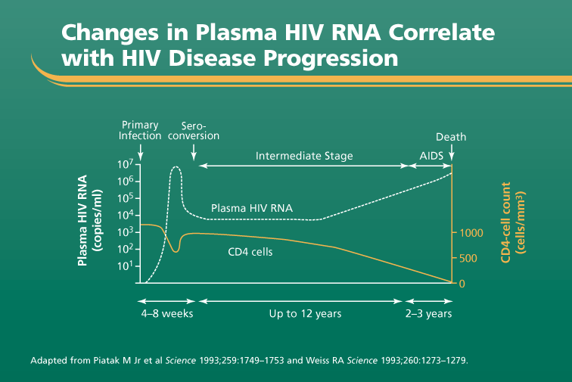

Slide 31
1. Primary HIV infection/Acute HIV syndrome
  On exposure, there is a 2-4 week period of INTENSE VIRAL REPLICATION and widespread dissemination of virus characterized by
    High plasma viral load (RNA)
    Rapid decline in CD4 count
    In some cases an acute illness occurs
      Lasts from 1-2 weeks, but it is rarely diagnosed
      Symptoms if present resemble those of other viral illnesses; requires high index of suspicion
    Symptom resolution with reduction in plasma viremia due to development of an immune response and antibodies to the virus

Slide 32
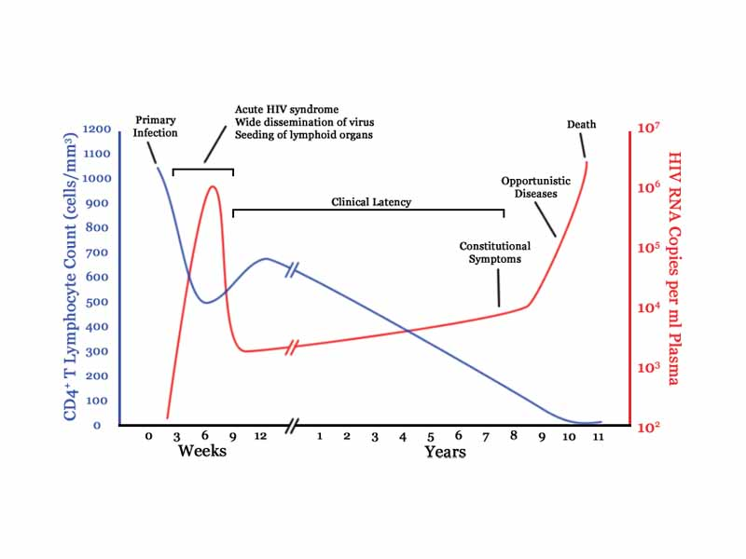
Time course of HIV infection
Acute HIV syndrome
  Up to 70% within 2 to 6 weeks
  Acute mononucleosis-like syndrome
  Non-descript clinical syndrome
    Fever
    Fatigue
    Myalgias
    Rash
    Lymphadenopathy
    Headache
    Sore-throat
Notes:
Up to 70% of patients with primary HIV infection develop an acute mononucleosis-like syndrome that usually occurs within 2 to 6 weeks following initial infections. Also known as acute retroviral syndrome (ARS), these signs and symptoms occur as a result of initial infection and dispersion of HIV, and consist of a typical, though, non-descript, clinical syndrome.

Slide 33
2. Asymptomatic/Latent HIV disease
Patients then enter a stage of asymptomatic disease phase lasting on average 2-10 years (clinical latency)
Characterized by GRADUAL decline in CD4 count
  Rate depends on viral load
Long term non-progressors
  Rare
  >>10-15 year survival without ART
  CD4>500; low viral load
  Host genetic/immunological or viral factors may be involved

Slide 34
Asymptomatic HIV disease
  Clinical latency vs. microbiologic latency
  Continuous viral replication
  Systemic immune activation

Slide 35
3. Symptomatic disease and AIDS
Viral load continues to rise causing
  Increased demands on immune system as production of CD4 cells cannot match destruction
  Increased susceptibility to common infections (URTI, pneumonia, skin etc)
  Late-stage disease is characterized by a CD4 count <200cells/mm³ and the development of opportunistic infections, selected tumors, wasting, and neurological complications).

Slide 36
Symptomatic HIV disease or AIDS
  Immunologic dysregulation
    Loss of cell-mediated Immunity
      Destruction of CD4⁺ helper T-lymphocytes
    Opportunistic infections
    Neoplasms
  Autoimmune phenomena
    HIV-Associated thrombocytopenia
    HIV-associated nephropathy

Slide 37
WHO CLINICAL STAGING OF HIV/AIDS
Primary HIV infection
Clinical Stage 1
  Asymptomatic
  Persistent generalized lymphadenopathy

Slide 38
Clinical Stage 2
  Unexplained moderate weight loss (<10%)
  Recurrent upper respiratory tract infections
  Herpes Zoster
  Angular cheilitis
  Recurrent oral ulceration
  Papular pruritic eruptions (PPE)
  Seborrhoeic dermatitis
  Fungal nail infection
Notes:
CHEILITIS: lips

Slide 39
Clinical stage 3
Unexplained severe weight loss (>10%)
Unexplained chronic diarrhea >1 month
Unexplained persistent fever (intermittent or constant for longer than one month)
Persistent oral candidiasis
Oral hairy leukoplakia
Pulmonary tuberculosis
Severe bacterial infections
Acute necrotizing ulcerative stomatitis, gingavitis or periodontitis
Unexplained anemia(<8 g/dl), neutropenia, and/or chronic thrombocytopenia
Notes:
Hairy leukoplakia (also known as oral hairy leukoplakia OHL, or HIV-associated hairy leukoplakia),is a white patch on the side of the tongue with a corrugated or hairy appearance. It is caused by Epstein-Barr virus (EBV) and occurs usually in persons who are immunocompromised, especially those with (HIV/AIDS). This white lesion CANNOT be scraped off. The lesion itself is benign and does not require any treatment, although its appearance may have diagnostic and prognostic implications for the underlying condition.

Slide 40
Clinical stage 4
Extrapulmonary tuberculosis
Kaposi sarcoma
Cytomegalovirus infection (retinitis or infection of other organs)
Central nervous system toxoplasmosis
HIV encephalopathy
Cryptococcosis, extrapulmonary (including meningitis)
Progressive multifocal leukoencephalopathy (PML)
HIV wasting syndrome
Pneumocystis pneumonia
Recurrent severe bacterial pneumonia
Chronic herpes simplex infection (orolabial, genital, or anorectal site for >1 month or visceral herpes at any site)
Esophageal candidiasis
Candida of the trachea, bronchi, or lungs

Slide 41
Clinical stage 4 cont……
Lymphoma (cerebral or B-cell non-Hodgkin)
Invasive cervical carcinoma
Atypical disseminated leishmaniasis
Symptomatic HIV-associated nephropathy
Symptomatic HIV-associated cardiomyopathy
Reactivation of American trypanosomiasis (meningoencephalitis or myocarditis)
Disseminated nontuberculosis Mycobacteria infection
Chronic cryptosporidiosis (with diarrhea)
Chronic isosporiasis
Disseminated mycosis (eg, histoplasmosis, coccidioidomycosis, penicilliosis)
Recurrent nontyphoidal Salmonella bacteremia

Slide 42
DIAGNOSIS
1. HIV serologic tests as noted below
There is a "window" of 6 months between primary infection and seroconversion, during which tests may be negative
1a. ELISA immunoassay
    Detects IgG antibody against HIV
    Sensitivity and specificity are approximately 99%
    Can be negative during the window period

Slide 43
1b. Western blot
    Detects IgG antibody against HIV proteins p24, gp120, gp 41
    More specific than ELISA
    Used to confirm a positive ELISA
1c. The p24 antigen assay
1d. Polymerase Chain Reaction (PCR) and viral cultures for HIV
      **Able to detect HIV during the window period**

Slide 44
2. baseline and monitoring laboratory parameters
      **Baseline parameters taken then repeated every 3-6/12 or when need be (e.g suspected ADR, treatment failure)**
Viral load (copies/ml)
CD4 count (Cells/mm³)
Liver function tests (ALT, AST, ALP…..)
Renal function tests (Creatinine, Urea, …)
Full haemogram (Hb, WBC, Platelets…)
Lipid profiles (LDL,HDL, Total Cholesterol..)

Slide 45
Respiratory symptoms
  Chest x-ray,
  ABG, and induced sputum for Gram stain,
  acid-fast bacillus (AFB)
  culture
Neurologic symptoms
  Head CT and lumbar puncture
  CSF for glucose, protein, Gram stain and culture, cell count with differential, AFB smear, India ink stain, cryptococcus titer, and VDRL

Slide 46
Gastrointestinal symptoms
  Stool for ova and parasites, Gram stain, culture, and Clostridium difficile assay
Fever workup
  Include aerobic/anaerobic,
  fungal, AFB, and MAC blood cultures
PCP pneumonia
  Pneumocystis identified on silver stain
Cryptococcal meningitis
  Positive CSF India ink
  Cryptococcal antigen assay
      -More sensitive than India ink test

Slide 47
ANTI-RETROVIRALS (ARVs)
ARV drugs work at different stages of the HIV replication cycle
They interfere with the essential steps in the cycle thus preventing the development of new infectious HIV particles
As a result further destruction of CD4 cells is prevented

Slide 48
TARGETS OF ARV DRUGS
gp41
gp120
Viral
assembly
CD4 Cell
Translation
HOST CELL
Protein
NRTI’s & NNRTI’s/ NtRTIs (e.g. AZT)2
RNA s
cleavage
e
Budding
Reverse
Protease
transcription
Transcription
Protease inhibitors (e.g. Kaletra) 3
Injection
of
contents
Entry/Fusion inhibitors work here 1
RNA
DNA
Provirus
Integrase
(circular
Maturation
structure)
Integration of provirus
DNA into host DNA
HIV Particle
Binding
HIV particle
sites
Completed
Cell
HIV particle
membrane
Notes:
Fusion inhibitor already in use, T20 (Enfuvirtide), effective. Currently used mainly in salvage therapy; needs to be given SC
Other entry inhibitors in development include the chemokine co-receptor inhibitors, CD4 receptors and other fusion inhibitors
NRTI drugs prevent viral DNA production by incorporating themselves into the newly forming DNA.
NNRTI drugs attach themselves to the viral enzyme reverse transcriptase, blocking its mechanism and making it unable to produce viral DNA

Slide 49
ARV classification
  NRTIs (nucleoside/nucleotide reverse transcriptase inihibitors)
  NNRTIs (non-nucleoside reverse transcriptase inhibitors)
  PIs (protease inhibitors)
  Fusion inhibitors (enfuvirtide)
  Integrase inhibitors (raltegravir)
  CCR5 Antagonists (maraviroc)

Slide 50
Combination therapy is a must!!!...
Rationale
    Prevent resistance
    Better virologic suppression
Bottom line (a must)
    At least 2 different classes
    At least 2 agents that the virus is susceptible to
When possible, shoot for
    3 agents that the virus is susceptible to
    2 NRTIs in the regimen
Usual regimen
    2 NRTIs + 1 other agent from a different class

Slide 51
Antiretroviral Drugs: Best Practice
Minimum combination of three drugs from at least 2 different classes drugs
  2 NRTIs + NNRTI
  2 NRTIs + 2 PIs* (ritonavir boosted PI)
  2 NRTIs + PI
Never use mono- or dual- therapy
  Do not adequately suppress viral replication
  Allow resistance to develop rapidly
    may adversely affect use of class of drugs involved
Notes:
*e.g pregnant mother in the first trimeatre with TB who requires both anti-TB and ARV treatment to be commenced. Less potent than standard dual class regimens
ABC+3TC+AZT (Trizivir^{TM)}
Higher failure rates in patients with VL>10⁵, those with prior NRTI use
Utility mainly in some cases of treatment simplification/ cases of drug interactions*/ switch for metabolic side effects
New studies suggest that this is an area that needs further investigation
DART trial CROI 2005 Boston- AZT+TDF+3TC achieved reasonable results in large cohort in Uganda and Zimbabwe. No comparator arm

Slide 52
Triple nucleoside therapy
  Best avoided as several triple nucleoside regimens have been shown to be inferior to standard 2-class regimens

Slide 53
Reverse Transcriptase Inhibitors (RTIs)
Nucleoside RTIs
    Lamivudine (3TC)
    Stavudine (d4T)
    Zidovudine (AZT)
    Didanosine (ddI)
    Abacavir (ABC)
    Emtricitabine (FTC)
    Zalcitabine (ddC)
Nucleotide RTI
    Tenofovir disoproxil fumerate (TDF)
Non-nucleoside RTIs
    Efavirenz (EFV)
    Nevirapine (NVP)
    Rilpivirine
    Etravirine
Notes:
Emtricitabine is a nucleoside reverse transcriptase inhibitor that is similar to 3TC. It suffers the same liability as does 3TC in terms of resistance – one mutation (M184V) in the RT gene results in high level drug resistance. These drugs can not therefore be used sequentially or together. A FDC tablet of FTC and TDF has been developed.
Tenofovir disoproxil fumerate is a nucleotide analog reverse transcriptase inhibitor (NtRTIs). NtRTIs are active in their native form and thus may be active against HIV in a wide variety of infected cells. By contrast, the NRTIs only work in cells that have the machinery to activate the drug by a process called phosphorylation. Renal toxicity has been reported, there renal assessment required prior to treatment initiation. TDF should be avoided in people with renal impairment. On current evidence TDF should only be used in combination with drugs from other ARV classes and not with 2 other NRTIs as a triple nucleoside combination. New research suggests that triple nucleoside combinations should be researched further

Slide 54
Tenofovir disoproxil fumerate is a nucleotide analog reverse transcriptase inhibitor (NtRTIs).
NtRTIs are active in their native form and thus may be active against HIV in a wide variety of infected cells.
By contrast, the NRTIs only work in cells that have the machinery to activate the drug by a process called phosphorylation.

Slide 55
Protease Inhibitors
Lopinavir/ritonavir (LPV/r/KaletraTM)
Atazanavir (ATV)
Nelfinavir (NFV)
Ritonavir (RTV)
Indinavir (IDV)
Saquinavir (SQV)
Amprenavir (APV)
Fosamprenavir (FPV)

Slide 56
A. Nucleoside/nucleotide reverse transcriptase inhibitors (NRTIs)
Tenofovir (TDF)- (only nucleotide reverse transcriptase inhibitor)
Emtricitabine (FTC)
Abacavir (ABC)
Lamivudine (3TC)
Zidovudine (ZDV, AZT)
Didanosine (ddI)
Stavudine (d4T)
Notes:
Tenofovir disoproxil fumerate is a nucleotide analog reverse transcriptase inhibitor (NtRTIs).
NtRTIs are active in their native form and thus may be active against HIV in a wide variety of infected cells.
By contrast, the NRTIs only work in cells that have the machinery to activate the drug by a process called phosphorylation.
Renal toxicity has been reported, there renal assessment required prior to treatment initiation.
TDF should be avoided in people with renal impairment.

Slide 57
Mechanism of action of NRTIs
Nucleoside analogues act as alternative substrates for the viral DNA polymerases (Reverse Transcriptase (RT) enzyme).
Because NRTIs lack a hydroxyl group in the 3′-position (required for the addition of the next nucleotide onto the primer) their incorporation causes termination of the growing HIV DNA strand.
Their intended therapeutic action is to prevent the formation of HIV DNA by inhibiting HIV reverse transcriptase.
Notes:
However, NRTIs have the potential to cause serious cellular toxicities by interacting in a similar manner with human DNA polymerases.
The enzymes responsible for the replication of human nuclear DNA are polymerase α and δ. Polymerase β and ε play roles in DNA repair, and polymerase γ is responsible for replication of mitochondrial DNA (mtDNA). The NRTIs currently used in the treatment of HIV infection (zidovudine, stavudine, lamivudine, didanosine, zalcitabine and abacavir) all inhibit DNA polymerases β and γ. The inhibition of polymerase β has not been shown to be of clinical significance, but it is widely believed that many side effects of NRTIs stem from their effect on polymerase γ and the likely resulting mitochondrial dysfunction.
They bind much more avidly to the active site of the RNA-dependent DNA polymerase of HIV (reverse transcriptase) than to the active site of mammalian cell DNA polymerases.
Zidovudine also has a relatively high avidity for the DNA polymerase- of human mitochondria. This may contribute to the development of the fatty liver and the myopathy sometimes observed in patients taking zidovudine.

Slide 58
Adverse effects: mitochondrial toxicity (THIS IS A CLASS EFFECT)
  Mainly with didanosine, stavudine, zidovudine
  (THE 3 “Ds”; DDI, D4T AND ZDV)
    Lactic acidosis with hepatic steatosis
    Pancreatitis and peripheral neuropathy (mostly didanosine and stavudine)
    Lipoatrophy (peripheral fat wasting)
          stavudine>didanosine>zidovudine
    Neuromuscular weakness (mostly stavudine)
  Rarely seen with tenofovir, emtricitabine, abacavir, lamivudine (TEAL)
Notes:
Hepatic steatosis: non-alcoholic fatty liver disease

Slide 59
Renal adjustment (for all except abacavir)
No dosage adjustment in hepatic impairment (except for abacavir)
Genetic barrier to resistance
  1. Low with lamivudine and emtricitabine (m184v mutations leading to resistance) however we still retain these drugs in the ARV regimen since they make the virus weaker (less virulent) so its more susceptible to the action of other ARVs
  2. Moderate with the other NRTIs

Slide 60
1. Emtricitabine (FTC) 200mg OD or Lamivudine (3TC) 150mg BD;
  SIMILAR DRUGS
  Minimal toxicity
  Hyperpigmentation/skin discoloration
  Nausea: emtricitabine only
Place in therapy: Preferred NRTI
  Almost always 1 of 2 NRTIs in an HIV regimen
  Choice of either depends on co-formulations

Slide 61
Important details of 3TC and FTC
  Similar drugs (don’t give together)
  Both with activity against Hepatitis B Virus (HBV) therefore preferred in a HIV-HBV co-infected patient
  m184v mutations leading to resistance to these two drugs

Slide 62
2. Tenofovir (TDF) 300mg OD
  Adverse effects (*****“Ten kids fell and broke their bones”****)
  Asthenia, headache, nausea, vomiting, diarrhea, flatulence
  Nephrotoxicity
    Avoid in patients with underlying renal insufficiency
  Potential for osteopenia
Notes:
Asthenia: loss of strength, weakness
Osteopenia: reduced bone mass of lesser severity than osteoporosis.

Slide 63
Place in therapy of TDF
  Preferred NtRTI in combination with lamivudine
    Less toxicity
    Better Efficacy
Important Details
  Active against Hepatitis B virus (HBV) therefore preferred in a HIV-HBV co-infected patient

Slide 64
3. Abacavir (ABC) 300mg BD
  Adverse effect: abacavir hypersensitivity
        Fever
        Skin rash
        Constitutional symptoms (malaise, fatigues, aches)
        Respiratory symptoms (pharyngitis, dyspnea, cough)
        GI symptoms (abdominal pain, diarrhea, nausea, vomiting)
  Do not use in patients who test positive for HLA-B*5701
Hypersensitivity reactions greatest risk during first 6 weeks
5-8% of white vs. 2-3% black patients
Notes:
HLA: Human Leucocytic Antigen

Slide 65
Place in therapy of ABC: Second preferred NRTI in patients who can’t take tenofovir
Toxicity: potential for increased risk of myocardial infarctions (contraindicated in coronary artery disease)
Efficacy: inferior to TDF

Slide 66
4. Zidovudine (AZT) 300mg BD
Pro-drug that has to be phosphorylated into its active form
Adverse effects
      Mitochondrial toxicity (Lipoatrophy, Lactic acidosis with hepatic steatosis)
      Bone marrow suppression (especially MACROCYTIC anemia)
      Hyperlipidemia
      Gastrointestinal intolerance
      Headache, insomnia, asthenia

Slide 67
Place in therapy of ZDV: 3rd preferred NRTI in patients who can’t take tenofovir or abacavir
Important details
  Avoid co-administration with ribavirin
    Inhibits phosphorylation of zidovudine into its active form (since the parent compound is in a pro-drug form)
    Zidovudine enhances ribavirin-related anemia

Slide 68
Didanosine and stavudine are hardly ever used due to their mitochondrial toxicity/mitochondrial dysfunction
Stavudine is notorious for its disfiguring lipoatrophy and lipodystrophy

Slide 69
B. Non-nucleoside reverse transcriptase inhibitors (NNRTIs)
First generation
  Efavirenz (EFV)
  Nevirapine (NVP)
Second generation
  Etravirine
  Rilpivirine

Slide 70
Mechanism of action of NNRTIs
NNRTIs bind onto RT enzyme and denatures it such that now the RT cannot produce viral DNA from viral rNA.

Slide 71
Adverse effects (which are a class effect)
  Increased transaminases (NVP>EFV/ETR/RPV)
    Symptomatic hepatotoxicity with nevirapine
  Rash (NVP/ETR>EFV/RPV)
    Including Stevens-Johnson Syndrome
Use caution in hepatic impairment; usually contraindicated with severe hepatic impairment
Drug interactions
  CYP 3A4 substrates, inhibitors, and inducers

Slide 72
NNRTI Resistance
Cross resistance between efavirenz and nevirapine
Cross resistance between etravirine and rilpivirine
If resistant to 1st-generation, can go to 2nd-generation
If resistant to 2nd-generation, RESISTANCE TO ALL NNRTIs
1St-Generation
Nevirapine
Efavirenz
2nd-Generation
Etravirine
Rilpivirine

Slide 73
Genetic barrier to resistance is
  Low for Efavirenz and nevirapine (K103N mutations are seen during resistance development)
  Moderate for etravirine and rilpivirine

Slide 74
Efavirenz (EFV) 600mg nocte
Adverse effects
      CNS symptoms (hence why its given at night)
        Use caution in patients with unstable psychiatric disease
          Most clinicians tend to avoid use
      Hyperlipidemia
      Elevated transaminases
      Rash
      Teratogenicity especially in the 1st trimester (pregnancy category D)

Slide 75
Place in therapy of EFV: Preferred NNRTI (favored)
  Less toxic compared to nevirapine
  Take on an empty stomach (fatty foods increase the absorption of EFV thus increasing the CNS side effects of EFV e.g. nightmares, altered behavior e.t.c)

Slide 76
2. Nevirapine (NVP)
Dose: 200 mg once daily for 14 days, then 200 mg twice daily so as to decrease the incidence of;
      Rash
      Autoinduction of NVP by CYP 3A4 (NVP induces its own metabolism especially at higher doses)

Slide 77
Adverse effects
  Rash (more common among NNRTIs)
  Elevated transaminases (most common among NNRTIs)
  Symptomatic (immune-mediated) hepatitis, including fatal hepatic necrosis
        Generally within first few weeks of treatment
        Avoid in women with CD4 >250 cells/mm³ (12-fold higher risk)
        Avoid in men with CD4>400 cells/mm³ (5-fold higher risk)

Slide 78
3. Etravirine (ETR)
Second generation NNRTI
Adverse effects (generally well tolerated)
  Rash (more common among NNRTIs)
  Elevated transaminases
Place in therapy: alternative therapy
  Patients with intolerable SEs from efavirenz
  Patients with resistance to efavirenz or nevirapine (K103N mutations)

Slide 79
  Do NOT give etravirine with ONLY 2 NRTIs
    Combined with darunavir/ritonavir in Phase III clinical trials in treatment-experienced patients
    Bad regimen: tenofovir/emtricitabine + etravirine
    Good regimen: tenofovir/emtricitabine + etravirine + raltegravir
Notes:
Raltegravir-integrase inhibitor

Slide 80
4. Rilpivirine
Adverse Effects
  Rare (<5%): rash, headache, insomnia, depressive disorders
  Elevated transaminases
Place in therapy: alternative therapy
  Patients with intolerable SEs from efavirenz
  Patients with resistance to efavirenz or nevirapine
Absorption depends on food and low gastric pH (like atazanavir, oral iron)
  Avoid PPIs, H2 Blockers, and antacids

Slide 81
Rilpo the Rat
Rilpivirine
Acid for absorption
Tolerable

Slide 82
C. Protease inhibitors (PIs)
Ritonavir
Atazanavir +/- ritonavir
Darunavir/ritonavir
Lopinavir/ritonavir
Fosamprenavir +/- ritonavir
Saquinavir/ritonavir
Tipranavir/ritonavir
Nelfinavir
Indinavir+/-ritonavir

Slide 83
Mechanism of action of protease inhibitors
Protease inhibitors act on the HIV protease enzyme thus competitively inhibit protease-mediated proteolytic cleavage of the HIV polypeptide precursors into
    mature enzymes and
    structural proteins
This prevents the conversion of HIV particles into their mature infectious form
Notes:
To make the virus infectious it is essential that new viral proteins are cut and structured correctly. Protease inhibitors work by blocking the site where the cutting takes place, preventing the new virus from maturing and infecting any other cells.

Slide 84
Adverse effects (Class effect)
  Metabolic syndrome (Lipodystrophy, Hyperlipidemia, Insulin resistance)
  Increased transaminases (liver derangement)
  Gastrointestinal intolerance

Slide 85
Drug interactions
  CYP 3A4 substrates and inhibitors
Levels almost always “boosted” with ritonavir
Use with caution in hepatic impairment; generally NOT recommended in severe hepatic impairment
PI cross resistance occurs
Higher pill burden and food restrictions with PIs

Slide 86
Boosted protease inhibitors
Definition: A small, NON-THERAPEUTIC dose of ritonavir is combined with a THERAPEUTIC dose of another PI in order to ‘boost’/increase the levels of the second (therapeutic) PI drug.
  Ritonavir (RTV) is a potent inhibitor of the cytochrome P450 3A4 isoenzyme

Slide 87
  Ritonavir acts as a “pharmacokinetic booster” to increase drug exposure and prolong serum half-lives of the active (therapeutic) PIs
  E.G. lopinavir with ritonavir (kaletra)

Slide 88
Single PI-based regimens/non-boosted PIs are less effective at high viral loads
  Require frequent dosing (unforgiving pharmacokinetics)
  If doses delayed or missed and effective drug levels are not maintained, resistance may develop
PIs are metabolized through the cytochrome P450 3A4 isoenzyme in the liver
Notes:
The drawbacks associated with this strategy are the potential for increased risk of hyperlipidemia and a greater potential of drug-drug interactions from the addition of ritonavir.

Slide 89
Ritonavir-boosting of selected PIs results in
    Better pharmacokinetic profile
          Higher drug concentration (both peak and trough) of the second therapeutic PI
          Less frequent dosing
          More tolerable regimens, reduced food restrictions
          Greater efficacy than single PI based regimens

Slide 90
1. Lopinavir/ritonavir (LPV/RTV) 400/100mg 2tabs BD (Alluvia®)
Adverse effects
    All class effects, but…
    Especially high triglycerides
    Asthenia
    PR and QT interval prolongation (remember ABC and increased risk of myocardial infarction)
    Take with food for oral solutions (like rilpivirine, atazanavir)

Slide 91
Place in therapy of LPV/RTV
    “Gold standard” PI for a long time, but no longer preferred because of;
        Ritonavir boosting dose (increased incidence of GIT side effects)
        Inferior to other PIs (atazanavir, darunavir)
    Preferred PI in pregnant patients and in treatment naïve pts

Slide 92
2. Atazanavir +/- ritonavir (ATV) 400/100mg OD
Adverse effects
  All class adverse effects, but…
    Less hyperlipidemia compared to lopinavir/ritonavir
    Less GI intolerance compared to lopinavir/ritonavir
  Indirect hyperbilirubinemia (4 to 9%) so can lead to jaundice and scleral icterus
  Nephrolithiasis (kidney stones) so advice the patient to drink plenty of water
  PR interval prolongation

Slide 93
Place in therapy: preferred PI
  Superior to lopinavir/ritonavir at 96 weeks
  Less adverse effects
  Absorption depends on food and low gastric pH (like rilpivirine)
    Avoid PPIs, H2 Blockers, and antacids (like rilpivirine NNRTI)
Notes:
Rilpivirine: NNRTI

Slide 94
With Atazanavir +/- ritonavir remember….
At a party, Bili was either stoned or on acid

Slide 95
Newer ARVs
Integrase inhibitors
  Raltegravir
CCR5 antagonists
  Maraviroc
Fusion inhibitors
  Enfuvirtide

Slide 96
D. Integrase inhibitors e.g. Raltegravir (RAL)
M.O.A: Inhibit the integration of viral DNA into host DNA
Adverse effects
  Overall, well-tolerated
  Creatinine phosphokinase (CPK) elevation

Slide 97
Place in therapy: preferred
  Well-tolerated
  Minimal drug interactions
Important details
  Low genetic barrier to resistance
  Minimal drug interactions, except with rifampin which is an enzyme inducer (increase the raltegravir dose if used together with rifampicin)

Slide 98

With Raltegravir remember….
Everybody loves Ralph because he plays well with others, but is not good at resisting bullies
  Well-tolerated
  Minimal drug interactions (except rifampicin)
  Low genetic barrier to resistance

Slide 99
E. CCR5 ANTagonists e.g Maraviroc (MVC)
Mode of action: antagonize CCR5 co-receptor and are thus viral entry inhibitors
Adverse effects (overall, well-tolerated)
Place in therapy: patients with resistance or tolerability issues
  Well-tolerated
Notes:
MARA AT THE TROPIC
People who do NOT express functional CCR5 receptors on their cells due to a naturally occurring genetic mutation known as CCR5-delta 32 are less likely to become infected with HIV.
Moreover, those with naturally reduced CCR5 expression experience a slower HIV disease progression.

Slide 100
Important details
  Only effective in patients with CCR5-tropic virus
  Test for co-receptor tropism before starting (Tropism test expensive)
Notes:
Tropism: the turning of all or part of an organism in a particular direction in response to an external stimulus
Drug interactions
CYP3A and P-glycoprotein substrate
Neither inducer nor inhibitor of CYP450

Slide 101
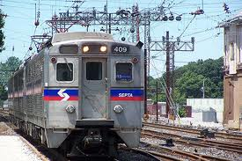

With Maraviroc (MVC) remember….
Mara takes the R5 train to get to work

Slide 102
F. Fusion inhibitors e.g. Enfuvirtide (T20)
MOA: these bind to gp41 and prevents the conformational change that enables viral-host cell membrane fusion
Adverse effects
  Local injection site reactions (almost 100%)
    Pain
    Erythema
    Induration
    Nodules and cysts
    Pruritus
    Ecchymosis
  Bacterial pneumonia
  Hypersensitivity reaction (remember like ABC HLA-B* 5701 allele)

Slide 103
Place in therapy: resistant patients
Disadvantages
    Adverse reactions
    Twice daily injections

Slide 104
When to start ART
WHO Guidelines
  Strong Recommendation
    HIV and WHO clinical stage 3 or 4 irrespective of CD4 count (check CD4 count if stage 1 or 2)
    CD4 count ≤500 cells/mm³
    HBV co-infection (when HBV treatment indicated)
    Active tuberculosis irrespective of CD4 count

Slide 105
ART therapy for treatment-naïve patients
 | WHO Guidelines (First-line)
NNRTI-based | TDF + (3TC or FTC) + EFV TDF + (3TC or FTC) + NVP AZT + 3TC + EFV AZT + 3TC + NVP

Slide 106
Most of the first line ARV regimens come as fixed dose combinations (FDC). Advantages of FDCs include;
Decreased pill burden
Increased adherence
Mono or dual therapy not possible (can’t split drug)
Lower cost
Simplify stock control and forecasting

Slide 107
Second-line ART
Should consist of a ritonavir-boosted protease inhibitor (PI) plus two NRTIs, one of which should be AZT or TDF,
      based on what was used in first-line therapy (i.e if TDF was used for 1st line then don’t use as 2nd line).
Ritonavir-boosted atazanavir (ATV/r) or lopinavir/ritonavir (LPV/r) are the preferred PIs.

Slide 108
Second-line ART (WHO)
 | WHO guidelines for second-line ART
PI-based | 2 NRTIs plus boosted-PI ATV/RTV and LPV/RTV preferred boosted PIs If d4T or AZT has been used in first-line, use TDF + (3TC or FTC) as NRTI backbone in second-line If TDF used in first-line, use AZT + 3TC as the NRTI backbone in second-line
(AZT or d4T) + (3TC or FTC) +
(EFV or NVP)
TDF + (3TF or FTC) + (ATV/RTV or LPV/RTV)
TDF + (3TC or FTC) +
(EFV or NVP)
AZT + (3TC or FTC) + (ATV/RTV or LPV/RTV)

Slide 109
When to switch to 2nd line ARVs
WHO Guidelines
New WHO Stage 4 condition
Immunologic criteria
    Fall of over 50% in the CD4+ T cell count from the peak value or
    Return of the CD4+ T cell count to or below the baseline (pre-HAART) CD4+ T cell count
    Persistent CD4 <100 cells/mm3
    3. Virologic Failure
    HIV RNA >5000 copies/mL after 48 weeks

Slide 110
Third-line ART
Patients on a failing second-line regimen with no new ARV options should continue with a tolerated regimen
Possible third-line agents
  Integrase inhibitors (raltegravir)
  Second-generation NNRTIs
    Etravirine
    Rilpivirine
  Protease Inhibitors
    Darunavir/ritonavir

Slide 111
What NOT to use together..!!!!!!!..
(3TC + ABC + TDF) or (3TC + ddI +TDF)
        High rates of failure
TDF + ddI + NNRTI (high rate of failure)
Stavudine and zidovudine (antagonism)
Atazanavir + indinavir (overlapping toxicities)
Didanosine + stavudine (overlapping toxicities)
2-NNRTI combination
Emtricitabine and lamivudine
Nevirapine in women with CD4 >250 or men with CD4>400
Zidovudine and ribavirin (enhanced anemia of ribavirin and inhibition of AZT phosphorylation)

Slide 112
WHO guidelines: ART for women who need treatment for their own health
ART regimens for eligible pregnant women
Preferred | AZT + 3TC + EFV* AZT + 3TC + NVP
Alternative | TDF + (3TC or FTC) + EFV* TDF + (3TC or FTC) + NVP
*Do not give in first trimester of pregnancy
Notes:
TDF is pregnancy category B, its contraindicated in lactation due to it passing via breastmilk and it’s risk of bone toxicity (osteopenia)

Slide 113
Infants born to moms receiving ART for their own health
Breastfeeding or non-breastfeeding infant
Daily AZT or NVP for 4-6 weeks

Slide 114
Three Main Reasons for Altering a Patient’s ARV Drug Regimen:
1. Drug Toxicity or Intolerance
  Single drug substitutions appropriate
2. Drug Interactions
  Single drug substitutions appropriate
3. Treatment Failure
  Entire regimen must be changed

Slide 115
Other reasons for altering a patient’s regimen
Pregnancy
Interruption of drug supply

