Slide 1
HIV / AIDS
Samuel Ngigi K.

Slide 2
What is HIV?
Human: Infecting human beings
Immunodeficiency: Decrease or weakness in the body’s ability to fight off infections and illnesses
Virus: A pathogen having the ability to replicate only inside a living cell
Notes:
HIV stands for Human Immunodeficiency Virus. It is the virus that causes AIDS.

Slide 3
Types of HIV Virus
HIV 1
  Most common in sub-Saharan Africa and throughout the world
  Groups M, N, and O
  Pandemic dominated by Group M
    Group M comprised of subtypes A - J
HIV 2
  Most often found in West Central Africa, parts of Europe and India
Notes:
Both produce the same patterns of illness. HIV2 causes a more slow progress of disease than those with HIV 1
It is important for tests to detect the HIV subtypes that are circulating in the region. Otherwise, testing may lead to false negative results.

Slide 4

What is AIDS?
Acquired: To come into possession of something new
Immune Deficiency: Decrease or weakness in the body’s ability to fight off infections and illnesses
Syndrome: A group of signs and symptoms that occur together and characterize a particular abnormality
AIDS is the final stage of the disease caused by infection with a type of virus called HIV.
Notes:
HIV infection leads to a weakened immune system. This makes a person with HIV vulnerable to a group of illness, e.g., opportunistic infections, that would not as easily affect a healthy person
AIDS results when HIV infection progresses to an advanced stage, damaging the immune system to a point at which the body can no longer fight illness.
AIDS is a syndrome because it is characterized by a group of illnesses
Drugs are available which can treat HIV and AIDS.
These drugs are called antiretrovirals (ARVs). They prevent the virus from replicating and slow the progress of the disease, but there is still no cure for AIDS or vaccine to prevent HIV transmission.

Slide 5
HIV vs. AIDS
HIV is the virus that causes AIDS
Not everyone who is infected with HIV has AIDS
Everyone with AIDS is infected with HIV
AIDS is result of the progression of HIV Infection
Anyone infected with HIV, although healthy, can still transmit the virus to another person

Slide 6
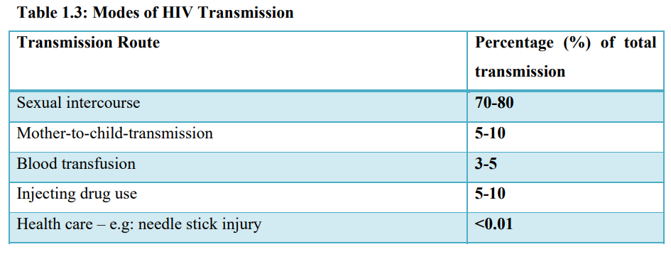
How is HIV Transmitted?

Slide 7
Epidemiology
Global situation and trends:
Since the beginning of the epidemic, 76 million people have been infected with the HIV virus and about 33 million people have died of HIV/AIDS.
Globally, 38.0 million people were living with HIV at the end of 2019.
An estimated 0.7% of adults aged 15–49 years worldwide are living with HIV, although the burden of the epidemic continues to vary considerably between countries and regions.
The WHO African region remains most severely affected, with nearly 1 in every 25 adults (3.7%) living with HIV and accounting for more than two-thirds of the people living with HIV worldwide.

Slide 8
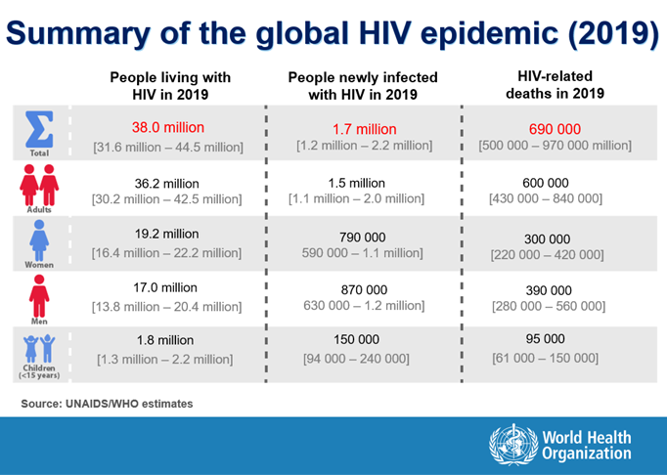

Slide 9
Kenya HIV Epidemiology
In Kenya the first diagnosis of HIV and AIDS was made in 1984.
The disease prevalence peaked to around 10% in the late 1990s.
As of 2012, the HIV prevalence among adults aged 15-64 years was 5.6% which translates to 1,192,000 people estimated to be living with HIV and AIDS in Kenya.
The HIV prevalence among children aged 18 months to 14 years was 0.9% which corresponds to an estimated 104,000 children infected with HIV nationwide.

Slide 10
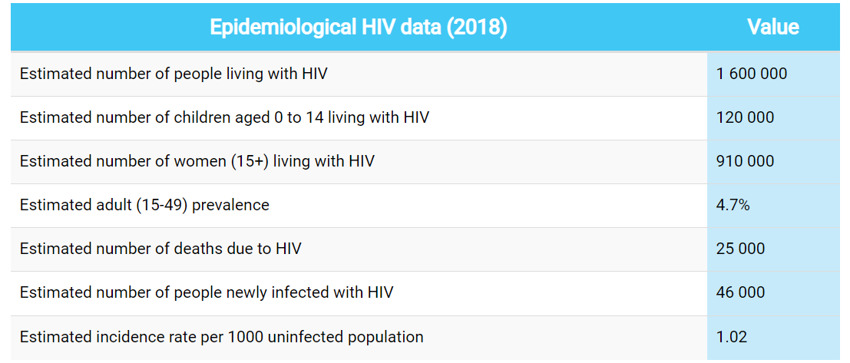
Kenya HIV Epidemiology

Slide 11
Provincial Variation
Even within Kenya, different regions have a different picture of the disease.
Among adults aged 15-64 years, the prevalence ranges from the highest at 15.1% in Nyanza to the lowest at 2.1% in Eastern North (2012 statistics).
Prevalence is higher in the urban areas than in the rural areas.
A higher proportion of women aged 15-64 (6.9 percent) than men (4.4 percent) are infected with HIV.

Slide 12
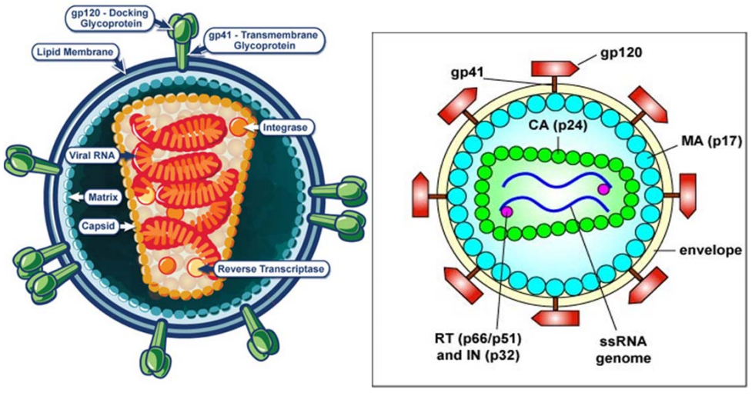
Structure of HIV Virus

Slide 13
Structure of HIV Virus
The virus has an outer double lipid membrane that is derived from the host membrane.
This lipid membrane is lined by protein matrix.
This is further studded with spikes known as the surface glycoprotein (gp) 120 which is anchored to the lipid membrane by the trans-membrane gp 41.
These glycoprotein spikes surround the cone-shaped protein core.
The gp120 and gp41 mediate the entry of virus into the host cells.

Slide 14
Structure of HIV Virus Cnt’d…
The core (capsid) is made up of the protein P24 that encapsulates two identical single strands of RNA - SSRNA (the viral genetic material) and viral enzymes.
These enzymes include reverse transcriptase (RT), Protease (P) and Integrase (I) enzymes which perform different functions in the viral replication process.
Reverse transcriptase is used for replication of the virus genetic material by converting the viral SSRNA into a double stranded deoxyribonucleic acid (DNA).
The integrase enzyme facilitates integration of the DNA into the host’s chromosomal DNA.
Protease enzyme splits generated macro-proteins into smaller viral proteins (core, envelope, regulatory proteins and enzymes) which go into forming new viral particles.

Slide 15
Lifecycle of HIV
Binding:
This step consists of several interactions between the host cell and the virus.
The first one involves the attachment of the virus through the gp 120 and gp 41 to the CD4 cell receptor of the host cell.
Thereafter, there is an interaction between a CD4 cell co‐receptor and the gp120 complex.
This step is the most important one in the process, without which no infection occurs.
This works like a key and a lock.
It is also important to remember as one of the sites for medicines called co‐ receptor antagonists

Slide 16
Lifecycle of HIV Cnt’d…
Fusion and Entry:
This step involves the fusion of the membranes of the host cell and that of the virus.
As noted in the previous figure, this step is the target of drugs such as enfurvitide.

Slide 17
Lifecycle of HIV Cnt’d…
Reverse Transcription:
By now you should have realised that the virus has uncoated itself by engaging in the last two steps and only the nucleus and its contents (RNA, reverse transcriptase, integrase, and other viral proteins) enter the host cell cytoplasm.
Using one of its enzymes, reverse transcriptase, the virus is able to transform from a SSRNA to a dsDNA.
Can you think of the reason why this virus takes up the DNA state?
Notes:
The reason for doing this, is to be able to use the human cell mechanisms.

Slide 18
Lifecycle of HIV Cnt’d…
Integration:
We have all heard of the adage that when you go to Rome you do what the Romans do!
The HIV virus having taken a DNA status is in a form similar to that in the host cell’s nucleus: DNA.
It is thus transported into the host nucleus and integrates into the host cell DNA.
This is aided by the viral enzyme Integrase.
Once this happens, the cell becomes infected permanently until it dies.

Slide 19
Lifecycle of HIV Cnt’d…
Protein Production:
The infected host cell’s mechanisms are then taken over by the virus.
As we all know, DNA gives rise to RNA part of which makes proteins.
The virus is now able to use the host cell’s transcription mechanisms to make new RNAs and messenger RNA(mRNA).
The latter is released into the cytoplasm of the host cells and translated into long protein complexes, often known as polypeptide chains.
The polypeptides are broken further into the constituent proteins and enzymes.
The other RNAs become the genomic RNA material that will eventually start off this cycle again

Slide 20
Lifecycle of HIV Cnt’d…
Viral assembly and budding:
The second last step is the assembly of the proteins, enzymes and RNAs into virions.
The RNA and proteins move to the cell surface, and new immature viruses bud off from the host cell taking with them part of the host cell’s membrane.
These budding are said to leave ‘holes’ within the membrane of the host cell, a factor that contributes towards the death of the CD4 cells.

Slide 21
Lifecycle of HIV Cnt’d…
Virus maturation:
The protease enzyme is involved in this final step by way of releasing individual HIV proteins.
You recall that this enzyme also took part in the protein production.
It thus acts both within the host cell’s cytoplasm and after release of the virus.

Slide 22
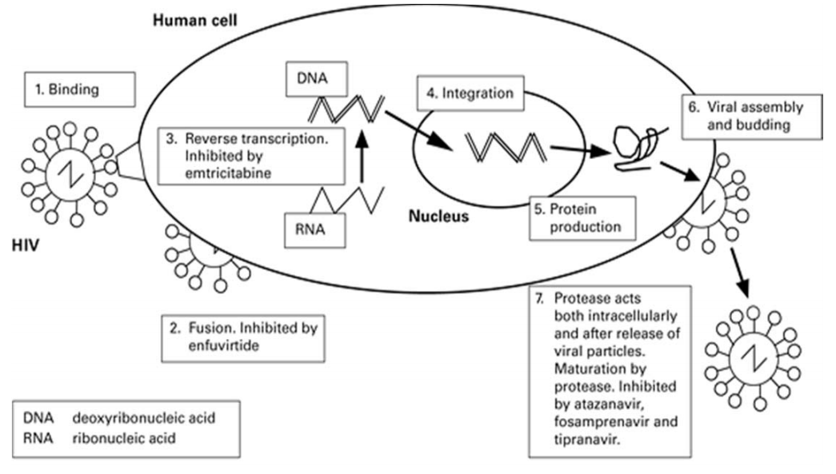
Lifecycle of HIV

Slide 23
Pathophysiology of HIV Infection
HIV attacks the immune system.
Specifically, it infects cells with the CD4 molecule on their surface.
The following immune cells have CD4 receptors:
T-Lymphocytes–CD4+ Cells
Macrophages
Monocytes
Dendritic cells
The most important of these is the helper T cells (often abbreviated as TH).
Helper T cells neither make antibodies -the job of B cells - nor kill infected cells -the responsibility of killer or cytotoxic T cells (TC).
Instead, they regulate the proliferation of B cells in response to the presence of a particular antigen.
When a TH cells recognizes the presence of the antigen to which it is attuned, it becomes activated which begins a process that culminates in B cells proliferation and antibody production towards that particular antigen.

Slide 24
Pathophysiology of HIV Infection Cnt’d...
By depleting the population of TH lymphocytes, HIV renders the body unable to mount an immune response, leaving it vulnerable to a host of bacterial, fungal, and viral infections.
The CD4+ T cell depletion is twofold, that is reduction in numbers and impairment in function.
The reduction in the CD4 cell number and the effects on their function reduces the capacity of the body to fight infectious diseases.
The hallmark of HIV/AIDS is a profound immunodeficiency as a result of depletion of CD4+ T lymphocytes.
Once HIV has entered the body, the immune system initiates anti-HIV antibody and cytotoxic T cell production.
However, it can take one to six months for an individual exposed to HIV to produce measurable quantities of antibody.

Slide 25
Classifications/ Staging of HIV
Some of the recognised international clinical staging systems which take into consideration the CD4 counts and percentages include the following:
World Health Organization (WHO) staging of HIV
Centre for Disease Control (CDC) staging of HIV

Slide 26
WHO Staging
From the history and physical examination, you should be in a position to clinically stage the patient.
WHO staging gives you an indication of the patient’s level of disease progression, with stage I being asymptomatic, and stage IV being advanced HIV or AIDS.
Document the stage in the patient’s file.

Slide 27
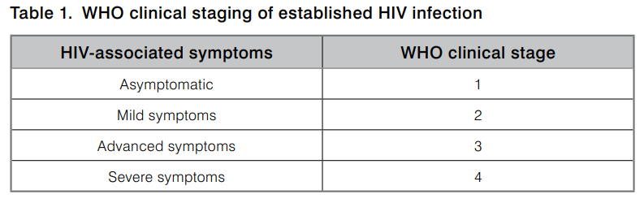
WHO Staging Cnt’d…

Slide 28
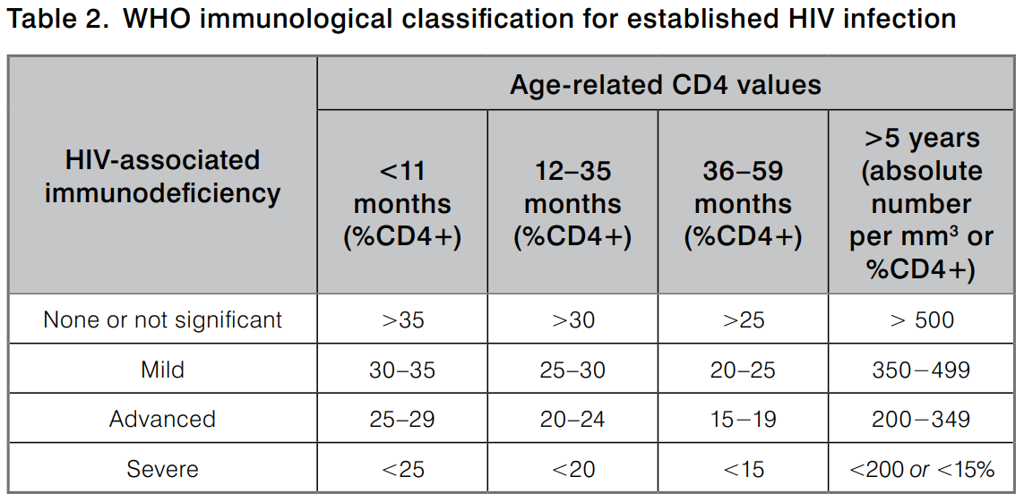
WHO Staging Cnt’d…

Slide 29
WHO staging(adults & adolescents)
Stage 1 :
Asymptomatic
Persistent generalized lymphadenopathy
Stage 2 :
Moderate unexplained weight loss (< 10% of presumed body weight)
Recurrent respiratory tract infections
Herpes zoster
Angular cheilitis
Recurrent oral ulcerations
Papular pruritic eruptions
Seborrheic dermatitis
Fungal nail infections
Notes:
Herpes zoster is viral infection that occurs with reactivation of the varicella-zoster virus. It is usually a painful but self-limited dermatomal rash. Symptoms typically start with pain along the affected dermatome, which is followed in 2-3 days by a vesicular eruption.
Angular cheilitis (AC) is inflammation of one or both corners of the mouth. Often the corners are red with skin breakdown and crusting. It can also be itchy or painful. The condition can last for days to years.
Seborrheic dermatitis is a common skin disease that causes an itchy rash with flaky scales. It causes redness on light skin and light patches on darker skin. It's also called dandruff, cradle cap, seborrhea, seborrheic eczema, and seborrheic psoriasis.

Slide 30
WHO staging(adults & adolescents)
Stage 3 :
Unexplained severe weight loss (> 10% of presumed body weight)
Unexplained chronic diarrhoea for more than one month
Unexplained persistent fever (intermittent or constant, lasting for >1 month)
Persistent oral candidiasis
Oral hairy leukoplakia
Pulmonary tuberculosis
Severe bacterial infections (e.g. pneumonia, empyema, meningitis)
Acute necrotizing ulcerative stomatitis, gingivitis or periodontitis
Unexplained anaemia, neutropenia and/or thrombocytopenia for more than one month
Notes:
Leukoplakia is a condition in which one or more white patches or spots (lesions) forms inside the mouth
Empyema is defined as a collection of pus in the pleural cavity, gram-positive, or culture from the pleural fluid.
Stomatitis is inflammation of the mouth and lips.
Gingivitis means inflammation of the gums, or gingiva.
Periodontitis is a severe gum infection that can lead to tooth loss and other serious health complications.
Anemia (also spelled anaemia) is a decrease in the total amount of red blood cells (RBCs) or hemoglobin in the blood, or a lowered ability of the blood to carry oxygen.
Neutropenia is when a person has a low level of neutrophils. Neutrophils are a type of white blood cell. All white blood cells help the body fight infection. Neutrophils fight infection by destroying harmful bacteria and fungi (yeast) that invade the body. Neutrophils are made in the bone marrow.
Thrombocytopenia is a condition characterized by abnormally low levels of platelets, also known as thrombocytes, in the blood.

Slide 31
WHO staging(adults & adolescents)
Stage 4:
HIV wasting syndrome (weight loss > 10%, plus either chronic unexplained diarrhoea or chronic unexplained fever)
Pneumocystis pneumonia
Recurrent severe bacterial pneumonia
Chronic herpes simplex infection for more than one month
Candidiasis of the oesophagus, trachea, bronchi or lungs
Extrapulmonary tuberculosis
Kaposi’s sarcoma
Cytomegalovirus infection
Central nervous system toxoplasmosis
HIV encephalopathy
Cryptococcal meningitis or other extrapulmonary cryptococcosis
Notes:
Pneumocystis pneumonia (PCP) is a serious infection that causes inflammation and fluid buildup in your lungs. It's brought on by a fungus called Pneumocystis jirovecii that spreads through the air.
The herpes simplex virus, also known as HSV, is an infection that causes herpes. Herpes can appear in various parts of the body, most commonly on the genitals or mouth.
Kaposi's sarcoma is a type of cancer that forms in the lining of blood and lymph vessels. The tumors (lesions) of Kaposi's sarcoma typically appear as painless purplish spots on the legs, feet or face. Lesions can also appear in the genital area, mouth or lymph nodes.
Cytomegalovirus infection is a common herpesvirus infection with a wide range of symptoms: from no symptoms to fever and fatigue (resembling infectious mononucleosis) to severe symptoms involving the eyes, brain, or other internal organs. This virus is spread through sexual and nonsexual contact with body secretions.

Slide 32
WHO staging(adults & adolescents)
Stage 4 cnt’d…:
Disseminated non-tuberculous mycobacteria infection
Progressive multifocal leukoencephalopathy
Chronic cryptosporidiosis
Chronic isosporiasis
Disseminated mycosis
Recurrent non-typhoid salmonella septicemia
Lymphoma
Invasive cervical carcinoma
Atypical disseminated leishmaniasis
Symptomatic HIV-associated nephropathy or HIV-associated cardiomyopathy
Notes:
Leukoencephalopathy refers to disorders of brain white matter. Neurologists have long appreciated the importance of white matter in the normal function of the central nervous system (CNS), and much is known of the effects of white matter lesions on motor and sensory systems.
Cryptosporidiosis is a diarrheal disease caused by microscopic parasites, Cryptosporidium, that can live in the intestine of humans and animals and is passed in the stool of an infected person or animal.
Isosporiasis, also known as cystoisosporiasis, is a human intestinal disease caused by the parasite Isospora belli (now known as Cystoisospora belli). It is found worldwide, especially in tropical and subtropical areas.
Lymphoma is cancer that begins in infection-fighting cells of the immune system, called lymphocytes.

Slide 33
CDC classification of HIV
The CDC classifies HIV infection into 3 categories, according to the presence of certain infections or diseases.
These conditions may be exacerbated by the HIV infection or represent true opportunistic infections.
Category A is asymptomatic HIV infection without a history of symptoms or AIDS-defining conditions.

Slide 34
CDC classification of HIV cnt’d…
Category B is HIV infection with symptoms that are directly attributable to HIV infection (or a defect in T-cell–mediated immunity) or that are complicated by HIV infection.
These include, but are not limited to, the following:
Bacillary angiomatosis
Oropharyngeal candidiasis (thrush)
Vulvovaginal candidiasis, persistent or resistant
Pelvic inflammatory disease (PID)

Slide 35
CDC classification of HIV cnt’d…
Category B cnt’d…
Cervical dysplasia (moderate or severe)/cervical carcinoma in situ
Oral hairy leukoplakia
Idiopathic thrombocytopenic purpura
Constitutional symptoms, such as fever (>38.5°C) or diarrhea lasting more than 1 month
Peripheral neuropathy
Herpes zoster (shingles), involving 2 or more episodes or 1 or more dermatomes

Slide 36
CDC classification of HIV cnt’d…
Category C is HIV infection with AIDS-defining opportunistic infections.

Slide 37
Screening for and Prevention of Specific Opportunistic Infections
All PLHIV should receive lifelong cotrimoxazole preventive therapy (CPT) unless they have allergy to sulfa drugs or develop toxicity from CPT
During pregnancy, CPT should be initiated irrespective of the gestational age and should continue throughout pregnancy, breastfeeding, and thereafter for life
When dapsone (as a substitute for CPT) is being used as PCP(Pneumocystis pneumonia) prophylaxis, it is only recommended for patients in WHO Stage 4 and/or absolute CD4 count ≤ 200 cells/mm 3 (or CD4% ≤ 25% for children ≤ 5 years old), and should be discontinued once a patient achieves viral suppression and a sustained CD4 count of > 200 cell/mm3 (or > 25% for children ≤ 5 years old) for at least 6 months

Slide 38
Screening for and Prevention of Specific Opportunistic Infections Cnt’d
All PLHIV should be screened for TB at every visit using the Intensified Case Finding (ICF) tool and assessed for Isoniazid Preventive Therapy (IPT) if screened negative for TB
All adolescent and adult PLHIV with a baseline CD4 count of ≤ 200 cells/mm3 should be screened for cryptococcal infection using the serum CrAg test

Slide 39
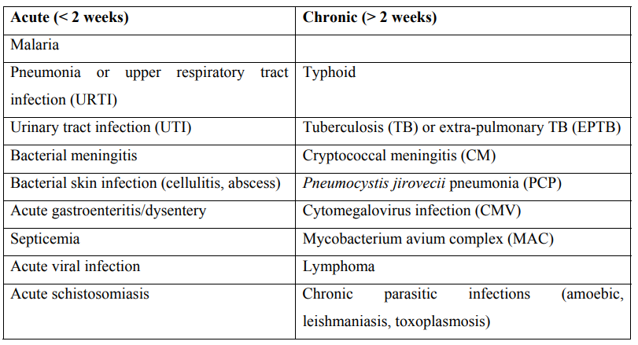
Common causes of acute and chronic fever in the HIV positive patient

Slide 40
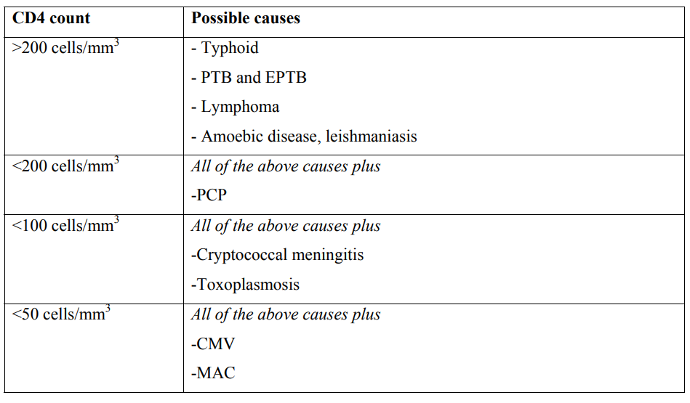
Likely causes of fever (usually chronic) according to CD4 count

Slide 41
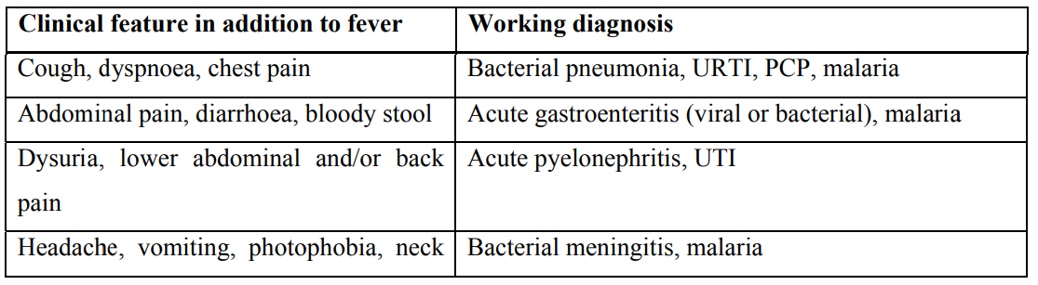
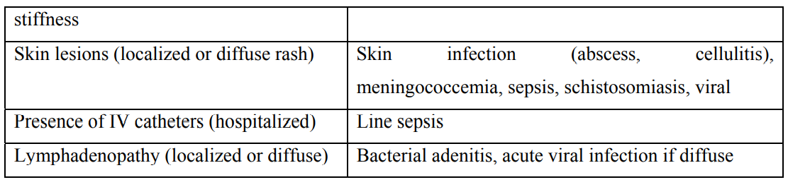
Working diagnosis for acute fever in PLHIV based on clinical features found on history and physical examination
Notes:
Adenitis is a general term for an inflammation of a gland. Often it is used to refer to lymphadenitis which is the inflammation of a lymph node.

Slide 42
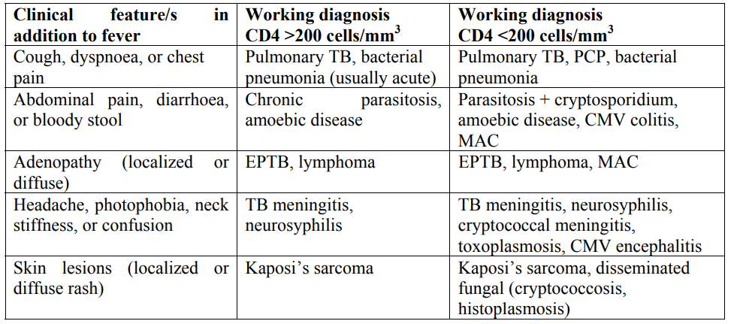
Working diagnosis for chronic fever in PLHIV based on CD4 count and clinical features found on history and physical examination

Slide 43
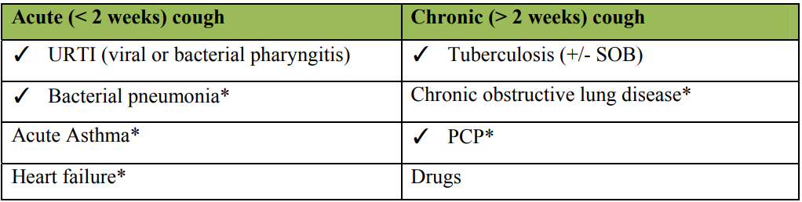
Common causes of acute and chronic cough in PLHIV

Slide 44
Bacterial pneumonia
Bacterial pneumonia is a common cause of morbidity and mortality in HIV infected individuals, occurring at any CD4 count.
Clinically it presents with an acute or abrupt onset of cough, fever, chills, sputum production, often yellow or green sputum (sometimes blood-tinged), unilateral chest pain and systemic symptoms of acute illness.
Frequent findings on physical examination are fever and respiratory rate > 20 breaths/minute.
On chest examination crepitations and sometimes bronchial breath sounds, signifying consolidation, can be heard.
For the outpatient who is stable and has not previously received antibiotics, treatment is with amoxicillin (1g TDS for 7 days). An alternative option is doxycycline (100mg BID for 7 days).
The patient who has already received amoxicillin and has not responded, or who was treated with antibiotics in the preceding month, should receive amoxicillin-clavulanate (1g amoxicillin component TDS for 10 days) plus erythromycin (500mg QID for 10 days).

Slide 45
Pneumocystis jiroveci pneumonia (PCP)
Pneumocystis jirovecii (previously called Pneumocystis carinii) is a fungus and most people have inhaled the organism by early childhood, without developing disease.
However, with declining cellular immunity, as in HIV with CD4 count below 200 cells/mm3 , the organism has the capacity to produce a sub-acute diffuse pneumonia.
The organism attacks the alveolar-capillary membrane, reducing oxygen diffusion capacity, and thus explaining the typical presentation of SOB and hypoxia.
Clinically, patients usually present with dry cough with a significant progressive SOB and reduced exercise capacity.
The SOB usually begins with exertion and becomes progressively worse over 1-3 weeks, and the patient is often SOB even at rest by the time they come to hospital.
Fever is common, and weight loss can occur although it is not usually as pronounced as in TB.
Chest pain and sputum production are less common but also occur.

Slide 46
Pneumocystis jiroveci pneumonia (PCP) Cnt’d...
The most useful clinical sign is decreased oxygen saturation at rest or with effort.
Auscultation may reveal rales and rhonchi, although approximately half of patients with PCP will have a normal chest exam.
Definite diagnosis of PCP requires bronchoscopy. This is not routinely accessible in Kenya therefore a high index of suspicion must be kept for patients with CD4 below 200 cells/mm3 and not on CTX prophylaxis.
Empirical treatment for PCP should be considered in a patient severely SOB with or without cough, and without other obvious causes (e.g. pleural effusion), or if there is a pneumothorax.
Treatment for PCP consists of high dose CTX, calculated as 15-20mg/kg of the trimethoprim component, divided TDS, and given for 21 days.
Additionally, in patients with severe SOB (RR > 30) steroids should be given concurrently. The following regimen of oral prednisone can be given: 40mg BID x 5 days, followed by 40mg OD x 5 days, and then 20mg OD x 11 days, and then stop.
Like all HIV-positive patients, after treatment for PCP they should be maintained on CTX 1 tablet once a day life.
Notes:
CTX: Cotrimoxazole Prophylaxis

Slide 47
Pulmonary TB
It can be difficult to differentiate between PCP and smear-negative PTB.
The following Table shows a few parameters that may be helpful.
Sometimes you may need to treat for PCP and PTB at the same time, or give a trial of PCP treatment and if there is no clinical improvement then switch to PTB treatment.

Slide 48
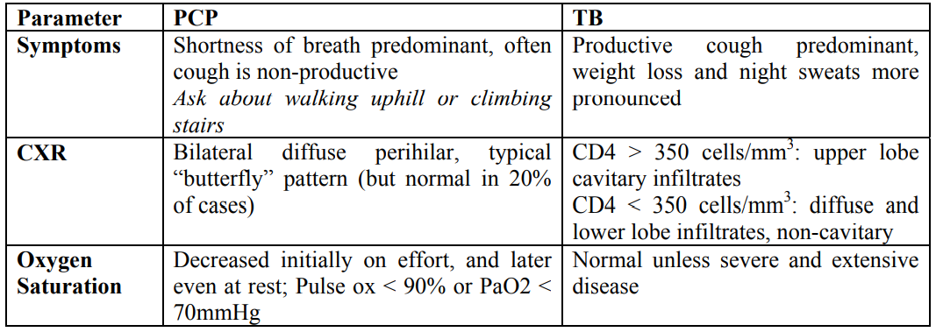
Helpful clinical differences between PCP vs. TB

Slide 49
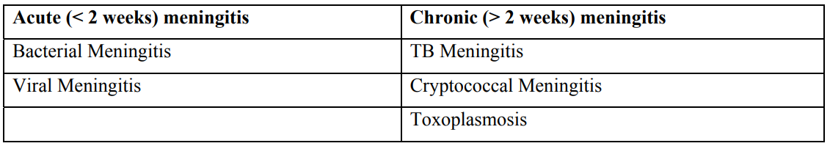
causes of acute and chronic meningitis

Slide 50
Toxoplasmosis
Toxoplasmosis is by far the most common cause of brain mass lesion in the immunosuppressed PLHIV and is caused by a parasite called Toxoplasma gondii.
Toxoplasmosis usually occurs with CD4 count below 100, but can occur even when below 200.
CTX prophylaxis is effective at preventing Toxoplasma infections, so it is unlikely to occur in patients who have been adherent to prophylaxis for several months.
The clinical presentation of CNS toxoplasmosis in HIV is usually over days to weeks and is characterized by headache, fever, and focal neurologic deficits, the nature of which depend on the anatomic location of the lesion/s. approximately 1/3 of patients with CNS toxoplasmosis will present with new onset of seizures.
If available, a CT scan with contrast will often show multiple ring-enhancing lesions

Slide 51
Toxoplasmosis Cnt’d…
The Preferred regimen:
Pyrimethamine 200 mg loading dose, then 50 mg –75 mg/day + Sulfadiazine 1000 mg to 1500mg P.O. 6 hourly + Folinic acid (leucovorin) 10-20mg/day PO
Alternative regimen:
Cotrimoxazole: 5mg/kg of Trimethoprim or 25mg/kg of CTX BD per day for 6 weeks (e.g. for 60kgman, 4 tablets per day (5X60=300 approximately 4 SS tablets).
This is the regimen of first choice locally in the absence of key constituents of the preferred choice above.
An advantage of this regimen over the above one is that it can also be given IV in patients unable to take oral treatment.
For patients who presented with seizure you should start them on an anticonvulsant for the duration of toxoplasmosis treatment.
Steroids should be considered if the patient has critical signs of raised intracranial pressure or if they worsen during the first 2 days of treatment.
Notes:
Like all PLHIV, after completion of the 6 week treatment course, CTX DS I tab OD should be continued for life. This is called secondary prophylaxis since we are preventing recurrences after successfully treating the acute disease. Note: for patients with CTX allergy Dapsone provides reasonable prophylaxis for PCP but it does not provide prophylaxis for toxoplasmosis.

Slide 52
Bacterial meningitis
Bacterial meningitis is an acute infection of the tissue surrounding the brain and spinal cord.
Patients present acutely (within hours to days of symptom onset) with a high fever (or rarely with hypothermia), stiff neck, severe headache, and altered mental status.
Often not all of these symptoms will be present.
CBC often shows increased WBCs.
LP often has raised opening pressure, and CSF will have high WBC (with differential more than 80% neutrophils), high protein, and low glucose.
Empiric treatment while waiting for gram stain results and cultures can be started with ceftriaxone 2g IV q12h, and then adjusted based on gram stain or cultures.

Slide 53
Cryptococcal meningitis
Caused by Cryptococcus neoformans and occurs when CD4 drops below 100 cells/µl.
CM is usually sub-acute or chronic meningitis, with malaise, low-grade fever, and headaches developing over a few weeks.
SCrAg test is highly sensitive and specific for CM in patients with this clinical presentation, and even if no other investigations are available then this can be used to begin treatment for CM.
If you can do an LP you will usually find a high opening pressure, primarily lymphocytes, and India ink stain may be positive (sensitivity of 50-75%).

Slide 54
Treatment options for Cryptococcal Meningitis
First-line treatment for CM is induction phase, followed by consolidation and maintainance phase.
Induction phase IV amphotericin B (0.7-1 mg/kg/day) + i.v Flucytosine (800 mg/day) for 2 weeks.
This is followed by a consolidation phase of either i.v or oral fluconazole 400-800 mg daily for 8 weeks, then secondary prophylaxis with fluconazole 200mg daily for life or until the patient is stable on ART and CD4 is maintained above 200 cells/µl for at least 6 months.

Slide 55
Kaposi’s Sarcoma
KS is a malignant, multifocal, systemic disease that originates from the vascular endothelium and has a variable clinical course.
The most frequent manifestation of the disease is skin and mucous membrane lesions, although the lungs, the gastrointestinal tract, and the lymphatic system may be involved.
Skin invlovement is the most common presentation and ranges from firm pigmented macular(patches), papular to nodular skin lesions.
It may be accompanied by non-pitting lymphoedema.
The colour of the lesion is variable form pink to red to purple or dark brow or black.
These lesions are painless but may get ulcerated or necrosis with ulceration.

Slide 56
Kaposi’s Sarcoma
Mucosal lesions occurs in oral cavity and hard palate lesions are most common.
These lesions can be flat red or purple/black plaques either focal or diffuse.
Other sites in month are gingival, tongue, uvula, tonsils, pharynx and tracheal area.
These lesions may interfere with eating and speaking, cause tooth loss or compromise the airways.
Visceral involvement is most aggressive form of KS.
It can occur in any part of the body like lungs, gastrointestinal track, liver, spleen, heart, pericardium etc. These lesions can lead to tissue destruction, bleeding and ultimately death.

Slide 57
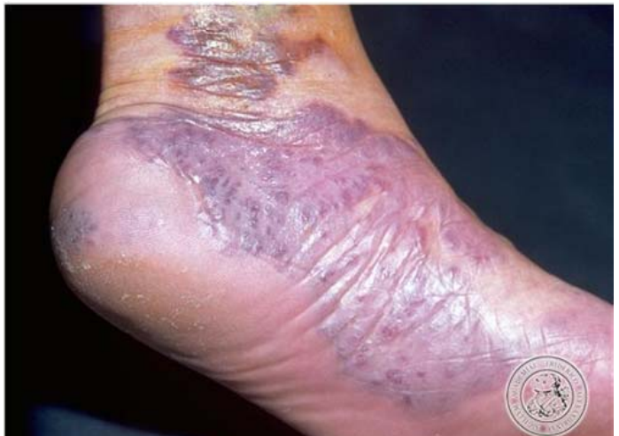
KS presenting as hyperpigmented patch on the right foot

Slide 58
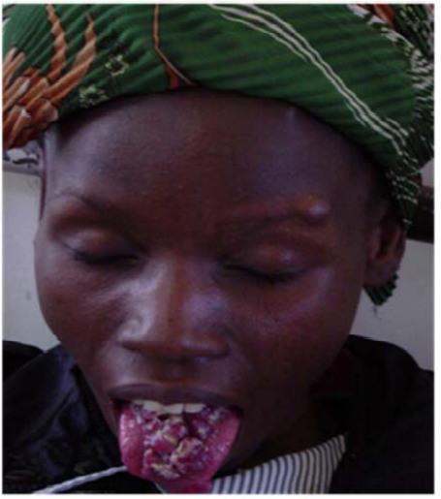
Nodular KS lesion on the dorsum of the tongue

Slide 59
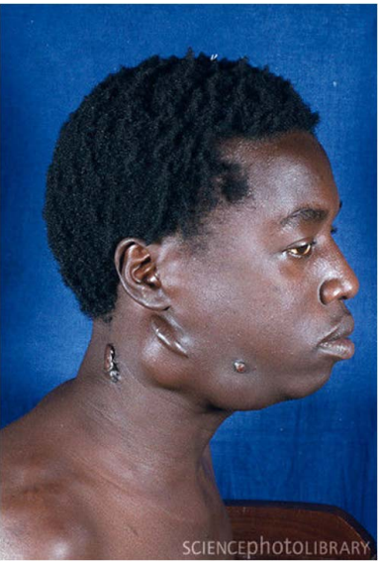
KS presenting as enlarged lymph nodes on the neck

Slide 60
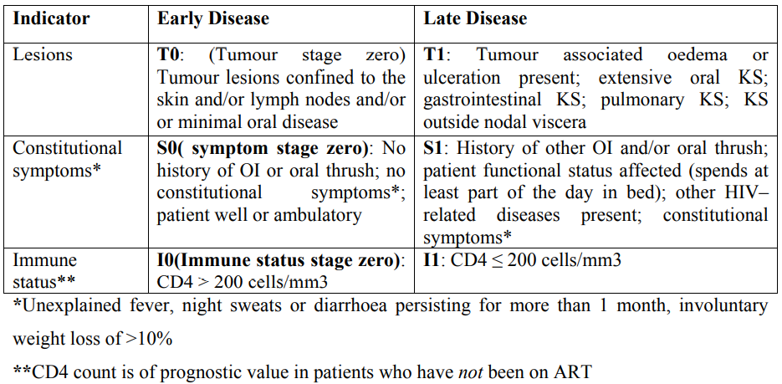
Staging of Kaposi’s sarcoma for PLHIV

Slide 61
Management of KS
The prognosis of KS is dependent on extent of disease and CD4 count.
ART is therefore the first line treatment and is indicated in all PLHIV with KS.
ART is associated with:
Reduced incidence of KS
Regression of lesions
Prolonged survival
In addition to ART, chemotherapy may be indicated in some patients with KS:
Patients with skin lesions associated with oedema or disability, or KS involving any system other than the skin, should be treated with combination chemotherapy (vincristine + bleomycin) or vincristine alone or bleomycin alone
Note: in patients with pulmonary KS, the chemotherapy should start at the same time as ART or before ART, in order to reduce the risk for a life-threatening immunereconstitution inflammatory syndrome

Slide 62
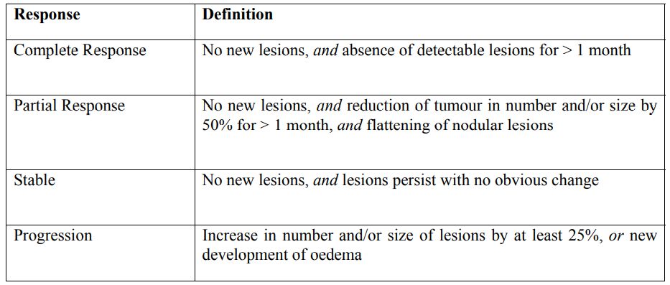
Definitions of response to treatment of KS

Slide 63
HIV Testing
An HIV test detects antibodies to HIV or the genetic material (RNA) of HIV in the blood or another type of sample.
This determines whether HIV infection is present (HIV-positive) or not (HIV negative).
After being infected, it takes between 2 weeks and 6 months for antibodies to HIV to appear in the blood.
The period between becoming infected with HIV and the point at which antibodies to HIV can be detected in the blood is called the seroconversion or "window" period.
During this period, an HIV-infected person can still spread the disease, even though an antibody test will not detect any antibodies in his or her blood.

Slide 64
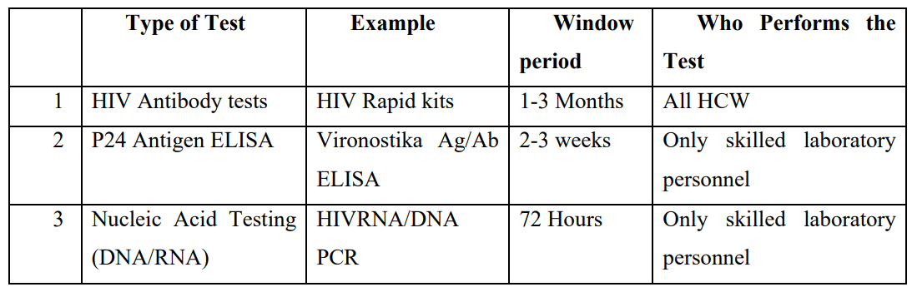
HIV Diagnostic Tests

Slide 65
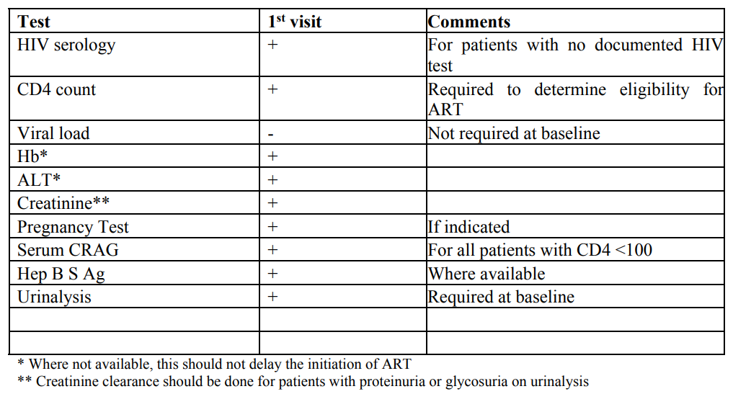
Laboratory Investigations: Baseline lab tests for all PLHIV
Notes:
Serum cryptococcal antigen (CRAG) is an accurate and sensitive predictor of cryptococcal meningitis in advanced patients with fever. It has been shown that 98% of patients with culture-proven cryptococcal meningitis have a positive serum CRAG.

Slide 66
Initial Evaluation and Follow-up for PLHIV
CD4 monitoring, is recommended for:
Baseline investigation for all PLHIV
Any patient with suspected treatment failure
Any patient on fluconazole maintenance therapy or on dapsone as prophylaxis, to determine when prophylaxis can be discontinued

Slide 67
Initial Evaluation and Follow-up for PLHIV Cnt’d…
Frequency of routine VL monitoring:
For PCR positive HEIs(HIV Exposed Infants): at baseline at the time of ART initiation
Age 0-24 years old: every 6 months
Age ≥ 25 years old: at month 6, 12, and then annually
Pregnant or breastfeeding: at confirmation of pregnancy (if already on ART) or 3 months after ART initiation (if ART initiated during pregnancy/breastfeeding), and then every 6 months until complete cessation of breastfeeding
Before any drug substitution (if no VL result available from the prior 6 months)
Three months after any regimen modification (including single-drug substitutions)

Slide 68
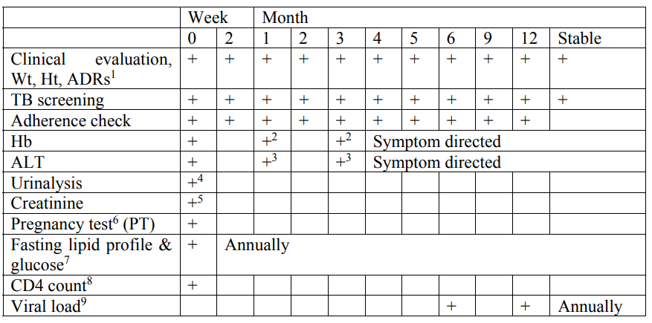
Summary of clinical and laboratory follow up of a patient on ART

Slide 69
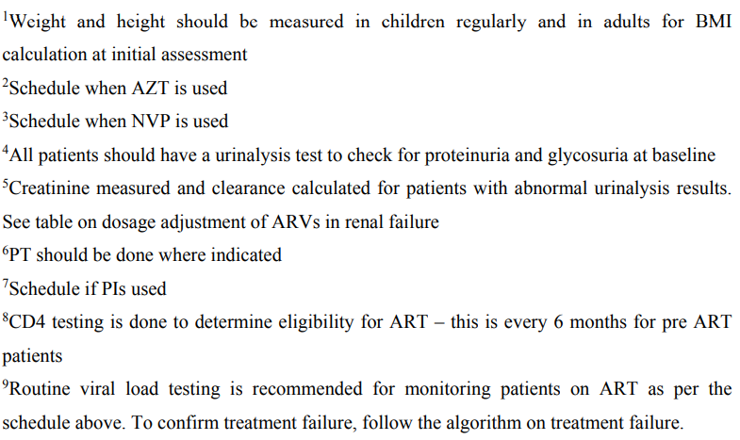
Summary of clinical and laboratory follow up of a patient on ART Cnt’d…
Notes:
Zidovudine (AZT)

Slide 70
Appropriate OI Prophylaxis in PLHIV
In Kenya, the most important drugs for OI prophylaxis are cotrimoxazole (CTX), and isoniazid (INH).
Primary prophylaxis prevents the first occurrence of the infection such as when cotrimoxazole is used to prevent the occurrence of Pneumocystis jirovecii pneumonia (PCP).
Secondary prophylaxis, on the other hand, prevents the recurrence of a particular OI once it has been successfully treated, such as using fluconazole prophylaxis after treating cryptococcal meningitis.

Slide 71
Cotrimoxazole Prophylaxis
Cotrimoxazole (CTX) commonly referred to as Septrin or Bactrim is a very effective prophylactic treatment against a variety of OIs.
All HIV-positive patients should be given life-long prophylaxis unless contraindicated
It is administered at a dose of 960 mg once daily for adults
It is effective against the following infections:
Common bacterial infections including bacterial pneumonia, septicemia
Diarrheal diseases caused by Isospora belli and other pathogens
Malaria
Toxoplasmosis
Pneumocystis jirovecii pneumonia (PCP)

Slide 72
Isoniazid Preventive Therapy (IPT)
Isoniazid is one of the drugs that are used in the treatment of TB in Kenya.
In addition, it has been shown to reduce the incident risk of TB in HIV-positive patients by 40% to 60% when administered for a period of 6 to 9 months.
The mechanism by which isoniazid prophylaxis works is by elimination of Latent TB Infection (LTBI).
LTBI refers to the presence of Mycobacterium tuberculosis in the body without signs or symptoms, and without radiographic or bacteriological evidence of active TB.
In the presence of immunosuppression, LTBI can progress to active TB disease.

Slide 73
Isoniazid Preventive Therapy (IPT) Cnt’d…
All patients infected with HIV should be screened for active TB, and those without active disease should be offered IPT (universal IPT for PLHIV).
When the decision to administer IPT is reached, INH should be given at a dose of INH of 300 mg/day for 6 months in adults and adolescents of >25 kg weight.
Pyridoxine at a dose of 25– 50 mg daily is recommended for prophylaxis against peripheral neuropathy for the duration of the prophylaxis.
Previous treatment for TB is not a contraindication for IPT; if treatment was completed more than 2 years previously then IPT should be considered.

Slide 74
Classification of Antiretroviral Drugs
Antiretroviral drugs are classified based on their site of action.
There are two major classes of ARVs used in Kenya today. These are:
Reverse Transcriptase Inhibitors
Protease Inhibitors

Slide 75
Reverse Transcriptase Inhibitors
The enzyme reverse transcriptase converts the single-stranded HIV RNA to doublestranded HIV DNA, which makes its way into the infected cell’s nucleus so the HIV particles can be produced.
The class of ARVs that blocks this enzyme are broadly classified into two groups: the Nucleoside and Nucleotide Reverse Transcriptase Inhibitors (NRTIs), and NonNucleoside Reverse Transcriptase Inhibitors (NNRTIs).

Slide 76
Reverse Transcriptase Inhibitors Cnt’d…
NRTIs are compounds that are very similar to the basic building blocks of the genetic material (RNA and DNA) that are called nucleosides.
In their presence, HIV reverse transcriptase enzyme is tricked into using the drug instead of the correct nucleosides resulting in defective genetic material and hence viral replication is aborted.
The NRTI class of drugs includes nucleoside inhibitors such as Lamivudine (3TC), Stavudine (d4T), Zidovudine (AZT), Didanosine (ddI), Abacavir (ABC) and Emtricitabine (FTC), and the nucleotide inhibitor Tenofovir (TDF).
NNRTIs, on the other hand, bind to the reverse transcriptase enzyme and consequently interfere with the process of replication of new genetic material.
Drugs available in this class are Efavirenz (EFV), Nevirapine (NVP), and Etravirine (ETR).

Slide 77
Protease Inhibitors (PIs)
Protease enzyme role is cleaving the long protein chains from the HIV genome into individual proteins.
Remember it is the newly cut proteins that come together with copies of the viral RNA to form new virus capsids.
Protease inhibitors act by inhibiting this important process in the HIV lifecycle.
The drugs in this class include: Lopinavir (LPV), Ritonavir (RTV), Atazanavir (ATV), Nelfinavir (NFV), Indinavir (IDV), Saquinavir (SQV), Amprenavir (APV) and Fosamprenavir (FPV), and Darunavir (DRV).

Slide 78
Protease Inhibitors (PIs) Cnt’d…
PIs are preferably combined as two PIs in one. Ritonavir is the preferred second PI in the combination of two PIs.
An example is (LPV/r). This is a combination of Lopinavir and Ritonavir.
PIs are metabolized through the cytochrome P450 3A4 isoenzyme in the liver.
RTV is a potent inhibitor of the cytochrome P450 3A4 isoenzyme.
By inhibiting the cytochrome P450, it slows down the breakdown of the other PIs.
A small, non-therapeutic dose of ritonavir is combined with a therapeutic dose of another PI in order to ‘boost’ or increase the levels of the second PI in the blood.
In this way, ritonavir acts as a “pharmacokinetic booster” to increase drug exposure and prolong serum half-lives of the other (active) PI.
In other words, RTV is used a helper for another PI to make the effect of the other PI stronger.

Slide 79
Other Classes of ARV Drugs
Fusion Inhibitors (e.g. Enfurvitide) : These work by preventing HIV from entering healthy CD4 cells by interfering with binding , fusion and entry into CD4 cells
CCR5 Antagonists (e.g. Maraviroc) : CCR5 co-receptor antagonists prevent HIV from entering and infecting immune cells by blocking CD4 cells surface receptors
Integrase Inhibitors (Raltegravir): These act by blocking the action of the viral enzyme integrase
These agents, plus the newer PI (Darunavir) and newer NNRTI (Etravirine) are reserved for third line or salvage therapies because of high cost, and are currently approved only by a special NASCOP committee.

Slide 80
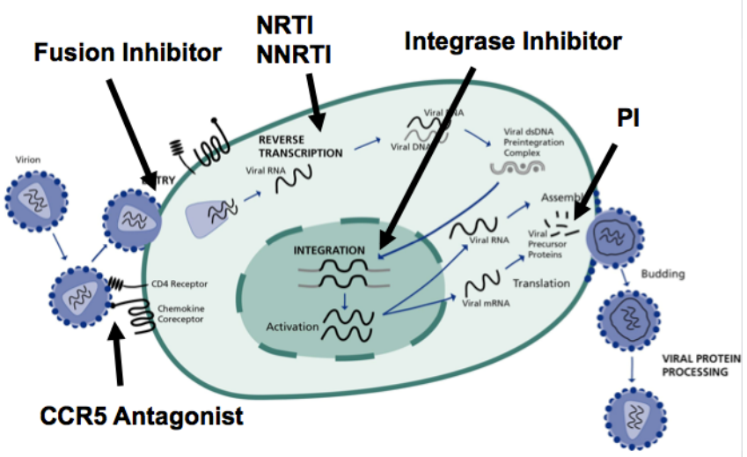
HIV life-cycle and point of action for ARV drugs

Slide 81
Antiretroviral Therapy in Infants, Children, Adolescents, and Adults
The goal of ART is to suppress viral replication with the aim of reducing the patient’s VL to undetectable levels
All individuals with confirmed HIV infection are eligible for ART, irrespective of CD4 count/%, WHO clinical stage, age, pregnancy or breastfeeding status, coinfection status, risk group, or any other criteria, provided that the individual is willing and ready to take ART and adhere to follow-up recommendations
ART should be started in all patients as soon as possible (preferably within 2 weeks of confirmation of HIV status)

Slide 82
First-line ART Regimens in Kenya
ARVs are usually administered as a combination of 3 drugs from two different classes.
Once it has been determined to start a client on ART, you need to initiate the recommended first line therapy.
This will usually consist of a combination of 2 NRTIs and 1 NNRTI.
TDF + 3TC + EFV is the preferred recommended first-line regimen for all new (treatment-naïve) adolescent and adult patients starting ART. This includes pregnant women.

Slide 83
First-line ART Regimens in Kenya Cnt’d…
Where TDF + 3TC + EFV cannot be used due to contraindications or other reasons the following can be used as alternatives in patients starting ART
TDF + 3TC + NVP
AZT + 3TC + EFV
AZT + 3TC + NVP
Why is tenofovir (TDF) the preferred NRTI for first line ART in adolescents and adults?
TDF containing regimen is less frequently associated with adverse events and is available in a single once a day pill in combination with 3TC and EFV

Slide 84
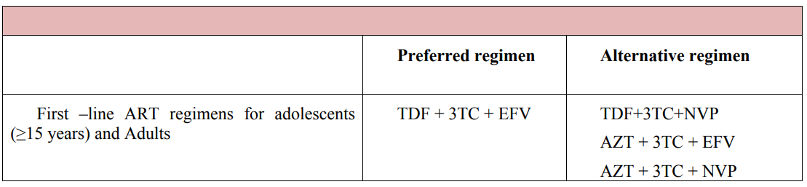
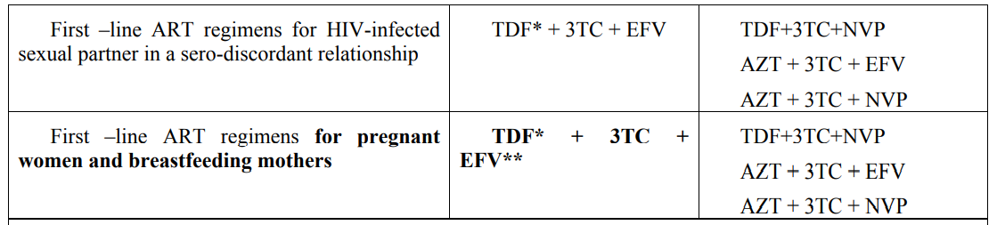
First Line ART Regimens for Adolescents and Adults

Slide 85
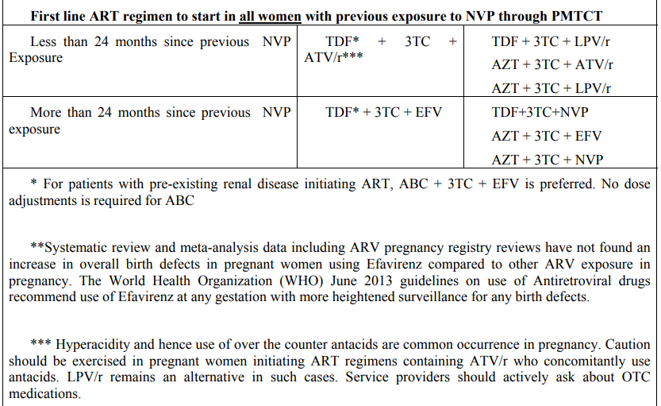
First Line ART Regimens for Adolescents and Adults Cnt’d…

Slide 86
Antiretroviral Therapy in Infants, Children, Adolescents, and Adults Cnt’d…
Preferred first-line ART for infants, children, adolescents and adults
Birth to 4 weeks: AZT + 3TC + NVP
4 weeks - < 3 years: ABC + 3TC + LPV/r
3 - 14 years (and < 35 kg body weight): ABC + 3TC + EFV
≥ 15 years (or ≥ 35 kg body weight): TDF + 3TC + DTG (or TDF + 3TC + EFV for women and adolescent girls of childbearing potential)
Adolescents who are virally suppressed on first line ABC + 3TC + EFV should transition to TDF + 3TC + DTG once they reach a weight of 35 kg or an age above 15 years to reduce pill burden and improve regimen durability and tolerability

Slide 87
Antiretroviral Therapy in Infants, Children, Adolescents, and Adults Cnt’d…
All patients who are virally suppressed on a first line regimen should be considered for optimization towards the current recommended first line regimen
Treatment failure is suspected when a patient has a high VL ≥ 1,000 copies/ml after at least 6 months of using ART
Treatment failure is only confirmed when VL is ≥ 1,000 copies/ml after assessing for and addressing poor adherence or other reasons for high VL, and then repeating VL after at least 3 months of excellent adherence to allow for viral re-suppression
Persistent low-level viremia (PLLV) is defined as having a detectable VL (above the LDL(lower than detectable limits) value) but < 1,000 copies/ml on two or more consecutive measures. These patients are at increased risk of progression to treatment failure, development of ARV resistance and death and therefore require a similar case management approach as patients with VL ≥ 1,000 copies/ml

Slide 88
Antiretroviral Therapy in Infants, Children, Adolescents, and Adults Cnt’d…
All PLHIV with a detectable VL (any value above LDL): assess for and address potential reasons for viremia, including intensifying adherence support, repeat the VL after 3 months of excellent adherence
If the repeat VL is ≥ 1,000 copies/ml, change to an effective regimen
If the repeat VL is detectable but < 1,000 copies/ml consult the Regional or National HIV Clinical TWG(Technical Working Group)
If the repeat VL is undetectable then continue routine monitoring

Slide 89
Prevention of Mother to Child Transmission of HIV
Prevention of mother-to-child transmission of HIV (PMTCT) should be offered as part of a comprehensive package of fully integrated, routine antenatal care interventions
Lifelong ART should be initiated in all pregnant and breastfeeding women living with HIV, regardless of gestational age, WHO clinical stage and at any CD4 count
ART should be started, ideally, on the same day as HIV diagnosis is made with ongoing enhanced adherence support
The preferred first line ART regimen for pregnant and breastfeeding women is TDF + 3TC + EFV

Slide 90
Prevention of Mother to Child Transmission of HIV Cnt’d…
Pregnant and breastfeeding women who are virally suppressed on a different first-line regimen should continue their current regimen until complete cessation of breastfeeding, after which they can be considered for regimen optimization
For pregnant and breastfeeding women newly initiated on ART, obtain VL 3 months after initiation, and then every 6 months until complete cessation of breastfeeding
For HIV positive women already on ART at the time of confirming pregnancy or breastfeeding, obtain a VL irrespective of when prior VL was done, and then every 6 months until complete cessation of breastfeeding

Slide 91
Prevention of Mother to Child Transmission of HIV Cnt’d…
For pregnant or breastfeeding women with a detectable VL (any value above LDL): assess for and address potential reasons for viremia, including intensifying adherence support, repeat the VL after 3 months of excellent adherence
If the repeat VL is ≥ 1,000 copies/ml, change to an effective regimen
If the repeat VL is detectable but < 1,000 copies/ml consult the Regional or National HIV Clinical TWG(Technical Working Group)
If the repeat VL is undetectable then continue routine monitoring

Slide 92
Prevention of Mother to Child Transmission of HIV Cnt’d…
All HEI should receive infant ARV prophylaxis consisting of 6 weeks of AZT + NVP and thereafter NVP should be continued until 6 weeks after complete cessation of breastfeeding
All infants irrespective of HIV status should be exclusively breastfed for the first 6 months of life, with timely introduction of appropriate complementary foods after 6 months, and continued breastfeeding up to 24 months or beyond

Slide 93
TB/HIV Co-infection Prevention and Management
Symptom-based TB screening using the ICF(Intensive Case Finding) tool MUST be performed for all PLHIV at every clinic visit
Patients who are screened negative should be evaluated for isoniazid preventive therapy (IPT)
Patients who are screened positive (presumptive TB) must complete definitive diagnostic pathways
The GeneXpert MTB/Rif(resistance to rifampicin) test is the preferred test for diagnosis of TB and rifampicin resistance in all presumptive TB cases
TB-LAM(Loop-mediated isothermal amplification) can be used as an adjunct rapid point-of-care diagnostic test for all PLHIV: with advanced HIV disease (WHO stage 3 or 4 or CD4 count ≤ 200 cells/mm3 (or CD4% ≤ 25% for children ≤ 5 years)) with presumed TB, or; any danger signs of severe illness, or; currently admitted to hospital

Slide 94
TB/HIV Co-infection Prevention and Management Cnt’d…
Those who are diagnosed with TB/HIV co-infection should be on CPT(Co-trimoxazole preventive therapy) as part of the comprehensive package of care for TB/HIV co-infection
Patients diagnosed with TB/HIV co-infection should start anti-TB treatment immediately and initiate ART as soon as anti-TB medications are tolerated, preferably within 2 weeks
Patients with TB/HIV co-infection who are already on ART should start anti-TB treatment immediately and continue ART, making any required adjustments to the ART regimen based on known drug-drug interactions
Always assess for ART failure in patients who develop TB after being on ART for ≥ 6 months

Slide 95
HBV/HIV and HCV/HIV Co-infection Prevention and Management
All HIV positive adolescents and adults should be screened for HBV infection, using serum HBsAg, as part of initial evaluation; children who did not complete routine childhood immunizations should also be screened for HBV
PLHIV without evidence of hepatitis B infection (HBsAg negative) should be vaccinated against hepatitis B
The recommended first-line ART for adults with HIV/HBV co-infection is TDF + 3TC + DTG (or TDF + 3TC + EFV for women and adolescent girls of childbearing potential)
HCV serology should be offered to individuals at risk of HCV infection
Direct acting antiviral therapies (DAAs) for treatment of HCV have simplified the management of HIV/HCV co-infection

Slide 96
Assessment for eligibility for PEP
The decision to give PEP is based on an assessment of the client before you.
It is based on assessing the risk of exposure, the clients’ HIV status and the duration that has elapsed following the exposure.
Time: PEP is efficacious when initiated as soon as possible (one hour) following the exposure and within a maximum of 72 hrs.
HIV status of client: PEP is indicated if client is HIV negative. PEP is not indicated if the client is already HIV positive. However, PEP should not be withheld if the clients HIV status is not known and cannot be immediately determined.
Risk of HIV acquisition: There is either high risk or low risk of HIV acquisition following exposure based on three parameters as summarized in following table.

Slide 97
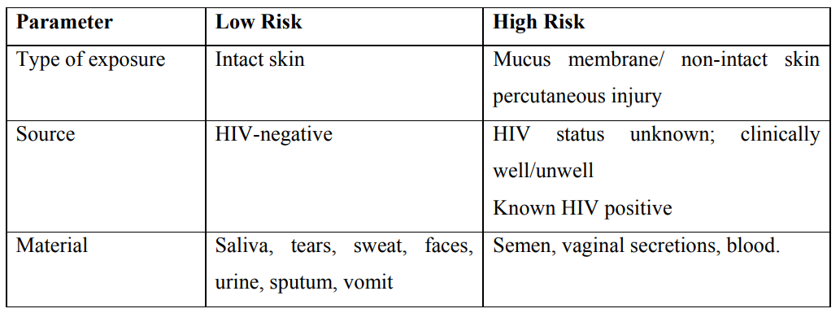
Degree of risk of HIV infection after exposure to various body fluids

Slide 98
Post Exposure Prophylaxis treatment
PEP should consist of a 3-drug antiretroviral regimen taken for duration of 28 days.
The preferred regimen is tenofovir + lamivudine + lopinavir/ritonavir.
ARV regimens: The current National guidelines recommendation is to use three drug regimens with at least one protease inhibitor once patient is eligible for PEP.
The recommended drugs for adults and paediatrics are:
0-14 years (and < 35 kg): ABC + 3TC + LPV/r
≥ 15 years old (or ≥ 35 kg): TDF + 3TC + DTG (or TDF + 3TC + ATV/r for women and adolescent girls of childbearing potential)

Slide 99
Oral Pre-Exposure Prophylaxis (PrEP)
Oral PrEP should be offered to HIV negative individuals at substantial ongoing risk of HIV infection (including the seronegative partner in a discordant relationship)
The recommended ARV regimen for use as PrEP is: TDF (300 mg) + FTC ( 200 mg) once daily
PrEP does not eliminate the risk of HIV infection and it does not prevent STIs or unintended pregnancies
PrEP should only be offered after assessment to establish eligibility, readiness for effective use, required follow-up (including HIV testing every 3 months) and absence of contraindications to TDF and/or FTC

Slide 100
People Who Inject Drugs (PWID) and HIV
The recommended first-line ART for adult PWID is TDF + 3TC + DTG (or TDF + 3TC + ATV/r for women and adolescent girls of childbearing potential)
PWID should be offered screening, diagnosis, treatment and prevention of STIs as part of comprehensive HIV prevention and care
PWID should have the same access to TB prevention, screening and treatment services as other populations at risk of or living with HIV
PWID should be screened for HBV (by HBsAg) and HCV (by HCV serology) at first contact
All PWID should be linked to Needle and Syringe Programmes (NSP) to access sterile injecting equipment

Slide 101
End of Presentation
Thank You

