Slide 1
HIV AND AIDS 30 hrs
By Anne Mbithi
BS(Medical Education)

Slide 2
Learning Outcomes
At the end of this session the participant should be able to:
Explain the global, regional, national and local distribution of HIV
Discuss the distribution of HIV by age and sex
Discuss changes in morbidity and mortality due to HIV/AIDS
Describe the classification of ARVs
Describe the site of action of the various classes of ARVs

Slide 3
FUNDAMENTALS OF HIV AND AIDS
INTRODUCTION
HIV: Human Immunodeficiency Virus.
AIDS: Acquired Immune Deficiency Syndrome.
HIV disease is a spectrum of disorders ranging from primary infection, asymptomatic state to advanced disease.

Slide 4
Epidemiology
HIV infection/AIDS is a global pandemic, especially in developing countries. The current estimate of the number of cases of HIV infection worldwide is ~33.2 million, two-thirds of whom are in sub-Saharan Africa; ~50% of cases are in women. Over the past decades HIV has continued to be a growing public health problem globally.
In Kenya, over 1.5 million people are estimated to be living with HIV, 900,000 of who were on antiretroviral therapy by the end of 2015.

Slide 5
Human Immunodeficiency Virus: Historical Background
1981 | Doctors in US recognized PCP in homosexual males, a condition previously unreported in healthy adults Later recognized that all these patients were immunosuppressed
1983/4 | Scientist described the cause of this acquired immunodeficiency syndrome (AIDS) as a retrovirus Lymphadenopathy Associated Virus (LAV) AIDs Associated Retrovirus (ARV) Human T- lymphotrophic Virus Ш (HTLV-Ш)
1984 | First case described In Kenya
1986 | Human Immunodeficiency Virus (HIV) accepted as international designation for the retrovirus in a WHO consultative meeting
Notes:
PNEMOCYCTIC CARANII PNEUMONIA – A life threatening lung infection mostly affecting people with weakende immune system.caused by pneumocystis pneumonia jiroveci

Slide 6
Historical Background. ctd
1996 | ARVs available in the world
1997 | ARVs available in Kenya private sector
2003 | ARVs available in Kenya public sector
2005 | 54,000 patients on ART
2010 | Approx.426,870 patients on ART

Slide 7
ETIOLOGY
HIV/AIDS is caused by infection by the human retroviruses HIV-1 or -2.
HIV-1 is the most common cause worldwide; HIV-2 has about 40% sequence homology

Slide 8
Retroviruses
HTLV-I HIV-1
HTLV-II HIV-2
STLV- I SIV
Cell proliferation Cell death

Slide 9
HIV Virus
A retrovirus from the Lentivirus family.
Genetic material consists of a single-stranded ribonucleic acid (RNA)
Viral particle is spherical in shape with a diameter of 80-100 nanometers (nm).

Slide 10
Types of Human Immunodeficiency Virus
Basic Virology:
There are two types of HIV.
HIV – 1
Is found worldwide
Is the main cause of the worldwide pandemic
HIV – 2
Is mainly found in West Africa, Mozambique and Angola.
Causes a similar illness to HIV – 1
Less efficiently transmissible rarely causing vertical transmission
Less aggressive with slower disease progression

Slide 11
HIV -1 Subtypes
HIV-1 has many subtypes: A-K
A-E are the predominant subtypes
A: W. Africa, E. Africa, Central Africa East Europe & Middle East
B: N. America, Europe, Middle East, E. Asia, Latin America
C: S. Africa, S. Asia, Ethiopia
D: E. Africa
E: S. E. Asia

Slide 12
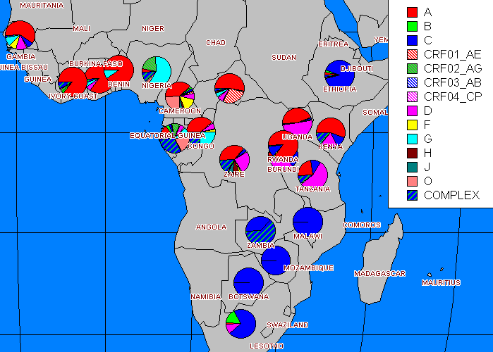
East and Central Africa has mainly subtype A and D.
Southern Africa mainly subtype C.
West Africa mainly A
Different subtypes can combine to form diverse recombinants.

Slide 13
Structure of Human Immunodeficiency Virus
Has an outer double lipid membrane, (derived from the host membrane).
The lipid membrane is lined by a matrix protein.
The lipid membrane is studded with the surface glycoprotein (gp) 120 and the transmembrane gp 41 protein.
These glycoprotein spikes surround the cone-shaped protein core.

Slide 14
Structure Of Human Immunodeficiency Virus

Slide 16
HIV Structure
HIV Glycoproteins
The gp120 and gp41 mediate the entry of virus into the host cells.
The core (capsid) is made up of several proteins:-
P₂₄ the main protein
Within the capsid are
two identical single strands of RNA (the viral genetic material).
viral enzymes

Slide 17
HIV Structure
Viral Enzymes
Most important: Reverse Transcriptase (RT), Protease and Integrase.
RT converts viral single-stranded RNA into a double stranded deoxyribonucleic acid (DNA).
DNA is incorporated into host nucleus as the proviral DNA.
Integrase facilitates integration of the DNA into the host’s chromosomal DNA.
Protease enzyme splits generated macro-proteins into smaller viral proteins (core, envelope & regulatory proteins and enzymes) which go into forming new viral particles.

Slide 18
It is necessary for a double stranded DNA chain to be formed so that it can be integrated into the double stranded host DNA. This step is catalyzed by RT which also acts as a DNA polymerase. This is essential for the integration process since the host DNA is a double stranded structure. In this way the virus establishes an infection that is not eradicable unless the host cell dies.

Slide 19
HIV Life cycle
Binding, Fusion and Entry
Transcription
Integration & Replication
Budding
Maturation

Slide 20
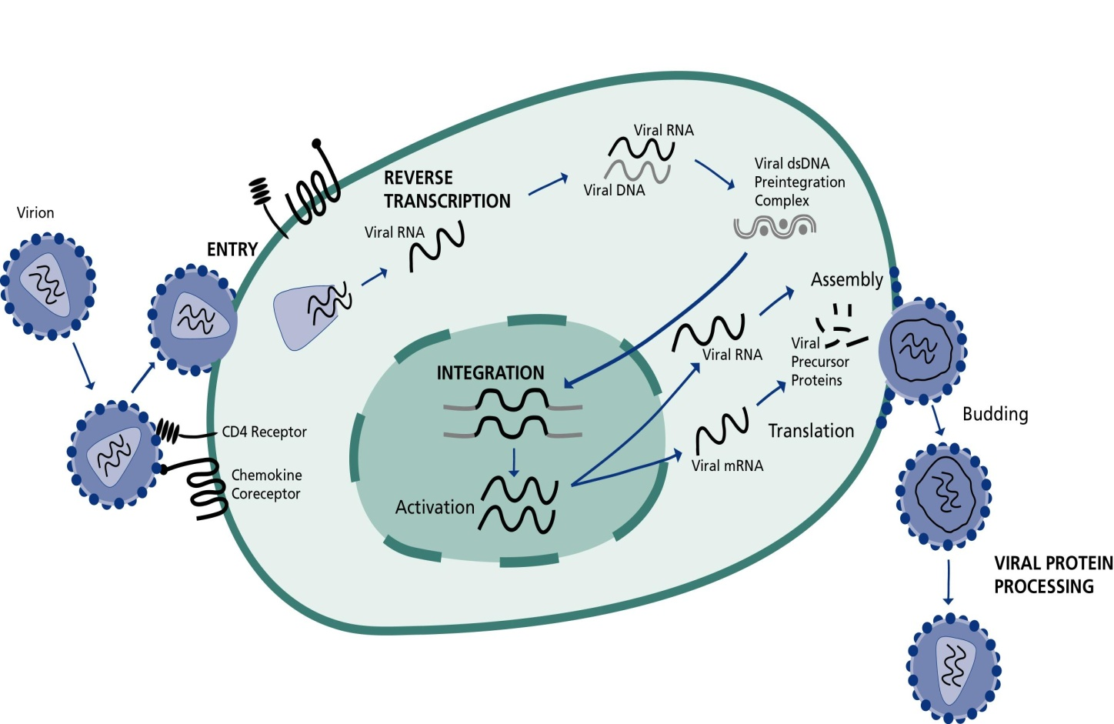

Slide 21
HIV Life Cycle
BINDING:
For successful entry into cells the HIV envelope glycoprotein GP 120 binds to the host receptor CD4 molecule
co-receptors are necessary (CCR5/CXCR4).

Slide 22
HIV Life Cycle
FUSION and ENTRY:
Viral binding to host cell triggers fusion of the viral and host cell membranes
Mediated by gp41
Allows entry of virus core into host cell cytoplasm
Core protein dissolved by host enzymes releasing viral RNA and enzymes

Slide 23
HIV Life Cycle
INTEGRATION
Reverse transcriptase converts the viral RNA into a DNA molecule
The DNA enters the host cell nucleus
Integrase catalyses the process of integration of the viral DNA into the host cell’s DNA

Slide 24
HIV Life Cycle
REPLICATION
Integrated viral DNA turns the host cell into a "factory" for manufacturing more virus.
Viral proteins are produced as a single multi-protein molecule
Viral proteins cleaved by protease enzyme

Slide 25
HIV Life Cycle
Budding and Maturation:
Viral proteins together with RNA gather at the membrane of the CD4+ cells
Viral particles are formed which bud off the cell and enter the bloodstream
The CD4 cells are often destroyed by HIV virus infection and replication resulting in profound immunodeficiency.

Slide 26
Transmission - HIV
(homo/bisexual
Male
(homo/bisexual)
Male
(heterosexual)
Female
(infected blood/tissue)
Male
(infected blood/tissue)
Female
Male/Female
(homosexual
Child

Slide 27
HIV can be transmitted in the body through these fluids:
Semen
Vaginal fluids
Blood
Breast milk
Amniotic fluids.

Slide 28
1. Sexual Transmission
Unprotected sexual intercourse with infected person.
Direct contact with body fluids of infected person. (blood, semen, vaginal secretions)
Note: Sexual transmission accounts for 87% of HIV transmission worldwide.
2. Mother to Child transmission
During pregnancy
During labour and delivery(most mother to child transmission occurs at this stage).
During breast feeding.
3. Use of unsafe sharp objects.
Injecting drugs and sharing needles with an infected person.
Piercing, tattooing or cutting with unclean knives or other objects.

Slide 29
Ways HIV is NOT transmitted
Sharing food or a drinking cup.
Hugging
Kissing
Shaking hands
Coughing or sneezing
Being near a PLWHA
Sharing latrines
Mosquitoes or insect bites even if they carry human blood. HIV cannot live outside humans.

Slide 30
Mechanisms for Maternal to Fetal Transmission

Slide 31
Risk factors for HIV infection
Unprotected sex – vaginal and anal sex.
Multiple sex partners.
STI infected people especially STIs that cause ulcerations like herpes, chancroid and syphillis.
Use of intravenous drugs, Sharing needles.
Children born to HIV positive mothers.
Uncircumcised male.
Alcohol and drug addiction.
HCWs where precautions are neglected or fail eg. Not using gloves or accidental needle stick injuries.
Blood transfusions especially where blood is not adequately screened.

Slide 32
Most At Risk Populations for HIV infection. (MARPS)
Injection drug users
Sex workers and their clients.
Men who have sex with men
Prisoners
Female sex workers
These groups are more vulnerable to HIV infection due a variety of factors such as:
More frequent exposures to the virus.
Involvement in risky behavior.
Potentially weak family and social support systems,
Marginalization.
Lack of resources
Inadequate access to health care services,
Stigma and Criminalization.

Slide 33
Myths And Misconceptions about HIV/AIDS
Myth: A widely held but false belief. An idea or story that is believed by many people but that is not true.
Misconception: A conclusion that is wrong because it’s based on faulty thinking or facts that are wrong.

Slide 34
Myths and Misconceptions about HIV/AIDS
HIV is spread through
-Breathing the same air
-Drinking from same cup or fountain
-Hugging kissing
-Sharing utensils
Mosquitoes spread HIV
You cant get HIV from oral sex
I don’t need to worry about getting HIV, drugs will keep me better.
If am getting treatment, I cant spread the virus.
My partner and I are both HIV positive, so we don’t have to practice safe sex.

Slide 35
PATHOPHYSIOLOGY
The hallmark of HIV disease is a profound immunodeficiency resulting from a progressive quantitative and qualitative deficiency of the subset of T lymphocytes
referred to as helper or inducer T cells.
This subset of T cells is defined phenotypically by the expression on the cell surface of the CD4 molecule, which serves as the primary cellular receptor for HIV.

Slide 36
ctd Pathophysiology
A co-receptor must be present with CD4 for efficient entry
of HIV-1 into target cells. The two major co-receptors for HIV-1 are the chemokine receptors CCR5 and CXCR4.
Although the CD4+ T lymphocyte and CD4+ monocyte lineage are the principal cellular targets of HIV, virtually any cell that expresses CD4 along with one of the co-receptors can potentially be infected by HIV; however, viral replication
is not efficient in these other cell types.

Slide 37
CLINICAL MANIFESTATIONS OF HIV INFECTION
Acute HIV (Retroviral) Syndrome:
Approximately 50–70% of infected individuals experience an acute syndrome following primary infection. The acute syndrome follows infection by 3–6 weeks. It can have multiple clinical features.
It lasts 1–2 weeks, and resolves spontaneously as an immune response to HIV develops and the viral load diminishes from its peak levels.
Most pts will then enter a phase of clinical latency, although an occasional pt will experience rapidly progressive immunologic and clinical deterioration.

Slide 38
Clinical Findings In The Acute Hiv Syndrome
General
Fever
Pharyngitis
Lymphadenopathy
Headache/retroorbital pain
Arthralgias/myalgias
Lethargy/malaise
Anorexia/weight loss
Nausea/vomiting/diarrhea
Neurologic
Meningitis
Encephalitis
Peripheral neuropathy
Myelopathy
Dermatologic
Erythematous maculopapular rash
Mucocutaneous ulceration

Slide 39
Asymptomatic Infection
The length of time between HIV infection and development of disease varies greatly, but the median is estimated to be 10 years in untreated individuals.
HIV disease with active viral replication usually progresses during this asymptomatic period, and CD4+ T cell counts fall.
The rate of disease progression is directly correlated with plasma HIV RNA levels.
Pts with high levels of HIV RNA progress to symptomatic disease faster than do those with low levels of HIV RNA.

Slide 40
Symptomatic
In general, the spectrum of illness changes as
the CD4+ T cell count declines. The more severe and life-threatening complications of HIV infection occur in patients with a CD4+ T cell count < 200/μl.
The key element to treating symptomatic complications of HIV disease, whether primary or secondary, is achieving good control of HIV replication through the use of combination antiretroviral therapy and instituting primary and secondary prophylaxis as indicated.
Major clinical syndromes seen in the symptomatic stage of HIV infection are summarized below.

Slide 41
Major clinical syndromes seen in the symptomatic stage of HIV infection include:
Persistent generalized lymphadenopathy: Palpable adenopathy at two or more extrainguinal sites that persists for >3 months without explanation other than HIV infection. Many pts will go on to disease progression.
Constitutional symptoms: Fever persisting for >1 month, involuntary weight loss of >10% of baseline, diarrhea for >1 month in absence of explainable cause.

Slide 42
Neurologic disease: Most common is HIV encephalopathy (AIDS dementia complex); other neurologic complications include opportunistic infections, primary CNS lymphoma, CNS Kaposi’s sarcoma, aseptic meningitis, myelopathy,peripheral neuropathy and myopathy.

Slide 43
Ctd:
Secondary infectious diseases: P. jiroveci pneumonia is most common opportunistic infection, occurring in ~80% of untreated individuals during the course of their illness. Other common pathogens include CMV (chorioretinitis,colitis,pneumonitis, adrenalitis), Candida albicans (oral thrush, esophagitis), M.avium intracellulare (localized or disseminated infection), M. tuberculosis, Cryptococcus neoformans (meningitis, disseminated disease), Toxoplasma gondii (encephalitis, intracerebral mass lesion), herpes simplex virus (severe mucocutaneous lesions, esophagitis), diarrhea due to Cryptosporidium spp. or Isospora belli, bacterial pathogens (especially in pediatric cases).

Slide 44
Secondary neoplasms: Kaposi’s sarcoma (cutaneous and visceral, more fulminant course than in non-HIV-infected pts), lymphoid neoplasms (especially B cell lymphomas of brain, marrow, GI tract).
Other diseases: A variety of organ-specific syndromes can be seen in HIVinfected pts, either as primary manifestations of the HIV infection or as complications of treatment

Slide 45
HIV Diagnosis
TYPE OF TESTS | HIV MARKERS | YEAR OF INTRODUCTION | TEST DURATION (in Hours)
ELISA | Gp 120, gp 41, p24, gp 36. | Early 1980s | 2-3
Western Blot | All HIV Markers | Early 1980s | 48
Viral Culture | Tissue Culture | Mid 1980s | 72
P24 Antigen Assay | Gag p24 | Late 1980s | 3
DNA PCR | RNA | Early 1990s | 12
RT PCR | RNA | Mid 1990s | 12
Rapid Tests | gp 120, gp 41, p24 | Late 1990s | 40 Minutes.

Slide 46
HIV Treatment
Antiretroviral Therapy
The cornerstone of medical management of HIV infection is highly active combination antiretroviral therapy, or HAART.
Aims of Treatment
Improved quality of life/increased longevity
Reduction of HIV related morbidity and mortality
Restoration and preservation of immune function
Maximal suppression of HIV replication

Slide 47
Principles of ARV Treatment
Antiretroviral treatment is part of the comprehensive care of HIV infection
Treatment should be planned and started in good time
Regular follow up and monitoring is essential
Treatment should be stopped/changed when necessary
The choice of drugs should take into account
Efficacy
Tolerability
Dose Schedule
Affordability and availability

Slide 48
Ctd: Principles of ART
ARV drugs are associated with adverse events and drug-drug interactions
Atleast 3 different drugs are included in an ART regimen referred to as HAART- Highly Active Anti Retroviral Therapy.
Adherence is key to successful treatment
Treatment may fail despite patient’s and carer’s best efforts
There should be commitment to continued support of patient (and family)

Slide 49
Characteristics of good HAART
Potent: should bring down viral load to an undetectable level within 3-4 months of therapy
Acceptable regimen to maximize adherence
- simple
- tolerable side effects
- patient commitment for life-long therapy
Reasonable options for future therapy
Affordable and sustainable

Slide 50
NOTE!
Currently HAART does not cure HIV but halts viral replication, thus prevent further disease progression and immune system damage

Slide 51
Suppression of HIV Replication
ARVs must be taken in combination of at least 3 drugs
Strict adherence to treatment is of the utmost importance
<95% adherence allows the rapid development of viral resistance
Poor adherers do badly
Fail treatment much earlier

Slide 52
Immune Reconstitution
ART prevents CD4 destruction by HIV
CD4 cell count can recover
Improved function of CD4 cells
CD4 cells are central to the immune system
So there is improved overall function of the immune system
It takes from 6 to 8 weeks for this to become evident clinically

Slide 53
Reduction of HIV related morbidity and mortality and Improvement of QOL –Quality of Life.
Decreased hospitalizations
Decreased risk of illnesses
Increased general well-being
Reversal of weight loss
Ability to return to work

Slide 54
Classes of Anti Retro Virals
Reverse transcriptase (RT) inhibitors
Nucleoside RT inhibitors (NRTI)
Non-nucleoside RT inhibitors (NNRTI)
Nucleotide RT inhibitors (NtNRI)
Protease inhibitors (PI)
Entry Inhibitors
Attachment inhibitors
Chemokine receptor antagonists
Fusion inhibitors
Integrase inhibitors

Slide 55
Antiretroviral Agents
NRTI (Nucleoside/Nucleotide Reverse Transcriptase Inhibitor): Block the enzyme reverse transcriptase from converting HIV genetic material RNA into human genetic material DNA, thus prevents further production of HIV RNA copies that can infect other cells.
Examples of NRTIs.
Zidovudine (AZT,ZDV)
Didanosine (ddI)
Zalcitabine (ddC)
Stavudine (d4T )
Lamivudine (3TC)
Abacavir (ABC)
Emtricitabine (FTC)

Slide 56
Ctd: ARVs
NNRTI (Non-Nucleoside Reverse Transcriptase Inhibitor): Inhibit reverse transcriptase by changing the shape of the viral enzyme to decrease its activity.
Nevirapine (NVP)
Delavirdine (DLV)
Efavirenz (EFV)
Nucleotide analogues
Tenofovir (TDF)

Slide 57
Ctd: ARVs
PI: Protease Inhibitors. Try to stop the activity of viral protease responsible for creating new HIV RNA particles,. Examples;
Saquinavir (SQV)
Ritonavir (RTV)
Indinavir (IDV)
Nelfinavir (NFV)
Amprenavir (APV)
Lopinavir/ ritonavir (LPV/r)
Atazanavir (ATV)
Darunavir(DRV)

Slide 58
Ctd: ARVs
Fusion/ Entry inhibitors: Block the HIV envelope from merging with the host CD4 cell membrane (fusion). This prevents HIV from entering the CD4 cells.
Enfuvirtide (T-20)
Maraviroc
Vicroviroc
Integrase inhibitors: Inhibit action of integrase, a viral enzyme that inserts the viral genome into DNA of the host cell.
-Raltegravir

Slide 59
Some ARVs as Fixed Drug Combinations (FDCs)
AZT + 3TC
d4T+3TC
AZT + 3TC + NVP
d4T + 3TC + NVP
d4T + 3TC + NVP
TDF + FTC + EFV
TDF + FTC
ABC + 3TC

Slide 60
Monitoring ART
Why?
Assess efficacy of intervention
Detect other treatable conditions
Assessment for drug related toxicities
How?
Clinical history and examination
Laboratory markers

Slide 61
Clinical Monitoring
Regular clinical evaluation is important to
Assess efficacy of ART
Monitor toxicity.
Frequency of visits for clinical monitoring
First visit at 2 weeks after initiating therapy
Ensure that medicines are being taken and stored correctly
Note and address possible side effects
Assess adherence
In stable patients
Subsequent visits should be monthly
6-12 months following initiation of ART, clinical appointments may be spaced at 2 to 3 month intervals in compliant and clinically stable patients with an excellent understanding of ART

Slide 62
Ctd: Clinical Monitoring
Plot the patient’s weight and note the trend
Falling weight may indicate treatment failure/new illness e.g. TB
Determine the patient’s physical condition.
Address ongoing medical problems including possibility of failure of treatment through the development of new OIs.
Treat inter-current infections
Check drug dosages and adjust according to weight.
The patients should be given medicines to last preferably for 1 month even when the clinic appointments are less frequent and patient should come to pick the medicines on monthly basis
Adherence should be assessed and appropriate counseling provided at EACH visit.

Slide 63
Ctd: Clinical Monitoring
Look for:
Patient self assessment of well being
Decrease or disappearance of symptoms
Increase in body weight
Decrease in frequency and severity of Opportunistic Infections

Slide 64
Laboratory Monitoring of ART
Laboratory tests are recommended for
Assessing response to and efficacy of treatment.
Monitoring toxicity

Slide 65
Laboratory Monitoring of ART
Assessing efficacy of treatment
For effective monitoring of efficacy of treatment, CD4 counts, and viral load are essential.
Resistance testing where available is a useful adjunct to choice of antiretroviral treatment.

Slide 66
Lab Tests: Monitoring For Toxicity
CD4 count should be determined at baseline or as soon as possible and thereafter at 6 monthly intervals.
CD4 count should not be measured during a concurrent infection
Delay until > 2 weeks after recovery
For consistency CD4 measurements in a patient should be carried out
In the same laboratory and preferably at the same time of day.

Slide 67
Laboratory Monitoring of ART: Viral Load
Viral load measurements are the most timely and sensitive way of assessing treatment response
Viral load should also be done,
Clinical failure is suspected OR
Immunological failure is suspected.

Slide 68
Lab Tests: Monitoring For Toxicity
Hematological and biochemistry Tests for monitoring toxicity
Where available the following tests should be done at baseline and while on ART to enable monitoring ARV drug toxicity
The clinical picture should always be taken into account when monitoring for toxicity

