Slide 1
HUMAN ANATOMY
INTRODUCTION
BY
F. R. KURIA

Slide 3
DEFINATION
Anatomy is a science that study's both microscopic and macroscopic structures structure of the body
Physiology – study of how the body work or functions.
anatomy forms the basis for the practice of medicine

Slide 4
IT IS DIVIDED INTO:
topographical or gross anatomy
histology
embryology
neuroanatomy

Slide 5
history
There are thousands of structures and it is impossible to describe them without an extensive and often highly specialized vocabulary.
these terms used, are often derived from Latin or Greek, and are used to the exclusion of any other, throughout the world.

Slide 6
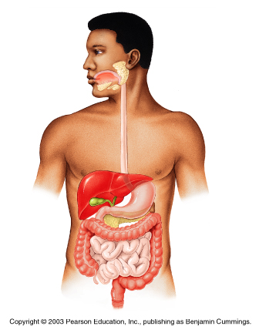
Gross anatomy is also known as macroscopic anatomy/ morphology/topographic anatomy-it studies large structures that are easily observable.

Slide 7
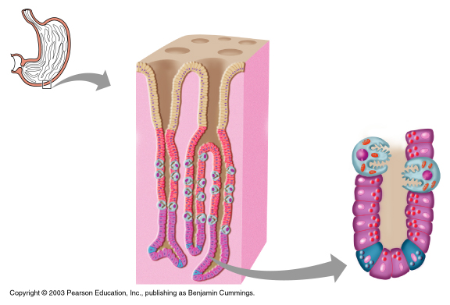
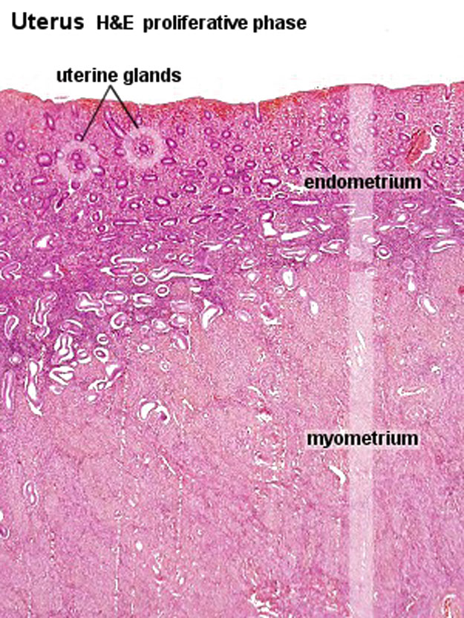
histology
is the microscopic study of the tissues of the body and of how these tissues are arranged to constitute organs.

Slide 8
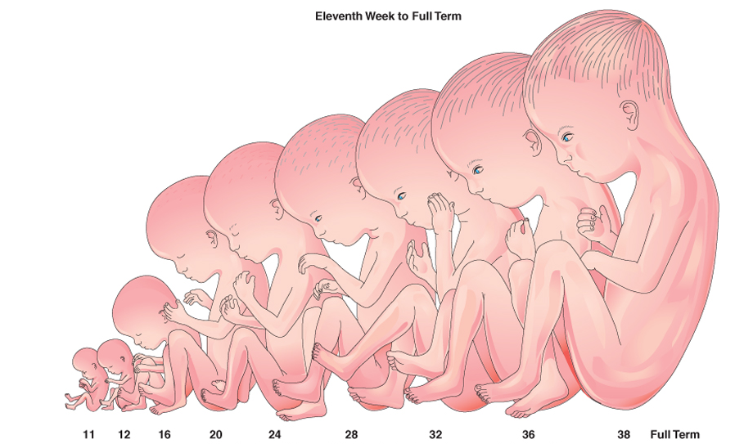
embryology
It’s the study of developmental anatomy that begins from the fusion of sperm and an ovum and continues to early adult hood.

Slide 9
Neuro-anatomy it’s the study of the nervous system, the central and peripheral nervous system and its functions.

Slide 10
The Language of Anatomy
To ensure unity and prevent misunderstanding there are terms which are used to describe:
Position
Direction
Regions
Structures
In relation to the human body.

Slide 11
Position and direction

Slide 12
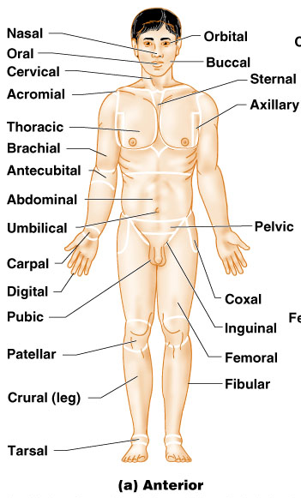
Body Landmarks
Anterior

Slide 13
Body Landmarks Posterior

Slide 14
Human body planes
Descriptions are based on imaginary planes median/sagittal, coronal/frontal and horizontal, applied to a body in the anatomical position.

Slide 15
The median plane (sagittal)passes longitudinally through the body and divides it into right and left halves.
The coronal plane (frontal)divides the body into anterior (front) and posterior (back).
A transverse plane passes horizontally through the body in a plane parallel to the floor.

Slide 17
The terms anterior and posterior are used to indicate the front and back of the body.
In describing the hand, the terms palmar and dorsal surfaces are used in place of anterior and posterior.
in describing the foot, the terms plantar and dorsal surfaces are used instead of lower and upper surfaces.
The terms proximal and distal describe the relative distances from the roots of the limbs, I.E. the arm is proximal to the forearm and the hand is distal to the forearm
NB (the proximal and distal aspect is derived based on its origin to the body, the closer the origin to the body it becomes proximal and the further the origin from the body it becomes distal )

Slide 20
Anatomical position is when a person is standing erect and facing forwards, upper limbs by the side with the palms facing forwards, and lower limbs together with the feet facing forward.

Slide 21
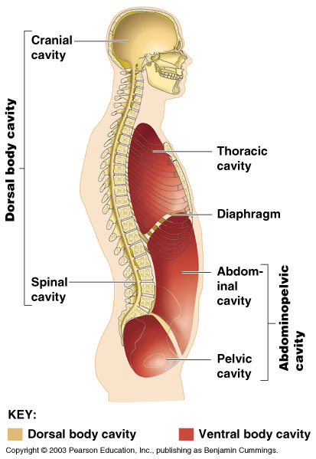
Cavities of the body
They are divided into two, the ventral and dorsal cavities.

Slide 22
Terms Related to Movement
Flexion is a movement that takes place in a sagittal plane. It is usually an anterior movement on the elbow joint, but posterior in the case of the knee joint .
Extension means straightening the joint and usually takes place in a posterior direction.
Lateral flexion is a movement of the trunk in the coronal plane

Slide 24
Abduction is a movement of a limb away from the midline of the body in the coronal plane.
Adduction is a movement of a limb toward the body in the coronal plane.
Rotation is the term applied to the movement of a part of the body around its long axis.
Medial rotation is the movement that results in the anterior surface of the part facing medially.
Lateral rotation is the movement that results in the anterior surface of the part facing laterally.

Slide 26
Pronation of the forearm is a medial rotation of the forearm in such a manner that the palm of the hand faces posteriorly .
Supination of the forearm is a lateral rotation of the forearm from the pronated position so that the palm of the hand comes to face anteriorly .
Circumduction is the combination in sequence of the movements of flexion, extension, abduction, and adduction (shoulder).
Protraction is to move forward.
retraction is to move backward (describes the forward and backward movement of the jaw).
Inversion is the movement of the foot so that the sole faces in a medial direction.
Eversion is the opposite movement of the foot so that the sole faces in a lateral direction.

Slide 28
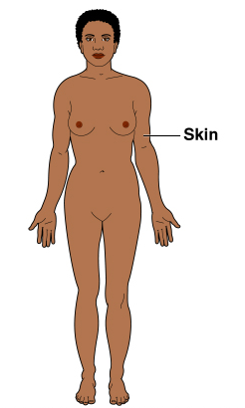
Organ System Integumentary
Forms the external body covering
Protects deeper tissue from injury
Synthesizes vitamin D
Location of cutaneous nerve receptors

Slide 29
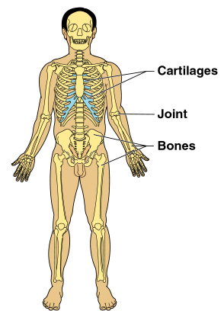
Skeletal
Protects and supports body organs
Provides muscle attachment for movement
Site of blood cell formation
Stores minerals

Slide 30
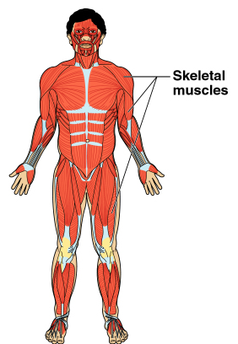
Muscular system
Allows locomotion
Maintains posture
Produces heat

Slide 31
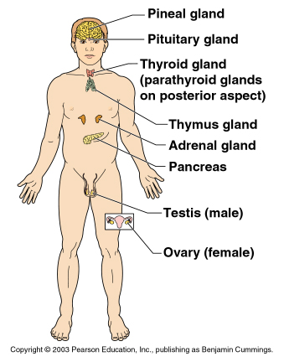
Endocrine
Secretes regulatory hormones
Growth
Reproduction
Metabolism

Slide 32
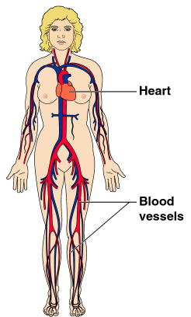
Cardiovascular
Transports materials in body via blood pumped by heart
Oxygen
Carbon dioxide
Nutrients
Wastes

Slide 33
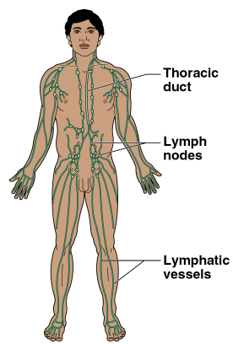
Lymphatic
Returns fluids to blood vessels
Disposes of debris
Involved in immunity

Slide 34
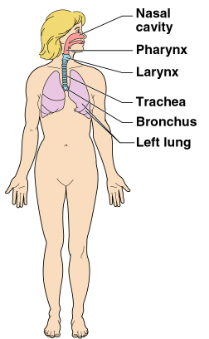
Respiratory
Keeps blood supplied with oxygen
Removes carbon dioxide

Slide 35
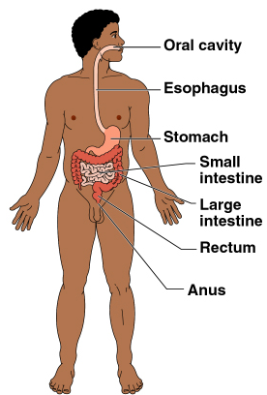
Digestive
Breaks down food
Allows for nutrient absorption into blood
Eliminates indigestible material

Slide 36
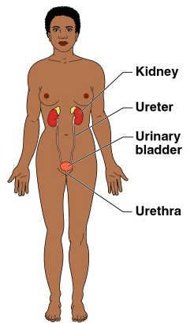
Urinary
Eliminates nitrogenous wastes
Maintains acid – base balance
Regulation of materials
Water
Electrolytes

Slide 37
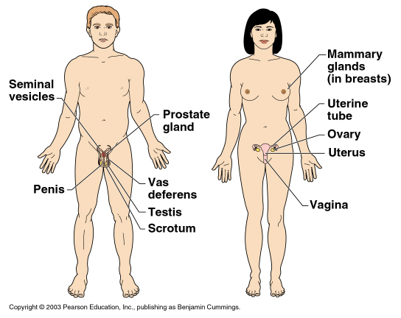
Reproductive
Production of offspring

Slide 38
THANK YOU
GOD BLESS YOU

