Slide 1
HYPERSENSITIVITY DISEASES:
MECHANISMS OF IMMUNE-MEDIATED INJURY

Slide 2
Immune responses are capable of causing tissue injury and diseases that are called hypersensitivity diseases.
This term originated from the idea that individuals who mount immune responses against an antigen are said to be "sensitized" to that antigen, and therefore, pathologic or excessive reactions are manifestations of "hypersensitivity."
Normally, an exquisite system of checks and balances optimizes the eradication of infecting organisms without serious injury to host tissues. However, immune responses may be inadequately controlled or inappropriately targeted to host tissues, and in these situations, the normally beneficial response is the cause of disease.
Normally, the immune system does not react against an individual's own antigens. This phenomenon is called self-tolerance, implying that all of us "tolerate" our own antigens.
Sometimes, self-tolerance fails, resulting in reactions against one's own cells and tissues that are called autoimmunity. The diseases caused by autoimmunity are referred to as autoimmune diseases

Slide 3
Reactions against microbes.
Microbial antigens may cause disease. The reaction may be excessive or the microbial antigen is unusually persistent. If antibodies are produced against such antigens, the antibodies may bind to the microbial antigens to produce immune complexes, which deposit in tissues and trigger inflammation; this is the underlying mechanism of poststreptococcal glomerulonephritis.
T-cell responses against persistent microbes may give rise to severe inflammation, sometimes with the formation of granulomas; this is the cause of tissue injury in tuberculosis and other infections.
Rarely, antibodies or T cells cross-react with a host tissue; this is believed to be the basis of rheumatic heart disease. In viral hepatitis, the virus that infects liver cells is not cytopathic, but it is recognized as foreign by the immune system. Cytotoxic T cells try to eliminate infected cells, and this normal immune response damages liver cells.
Reactions against environmental antigens.
Most healthy individuals do not react strongly against common environmental substances (e.g., pollens, animal danders, or dust mites), but almost 20% of the population is "allergic" to these substances.
Allergies are diseases caused by unusual immune responses to a variety of noninfectious, and otherwise harmless, antigens to which all individuals are exposed but against which only some react
  In all these conditions, tissue injury is caused by the same mechanisms that normally function to eliminate infectious pathogens, namely antibodies, effector T lymphocytes, and various other effector cells. The problem in these diseases is that the response is triggered and maintained inappropriately.
  Because the stimuli for these abnormal immune responses are difficult or impossible to eliminate (e.g., self antigens, persistent microbes, or environmental antigens), and the immune system has many intrinsic positive feedback loops (amplification mechanisms), once a pathologic immune response starts it is difficult to control or terminate it. Therefore, these hypersensitivity diseases tend to be chronic, often debilitating, and are therapeutic challenges. Since inflammation, typically chronic inflammation, is a major component of the pathology of these disorders, they are sometimes grouped under the rubric immune-mediated inflammatory diseases

Slide 4
Hypersensitivity disorders
Type | Prototype Disorder | Immune Mechanisms | Pathologic Lesions
Immediate (type I) hypersensitivity | Anaphylaxis, allergies, bronchial asthma (atopic forms) | Production of IgE antibody →immediate release of vasoactive amines and other mediators from mast cells; recruitment of inflammatory cells (late-phase reaction) | Vascular dilation, edema, smooth muscle contraction, mucus production, inflammation
Antibody-mediated (type II) hypersensitivity | Autoimmune hemolytic anemia; Goodpasture syndrome | Production of IgG, IgM →binds to antigen on target cell or tissue →phagocytosis or lysis of target cell by activated complement or Fc receptors; recruitment of leukocytes | Phagocytosis and lysis of cells; inflammation; in some diseases, functional derangements without cell or tissue injury

Slide 5
Type | Disorder | Immune mechanism | Pathologic lesion
Immune complex-mediated (type III) hypersensitivity | Systemic lupus erythematosus; some forms of glomerulonephritis; serum sickness; Arthus reaction | Deposition of antigen-antibody complexes →complement activation →recruitment of leukocytes by complement products and Fc receptors →release of enzymes and other toxic molecules | Inflammation, necrotizing vasculitis (fibrinoid necrosis)
T-cell-mediated (type IV) hypersensitivity | Contact dermatitis; multiple sclerosis; type I diabetes; transplant rejection; tuberculosis | Activated T lymphocytes →(i) release of cytokines and macrophage activation; (ii) T-cell-mediated cytotoxicity | Perivascular cellular infiltrates, edema, cell destruction, granuloma formation

Slide 6
Immediate (Type I) Hypersensitivity
Immediate hypersensitivity is a tissue reaction that occurs rapidly (typically within minutes) after the interaction of antigen with IgE antibody that is bound to the surface of mast cells in a sensitized host.
The reaction is initiated by entry of an antigen, which is called an allergen because it triggers allergy.
Many allergens are environmental substances that are harmless for most individuals. Some individuals apparently inherit genes that make them susceptible to allergies.
This susceptibility is manifested by the propensity of these individuals to make strong TH2 responses and, subsequently, IgE antibody against the allergens.
Mast cells derived from bone marrow, are widely distributed in tissues, and often reside near blood vessels and nerves and in subepithelial locations. Mast cells express a high-affinity receptor for the Fc portion of the ε heavy chain of IgE.
Basophils are the circulating counterparts of mast cells. They also express FcεRI, but their role in most immediate hypersensitivity reactions is not established (since these reactions occur in tissues and not in the circulation).
The third cell type that expresses FcεRI are eosinophils, which are often present in these reactions and also have a role in IgE-mediated host defense against helminth infections
IgE is central to the activation of the mast cells and release of mediators that are responsible for the clinical and pathologic manifestations of the reaction

Slide 7
Immediate hypersensitivity may occur as a local reaction that is merely annoying (e.g., seasonal rhinitis, or hay fever) or severely debilitating (asthma) or may culminate in a fatal systemic disorder (anaphylaxis).
When individuals who were sensitized by exposure to an allergen are re-exposed to the allergen, it binds to multiple specific IgE molecules on mast cells, usually at or near the site of allergen entry.
When these IgE molecules are cross-linked, a series of biochemical signals is triggered in the mast cells. The signals culminate in the secretion of various mediators from the mast cells.

Slide 8
Three groups of mediators are the most important in different immediate hypersensitivity reactions:
  Vasoactive amines released from granule stores of mast cells, contain histamine, which is released within seconds or minutes of activation. Histamine causes vasodilation, increased vascular permeability, smooth muscle contraction, and increased secretion of mucus.
  Other rapidly released mediators include adenosine (which causes bronchoconstriction and inhibits platelet aggregation) and chemotactic factors for neutrophils and eosinophils.
  Other mast cell granule contents that may be secreted include several neutral proteases (e.g., tryptase), which may damage tissues and also generate kinins and cleave complement components to produce additional chemotactic and inflammatory factors (e.g., C3a. The granules also contain acidic proteoglycans (heparin, chondroitin sulfate), the main function of which seems to be as a storage matrix for the amines.
  Mast cells synthesize and secrete prostaglandins and leukotrienes, by the same pathways as do other leukocytes. These lipid mediators have several actions that are important in immediate hypersensitivity reactions.
  Prostaglandin D2 (PGD2) is the most abundant mediator generated by the cyclooxygenase pathway in mast cells. It causes intense bronchospasm as well as increased mucus secretion. Leukotrienes C4 and D4 (LTC4, LTD4) are the most potent vasoactive and spasmogenic agents known; on a molar basis, they are several thousand times more active than histamine in increasing vascular permeability and causing bronchial smooth muscle contraction. LTB4 is highly chemotactic for neutrophils, eosinophils, and monocytes.Cytokines.
Activation of mast cells results in the synthesis and secretion of several cytokines that are important for the late-phase reaction. These include TNF and chemokines, which recruit and activate leukocytes (Chapter 2), IL-4 and IL-5, which amplify the TH2-initiated immune reaction, and IL-13, which stimulates epithelial cell mucus secretion

Slide 9
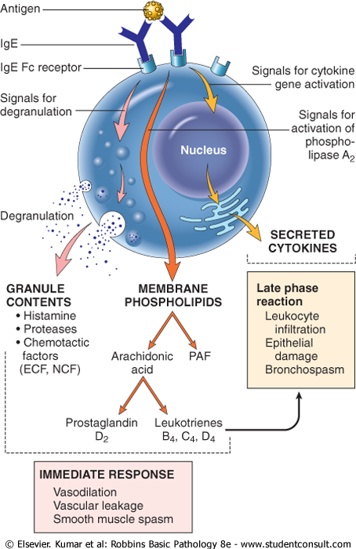

Slide 10
Late-phase reactions
The IgE-triggered reaction has two well-defined phases:
(1) immediate response, characterized by vasodilation, vascular leakage, and smooth muscle spasm, usually evident within 5 to 30 minutes after exposure to an allergen and subsiding by 60 minutes; and
(2) late-phase reaction that usually sets in 2 to 8 hours later and may last for several days and is characterized by inflammation as well as tissue destruction, such as mucosal epithelial cell damage.
The dominant inflammatory cells in the late-phase reaction are neutrophils, eosinophils, and lymphocytes, especially TH2 cells.
Neutrophils are recruited by various chemokines; Eosinophils are recruited by eotaxin and other chemokines released from TNF-activated epithelium and are important effectors of tissue injury in the late-phase response.
Eosinophils produce major basic protein and eosinophil cationic protein, which are toxic to epithelial cells, and LTC4 and platelet-activating factor, which promote inflammation.
Cytokines produced by TH2 cells have multiple actions.
The recruited leukocytes can amplify and sustain the inflammatory response even in the absence of continuous allergen exposure. In addition, inflammatory leukocytes are responsible for much of the epithelial cell injury in immediate hypersensitivity.
Because inflammation is a major component of many allergic diseases, notably asthma and atopic dermatitis, therapy usually includes anti-inflammatory drugs such as corticosteroids

Slide 11
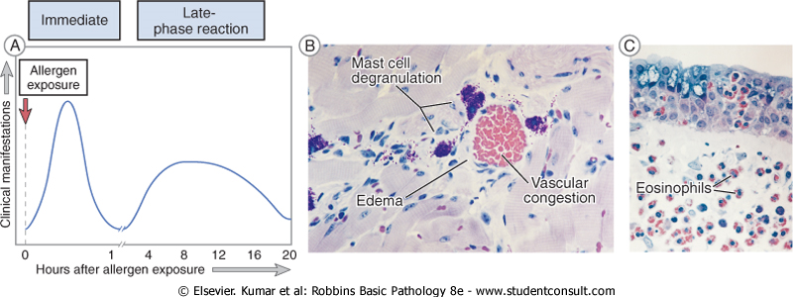

Slide 12
Antibody-Mediated Diseases (Type II Hypersensitivity)
Antibody-mediated (type II) hypersensitivity disorders are caused by antibodies directed against target antigens on the surface of cells or other tissue components.
The antigens may be normal molecules intrinsic to cell membranes or extracellular matrix, or they may be adsorbed exogenous antigens (e.g., a drug metabolite).
Antibody-mediated abnormalities are the underlying cause of many human diseases;
In all these disorders the tissue damage or functional abnormalities result from a limited number of mechanisms

Slide 13
Examples of type II dses
Disease | Target Antigen | Mechanisms of Disease | Clinicopathologic Manifestations
Autoimmune hemolytic anemia Autoimmune thrombocytopenic purpura | Erythrocyte membrane proteins (Rh blood group antigens, I antigen) Platelet membrane proteins (gpllb:Illa integrin) | Opsonization and phagocytosis of erythrocytes Opsonization and phagocytosis of platelets | Hemolysis, anemia Bleeding
Pemphigus vulgaris | Proteins in intercellular junctions of epidermal cells (epidermal cadherin) | Antibody-mediated activation of proteases, disruption of intercellular adhesions | Skin vesicles (bullae)
Vasculitis caused by ANCA | Neutrophil granule proteins, presumably released from activated neutrophils | Neutrophil degranulation and inflammation | Vasculitis

Slide 14
Goodpasture syndrome | Noncollagenous protein in basement membranes of kidney glomeruli and lung alveoli | Complement- and Fc receptor-mediated inflammation | Nephritis, lung hemorrhage
Acute rheumatic fever | Streptococcal cell wall antigen; antibody cross-reacts with myocardial antigen | Inflammation, macrophage activation | Myocarditis, arthritis
Myasthenia gravis | Acetylcholine receptor | Antibody inhibits acetylcholine binding, down-modulates receptors | Muscle weakness, paralysis
Graves disease (hyperthyroidism) | TSH receptor | Antibody-mediated stimulation of TSH receptors | Hyperthyroidism
Insulin-resistant diabetes | Insulin receptor | Antibody inhibits binding of insulin | Hyperglycemia, ketoacidosis
Pernicious anemia | Intrinsic factor of gastric parietal cells | Neutralization of intrinsic factor, decreased absorption of vitamin B₁₂ | Abnormal erythropoiesis, anemia

Slide 15
Immune Complex Diseases (Type III Hypersensitivity)
Antigen-antibody (immune) complexes that are formed in the circulation may deposit in blood vessels, leading to complement activation and acute inflammation.
The antigens in these complexes may be exogenous antigens, such as microbial proteins, or endogenous antigens, such as nucleoproteins.
The mere formation of immune complexes does not equate with hypersensitivity disease; antigen-antibody complexes are produced during many immune responses and are usually phagocytosed, representing a normal mechanism of antigen removal. It is only when these complexes are produced in large amounts, persist, and are deposited in tissues that they are pathogenic.
Pathogenic immune complexes may form in the circulation and subsequently deposit in blood vessels, or the complexes may form at sites where antigen has been planted (in situ immune complexes).
Immune complex-mediated injury is systemic when complexes are formed in the circulation and are deposited in several organs, or localized to particular organs (e.g., kidneys, joints, or skin) if the complexes are formed and deposited in a specific site. The mechanism of tissue injury is the same regardless of the pattern of distribution; however, the sequence of events and the conditions leading to the formation of systemic and local immune complexes are different and will be considered separately
The pathogenesis of systemic immune complex disease can be divided into three phases: (1) formation of antigen-antibody complexes in the circulation and (2) deposition of the immune complexes in various tissues, thus initiating (3) an inflammatory reaction in various sites throughout the body leading to disease

Slide 16
Examples
Disease | Antigen Involved | Clinicopathologic Manifestations
Systemic lupus erythematosus | Nuclear antigens | Nephritis, skin lesions, arthritis, others
Poststreptococcal glomerulonephritis | Streptococcal cell wall antigen(s); may be "planted" in glomerular basement membrane | Nephritis
Polyarteritis nodosa | Hepatitis B virus antigen | Systemic vasculitis
Reactive arthritis | Bacterial antigens (Yersinia) | Acute arthritis
Serum sickness | Various proteins, such as foreign serum protein (horse anti-thymocyte globulin) | Arthritis, vasculitis, nephritis
Arthus reaction (experimental Example of local immune complex deposition) | Various foreign proteins | Cutaneous vasculitis

Slide 17
T-Cell-Mediated (Type IV) Hypersensitivity
Two types of T-cell reactions are capable of causing tissue injury and disease:
Delayed-type hypersensitivity (DTH), initiated by CD4+ T cells. In DTH, TH1-type CD4+ T cells secrete cytokines, leading to recruitment of other cells, especially macrophages, which are the major effector cells of injury.
Direct cell cytotoxicity, mediated by CD8+ T cells. In cell-mediated cytotoxicity, cytotoxic CD8+ T cells are responsible for tissue damage

Slide 18
Examples
Disease | Specificity of Pathogenic T cells | Clinicopathologic Manifestations
Type 1 diabetes mellitus | Antigens of pancreatic islet βcells (insulin, glutamic acid decarboxylase, others) | Insulitis (chronic inflammation in islets), destruction of βcells; diabetes
Multiple sclerosis | Protein antigens in CNS myelin (myelin basic protein, proteolipid protein) | Demyelination in CNS with perivascular inflammation; paralysis, ocular lesions
Rheumatoid arthritis | Unknown antigen in joint synovium (type II collagen?); role of antibodies? | Chronic arthritis with inflammation, destruction of articular cartilage and bone
Peripheral neuropathy; Guillain-Barré syndrome? | Protein antigens of peripheral nerve myelin | Neuritis, paralysis
Inflammatory bowel disease (Crohn's disease) | Unknown antigen; may be derived from intestinal microbes | Chronic inflammation of ileum and colon, often with granulomas; fibrosis, stricture
Contact dermatitis | Environmental chemicals, e.g., poison ivy (pentadecylcatechol) | Dermatitis, with itching; usually short-lived, may be chronic with persistent exposure

Slide 19
A classic example of DTH is the tuberculin reaction, elicited by antigen challenge in an individual already sensitized to the tubercle bacillus by a previous infection.
Between 8 and 12 hours after intracutaneous injection of tuberculin (a protein extract of the tubercle bacillus), a local area of erythema and induration appears, reaching a peak (typically 1-2 cm in diameter) in 24 to 72 hours (hence the adjective, delayed) and thereafter slowly subsiding.
Histologically, the DTH reaction is characterized by perivascular accumulation ("cuffing") of CD4+ helper T cells and macrophages. Local secretion of cytokines by these mononuclear inflammatory cells leads to increased microvascular permeability, giving rise to dermal edema and fibrin deposition; the latter is the main cause of the tissue induration in these responses.
The tuberculin response is used to screen populations for individuals who have had prior exposure to tuberculosis and therefore have circulating memory T cells specific for mycobacterial proteins.
Notably, immunosuppression or loss of CD4+ T cells (e.g., resulting from HIV infection) may lead to a negative tuberculin response even in the presence of a severe infection

Slide 20
End
Q/A

