Slide 1
HYPERTENSION Sila. M.M

Slide 2
The British Hypertension Society defines hypertension as a BP >140/90 mmHg.
Hypertension - persistently elevated, systolic and/or diastolic blood pressure (BP) of 140/90 mmHg or more in subjects aged 18 years and above.
The definition also applies to those individuals who are already taking antihypertensive medications even if their current blood pressure is less than 140/90mmHg.

Slide 3
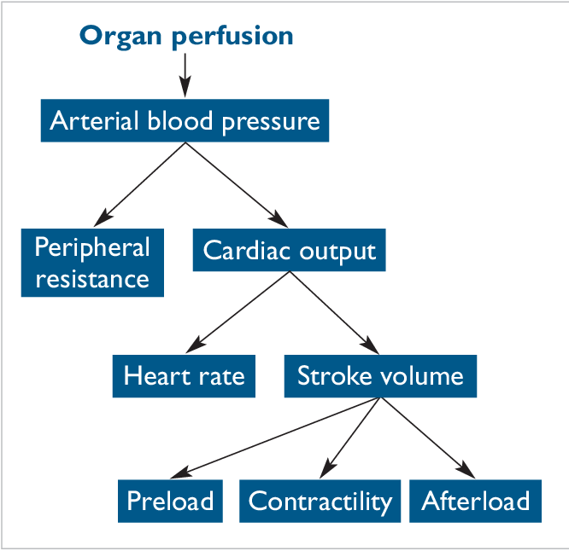
Physiology Of Blood Pressure

Slide 4
Hypertension Etiological Classification
. Primary or essential hypertension: the cause is unknown, constitutes about 95% of cases in adults.
Secondary hypertension: cases where the cause of hypertension can be identified and sometimes treated, around 5% of the cases.

Slide 5
Primary htn, risk factors
tobacco use
high dietary salt
low dietary potassium
low vitamin d
chronic/heavy alcohol use
age above 45 (60 years in women)
race (more in blacks)
family history
overweight/central obesity
physical inactivity

Slide 6
Secondary Hypertension, Causes
Alcohol
obesity
Renal disease (renal vascular disease, glomerulonephritis, polycystic kidney disease).
Endocrine disorders (phaeochromocytoma, Cushing’s syndrome, thyrotoxicosis, congenital adrenal hyperplasia, primary hypothyroidism.
Pregnancy (pre-eclampsia)
Coarctation of the aorta
Drugs (corticosteroids, oestrogen-containing oral contraceptive pill, anabolic steroids).
Psychoactive/recreational drugs: amphetamines, cocaine

Slide 8
Pathogenesis of Complications of Hypertension
Acute complications
Hypertensive emergency & urgency (hypertensive crisis)
Atherosclerosis: CAD, CVA, PAD
Left ventricular hypertrophy and heart failure

Slide 9
Acute Complications
Stroke
Aortic dissection
Acute left ventricular failure
Pulmonary oedema
Adrenergic crisis
Preeclampsia
Require hospitalization and iv medication
Hypertensive urgency:severe hypertension without end organ damage.
Hypertensive emergencies :Presence of severe hypertension(>180/120) with acute end organ damage.
Malignant hypertension
Hypertensive encephalopathy

Slide 10
Complications From Atherosclerosis
ischaemic heart disease (coronary arterial disease).
Stroke
Ischaemic
Haemorrhagic
Peripheral arterial disease
Renal failure (arteriolosclerosis)

Slide 11
History Relevant To Hypertension
Aim of history and physical examination is to look for possible causes, complications and associated risk factors
Note any presenting complaint
In the HPI explore for the following: headache/ confusion, blurred vision ,epistaxis ,focal weakness ,chest pain/ cough/ palpitation/ dyspnoea/ orthopnea/ PND ,oedema ,weight gain ,social history of cigarette smoking and alcohol use ,family history of cardiovascular disease
Past medical history (elevated cholesterol, diabetes and current medication)

Slide 12
Examination:
may reveal features of heart failure,
diminished/absent peripheral pulses in pad
radio-femoral delay in coarctation of the aorta
abdominal bruits in renal artery stenosis
enlarged kidneys in polycystic kidney disease
obesity; BMI
features of Cushing's disease & thyroid disorders.
Tendo xanthomas in hyperlipidemia.
Complications: retinopathy, left ventricular hypertrophy.

Slide 13
Diagnosis
Hypertension is often asymptomatic; pts present due to complications.
Based on at least two elevated blood pressure readings on two separate occasions at least 6 hours apart.
Initial evaluation should aim at picking risk factors e.g. sedentary lifestyle, obesity, family history & complications such as CAD, CVA/TIA, PAD, retinopathy, renal disease.
Features of pheochromocytoma; paroxysmal headache, sweating & palpitations may be revealed in hx.

Slide 14
Initial Work Ups
urinalysis ;Evidence of kidney disease or diabetes; proteinuria, glucose, blood.
Blood glucose :Diagnosis of diabetes.
CBC :Anaemia may indicate CKD
UECS: Diagnosis of renal disease. Electrolytes imbalance may suggest renal or hormonal anomaly. Hypokalemia may indicate primary hypoaldosteronism.
Lipid profile: Dyslipidaemia is a cardiovascular disease risk factor
Thyroid function test.
( ECG ) :Identify cardiac anomalies such as enlargement, infarction, ventricular dysfunction etc
Fundoscopy: hypertensive retinopathy.

Slide 15
Additional Investigations
CXR; quantify cardiomegaly, heart failure & coarctation of the aorta.
Echo: quantify left ventricular hypertrophy.
Renal ultrasound: polycystic renal disease.
Renal angiography: detect renal stenosis.
Urinary catecholamines: pheochromocytoma
Plasma renin activity & aldosterone: detect possible primary hyperaldosteronism.
Urinary cortisol & dexamethasone suppression test: detect Cushing's syndrome.

Slide 16
Management
Management goal: bp control, risk modification, prevention of complications.
The target bp is < 139/83 mmHg, even lower in pts with dm.
Pts on antihypertensive need 3/12 follow up; to monitor bps & reinforce lifestyle advice.
Management is both pharmacological & non pharmacological.

Slide 17
Initiation of BP lowering therapy (pharmacological and non-pharmacological) is decided on two criteria:
the level of SBP and DBP,
the level of total CV risk.
Hypertension should be managed together with other comorbidities and CV risk factors

Slide 18
Non-pharmacologic Therapy
Lifestyle modification alone may unnecessitate the need for antihypertensives in pts with borderline HTN, reduce dose/ number of anti-HTN in pts already on meds & directly reduce cardiovascular risk.
Weight loss
Cessation of smoking/ alcohol intake.
Restriction of salt intake.
Regular physical exercise.
Diet less of saturated fats, high on vegetables & fruits.

Slide 19
When To Initiate Antihypertensive Therapy
Stage 1 hypertension
Lifestyle modification for three months, if no control start drugs.
If has end organ damage/ increased cardiovascular risk: start medication.
Stage two hypertension : Start at diagnosis

Slide 20
Antihypertensives
BP= CO *TPR
Drugs target either to reduce cardiac output or total peripheral resistance.
Reduction of cardiac output: (reduction of either heart rate/ preload) CO= SV* HR.
Diuretics induce sodium & water excretion & thus reduce preload.
Drugs that block RAAS (ACEIS & ARBS), reduce aldosterone release & increase water & sodium excretion.

Slide 21
Cont. ..
Drugs that reduce sympathetic discharge reduce heart rate & thus reduce cardiac output. E.g. beta blockers.
Reduction of total peripheral resistance:
Work by vasodilation of the arterioles & venules.
Include hydralazine, calcium channel blockers.

Slide 22
Angiotensin Converting Enzyme Inhibitors (ACEIs) (e.g. enalapril, lisinopril).
Side effects include: 1st time use hypotension, dry cough, hyperkalemia & renal dysfunction. Uecs indicated before & 2/52 after starting meds.
Angiotensin receptor blockers (ARBs); valsartan. Same action as ACEIS, do not cause cough. Better tolerated.

Slide 23
β-blockers (BBs); e.g. atenolol, metoprolol, propranolol.
Not used as 1st line anti-HTN except in pts with other indications e.g. angina.
Selective β-1 blockers only act on the cardiac beta adrenoreceptors unlike beta-2 agonists which cause Vaso & bronchodilatation

Slide 24
Calcium Channel Blockers (CCBs);
Work by causing vasodilation an therefore reducing TPR.
the dihydropyridines e.g. nifedipine, amlodipine are effective, tolerated.
Side effects include: flushing, palpitations & fluid retention.
Rate limiting CCBS e.g. diltiazem & verapamil are important if hypertension coexists angina.
Side effects include bradycardia.

Slide 25
Thiazide or thiazide-like diuretics & other diuretics, hydrochlorothiazide, loop diuretics (furosemide), potassium sparing diuretics (spironolactone, metolazone).
Work by increasing water & sodium excretion, result in reduction of preload & therefore cardiac output.

Slide 26
others (sympatholytic, α adrenergic blockers e.g. prazosin.
centrally acting alpha 2- agonists e.g. methyldopa & clonidine. Methyldopa is used in pregnancy induced htn, can cause hepatitis & Coombs +ve hemolytic anemia.
Combined alpha & beta antagonists: carvedilol & losartan.
direct arterial vasodilators e.g. hydralazine.

Slide 27
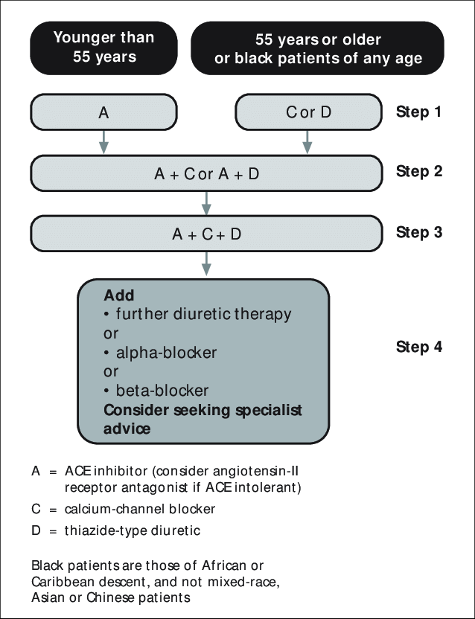
Antihypertensive drug combinations

Slide 29
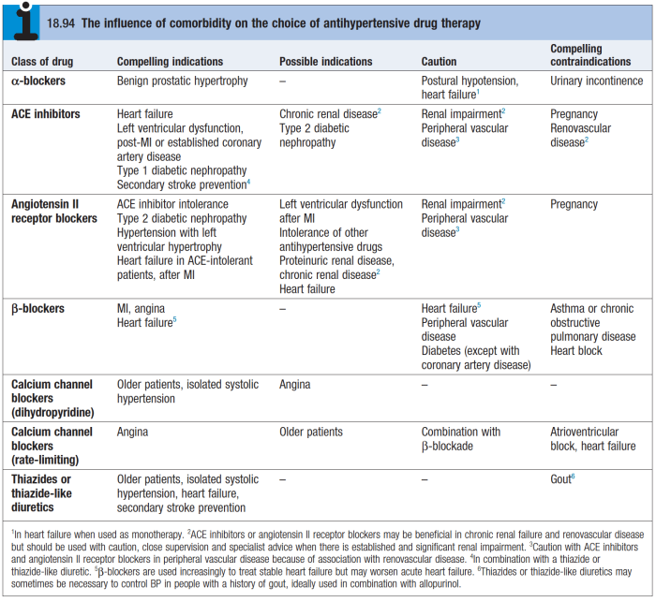

Slide 30
Adjuvant Drug Therapy
Antiplatelet therapy
Antiplatelet therapy reduces cardiovascular risk especially in diabetic pts, end organ damage or 15% 10 year risk of coronary artery disease.
Runs a risk of bleeding, particularly intracerebral haemorrhage.
Statins:
Treating hyperlipidaemia reduces cardiovascular risk.
Indicated in pts with vascular disease/at increased risk of cardiovascular disease.

Slide 31
Hypertensive Urgencies
Hypertensive urgencies: severe elevations in BP without progressive end organ damage/ dysfunction.
Causes:
Non-compliance.
inadequately treated hypertensive individuals.
can be managed in the outpatient setting by investigating the factors that may underlie the BP rise and dose adjustments as necessary.

Slide 32
Hypertensive Emergencies
Hypertensive emergencies: large elevations in SBP or DBP (>180mmHg or >120mmHg, respectively) with acute/ impending or progressive end organ damage.
require immediate BP reduction (not necessarily to normal) to prevent or limit target organ damage.
Types;
Malignant hypertension, hypertensive encephalopathy, stroke, pulmonary edema, aortic dissection, acute left ventricular failure, pre-eclampsia/eclampsia.

Slide 33
Malignant Hypertension
Severe abrupt hypertension associated with:
Diffuse necrotizing vasculitis.
Arteriolar thrombi.
Fibrin deposition in arteriolar walls.
presents with:
Progressive retinopathy, deteriorating renal functions with proteinuria, microangiopathic anemia & encephalopathy.

Slide 34
Pathophysiology
The characteristic vascular lesion is fibrinoid necrosis of arterioles and small arteries, which causes the clinical manifestations of end-organ damage.
Red blood cells are damaged as they flow through vessels obstructed by fibrin deposition, resulting in microangiopathic hemolytic anemia.
Dilatation of cerebral blood vessels resulting in hyper -perfusion & cerebral edema, hypertensive encephalopathy.

Slide 35
Clinical Presentation
Retinal features:
Retinal hemorrhages & exudates on fundoscopy.
Accelerated htn
Papilledema.
Malignant nephrosclerosis:
AKI
Hematuria
Proteinuria.
Glomerular damage, protein leakage, activation of RAAS; high bps.
Neurologic:
Intracerebral bleeding
Subarachnoid hemorrhage
Hypertensive encephalopathy.
Microangiopathic anemia.

Slide 36
Hypertensive Encephalopathy
Transient neurologic symptoms associated with malignant hypertensive emergency.
Result from breakthrough vasodilation of cerebral vasculature due to sudden rise of bps.
Presents with headache, nausea & vomiting, non-localizing signs & symptoms; confusion, seizures, coma.

Slide 37
Management Of Malignant Hypertension
Iv nitroprusside; a non-selective vasodilator.
2-4mcg/kilo/minute.
Side effect; cyanide toxicity especially in pts with renal insufficiency.
Iv Nicardipine; arteriolar vasodilator
Iv labetalol; alpha & beta blocker.
Bolus at 20mg stat, followed by 20-80 mg every ten minutes, maximum dosage of 300mg/day.

Slide 38
Target Blood Pressure:
Initial reduction by 25% over first minutes- 8 hours.
Target a diastolic of 100-105 mmhg over next 2-6 hours & 85-90 over next 2-3 months.
This is to avoid hypotensive crisis & cerebral ischemia.
It also allows gradual healing of damaged necrotic vascular lesions.

Slide 39
Prognosis
Even with good BP control, going forward pts have chronic & acute vascular damage that predisposes them to:
CAD
CVA
PAD
Renal disease.

Slide 40
Acute Ischemic Stroke
Distal to the obstruction, vessels dilate.
Cerebral perfusion is maintained by rising systemic bp.
CPP= MAP – ICP
CPP; cerebral perfusion pressure
MAP; mean arterial pressure
ICP; intracranial pressure.
MAP = 1/3 (SBP – DBP) + DBP

Slide 41
Management
Acute reduction of blood pressure leads to clinical deterioration.
If bp between 220/120 mmHg ; no immediate treatment is needed.
Indications for Rx if BP 220/120 mmHg:
Other end organ damage.
Anticipation of thrombolysis (target <185/110). Reduce BP by 15 % in the 1st 24 hours, if not start management after 24 hrs.

Slide 42
1st line : labetalol, nitroglycerin & iv nicardipine.
2nd line: nitroprusside.
Avoid short acting nifedipine; rapid bp drop & clinical deterioration.

Slide 43
General Management Principles
In hypertensive emergencies, BP should almost never be rapidly lowered.
Goal of 10-20% reduction of MAP in first hour, and then 5-15% further in next 23 hours.
Exceptions:
Aortic dissection: target of SBP of < 120 in 20 minutes)
Acute ischemic stroke (thrombolysis candidate < 185/110)

Slide 44
Acute Intracerebral Hemorrhage
BP lowering when the SBP is> 200 mmHg or the DBP is> 110 mmHg .
If signs of raised ICP, maintain MAP just below 130 mmHg (or SBP < 180 mmHg) for first 24 hours after onset.
Patient without raised ICP, maintain MAP < 110 mmHg (or SBP < 160 mmHg) for first 24 hours after symptoms onset.

Slide 45
Subarachnoid Hemorrhage:
Maintain SBP < 160 mmHg until the aneurysm is treated or cerebral vasospasm occurs.
Oral nimodipine is used to prevent delayed ischemic neurological deficits, but it is NOT indicated for treating acute hypertension.

Slide 46
Aortic Dissection:
reduce the SBP < 110 mmHg and maintain it at this level unless signs of end organ hypo- perfusion are present.
Preferred rx includes a combination of;
narcotic analgesics (morphine sulphate),
β-blockers (labetalol, esmolol) or calcium channel blockers (verapamil, diltiazem); Avoid β-blockers if there is aortic valvular regurgitation or suspected cardiac tamponade.

Slide 47
Acute Coronary Syndrome:
Treat if SBP > 160 mmHg and/or DBP > 100 mmHg.
Reduce BP by 20-30 %of baseline.
Thrombolytics are contraindicated if BP is> 185 / 100 mmHg.
Preferred medications include β-blockers & Nitroglycerin.

Slide 48
Acute Heart Failure:
rx with vasodilators (in addition to diuretics) for SBP ≥140 mmHg.
IV or sublingual nitroglycerin is the preferred agent.

Slide 49
Preeclampsia / eclampsia;
Prepartum and intrapartum: SBP should be < 160 mmHg and DBP < 110mmhg.
If the platelets < 100 , SBP should be maintained below 150/110 mmHg.
IV Magnesium sulphate @ 4 gm diluted in 100mL NS over 15 mins then with an infusion o f 2 gm /hour to avoid seizures.
Preferred medications Hydralazine, Labetalol, Nifedipine

