Slide 3
HYPERTENSION
Samuel Ngigi K.
KMTC

Slide 4
Purpose
Why JNC 7?
  Publication of many new studies.
  Need for a new, clear, and concise guideline useful for clinicians.
  Need to simplify the classification of BP.
Notes:
JNC: Joint National Committee

Slide 5
New Features and Key Messages
For persons over age 50, SBP is a more important than DBP as CVD risk factor.
Starting at 115/75 mmHg, CVD risk doubles with each increment of
20/10 mmHg throughout the BP range.
Persons who are normotensive at age 55 have a 90% lifetime risk for developing HTN.
Those with SBP 120–139 mmHg or DBP 80–89 mmHg should be considered prehypertensive who require health-promoting lifestyle modifications to prevent CVD.
Notes:
Cardiovascular disease (CVD)

Slide 6
New Features and Key Messages (Continued)
Thiazide-type diuretics should be initial drug therapy for most, either alone or combined with other drug classes.
Certain high-risk conditions are compelling indications for other drug classes.
Most patients will require two or more antihypertensive drugs to achieve goal BP.
If BP is >20/10 mmHg above goal, initiate therapy with two agents, one usually should be a thiazide-type diuretic.

Slide 7
New Features and Key Messages (Continued)
The most effective therapy prescribed by the careful clinician will control HTN only if patients are motivated.
Motivation improves when patients have positive experiences with, and trust in, the clinician.
Empathy builds trust and is a potent motivator.
The responsible physician’s judgment remains paramount.

Slide 9



U.S. Department of
Health and Human Services
The Seventh Report of the
Joint National Committee on
Prevention, Detection,
Evaluation, and Treatment of High Blood Pressure (JNC 7)
National Institutes
of Health
National Heart, Lung, and Blood Institute

Slide 10
Blood Pressure Classification
BP Classification | SBP mmHg |  | DBP mmHg
Normal | <120 | and | <80
Prehypertension | 120–139 | or | 80–89
Stage 1 Hypertension | 140–159 | or | 90–99
Stage 2 Hypertension | >160 | or | >100

Slide 11
CVD Risk
HTN prevalence ~ 50 million people in the United States.
The BP relationship to risk of CVD is continuous, consistent, and independent of other risk factors.
Each increment of 20/10 mmHg doubles the risk of CVD across the entire BP range starting from 115/75 mmHg.
Prehypertension signals the need for increased education to reduce BP in order to prevent hypertension.

Slide 12
Benefits of Lowering BP
Average Percent Reduction
Stroke incidence 35–40%
Myocardial infarction 20–25%
Heart failure 50%

Slide 13
Benefits of Lowering BP
In stage 1 HTN and additional CVD risk factors, achieving
a sustained 12 mmHg reduction in SBP over 10 years will
prevent 1 death for every 11 patients treated.

Slide 14
BP Measurement Techniques
Method | Brief Description
In-office | Two readings, 5 minutes apart, sitting in chair. Confirm elevated reading in contralateral arm.
Ambulatory BP monitoring | Indicated for evaluation of “white-coat” HTN. Absence of 10–20% BP decrease during sleep may indicate increased CVD risk.
Self-measurement | Provides information on response to therapy. May help improve adherence to therapy and evaluate “white-coat” HTN.

Slide 15
Office BP Measurement
Use auscultatory method with a properly calibrated and validated instrument.
Patient should be seated quietly for 5 minutes in a chair, feet on the floor, and arm supported at heart level.
Appropriate-sized cuff should be used to ensure accuracy.
At least two measurements should be made.
Clinicians should provide to patients, verbally and in writing, specific BP numbers and BP goals.

Slide 16
Ambulatory BP Monitoring
ABPM is warranted for evaluation of “white-coat” HTN in the absence of target organ injury.
Ambulatory BP values are usually lower than clinic readings.
Awake, individuals with hypertension have an average BP of >135/85 mmHg and during sleep >120/75 mmHg.
BP drops by 10 to 20% during the night; if not, signals possible increased risk for cardiovascular events.

Slide 17
Self-Measurement of BP
Provides information on:
  Response to antihypertensive therapy
  Improving adherence with therapy
  Evaluating white-coat HTN
Home measurement of >135/85 mmHg is generally considered to be hypertensive.
Home measurement devices should be checked regularly.

Slide 19
Patient Evaluation
Evaluation of patients with documented HTN has three objectives:
Assess lifestyle and identify other CV risk factors or concomitant disorders that affects prognosis and guides treatment.
Reveal identifiable causes of high BP.
Assess the presence or absence of target organ damage and CVD.

Slide 20
CVD Risk Factors
Hypertension*
Cigarette smoking
Obesity* (BMI >30 kg/m²)
Physical inactivity
Dyslipidemia*
Diabetes mellitus*
Age (older than 55 for men, 65 for women)
*Components of the metabolic syndrome.
Notes:
Metabolic syndrome is a cluster of conditions that occur together, increasing your risk of heart disease, stroke and type 2 diabetes. These conditions include increased blood pressure, high blood sugar, excess body fat around the waist, and abnormal cholesterol or triglyceride levels.

Slide 21
Identifiable
Causes of Hypertension
Sleep apnea
Drug-induced or related causes
Chronic kidney disease
Primary aldosteronism
Renovascular disease
Chronic steroid therapy and Cushing’s syndrome
Pheochromocytoma
Coarctation of the aorta
Thyroid or parathyroid disease
Notes:
Aldosteronism: a condition in which there is excessive secretion of aldosterone, which disturbs the balance of sodium, potassium, and water in the blood and so leads to high blood pressure.
Cushing syndrome occurs when your body is exposed to high levels of the hormone cortisol for a long time. Cushing syndrome, sometimes called hypercortisolism, may be caused by the use of oral corticosteroid medication. The condition can also occur when your body makes too much cortisol on its own.
A pheochromocytoma (fee-o-kroe-moe-sy-TOE-muh) is a rare, usually noncancerous (benign) tumor that develops in an adrenal gland. You have two adrenal glands —one located at the top of each kidney. Usually, a pheochromocytoma develops in only one adrenal gland. But tumors can develop in both.

Slide 22
Target Organ Damage
Heart
  Left ventricular hypertrophy
  Angina or prior myocardial infarction
  Prior coronary revascularization
  Heart failure
Brain
  Stroke or transient ischemic attack
Chronic kidney disease
Peripheral arterial disease
Retinopathy

Slide 23
Laboratory Tests
Routine Tests
  Electrocardiogram
  Urinalysis
  Blood glucose
  Serum potassium, creatinine, or the corresponding estimated GFR, and calcium
  Lipid profile, after 9- to 12-hour fast, that includes high-density and low-density lipoprotein cholesterol, and triglycerides

Slide 27
Treatment
Overview
Goals of therapy
Lifestyle modification
Pharmacologic treatment
  Algorithm for treatment of hypertension
Classification and management of BP for adults
Follow up and monitoring

Slide 28

TREAT TO TARGET
BLOOD PRESSURE

Slide 29
Goals of Therapy
Reduce CVD and renal morbidity and mortality.
Treat to BP <140/90 mmHg or BP <130/80 mmHg in patients
with diabetes or chronic kidney disease.
Target of 125/75mmHg if proteinuric
Achieve SBP goal especially in persons >50 years of age.

Slide 30
Lifestyle Modification
Modification | Approximate SBP reduction (range)
Weight reduction | 5–20 mmHg/10 kg weight loss
Adopt DASH eating plan | 8–14 mmHg
Dietary sodium reduction | 2–8 mmHg
Physical activity | 4–9 mmHg
Moderation of alcohol consumption | 2–4 mmHg
Notes:
Dietary Approaches to Stop Hypertension (DASH). The DASH diet emphasizes foods that are lower in sodium as well as foods that are rich in potassium, magnesium and calcium — nutrients that help lower blood pressure.

Slide 31
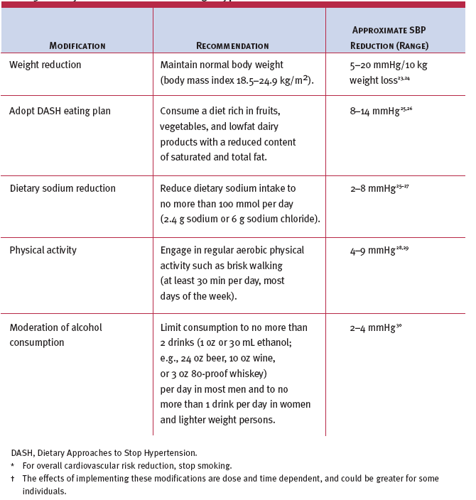

Slide 32
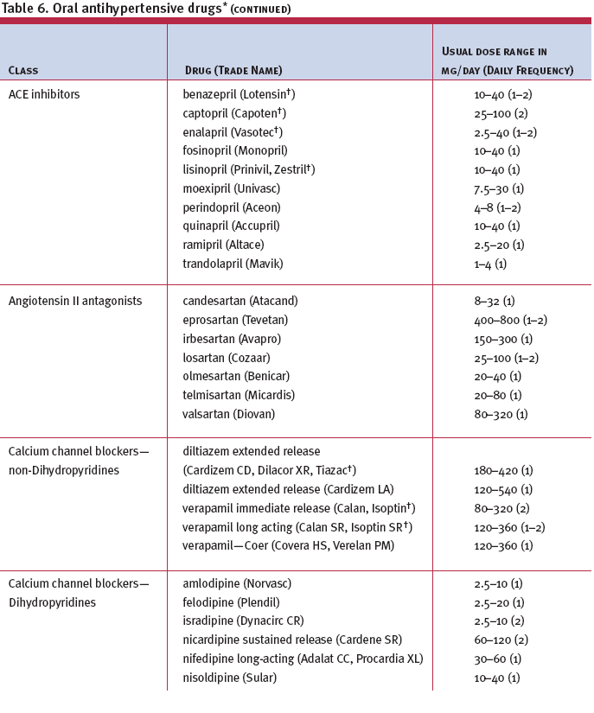

Slide 33
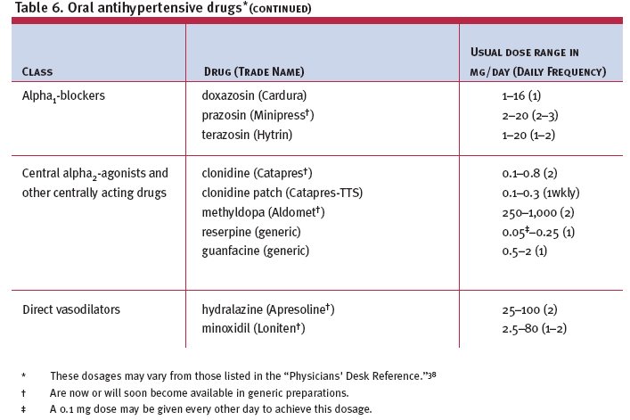

Slide 34
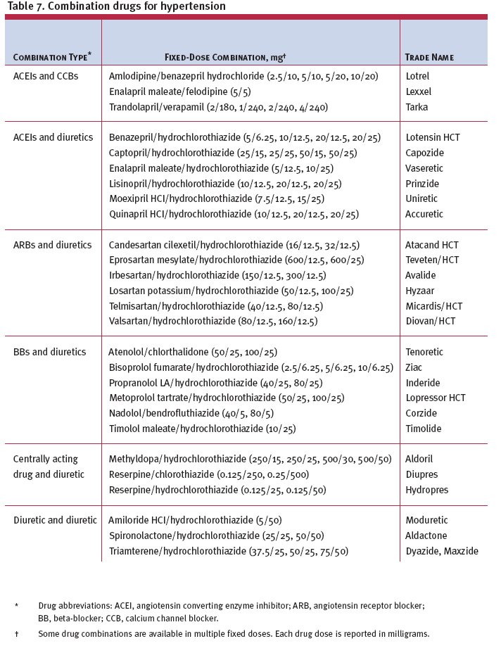

Slide 35
Algorithm for Treatment of Hypertension
Lifestyle Modifications
Not at Goal Blood Pressure (<140/90 mmHg)
(<130/80 mmHg for those with diabetes or chronic kidney disease)
Initial Drug Choices
Without Compelling
Indications
With Compelling
Indications
Stage 1 Hypertension
(SBP 140–159 or DBP 90–99 mmHg)
Thiazide-type diuretics for most.
May consider ACEI, ARB, BB, CCB,
or combination.
Stage 2 Hypertension
(SBP >160 or DBP >100 mmHg)
2-drug combination for most (usually thiazide-type diuretic and
ACEI, or ARB, or BB, or CCB)
Drug(s) for the compelling indications
Other antihypertensive drugs (diuretics, ACEI, ARB, BB, CCB)
as needed.
Not at Goal
Blood Pressure
Optimize dosages or add additional drugs
until goal blood pressure is achieved.
Consider consultation with hypertension specialist.

Slide 36
Classification and Management of BP for adults
BP classification | SBP* mmHg | DBP* mmHg | Lifestyle modification | Initial drug therapy
 |  |  |  | Without compelling indication | With compelling indications
Normal | <120 | and <80 | Encourage
Prehypertension | 120–139 | or 80–89 | Yes | No antihypertensive drug indicated. | Drug(s) for compelling indications. ‡
Stage 1 Hypertension | 140–159 | or 90–99 | Yes | Thiazide-type diuretics for most. May consider ACEI, ARB, BB, CCB, or combination. | Drug(s) for the compelling indications.‡ Other antihypertensive drugs (diuretics, ACEI, ARB, BB, CCB) as needed.
Stage 2 Hypertension | >160 | or >100 | Yes | Two-drug combination for most† (usually thiazide-type diuretic and ACEI or ARB or BB or CCB).
*Treatment determined by highest BP category.
†Initial combined therapy should be used cautiously in those at risk for orthostatic hypotension.
‡Treat patients with chronic kidney disease or diabetes to BP goal of <130/80 mmHg.

Slide 37
Followup and Monitoring
Patients should return for follow up and adjustment of medications until the BP goal is reached.
More frequent visits for stage 2 HTN or with complicating comorbid conditions.
Serum potassium and creatinine monitored 1–2 times per year.

Slide 38
Followup and Monitoring
(continued)
After BP at goal and stable, follow up visits at 3- to 6-month intervals.
Comorbidities, such as heart failure, associated diseases, such as diabetes, and the need for laboratory tests influence the frequency
of visits.

Slide 39
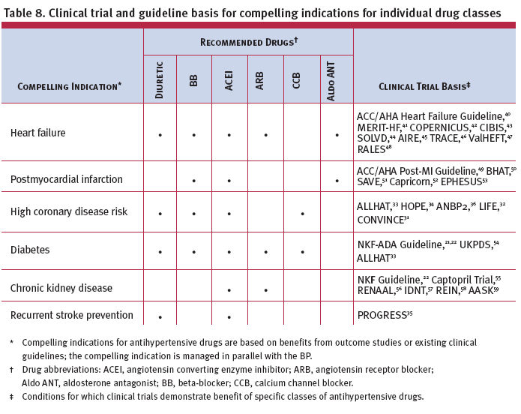

Slide 40
Special Considerations
Compelling Indications
Other Special Situations
  Minority populations
  Obesity and the metabolic syndrome
  Left ventricular hypertrophy
  Peripheral arterial disease
  Hypertension in older persons
  Postural hypotension
  Dementia
  Hypertension in women
  Hypertension in children and adolescents
  Hypertension urgencies and emergencies
Notes:
Orthostatic hypotension — also called postural hypotension — is a form of low blood pressure that happens when you stand up from sitting or lying down. Orthostatic hypotension can make you feel dizzy or lightheaded, and maybe even cause you to faint.

Slide 41
Compelling Indications for
Individual Drug Classes
Compelling Indication | Initial Therapy Options | Clinical Trial Basis
Heart failure
Postmyocardial infarction
High CAD risk
THIAZ, BB, ACEI, ARB, ALDO ANT
BB, ACEI, ALDO ANT
THIAZ, BB, ACE, CCB
ACC/AHA Heart Failure Guideline, MERIT-HF, COPERNICUS, CIBIS, SOLVD, AIRE, TRACE, ValHEFT, RALES
ACC/AHA Post-MI Guideline, BHAT, SAVE, Capricorn, EPHESUS
ALLHAT, HOPE, ANBP2, LIFE, CONVINCE

Slide 42
Compelling Indications for
Individual Drug Classes
Diabetes
Chronic kidney disease
Recurrent stroke prevention
THIAZ, BB, ACE, ARB, CCB
ACEI, ARB
THIAZ, ACEI
NKF-ADA Guideline, UKPDS, ALLHAT
NKF Guideline, Captopril Trial, RENAAL, IDNT, REIN, AASK
PROGRESS
Compelling Indication | Initial Therapy Options | Clinical Trial Basis

Slide 43
Minority Populations
In general, treatment similar for all demographic groups.
Socioeconomic factors and lifestyle important barriers to BP control.
Prevalence, severity of HTN increased in African Americans.
African Americans demonstrate somewhat reduced BP responses to monotherapy with BBs, ACEIs, or ARBs compared to diuretics or CCBs.
These differences usually eliminated by adding adequate doses of a diuretic.

Slide 44
Left Ventricular Hypertrophy
LVH is an independent risk factor that increases the risk of CVD.
Regression of LVH occurs with aggressive BP management: weight loss, sodium restriction, and treatment with all classes of drugs except the direct vasodilators hydralazine and minoxidil.

Slide 45
Peripheral Arterial Disease
(PAD)
PAD is equivalent in risk to ischemic heart disease.
Any class of drugs can be used in most PAD patients.
Other risk factors should be managed aggressively.
Aspirin should be used.

Slide 46
Hypertension in Older
Persons
More than two-thirds of people over 65 have HTN.
This population has the lowest rates of BP control.
Treatment, including those who with isolated systolic HTN, should follow same principles outlined for general care of HTN.
Lower initial drug doses may be indicated to avoid symptoms; standard doses and multiple drugs will be needed to reach BP targets.

Slide 47
Postural Hypotension
Decrease in standing SBP >10 mmHg, when associated with dizziness/fainting, more frequent in older SBP patients with diabetes, taking diuretics, venodilators, and some psychotropic drugs.
BP in these individuals should be monitored in the upright position.
Avoid volume depletion and excessively rapid dose titration of drugs.

Slide 48
Dementia
Dementia and cognitive impairment occur more commonly in people with HTN.
Reduced progression of cognitive impairment occurs with effective antihypertensive therapy.

Slide 49
Hypertension in Women
Oral contraceptives may increase BP, and BP should be checked regularly. In contrast, HRT does not raise BP.
Development of HTN—consider other forms of contraception.
Pregnant women with HTN should be followed carefully. Methyldopa, BBs, and vasodilators, preferred for the safety of the fetus. ACEI and ARBs contraindicated in pregnancy.

Slide 50
Children and Adolescents
HTN defined as BP—95th percentile or greater, adjusted for age, height, and gender.
Use lifestyle interventions first, then drug therapy for higher levels of BP or if insufficient response to lifestyle modifications.
Drug choices similar in children and adults, but effective doses are often smaller.
Uncomplicated HTN not a reason to restrict physical activity.

Slide 51
Hypertensive Urgencies and Emergencies
Patients with marked BP elevations and acute TOD (e.g., encephalopathy, myocardial infarction, unstable angina, pulmonary edema, eclampsia, stroke, head trauma, life-threatening arterial bleeding, or aortic dissection) require hospitalization and parenteral drug therapy.
Patients with markedly elevated BP but without acute TOD usually do not require hospitalization, but should receive immediate combination oral antihypertensive therapy.

Slide 52
Additional Considerations in Antihypertensive Drug Choices
Potential favorable effects
Thiazide-type diuretics useful in slowing demineralization in osteoporosis.
BBs useful in the treatment of atrial tachyarrhythmias/fibrillation, migraine, thyrotoxicosis (short-term), essential tremor, or perioperative HTN.
CCBs useful in Raynaud’s syndrome and certain arrhythmias.
Alpha-blockers useful in prostatism.

Slide 53
Additional Considerations in Antihypertensive Drug Choices
Potential unfavorable effects
Thiazide diuretics should be used cautiously in gout or a history of significant hyponatremia.
BBs should be generally avoided in patients with asthma, reactive airways disease, or second- or third-degree heart block.
ACEIs and ARBs are contraindicated in pregnant women or those likely to become pregnant.
ACEIs should not be used in individuals with a history of angioedema.
Aldosterone antagonists and potassium-sparing diuretics can cause hyperkalemia.

Slide 54
Improving Hypertension Control
Adherence to regimens
Resistant hypertension

Slide 55
Strategies for Improving
Adherence to Regimens
Clinician empathy increases patient trust, motivation, and adherence to therapy.
Physicians should consider their patients’ cultural beliefs and individual attitudes in formulating therapy.

Slide 56
Causes of
Resistant Hypertension
Improper BP measurement
Excess sodium intake
Inadequate diuretic therapy
Medication
  Inadequate doses
  Drug actions and interactions (e.g., nonsteroidal anti-inflammatory drugs (NSAIDs), illicit drugs, sympathomimetics, oral contraceptives)
  Over-the-counter (OTC) drugs and herbal supplements
Excess alcohol intake
Identifiable causes of HTN

Slide 57
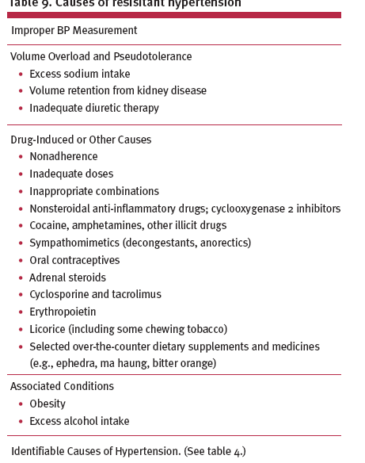

Slide 58
Public Health Challenges and Community Programs
Public health approaches (e.g. reducing calories, saturated fat, and salt in processed foods and increasing community/school opportunities for physical activity) can achieve a downward shift in the distribution of a population’s BP, thus potentially reducing morbidity, mortality, and the lifetime risk of an individual’s becoming hypertensive.
These public health approaches can provide an attractive opportunity to interrupt and prevent the continuing costly cycle of managing HTN and its complications.

Slide 59
Population-Based Strategy
SBP Distributions
After
Intervention
Before
Intervention
Reduction
in BP
Reduction in SBP
mmHg
2
3
5
% Reduction in Mortality
Stroke CHD Total
–6 –4 –3
–8 –5 –4
–14 –9 –7

Slide 60
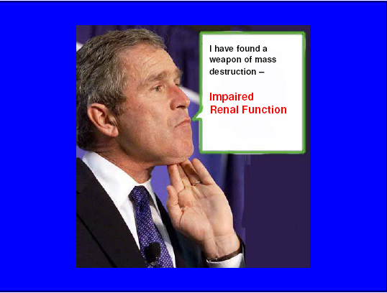

Slide 61
Thank you

Slide 62

THANK YOU
THE END

