Slide 1
CIRCULATORY DISTURBANCES OF OBSTRUCTIVE NATURE
By Kate (SCO)

Slide 2
HAEMORRAGE AND HAEMOSTASIS

Slide 3
HAEMORRHAGE
Haemorrhage is the escape of blood from a blood vessel.
BLEEDING DISORDERS
Also called HAEMORRHAGIC DIATHESIS
Bleeding disorders are a group of disorders characterised by defective haemostasis with abnormal bleeding.

Slide 4
CAUSES
They are divided into:
Haemorrhagic diathesis due to vascular abnormalities.
Haemorrhagic diathesis related to platelet abnormalities. E.g. thrombocytopaenia
Disorders of coagulation factors. E.g. Haemophilia, Christmas Disease
Haemorrhagic diathesis due to fibrinolytic defects.
Combination of all these as occurs in disseminated intravascular coagulation (DIC).

Slide 5
BLOOD GROUPS AND BLOOD TRANSFUSION

Slide 6
BLOOD GROUP ANTIGENS AND ANTIBODIES
Discribed by Karl Landsteiner in 1900.
The term blood group is applied to any well-defined system of red blood cell antigens which are inherited characteristics.
There are over 20 blood group systems having approximately 400 blood group antigens.
The ABO and Rhesus (Rh) blood group systems are of major clinical significance.
Other minor and clinically less important blood group systems are: Lewis system, P system, I system, MNS system, Kell and Duffy system, and Luthern system.

Slide 7
Blood type/ blood group is a classification of blood, based on the presence and absence of antibodies and inherited antigenic substances on the surface of RBCs.
ABO SYSTEM.
This system consists of 3 major allelic genes: A, B and O, located on the long arm of chromosome 9.
These genes control the synthesis of blood group antigens A and B.
These antigens may be proteins, carbohydrates, glycoproteins or glycolipids depending on the blood group system.
Some of these antigens are also present on the surface of other types of cells of various tissues.

Slide 8
Regarding the antigen property of the blood all human beings can be classified into 4 groups, those with antigen A (group A), those with antigen B (group B), those with both antigen A and B (group AB) and those with neither antigen (group O).
The ABO Blood Groups.
Blood Group Antigens on Red Cells Naturally-Occurring Serum Antibodies
AB AB None
A A Anti-B
B B Anti-A
O O Anti-A, Anti-B

Slide 9
RHESUS SYSTEM.
The Rh allelic genes are C or c, D or d and E or e, located on chromosome 1.
The most significant Rh antigen is the D antigen, because it is the most likely to provoke an immune system response of the five main Rh antigens.
The presence or absence of the Rh(D) antigen is signified by the + or − sign, so that, for example, the A− group is ABO type A and does not have the Rh (D) antigen.

Slide 10
BLOOD TRANSFUSION
Compatibility procedure consists of the following:
ABO and Rh(D) grouping of the patient (recipient).
Antibody screening of the patient’s serum to detect the presence of clinically significant antibodies.
Selecting the donor blood of the same ABO and Rh group.
Cross-matching the patient’s serum against donor red cells to confirm donor-recipient compatibility.

Slide 11
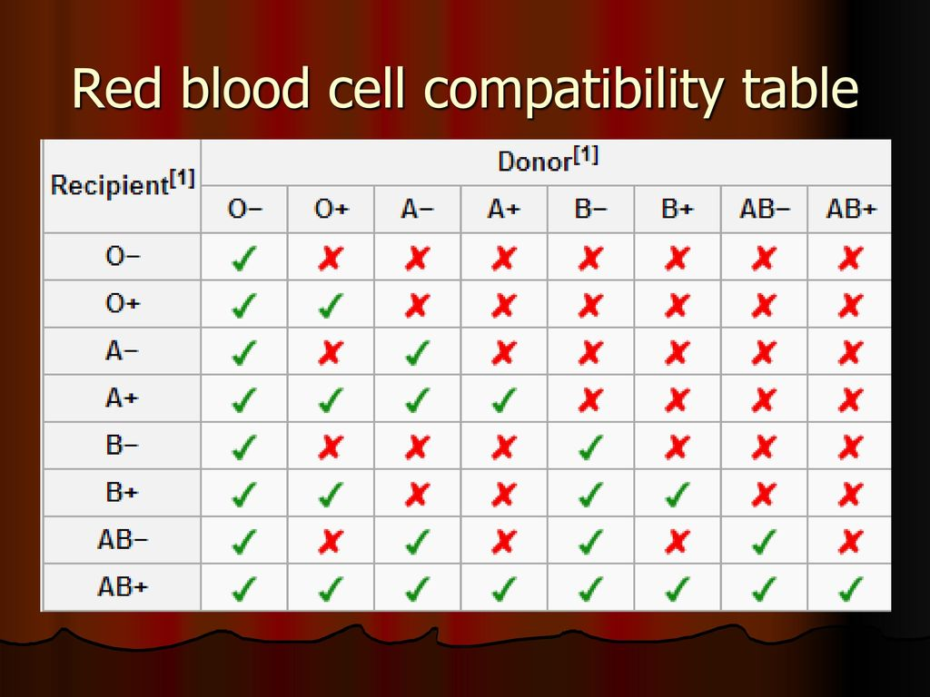

Slide 12
Complications of Blood Transfusion
A carefully prepared and supervised blood transfusion is quite safe. However, in 5-6% of transfusions, complications occur, some of which are minor while others are more serious and at times fatal.
Transfusion reactions are classified into 2 types:
Immunologic transfusion reactions- may be against red blood cells (haemolytic reactions), leucocytes, platelets or immunoglobulins.
Non-immune transfusion reactions- include circulatory overload, massive transfusion, or transmission of an infectious agent.

Slide 13
BLOOD COMPONENTS
Packed RBCs. These are used to raise the oxygen-carrying capacity of blood and are used in normovolaemic patients of anaemia without cardiac disease. One unit of packed RBCs may raise haemoglobin by 1 g/dl.
Platelets. Transfusion of platelets is done in patients of thrombocytopenia who have haemorrhage. Each unit of platelets can raise platelet count by 5,000 to 10,000/μl.
Fresh frozen plasma. FFP contains plasma proteins and coagulation factors that include albumin, protein C and S and antithrombin. FFP transfusion in indicated in patients of coagulation failure and TTP. Each unit of FFP raises coagulation factors by about 2%.
Cryoprecipitate. Cryoprecipitate is a source of insoluble plasma proteins, fibrinogen, factor VIII and von Willebrand Factor. Transfusion of single unit of cryoprecipitate yields about 80 IU of factor VIII.

Slide 14
HOMEOSTASIS

Slide 15
Normal haemostasis accomplish two functions
Maintain blood in fluid, clot free state in normal vessels
Induces haemostasis clot at the site of any vascular injury

Slide 16
The pathologic opposite of haemostasis is thrombosis which is the inappropriate activation of normal haemostatic processes such as the formation of a blood clot (thrombus in uninjured vasculature or in a minor injury)
Both haemostasis and thrombosis are regulated by 3 general components:
Vascular wall (vascular endothelium)
Platelets
Coagulation cascade (clotting or coagulation process)

Slide 17
Normal haemostasis
Injury-arteriolar vasoconstriction due to reflex neurogenic mechanism and endothelin release
Primary haemostasis- aggregation of platelets at the site of the injury which also discharge the contents of their storage granules-platelet release reaction -ADP, 5hydroxytryptamine, platelet factor 3, thromboxane A2 and stable prostaglandins
Secondary haemostasis- tissue factor-procoagulant synthesized by endothelium exposed at the site of injury together with platelet secreted factor activate the coagulation cascade- thrombin then thrombin converts circulating soluble fibrinogen to insoluble fibrin

Slide 18
Thrombus and anti thrombotic events where polymerized fibrin and platelet aggregate form a solid permanent plug to prevent further haemorrhage ensue. At this stage – counter regulatory mechanisms e.g. tissue plasminogen activator (+-PA) are set in motion to limit the haemostatic plug to the site)

Slide 19
Antithrombotic properties:
Antiplatelet effects- intact endothelium and even if activated, thrombocytes may be both of which are potent vasodilators
Anticoagulant effect- mediated by membrane of associated heparin like molecules and thrombo-modulin. They act with antithrombin III to inactivate thrombin factor Xa.
Fibrolytic effects- endothelial cells synthesize tissue- type plasminogen activator promoting fibrinolytic activities to clear fibrin deposists from endothelial surfaces.

Slide 20
COAGULATION

Slide 21
The coagulation (clotting system)
This is the conversion of fibrinogen into solid fibrin
The coagulation system is involved in both haemostatic process and thrombus formation
Intrinsic (blood) pathway
Extrinsic (tissue) pathway

Slide 22
Fibrinogen I
Prothrombin II
Tissue factor III
Calcium IV
Pro-accellerin V
Pro-convertin VII
Antihaemophilic factor VIII
Christmas factor Plasma thromboplastin IX
Stuart factor X
Plasma Thromboplastin Antecedent XI
Hageman factor XII
Fibrin stabilizing factor XIII
CLOTING FACTORS

Slide 23
Coagulation “cascade”
INTRINSIC(contact)/EXTRINSIC(Tissue Factor)
Proenzymes→Enzymes
Prothrombin(II)→Thrombin(IIa)
Fibrinogen(I)→Fibrin(Ia)
Cofactors
  Ca++
  Phospholipid (from platelet membranes)
Vitamin-K dep. factors: II, VII, IX, X, Prot. S, C, Z

Slide 24
The intrinsic pathway
Contact with abnormal surface leads to activation of factor XII and the sequential interactions of factors XI, IX, VIII and finally factor X, along with calcium ions (factor IV) and platelet factor 3.

Slide 25
The extrinsic pathway
Tissue damage results in the release of tissue factor or thromboplastin. Tissue factor on interaction with factor VII activates factor X.

Slide 26
The common pathway
It begins where both intrinsic and extrinsic pathways converge to activate factor X which forms a complex with factor Va and platelet factor 3, in the presence of calcium ions. This complex activates prothrombin (factor II) to thrombin (factor IIa) which, in turn, converts fibrinogen to fibrin. Initial monomeric fibrin is polymerised to form insoluble fibrin by activation of factor XIII.

Slide 27
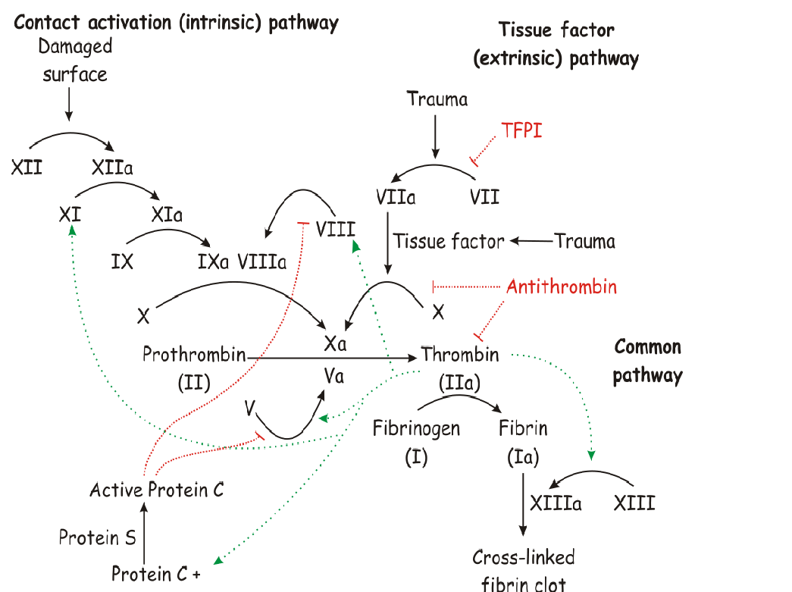
Coagulation cascade illustration

Slide 28
Coagulation is also regulated by 3 types of natural anticoagulants
a) antithrombins e.g. antithrombin III which inhibit activities of thrombin and factors IXa, Xa, Xia and XIIa
b) Protein C and S vitamin K dependent proteins, inactivate factor Va and VIIIa
c) Tissue factor pathway inhibitor Inactivates factor Xa andVIIa

Slide 29
THROMBOSIS

Slide 30
Def…
Is the process of formation of solid mass in circulation from the constituents of flowing blood; the mass itself is called a thrombus.

Slide 31
Composition of thrombi
Pale thrombus- mainly found in first flowing blood as in arteries and consist of aggregated platelets with some fibrin. Arterial thrombi tend to be white and mural. White thrombi are firm and pale.
Red thrombus- which occurs mainly in stagnant blood vessels where strands of fibrin lying among elements of whole blood. The venous thrombi are red and occlusive. They are soft, red and gelatinous
Mixed thrombus- form in slowly moving blood. They consist of alternate white and red layers called lines of Zahn.

Slide 32
NOTE
Formation of a solid or semi-solid mass from the constituents of the blood within the vascular system during life.
In contrast, a blood clot is the mass of coagulated blood formed in vitro.

Slide 33
VIRCHOW’S TRIAD
Virchow described three primary events which predispose to thrombus formation:
Endothelial injury
Haemodynamic changes (Altered blood flow)
Hypercoagulability of blood.

Slide 34
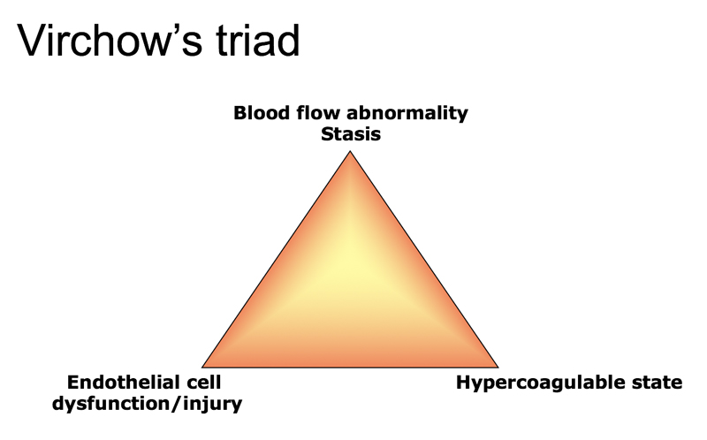

Slide 35
                ENDOTHELIAL INJURY.
The integrity of blood vessel wall is important for maintaining normal blood flow. An intact endothelium has the following functions:
It protects the flowing blood from the thrombogenic influence of subendothelium.

Slide 36
It elaborates a few anti-thrombotic factors (thrombosis inhibitory factors) e.g. Heparin-like substance which accelerates the action of antithrombin III and inactivates some other clotting factors.
It can release a few prothrombotic factors which have procoagulant properties (thrombosis favouring factors) e.g. a) Thromboplastin or tissue factor released from endothelial cells.

Slide 37
Vascular injury exposes the subendothelial connective tissue (e.g.collagen, elastin, fibronectin, laminin and glycosaminoglycans) which are thrombogenic and thus plays important role in initiating haemostasis as well as thrombosis.
Endothelial injury is of major significance in the formation of arterial thrombi and thrombi of the heart, especially of the left ventricle.

Slide 38
  ROLE OF PLATELETS.
Following endothelial cell injury, platelets come to play a central role in normal haemostasis as well as in thrombosis.
Platelet adhesion. The platelets in circulation recognise the site of endothelial injury and adhere to exposed subendothelial collagen (primary aggregation)
Platelet release reaction. The activated platelets then undergo release reaction by which the platelet granules are released to the exterior. (There is ADP released here- adenosine diphosphate)

Slide 39
Platelet aggregation. Following release of ADP, a potent platelet aggregating agent, aggregation of additional platelets takes place (secondary aggregation). This results in formation of temporary haemostatic plug

Slide 40
HAEMODYNAMIC CHANGES / ALTERATION OF BLOOD FLOW.
Turbulence means unequal flow while stasis means slowing.
Normally, there is axial flow of blood, most rapidly-moving central stream consists of leucocytes and red cells. Platelets are present in the slow-moving laminar stream adjacent to the central stream while the peripheral stream consists of most slow-moving cell-free plasma close to endothelial layer

Slide 41
Turbulence and stasis occur in thrombosis in which the normal axial flow of blood is disturbed. When blood slows down, blood cells including platelets marginate to the periphery and form a pavement close to endothelium (margination and pavementing)Turbulence may injure the endothelium resulting in deposition of platelets and fibrin.
Formation of arterial and cardiac thrombi is facilitated by turbulence in the blood flow, while stasis initiates the venous thrombi even without evidence of endothelial injury.

Slide 42
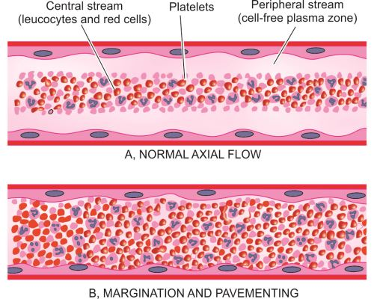

Slide 43
NOTE
Non-laminar flow, Turbulence, Eddies, Stasis, “Disrupted” endothelium.
ALL of these factors may bring platelets into contact with endothelium and/or ECF.

Slide 44
            Hypercoagubility states
Changes in blood favouring platelets aggregation and fibrin formation.
The coagulation system is involved in both haemostatic process and thrombus formation.

Slide 45
Hypercoagulability may occur by the following changes in the composition of blood:
i) Increase in coagulation factors e.g. fibrinogen, prothrombin, factor VIIa, VIIIa and Xa.
ii) Increase in platelet count and their adhesiveness.
iii) Decreased levels of coagulation inhibitors e.g. antithrombin III, fibrin split products.

Slide 46
Formation of thrombus

Slide 47
PREDISPOSING FACTORS TO THROMBOSIS
    Primary (Genetic) factors:
    Deficiency of antithrombin
    Deficiency of protein C or S
    Defects in fibrinolysis
    Mutation in factor V

Slide 48
    Secondary (acquired) factors:
    Risk factors:
    Advanced age
    Prolonged bed-rest
    Immobilisation
    Cigarette smoking

Slide 49
b) Clinical conditions predisposing to thrombosis:
Heart diseases (e.g. myocardial infarction, CHF, rheumatic mitral stenosis, cardiomyopathy)
Vascular diseases (e.g. atherosclerosis, aneurysms of the aorta and other vessels, varicosities of leg veins)
Hypercoagulable conditions (e.g. polycythaemia, dehydration, nephrotic syndrome , disseminated cancers)

Slide 50
site:/predisposing factors of emboli formation
Cardiac thrombosis: - walls of the chambers of the heart and valve cusps in cases of myocardial infarction.
Arterial thrombosis- rare and uncommon because of rapid blood flow
Atheroma is by far the commonest predisposing lesion. It consists of multiple particles of fibrous thickening and lipid depositing in the intima of arteries of various sizes
Aneurysms
Inflammatory lesions
Hypertension

Slide 51
C. Venous thrombosis posterior tibial and popliteal veins,femoral and iliac
Bed ridden after surgery
Malnutrition
Severe debilitating disease
Carcinoma
Leukaemia
Polycythaemia rubra vera
Inflammation of veins(phlebitis – thrombophlebitis
D. Capillary thrombosis – severe acute inflammatory lesions

Slide 52
FATE OF THROMBUS
1. RESOLUTION.
Thrombus activates the fibrinolytic system with consequent release of plasmin which may dissolve the thrombus completely resulting in resolution.
2. ORGANISATION.
If thrombus is not removed, it’s organised. Phagocytic cells (neutrophils and macrophages) appear and begin to phagocytose fibrin and cell debris. Capillaries grow into the thrombus from the site of its attachment and fibroblasts start invading the thrombus. The thrombus becomes part of vessel wall. The new vascular channels in it may be able to re-establish the blood flow, called recanalisation.

Slide 53
4. THROMBOEMBOLISM.
The thrombi in early stage and infected thrombi are quite friable and may get detached from the vessel wall. These are released in part or completely in bloodstream as emboli.
3. PROPAGATION.
The thrombus may enlarge in size due to more deposition from the constituents of flowing blood. It may ultimately cause obstruction of some important vessel.

Slide 54
NOTE
Thrombi developing in the unruptured cardiovascular system may be life-threatening by causing one of the following harmful effects:
Ischaemic injury. Thrombi may decrease or stop the blood supply to part of an organ or tissue and cause ischaemia which may subsequently result in infarction.
Thromboembolism. The thrombus or its part may get dislodged and be carried along in the bloodstream as embolus to lodge in a distant vessel.

Slide 55
EMBOLISM

Slide 56
Def…
Embolism is the process of partial or complete obstruction of some part of the cardiovascular system by any mass carried in the circulation.
Embolism is the process of transference of abnormal material by the blood stream and its impaction in a vessel

Slide 57
The transported intravascular mass detached from its site of origin is called an embolus.
Most forms of emboli (90%) are thromboemboli i.e. originating from thrombi or their parts detached from the vessel wall.
By far, this is a dramatic effect arising from thrombosis. Rare forms of emboli include fat, bubbles of air, athero sclerotic debris; tumours and bits of bone narrow.

Slide 58
TYPES OF EMBOLI
Depending upon the matter in the emboli:
Solid e.g. detached thrombi (thromboemboli), atheromatous material, tumour cell clumps, tissue fragments, parasites, bacterial clumps, foreign bodies.
Liquid e.g. fat globules, amniotic fluid, bone marrow.
Gaseous e.g. air, other gases.

Slide 59
B. Depending upon whether infected or not:
Bland - when sterile.
Septic - when infected.

Slide 60
C. Depending upon the source of the emboli:
Cardiac emboli from left side of the heart e.g. emboli originating from atrium and atrial appendages, infarct in the left ventricle, vegetations of endocarditis.
Arterial emboli e.g. in systemic arteries in the brain, spleen, kidney, intestine.
Venous emboli e.g. in pulmonary arteries.
Lymphatic emboli can also occur.

Slide 61
D. Depending upon the flow of blood, two special types of emboli are mentioned:
Paradoxical embolus. An embolus which is carried from the venous side of circulation to the arterial side or vice versa e.g. through arteriovenous communication such as in patent foramen ovale, septal defect of the heart, and arteriovenous shunts in the lungs.
Retrograde embolus. An embolus which travels against the flow of blood. e.g. metastatic deposits in the spine from carcinoma prostate.

Slide 62
Effects
Pulmonary Thrombo-embolism
Systemic embolism- brain, lower limps
Septic emboli

Slide 63
QUESTIONS

Slide 64
What is thromboembolism?
What are the different types of thromboembolism?

Slide 65
Discovery is one way of finding answers

