Slide 1
Head and face
Skull
The skull is a strong, bony capsule that rests on the neck and encloses the brain.
The adult skull consists of 28 bones, including 6 middle ear ossicles located within the 2 middle ear cavities
It consists of two major parts:
The neurocranium (cranial vault) – This consists of the floor, sides and roof of the cranium. The latter two together are called the calvaria or ‘skullcap’. The neurocranium contains and protects the brain
The viscerocranium (facial skeleton). The viscerocranium supports mainly the facial muscles and a variety of anatomical structure

Slide 2
The viscerocranium contains and protects the upper parts of the digestive and respiratory system
The floor of the neurocranium contains numerous openings and holes called foramina (singular foramen)
Cranial nerves from the brain and their branches leave through specific holes to be distributed to various areas of the head to supply muscle, glands, skin or muvous membrane. Blood vessels also pass through these foramina

Slide 3
The skull is a bony structure that supports the face and forms a protective cavity for the brain. It is comprised of many bones, which are formed by intramembranous ossification, and joined by sutures (fibrous joints).
The bones of the skull can be considered as two groups: those of the cranium (which consist of the cranial roof and cranial base) and those of the face.

Slide 4
Cranium
The cranium (also known as the neurocranium) is formed by the superior aspect of the skull. It encloses and protects the brain, meninges, and cerebral vasculature.
Anatomically, the cranium can be subdivided into a roof and a base:
Cranial roof – comprised of the frontal, occipital and two parietal bones. It is also known as the calvarium.
Cranial base – comprised of six bones: frontal, sphenoid, ethmoid, occipital, parietal and temporal. These bones articulate with the 1st cervical vertebra (atlas), the facial bones, and the mandible (jaw).

Slide 5
The bones of the cranium are:
frontal bone
2 parietal bones
2 temporal bones
1 occipital bone
1 sphenoid bone
1 ethmoid bone.

Slide 6
Frontal bone
This is the bone of the forehead.
It forms part of the orbital cavities (eye sockets) and the prominent ridges above the eyes, the supraorbital margins.
Just above the supraorbital margins, within the bone, are two air-filled cavities or sinuses lined with ciliated mucous membrane, which open into the nasal cavity.
The coronal suture joins the frontal and parietal bones and other fibrous joints are formed with the sphenoid, zygomatic, lacrimal, nasal and ethmoid bones.
The bone originates in two parts joined in the midline by the frontal suture

Slide 7
Parietal bones
These bones form the sides and roof of the skull.
They articulate with each other at the sagittal suture, with the frontal bone at the coronal suture, with the occipital bone at the lambdoidal suture and with the temporal bones at the squamous sutures.
The inner surface is concave and is grooved to accommodate the brain and blood vessels.

Slide 8
Temporal bones
These bones lie one on each side of the head and form fibrous immovable joints with the parietal, occipital, sphenoid and zygomatic bones.
Each temporal bone has several important features.
The squamous part is the thin fan-shaped area that articulates with the parietal bone. The zygomatic process articulates with the zygomatic bone to form the zygomatic arch (cheekbone)

Slide 9
The mastoid part contains the mastoid process, a thickened region easily felt behind the ear.
It contains a large number of very small air sinuses that communicate with the middle ear and are lined with squamous epithelium.
The petrous portion forms part of the base of the skull and contains the organs of hearing (the spiral organ) and balance.

Slide 10
The temporal bone articulates with the mandible at the temporomandibular joint, the only movable joint of the skull.
Immediately behind this articulating surface is the external acoustic meatus (auditory canal), which passes inwards towards the petrous portion of the bone.
The styloid process projects from the lower process of the temporal bone, and supports the hyoid bone (u-shaped bone located at root of the tongue) and muscles associated with the tongue and pharynx.

Slide 11
Occipital bone
This bone forms the back of the head and part of the base of the skull.
It has immovable fibrous joints with the parietal, temporal and sphenoid bones.
Its inner surface is deeply concave and the concavity is occupied by the occipital lobes of the cerebrum and by the cerebellum. The occiput has two articular condyles that form condyloid joints with the first bone of the vertebral column, the atlas.
This joint permits nodding movements of the head. Between the condyles is the foramen magnum (meaning ‘large hole’) through which the spinal cord passes into the cranial cavity.

Slide 12
Sphenoid bone
This bone occupies the middle portion of the base of the skull and it articulates with the occipital, temporal, parietal and frontal bones .
It links the cranial and facial bones, and cross braces the skull.
On the superior surface in the middle of the bone is a little saddle-shaped depression, the hypophyseal fossa (sella turcica) in which the pituitary gland rests.
The body of the bone contains some fairly large air sinuses lined with ciliated mucous membrane with openings into the nasal cavity.

Slide 13
Ethmoid bone
The ethmoid bone occupies the anterior part of the base of the skull and helps to form the orbital cavity, the nasal septum and the lateral walls of the nasal cavity.
On each side are two projections into the nasal cavity, the superior and middle conchae or turbinated processes.
It is a very delicate bone containing many air sinuses lined with ciliated epithelium and with openings into the nasal cavity.
The horizontal flattened part, the cribriform plate, forms the roof of the nasal cavity and has numerous small foramina through which nerve fibres of the olfactory nerve (sense of smell) pass upwards from the nasal cavity to the brain.
There is also a very fine perpendicular plate of bone that forms the upper part of the nasal septum.

Slide 14
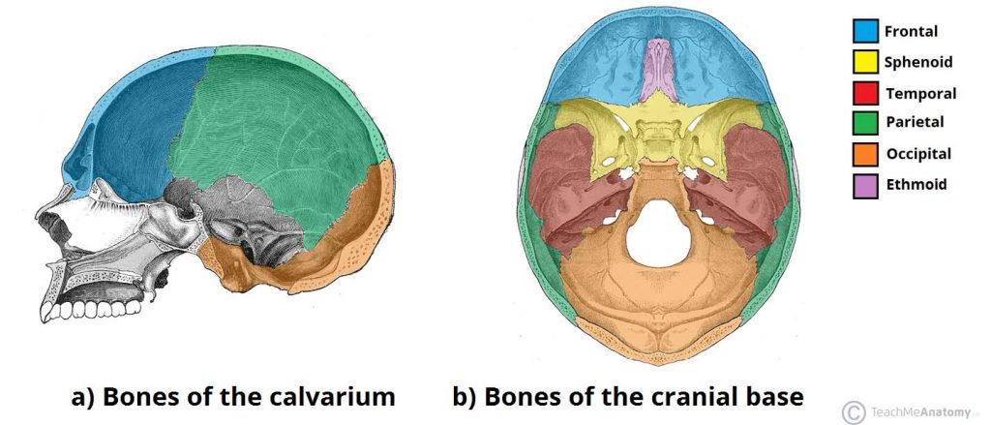

Slide 15
Face
The facial skeleton (also known as the viscerocranium) supports the soft tissues of the face.
It consists of 14 bones, which fuse to house the orbits of the eyes, the nasal and oral cavities, and the sinuses.
The frontal bone, typically a bone of the calvaria, is sometimes included as part of the facial skeleton.

Slide 16
The skeleton of the face is formed by 13 bones in addition to the frontal bone already described.
2 zygomatic (cheek) bones
1 maxilla
2 nasal bones
2 lacrimal bones
1 vomer
2 palatine bones
2 inferior conchae
1 mandible

Slide 17
Zygomatic (cheek) bones
The zygomatic bone originates as two bones that fuse before birth.
They form the prominences of the cheeks and part of the floor and lateral walls of the orbital cavities.

Slide 18
Maxilla (upper jaw bone)
This originates as two bones, but fusion takes place before birth.
The maxilla forms the upper jaw, the anterior part of the roof of the mouth, the lateral walls of the nasal cavity and part of the floor of the orbital cavities.
The alveolar ridge, or process, projects downwards and carries the upper teeth.
On each side is a large air sinus, the maxillary sinus, lined with ciliated mucous membrane and with openings into the nasal cavity.

Slide 19
Nasal bones
These are two small flat bones that form the greater part of the lateral and superior surfaces of the bridge of the nose.
Lacrimal bones
These two small bones are posterior and lateral to the nasal bones and form part of the medial walls of the orbital cavities.
Each is pierced by a foramen for the passage of the nasolacrimal duct that carries the tears from the medial canthus (the inner corner of the eye where upper and lower lid meets) of the eye to the nasal cavity.

Slide 20
Vomer
The vomer is a thin flat bone that extends upwards from the middle of the hard palate to form most of the inferior part of the nasal septum.
Superiorly it articulates with the perpendicular plate of the ethmoid bone.
Palatine bones
These are two small L-shaped bones.
The horizontal parts unite to form the posterior part of the hard palate and the perpendicular parts project upwards to form part of the lateral walls of the nasal cavity.
At their upper extremities they form part of the orbital cavities.

Slide 21
Inferior conchae
Each concha is a scroll-shaped bone, which forms part of the lateral wall of the nasal cavity and projects into it below the middle concha.
The superior and middle conchae are parts of the ethmoid bone.
The conchae collectively increase the surface area in the nasal cavity, allowing inspired air to be warmed and humidified more effectively.

Slide 22
Mandible (lower jaw bone)
This is the lower jaw, the only movable bone of the skull.
It originates as two parts that unite at the midline.
Each half consists of two main parts: a curved body with the alveolar ridge containing the lower teeth and a ramus, which projects upwards almost at right angles to the posterior end of the body.

Slide 23
At the upper end the ramus divides into the condylar process which articulates with the temporal bone to form the temporomandibular joint and the coronoid process, which gives attachment to muscles and ligaments that close the jaw.
The point where the ramus joins the body is the angle of the jaw.

Slide 24
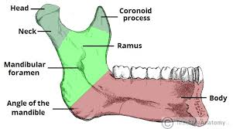

Slide 25
Hyoid bone
This is an isolated horseshoe-shaped bone lying in the soft tissues of the neck just above the larynx and below the mandible.
It is located in the upper neck near the level of the inferior mandible, with the tips of the “U” pointing posteriorly.
It does not articulate with any other bone, but is attached to the styloid process of the temporal bone by ligaments.
It supports the larynx and gives attachment to the base of the tongue.

Slide 26
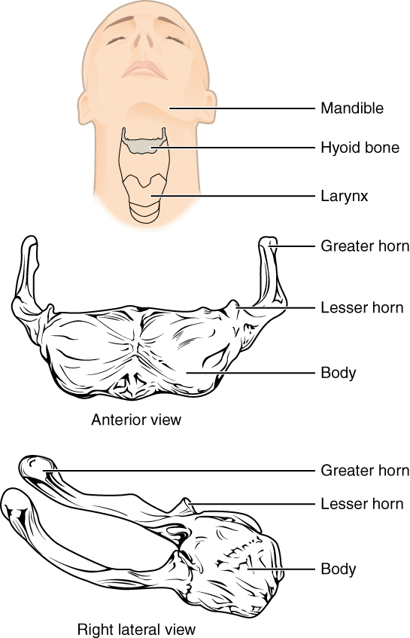

Slide 27
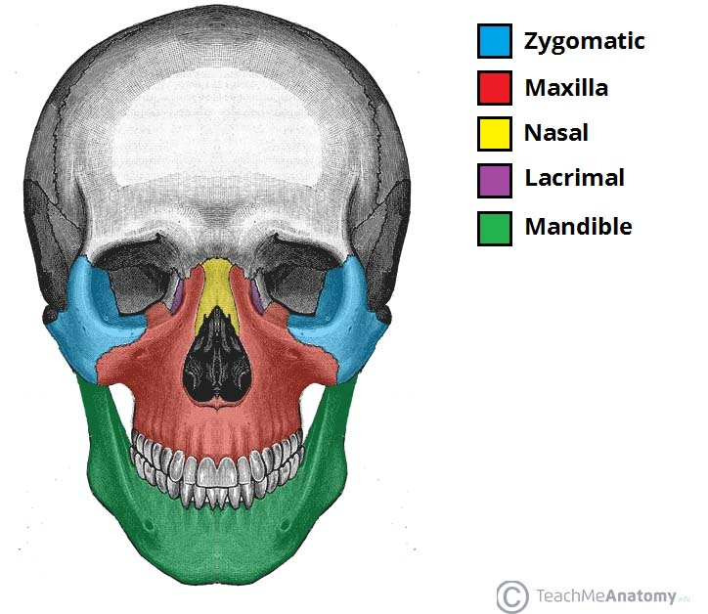
Anterior view of face. Vomer, palatine and inferior conchae lie deep within the face

Slide 28
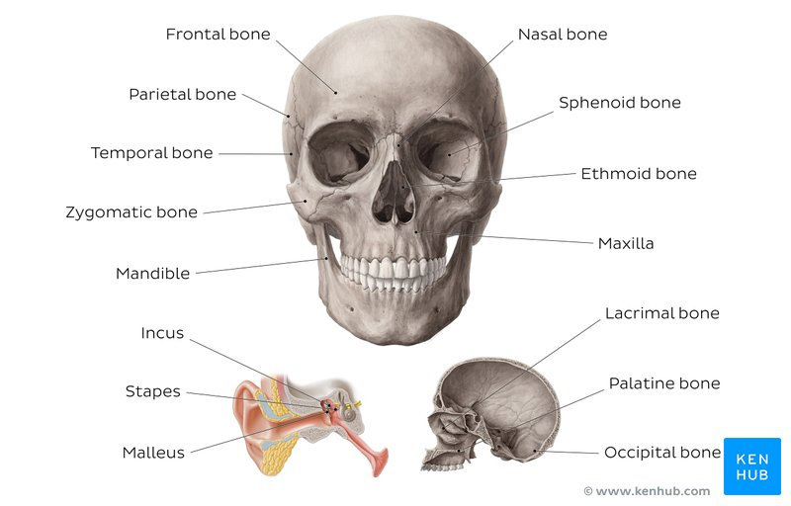
Skull bones

Slide 29
Sutures of the Skull
Sutures are a type of fibrous joint that are unique to the skull. They are immovable and fuse completely around the age of 20.
These joints are important in the context of trauma, as they represent points of potential weakness in the skull. The main sutures in the adult skull are:
Coronal suture – fuses the frontal bone with the two parietal bones.

Slide 30
Sagittal suture – fuses both parietal bones to each other.
Lambdoid suture – fuses the occipital bone to the two parietal bones.
In neonates, the incompletely fused suture joints give rise to membranous gaps between the bones, known as fontanelles. The two major fontanelles are:
Frontal fontanelle – located at the junction of the coronal and sagittal sutures
Occipital fontanelle – located at the junction of the sagittal and lambdoidal sutures
By Te (2021)

Slide 31
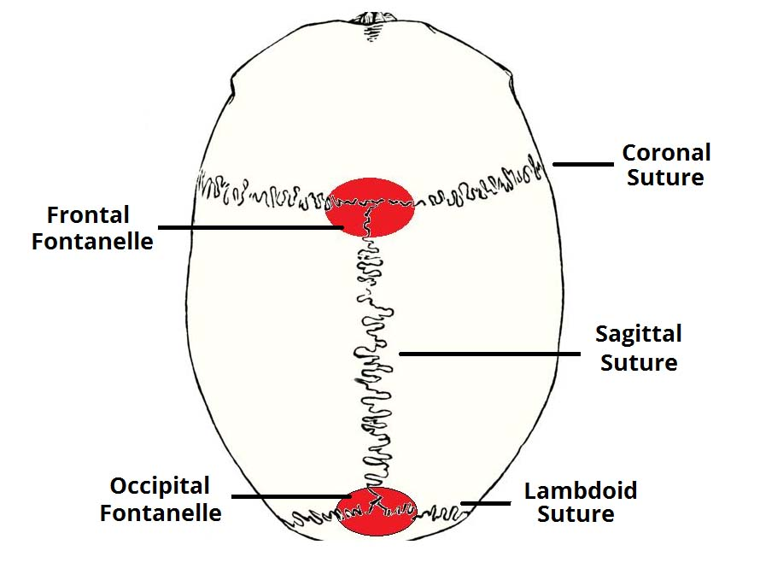
Major fontanelles and sutures of the skull

Slide 32
Muscles of face and head
Muscles of facial expression
The muscles of facial expression are located in the subcutaneous tissue, originating from bone or fascia, and inserting onto the skin. By contracting, the muscles pull on the skin and exert their effects. They are the only group of muscles that insert into skin.
All the muscles of facial expression are innervated by the facial nerve.
The facial muscles can broadly be split into three groups: orbital, nasal and oral.

Slide 33
1.Orbital Group
The orbital group of facial muscles contains two muscles associated with the eye socket.
These muscles control the movements of the eyelids, important in protecting the cornea from damage.
They are both innervated by the facial nerve

Slide 34
a. Orbicularis Oculi
The orbicularis oculi muscle surrounds the eye socket and extends into the eyelid. It has three distinct parts – palpebral, lacrimal, and orbital.
Attachments – Originates from the medial orbital margin, the medial palpebral ligament, and the lacrimal bone. It then inserts into the skin around the margin of the orbit, and the superior and inferior tarsal plates.

Slide 35
Actions:
Palpebral part – gently closes the eyelids.
Lacrimal part – involved in the drainage of tears.
Orbital part – tightly closes the eyelids.
Innervation
Temporal and zygomatic branches of facial nerve (CN VII)

Slide 36
b. Corrugator supercilii (superficialialis)
The corrugator supercilii is a much smaller muscle and is located posteriorly to the orbicularis oculi.
Attachments – Originates from the superciliary arch, running in a superolateral direction. Inserts into the skin of the eyebrow.
Actions – Acts to draw the eyebrows together, creating vertical wrinkles on the bridge of the nose.
Innervation – Facial nerve

Slide 37
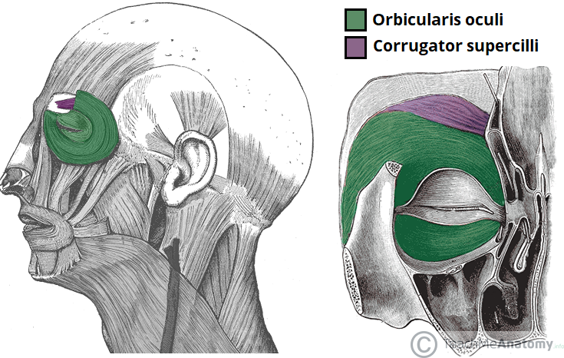

Slide 38
2. Nasal group
The nasal group of facial muscles are associated with movements of the nose, and the skin around it.
There are three muscles in this group, and they are all innervated by the facial nerve.
They serve little importance in humans.

Slide 39
Nasalis
The nasalis is the largest of the nasal muscles.
It is split into two parts: transverse and alar.
Attachments: Both portions of the muscle originate from the maxilla. The transverse part attaches to an aponeurosis across the dorsum of the nose. The alar portion of the muscle attaches to the alar cartilage of the nasal skeleton.
Actions: The two parts have opposing functions. The transverse part compresses the nares, and the alar part opens the nares.
Innervation: Facial nerve.

Slide 40
Procerus
The procerus is the most superior of the nasal muscles. It also lies superficially to the other muscles of facial expression.
Attachments: It originates from the nasal bone, inserting into the lower medial forehead.
Actions: Contraction of this muscle pulls the eyebrows downward to produce transverse wrinkles over the nose.
Innervation: Facial nerve.

Slide 41
Depressor Septi Nasi
This muscle assists the alar part of the nasali in opening the nostrils.
Attachments: It runs from the maxilla (above the medial incisor tooth) to the nasal septum.
Actions: It pulls the nose inferiorly, opening the nares.
Innervation: Facial nerve.

Slide 42
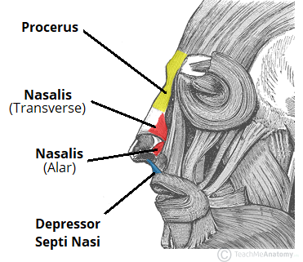

Slide 43
3.Oral group
These are the most important group of the facial expressors: responsible for movements of the mouth and lips. Such movements are required in singing and whistling and add emphasis to vocal communication.
The oral group of muscles consists of the orbicularis oris, buccinator, and various smaller muscles.

Slide 44
Orbicularis Oris
The fibres of the orbicularis oris enclose the opening to the oral cavity.
Attachments: Arises from the maxilla and from the other muscles of the cheek. It inserts into the skin and mucous membranes of the lips.
Action: Purses the lips.
Innervation: Facial nerve.

Slide 45
Buccinator
This muscle is located between the mandible and maxilla, deep to the other muscles of the face.
Attachments: It originates from the maxilla and mandible. The fibres run in an inferomedial direction, blending with the orbicularis oris and the skin of the lips.
Actions: The buccinator pulls the cheek inwards against the teeth, preventing accumulation of food in that area.
Innervation: Facial nerve.

Slide 46
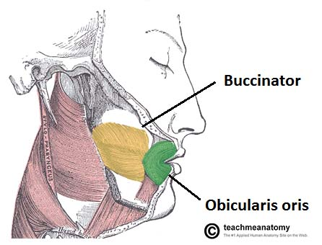

Slide 47
Other Oral Muscles
There are other muscles that act on the lips and mouth. Anatomically, they can be divided into upper and lower groups:
The lower group contains the depressor anguli oris, depressor labii inferioris and the mentalis.
Depressor anguli oris – originates from mental tubercle and oblique mandible (it is continous with platysma muscle). Inserts into modiolus. Its action is to depress angle of the mouth. Blood supply is by inferior labial artery(facial artery); mental artery (maxillary artery). Nerve supply is by buccal and mandibular branches of facial nerve

Slide 48
Depressor labii inferioris- originates from oblique line of mandible (continous with platsyma)a nd inserts into skin and submucosa of lower lip. Its blood supply is by inferior labial branch of facial artery, mental branch of maxillary artery . Nerve supply is by Mandibular branch of facial nerve (CN VII) . It action is to depress lower lip inferolaterally
Mentalis- originates from the mandible (lower jaw) and runs vertically from below the lower lip to the lower part of the chin. Elevates, everts and protrudes lower lip, wrinkles skin of chin. Innerveted by Mandibular branch of facial nerve (CN VII). Inferior labial branch of facial artery, mental branch of the maxillary artery

Slide 49
The upper group contains the
Risorius- responsible for the lateral movement of the mouth i.e it if found around the lips. It closes the lips, responsible for whistling and kissing i.e protrusion of mouth. It originates from parotid fascia, buccal skin, zygomatic bone and inserts in modiolus. Nerve supply is by buccal branch of facial nerve. Blood supply is by superior labial artery of facial artery

Slide 50
zygomaticus major- a muscle of facial expression which draws the muscle of angle of the mouth superiorly and posteriorly to allow one to smile. Originates from anterior of zygomatic and inserts in modiolus of the mouth. Nerve supply is by zygomatic and buccal branches of the facial nerve. Blood supply is by superficial labial branches of facial artery. It draws the angle of the mouth upward laterally
zygomaticus minor- it originates from lateral aspect of vzygomatic bone and inserts into the outer part of the upper lip. It is innerted by zygomatic and buccal branches of facial nerve (CN VII). Blood supply is superior labial branch of facial artery. It elevates upper lip, exposes maxillary teeth

Slide 51
levator labii superioris- originates from maxillary process of zygomatic bone. Inserts in upper lip. Elevates upper lip, exposes maxillry teeth. Blood supply is by facial artery and infraorbital branch of maxillary artery. It is innervated by zygomatic and buccal branches of facial nerve
levator labii superioris alaeque nasi- originates from maxilla and inserts into nostrils and upper lip. Nerve innervation is by buccal branch of facial nerve. It dilates nostrils, elevates upper lip and wing of the nose
levator anguli oris- originates from Canine fossa of maxilla. It inserts in modiolus. Its action is to elevate angle of mouth. It is supplied by Zygomatic and buccal branches of facial nerve (CN VII) and Superior labial branch of facial artery, infraorbital branch of maxillary artery

Slide 52
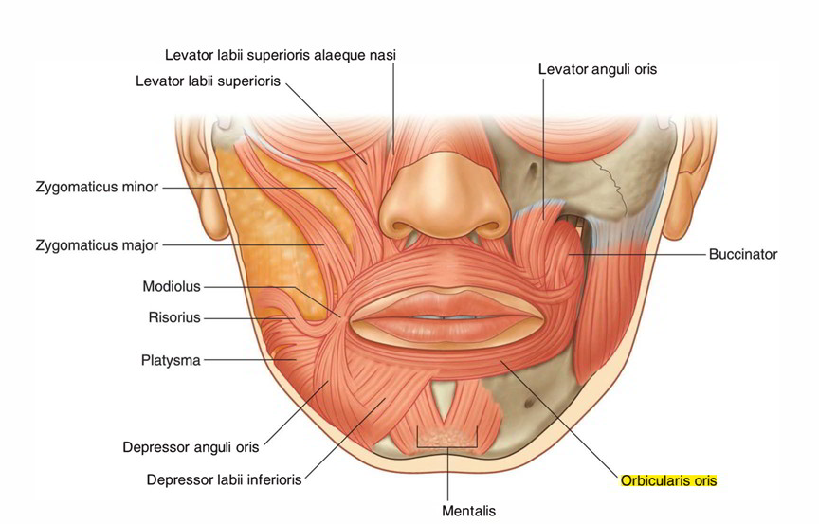

Slide 53
Muscles of mastication
The muscles of mastication are associated with movements of the jaw (temporomandibular joint). They are one of the major muscle groups in the head – the other being the muscles of facial expression.
There are four muscles:
Masseter
Temporalis
Medial pterygoid
Lateral pterygoid

Slide 54
The muscles of mastication develop from the first pharyngeal arch. Thus, they are innervated by a branch of the trigeminal nerve (CN V), the mandibular nerve.
Masseter
The masseter muscle is the most powerful muscle of mastication.
It is quadrangular in shape and has two parts: deep and superficial.
The entirety of the muscle lies superficially to the pterygoids and temporalis, covering them.
Attachments: The superficial part originates from maxillary process of the zygomatic bone. The deep part originates from the zygomatic arch of the temporal bone. Both parts attach to the ramus of the mandible.
Actions: Elevates the mandible, closing the mouth.
Innervation: Mandibular nerve (V3).

Slide 55
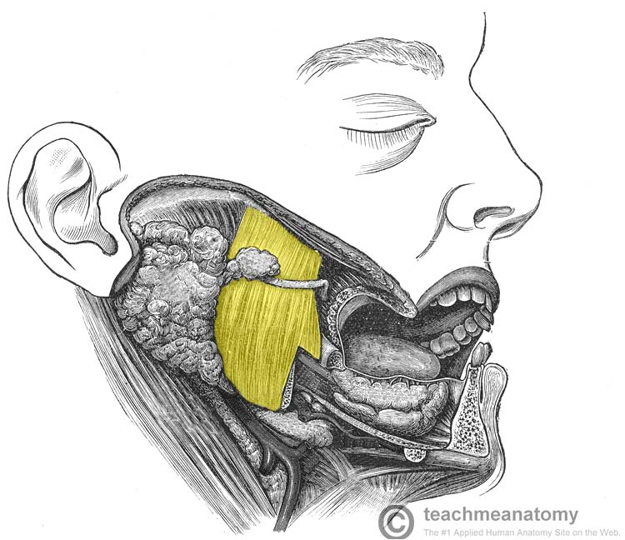

Slide 56
Temporalis
The temporalis muscle originates from the temporal fossa – a shallow depression on the lateral aspect of the skull.
The muscle is covered by tough fascia which can be harvested surgically and used to repair a perforated tympanic membrane (an operation known as a myringoplasty).

Slide 57
Attachments: Originates from the temporal fossa. It condenses into a tendon, which inserts onto the coronoid process of the mandible.
Actions: Elevates the mandible, closing the mouth. Also retracts the mandible, pulling the jaw posteriorly.
Innervation: Mandibular nerve (V3).

Slide 58
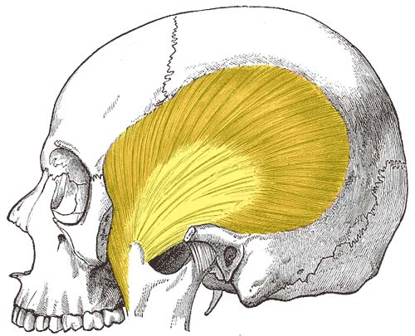

Slide 59
Lateral Pterygoid
The lateral pterygoid muscle has a triangular shape with two heads: superior and inferior. It has horizontally orientated muscle fibres, and thus is the major protractor of the mandible.
Attachments:
The superior head originates from the greater wing of the sphenoid.
The inferior head originates from the lateral pterygoid plate of the sphenoid.
The two heads converge into a tendon which attaches to the neck of the mandible.

Slide 60
Actions: Acting bilaterally, the lateral pterygoids protract the mandible, pushing the jaw forwards. Unilateral action produces the ‘side to side’ movement of the jaw.
Note: Contraction of the lateral pterygoid will produce lateral movement on the contralateral side. For example, contraction of left lateral pterygoid will deviate the mandible to the right.
Innervation: Mandibular nerve (V3).

Slide 62
Muscles of the tongue
Most muscles serve to attach one bone, usually via a tendon, to another.
There are a few places where that is not entirely true: the ocular muscles, the scapulothoracic joint, the diaphragm and perineum are all good exceptions.
However, the tongue is extraordinary. A boneless mass that you can protrude at will, fold, invert, lay flat or fill the mouth

Slide 63
Intrinsic Muscles
The intrinsic muscles only attach to other structures in the tongue.
There are four paired intrinsic muscles of the tongue and they are named by the direction in which they travel: the superior longitudinal, inferior longitudinal, transverse and vertical muscles of the tongue.
These muscles affect the shape and size of the tongue – for example, in tongue rolling – and have a role in facilitating speech, eating and swallowing.
Motor innervation for the intrinsic muscles of the tongue is via the hypoglossal nerve (CNXII).

Slide 64
Extrinsic Muscles
The extrinsic muscles are as follows:
a. Genioglossus
Attachments: Arises from the mandibular symphsis. Inserts into the body of the hyoid bone and the entire length of the tongue.
Function: Inferior fibres protrude the tongue, middle fibres depress the tongue, and superior fibres draw the tip back and down
Innervation: Motor innervation via the hypoglossal nerve (CNXII).

Slide 65
b. Hyoglossus
Attachments: Arises from the hyoid bone and inserts into the side of the tongue
Function: Depresses and retracts the tongue
Innervation: Motor innervation via the hypoglossal nerve (CNXII).
c. Styloglossus
Attachments: Originates at the styloid process of the temporal bone and inserts into the side of the tongue
Function: Retracts and elevates the tongue
Innervation: Motor innervation via the hypoglossal nerve (CNXII).

Slide 66
c. Palatoglossus
Attachments: Arises from the palatine aponeurosis and inserts broadly across the tongue
Function: Elevates the posterior aspect of the tongue
Innervation: Motor innervation via the vagus nerve (CNX).
All of the intrinsic and extrinsic muscles are innervated by the hypoglossal nerve (CN XII), except palatoglossus, which has vagal innervation (CN X).

Slide 67
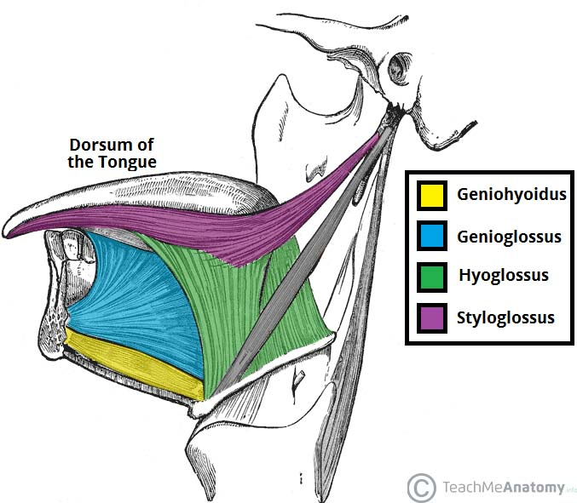
Extrinsic muscles of the tongue

Slide 68
Innervation
In the anterior 2/3, general sensation is supplied by the trigeminal nerve (CNV). Specifically the lingual nerve, a branch of the mandibular nerve (CN V3).
On the other hand, taste in the anterior 2/3 is supplied from the facial nerve (CNVII). In the petrous part of the temporal bone, the facial nerve gives off three branches, one of which is chorda tympani. This travels through the middle ear, and continues on to the tongue.
The posterior 1/3 of the tongue is slightly easier. Both touch and taste are supplied by the glossopharyngeal nerve (CNIX).

Slide 69
Vasculature
The lingual artery (branch of the external carotid) does most of the supply, but there is a branch from the facial artery, called the tonsillar artery, which can provide some collateral circulation. Drainage is by the lingual vein.
Lypmphatic drainage
The lymphatic drainage of the tongue is as follows:
Anterior two thirds – initially into the submental and submandibular nodes, which empty into the deep cervical lymph nodes
Posterior third – directly into the deep cervical lymph nodes

Slide 70
Muscles of the neck
Suboccipital muscles
The suboccipital muscles are a group of four muscles situated underneath the occipital bone. All the muscles in this group are innervated by the suboccipital nerve.
They are located within the suboccipital compartment of the neck; deep to the sternocleidomastoid, trapezius, splenius and semispinalis muscles. They collectively act to extend and rotate the head.

Slide 71
a. Rectus Capitis Posterior Major
The rectus capitis posterior major is the larger of the rectus capitis muscles. It is located laterally to the rectus capitis posterior minor.
Attachments: Originates from the spinous process of the C2 vertebrae (axis), and inserts into the lateral part of the inferior nuchal line of the occipital bone.
Actions: Extension and rotation of the head.
Innervation: Suboccipital nerve (posterior ramus of C1).
b. Rectus Capitis Posterior Minor
The rectus capitis posterior minor is the most medial of the suboccipital muscles. There is a connective tissue bridge between this muscle and the dura mater (outer membrane of the meninges) – which may play a role in cervicogenic headaches.

Slide 72
Attachments: Runs from the posterior tubercle (a rudimentary spinous process) of the C1 vertebra to the medial part of the inferior nuchal line of the occipital bone.
Actions: Extension of the head.
Innervation: Suboccipital nerve (posterior ramus of C1).

Slide 73
c. Obliquus Capitis Inferior
As its name suggests, the obliquus capitis inferior is the most inferiorly positioned of the suboccipital muscles. Additionally, it is the only capitis muscle that has no attachment to the cranium.
Attachments: Originates from the spinous process of the C2 vertebra, and attaches into the transverse process of C1.
Actions: Extension and rotation of the head.
Innervation: Suboccipital nerve (posterior ramus of C1)

Slide 74
d. Obliquus Capitis Superior
The obliquus capitis superior is located laterally in the suboccipital compartment.
Attachments: Originates from the transverse process of C1 and attaches into the occipital bone (between the superior and inferior nuchal lines).
Actions: Extension of the head.
Innervation: Suboccipital nerve (posterior ramus of C1)

Slide 75
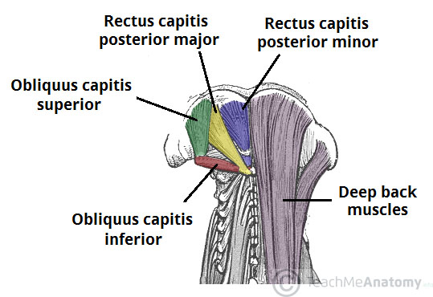

Slide 76
Suprahyoid muscle
The suprahyoid muscles are a group of four muscles located superior to the hyoid bone of the neck. They all act to elevate the hyoid bone – an action involved in swallowing.
The arterial supply to these muscles is via branches of the facial artery, occipital artery, and lingual artery.

Slide 77
a. Stylohyoid
The stylohyoid muscle is a thin muscular strip, which is located superiorly to the posterior belly of the digastric muscle.
Attachments: Arises from the styloid process of the temporal bone and attaches to the lateral aspect of the hyoid bone.
Actions: Initiates a swallowing action by pulling the hyoid bone in a posterior and superior direction.
Innervation: Stylohyoid branch of the facial nerve (CN VII). This arises proximally to the parotid gland.

Slide 78
b. Digastric
The digastric is comprised of two muscular bellies, which are connected by a tendon. In some cadaveric specimens, this tendon can be seen to pierce the stylohyoid muscle.
Attachments:
The anterior belly arises from the digastric fossa of the mandible.
The posterior belly arises from the mastoid process of the temporal bone.
The two bellies are connected by an intermediate tendon, which is attached to the hyoid bone via a fibrous sling.
Actions: Depresses the mandible and elevates the hyoid bone.

Slide 79
Innervation:
The anterior belly is innervated by the inferior alveolar nerve, a branch of the mandibular nerve (which is derived from the trigeminal nerve, CN V).
The posterior belly is innervated by the digastric branch of the facial nerve.
c. Mylohyoid
The mylohyoid is a broad, triangular shaped muscle. It forms the floor of the oral cavity and supports the floor of the mouth.
Attachments: Originates from the mylohyoid line of the mandible, and attaches onto the hyoid bone.
Actions: Elevates the hyoid bone and the floor of the mouth.
Innervation: Inferior alveolar nerve, a branch of the mandibular nerve (which is derived from the trigeminal nerve).

Slide 80
d. Geniohyoid
The geniohyoid is located close to the midline of the neck, deep to the mylohyoid muscle.
Attachments: Arises from the inferior mental spine of the mandible. It then travels inferiorly and posteriorly to attach to the hyoid bone.
Actions: Depresses the mandible and elevates the hyoid bone.
Innervation: C1 nerve roots that run within the hypoglossal nerve.

Slide 81
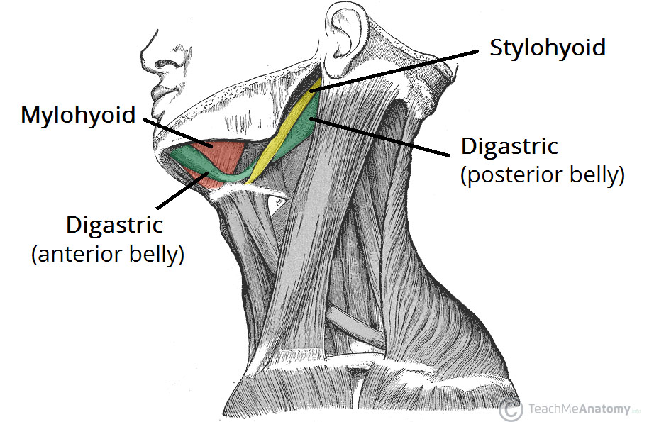

Slide 82
Infrahyoid muscles
The infrahyoid muscles are a group of four muscles that are located inferiorly to the hyoid bone in the neck. They can be divided into two groups:
Superficial plane – omohyoid and sternohyoid muscles.
Deep plane – sternothyroid and thyrohyoid muscles.
The arterial supply to the infrahyoid muscles is via the superior and inferior thyroid arteries, with venous drainage via the corresponding veins.

Slide 83
a. Omohyoid
The omohyoid is comprised of two muscle bellies, which are connected by a muscular tendon.
Attachments:
The inferior belly of the omohyoid arises from the scapula. It runs superomedially underneath the sternocleidomastoid muscle.
It is attached to the superior belly by an intermediate tendon, which is anchored to the clavicle by the deep cervical fascia.
From here, the superior belly ascends to attach to the hyoid bone.
Actions: Depresses the hyoid bone.
Innervation: Anterior rami of C1-C3, carried by a branch of the ansa cervicalis.

Slide 84
b. Sternohyoid
The sternohyoid muscle is located within the superficial plane.
Attachments: Originates from the sternum and sternoclavicular joint. It ascends to insert onto the hyoid bone.
Actions: Depresses the hyoid bone.
Innervation: Anterior rami of C1-C3, carried by a branch of the ansa cervicalis.

Slide 85
c. Sternothyroid
The sternothyroid muscle is wider and deeper than the sternohyoid. It is located within the deep plane.
Attachments: Arises from the manubrium of the sternum, and attaches to the thyroid cartilage.
Actions: Depresses the thyroid cartilage.
Innervation: Anterior rami of C1-C3, carried by a branch of the ansa cervicalis.

Slide 86
d.Thyrohyoid
The thyrohyoid is a short band of muscle, thought to be a continuation of the sternothyroid muscle.
Attachments: Arises from the thyroid cartilage of the larynx, and ascends to attach to the hyoid bone.
Actions: Depresses the hyoid. If the hyoid bone is fixed, it can elevate the larynx.
Innervation: Anterior ramus of C1, carried within the hypoglossal nerve.

Slide 87
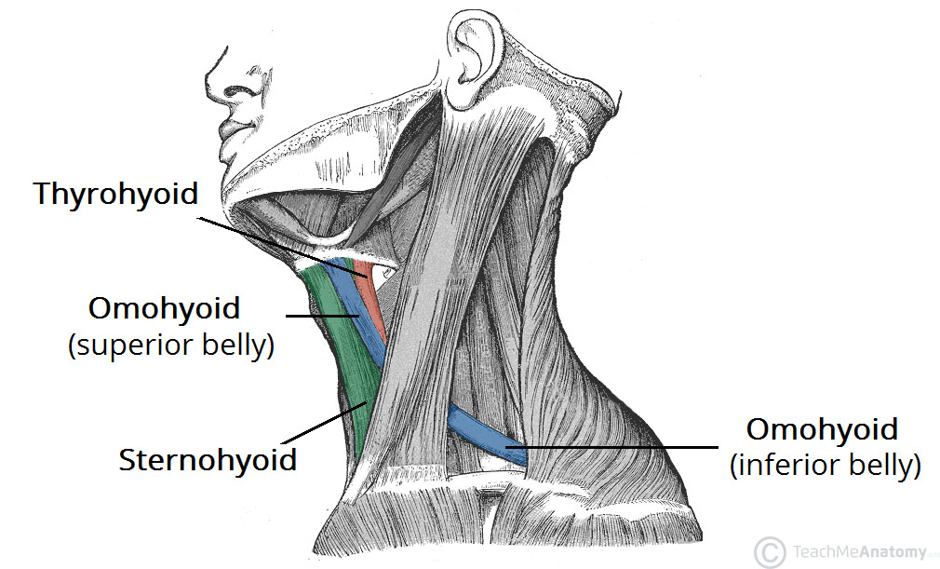
Lateral review of infrahyoid bone

Slide 88
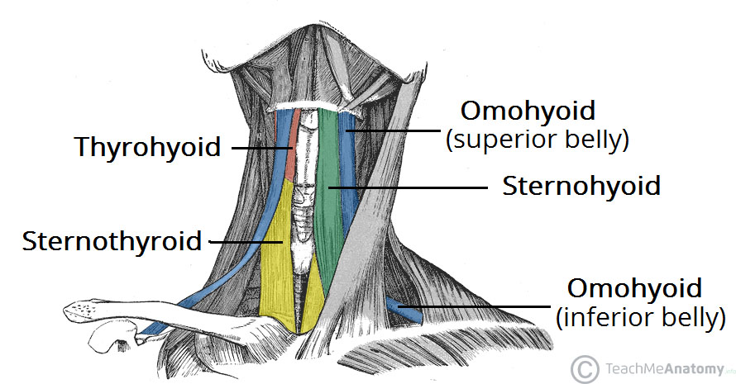
Anterior view of infrahyoid bone

Slide 89
Scalene muscles
The scalene muscles are three paired muscles (anterior, middle and posterior), located in the lateral aspect of the neck. Collectively, they form part of the floor of the posterior triangle of the neck.
The scalenes act as accessory muscles of respiration, and perform flexion at the neck

Slide 90
Anterior Scalene
The anterior scalene muscle lies on the lateral aspect of the neck, deep to the prominent sternocleidomastoid muscle.
Attachments: Originates from the anterior tubercles of the transverse processes of C3-C6, and attaches onto the scalene tubercle, on the inner border of the first rib.
Function: Elevation of the first rib. Ipsilateral contraction causes ipsilateral lateral flexion of the neck, and bilateral contraction causes anterior flexion of the neck.
Innervation: Anterior rami of C5-C6.

Slide 91
Middle Scalene
The middle scalene is the largest and longest of the three scalene muscles. It has several long, thin muscles bellies arising from the cervical spine, which converge into one large belly that inserts into the first rib.
Attachments: Originates from the posterior tubercles of the transverse processes of C2-C7, and attaches to the scalene tubercle of the first rib.
Function: Elevation of the first rib. Ipsilateral contraction causes ipsilateral lateral flexion of the neck.
Innervation: Anterior rami of C3-C8.

Slide 92
Posterior Scalene
The posterior scalene is the smallest and deepest of the scalene muscles. Unlike the anterior and middle scalene muscles, it inserts into the second rib.
Attachments: Originates from the posterior tubercles of the transverse processes of C5-C7, and attaches into the second rib.
Function: Elevation of the second rib, and ipsilateral lateral flexion of the neck.
Innervation: Anterior rami of C6-C8.

Slide 93
Anatomical Relationships
The scalene muscles are an important part of the anatomy of the neck, with several important structures located between and around them.
The brachial plexus and subclavian artery pass between the anterior and middle scalene muscles. This provides an important anatomical landmark in anaesthetics for performing an interscalene block.
The subclavian vein and phrenic nerve pass anteriorly to the anterior scalene – the subclavian vein courses horizontally across it, while the phrenic nerve runs vertically down the muscle. The subclavian artery is located posterior to the anterior scalene.

Slide 94
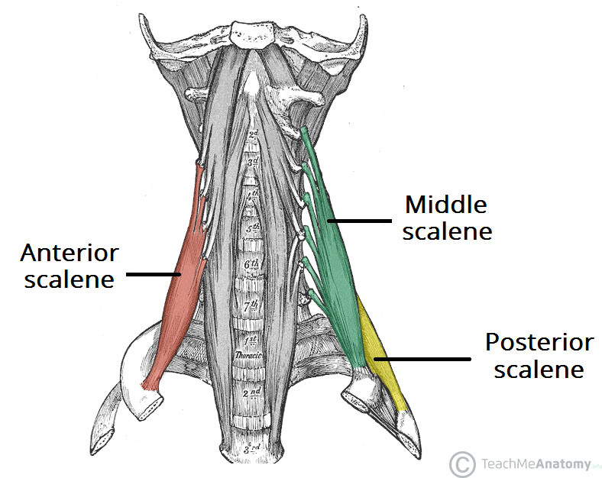

Slide 95
Other muscles of the neck
Sternocleidomastoid
This muscle arises from the manubrium of the sternum and the clavicle and extends upwards to the mastoid process of the temporal bone.
It assists in turning the head from side to side.
When the muscle on one side contracts it draws the head towards the shoulder.
When both contract at the same time they flex the cervical vertebrae or draw the sternum and clavicles upwards when the head is maintained in a fixed position, e.g. in forced respiration

Slide 96
Trapezius
This muscle covers the shoulder and the back of the neck.
The upper attachment is to the occipital protuberance, the medial attachment is to the transverse processes of the cervical and thoracic vertebrae and the lateral attachment is to the clavicle and to the spinous and acromion processes of the scapula.
It pulls the head backwards, squares the shoulders and controls the movements of the scapula when the shoulder joint is in use.

Slide 97
SCALP
The scalp refers to the layers of skin and subcutaneous tissue that cover the bones of cranial vault.
Layers of the scalp
The scalp consists of five layers. The first three layers are tightly bound together and move as a collective structure.
The mnemonic ‘SCALP’ can be a useful way to remember the layers of the scalp: Skin, Dense Connective Tissue, Epicranial Aponeurosis, Loose Areolar Connective Tissue and Periosteum.

Slide 98
Skin – contains numerous hair follicles and sebaceous glands (thus a common site for sebaceous cysts).
Dense Connective tissue – connects the skin to the epicranial aponeurosis. It is richly vascularised and innervated.
The blood vessels within the layer are highly adherent to the connective tissue. This renders them unable to constrict fully if lacerated – and so the scalp can be a site of profuse bleeding.

Slide 99
Epicranial Aponeurosis – a thin, tendon-like structure that connects the occipitalis and frontalis muscles.
Loose Areolar Connective Tissue – a thin connective tissue layer that separates the periosteum of the skull from the epicranial aponeurosis.
It contains numerous blood vessels, including emissary veins which connect the veins of the scalp to the diploic veins and intracranial venous sinuses.
Periosteum – the outer layer of the skull bones. It becomes continuous with the endosteum at the suture lines.

Slide 100
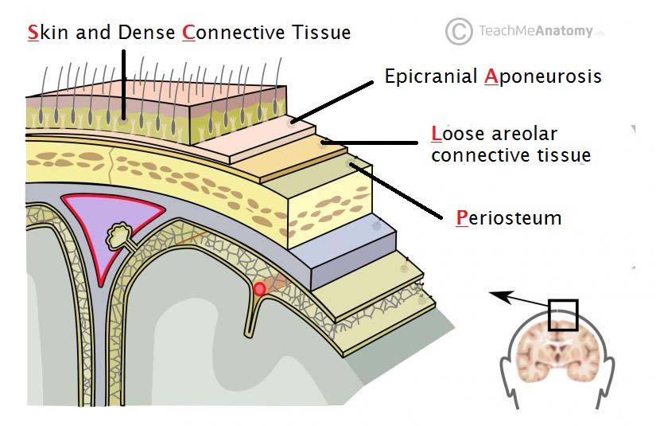

Slide 101
Arterial Supply
The scalp receives a rich arterial supply via the external carotid artery and the ophthalmic artery (a branch of the internal carotid). There are three branches of the external carotid artery involved:
Superficial temporal – supplies the frontal and temporal regions
Posterior auricular – supplies the area superiorly and posteriorly to the auricle.
Occipital – supplies the back of the scalp
Anteriorly and superiorly, the scalp receives additional supply from two branches of the ophthalmic artery – the supraorbital and supratrochlear arteries. These vessels accompany the supraorbital and supratrochlear nerves respectively.

Slide 102
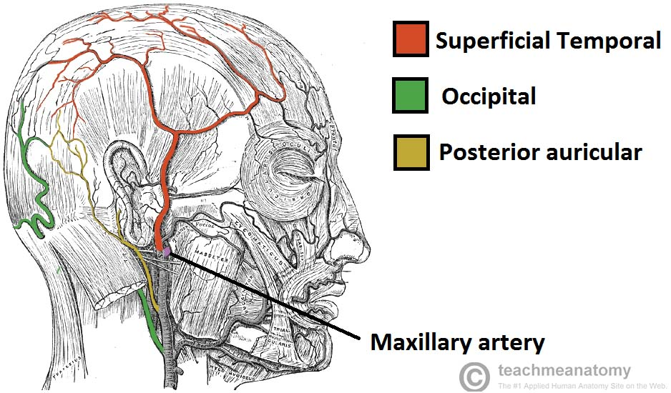
Three branches supplying the scalp

Slide 103
Venous drainage
The venous drainage of the scalp can be divided into superficial and deep components.
The superficial drainage follows the arterial supply: superficial temporal, occipital, posterior auricular, supraorbital and supratrochlear veins.
The deep (temporal) region of the skull is drained by the pterygoid venous plexus. This is a large plexus of veins situated between the temporalis and lateral pterygoid muscles,and drains into the maxillary vein.
Importantly, the veins of the scalp connect to the diploic veins of the skull via valveless emissary veins. This establishes a connection between the scalp and the dural venous sinuses.

Slide 104
Innervation
The scalp receives cutaneous innervation from branches of the trigeminal nerve or the cervical nerve roots.
Trigeminal Nerve
Supratrochlear nerve – branch of the ophthalmic nerve which supplies the anteromedial forehead.
Supraorbital nerve – branch of the ophthalmic nerve which supplies a large portion of the scalp between the anterolateral forehead and the vertex.
Zygomaticotemporal nerve – branch of the maxillary nerve, this supplies the temple.
Auriculotemporal nerve – branch of the mandibular nerve which supplies skin anterosuperior to the auricle.

Slide 105
Cervical Nerves
Lesser occipital nerve – derived from the anterior ramus (division) of C2 and supplies the skin posterior to the ear
Greater occipital nerve – derived from the posterior ramus (division) of C2 and supplies the skin of the occipital region.
Great auricular nerve – derived from the anterior rami of C2 and C3 and supplies the skin posterior to the ear and over the angle of the mandible.
Third occipital nerve – derived from the posterior ramus of C3 and supplies the skin of the inferior occipital region.

Slide 106
Cranial cavity
The cranial cavity, also known as intracranial space, is the space within the skull
The space inside the skull is formed by eight cranial bones known as the neurocranium. The neurocranium is the upper back part that forms the protective case around the brain.
The skull cap of the neurocranium covers the cranial cavity and the remainder of the skull is called the facial skeleton.
The skull (minus the mandible) is also known as the cranium, and contains the brain.
Meninges are protective membranes that surround the brain to minimize damage of the brain when there is head trauma. Meningitis is the inflammation of meninges caused by bacterial or viral

Slide 107
The spaces between meninges and the brain are filled with a clear cerebrospinal fluid, increasing the protection of the brain. Facial bones of the skull are not included in the cranial cavity.
It is formed by blending of eight cranial bones: The occipital, two parietal, the frontal, two temporal, the ethmoid and the sphenoid bones are fused together by the ossification of fixed fibrous sutures

Slide 108
The three meninges are the three membranes that envelop the brain and spinal cord, in which the central nervous system developed, which are the pia mater, the arachnoid mater, and the dura mater.
The latter is the thickest and outermost of the three membrane layers; it contains the most collagen, and it is derived from the mesoderm
The pituitary gland is also found in the make up of the cranial cavity. It plays a major role in the body, creating and secreting many bodily hormones. The gland secretes different fluids that are important for the body to function. The body's temperature, physical, and sexual functions are regulated by this gland. One of the major glands are controlled through this cavity.

Slide 109
Cranial cavity is divided into 3 fossae
Anterior
Middle
Posterior
Anterior cranial fossae
The anterior cranial fossa is the most shallow and superior of the three cranial fossae. It lies superiorly over the nasal and orbital cavities. The fossa accommodates the anteroinferior portions of the frontal lobes of the brain.

Slide 110
Middle Cranial Fossa
The middle cranial fossa is deeper and situated posterior to the anterior fossa. It extends from the lesser wings of the sphenoid bone anteriorly, to the petrous ridges (petrous portion of the temporal bones) posteriorly
The middle cranial fossa consists of three bones – the sphenoid bone and the two temporal bones.
Posterior Cranial Fossa
The posterior cranial fossa is the most posterior and deepest portion of the cranial cavity.
It accommodates the brainstem and cerebellum of the brain.
The posterior fossa is bounded anteriorly by the petrous ridges, while the occipital bone forms the floor and posterior wall. It is divided at the midline by the large foramen magnum (“great aperture”), the opening that provides for passage of the spinal cord.

Slide 111
BRAIN
The brain has three main parts: forebrain middle brain and hind brain
The brain is contained in, and protected by, the skull bones of the head

Slide 112
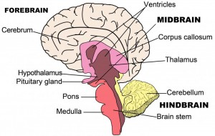
Parts of the brain

Slide 113
Forebrain
The Cerebrum: Also known as the cerebral cortex,
The cerebrum is the largest part of the human brain, and it is associated with higher brain function such as thought and action.
Nerve cells make up the gray surface, which is a little thicker than our thumb.
White nerve fibers beneath the surface carry signals between nerve cells in other parts of the brain and body.

Slide 114
Its wrinkled surface increases the surface area, and is a six-layered structure found in mammals, called the neocortex.
It is divided into four sections, called “lobes”. They are; the frontal lobe, the parietal lobe, the occipital lobe and the temporal lobe.

Slide 116
Functions Of The Lobes:
Frontal Lobe – The frontal lobe lies just beneath our forehead (the front of the head) and is associated with our brain’s ability to reason, organize, plan, speak, move, make facial expressions, serial task, problem solve, control inhibition, spontaneity, initiate and self-regulate behaviors, pay attention, remember and control emotions.

Slide 117
Parietal Lobe – The parietal lobe is located at the upper rear of our brain (the middle part of the brain), and controls our complex behaviors, including senses such as vision, touch, body awareness and spatial orientation.
It plays important roles in integrating sensory information from various parts of our body, knowledge of numbers and their relations, and in the manipulation of objects.
Portions are involved with our visuospatial processing, language comprehension, the ability to construct, body positioning and movement, neglect/inattention, left-right differentiation and self-awareness/insight.

Slide 118
Occipital Lobe – The occipital lobe is located at the back of our brain, and is associated with our visual processing, such as visual recognition, visual attention, spatial analysis and visual perception of body language; such as postures, expressions and gestures.
Temporal Lobe – The temporal lobe is located near our ears (the sides of the brain) and is associated with processing our perception and recognition of auditory stimuli (including our ability to focus on one sound among many, like listening to one voice among many at a party), comprehending spoken language, verbal memory, visual memory and language production (including fluency and word-finding), general knowledge and autobiographical memories.

Slide 119
A deep furrow divides the cerebrum into two halves, known as the left and right hemispheres.
The two halves join at a large deep sulcus (interhemispheric fissure AKA, the medial longitudinal fissure) that runs from front of head to the back
And, while the two hemispheres look almost symmetrical, each side seems to function differently.
The right hemisphere is considered our creative side, and the left hemisphere is considered our logical side.
The right hemisphere controls the left side of the body while the left hemisphere control the right side of the body
A bundle of axons, called the corpus callosum (a C-shaped structure of white matter and nerve pathways), connects the two hemispheres and allow communication between the two halves. The corpus callosum is at the center of the cerebrum

Slide 120
Midbrain
The midbrain is located below the cerebral cortex, and above the hindbrain placing it near the center of the brain.
It is comprised of the tectum(Latin for roof)- is the dorsal side of the midbrain , tegmentum -is the ventral part of the midbrain , cerebral aqueduct (the structure within the brainstem that connects the third ventricle to the fourth) cerebral peduncles (are the two stalks that attach the cerebrum to the brainstem) and several nuclei and fasciculi.
The primary role of the midbrain is to act as a sort of relay station for our visual and auditory systems.

Slide 121
Portions of the midbrain called the red nucleus and the substantia nigra are involved in the control of body movement, and contain a large number of dopamine-producing neurons.
The degeneration of neurons in the substantia nigra is associated with Parkinson’s disease.
The midbrain is the smallest region of the brain, and is located most centrally within the cranial cavity.

Slide 122
Limbic System – the limbic system is often referred to as our “emotional brain”, or ‘childish brain’. It is found buried within the cerebrum and contains the thalamus, hypothalamus, amygdala and hippocampus.
Thalamus – the primary role of the thalamus is to relay sensory information from other parts of the brain to the cerebral cortex
Hypothalamus – the primary role of the hypothalamus is to regulate various functions of the pituitary gland and endocrine activity, as well as somatic functions e.g.body temperature, sleep, appetite.

Slide 123
Amygdala – the primary role of the amygdala is to be a critical processor for the senses. Connected to the hippocampus, it plays a role in emotionally laden memories and contains a huge number of opiate receptor sites that are implicated in rage, fear and sexual feelings
Hippocampus – the primary role of the hippocampus is memory forming, organizing and storing information. It is particularly important in forming new memories, and connecting emotions and senses, such as smell and sound, to memories.

Slide 124
Pituitary Gland – the primary role of the pituitary gland is an important link between the nervous system and the endocrine system.
It releases many hormones which affect growth, metabolism, sexual development and the reproduction system.
It is connected to the hypothalamus and is about the size of a pea.
It is located in the center of the skull, just behind the bridge of the nose.

Slide 125
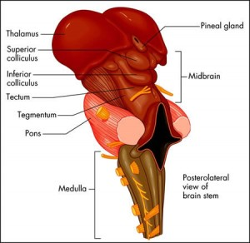
Midbrain

Slide 126
Hindbrain
The Cerebellum – The cerebellum, or “little brain”, is similar to the cerebrum with its two hemispheres and highly folded surface. It is associated with regulation and coordination of movement, posture, balance and cardiac, respiratory and vasomotor centers.
Brain Stem – The brain stem is located beneath the limbic system. It is responsible for vital life functions such as breathing, heartbeat, and blood pressure. The brain stem is made of the midbrain, pons, and medulla.

Slide 127
Pons – The primary role of the pons is to serve as a bridge between various parts of the nervous system, including the cerebellum and cerebrum. Many important nerves that originate in the pons, such as the trigeminal nerve, responsible for feeling in the face, as well as controlling the muscles that are responsible for biting, chewing, and swallowing.
It also contains the abducens nerve, which allows us to look from side to side and the vestibulocochlear nerve, which allows to hear.
As part of the brainstem, a section of the lower pons stimulates and controls the intensity of breathing, while a section of the upper pons decreases the depth and frequency of breaths.
The pons is also associated with the control of sleep cycles, and controls respiration and reflexes. It is located above the medulla, below the midbrain, and just in front of the cerebellum.

Slide 128
Medulla – The primary role of the medulla is regulating our involuntary life sustaining functions such as breathing, swallowing and heart rate.
As part of the brain stem, it also helps transfer neural messages to and from the brain and spinal cord.
It is located at the junction of the spinal cord and brain.

Slide 129
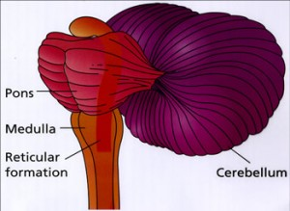

Slide 130
Cranial nerves
There are 12 pairs of major nerves called cranial nerves that serve both sides of the body.
These nerves innervate the structuresof head and neck
Except for accessory nerve (CN XI) which has origin in the spinal cord, all other cranial nerves emerge from the brain
The cranial nerves and their responsibilities include:
Olfactory (CN 1)- a sensory nerve: smell
Optic (CN II) – sensory nerve: sight
Oculomotor (CN 111)- motor nerve: contraction of eye muscles
Trochlear ( CN 1V)- motor nerve: one muscle of the eye

Slide 131
Trigeminal (CN V)-mixed nerve: large sensory nerve of
Has 3 branches; opthalmic branch, maxillary branch, mandibular branch
Abducens (CN VI)-motor nerve: one muscle of the eye
Facial (CN VII) - mixed nerve: facial expression, taste sensation
Vestibulocochlear (CN VIII)- sensory nerve-: has 2 division vestibule division for body balance and cochlea division for hearing

Slide 132
Glossopharyngeal (CN IX)- mixed nerve: back of tongue, including taste senses, and the sylopharyngeus muscle in the throat
Vagus (CN X)- mixed nerve: thoracic and abdominal cavities as well as larynx. Is the only nerve which inervates structures beyond head and neck region
Accessory (CN XI)- motor nerve: larynx, neck, and lower neck muscles
Hypoglossal (CN XII)-motor nerve: muscles of the tongue

Slide 133
Arterial blood supply
The head’s blood supply comes mainly from the external and internal carotid arteries. These are the arteries you use to check your pulse in your neck.
Damage to these arteries poses severe, immediate health risks that can be fatal.
The vertebral arteries also supply the brain.
Internal carotid artery
The internal carotid artery travels up from the aortic arch just outside the heart. It travels into the brain to provide oxygenated blood to the eyes, the front of the brain, and portions of the scalp.

Slide 134
This is a major contributor to the circulus arteriosus (circle of Willis) which supplies the greater part of the brain.
It also has branches that supply the eyes, forehead and nose.
It ascends to the base of the skull and passes through the carotid foramen in the temporal bone

Slide 135
Circulus arteriousus (Circle of willis)
The greater part of the brain is supplied with arterial blood by an arrangement of arteries called the circulus arteriosus or the circle of Willis .
Four large arteries contribute to its formation: the two internal carotid arteries and the two vertebral arteries .

Slide 136
The vertebral arteries arise from the subclavian arteries, pass upwards through the foramina in the transverse processes of the cervical vertebrae, enter the skull through the foramen magnum, then join to form the basilar artery.
The arrangement in the circulus arteriosus is such that the brain as a whole receives an adequate blood supply when a contributing artery is damaged and during extreme movements of the head and neck.

Slide 137
Anteriorly, the two anterior cerebral arteries arise from the internal carotid arteries and are joined by the anterior communicating artery.
Posteriorly, the two vertebral arteries join to form the basilar artery.
After travelling for a short distance the basilar artery divides to form two posterior cerebral arteries, each of which is joined to the corresponding internal carotid artery by a posterior communicating artery, completing the circle.

Slide 138
The circulus arteriosus is therefore formed by:
2 anterior cerebral arteries
2 internal carotid arteries
1 anterior communicating artery
2 posterior communicating arteries
2 posterior cerebral arteries
1 basilar artery

Slide 139
From this circle, the anterior cerebral arteries pass forward to supply the anterior part of the brain, the middle cerebral arteries pass laterally to supply the sides of the brain, and the posterior cerebral arteries supply the posterior part of the brain.
Branches of the basilar artery supply parts of the brain stem.

Slide 140
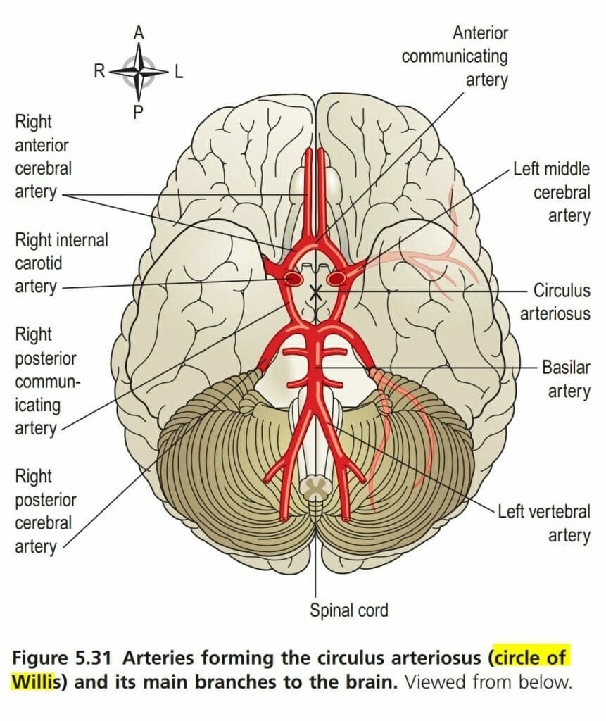

Slide 141
External carotid artery
The external carotid artery helps supply part of the brain through its many branches, and it also gives blood to the thyroid gland in the neck. The thyroid gland is one of the largest endocrine glands in the body. Hormones from the thyroid gland control how quickly the body uses energy, when to make proteins, and how the body responds to other hormones.
Inside the brain, important areas get blood from more than one source, which involves communication between two blood vessels. This is called anastomosis. This process also occurs in the hands, feet, and intestinal tract.

Slide 142
This artery supplies the superficial tissues of the head and neck, via a number of branches:
The superior thyroid artery supplies the thyroid gland and adjacent muscles.
The lingual artery supplies the tongue, the lining membrane of the mouth, the structures in the floor of the mouth, the tonsil and the epiglottis.
The facial artery passes outwards over the mandible just in front of the angle of the jaw and supplies the muscles of facial expression and structures in the mouth. The pulse can be felt where the artery crosses the jaw bone.

Slide 143
The occipital artery supplies the posterior part of the scalp.
The temporal artery passes upwards over the zygomatic process in front of the ear and supplies the frontal, temporal and parietal parts of the scalp. The pulse can be felt in front of the upper part of the ear.
The maxillary artery supplies the muscles of mastication and a branch of this artery, the middle meningeal artery, runs deeply to supply structures in the interior of the skull.

Slide 144
Venous return from the head and neck
The venous blood from the head and neck is returned by deep and superficial veins.
Superficial veins with the same names as the branches of the external carotid artery return venous blood from the superficial structures of the face and scalp and unite to form the external jugular vein

Slide 145
The external jugular vein begins in the neck at the level of the angle of the jaw.
It passes downwards in front of the sternocleidomastoid muscle, then behind the clavicle before entering the subclavian vein.
The venous blood from the deep areas of the brain is collected into channels called the dural venous sinuses. The dural venous sinuses of the brain are formed by layers of dura mater lined with endothelium. The dura mater is the outer protective covering of the brain .
The main venous sinuses are listed below:

Slide 146
The superior sagittal sinus carries the venous blood from the superior part of the brain. It begins in the frontal region and passes directly backwards in the midline of the skull to the occipital region where it turns to the right side and continues as the right transverse sinus.
The inferior sagittal sinus lies deep within the brain and passes backwards to form the straight sinus.
The straight sinus runs backwards and downwards to become the left transverse sinus.
The transverse sinuses begin in the occipital region. They run forward and medially in a curved groove of the skull, to become continuous with the sigmoid sinuses.

Slide 147
The sigmoid sinuses are a continuation of the transverse sinuses. Each curves downwards and medially and lies in a groove in the mastoid process of the temporal bone.
Anteriorly only a thin plate of bone separates the sinus from the air cells in the mastoid process of the temporal bone. Inferiorly it continues as the internal jugular vein.

Slide 148
The internal jugular veins begin at the jugular foramina in the middle cranial fossa and each is the continuation of a sigmoid sinus. They run downwards in the neck behind the sternocleidomastoid muscles. Behind the clavicle they unite with the subclavian veins, carrying blood from the upper limbs, to form the brachiocephalic veins.
The brachiocephalic veins are situated one on each side in the root of the neck. Each is formed by the union of the internal jugular and the subclavian veins.

