Slide 1
Health promotion and health education

Slide 2
HEALTH PROMOTION
Ms Omuro
.

Slide 3
Definition
The process of enabling people to increase control over, and to improve, their health. It moves beyond a focus on individual behavior towards a wide range of social and environmental interventions.(WHO 2005)

Slide 4
Introduction/concept
Health promotion and disease prevention programs focus on keeping people healthy.
Health promotion programs aim to engage and empower individuals and communities to choose healthy behaviors, and make changes that reduce the risk of developing chronic diseases and other morbidities.
Health promotion and disease prevention programs often address social determinants of health, which influence modifiable risk behaviors. Social determinants of health are the economic, social, cultural, and political conditions in which people are born, grow, and live that affect health status. Modifiable risk behaviors include, for example, tobacco use, poor eating habits, and lack of physical activity, which contribute to the development of chronic disease.

Slide 5
Introduction/concept
Health promotion policy requires the identification of obstacles to the adoption of healthy public policies in non-health sectors, and ways of removing them. The aim must be to make the healthier choice the easier choice for policy makers as well.
Health promotion is directed towards action on the determinants or causes of disease. health promotion, therefore, requires a close co-operation of sectors beyond health services, reflecting the diversity of conditions which influence health.
Government at both local and national levels has a unique responsibility to act appropriately and in a timely way to ensure that the ‘total’ environment, which is beyond the control of individuals and groups, is conducive to health.

Slide 6
Introduction/concept
„Health promotion represents a comprehensive social and political process, it not only embraces actions directed at strengthening the skills and capabilities of individuals, but also action directed towards changing social, environmental and economic conditions so as to alleviate their impact on public and individual health. Health promotion is the process of enabling people to increase control over the determinants of health and thereby improve their health (WHO 1998)‟.

Slide 7
Aims of health promotion
Raise awareness or educate
Prevent ill health
Improve fitness levels
To educate about the importance of healthy behaviour to move into the arena of healthy public policy, and to advocate a clear political commitment to health and equity in all sectors;
to counteract the pressures towards harmful products, resource depletion, unhealthy living conditions and environments, and bad nutrition; and to focus attention on public health issues such as pollution, occupational hazards, housing and settlements;
to respond to the health gap within and between societies, and to tackle the inequities in health produced by the rules and practices of these societies;
to acknowledge people as the main health resource; to support and enable them to keep themselves, their families and friends healthy through financial and other means, and to accept the community as the essential voice in matters of its health, living conditions and well-being;
to reorient health services and their resources towards the promotion of health; and to share power with other sectors, other disciplines and, most importantly, with people themselves;
to recognize health and its maintenance as a major social investment and challenge; and to address the overall ecological issue of our ways of living.

Slide 8
PRINCIPLES OF HEALTH PROMOTION
The five key principles of health promotion as determined by
WHO
Health promotion involves the population as a whole in the context of their everyday life, rather than focusing on people at risk from specific disease.
Health promotion is directed towards action on the determinant or cause of disease. Therefore, requires a close co-operating of sectors beyond the health services, reflecting the diversity of conditions which influence health.
Health promotion combines diverse, but contemporary methods or approaches including communication, education, legislation, fiscal measures, organizational change, community change, community development and spontaneous local activities against health hazards.

Slide 9
Principles of health promotion
Health promotion aims particularly at effective and concrete public participation. This requires the further development of problem defining and decision making life skills, both individually and collectively, and the promotion of effective participation mechanisms.
Health promotion is primarily a societal and political ventures and not medical service, although health professionals have an important role in advocating and enable health promotion.

Slide 10
Principles of health promotion
Empowerment - a way of working to enable people to gain greater control over decisions and actions affecting their health.
Participative - where people take an active part in decision making.
Holistic - taking account of the separate influences on health and the interaction of these dimensions.
Equitable - ensuring fairness of outcomes for service users. Giving priority to at risk groups and those most in need focusing health initiatives on the determinants of health.
Intersectoral /partnership and collaboration- working in partnership with other relevant agencies/organisations.
Sustainable - ensuring that the outcomes of health promotion activities are sustainable in the long term.
Multi Strategy - working on a number of strategy areas such as programmes, policy.

Slide 11
The benefits of partnerships in health promotion
1.more effective service delivery
2.more efficient resourcing
3.policy development at organisational or community levels
4.systems development as a result of changed relations between organisations
5.social and community development aimed at strengthening community action

Slide 12
Elements of health promotion
Good governance
Health literacy
Health cities

Slide 13
Elements of health promotion-1
1. Good governance for health
Health promotion requires policy makers across all government departments to make health a central line of government policy. This means they must factor health implications into all the decisions they take, and prioritize policies that prevent people from becoming ill and protect them from injuries.
These policies must be supported by regulations that match private sector incentives with public health goals. For example, by aligning tax policies on unhealthy or harmful products such as alcohol, tobacco, and food products which are high in salt, sugars and fat with measures to boost trade in other areas. And through legislation that supports healthy urbanization by creating walkable cities, reducing air and water pollution, enforcing the wearing of seat belts and helmets.

Slide 14
Elements of health promotion-2
2. Health literacy
People need to acquire the knowledge, skills and information to make healthy choices, for example about the food they eat and healthcare services that they need. They need to have opportunities to make those choices. And they need to be assured of an environment in which people can demand further policy actions to further improve their health.

Slide 15
Elements of health promotion-3
3. Healthy cities
Cities have a key role to play in promoting good health. Strong leadership and commitment at the municipal level is essential to healthy urban planning and to build up preventive measures in communities and primary health care facilities. From healthy cities evolve healthy countries and, ultimately, a healthier world.

Slide 16
Ottawa charter
First International Conference on Health Promotion, Ottawa, 21 November 1986
The first International Conference on Health Promotion, meeting in Ottawa this 21st day of November 1986, hereby presents this CHARTER for action to achieve Health for All by the year 2000 and beyond.
This conference was primarily a response to growing expectations for a new public health movement around the world.
Discussions focused on the needs in industrialized countries, but took into account similar concerns in all other regions.
It built on the progress made through the Declaration on Primary Health Care at Alma-Ata, the World Health Organization's Targets for Health for All document, and the recent debate at the World Health Assembly on intersectoral action for health.

Slide 17
Declarations of the Ottawa charter conference
health Promotion should be a part of public policy, documents and measures.
Health promotion should be a part of community policy and practice.
Environment should enable and promote health.
People should be able to gain information, knowledge and skills enabling development of health.
Health services should more orient on health promotion and support.

Slide 18
The five major areas/strategies in health promotion(Ottawa charter)
1. healthy public policy
It is a pre-requisite for successful health promotion.
A healthy public policy is characterized by a concern for health and equity and a accountability for health impacts.
Health should be made a priority item on the agendas of policy-makers in all sectors.
Policy-makers should be made aware of the health consequences of their decision. They should create pro-health policies, whether in the areas of development, legislation, taxation etc

Slide 19
The five major areas/strategies in health promotion(Ottawa charter)
Health public policy
Healthy public policy covers a combination of diverse by contemporary measures and approaches such as legislation, taxation, fiscal incentives and disincentives, policy analysis and review and organizational change
Joint action by all sectors will to achieving safer and healthier goods and services, healthier public services, and cleaner and more healthy environmental
The aim is to make the healthier choice the easy choice for all people

Slide 20
The five major areas/strategies in health promotion(Ottawa charter)
Health public policy
Health promotion should lead to a supportive environment to enable people to lead healthy live
According to Adelaide Conference(1988) the aim of HPP is to create a supportive environment to enable people to lead health lives. Healthy choices are thereby made and easier for citizens.
All relevant government sectors like agriculture, trade, industry, education and finance need to be given important consideration to health as an essential factor during their formulation

Slide 21
The five major areas/strategies in health promotion(Ottawa charter)
2. Create a supportive environment
A supporting environment is essential for health
Supportive environment covers the physical , social, economic and political environment.
Supportive environment encompass where live, work and play. This is what is envisaged by the setting approach
Everyone has a role is creating a supportive environment.

Slide 22
The five major areas/strategies in health promotion(Ottawa charter)
3. Strengthen community action; community participation.
According to Ottawa charter, health promotion works concrete and effective community action in setting priorities, making decisions, planning strategy and implementing them to achieve better health
There are many ways of defining a community. Factors are geographical, culture or social stratification
community action is any activity undertaken by the community in order to affect change(including voluntary or self help services.

Slide 23
The five major areas/strategies in health promotion(Ottawa charter)
3. Strengthen community action; community participation.
Community participation covers a spectrum of activities
At the low end, it may be token participation in the form of consultation or endorsing plans drawn up by the health authorities. At the high end, it may be in the form of ‘people power’ where they have full say in identifying needs, setting priorities, planning strategies and activities and implementing the programme.
Full participation occurs when communities participate in equal partnership with health professionals as stakeholders in setting the health agenda.
Community participation is a social process where by groups with shared living in a defined geographical area actively pursue identification of their needs, take decisions and establish mechanisms to meet their needs

Slide 24
The five major areas/strategies in health promotion(Ottawa charter)
3. Strengthen community action; community participation.
According to Jakarta declaration 1977, health promotion improves both the ability of the individual to take action and the capacity of the group, organization communities to influence the determinants of health
Empowerment is an important strategy based on the notion health is significantly affected by the extent to one has control or power over one's life

Slide 25
The five major areas/strategies in health promotion(Ottawa charter)
4. Develop personal skill
Strategies for empowering the community include leadership training, learning opportunities for health, and access to resources including material and funding
Empowerment helps people to identify their own needs and concerns, and gain the power, skills and confidence to act upon them. It is a bottom-up strategy which requires the health promoter to act as a facilitator and catalyst for change.

Slide 26
The five major areas/strategies in health promotion(Ottawa charter)
4. Develop personal skill
Skills which can promote an individual’s health include those pertaining to identifying, selecting and applying healthy options in daily life.
Health education is life-long, so that people can develop the relevant skills to meet the health challenges of all stages of life, and to be able to cope with chronic illness and disabilities.
Health education should be conducted in all settings.

Slide 27
The five major areas/strategies in health promotion(Ottawa charter)
5. Reorient health services
Shift of emphasis from provision of curative services.
Health care system must be equitable and client-centered.
May necessitate reengineering and organizational change, especially in the areas of professional education and training, management, recruitment and deployment of health personnel, and planning, development and delivery of services

Slide 28
IMPORTANT AREAS FOR CONSIDERATION IN HEALTH PROMOTION (Ottawa Charter, 1986)
Building a
healthy public
policy
Creating supportive
environment
Reorientating
health services
Developing
personal skills
Strengthening
community
action
Ottawa charter

Slide 29
Basic strategy for health promotion
Advocate
Enable
Mediate

Slide 30
Advocate
Good health is a major resource for social, ecomomic and personal development and an important dimension of quality of life.
Political,economic,social, cultural and environmental, behavioral and biological factors can all favor health or be harmful to it.
Health promotion actions aims at making these conditions favourable through advocacy of health.

Slide 31
Enable
Health promotion focuses on achieving equity in health.
Health promotion action aims at reducing differences in current health status and ensuring equal opportunities and resources to enable all people to achieve their fullest health potential.
This includes a secure foundation in a supportive environment, access to information, life skills and opportunities for making healthy choices.
People cannot achieve their fullest health potential unless they are able to take control of those things which determine their health. This must apply equally to women and men.

Slide 32
Mediate
The prerequisite and prospects for health cannot be ensured by the health sector alone. More importantly, health promotion demands coordinated action by all concerned: by governments, by health and other social and economic sectors, by non government and voluntary organization , by local authorities, by industry and by the media.
People in all walks of life are involved as individuals, families and communities. Professional and social groups and health personnel have a major responsibility to mediate between differing interests in society for pursuit of health.
Health promotion strategies and programmes should be adapted to the local needs and possibilities of individual countries and regions to take into account differing social, cultural and economic systems.

Slide 33
Main approaches to health promotion
Medical or Preventive
Behavioral change
Educational
Empowerment
Social change

Slide 34
The medical or preventive approach
Aims
Reduce morbidity and premature mortality
Target: whole population or high risk groups
Promotion of medical interventions to prevent health

Slide 35
Behavioral change approach
Aims
Encourages individuals adopt healthy behavior which improves health.
View health as a property of individuals.
People can make real improvement to their health by choosing to change lifestyle.
It is people’s responsibility to take action to look after themselves.
Involves a change in attitude followed by a change in behavior.

Slide 36
The educational approach
Aim
To enable people to make an informed choice about their health behaviour by
Providing knowledge and information
Developing the necessary skills
Not similar the behavioral approach, it does not try to persuade or motivate change in particular directions.
Outcome is client’s voluntary choice which may be different from the one preferred by health promoters

Slide 37
Empowerment approach
Aim
Help people identify their own concerns and gain and skills and confidence necessary to act upon them.
This is the only approach to use a ‘bottom-up’(other than ‘to-down’) approach
Empowerment may involve both self-empowerment and community empowerment
Self empowerment
  Based on counselling
  Uses non directive ways
  Increase person's control over his/her own live.

Slide 38
Aims (cont..)
For people to be empowered they need to:
Recognize and understand their powerlessness
Feel strongly enough about their situation to want to change it.
Feel capable of changing the situation by having information support and life skills.

Slide 39
Social change approach
Aims
Radical approach which aims to change society not individual behaviour
Aims to bring changes in the physical, economic and social environment.
Healthy choice to become the easier choice in terms of cost, availability and accessibility.
Targeted towards groups and populations.

Slide 40
These approaches have different objectives
To prevent disease
To insure that people are well informed and are able to make health choices.
To help people acquire the skills and confidence to take greater control over their health.
To change policies and environments in order to facilitate healthy choices.

Slide 41
Top-down vs. bottom up
Priorities set by health promoters who have the power and resources to make decisions and impose ideas of what should be done.(top-down)
Priorities are set by people themselves identifying issues they perceive as relevant.(bottom-up)

Slide 42
THE FIVE APPROACHES EXAMPLES RELATED TO SMOKING BASED ON Ewles and Simnets(1992:36)

Slide 43
The medical approach
Aims; free from lung disease, heart disease and other smoking related disorders
Activity; encourage people to seek early detection and treatment of smoking related disorders.

Slide 44
Behavioral change approach
Aim; behavior changes from smoking to not smoking
Activity; persuasive education to
Prevent non-smokers from starting to smoke
Persuade smokers to stop

Slide 45
Educational approach
Aim; clients understand effects of smoking on health and will make a decision whether to smoke or not and act on inner decision.
Activity; giving information to clients about effects of smoking
Helping them explore their values and attitude and come to a decision.
Helping them learn how to stop smoking if they want to.

Slide 46
The empowerment approach
Aim; anti-smoking issues is considered only if clients identify it as concern.
Activity; clients identify what, if anything, they want to know and do about it.

Slide 47
Social change approach
Aims; make smoking socially unacceptable so it is easier not to smoke than to smoke.
Activity;
No smoking policy in all public places
Cigarettes sales less accessible.
Promotion of non-smoking as a social norms.
Limiting and challenging tobacco advertisements and sports sponsorship.

Slide 48
Models
The medical model
The behaviour change model
The educational model
The empowerment models
The social change model

Slide 49
HEALTH PROMOTION INTERVENTIONS

Slide 50
HEALTH PROMOTION INTERVENTIONS
INTERVENTIONS are activities used by programme planners to bring about outcomes identified in the programme objectives
These activities are sometimes referred to as treatments.
I SELECTING APPROPRIATE INTERVENTION ACTIVITIES
Selection should be based on a sound rationale as opposed to chance and the intervention should be both effective and efficient. The following questions will serve as a guide:
  1. Do the intervention activities fit the goals and objectives of the program me?
  2. At what level(s) of influence will the intervention be focused?tivities used by p

Slide 51
CONT.
  3.Are the activities based on an appropriate theory?
  4.Is the intervention an appropriate fit for the target population?
  5.Are the necessary resources available to implement the intervention selected?
  6.What types of intervention activities are known to be effective in dealing with the program focus?
  7.Would it be better to use an intervention that consists of a single activity or one that is made up of multiple activities?

Slide 52
TYPES OF INTERVENTION ACTIVITIES
  Communication activities
  Educational activities
  Behavior modification activities
  Environmental change activities
  Regulatory activities
  Community advocacy activities
  Organizational culture activities
  Incentives and disincentives
  Health status evaluation activities
  Social activities
  Technology-delivered activities

Slide 53
1. COMMUNICATION ACTIVITIES
Useful in helping reach the many goals and objectives of health promotion programme such as:
Increasing awareness and knowledge
Changing and reinforcing attitudes
Maintaining interest
Providing cues for action
Demonstrating simple skills
2. EDUCATIONAL ACTIVITIES
Those usually associated with formal education in courses,
seminars and workshops

Slide 54
3. BEHAVIOUR MODIFICATION ACTIVITIES
often used in intra-personal level communication and include techniques intended to help those in the target population experience a change in behavior
systematic procedure for changing a behavior and process based on stimulus response theory
that one might want to increase or decrease
particular attention given to changing the events that are antecedent or subsequent to the behavior that is to be modified

Slide 55
4. ENVIRONMENTAL CHANGE ACTIVITIES
Measures that alter or control the legal, social, economic and physical environment
changes are characterized by changes in those things “around” individuals that may influence their awareness, knowledge, attitudes, skills or behavior
activities to provide a “forced choice” situation (e.g. selection of food and drinks in vending machines and canteens changed to include only “healthy food”
activities to also include providing target population with health messages and environmental cues for certain types of behavior
      (e.g. posting no-smoking signs, providing lockers and showers, using role-modelling by others, food labelling

Slide 56
4. ENVIRONMENTAL CHANGE ACTIVITIES
Measures that alter or control the legal, social, economic and physical environment
changes are characterized by changes in those things “around” individuals that may influence their awareness, knowledge, attitudes, skills or behavior
activities to provide a “forced choice” situation (e.g. selection of food and drinks in vending machines and canteens changed to include only “healthy food”
activities to also include providing target population with health messages and environmental cues for certain types of behavior
      (e.g. posting no-smoking signs, providing lockers and showers, using role-modelling by others, food labelling

Slide 57
5. REGULATORY ACTIVITIES
Include executive orders, laws, ordinances, policies, position statements, regulations and formal and informal rules
Classified as mandate or regulated activities to guide individual or collective behavior.
Intervention activity may be controversial as it mandates a particular response from an individual and take away individual freedom
Regulatory activities do not allow for ‘voluntary action’ conducive to health.
This type of activity can get people to change their behavior when other strategies have failed.
Since these activities are mandatory, it is particularly important to use good judgement and show respect for others when implementing them.

Slide 58
6. COMMUNITY ADVOCACY ACTIVITIES
are used to influence social change
is a process in which the people of the community become involved in the institutions and decisions that will have an impact on their lives.
Has the potential for creating more support keeping people informed influencing decision activating non-participants, improving services, and making people , plan, and programmes more responsive
activities are not without cost - requires time and effort as well as persistence
techniques often used in advocacy activities include:
    personal visits to educate or lobby the key people
    a community rally
    telephone call campaign to the office of decision makers
    TV or radio appearance to express your views

Slide 59
6. COMMUNITY ADVOCACY ACTIVITIES
letter-witing campaign to:
The key-people who educate /influence decision makers.
Newspaper editors, expressing concern about the results of a vote by decision makers on a particular issues.
Decision-makers, thanking them for their support on a key issue

Slide 60
7. ORGANIZATIONAL CULTURE ACTIVITIES
Closely aligned with environmental change activities and that which affect organizational culture
Culture is usually associated with norms and traditions that are generated by and linked to a “community” of people
The culture expresses what is and what is not considered important to the organization
It takes a long time to establish norms and traditions and still change can occur very quickly if the decision-makers in the organization support it

Slide 61
7. ORGANIZATIONAL CULTURE ACTIVITIES
Some organizational culture activities may include:
Providing employees with extra 20-mins at lunch time for exercise
Use of common exercise facility by senior manager
Changing the type of food found in vending machines
Offering discount on health food

Slide 62
8. INCENTIVES AND DISINCENTIVES
use of incentives and disincentives to influence health outcomes is a common type of activity
activity is based on many health behaviour theories - suggest that anticipation of rewards increases the probability of an individual engaging in desired health behaviour
  An incentive can increase the perceived value of an activity, motivate people to get involved, and remind programme participants of their commitment to and goals for behaviour change
  for the activity to work, the planner needs to match the incentives with the needs, wants, or desires of the target population

Slide 63
CONT.
two major categories of incentives – the first group includes incentives called “social reinforces” and the second group called “material reinforces”
just as incentives can be used to get people involved in behavior change, disincentives can be used to discourage a certain behavior (e.g. tax on cigarettes, surcharge on health insurance for smokers, fines for not wearing safety-belts)

Slide 64
9. HEALTH STATUS EVALUATION ACTIVITIES
aimed at making those in the target population more aware of their current health status
part of multi-activity intervention
activities involved the completion of a health risk appraisal form, self-screening, clinical screening
settings for such activities - health fairs, work-sites and health care facilities

Slide 65
10. SOCIAL ACTIVITIES
social support important for behaviour change
people find it much easier to change a behaviour if those around them provide support or are willing to be partners in the behaviour change process
social support could work as in incentive
other social interventions could include support groups or buddy support, social activities and social networks

Slide 66
11. TECHNOLOGY-DELIVERED ACTIVITIES
traditional delivery of many health education and health promotion programmes - face-toface contact between provider and target population
with technology programmes are now delivered through a variety of ways – internet and computer-assisted instruction
telephone-delivered intervention activities – individual-initiated or outreach

Slide 67
Evaluation of Health promotion activities in a community:
By assessing:
1. Quality of life indicators.
2. Health knowledge, attitude, motivation and skills among population sectors.
3. Social action and influence (community participation & public opinion).
4. Legislation, regulation for public health

Slide 68
Evaluation of Health promotion activities in a community:
5- Resource allocation for health in relation to national budget.
6- improved health indicators as morbidity & mortality
7- improved productivity, reduced absenteeism.
8- decrease in medical care utilization
9- decrease in health care cost.
H. Promotion = h.education x healthy public policy

Slide 69
Problems facing health promotion in developing countries
Poverty and consequently the poor living conditions (e.g. poor nutrition, poor housing, environmental degradation) associated with it are major obstacle for improving health of people in developing countries.
Unless fundamental changes are made to this wider context it will be difficult to make major advances in health promotion. The challenge of reducing poverty cannot be underestimated.

Slide 70
Decision makers must find answers for these questions:
1-How to draw more resources from the community and individuals to meet the health challenges they face?
2-How to direct health expenditures? Either for prevention or for control?

Slide 71
Economic priorities
Most developing countries have limited resources and many competing demands for these resources. They are seeking to achieve rapid economic gains and development by industrialization and food production that gives priority to foreign markets for earning foreign exchange.
Insufficient attention is given to the needs of local citizens leading to low wages and poverty, poor nutrition and worse environmental condition, all of which have serious health consequences. International donors tend to encourage activities that promote economic development and have quick and visible outcomes.
The challenge for health promotion is to convince policymakers that good health is an economic asset rather than a cost and it is an essential component of social and economic empowerment

Slide 72
Education
Low levels of literacy specially health literacy provide another challenge for the health promotion approach. This can be an obvious problem when trying to promote better health behavior among people. Poor levels of knowledge is an important factor that contribute to almost all diseases. Efforts done to improve illiteracy actually share in health promotion

Slide 73
Political stability
Where there is political instability, internal conflict and war, it is extremely difficult to develop health-promoting environments. Not only are the economic resources and priorities of governments directed elsewhere, but also the regulatory environment to create health supportive settings is lacking.

Slide 74
Commercial interests
Marketing does not necessarily consider health of citizens of developing countries uppermost in their priorities. This is often result in poor health outcomes. For example marketing tobacco, and western food products.
Commercial propaganda of unhealthy products and lifestyles make it difficult for healthy choices to be the easiest or the attractive choices.
Regulation of the activities of these commercial interests is required through political rules to introduce sufficient levels of regulation as the taxes gained from unhealthy products and used as an important source of governmental funds. Poor governments can find it difficult to resist this source of revenue.

Slide 75
The double burden of disease
One of the particular challenges that face developing countries is that the epidemic of non communicable disease is developing before the burden of communicable (infectious disease) has been dealt with. The difficulty faced by developing nations is to deal with these dual sources of disease without adequate economic resources.

Slide 76
Inter sectoral co-operation
Decision-makers in all sectors (even in areas that are indirectly related to health as agriculture, commerce, education, industry etc) must focus on the health implications of their policies, in fact, their competing priorities may lead them to disregard the health implications of their decisions.

Slide 77
The speed of change
Populations in the developing world are increasing at a much faster rate than countries in the developed world. It is much easier for countries to adjust to gradual population transitions than to these rapid changes. Population increase at such a rate that all policy systems have not kept pace. The speed of the transition and the economic cost make it nearly impossible for d. countries to provide all needs of citizens.

Slide 78
QUALITY OF LIFE QOL
WHO defined QOL as the individual’s perception of position in life in relation to his goals, expectations, standards and concerns.
It is to live normal life, to feel happy, achieve your goals and to be satisfied with your self and your surroundings.
It is the sense of wellbeing.

Slide 79
Why measuring QOL
To evaluate the effects of health (and other) services on citizen’s life. The higher the score of QOL the better is the promotion services.
To classify health hazards according to their effect on QOL (in putting priorities)
To evaluate the effects of different lines of treatment on patients.
To evaluate the rehabilitation methods used by handicapped.

Slide 80
How to assess QOL?
By using questionnaires :
1- physical aspects
2- psychological aspects
3- spiritual aspects
4- social aspects
5- environmental aspects

Slide 81
Global burden of disease
Using certain indicators as:
QALY= quality adjusted life years
DALY=disability adjusted life years
YLL= years of life lost
YLD=years lost due to disability

Slide 82
HEALTH PROMOTION TOPICS
INFANTS
Infant parent attachment/bonding
Breast feeding
Sleep patterns
Playful activity to stimulate development
Immunization
Safety promotion and injury control

Slide 83
Health promotion topics..
CHILDREN
Nutrition
Dental checkup
Rest and exercise
Immunizations
Safety promotion and injury control

Slide 84
Health promotion topics..
ADOLECENTS
Communicating with the teen
Hormonal changes
Nutrition
Exercise and rest
Peer group influences
Self concept and body image
Sexuality
Safety promotion andaccidental prevention.

Slide 85
Health promotion topics..
ELDERS
• Adequate sleep
Appropriate use of alcohol
Dental/oral health
Drug management
Exercise
Foot health
Health screening
Hearing aid use
Safety precautions
Weight control etc.

Slide 86
AIMS AND METHODS IN HEALTH PROMOTION

Slide 87
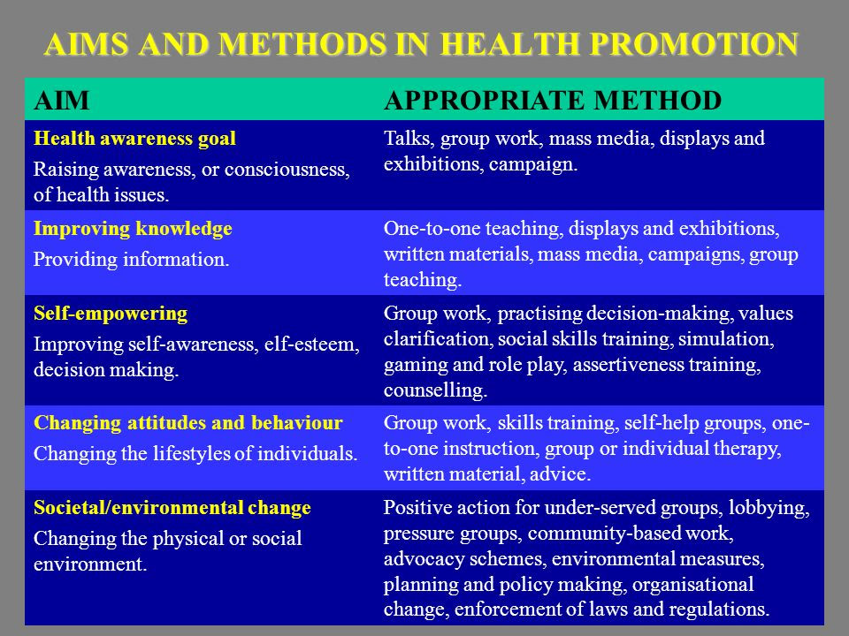

Slide 88
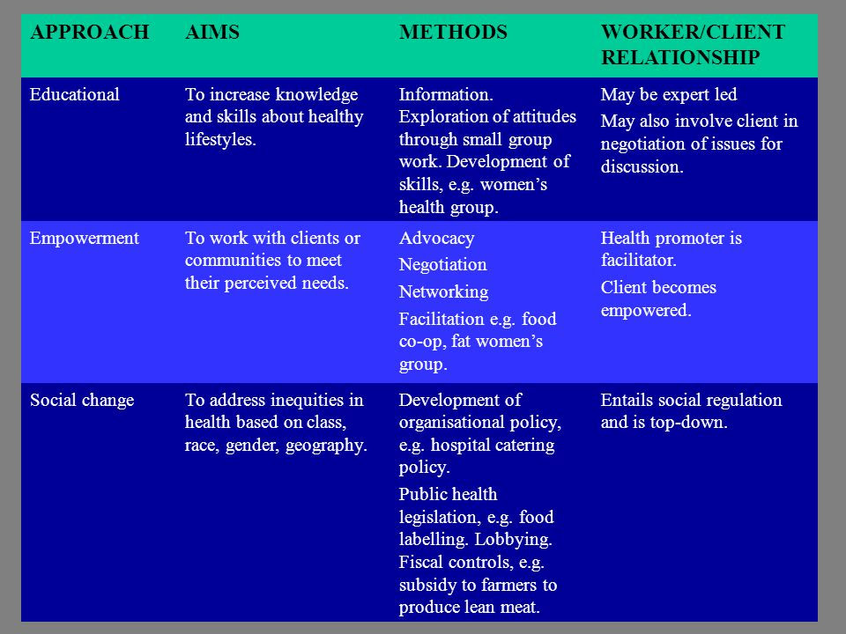

Slide 89
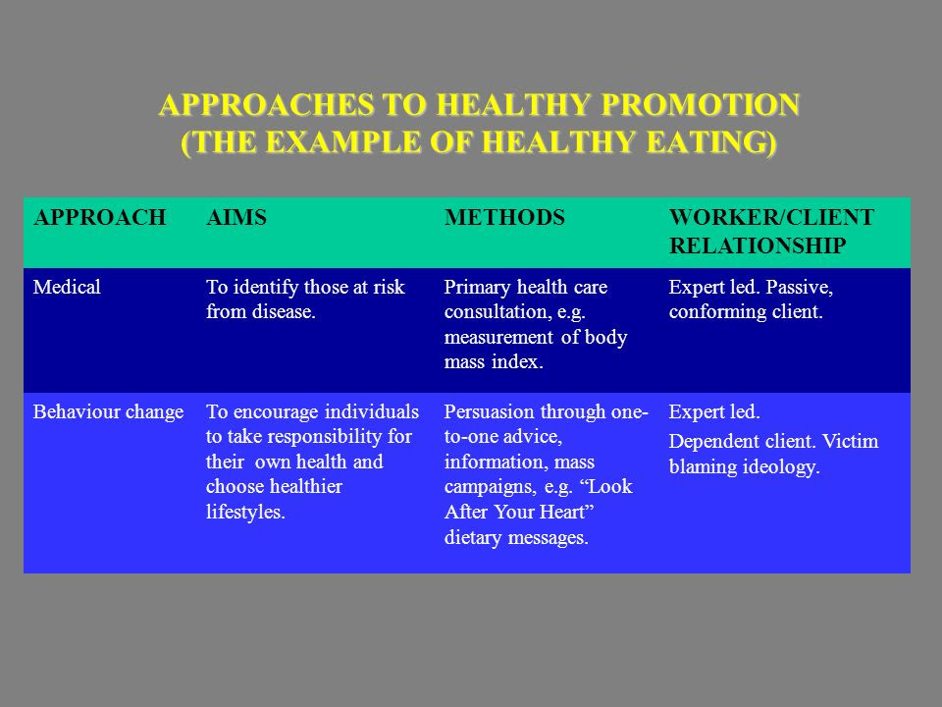

Slide 90
METHODS AND APPROACHES: INDIVIDUAL

Slide 91
INDIVIDUAL APPROACH -1
Individual focus – the cradle of health promotion.
One-to-one basis – individual advice, counselling
Interactive nature of face-to-face communication allows better possibilities for success than perhaps any other communication medium
Individual methods of health promotion are usually but not exclusively associated with secondary prevention or tertiary prevention

Slide 92
INDIVIDUAL APPROACH -2
LIMITATIONS
For a large population to labour intensive to reach everyone in this manner
One-to-one individual methods not as appropriate in the area of primary prevention – cost-ineffectiveness among large target audiences, many of whom may not develop the specific disease
Difficult to gain access to people and also health information competing with a myriad of other messages (often anti-health forces)

Slide 93
INDIVIDUAL APPROACH -3
As most information concerning health is so technical and complex, a translational process is necessary to transform scientific and medical jargon into information which can be understood and acted on by the general public

Slide 94
METHODS AND APPROACHES: GROUPS

Slide 95
GROUP APPROACHES -1
Group techniques offer an intermediary between one to-one approaches and wider community appeals through media and whole community approaches
Groups can range in size from 2-3 people to several hundreds and can be either homogenous or heterogenous in nature
Health education methods in such groups can be classified as didactic (i.e. lectures, seminars) or experiential (i.e. skills training, simulation/games etc.)

Slide 96
GROUP APPROACHES -2
Group methods have been used by health educators to empower individuals, organisations and communities in key ways.
These include assisting individuals:
  – to modify or maintain health-related behaviour
  – to provide a supportive setting for individuals sharing a common goal or problem
  – to organise community to improve their capability to identify and solve their own problems (i.e. community organisation)
  – to organise individuals and groups to undertake macro-level social change (e.g. training community leaders)

Slide 97
GROUP APPROACHES -3
Group methods can also be used in a range of different settings, including those at which the level of prevention is mainly:
– primary (schools, workplace, organisations)
– secondary (medical practice, health centres, outpatient clinics, drug refgerral centres), or
– tertiary (hospitals, rehabilitation centres, nursing homes

Slide 98
2. Group approach
Groups can range in size from 2-3 people to several hundreds and can be either homogenous or heterogenous in nature
Methods of communication used:-
DIDACTIC GROUP METHODS
LECTURE-DISCUSSION
Best for knowledge transmission, motivation in large groups. Requires dynamic, effective speaker with more knowledge than the audience.
SEMINAR
Smaller numbers (2-20). Leader-group feedback. Leader most knowledgeable in the group. Best for trainer learning.
CONFERENCE
Can combine lecture/seminar techniques. Best for professional development. Several authorities needed.

Slide 99
CONT.
EXPERIENTIAL GROUP METHODS
SKILLS TRAINING
Requires motivated individuals. Includes explanation, demonstration and practice, e.g. relaxation, childbirth, exercise.
INQUIRY LEARNING
Used mainly in school settings. Requires formulating and problem solving through group co-operation.
PEER GROUP DISCUSSION
Useful where shared experiences, support, awareness are important. Participants homogeneous in at least one factor, e.g. old people, prisoners, teenagers.
SIMULATION
Useful for influencing attitudes in individuals with varying abilities. Generally in school setting, but of relevance to other groups.

Slide 100
CONT….
BEHAVIOUR MODIFICATION
Learning and unlearning of specific habits. Stimulus-response learning. Generally behaviour specific, e.g. quit smoking phobia desensitisation.
SENSITIVITIY/ ENCOUNTER
Consciousness raising. Suitable for professional training and some middle-class health goals

Slide 101
CONT.
ROLEPLAY
Acting of roles by group participants. Can be useful where communication difficulties exist between individuals in a setting, e.g. families, professional practice, etc.
SELF-HELP
Requires motivation and independent attitude. Valuable for ongoing peer support, values clarification, etc. Can be therapy or a forum for social action.

Slide 102
METHODS AND APPROACHES: GENERAL POPULATION

Slide 103
3. GENERAL PUPOLATION APPROACH
Mass Media in Health promotion
Definition of some terms;
MASS MEDIA:
Any printed or audio-visual material designed to reach a mass audience. This includes newspapers, magazines, radio, television, billboards, exhibition, display, posters and leaflets
MESSAGE
A cultural communication encoded in-signs and symbols

Slide 104
MARKETING:
The sum total of all activities (the marketing mix) designed to persuade people to adopt certain behaviours
ADVERTISING
One component of marketing mix
AUDIENCE SEGMENTATION:
The division of a mixed population into more homogenous groups or market segments. Market segments are defined by certain shared characteristics which affect attitudes, beliefs and knowledge. Targeting specific market segments allows for more specific messages which will have a greater effect.

Slide 105
MASS MEDIA, ADVERTISING, MARKETING AND HEALTH PROMOTION -1
Unrealistic expectations of media effectiveness due in part to a basic misunderstanding
Health promoters assumed that advertising alone was responsible for the behaviour change achieved by commercial companies. They failed to appreciate that advertising is just one part of what is called “the marketing mix”

Slide 106
MASS MEDIA, ADVERTISING, MARKETING AND HEALTH PROMOTION -2
Advertising a commercial product is very different from trying to sell health. Advertising typically mobilizes predispositions whereas health promotion typically tries to counter them
Advertising is selling things in the here and now, to be immediately consumed and enjoyed. By contrast, health education messages are often about foregoing present enjoyment for future benefits

Slide 107
MASS MEDIA, ADVERTISING, MARKETING AND HEALTH PROMOTION -3
Advertising spends large sums of money for relatively small shifts in behaviour. Health education spends a fraction of commercial budgets attempting to generate large shifts in behaviour

Slide 108
WHAT THE MASS MEDIA CAN AND CANNOT DO
The mass media can:
Raise consciousness about health issues
Help place health on the public agenda
Convey simple information
Change behaviour if other enabling factors are present
Using the mass media is effective if:

Slide 109
WHAT THE MASS MEDIA CAN AND CANNOT DO -2
Using the mass media is effective if:
It is part of an integrated campaign including other elements such as one-to-one advice
The information is new and presented in an emotional context
The information is seen as being relevant for “people like me”

Slide 110
WHAT THE MASS MEDIA CAN AND CANNOT DO -3
The mass media cannot:
Convey complex information
Teach skills
Shift people’s attitudes or beliefs. If messages are presented which challenge basic beliefs, it is more likely that the message will be ignored, dismissed or interpreted to mean something else
Change behavior in the absence of other enabling factors

Slide 111
FACTORS IMPORTANT TO MEDIA EFFECTIVENESS
CREDIBILITY: The source must be trusted and reliable
CONTEXT: The message should be relevant to the receiver
CONTENT: The message must be meaningful
CLARITY: The receiver must be able to understand the message
CONTINUITY: The message should be consistent without being boring
CHANNELS: The message must used the established channel of the receiver
use the media
CAPABILITY: The receiver must be capable of acting on the message meaningful
COLLABORATION: Media professionals should be involved to determine how best to use the media

Slide 112
WHEN TO USE THE MEDIA IN HEALTH PROMOTION -1
when a wide exposure is desired
when public discussion is likely to facilitate the educational process
when awareness is the main goal
when media is on-side
when accompanying on the ground back-up can be provided

Slide 113
WHEN TO USE THE MEDIA IN HEALTH PROMOTION -2
when long-term follow-up is possible
when a generous budget exists
when counter-argument is likely to be productive
when the behaviour goal is simple
when a hidden agenda is public relations

Slide 114
MASS MEDIA METHODS OF COMMUNICATION
Pamphlets
Information sheet
Tv’s
Stickers
Videos
T-shirts
ong and short copy information. Material dependent on type of paper and day of week.
Newsletters
Radio
Newspaperl
Posters
Magazines

Slide 115
SOCIAL MARKETING
SOCIAL MARKETING is the application of marketing concepts and techniques to the marketing of various socially beneficial ideas and causes instead or products and services in the commercial sense. (FOX & KOTLER, 1980)
THE MARKETING MIX: THE FOUR P’S
PRODUCT: The physical product and its symbolic meaning
PRICE: the value of the product
PLACE: where the product is available
PROMOTION: Advertising, sales promotion, personal selling.

Slide 116
CONT.
1. PRODUCT
Does not necessarily mean a physical product
socially desirable goals e.g. behavioural, attitudinal, idea change to new habits, norms and values through learning
2. PRICE
represents the price the “buyer” must accept in order to obtain the “product”
includes costs in terms of money, opportunity, energy and pychological e.g.
    buying seat belts and installing it
    giving up the pleasures of smoking
    giving up favourite food

Slide 117
CONT.
3. PLACE
important for providing adequate and compatible distribution and response channels
arranging for accessible outlets which permit translation of motivation to act
requires effective & efficient marketing strategy e.g. prime time announcements, strategic places for display, direct telephone linkages, information centers etc.
4. PROMOTION
  key element in all marketing as consumer demand responds to promotion and product advertising

Slide 118
CONT.
  uses PERSUASIVE STRATEGY to make the product familiar, acceptable and desirable
  not “TELLING” but “SELLING” by stressing the benefits
include:
    advertising
    personal selling
    publicity and
    sales promotion

Slide 119
4. PROMOTION (Cont’d)
advertising through:
  choice of appeal
  selection of effective and efficient media
  development of presentation strategies
  use of various media, methods, et

Slide 120
8 IMPORTANT STEPS IN SOCIAL
MARKETING PROGRAMMES
Establishing management and operating procedures
Selecting the products to be marketed
Identifying the consumer population
Deciding on brand names and packaging
Setting an appropriate price
Recruiting sales outlets
Arranging and maintaining a distribution system
Carrying out promotion

Slide 121
SOCIAL MARKETING: STRENGTHS
A valuable change tool
Useful in persuasion
Useful in creating awareness and interest
Helpful by reinforcing through repetition of message
Usually offer long term benefits of the behaviours promoted
Useful in increasing programme effectiveness if used in combination with other strategies
Has mass media appeal
Cost-efficient

Slide 122
SOCIAL MARKETING: WEAKNESSES & LIMITATION
Heavy reliance on mass media (effects of selective processes)
Makes the audience passive
Tends to be manipulative
May create negative public sentiments for real consumer products
Creates resistance if opposed to strongly reinforced and deeply entrenched ideas/habits
Focus on the “individual” rather than the “community” at large for the proposed change
Only appropriate in certain circumstances
Ideas from “outside” - not the audience’s own

Slide 123
COMMUNITY DEVELOPMENT APPROACH
Community Development
Means working to stimulate and encourage communities to express their needs and to support them in their collective action
It is not about dealing with people’s problems on a one-to-one basis
It aims to develop the potential of a community
A community development approach to health involves working with groups of people to identify their own health concerns and to take appropriate action
Community development health workers are essentially facilitators locally based whose role is to help people in the community to acquire the skills, knowledge and confidence to act on health issues • Community development health workers are essentially facilitators locally based whose role is to help people in the community to acquire the skills, knowledge and confidence to act on health issues

Slide 124
ADVANTAGES AND DISADVANTAGES OF THE COMMUNITY DEVELOPMENT APPROACH
ADVANTAGES
DISADVANTAGES
Starts with people’s concerns, so it is more likely to gain support.
Focuses on root causes of ill health, not symptoms.
Creates awareness of the social causes of ill health
The process of involvement is enabling and leads to greater confidence
The process includes acquiring skills which are transferable, for example, communication skills, lobbying skills.
If health promoter and people meet as equal, Work is usually with small groups of people. it extends principle of democratic accountability..
Time consuming
Results are often not tangible or quantifiable.
Evaluation is difficult
Without evaluation, gaining funding is difficult.
The health promoter may find his or her role contradictory. O whom are they ultimately accountable – employer or community?
Work is usually with small groups of people.

Slide 125
COMMUNITY PARTICIPATION IN PLANNING HEALTH WORK
NO PARTICIPATION :The community is told nothing, and is not involved in any way.
VERY LOW PARTICIPATION :The community is informed. The legacy makes a plan and announces it. The community is convened or notified in other ways in order to be informed; compliance is expected.
LOW PARTICIPATION :The community is offered ‘token’ consultation. The agency tries to promote a plan and seeks support or at least sufficient sanction so that the plan can go ahead. It is unwilling to modify the plan unless absolutely necessary.
MODERATE PARTICIPATION: The community advises through a consultation process. The agency presents a plan and invites questions, comments and recommendations. It is prepared to modify the plan

Slide 126
CONT….
HIGH PARTICIPATION: The community plan jointly. Representatives of the agency and the community sit down together from the beginning to devise a plan.
VERY HIGH PARTICIPATION :The community has delegated authority. The agency identifies and presents an issue to the community, defines the limits and asks the community to make a series of decisions which can be embodied in a plan which it will accept.
HIGHEST PARTICIPATION: The community has control. The agency asks the community to identify the issue and make all the key decisions about goals and plans. It is willing to help the community at each step to accomplish its goals even to the extent of delegating administrative control of the work.

Slide 127
WAYS OF DEVELOPING COMMUNITY PARTICIPATION
Be open about policies and plans
Plan for the community’s expressed needs
De-centralise planning
Develop joint forums and networks
Provide support, advice and training for community groups
Provide information
Provide help with funding and resources

Slide 128
Community dialogue
Defination:Community dialogues are an interactive participatory communication process of sharing information between people or groups of people aimed at reaching a common understanding and workable solution.

Slide 129
Steps of an organized community dialogue
Step 1. Problem identification
Step 2. Problem analysis
Step 3. Identify best option
Step 4. Choose the best option
Step 5. Planning together
Step 6. Acting together
Step 7. Evaluate and give feedback

Slide 130
Step 1. problem identification
The first step in conducting a community dialogue is to identify the problem or issue at hand.
In this case the issue could be HIV and AIDS focusing on HIV testing and counselling (HTC), human rights or gender. It could be poor hygiene and sanitation due to lack of clean water and sanitary facilities.
Step 2. Problem analysis
Problem analysis involves a thorough analysis of the issue /situation at hand. Questions that can be asked under this section include:
What are the causes of the problem /issue at hand?

Slide 131
Step 1. problem identification
The first step in conducting a community dialogue is to identify the problem or issue at hand.
In this case the issue could be HIV and AIDS focusing on HIV testing and counselling (HTC), human rights or gender. It could be poor hygiene and sanitation due to lack of clean water and sanitary facilities.
Step 2. Problem analysis
Problem analysis involves a thorough analysis of the issue /situation at hand. Questions that can be asked under this section include:
What are the causes of the problem /issue at hand?

Slide 132
Cont.
Is the issue /problem a shared problem in this community or it is perceived as a problem for only a few?
How is the community responding to the problem? What is the community’s current knowledge? What are current attitudes, practices and beliefs about the issue at hand?
Have traditional, religious and political leaders been involved in trying to address the problem /issue at hand?

Slide 133
Step 3. Identify best option
This section shall assist the user to identify the best options. In doing this, emphasis is placed on actions to be taken to achieve the intended behaviors and how to sustain them.
Step 4. Choose the best option
Identified options are chosen based on their effectiveness, feasibility, relevance and appropriateness within the community’s context
Step 5. Joint planning
At this planning stage participants will examine the priorities set during the previous step before designing an appropriate Community or Village Action Plan. The plan will include the following elements

Slide 134
Cont.
What will be done.
When it will be done.
Who will do what.
Resources required and potential challenges.
Measures or indicators of success.
Participatory tools for monitoring and evaluating actions

Slide 135
Step 6: Acting together
After collectively developing an action plan, implementation of the plan should be conducted in a participatory manner, with each member recognizing her/his role in the project.
It is therefore important to build commitment of the various community members and stakeholders in order to ensure the success of the project.

Slide 136
Step 7: Monitoring, evaluation and feedback
Participatory evaluation involves a collective reflection of achievements, identifying what went well and why particular actions did not go well.
Participatory evaluation creates a learning process for the program recipients, which helps them in their efforts.
After the evaluation process the necessary feedback should be provided. This promotes ownership of the process and the will to do better next time. Reinforcement is also important to motivate participants to do better or sustain the desired behaviour.

Slide 137
Nurses’ role in health prompotion

Slide 138
To develop good practice in health promotion, the nurses need to condider the following;
Incorporate health promotion as an integral poart of nursing practice in different health care settings and in the community.
Facilitate and empower individuals, families and communities to increase control over the determinants of health via capacity building strategies.
Work in paertnerdhip with other disciplines and sectors in promoting the health of the community.

Slide 139
Evaluate the outcome of health promotion activities and pursue continuous improvement.
Participate in and contribute to the development of evidence-based practice in health promotion
Advocate for the individual, families, and communities, and contribute to the formulation of public health policies for promoting the health of the population at large.

Slide 140
Roles of the nurse the health promotion
1. assessing health needs
The nurse should asses the health needs of the individual or the public and provide them with information and education that enables them to promote health, assume self-care at different stages of their lives; and cope with acute/chronic illness and injury.

Slide 141
Roles of the nurse the health promotion
2.Building capacityin health promotion
The nurse should acquire specialized skills and competences in health promotipn through lifelong learning. He/she should then adopt various health promotion strategies that help people to build capacityin controlling their own health and in making healthy life choices

Slide 142
Roles of the nurse the health promotion
3. Participate as a proactive key player in inter-sectoral collaboration
The nurse working in diverse settings should contribute to the implementationof health promotion strategies in partnership with other interested parties, as mursing acknowledges inter-sectoral contribution to health promotion

Slide 143
Roles of the nurse the health promotion
4. Tackling multiple health determinants
The nurse has an important role to pay in the promoting health isn a wide range of settings, including school , workplace , hospitalsand loca; communities as well as at the broad societal level. By raising awareness of people of the multiple and changing determinants of health and their responsibilities in controlling them, the nurse may help to reomove obstacles to health promotion.

Slide 144
Roles of the nurse the health promotion
5. evaluating the health promotion activities
The nurse should include evaluation strategies in his/her initial planning for health promotion activities so that the efeectivenesss of the programme and health outcome could be evaluated as appropriate , this is important for making continuous improvements for the future activities.

Slide 145
Roles of the nurse the health promotion
6 generating new knowledge and understanding of health promption by research
The nurse should participate in conducting research and/or disseminating research findings on both health promoting information and health promotion programmes so that a scientific database is built for the development of evidence based practice. Moreover, new concepts and strategies would be generated to guide future practices

Slide 146
Roles of the nurse the health promotion
7. advocating the individual and community at political and social level.
The nurse should advocate for the community development and social involvement, public and social policy change for conducive to promoting the health of the population at large.

Slide 147
Roles of the nurse the health promotion
8. model health behaviors and attitude
9. facilitate client involvement in the assessment, implementation and evaluation of health goals
10.teach health care strategies to enhance fitness improve nutrition, manage stress and enhance relationships.
11. assist individuals, families and communities to increase their level of health
12. educate clients to be effective health care consumers.
13. assist clients, families and communities to develop and choose health promoting options

Slide 148
Roles of the nurse the health promotion
14. guide clients development in effective problem solving and decision making
15. reinforce clients personal and family health promoting behaviour.
16. advocate in the community changes that promote a healthy environment.

