Slide 1
Home Visiting

Slide 2
Home visiting
The home visit is a family-nurse contact which allows the health worker to assess the home and family situations in order to provide the necessary nursing care and health related activities. In performing this activity, it is essential to prepare a plan of visit to meet the needs of the client and achieve the best results of desired outcomes.

Slide 3
Home visiting
“components of a continuum of a comprehensive health care in which health services are provided to individuals, and families in their place of residence for the purpose of promoting, maintaining or restoring health
Or
Purpose of maximizing the level of independence while minimizing the effect of disability and illness, including terminal illness”

Slide 4
objectives
Assessment
Nursing care
Treatment
Health education
Referral

Slide 5
Purpose of Home Visiting
Afford the opportunity to gain more accurate assessment of the family structure and behavior in the natural environment
Provide opportunity to make observations of the home
environment and to identify both barriers and supports for reaching family health promotion work
Meeting the family on their home ground may also
contribute to family’s sense of control and active
participation in meeting their health needs

Slide 6
Purposes of home health services
To prevent institutionalization (primary goal)
To maximize clients level of independence
To maximize the effects of existing disabilities through non-institutional services

Slide 7
Principles of home visit
Should provide opportunity to undertake nursing process
Should be convenient and acceptable
Positive interpersonal relationship should be built (trust)
Respect clients right to accept or reject care and participation in goal setting & achievement
Home visits should be recorded in a diary/records

Slide 8
Principles
Have a purpose/ objective beneficial to the client
Regular and flexible
Planning for the visit should make use of all the information available on the patient and his family
In planning priority should be given to essential needs of the family
Should be educative

Slide 9
Principles of home visiting
Family members should be included in all phases
of the care process
The health workers (teams) are guests in the clients home there fore only make these interventions that the clients agrees with
Mutual health team – client goal and intervention
may require long periods to achieve, therefore, patience is necessary
Home visiting can be done by health professionals
employed in various ways.

Slide 10
Advantages
1. the family is seen in a familiar atmosphere which is relaxed and makes communication easier than at hospital or clinic
2. All family members can be seen & assessed by one person at one visit
3. The health workers is made aware of local problems, priorities, customs, difficulties, & resources
4. High risk families can be identified & visited as a priority
5. The health workers, can observe, assess, & act upon obvious and latent health problems.
Health workers can follow these problems at subsequent visit.’

Slide 11
Advantages
6. Much can be assessed at one time. e.g. personal hygiene, water supply, sanitation, waste disposed, food storage ……
7. More accurate assessment is done
8. Better understanding & good relation ship is
established with the family members
9. Advice will be practical and suited to the family’s
needs

Slide 12
Advantages
10. Provides opportunity to implement nursing process
11. Helps clarify doubts from family members
12. Helps in prevention and immediate handling of problems
13. Best option for incapacitated patients

Slide 13
Phases and activities of home visiting
Phase 1. Initiation phase – clarify purpose of home visiting
-share information to family member
Phase 2. Pre-visit phase – initiate contact with family
-determine family willingness
-schedule home visiting
-review records
Phase 3. On home phase – introduction him/her self
-warm greeting
-social interaction (to develop trusting r/ship)
-implement nursing process
Phase 4. Termination phase – review visit with family
- plan for future visit
Phase 5. Post – visit phase – Record visit
- plan for next visit

Slide 14
Phases and activities of home visiting
Phase 1. Initiation phase
  clarify source of referral
  clarify purpose of home visiting
  share information on reason and purpose with family members to family member

Slide 15
Phase 2. Pre-visit phase
(gather certain information necessary prior to the real visit)
Location of the family-physical address
gather information on patient, community resources, assemble supplies and plan for contact
initiate contact with family
-determine family willingness
-schedule home visiting
-review records

Slide 16
Phase 3. On home phase
Relationship building phase:
  Greet the patient and introduce yourself
  Introduce agency/organisation, obligations, program services
  social interaction (to develop trusting r/ship)
  State and explain the purpose of the visit
  Build nurse-pt relationship
  Discuss client rights and responsibility
  Assess possible safety of care plan : is there a primary care giver present and available if needed
  Consider your safety ( don’t enter house of client is not there, dress professionally, avoid expensive jewellery,)

Slide 17
Phase 3. On home phase
Intervention phase
  Carry out initial
      Client assessment
      Family assessment
      Environmental assessment
  Elicit how you can assist
  Assess need for other agencies e.g. physical therapy or referral to other organizations
  Assess need for equipment or supplies
  Assess need for stated third party reimbursement

Slide 18
Areas (points) to be assessed during Home visiting
  1. General cleanliness
  2. Solid waste disposal
  3. latrine
  4. personal hygiene
  5. vaccination of <1yr infants
  6. vaccination of women
  7. ANC
  8. Feeding of children <2 yrs
  9. FP
  10. Presence of insects / rodents in the house
  11. Presence of sick person in the house and action taken

Slide 19
Phase 3. On home phase
Intervention phase
If on medication-confirm doses, drugs and clients knowledge of medication
Identify clients knowledge base in relation to identified problem
  Disease process
  care of infant
Discuss estimated length of services including limitations

Slide 20
Phase 4. Termination phase –
Summarize / review visit activities with family
Together decided what the client and family will be doing between now and next visit
inform client how to contact in between visits
Make appointment for a return visit

Slide 21
Phase 5. Post – visit phase
Recording and reporting
    Record visit
    Record all important date, observation and care rendered.
    Develop nursing care plan for the family
    Complete agency report/paper work
Evaluate visit progress
  Plan for next visit

Slide 22
Limitations
Time consuming
Unforeseen events
Limited equipment can only be carried to home
Appointment might be not kept
Distractions in the home makes constructive discussions difficult
Certain homes may be geographical not reachable
Health worker safety not guaranteed
Non acceptance
Language barrier
Role confusion

Slide 23
Guidelines to consider regarding the frequency of home visits
The physical needs psychological needs and educational needs of the individual and family.
The acceptance of the family for the services to be rendered, their interest and the willingness to cooperate.
The policy of a specific agency and the emphasis given towards their health programs. Take into account other health agencies and the number of health personnel already involved in the care of a specific family.

Slide 24
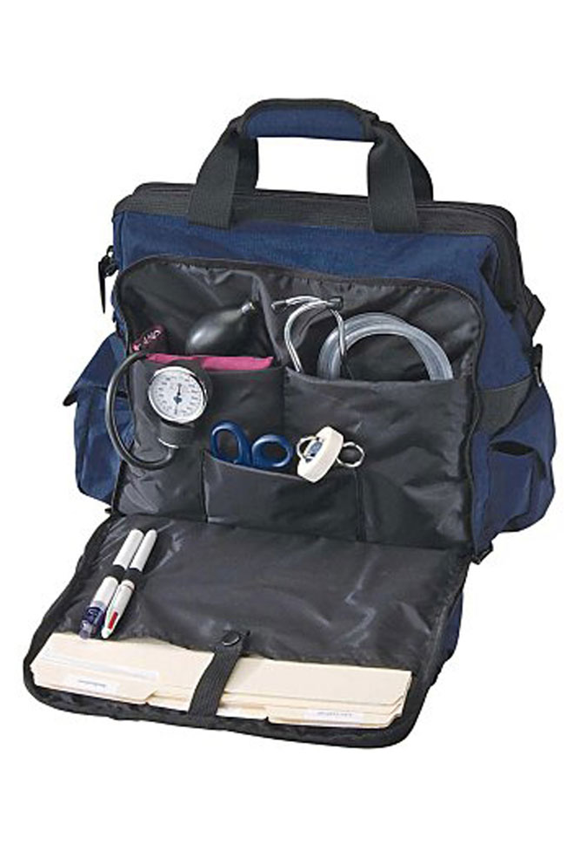
The bag technique
The bag technique is a tool by which the nurse, during her visit will enable her to perform a nursing procedure with ease and deftness, to save time and effort with the end view of rendering effective nursing care to clients.
The public health bag is an essential and indispensable equipment of a public health nurse which she has to carry along during her home visits.
It contains basic medication and articles which are necessary for giving care.
Nursing bag

Slide 25
Principles of bag technique
Performing the bag technique will minimize, If not prevent the spread of any infection.
It saves time and effort in the performance of nursing procedures.
The bag technique can be performed in a variety of ways depending on the agency’s policy, the home situation, or as long as principles of avoiding transfer of infection is always observed.

Slide 26
Contents of the public health bag
Paper lining
Extra paper for making waste bag
Plastic/linen lining
Apron
Hand towel
Soap in a soap dish
Thermometers (oral and rectal)
2 pairs of scissors (surgical and bandage)
2 pairs of forceps (curved and straight)
Disposable syringes with needles (g. 23 & 25)
Hypodermic needles (g. 19, 22, 23, 25)
Sterile dressing
Cotton balls
. Cord clamp
Micropore plaster
Tape measure
1 pair of sterile gloves
Baby’s scale
Alcohol
lamp
2 test tubes
Test tube holders
Solutions of:
  Betadine
  70% alcohol
  Zephiran solution
  Hydrogen peroxide
  Spirit of ammnonia
  Ophthalmic ointment
  Acetic acid
  Benedict’s solution
*Sphygmomanometer and stethoscope are carried separately

Slide 27
Steps in performing Bag technique
Upon arrival at the patient’s home, place the bag on the table lined with a clean paper.
The clean side must be out and the folder part, touching the table. Rationale: To protect the bag from getting contaminated.
Ask for a basin of water or a glass of drinking water if tap waster is not available. Rationale: To be used for hand washing.
Open the bag and take out the towel and soap. Rationale: To prepare for hand washing.
Wash hands using soap and water, wipe to dry. Rationale: To prevent infection from the care provider to the client

Slide 28
Steps in performing Bag technique
Take out the apron from the bag and put it on with the right side out Rationale: To protect the nurse’s uniform.
Put out all the necessary articles needed for the specific care. Rationale: To have them readily accessible
Close the bag and put it in one corner of the working area. Rationale: To prevent contamination
Proceed in performing the necessary nursing care treatment. Rationale: To give comfort and security and hasten recovery

Slide 29
Steps in performing Bag technique
After giving the treatment, clean all things that were used and perform hand washing. Rationale: To protect the caregiver and prevent infection
Open the bag and return all things that were used in their proper places after cleaning them.
Remove apron, folding it away from the person, the soiled side in and the clean side out.
Place it in the bag. Fold the lining, place it inside the bag and close the bag
Take the record and have a talk with the mother.
Write down all the necessary data that were gathered, observations, nursing care and treatment rendered.
Give instructions for care of patients in the absence of the nurse. Rationale: For reference in the next visit. Make appointment for the next visit (either home or clinic) taking note of the date and time. Rationale: For follow-up care

Slide 30
Important points to consider in the use of the bag
The bag should contain all the necessary articles, supplies and equipments that will be used to answer the emergency needs
The bag and its contents should be cleaned very often, the supplies replaced and ready for use anytime.
The bag and its contents should be well protected from contact with any article in the patient’s home.
Consider the bag and its contents clean and sterile, while articles that belong to the patients as dirty and contaminated.
The arrangement of the contents of the bag should be the one most convenient to the user, to facilitate efficiency and avoid confusion.

Slide 31
Guidelines to consider regarding the frequency of home visits
Careful evaluation of past services given to the family and how the family avails of the nursing services.
The ability of the patient and his family to recognize their own needs, their knowledge of available resources and their ability to make use of their resources for their benefits.

