Slide 1
Humerus shaft
MAINA

Slide 2
Incidence
3-5% of all fractures
Bimodal age distribution
  young patients: high-energy trauma
  elderly, osteopenic patients: low-energy injuries

Slide 3
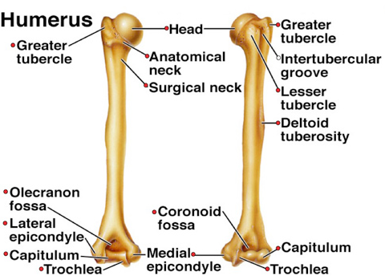
Diagram

Slide 4
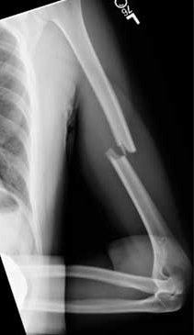
Image

Slide 5
Important relation
Radial nerve
  courses along spiral groove
  14cm proximal to the lateral epicondyle
  20cm proximal to the medial epicondyle

Slide 6
Classes
Classification
OTA bone number: 1 fracture location: 2 fracture pattern: simple: A, wedge: B, complex: C Descriptive fracture location: proximal, middle or distal third fracture pattern: spiral, transverse, comminuted Holstein-Lewis fracture a spiral fracture of the distal one-third of the humeral shaft commonly associated with neuropraxia of the radial nerve (22% incidence)

Slide 7
Clinical features
Symptoms
  pain
  extremity weakness
Physical exam
  examine overall limb alignment
  preoperative or pre-reduction neurovascular exam is critical
    examine and document status of radial nerve pre and post-reduction

Slide 8
Radiographic views
  AP and lateral
    include joint above and below the injury
  transthoracic lateral
    may give better appreciation of sagittal plane deformity
  traction views
    may be necessary for fractures with significant shortening, proximal or distal extension but not routinely indicated

Slide 9
Nonoperative treatment
Coaptation splint followed by functional brace
  indicated in vast majority of humeral shaft fractures
    criteria for acceptable alignment include:
    < 20° anterior angulation
    < 30° varus/valgus angulation
    < 3 cm shortening
  absolute contraindications
    severe soft tissue injury or bone loss
    vascular injury requiring repair
    brachial plexus injury
    radial nerve palsy is NOT a contraindication to functional bracing
  outcomes
    90% union rate
      increased risk with proximal third oblique or spiral fracture
    varus angulation is common but rarely has functional or cosmetic problems

Slide 10
Operative
absolute indications
open fracture
vascular injury requiring repair
brachial plexus injury
ipsilateral forearm fracture (floating elbow)
compartment syndrome

Slide 11
Operative
Plates and screws
IM nails

Slide 12
Coaptation Splint & Functional Bracing
Coaptation splint
  applied until swelling resolves
  adequately splint extends up to axilla and over shoulder
  common deformities include varus and extension
    Mold accordingly to counter displacement
Functional bracing
  extends from 2.5 cm distal to axilla to 2.5 cm proximal to humeral condyles
  sling should not be used to allow for gravity-assisted fracture reduction
  shoulder extension used for more proximal fractures

Slide 13
Complications
Radial nerve palsy
  seen in 8-15% of closed fractures
  increased incidence distal one-third fractures
  neuropraxia most common injury in closed fractures and neurotomesis in open fractures
  85-90% of improve with observation over 3 months
  spontaneous recovery found at an average of 7 weeks, with full recovery at an average of 6 months

Slide 14
Treatment of radial nerve palsy
observation
  initial treatment in closed humerus fractures
  obtain EMG at 3-4 months
  wrist extension in radial deviation is expected to be regained first
  brachioradialis first to recover, extensor indicis is the last
surgical exploration
  indications
    open fracture with radial nerve palsy (likely neurotomesis injury to the radial nerve)
    closed fracture that fails to improve over ~ 3-6 months
    fibrillations (denervation) seen at 3-4 months on EMG

Slide 15
Other complications
Malunion
Non union
Infection

