Slide 1
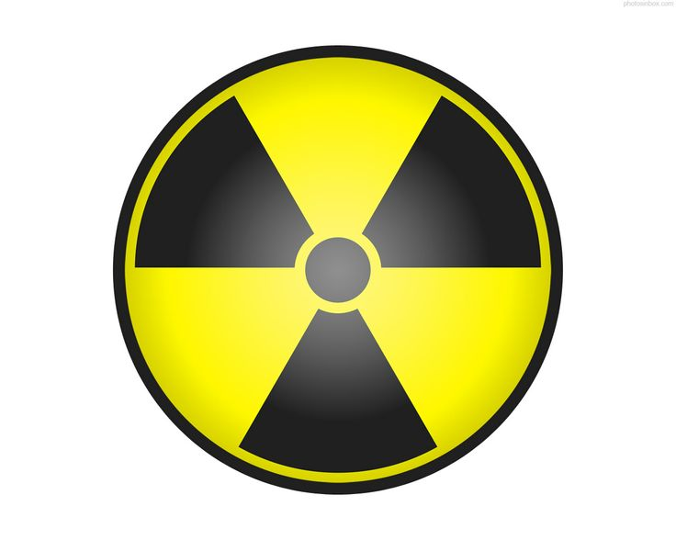
IMAGING AND THERAPEUTIC MODALITIES (ITM 1)
Vivianne Ochiel - Odawa

Slide 2
The EXPERT in anything was once a BEGINNER

Slide 3
Topic Outline
Imaging
Modalities
Branches
Considerations
Ethics
Radiation protection
Image quality
Upper limbs
Lower limbs
Shoulder girdle
Pelvic girdle
Spine
Chest
abdomen

Slide 4
Medical Imaging
Is the science of taking images for diagnostic purposes. The old name is Radiography which does not embrace all modalities.
The modalities are six namely conventional imaging, ultrasonography, computerized tomography, magnetic resonance imaging, nuclear medicine and radiotherapy
The branches are medical, veterinary and industrial imaging

Slide 5
Considerations
Patient identity
Waiting time
Preparation- psychologically, physically and physiological
Privacy
Comfort, hygiene
Immobilization
Care – before, during and after exam
Consent
Procedure explanation

Slide 6
Ethics
The dos’ and don’ts’ when dealing with a patient are;
No request form no imaging
No consent when needed no imaging
No imaging under intoxication
No abuse to patient
Radiation protection
Privacy of patient
Prior patient preparation
Records kept
integrity

Slide 7
Effects of ionizing radiation
Ionizing radiation has harmful effects
These are somatic and genetic
somatic affect the person who is irradiated and are hair loss, cataract, erythema, still birth, abortion, life shortening, vomiting, cell death and leukemia
Genetic effects manifest in the offspring and entail body deformities due to gonad cells damage

Slide 8
Radiation protection
This is done by practicing the following
Beam collimation
Fast screens and films-high speed
Meticulous technique
Proper instructions
Patient identification
Short exposures

Slide 9
Cont’
Do not use faulty equipment
Use productive materials
Minimize use of ionizing radiation
All this is for self, staff, patient and the public at large
Inverse square law
Doors closed
Few people in the room
Notes:
Use protective materials

Slide 10
Terminology
Basic terms
anterior is towards the front of the body (Latin: before)
posterior is towards the back of the body (Latin: after)
superior is towards the top of the body (Latin: above)
inferior is towards the bottom of the body (Latin: below)
medial is towards the midline (Latin: middle)
compared with median which is in the midline rather than towards the midline

Slide 11
lateral is away from the midline (Latin: side)
proximal is towards the centre of the body (Latin: near)
distal is away from the centre of the body (Latin: far)
superficial is towards the surface of the body
deep is away from the surface of the body
ipsilateral is on the same side of the body
contralateral is on the opposite side of the body

Slide 12
Planes
The axial plane (transverse or trans axial plane): horizontal plane perpendicular to the long axis of the body, divides the body into superior and inferior parts
The sagittal plane: vertical plane parallel to the median plane (or midsagittal plane) divides the body into right half and left halves
The coronal plane: vertical plane perpendicular to the median plane divides the body into anterior and posterior parts

Slide 13
Body positions
erect: either standing or sitting
decubitus: lying down
supine: lying on back
prone: lying face-down
lateral decubitus: lying on one side
right lateral: right side touches the cassette
left lateral: left side touches the cassette

Slide 14
Projections
antero-posterior: central ray passes from anterior to posterior
postero-anterior: central ray passes from posterior to anterior
lateral: central ray passes from one side of body to the other through the axial plane
oblique: central ray passes through the body/body part through a plane which is at an angle to the transverse plane/coronal plane

Slide 15
Assignment
Explain body Movements
flexion: decrease in the angle of the joint
extension: increase in the angle of the joint
abduction: movement of limb away from midline
adduction: movement of limb towards the midline
pronation: movement of hand and forearm to bring the palm facing posterior
supination: movement of hand and forearm to bring the palm facing anterior
circumduction: circular movement of a joint using a combination of flexion, abduction, extension and adduction such that the distal limb describes a circle
opposition: thumb brought to oppose another digit
reposition: thumb repositioned back to the anatomic position
elevation: movement of the scapular superiorly
depression: movement of the scapular inferiorly
eversion: movement of the sole of the foot away from the median plane
inversion: movement of the sole of the foot towards from the median plane
protrusion: movement of the mandible, lips or tongue anteriorly
retraction: movement of the mandible, lips or tongue posteriorly

Slide 16
UPPER LIMBS
The upper limb consists of shoulder girdle which is made of
Scapula, clavicle and the arm consisting of humerus, forearm (radius and ulna), 8 carplal bones, 5 metacarpals and 14 phalanges
The joints are shoulder, elbow, wrist, carpo-metacarpal, metacarpo-phalangeal and inter-phalangeal

Slide 17
Projections
There are mandatory views thus:
Basic views antero-posterior and lateral
Supplementary or additional views
Alternative views when the basic is impossible example the chest AP instead of PA for very sick patients and children or in theatre or the ward

Slide 19
Fingers
Are formed by the 14 phalanges each digit with 3 except the thumb and the projections are PA and lateral
Postero-Anterior – The hand lies on a cassette with extended fingers and hand pronation. 18cmX24cm cassette is used. FFD is 100cm
Centre over the head of proximal phalanx of 3rd finger and collimate beam to area of interest
Lateral – Hand and forearm rotated 90 degrees, thumb rests on a foam pad. Centre over the head of 1st phalanx or proximal of index finger. FFD is 100cm, film 18cmX24cm and beam collimated. To show bone displacement if fracture present.

Slide 20
Thumb
Poster-Anterior: Hand in lateral 90 degrees from pronation, thumb rests on a foam pad. 18cmX24cm cassette is used. FFD 100cm
Lateral- Hand in pronation, palm slightly raised and rotated medially on foam pad as to bring it in a true lateral. Centre to the metacapo-phalangeal joint
Alternative is latero-medial of thumb perpendicular to film and AP inward and outward posterior part on film

Slide 21
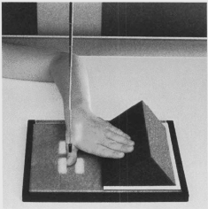
Thumb PA and Lateral

Slide 22
Index finger and middle finger
Lateral –hand rotated inward until lateral of index in contact with the film, the rest flexed. Centre over the head of 1st phalanx of the ring finger.
Ring and 5th fingers- Lateral – Medial aspect of the fingers in contact with 18X24 cm cassette, the rest flexed and thumb on foam pads. Centre to the head of 1st phalanx of ring finger.
Postero-anterior PA as of hand

Slide 23
Hand
PA - Hand is for grasping and formed by phalanges and carpals. One a 18X24 cm hand in pronation. Fingers extended. Centre to the head of 3rd metacarpal. Collimation beam and FFD is 100cm
Oblique – Hand 45 degrees from pronation. Fingers curved and supported on foam pad. Centre to the head of 3rd metacarpal. Lateral may be done for bone displacement and same film used.

Slide 24
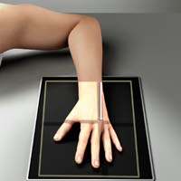
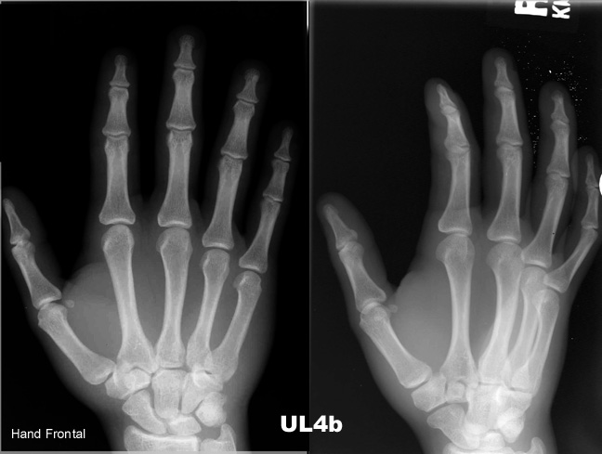

Slide 25
AP OBLIQUE BILATERAL PROJECTION: Ball-catcher's Position)
This position is performed commonly to evaluate for early evidence of rheumatoid arthritis at the second through fifth proximal phalanges and MCP joints. It also may demonstrate fractures of the base of the fifth metacarpal.
Both hands generally are taken with one exposure for bony structure comparison of both hands.

Slide 26
Cont’ ball catchers
Position:
Supinate hands and place medial aspect of both hands together at center of IR.
From this position, internally rotate hands 45degrees and support posterior of hands on 45degrees radiolucent block
Extent fingers and ensure that they are relaxed, slightly separated but parallel to IR.
Abduct both thumbs to avoid superimposition.
Central Ray:
CR perpendicular, directed to midpoint between both hands at level of fifth metacarpophalangeal joints
FFD (100cm)

Slide 27
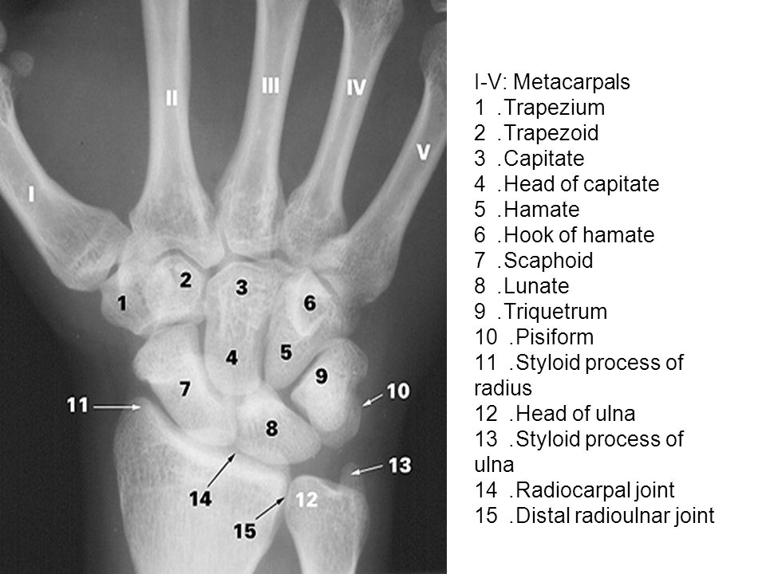
Wrist joint
Formed by scaphoid, lunate, triquetral, radius and ulna. Ulna isolated by a fibro-cartilage. Wrist bones medio-lateral are Pisiform, triquetral, lunate and scaphoid proximally. Distally latero-medial is Trapezium, Trapezoid, Capitate and Hamate. Capitate is the largest and first to ossify, lunate half moon and likely to be dislocated. Scaphoid is the most frequently fractured. Views are PA and Lateral

Slide 28
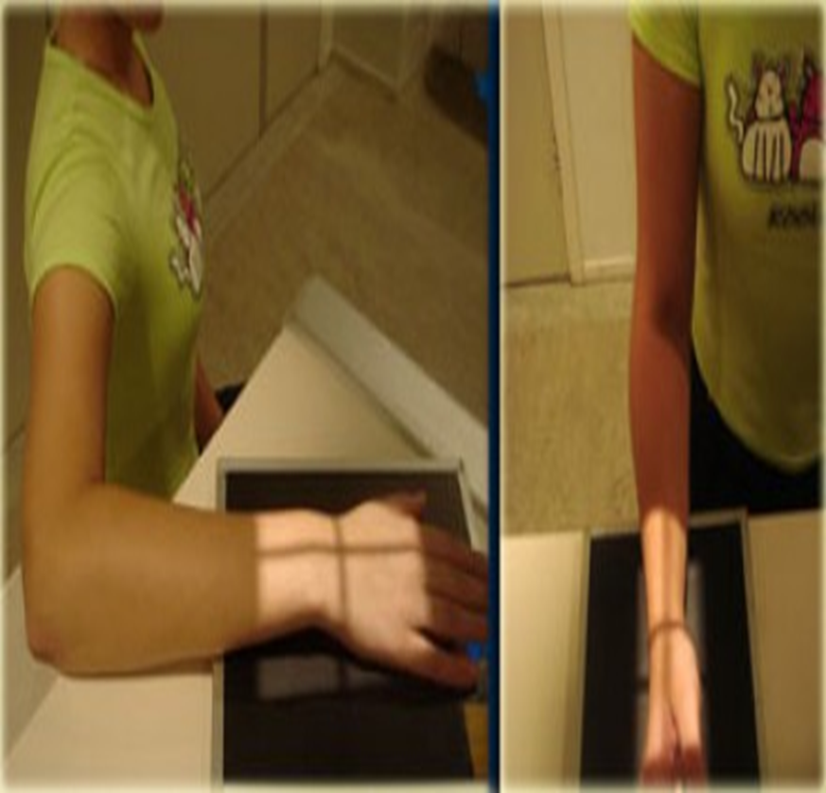
Wrist joint
Postero-anterior
Wrist on a 18X24 cm cassette in pronation, patient besides the x-ray couch, elbow flexed. Centre between the styloid processes of radius and ulna.
Lateral
Elbow flexed and wrist at 90 degrees. Centre to Lateral styloid process. Done for Colles fracture and displaced epiphyses-ulnar deviation. Colles fracture is a fracture of the distal radius which may be difficult to heal hence calling for fixation of metal plates or nailing

Slide 29
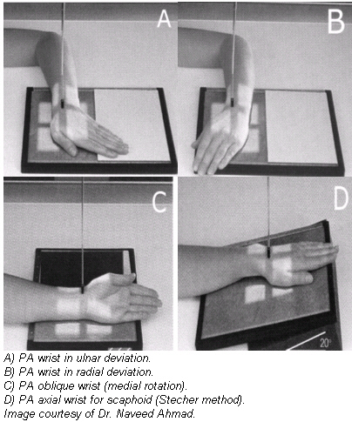
Scaphoid views
Four views used
PA as normal wrist
Lateral as wrist
PA ulnar deviation as PA but hand rotated outward or laterally
PA or AP oblique

Slide 30
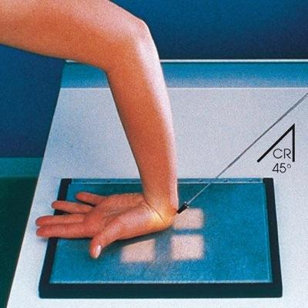
Carpal tunnel
Formed by depression of carpal bones. Nerves, vessels and ligaments pass here and carpal tunnel syndrome occurs. Axial view done with patient sitting backwards, fingers on film

Slide 31
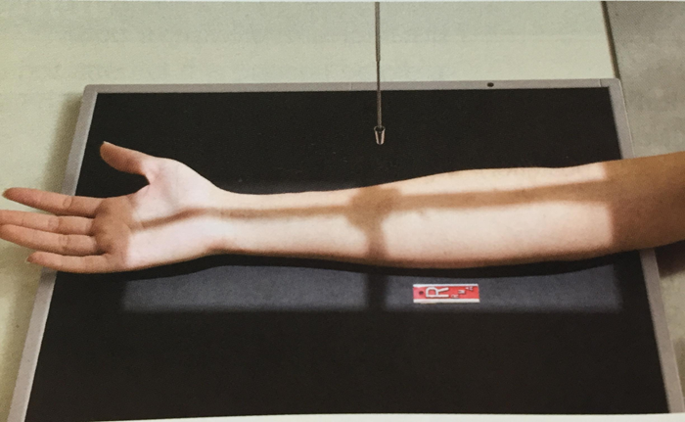
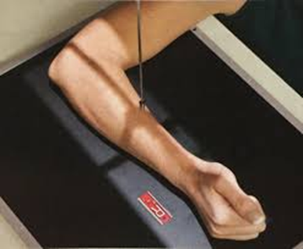
Forearm
Basic projection AP and Lateral
Antero-posterior- Patient sits besides the x-ray table. The elbow is extended and forearm put in supination on a 24X30 cm cassette. Centre to middle of forearm. FFD is 100cm
Lateral- form supination 90 degrees. Elbow is flexed. Centre to the middle of cassette.

Slide 32
Elbow joint
Is a hinge joint. Movement flexion and extension
indications:- fractures, dislocations, pathology eg osteoarthritis, foreign body.
Basic projections are AP and Lateral
Lateral- this projection is usually taken first because the position is easier for the patient. The patient sits beside the xray table with the elbow flexed at right angles and the hand in the lateral position. Humerus and forearm must be n the same plane so either patient sits on a low stool or cassette is raised on a firm support or the table is raised until it is at the centre
The CR is centered to the lateral epicondyle

Slide 33
Antero-posterior
Patient position as for lateral
From lateral position the elbow is extended and forearm outstretched with the back of the hand on the table resting on a foam pad. Sand bag is placed on the hand for immobilization.
CR
The vertical and perpendicular central ray is centered 2.5 cm below midpoint of epicondyles
FFD is 100cm
Cassette 24X30cm

Slide 34
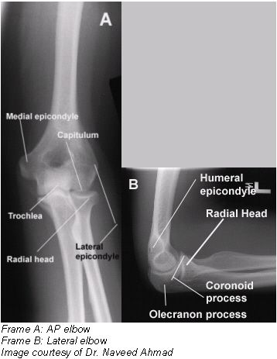
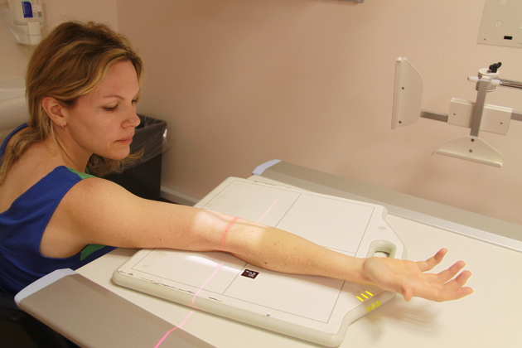
Elbow joint

Slide 35
The ulnar groove
This is a groove to medial humeral epicondyle. Passage of ulnar nerve. Ulnar called funny bone because of the sensations from the nerve.
Patient sits with his back to the x-ray table. The arm is extended backward with the elbow flexed and the forearm placed on the cassette. The upper arm is adjusted to make an angle of 45 degrees to the film.
Centre to the lateral part of the medial epicondyle. FFD is 100cm
Cassette size 18X24 cm

Slide 36
The Humerus
Indications:- fracture, pathology e.g osteogenic sarcoma, osteomyelitis, FB
Basic projections AP and lateral
Antero-posterior- The patient faces the x-ray tube in the erect or supine position, the elbow is extended with palm in the anatomical position. The epicondyles must be equidistant from the cassette. The upper boarder of the cassette is placed 2.5cm above the top of the shoulder and should be large enough to include the shoulder joint and the elbow join.
CR is centered midway between the shoulder and elbow joint (midshaft)
Cassette 15X40cm
FFD 100cm

Slide 37
Lateral – from the antero-posterior position the arm is abducted and rotated medially through 90 degrees with the elbow flexed and the hand placed on the abdomen. The epicondyles must be superimposed. The cassette may be raised on sand bags soft pads to bring it into close contact with the humerus.
Centre mid shaft of humerus
Cassette 15X40cm
FFD is 100cm

Slide 38
Special circumstances
Transthoracic projection for a fixed humerus
When the humerus is fixed in abduction by splint or plaster

Slide 39
THE SHOULDER GIRDLE The shoulder joint
Indications:- pathology, trauma, muscle calcification, foreign bodies, age assessment
Basic View :- AP and Axial (supero-inferior)
Antero-posterior – Patient is examined either in the erect or horizontal position. The erect position is preferred unless the patient can not stand or sit
Patient position (erect)
A 24X30 cm cassette with the appropriate anatomical side marker in place, is vertically placed in the vertical cassette holder. It is adjusted so that the shoulder joint is at the center of the cassette. With the patient erect and facing the x-ray tube, he is rotated 30 degrees towards the joint under examination until the scapula of the side under examination is parallel to the film.

Slide 40
b) Patient position Supine
The technique is same as with the patient in the erect position except that:-
The cassette is placed on the x-ray table
The patient is helped to be supine on the couth and supported posteriorly to assume 30 degree rotation towards the joint under examination.
CR : is vertical
Note: A secondary air gap / grid is necessary in the case of patients with developed deltoid muscles

Slide 41
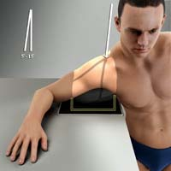
c) Axial view (Supero-Inferior)
An 18X24cm curved cassette (if available) is placed on the table and marked appropriately. The patient sits beside the x-ray table with the arm abducted and the elbow flexed so that the forearm is at right angles to the humerus.
The curved cassette is adjusted under axilla
and the patient leans over it so that the
shoulder region is as flat as possible to
avoid distortion of the joint
CR with the CR perpendicular to the
cassette centre to the head of the humerus

Slide 42
Special circumstances
Infero-superior – This is usually done, when the patient is unable to abduct sufficiently for a supero-inferior projection.
With the patient in the erect position the are is abducted as much as possible. The x-ray tube preferably with a long extension (cone) is placed at the side of the patient and directed upwards towards the axilla.
An 18X24cm cassette is supported horizontally above the shoulder and pressed firmly against the neck so that the shoulder joint will not be projected off the film.
With the beam in a vertical upward projection, centre through the axila with the CR as perpendicular to cassette as possible

Slide 43
ii) Lateral projection
Is performed when the patients arm cant be abducted because it is in a sling or is too painful to be moved.
The patient is examined in the sitting or erect position facing the x-ray tube. Patient is rotated until the spine of the scapula of the side under examination is at right angles with the cassette.
Patient should be adequately immobilized and use of short exposure time is recommended.
CR – using a horizontal beam centre to the head of humerus or just below the coracoid process.

Slide 44
Supplementary views
AP with internal and external rotation - demonstration of muscle and tendon calcification
Stryker's view – recurrent subluxation
25 degrees AP – to demonstrate sub-acromial calcification
Axial – for bicipital groove

Slide 45
i) AP with internal and external rotation
Besides muscle and tendon calcification these views are also essential to obtain further information concerning any lesion seen on the basic view.
Two radiographs are taken
Patient is positioned as for the basic AP view. The elbow remains flexed, the forearm is placed either across the chest behind the back to produce full internal rotation of the shoulder joint
Patient is repositioned in the AP position with the elbow flexed, the arm is then externally rotated as far as possible.
For both exposures centre the coracoid process

Slide 46
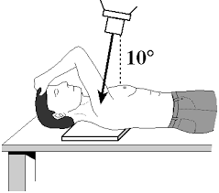
ii) Stryker’s view
Patient lies supine on the x-ray couch facing the tube
A 24X30cm cassette appropriately marked is placed under the shoulder being examined. The cassette is adjusted so that the shoulder under examination is in the middle.
The palm of the hand of the side under examination is placed on top of the head and the elbow directed forwards.
Centre to the coracoid process, with the tube angle 10 degrees cephalad

Slide 47
iii) 25 degrees AP view
Patient lies supine on the x-ray table and is made comfortable. The elbow is flexed, the hand pronated and then placed under the back.
An 18X24cm cassette appropriately marked is placed under the shoulder being examined and adjusted to be in line with the CR
Centre to the acromial process with the tube angled 25 degrees caudad

Slide 48
The Scapula
Indications
Trauma
Pathology
Muscle calcification
Foreign bodies
Basic views
AP
Lateral

Slide 49
Anteroposterior
The patient may be examined while standing, sitting or lying supine facing the xray tube. He is rotated 30 degree to bring the plane of the scapula parallel with the cassette. A 24X30cm cassette appropriately marked is placed under the scapula with the upper boarder 2.5cm above the shoulder joint.
Along exposure time is used with the patient breathing gently, this blurs out the lung and rib shadows to give a clear view of the scapula. With the central ray at right angles with the cassette centre over head of the humerus

Slide 50
Lateral projection
The patient faces the cassette with the elbow of the side under examination flexed and the arm slightly adducted to separate the humerus shaft from the scapula.
The patient is then rotated about 60-70 degrees with the shoulder in contact with the cassette.
The patient is adjusted until the plane of the scapula is at right angles to the cassette. Centre to the medial border of the scapula or to the 4th-5th thoracic vertebral body

Slide 51
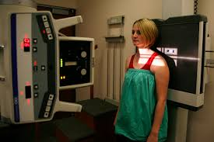
Acromio-clavicular joints and clavicle
For children both joints done for comparison. Centre between the joints. Cassette 24x18 cm.
Clavicle
AP done centering to middle of clavicle.
FFD 100 cm and cassette 24x18 cm.

Slide 52
LOWER LIMB
Has lower and upper part. Consists of femur, patella, tibia, fibula, tarsals (7), metatarsals (5) and 14 phalanges. Called leg with upper and lower leg.

Slide 53
Foot
Made of tarsals, metatarsals and phalanges.
Dorsi-plantar oblique
Patient steps on a 30x24 cassette, foot rotated 45 degrees medially. Centre through cuboid-navicular area. FFD 100 cm and beam collimated to area of interest.
Dorsi-Plantar
Patient sits on the couch, foot on cassette, knee medial rotation. Centre through cuboid -navicular region. Lateral can be done for foreign body (FB), Flat foot weight bearing. This condition is called Pes Planus. Calcaneal spur is a bone growth on the calcaneus which is very painful- lateral view done for both calcani for comparison.

Slide 54
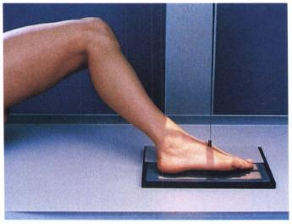

Slide 55
Supplementary views
Indications
Pes-planus (flat foot)
Hallux- valgus - the problem is lateral deviation of the great toe
Os trigonum - one of the bony ossicles of the foot and can be mistaken for a fracture
Calcaneal spur
Foreign body

Slide 56
i) Weight bearing view for flat foot/lateral
This projection demonstrates any variation in the longitudinal arches. The patient is examined erect when the feet bear the whole body weight. The patient stands on a low platform made of a radiolucent material, leaving a shallow gap between the feet to allow the cassette to be supported vertically.
The cassette lower boarder should be at least 2.5cm below the level of the soles of the feet. For mobilization the patient rests on a convenient vertical support
With the central ray horizontal and perpendicular to the beam, centre to the lateral aspect of foot at the level of the cuboid. A view of each foot is taken in turn

Slide 57
ii)Weight bearing dorsi-plantar for hallux valgus
The patient stands on a 24cm X30cm cassette appropriately marked and placed on the floor, the body weight is equally distributed to the film, centre between the feet at the level of the 1st metatarsal-phalangeal joint

Slide 58
iii) Lateral projection for Os trigonum
Patient sits on the x-ray table and is made comfortable. Both knee and hip joints are flexed and abducted outwards until the soles of the feet touch each other, the knees are supported over sand bags on both sides.
Centre between the heads with the vertical and perpendicular central ray
Note
This view also demonstrates calcaneal spur

Slide 59
iv) Lateral projection of the foot
This view is considered basic when the indication is foreign body or calcaneal fracture.
From the seated position the patient lies on the affected side with the knees flexed and the sound limb raised on sandbags behind the injured limbs.
The knee of the side under examination is raised on sand bags to bring the plantar aspect of the foot at right angles to the cassette
Using a vertical and perpendicular central ray, entre to the navicular

Slide 60
iv)Hallux (big toe/great toe)
Basic projections
Dorsi plantar – centre over 1st metatarsal phalangeal joint
Dorsi-plantar oblique – centre over the metatarsal-phalangeal joint
Lateral view – the patient is seated on the x-ray table, the injured foot is rotated medially so as to bring the medial border of the foot into contact with the cassette, the heel is raised on a sand bag and the sole of the foot is obliquely positioned relation to the film. Centre over the thenar eminence of the great toe
Indication – FB, fracture, hallux valgus, acro-megally

Slide 61
The calcaneus
Indication – calcaneal spur, foreign body, fracture, acromegaly
Basic views – lateral (single or both on the same plane) and axial
Lateral – same as for the lateral of the foot (positioning). Centre at talo-calcaneal articulation
Axial view – there are 4 ways of performing this position with the patient standing, sitting, lying prone or lying supine. The sitting and standing positions are most commonly used.

Slide 62
i) Patient standing
The patient stands with one or both heels on the cassette which is placed on the floor. The patient the bends the knees slightly and leans forward with the chair in front of him for support.
Centre to the heel or midway between the two heels, if both are being examined at the level of the upper border of the calcaneum with the tube angled 10-15 degrees towards the toes.
If the knees are not flexed centre to the upper border of the calcaneum with the tube angled at 30 degrees towards the toes

Slide 63
ii) Patient seated
The patient sits on the x-ray table with the lower limb extended in the AP position. The ankles are flexed by use of bandage, placed around the fore part of the soles of the feet.
An 18cmX24cm cassette appropriately marked is placed under the calcaneus to include the calcaneo-cuboid articulation
Centre to the planter aspect of the heel with the central ray angled 40 degrees towards the ankle joint (or cephalad)

Slide 64
The talo-calcaneal articulation
The most important of the inter-tasral joints is the talo-calcaneal joint which is a common request by the orthopedic surgeons. It is a common injury from heights.
Articular surface is very irregular, can fully be demonstrated in stages.
In order to be able to fully demonstrate this articulation, several oblique projections are taken in stages. Two positions of the foot are used
latero-medial oblique
Medio-lateral oblique

Slide 65
a) Latero-medial oblique
The patient sits and extends the leg on the x-ray table, with the plantar surface of the foot, perpendicular to the table top.
The foot is then rotated 45 degrees medially and immobilized in that position.
Centre 3cm below the lateral malleolus. With the tube angled for each exposure in turn
40 degrees – demonstrate anterior part of the posterior talo-calcaneal articulation
20- 30 degrees to show the articulation between the talus and sustentaculum tali
10 degrees cephalad to show the posterior talo calcaneal articulaton

Slide 66
b) Medio-lateral oblique
From the above position the limb is rotated laterally until the foot is again at an angle of 45 degrees to the cassette and immobilized in that position.
Centre 2.5cm below the medical malleolus, with the tube angled 15 degrees cephalad. This view demonstrates the SULCUS CALCANEI

Slide 67
Toes
Dorsi-plantar, dorsi plantar oblique and lateral as for the foot but centering to the toe of interest. Sub-talar joints also the same. March fracture may occur along the metatarsals common with marching soldiers.

Slide 68
Ankle joint
Hinge synovial joint formed by talus and distal tibia and fibula.
Indications - Potts fracture, dislocation/subluxation due to rapture or stretching of the lateral ligaments, pathology (osteoarthritis), foreign bodies

Slide 69
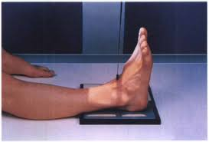
Ankle joint
Antero-Posterior (AP)
Patient sits on the X-ray couch, leg extended and foot medial rotation to make malleoli equidistant from the cassette. FFD 100 cm, 24x30 cm cassette used. Foot is vertical. Centre between the malleoli.

Slide 70
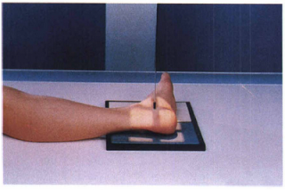
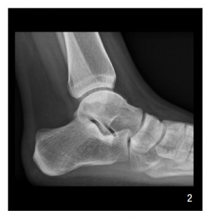
Lateral
Patient is rotated to injured side. Ankle joint and knee in contact with cassette. Malleoli superimposed.
Centre to medial malleolus. Stress views could be done. This is applied by the surgeon. Potts fracture may occur along distal tibia.

Slide 71
Special circumstances
A horizontal beam may be used to obtain a lateral view when the patient can not turn on the side being examined or the lateral projection
When the patient has injuries or bruises on the lateral aspect of the ankle joint, a latero-medial view is done

Slide 72
Supplementary views
Oblique – 45 degrees rotation either medial or lateral. Centre midway between the malleoli
Lateral – oblique – The patient makes further lateral rotation to make 40 degrees with the cassette surface and the patella in contact with the table. Centre to the ankle joint with the tube angled 20 degrees caudad
AP in forced eversion and inversion (stress views) – This stress views are indicated in suspected subluxation due to over stretched or torn medial and lateral ligaments following trauma
Patient position – patient is placed s for basic AP view. The ankle is then forcibly inverted and everted in turn by an orthopedic surgeon wearing lead rubber gloves and apron

Slide 73
Tibia and Fibula
Normally called lower leg. AP and lateral done.
Indications- fracture, pathology (Osteomyelitis, cysticercocis-parasitic calcification
AP- Patient sits on the couch, knee extended, malleoli equidistant, 30x40 cassette used. Centre to middle of leg and include joint near point of injury if not all joints

Slide 74
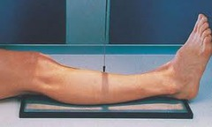
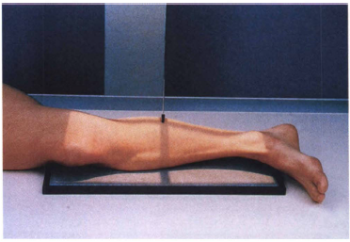
Lateral
Patient (Pt) is rotated to injured side, knee flexed, malleoli superimposed. Centre to middle leg. Horizontal beam used on patients on traction. FFD 100cm and same cassette used as in AP projection
Lateral
AP

Slide 75
Special circumstances
When it is impossible to include the whole tibia/fibula on one film additional views of either the ankle or knee joint are necessary
When the patient is unable to rotate the leg into the basic lateral position, the lateral view is taken using a lateral beam.
Supplementary views
Localized views - In additional to the basic views two or more oblique views of any lesion may be required.
Proximal tibio-fibula joint – from the basic AP position the leg is medially rotated about 10 degrees and immobilized in that position. Centre the head of the fibula
Additional examination :- arteriography, venography, CT, MRI

Slide 76
Knee joint
Synovial hinge joint formed by femoral condyles, tibia and posterior aspect of patella.
Indications :- fracture, dislocation, effusion of the joint, osteoarthritis, lipo-hemarthrosis, foreign body, genu valgum (knock knees), genu varum (bowlegs)

Slide 77
Antero-posterior
Patient sits or lie supine on the X-ray couch, knee extended. Foot vertical and condyles equidistant from cassette, 18x24 appropriately marked cassette used, FFD 100cm. Centre through the joint or 1 cm below apex of patella.
Lateral
Patient rotated to injured side, Condyles superimposed, heel supported. Centre to medial condyle and collimate beam to area of interest. FFD 100 cm and cassette 24x18 cm.

Slide 78
Special circumstances
When the patient has severe injuries or is arthritic, or obese the lateral position may be painful or difficult to maintain. In such cases patient remains in a supine position and the knee is raised on soft pad. The cassette is vertically supported between knees and the tube is directed horizontal with the central ray centered to the lateral tibio-condyle.
When the investigation is suspected for lipo-hemarthrosis the lateral view using horizontal beam is preferable. This may demonstrate fluid levels
The air gap technique or grid is used when the patient has fat or very muscular knees or has increased bone density eg in pagets disease

Slide 79
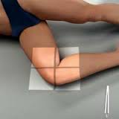

Slide 80
Supplementary views
Obliques – medial and lateral 45 degrees
Intercondylar view
Indications loose bodies, osteochondritis diseases
Intercondylar view
PP – the patient lies on the x-ray table with the knee flexed over a curved cassette to make an angle of approximately 135 degrees posteriorly. The upper border of the curved cassette is placed well above the knee joint, under the lower 1/3 of the thigh to compensate for the tube angulation, towards the head. Sand bags are placed on either side of ankle joint to immobilize the leg in slight medial rotation.
CR 0 centre to the upper border of the tibia paralle to the tibial plateau with the central ray
90 degrees to the tibial shaft to demonstrate the posterior aspect of the intercondylar notch and
110 degrees to the tibial shaft to demonstrate the anterior aspect of intercondylar notch

Slide 81
Patella
A sesamoid bone from ligaments.
Skyline view or infero-superior view done and lateral. Patient lies prone and knee at 90 degrees. Centre to inferior surface, tube angled 15 degrees cephalad that is beam towards the head.
Tibial tubercle in Os Good Schlatters disease a lateral is done. This is osteoarthritis. PA done prone. Intercondylar view for loose bodies in knee joint.

Slide 82
Femur
The examination of the upper 1/3 of femur you must include the hip joint and if it’s the lower the knee is included.
Indications are fracture, pathology (osteomyelitis, osteosarcoma) Foreign bodies
Basic views AP and Lateral

Slide 83
Femur
Longest and strongest bone of the leg to bear the body weight
Antero-Posterior
Patient lies supine, knee and hip extended, foot vertical and medial rotation to avoid neck foreshortening. FFD 100 cm, 15x40 cm cassette. Centre to middle of cassette and include all joints if not one near point of injury.
Lateral
Patient is rotated to the affected side, condyles superimposed, centre to middle of femur or cassette. Sometimes horizontal beam is used when patient on traction or on weights.

Slide 84
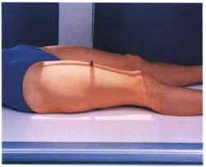

Slide 85
Special circumstances
When the patient cannot be turned to the side for lateral projection the sound limb is raised on a support high enough to allow passage of horizontal beam. The film is vertically supported against the lateral aspect of the injured thigh.
The tube is adjusted for a horizontal projection.
The central ray is directed from the medial aspect of the thigh and centred to the shaft of the femur at the level of the middle of the cassette.

Slide 86
THE PELVIC GIRDLE
Land marks for radiography:- ASIS,PSIS, symphysis pubis and coccyx
Indications
Congenital abnormalities
Pathology – OA and TB spine
Cephalo-pelvic disproportion CPD
Skeletal survey
Fractures/ dislocation
Pelvic neoplasm
Rickets

Slide 87
Pelvic girdle
Attachment for lower limbs. Has 2 innominate bones. 3 bones Ischium, Ilium and Pubic bones to form acetabulum which receives head of femur to form hip joint.
Pelvis
Formed by innominate bones. Posterior is coccyx and sacrum. AP done. Pt supine and pelvis symmetrical A.S.I.S (Anterior Superior Iliac Spine) equidistant from the cassette. The legs extended, the feet are slightly rotated to bring both great toes together. FFD 100 cm and 35x43 cm cassette used. Centre to midline 5cm below A.S.I.S or 5 cm above upper border of symphysis pubis. Erect for weight bearing in subluxation weight on each leg. Symphysis pubis small aperture AP.

Slide 88
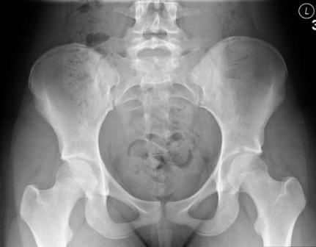
Pelvis x-ray

Slide 89
a) Lateral pelvis
Usually done as one of the obstetric radiological examination, performed with the patient erect to determine pelvic measurement in suspected cephalo-pelvic disproportion. The patient stands, the lateral aspect of the pelvis against an erect bucky stand with a 35cm X43cm film cassette.
The median sagittal plane is adjusted

Slide 90
Supplementary views
Lateral pelvis
Posterior oblique
Anterior oblique
Erect PA or AP

Slide 91
Hip joint
Synovial joint of lower limb formed by head of femur and acetabulum of the pelvic bones.
AP
Pt supine, legs medial rotation. Pelvis symmetrical. Centre 2.5 cm above symphysis pubis. One hip centre to femoral pulse. FFD 100 cm and cassette 24x30 cm for one hip.
Lateral
Pt rotated to injured side knee and hip flexed. FFD 100 cm, cassette 24x30cm, beam collimated. Centre to femoral pulse. Femoral neck true lateral is done a horizontal beam.

Slide 92
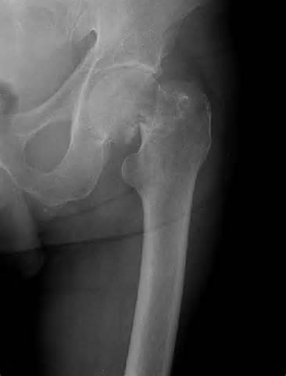
Hip joint AP showing fractured neck of femur

Slide 93
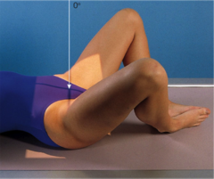
Von Rosen view
This is for congenital hip dislocation or dysplasia. Hips rotated 45 degrees each. Centre to the midline at the level of femoral pulse. Occurs mostly in children. FFD 100 cm and cassette 24x30 cm.
Frog position
Pelvis symmetrical, hips, knees flexed and rotated externally. Centre as for Von Rosen view. This shows epiphyses. FFD 100 cm and cassette 24x30 cm.

Slide 94
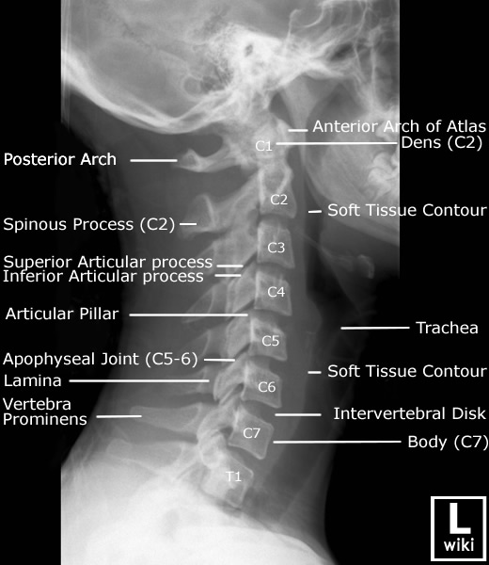

Slide 95
THE VERTEBRAL COLUMN
Indications
a) Local disease requiring several coned views of the lesion e.g fractures, dislocation, ankylosing spondylitis, spondylolisthesis (anterior displacement of one body over the other L5) osteoarthritis of the spine, TB spine- Pott`s disease
b) Spinal deformities e.g scoliosis, kyphosis, torticollis, spina bifida.
c)Generalized/systemic disease requiring skeletal survey e.g osteoporosis, heavy metal poisoning, multiple myeloma.

Slide 96
Vertebral Column
Consists of 33 irregular bones as follows:
Cervical 7, Thoracic 12, Lumbar 5, Sacral 5 and Coccygeal 4.

Slide 97
RADIATION PROTECTION
With the exception of the lumbo-sacral region and the sacrum in female pts, its always possible to protect the gonads from direct radiation by;
accurate collimation
placing a lead rubber piece over the gonads
Accurate technique to avoid repeat exposure
Proper instruction and preparation of the pt before examination
Use of high kv technique
Use of fast screen/film combination.

Slide 98
CERVICAL VERTEBRAE
Indication
1. Torticollis
2. Osteo arthritis
3. Odontoid
4. Cervical spondlylosis
5.Cervical body
Basic views
1. Anteroposterior; to cover C-C3
2.Antero posterior; C4 to G
3. Lateral

Slide 99
Antero posterior C1-C3
Pt lies supine on the x-ray table. The chin is tucked down so that the maxilla is superimposed on the lower border of the occiput.
In this position the pts mouth is opened as wide as possible and pt is instructed not to move.
An 18cm by 24cm cassette appropriately marked is placed longitudinally with its upper border at the level of external auditory meatus.
Immobilization of the head is important and close collimation of the beam.
Using the vertical central ray centre to the middle of the open mouth. FFD 150cm

Slide 100
Antero posterior C4-C7
Patient lies supine with the chin raised or extended to bring the radiographic base line between 100 to 110 degrees to the film plane.
In this positon the mandible is superimposed in the occipital bone in the resultant radiograph.
Using a perpendicular central ray centre to the sternal notch or to the level of the C4 with the central ray angled 10 degrees cephalad.

Slide 101
Anterior oblique
The patient stands facing the cassette. The patient is rotated and head kept in lateral position, centre to the mid cervical region with the tube angled 15 degrees caudad.
Note
Left anterior oblique demonstrates left intervertebral foramina
Right anterior demonstrates right intervertebral foramina

Slide 102
Lateral
Demonstration of the whole cervical spine is achieved by use of a high centering point, which enables us to use the oblique in this projection.
The pt stands in the lateral position against an erect cassette holder or erect bucky, the shoulders are lowered as much as possible if the condition allows equal weights may be held in both hands to achieve this position.
Pts chin is raised to avoid superimposition of the mandible over the upper vertebrae.
Along FFD of 150cm is used to reduce magnification due to the long OFD. An 18 by 24cm cassette is supported on the vertical holder with its upper border at the level of the top of the pinna.
-Using a horizontal central ray centre 2.5cm behind the angle of the mandible at the level of C2 vertebral body.

Slide 103
Special circumstances
1. Diffusion technique
The pt is positioned as for AP for C 1, to C3 and the head is adequately immobilized. The patient is instructed to open and close the mouth continuously as exposure is made.
Use long exposure time of about 3secs.
Centre to the symphysis menti.
2. Torticollis
it’s usually flexion and rotation
More than one exposure in varying angles in AP and lateral position may be necessary to demonstrate all the cervical vertebrae

Slide 104
3.Tomography
Tomography may be necessary to demonstrate the atlanto-axial joint and the odontoid peg when they are inadequately demonstrated in the basic views.
4. For a patient with a traumatic are destructive lesion the lateral view is performed with the horizontal beam and vertically supported cassette.

Slide 105
Supplementary views
1.Posterior and anterior oblique
These are performed to demonstrate the intervertebral foramina both sides are examined.
One may perform either posterior oblique or anterior oblique. The posterior obliques are more preferable because of ease of positioning and the fact that the shadow of the mandible is further than the case in anterior obliques

Slide 106
Posterior oblique
P.P
The pt stands facing the tube, he is then rotated 45 degrees each side, the chin is placed in the lateral position to avoid the ramus obscuring the upper foramina.
Centre in the mid cervical region with the tube angled 15 degrees cephalad.
NOTE;
When you do a LP oblique you demonstrate right and Right and Posterior oblique to demonstrate the left.
Clear marking is essential.

Slide 107
Antero Posterior
The patient is placed in the supine or upright position with their back against the cassette, the shoulders lie in the same horizontal plane to prevent rotation
Align the medial plane of the patients body to the midline of the cassette.
The chin is raised such that the line from the upper occlusal plane to the base od skull is perpendicular to the cassette to prevent superimposition of the mandible
Centre the cassette at the level of C4
The CR is directed through the C4 at an angle of 20 degrees cephalad
An 18cmX24cm cassette appropriately marked is used. FFD 150cm

Slide 108
2. Atlanto – occipital joint
Lateral :-
Head is placed in the lateral position and immobilized. Centre 2.5cm below the external auditory meatus
ii) Oblique (frontal occipital oblique)
The patient is placed in the supine position with the median sagittal plane, perpendicular to the film, turn the head 15 degrees to each side in turn.
Centre in the mid-line of the orbit near the tube

Slide 109
3. Mobility and stability
Lateral views in flexion and extension
Two radiographs are taken, one in full flexion so that the chin rests on the chest and one in full extension
Centre mid cervical region
Note
For the flexion view the cassette should be placed transversely

Slide 110
CERVICO- THORACIC SPINE
Request for this region should include both the lower cervical spine and upper thoracic spine, the resultant radiograph should include C4-T4. 24cm by 30cm cassette is used or 30cm by 40cm for a big patient
Basic views
antero-posterior
Lateral
Posterior oblique

Slide 111
Antero- posterior
The patient lies supine in the middle of the x-ray table and may be made comfortable, a 24cmX30cm cassette appropriately marked is placed in the bucky tray with its center at the level of the sternal notch
The perpendicular central ray is centred to the sternal notch

Slide 112
Lateral ( three approaches)
Lateral 1
With the patient erect in the lateral position the shoulders are depressed to the lowest possible level. The patient may hold appropriate weights in both hands
A 24cmX30cm cassette appropriately marked is placed in the bucky tray to include the region
Centre at the level of the 3rd cervical vertebrae using horizontal ray

Slide 113
Lateral 2
For spinous processes
With the patient in the general lateral position the arms are brought forward and the neck flexed so that the chin may rest on the upper chest, in this position the shoulders are well forward in front of the vertebral bodies
Centre at the T1 at the level of the head of the humerus

Slide 114
Lateral 3
The patient stands against the erect bucky with the arm nearest to the film folded over the head, the patient is then instructed to bend a little downwards the tube. In this position the shoulders are at different levels.
Centre just above the shoulder nearest to the tube with tube angled 15 degrees caudad

Slide 115
Posterior- Oblique
From the lateral position the shoulder nearest to the tube is rotated slightly backwards about 20 degrees and the spine adjusted to be at the middle of the coach.
The arm in contact with the coach is brought well forward while the other is moved well backward away from the trunk
In this position the spine remains almost lateral and the shoulder masses are separated. The aim is to demonstrate this part of the spine between the shoulder masses
Centre to the level of the sternal notch on the side nearest to the tube

Slide 116
THORACIC SPINE
Technical considerations
In the AP position the upper 4 thoracic vertebrae are overshadowed by the air filled trachea
The lower vertebrae are overshadowed by the dense heart muscles, mediastinum and sub diaphragmatic structures.
In the lateral view the upper 3 vertebrae are obscured by the dense shoulder structures.
For the vertebral bodies to be visible through the air filled lungs a long exposure time of upto 3 seconds is employed in the lateral view with the patient breathing gently

Slide 117
Antero- posterior
The patient supine on the x-ray table and made comfortable, pelvis symmetrical, knees and hips flexed.
A 15cmX43cm cassette appropriately marked is placed longitudinally on the bucky tray.
Using perpendicular central ray centre in the midline between the cricoid cartilage and xiphoid process of the sternum (level of 2.5cm below the sternal angle) FFD 100

Slide 119
Lateral
Pt rotated 90 degrees from supine, legs and hips flexed, foam pad under the spine to reduce lordosis.
The shoulders are separated by bringing the arm nearest to the film in front and the other behind the trunk. 15cm by 43cm cassette, FFD 100
Centre in the mid axillary line at the level of T6
Note – long exposure time about 3seconds is used with the patient breathing gently to blur out the rib shadows

Slide 120
Special circumstances
Patient with Kyphosis
For a patient with kyphosis more penetration KV will be required than for a normal patient. Higher for the AP than for the lateral view of the same patient.
Soft pads should be suitably placed to relieve pressure that may be painful for the patient.
An erect AP view may be more comfortable for such a patient
b) Scoliosis
The AP view should include the iliac crest to show alignment and comparison with post surgical appearances

Slide 121
Supplementary views
a) AP and b) lateral weight bearing
This views are taken in the erect positon in cases of suspected reduced intervertebral spaces.
Positioning and centering points ate the same as for the basic views but in the lateral erect view the arms are folded over the head
c) Posterior oblique
From the supine position the patient is rotated 45 degrees to each side in turn. Soft pads and sand bags are used to support the patient
A radiograph is taken in each position
Centre to the mid clavicular line on the side nearest to the tube at the level of 2.5cm below the sternal notch

Slide 122
Thoraco-lumbar spine
This region describes the area between the T10 and L3. in the AP view these vertebrae are over shadowed by the dense mediastinal and sub diaphragmatic structures
In the lateral view the diaphragm is superimposed on thoraco lumbar region. This view (lateral) therefore must be taken on full arrested expiration when the diaphragm is at its highest level and this region is seen below it.
Basic views
Ap
Lateral

Slide 123
Antero-posterior
The patient lies supine with the knees and hips flexed and the soles of the feet placed on the table (to reduce the lumbar lordosis)
A 24cmX30cm cassette, appropriately marked is locked in the bucky. Centre in the midline at the level of the T12 about 10cm above the lower costal margin

Slide 124
Lateral view
The patient lies on the side facing away from the radiographer, with the knees and hips flexed, small pads are placed under the waist to maintain the spine parallel to the film surface.
A 24cmX30cm cassette appropriately marked is locked in a bucky
Centre 10cm (4 inches) above the lower costal margin in the mid axillary line. FFD 100cm
Exposure is made on full arrested expiration

Slide 125
Special circumstances
Ankylosing spondylosis
In the investigation of this condition, at least one additional view of the sacro-iliac joints should be done to make the investigation complete

Slide 126
LUMBAR SPINE
Lumbar sacral angle varies from patient to patient and is larger in females
Technical considerations
The lumbar arch is greatest with the patient erect or lying down with the extended
Parts of the spine may be obscured by feacal matter or gases in the colon. Abdominal preparation may be necessary especially when the patient is bed-ridden
Due to the proximity of the reproductive organs in this region, examination must be clearly indicated and due care taken when examining the patient. The 10day rule should be observed if the degree of clinical urgency permits

Slide 127
Indications
Sciatica- compression of sciatic nerve
Fracture
PID
Osteoarthritis
Lumbargo
Metastatis
Spondylolisthesis
Senile osteoporosis
Para-vertebral abscess or lession

Slide 128
Basic views
i) AP
ii) Lateral L1-L5
Coned view L5 –S1

Slide 129
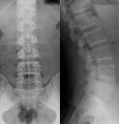
Lumbar Vertebrae
AP
Patient supine, knees and hips extended, pelvis symmetrical, FFD 100 cm, film 24x30cm. Centre to the midline at the level of lower costal margin.

Slide 130
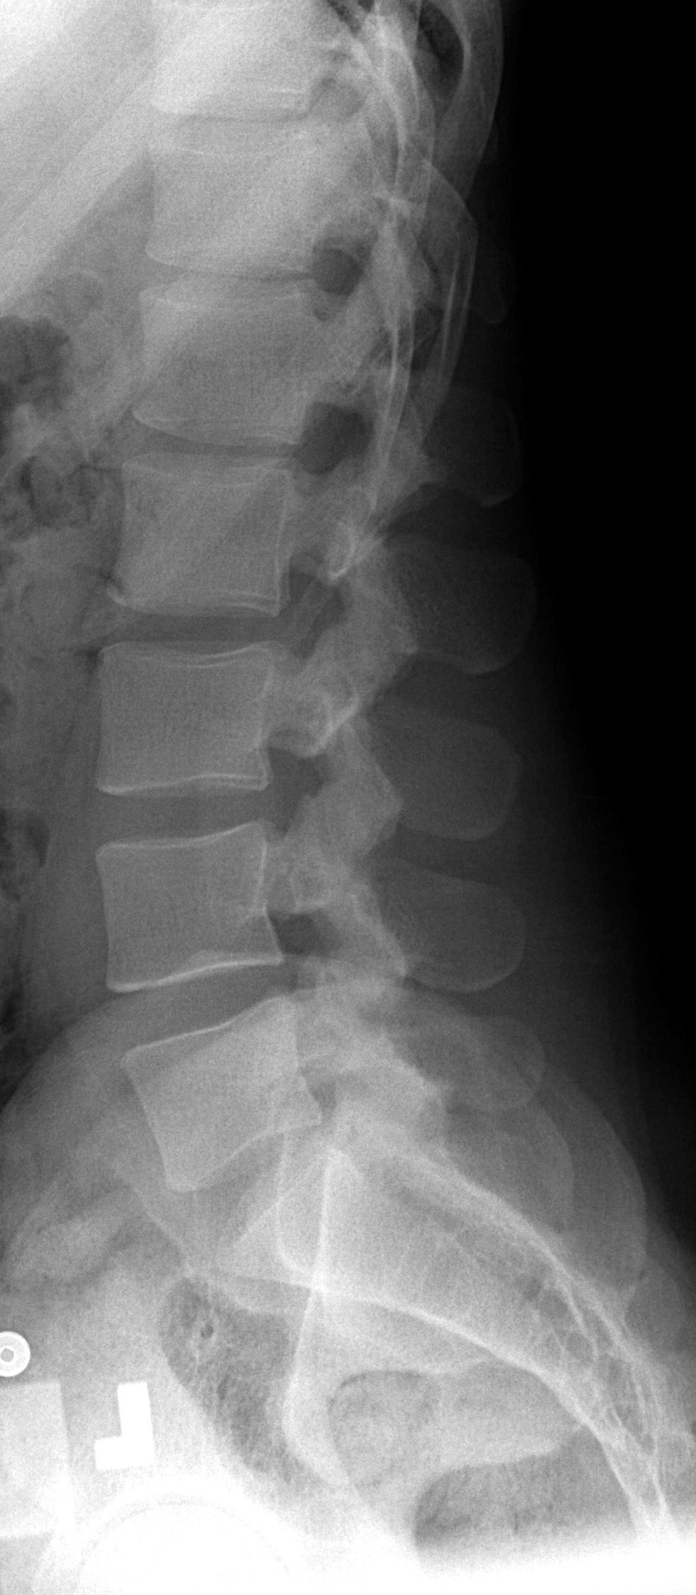
Lateral
Patient rotated 90 degrees from supine, knee and hip joints flexed, Centre 2.5 cm anterior to the body of lumbar vertebra (L 3). FFD 100 cm, cassette 24x30 cm and beam collimated.

Slide 131
Coned view
For L 5 S1. This is as lateral lumbar but centre to joint and cassette size 18x24 cm. It should be noted that lumbar vertebra there are three basic views as described. Coccyx and Sacrum as for pelvis and beam collimated.

Slide 132
Sacro- Iliac Joints
S- shaped joints difficult to demonstrate. Prone projection done and that is enough. Sometimes obliques are done for both sides. Ankylosing spondilitis is arthritis of the joints which fuse and cause a lot of pain. These views done for various traumatic and pathological reasons.

Slide 134
CHEST XRAY
This is the area from root of the neck to the diaphragm. AP and Lateral done for various infections.
Radiographic examination of the chest is the most frequently requested or performed in any general x-ray department. The particular projections/views vary with the presenting clinical condition.

Slide 135
Patient preparation
Undressing from the waist upwards and removal of all radio-opaque objects from the entire chest area eg chains, buttons, brassier fasteners, long earrings
Long hair (natural/artificial) must be pinned up on top of the head, to avoid obscuring any part of the lung fields.

Slide 136
Why the ERECT position is recommended in chest radiography
A large area of the lung structure is demonstrated i.e not obscured by the shadows of the diaphragm
It is easier to position the patient straight without rotation and also easier to remove the shadows of the scapula away from the lung fields. Rotated radiographs demonstrate a distorted shadow of the heart and mediastinum which may lead to false diagnosis.
The pulmonary vessels are not engorged in the erect position.

Slide 137
The patient is able to breath to the maximum i.e the diaphragm is pushed to its lowest level thus demonstrating most of the lung field.
The erect positioning is more comfortable for the patient.
Appropriate film focus distance is attained especially in demonstration of the heart.
It is possible to demonstrate fluid levels

Slide 138
Use of arrested respiration
To avoid motional blur caused by respiratory movement, exposure should be made at the end of a full inspiration on the second breath. This way the lung fields appear more aerated.
The Heart
Exposure for the heart is made at the end of normal (shallow) breathing (inhalation) in-order to prevent elongation of the heart by a full downward movement of the diaphragm as in deep arrested inspiration.
The FFD used should be 180cm (at least 150cm) to minimise cardiac magnification.

Slide 139
Use of the lateral view of the chest
In many departments the lateral view is not performed as a routine for reasons of economy and radiation dose to the patient. It may be needed however in the following cases.
1. To reveal lesions that may be obscured by the heart or diaphragm.
2. To localise a lesion seen in the AP or PA view to determine whether it is anterior or posterior.

Slide 140
3. To demonstrate any characteristic out line eg depressed sternum, lobar effusion or lung collapse especially middle right lobe collapse.
4. To confirm anatomical abnormalities eg depressed sternum
5. To demonstrate suspected retrosternal lesions
6. To demonstrate the heart and the aorta

Slide 141
Radiation Protection
The gonads must always be protected either by a lead apron worn at the back or by a lead screen adjustable in height. For an infant a piece of lead rubber apron is placed over the abdomen and pelvis.
The upper border of the apron should be as high as possible without obscuring the costo-phrenic angles.
In practise, this is placed just above the iliac crests.
The radiation field collimated to the required area, accurate exposure factors and positioning must be used to avoid repeats.
Other measures include use of high Kv technique, use of fast intensifying screens and appropriate instructions to the patient.

Slide 142
Patient positioning
Care must be taken in positioning to ensure that there is no rotation of the patient as abnormal rotation of the heart and mediastinum may simulate pathology
If the medial ends of the clavicles appear on the radiograph as equidistant from the spinous process at that level these shows that the patient is correctly positioned
To move the scapula shadows away from the thorax the elbows are flexed, the back of the hands are placed on the hips and elbows are pushed gently forwards. The shoulders must not be raised so that the apices of the lungs are not obscured by the clavicle.
Clear instructions regarding position and breathing should be given in advance and ample time must be allowed for patient to carry them out prior to the exposure.
The upper border of the cassette should be placed 5cm above the level of the shoulder to ensure that the apices of the lungs are included.

Slide 143
Problems encountered in paediatric chest radiography
Infants and children get scared easily scared because of the unfamiliar environment, it is therefore difficult to keep them still. Resultant radiographs have motional blur and images look rotated, the heart size and shape are also altered.
It is difficult to protect them from radiation.
It is not possible to perform erect chest radiograph therefore the FFD is limited.
Choice of exposure factors is difficult.
Parents may be uncooperative when asked to hold the child.
It is time consuming

Slide 144
Characteristics of a good chest radiograph
1. The whole of the chest wall must be included on the radiograph
2. The whole of the lung field from the apical areas to the costal phrenic angles must be included.
3. The patient identification details must be clearly demonstrated.
4. The radiograph must be correctly anatomically marked.
5. At least nine intercostal spaces should be demonstrated.
6. The spine below the 4th thoracic vertebrae T4 should not be visible. An over penetrated chest radiograph shows the spine through the heart shadow.

Slide 145
7. There should be no motional blur on the radiograph.
8. The radiograph should neither be over or under exposed i.e it should have optimum density and contrast.
9. No radiopaque shadow/artifact should be seen.
10. The scapula shadows should be moved away from the lung fields.
11. The shoulder should be at the same level.
12. Both sterno-clavicular joints should be equidistant from the midline or from the middle of the thoracic spine at that level
13. The chin should not obscure the trachea

Slide 146
Basic View i) Postero- anterior
Patient stands erect with the feet apart as an aid for mobilization facing the cassette holder. The chin is raised and placed on top and in the midline of the cassette support.
The upper border of the cassette is placed 5cm above the level of the shoulders.
The elbows are flexed, the back of the hands pushed forward.
The shoulders are adjusted to be equidistant from the cassette so that there is no rotation.
The horizontal central ray is centred to the midline at the level of the 4th thoracic vertebrae (T4)
FFD 150cm
The exposure is made at arrested full inspiration.

Slide 147
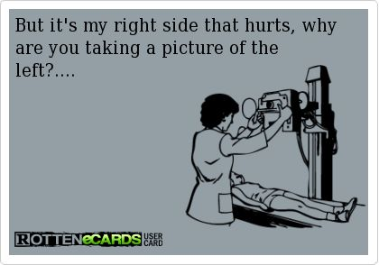

Slide 148
Additional view ii) Lateral view
From the PA position the patient is rotated 90 degrees so that the side under examination is against the cassette.
The arms are folded over the head and the axilla is placed over the cassette
The elbows must be raised so that the soft tissues of the humerus may not obscure the lung apices.
Centre to the axilla at the level of the sternal notch or T5

Slide 149
Indications
-Pneumonia -bronchitis
-PTB -bronchopneumonia
-Pleural effusion -pulmonary carcinoma
-pneumoconiosis -congestive cardiac failure
-haemothorax -diaphragmatic hernia
-pneumo thorax

Slide 150
Special circumstances 1.Paediatric (infants and children)
From birth to about 8 or 9 years of age children are happier when examined in the supine position, the advantages of film, patient and tube are:-
1. The anxious children will be able to see what is happening around them
2. It is a readily acceptable position by most children.
3. Chest movements with breathing can be observed by the radiographs and exposure made on full inspiration or nearly so.
4. Immobilization of the children is easily achieved in this position.

Slide 151
a) Antero-posterior
After the removal of all opacities around the chest and neck, the child is placed over a towel covered cassette, placed transversely.
The upper border of the cassette is placed 5cm above the shoulders.
The tube is moved to maximum table top distance.
The central ray is centred to the sternal angle and exposure made at full inspiration and since the child will not be able to follow breathing instructions the radiographer will have to watch the chest movements and make the exposure at the appropriate distance.
Note
An 18cmX24cm or 24cmX30cm may be used depending on the size of the patient.

Slide 152
b) Lateral
From AP position the child is rotated 90 degrees to lie on the side on the covered cassette, now placed longitudinally to the axis of the body.
Both knees and hips are flexed, hands are held above the chin level. The tube is raised to the maximum table top distance and the central ray to the axilla at the level of T5 or sternal angle.

Slide 153
2. Pre-operative chest radiography
A chest radiograph is a common request for a patient/s who have been booked for major surgery.
This may be directly related to the chest eg thoracotomy, lobectomy or prior to laparotomy, to rule out any chest condition which would worsen the condition of the sedated patient.
Follow up radiographs may be required post-operatively. An AP view is taken with the patient supine

Slide 154
3.Fluid and air levels in bed-ridden patients
If the presence of pleural effusion, haemothorax or pneumothorax is suspected in a patient who is too ill to sit up. A projection should be taken with the tube directed horizontal to demonstrate fluid which lies posteriorly or air which collects uppermost.
A lateral decubitus is taken. To demonstrate a pneumothorax, the patient lies with the affected side uppermost.
Pleural effusion or haemothorax are demonstrated with the patient lying on the affected side, raise on foam pads so that the whole lung is included on the radiograph.

Slide 155
Supplementary views 1. The lordotic view
To demonstrate interlobar effusion and/or right middle lobe collapse.
The patient stands erect facing the cassette holder, the hands are brought forward and clasped above the erect cassette support.
From the waist the patient bends backwards to make approximately 45 degrees.
Centre to the 4th thoracic vertebra T4 using horizontal view

Slide 156
Bronchography
An imaging investigation of the bronchial tree. Water soluble contrast medium is used but presently it is not common for it has been replaced by the other medical imaging modalities. The bronchi and their branches in the lungs are visualized to detect any lesions in the airway. Mostly done to check for bronchiectasis which is dilatation of the bronchi and masses of the lungs. It is done under aseptic procedure and local anaesthetics. A sterile trolley is necessary. It is quite an invasive procedure

Slide 157
ABDOMEN
Indications
Acute abdomen, intestinal obstruction, renal colic, foreign bodies (ingested/embedded) ,perforated duodenal ulcer PUD, rapture of abdomen, abdominal aortic aneurysm, portal hypertension, splenomegaly, gall stones, imperforated anus

Slide 158
Patient Preparation
The patient should be accurately identified before he is assisted to change and put on a clean hospital gown
The patient is gently assisted to lie on the x-ray couch from the stretcher
Brief explanation is given to the patient and also breathing instructions
Thick folds of sheet or blanket must be avoided so as to prevent artifacts on the radiograph

Slide 159
Care of the patients
The patient presenting with acute abdominal symptoms is often very ill and gentle treatment is imperative. Most of these patients are often referred from emergency unit en route to the ward or operating theatre.
The time spent with such patients must be minimised as much as possible
Once the patient is placed on the x-ray table disturbance should be minimal
Particular attention should be paid to a drip infusion or drainage tube so that they are not dislodged
When the patient is to be examined in the erect position it must be established that they can at least sit before moving them
When a tilting table is used the footrest and hand grips must be in a suitable position and fastened and the table slowly brought into the vertical position.
If the patient is unable to stand and the tilting table is not available, some method of supporting the patient in sitting position must be provided.

Slide 160
Radiographic technique
Radiological examination of the abdomen may be required in
An acute surgical emergency
As a preliminary in many radiological procedures
As follow up after management
Abdominal x-ray for some reasons may be divided into 2 categories each requiring different views
1. gastro-intestinal tract GIT – which require supine, prone and erect views of the whole abdomen
2. Urinary tract and retroperitoneal structure which may require views of the kidney, ureters or bladder KUB and organs such as liver spleen and suprarenal glands.

Slide 161
Radiograph of the abdomen must include both the diaphragm and symphysis pubis.
The kidney outline, the psoas muscles shadows, soft tissues and the pro-peritoneal fat in the lateral view must be demonstrated.
Exposure factors must be chosen to give optimum soft tissue differentiation
Low Kv is usually employed for this purpose. Exposure are made on full arrested expiration in most cases with the exception of the following when exposure is done by use of full arrested inspiration i.e
Determination of the relationship of an opacity to the kidney
Demonstration of the liver and spleen
To show small renal calculi or other calcification, there must be no movement or respiratory blur
Use of high mA values will allow use of very short exposure times
In cases of suspected intestinal obstruction or perforation of viscera the examination MUST include a view taken with a horizontal beam in order to show the presence of any fluid levels of free peritoneal gas

Slide 162
If the patient is able to stand a postero-anterior erect view is preferred because of the following reasons
The patient applies self compression which leads to better details in the radiograph
Fluid and air levels are easily seen
NOTE
In examination of the acute abdomen a PA view of the chest is taken as an integral part of the examination because primary intra thoracic may present with symptoms similar to those of an abdominal emergency

Slide 163
Infants
A babies abdomen is almost as wide as its long and the width of the abdomen is greater than the width of the pelvis
The abdominal organs completely fill the abdominal cavity , the light beam diaphragm must therefore be collimated carefully to ensure that the whole abdomen is included.
A grid is not usually required at this stage

Slide 164
Postero-anterior – Erect and Prone
Erect
Patient stands with his abdomen against the erect bucky stand. A 35cmX43cm cassette appropriately marked is placed in the bucky with its upper boarder 5cm above the zyphi sternum to include the diaphragm
Using horizontal CR centre in the midline at the level of the lower costal margin. Exposure at deep arrested expiration. FFD 100cm

