Slide 1
Infectious lung diseases
BY SILAS MKOMBE

Slide 2
Content
Lung abscess
Pleural effusion
Empyema

Slide 3
Cont.
Lung abscess
Def. A lung abscess is a localized suppurative infxn of the lung leading to necrosis and cavitation.
Commonly follows aspiration pneumonia.
It may be:
1⁰ – 60%
2⁰ – 40%

Slide 4
Cont.
Risk factors:
Aspiration ( Oropharyngeal/Gastric) –alcoholism is the most common predisposing factor
Penetrating chest injury
Inadequately treated pneumonia, necrotizing pneumonia
Chronic respiratory sepsis
-Sinusitis
- Tonsillitis
-Dental infxn

Slide 5
Cont.
Bronchial obstruction
- Carcinoma esp.pry. carcinoma of lung
- Intramural FB
- Post –op atelectasis
Septicemia, septic emboli, Rt heart endocarditis, IV drug use
Vasculitis – Wegenersgranulomatosis
Subphrenic or hepatic abscess
Pulmonary infarct

Slide 6
Cont.
Causes
1.Bacterial
Anaerobic bacteria; streptococcus, Bacteroides,, Fusobacteria
Aerobic bacteria; Staph aureus, Klebsiella, Haemophillus influenza, Pseudomonas, Nocardia, Esch. Coli
2. Fungi
3. Parasites; Lung flukes esp. ParagonimusWestermania, Entamoebahistolytica

Slide 7
Cont.
Pathogenesis:
Pyogenic lung abscess usually occurs as a result of aspiration of septic debris during a period when the cough reflex is suppressed.
The most direct route for the airway embolus to travel is into the Rt main bronchus.
The most common sites of lodgement of septic emboli and development of lung abscesses are the superior division of the Rt lower lobe and the posterior segment of the Rt upper lobe.

Slide 8
Cont.
Following the development of severe pneumonitis in response to the embolus, liquefaction may occur.
As the liquefied necrotic material empties through the bronchus, a necrotic cavity containing air is formed.

Slide 9
Cont.
An area of dense pneumonic consolidation precedes the appearance of the xtic cavitary lesion.
Multiple abscesses may form multiple cavities.

Slide 10
Clinical features:
Usually gradual in onset
Swinging fevers
Cough; purulent foul smelling sputum, haemoptysis.
Night sweats
Pleuritic chest pain
Lethargy/ malaise
Cachexic, wt loss
May have finger clubbing
Localized dullness
Bronchial breath sounds/ crackles

Slide 11
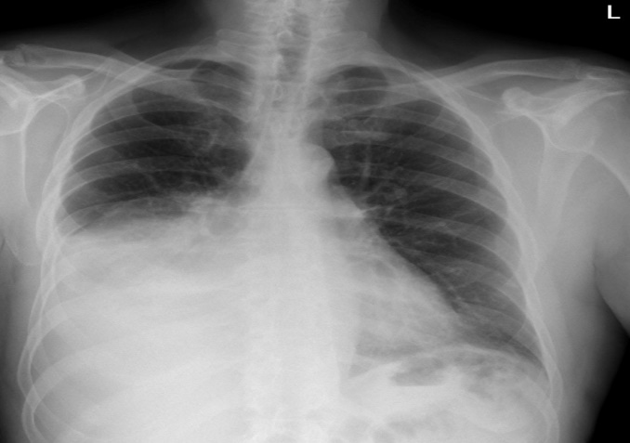
Cont.
Diagnosis:
1. Clinical
2. CXR – Unilateral consolidation with cavitating shadow.
- Air fluid level

Slide 12
Cont.
Diagnosis:
3. Laboratory investigations
- Blood tests; FBC (Hb, WBC, ESR, CRP)
4.Bronchoscopy
5.CT scan

Slide 13
Cont.
Complications
Septicemia
Brain abscess
Emphysema
Bronchiectasis

Slide 14
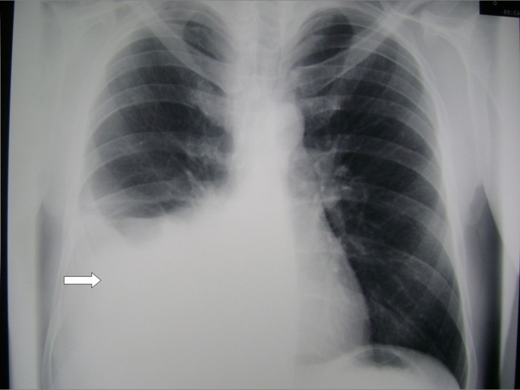
Cont.
DISORDERS OF PLEURA
1. PLEURAL EFFUSION
Def: Excessive accumulation of serous fluid in the pleural space.

Slide 15
Cont.
Epidemiology- pleural effusion affects more than 1.5 million people in the USA and probably more people in sub-Sahara Africa.
Classification
Transudative
Exudative

Slide 16
Cont.
Causes – grouped according to type of effusion
Transudative causes
Cardiovascular causes- CCF, pericardial disease, myocardial infarction, SVC obstruction
Hypoalbuminemia –cirrhosis/ liver failure, nephrotic syndrome, malnutrition.
Intra- abdo: Fluid- peritoneal dialysis, ascites.

Slide 17
Cont.
Exudative causes
Infections- pneumonia, PTB, fungal, viral or parasitic infection.
Neoplasm- mesothelioma, metastatic lesions- ca breast, lymphomas.
Trauma to the chest- haemothorax, chylothorax, post cardiac injury.

Slide 18
Cont.
Pulmonary infarction.
GIT diseases- oesophageal perforation, post-abdo surgery, pancreatic disease.
Collagen (vascular) diseases- Rh. Arthritis, SLE, wegeners granulomatosis.

Slide 19
Cont.
Others
Drug induced- nitrofurantoin, bromocriptine, amiodarone.
Uremia
Radiation therapy
Meig’s syndrome
Lymphedema (yellow nail syndrome)
NB: Most common causes
Pneumonia, PTB, pulmonary infarction, malignant diseases, CCF, sub-diaphragmatic disorders (sub-phrenic abscess, pancreatitis).

Slide 20
Cont.
Pathology
Pleural fluid usually accumulates when there is an imbalance between pleural fluid formation and pleural fluid absorption.
Excess fluid can be from parietal pleura, interstitial space of lung or the peritoneal cavity or when there is decreased removal by the lymphatics.

Slide 21
Cont.
A transudative pleural effusion occurs when systemic factors that influence the formation and absorption are altered (increases in vascular hydrostatic pressures or decrease in plasma oncotic pressures.)
An exudative pleural effusion occurs when local factors that influence the formation and absorption of pleural fluid are altered such as increases in vascular permeability from trauma, abnormal communication between pleural space and peritoneal space lung parenchyma.

Slide 22
Cont.
Clinical presentation
May be asymptomatic
Symptoms
Breathlessness; Severity depends on size and rate of accumulation.
Chest pain; classically sharp and exacerbated by coughing or deep breathing.

Slide 23
Cont.
Signs
Tachypnea, there may be features of the underlying disorder; Cachexia, finger clubbing
RD, +asymmetrical chest, deviated trachea towards normal side in unilateral effusions.
Decreased chest expansion on the affected side, stony dullness, decreased vocal fremitus; decreased breath sounds or absent breath sounds.
There may be aegophony (bronchial breathing and bleating vocal resonance) at the superior edge of effusion due to lung compression.

Slide 24
Cont.
Investigations
To confirm diagnosis
To determine cause.
Investigations
1. CXR – Erect PA –elevation of hemidiaphragm, curved shadow at base of lung
-blunted costophrenic angle and ascending towards axilla
-Lat. decubitus-demonstrate free flowing fluid, for estimating vol. and R/o sub-pulmonic effusion.

Slide 25
Pleural effusion

Slide 26
Cont.
2. Diagnostic aspiration/ thoracocentesis
Pleural fluid
Naked eye exam/gross- clear, yellow chyle, blood, pus, milky,brown.
Biochemical studies- protein, glucose, LDH, PH, amylase
Microbiological studies- Gm stain, c/s, AAFB, fungal cultures.
Cytology- neutrophils, lymphocytes, mesothelial cells, lupus erythematosus cells.
Immunological studies- Rh factor, antinuclear antibodies, complement levels.
Pleural fluid Hct.→ blood stained effusion.

Slide 27
Cont.
3. Blood tests
FBC; Hb, neutrophils, WBC
U/E serum protein ( ≥3g/dl in exudative), serum LDH
4. Ultrasonography- fluid vol. and distingiushes pl. fluid from pl. thickening.
5. Computed tomography- benign from malig. Pleural dz
6. Pleural biopsy – esp. suspected TB
7. Other- directed towards suspected cause.

Slide 28
Cont.
EMPYEMA
Def: Presence of pus in the pleural space.
Empyema may be loculated (involve whole space) or encysted (involved only part of pleural space) and is almost invariably unilateral.
Empyema may be acute or chronic.

Slide 29
Cont.
Causes
May be secondary to
Bacterial pneumonia - 40% leads to pl. effusion →empyema 15%
PTB
Others
Infection of a haemothorax
Rupture of sub-phrenic abscess or lung abscess.

Slide 30
Cont.
Pathology- Thick, shaggy inflammatory exudate.
The pus is usually under pressure → rupture into bronchus→ bronchopleural fistula and pyoneumothorax or track through chest wall → subcutaneous abscess or sinus.
Delay in Rx → thickened, rigid visceral pleura.
Clinical features
Requires a high index of suspicion in patients with pulmonary infection

Slide 31
Cont.
Symptoms
Non specific systemic features
Persistent or recurrent high fever despite administration of a suitable antibiotic.
Rigors, sweating, malaise, weight loss
Local features/ symptoms- Pleuritic chest pain, breathlessness, cough- productive of copious sputum if empyema ruptures into a bronchus
Signs
Patient is ill-looking , tachypnoenic
Clinical signs of fluid in the pleural space.

Slide 32
Cont.
Investigations
1. Radiological
CXR – horizontal fluid level in pyopneumothorax.
Ultrasound
CT Scan R/O underlying lung parenchyma dz and patency of the major bronchi.

Slide 33
Cont.
2. Aspiration of pus
Gross examination
Bioch-P^{H} <7.2, glucose decreased, LDH increased
Microbiology
Histology
3. Blood tests
FBC, U/E, CRP

Slide 34
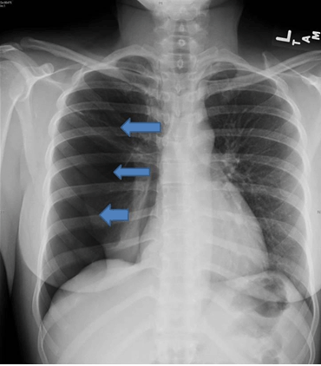
Cont.
PNEUMOTHORAX
Def: Presence of air in the pleural space

Slide 35
Cont.
PNEUMOTHORAX
Def: Presence of air in the pleural space
Classification and causes
1. Traumatic pneumothorax
Follows chest injury, thoracic surgery or biopsy, transthoracic needle aspiration, thoracocentesis or central venous catheter.

Slide 36
Cont.
2. Spontaneous pneumothorax (SP)
Primary sp mostly common in young males 15-30yrs, tall, thin and often smoking M:F 6:1 no evidence of overt lung disease.
Follows rupture of apical pleural bleb or an emphysematous bullae
Secondary sp –common in older people >40yrs.
Follows an underlying lung disease- COPD, asthma, PTB, Pneumonia ,Lung abscess ,Ca lung ,cystic lung disease.
Associated with highest mortality rate

Slide 37
Cont.
Both types may be
Closed type – mean pleural pressure is negative.
Open type – mean pleural pressure is at atmospheric.
Tension type – mean pleural pressure is positive through out cycle with mediastinal shift to opposite side. This is a medical emergency and commonly follows trauma, mech. Ventilation or resuscitative efforts.

Slide 38
Cont.
Clinical features
May be asymptomatic
Symptoms
Sudden onset unilateral chest pain and breathlessness.
Those with asthma or COPD may present with sudden deterioration.

Slide 39
Cont.
Signs
Tachypnea (pain deflation reflex)
Tachycardia, cyanosis, hypotension and deviated trachea to normal side in tension pneumothorax.
Reduced chest expansion
Resonant or hyper-resonant percussion note.
Reduced or absent breath sounds on affected side.
NB: Absent breaths sounds and resonant percussion note is diagnostic

Slide 40
Cont.
Investigations
CXR – sharply defined edge of deflated lung with complete translucency (no lung markings) between this and chest wall.
Mediastinal displacement, R/O pleural effusion or pulmonary disease.
CT scan – distinguishes bullae from pleural air.

