Slide 1
INFLAMATION
Joel Nthigah

Slide 2
objectives
At the end of the lesson, the learner should be able to;
1 .define inflamation.
2. Describe the process of inflamation.
3.Describe acute iflamation.
4. Describe chronic inflamation.

Slide 3
DEFINITION
Inflammation is the local response of living mammalian tissues to injury due to any agent.
It is bodys defense reaction in order to eliminate or limit the spread of injurious agent, followed by removal of the necrosed cells and tissues.

Slide 4
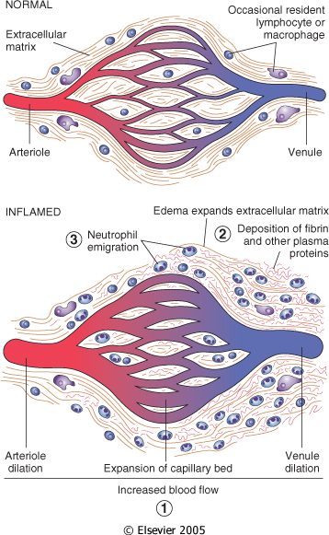

Slide 5
CAUSES OF INFLAMATION
1. Infective agents like bacteria, viruses and their toxins, fungi, parasites.
2. Immunological agents like cell-mediated and antigen-antibody reactions.
3. Physical agents like heat, cold, radiation, mechanical trauma.
4. Chemical agents like organic and inorganic poisons.
5. Inert materials such as foreign bodies.

Slide 6
Differencies btn inflammation and infection
inflammation is a protective response by the body to variety of etiologic agents (infectious or non-infectious)
infection is invasion into the body by harmful microbes and their resultant ill-effects by toxins.
Inflammation involves 2 basic processes with some overlapping, i.e early inflammatory response and later followed by healing. Though both these processes generally have protective role against injurious agents, inflammation and healing may cause considerable harm to the body as well e.g. anaphylaxis to bites by insects or reptiles, drugs, toxins, atherosclerosis, chronic rheumatoid arthritis, fibrous bands and adhesions in intestinal obstruction.

Slide 7
SIGNS OF INFLAMMATION.
The Roman writer Celsus in 1st century A.D. named the famous 4 cardinal signs of inflammation
1 rubor (redness);
2 tumor (swelling);
3 calor (heat);
4 dolor (pain).
NB To these, fifth sign functio laesa (loss of function) was later added by Virchow.

Slide 8
Pathogenesis
After an injury, there transient constriction of blood vessels followed by widespread dilatation of arterioles and venules and opening up of small blood vessels (active hyperaemia) this leads to increased blood flow upto ten times. Initially the flow in this vessels is very fast hence axial flow is maintained but later the flow slows down until there is stasis. This leads to protein rich oedema fluid, fibrin and neutrophil polymorphs accumulate in the extracellular spaces of the damaged tissue.
The acute inflammatory response involves three processes:
  changes in vessel calibre and, consequently, flow
  increased vascular permeability and formation of the fluid exudate
  formation of the cellular exudate by emigration of the Neutrophil polymorphs into the extravascular space.

Slide 9
TYPES OF INFLAMMATION
1 Acute inflammation
2 Chronic inflammation

Slide 10
Acute inflammation
its of short duration (lasting less than 2 weeks) and represents the early body reaction, resolves quickly and is usually followed by healing.
main features of acute inflammation
1. accumulation of fluid and plasma at the affected site;
2. intravascular activation of platelets;
3. polymorphonuclear neutrophils as inflammatory cells.
NB Sometimes, the acute inflammatory response may be quite severe and is termed as fulminant acute inflammation.

Slide 11
Chronic inflammation
its of longer duration and occurs either after the causative agent of acute inflammation persists for a long time, or the stimulus is such that it induces chronic inflammation from the beginning.
A variant, chronic active inflammation, is the type of chronic inflammation in which during the course of disease there are acute exacerbations of activity.
The characteristic feature of chronic inflammation is presence of chronic inflammatory cells such as lymphocytes, plasma cells and macrophages, granulation tissue formation, and in specific situations as granulomatous inflammation.
In some instances, the term subacute inflammation is used for the state of inflammation between acute and chronic

