Slide 1
INFLAMMATORY BOWEL SYNDROME
MEDICINE 2
GIT DISORDERS

Slide 2
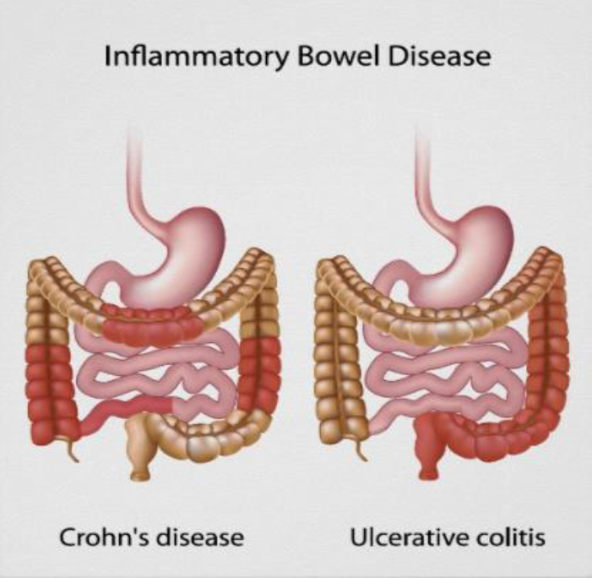

Slide 3
INTRODUCTION
Inflammatory bowel disease (IBD) represents a group of intestinal disorders that cause prolonged inflammation of the digestive tract.
It is a spectrum of chronic idiopathic inflammatory condition.

Slide 4
INTRODUCTION
Ulcerative colitis: is a disease that causes mucosal inflammation and sores (ulcers)in the lining of the the large intestine (colon).
Chron’s disease: it is a chronic, relapsing and remitting inflammatory disease of the gastrointestinal tract, affecting any site site from mouth to anus .

Slide 6
ETIOLOGY
Unknown
Infectious agents
Viruses (Measles)
Bacteria (Mycobacteria)
Genetics
Environmental factors
Diet
Smoking
Psychological factors
Stress
Emotional or physical trauma

Slide 7
CROHN’S DISEASE (REGIONAL ENTERITIS)
DEFINITION
Crohn’s disease is also called regional enteritis
It is a chronic inflammation of the intestines which is usually confined to the terminal portion of the small intestine, the ileum.
Crohn’s disease is usually first diagnosed in adolescents or young adult but can appear at any time in life.
it seen more often in smokers than in non-smokers

Slide 8
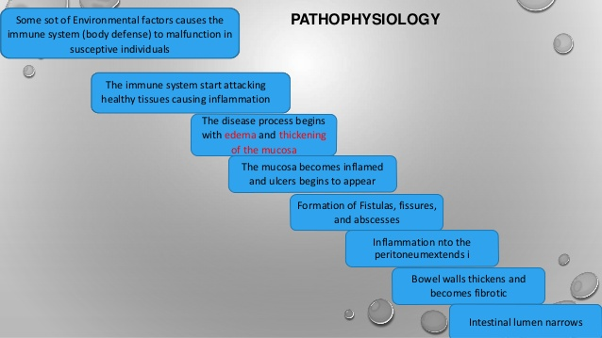

Slide 9
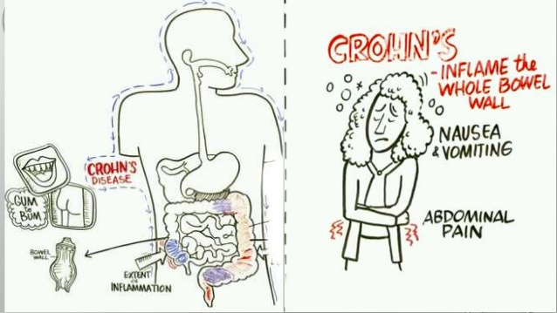

Slide 10
CROHN’S DISEASE
In moderate to severe crohn’s disease the ulcer becomes larger and deeper with a lot of surrounding redness
the inflammation can make the intestine thicken and blocking the passage of digestive food.
In some case, deep ulcers break through the intestine causing infection outside the bowel, known as ABSCESS this can actually spread to the skin or nearby part of the body, called a FISTULA

Slide 11
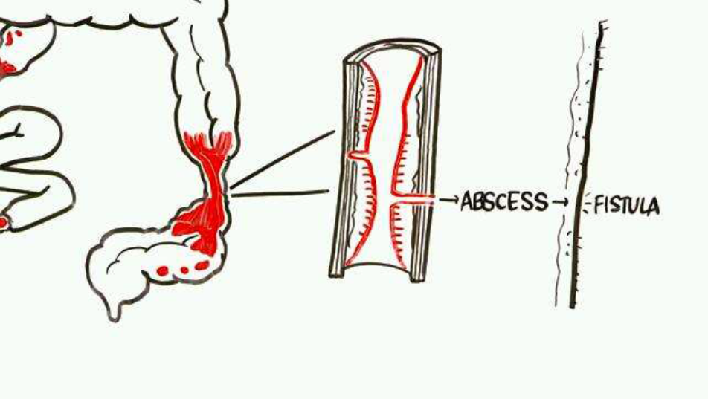

Slide 12
MAJOR SYMPTOMS

Slide 13
CLINICAL MANIFESTATIONS
Loss of weight
General ill health
Aphthous ulceration of mouth, glossitis angular stomatitis
Abdominal tenderness and RIF mass
Perianal skin tags, fissures, fistulae

Slide 14
CLINICAL MANIFESTATIONS
Inflammatory bowel disease can have different symptoms in different people, some people may have fewer symptoms than others while still having the same disease.

Slide 15
ASSESSMENT AND DIAGNOSTIC FINDING

Slide 16
COMPLICATIONS
Intestinal obstruction or stricture formation
Electrolyte imbalances
Malnutrition from malabsorption
Fistula and abscess formation
The most common type of small bowel fistula caused by crohn’s disease is the enterocutaneous fistula (an abnormal opening between the small bowel and the skin).

Slide 17
ULCERATIVE COLITIS
DEFINITION
An inflammatory disease of the mucosa and submucosa layers of the colon and rectum.
ulcerative colitis is an inflammatory disease of the large intestine.
Ulcers form in the inner lining, or mucosa, of the colon or rectum, often resulting in diarrhea, blood, and pus.
The inflammation is usually most severe in the sigmoid and rectum and typically diminishes higher in the colon.
The disease develops uniformly and consistently until, in some cases, the colon becomes rigid and foreshortened.

Slide 18
ETIOLOGY
Unknown
Infectious agents
Viruses (Measles)
Bacteria (Mycobacteria)
Genetics
Environmental factors
Diet
Smoking
Psychological factors
Stress
Emotional or physical trauma

Slide 19
PATHOPHYSIOLOGY
ulcerative colitis affect the superficial mucosa of the colon and it characterized by multiple ulcerations, diffuse inflammation and desquamation or shedding of the colonic epithelium.
Bleeding occur as a result of ulcerations.
The mucosa becomes edematous and inflamed.
The lesion are continues, and occurring one after the other.

Slide 20
PATHOPHYSIOLOGY
Abscesses form, and infiltrate is seen in the mucosa and submucosa, with clumps of neutrophils found in the lumens of the crypts that line the intestine mucosa.
The disease process usually begins in the rectum and spreads proximally to involve the entire colon.
Eventually the bowel narrows, shorting, and thickens because of muscular hypertrophy and fat deposit.
Because the inflammatory process is not transmural (i.e. affect the inner lining only), fistula, obstruction, and fissure are uncommon

Slide 21
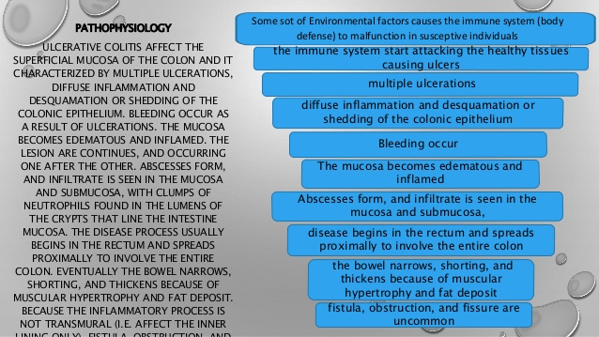

Slide 22
CLINICAL MANIFESTATION
The predominant symptoms of ulcerative colitis includes
Diarrhea
Passage of mucus and pus
Pain in the left lower abdominal quadrant
Intermittent tenesmus rectal bleeding
The patient may have anorexia, weight loss, fever, vomiting and dehydration, as well as cramping
The feeling of an urgent need of defecation, and the passage of 10 to 20 liquid stool each day

Slide 23
COMPLICATION OF UC
Hemorrhage
Perforation
Toxic megacolon (transverse colon with a diameter of more than 5 cm to 6cm with loss of haustration)
Cancer: with active colitis of more than eight year

Slide 24
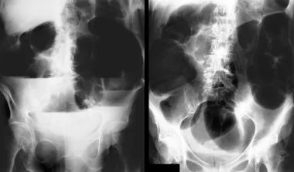

Slide 25
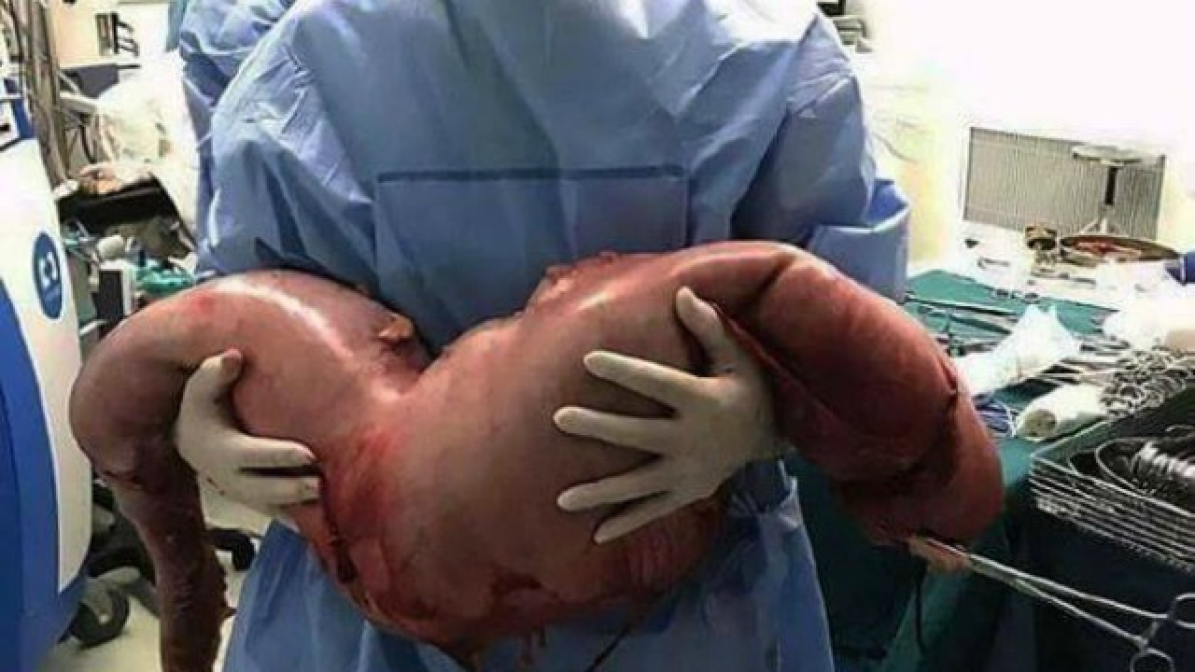

Slide 26
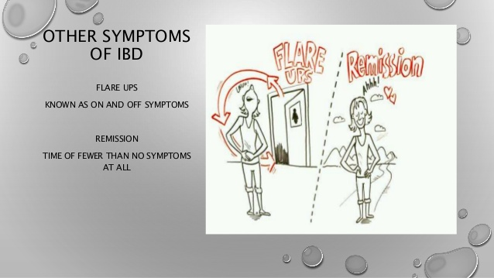
OTHER SYMPTOMS OF IBD
Flare ups→ known as on and off symptoms
Remission→ time of fewer than no symptoms at all

Slide 27
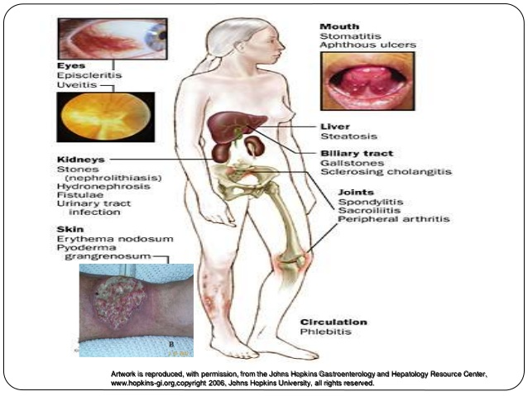

Slide 28
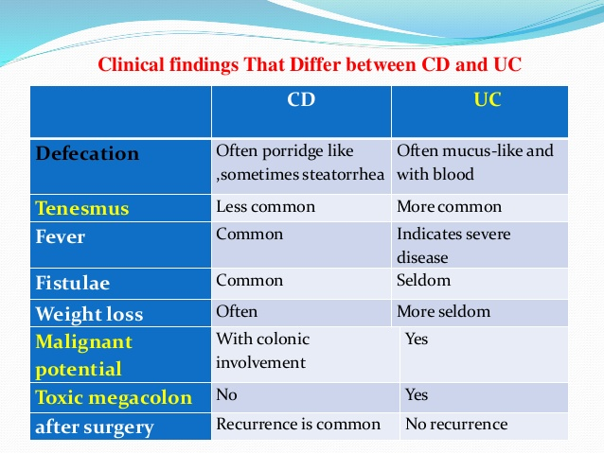

Slide 29
ASSESSMENT AND DIAGNOSTIC FINDINGS
PHYSICAL ASSESSMENT
  hypotension
  tachypnea
  tachycardia
  fever
  pallor
  dehydration and nutritional status
  presence of bowel sounds
  Abd distention and tenderness
  bloody stool

Slide 30
ASSESSMENT AND DIAGNOSTIC FINDINGS
Blood tests:
  low htc and Hb level and elevated wbc count
  low albumin level and electrolyte imbalance
Abdominal x-ray- I.O; Pneumoperitoneum
Sigmoidoscopy
Colonoscopy
Barium enema

Slide 32
MANAGEMENT OF CHRONIC INFLAMMATORY
BOWEL DISEASE
Medical treatment for both crohn’s disease and ulcerative colitis is aimed at:
  reducing inflammation
  suppressing inappropriate immune responses
  providing rest for a diseased bowel so that healing may take place.
Management depends on the disease location, severity, and complications

Slide 33
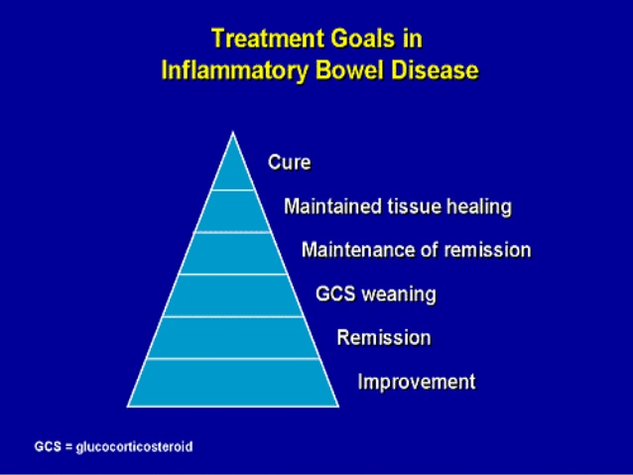

Slide 34
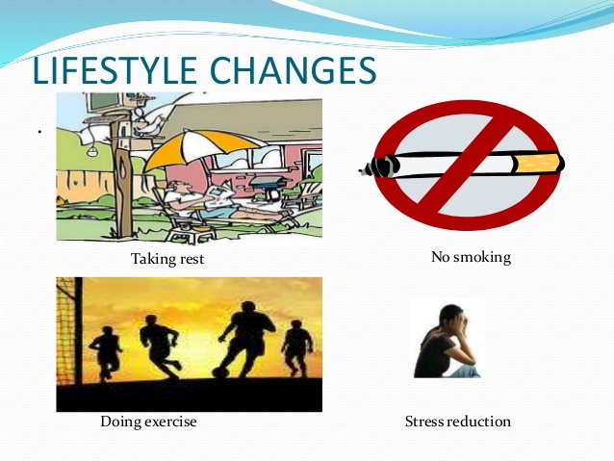

Slide 35
NUTRITIONAL THERAPY
Oral fluid and a low-residual, high protein, high caloric diet with supplemental vitamin therapy and iron replacement are prescribed to meet nutritional need.
Fluid and electrolyte imbalance from dehydration are corrected by therapy as necessary if the patient is hospitalized or by oral fluids fluid if the patient is managed at home.
Any food that exacerbate diarrhea are avoided.
Milk may contribute to diarrhea in those with lactose intolerant.
Cold food and smoking are avoided because both increase intestinal motility.
Parenteral nutrition may be indicated

Slide 36
DRUG THERAPY
Sedative, antidiarrheal, and antiperistalsis.
Aminosalicylates such as sulfasalazine for mild to moderate inflammation ( 3-4g/day orally, 3 divided doses after meals)
Corticosteroids (prednisone, hydrocortisone) used to treat severe and fulminant disease and can be administered orally
Budesonide rectal administration.
Among the newest biological therapies using monoclonal antibodies are natalizumab (tysabri) for crohn’s disease, and infliximab (remicade) for ulcerative colitis
Anticytokine therapy using anti-interlukin type drug (e.g. - anti-il-12) for crohn’s disease.

Slide 37
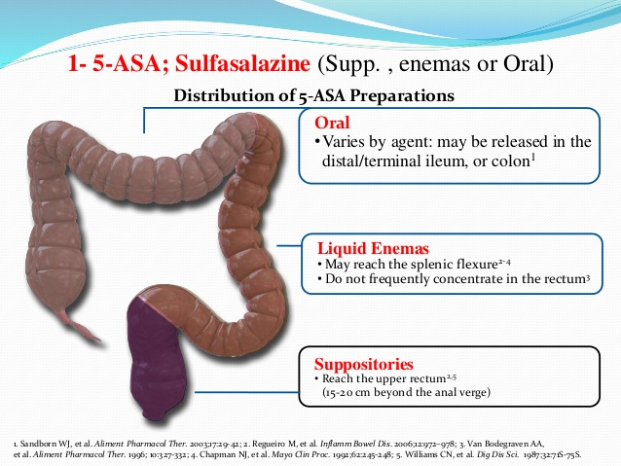

Slide 38
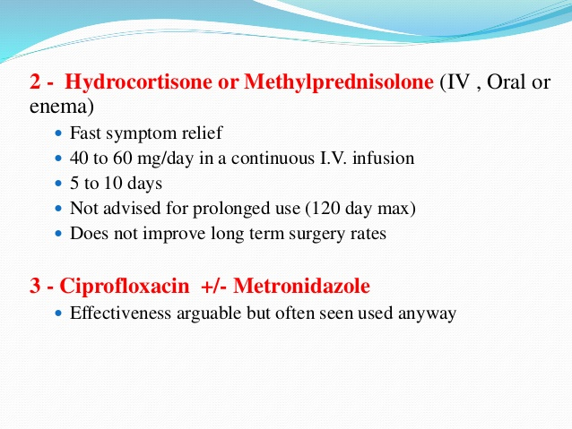

Slide 39
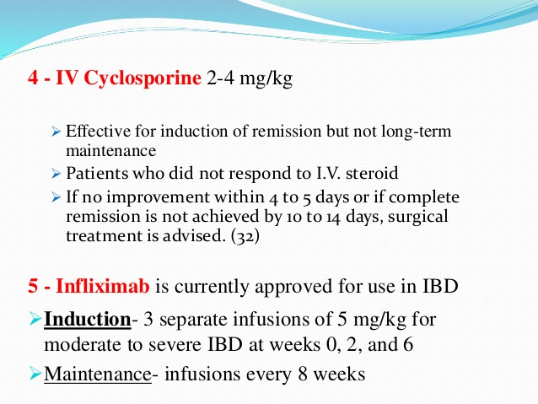

Slide 40
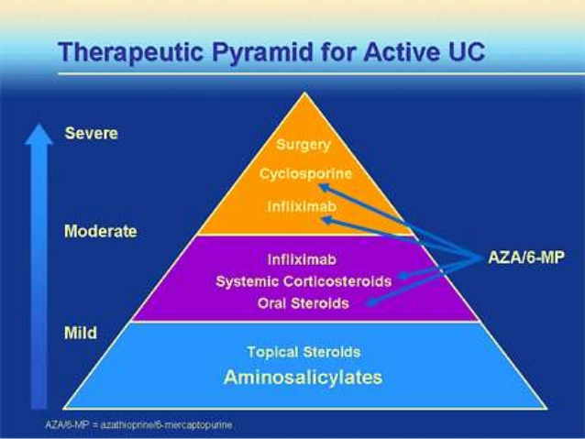

Slide 41
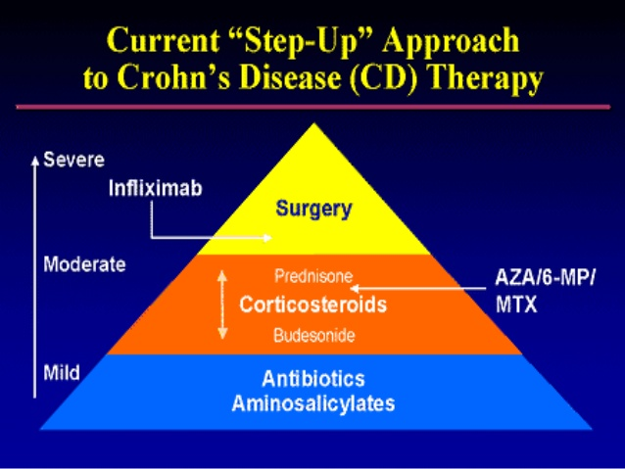

Slide 42
SURGICAL MANAGEMENT
Stricture plasty, → the blocked or narrowed section of the intestine are widened, leaving the intestine intact.
Small bowel resection is performed and diseased segment of the small intestines are resected and the remaining portions of the intestine are anastomosed.
Surgical removal of up to 50% of the small bowel usually can be tolerated. in case of severe crohn’s disease of the colon, a total colectomy and ileostomy may be the procedure of choice.
A new surgical procedure developed for patient with severe crohn’s disease is intestinal transplant.
Protocolectomy with ileostomy (complete excision of colon, rectum, and anus). if the rectum can be reversed, restorative protocolectomy with ileal pouch anal anastomosis is the procedure of choice

Slide 43
COLORECTAL CANCER
MEDICINE 2
GIT DISORDERS

Slide 44
EPIDEMIOLOGY
Colorectal Cancer (CRC) is the 3rd most common cancer in men and the second in women worldwide.
Race > Higher Incidence in African Americans
Sex > almost equal (ratio of 1.2:1)
Age > 55-65 years
Geographic > Countries which are more industrialized like U.S., Canada, UK, Western Europe, Australia have a much higher incidence than less industrialized parts of the world like Asia, Africa, and South America.

Slide 45
ETIOLOGY / RISKS
Age > 60 Yrs
Diet high in red or processed meats
Ulcerative colitis or Crohn’s Disease
Have a family history of colon cancer
Other Cancers Breast, uterine, or ovarian cancer
Familial Adenomatous Polyposis (FAP).
Hereditary non-polyposis colorectal cancer (HNPCC) syndromes
Smoking & Alcohol
Obesity
Drug effects: Recent studies have suggested that estrogen replacement therapy and NSAID’s such as aspirin may reduce colorectal cancer risk.

Slide 46
PATHOLOGY

Slide 47
How Does Colorectal Cancer Develop?

Slide 48
PATHOLOGY
Macroscopically:
colorectal cancers may appear to the naked eye as:
  Exophytic cauliflower-type of growth
  Ulcerating lesion penetrating through the bowel wall
  Annular constricting growth
  Colloid mucus- secreting tumors
Microscopically:
almost all colorectal cancers are adenocarcinoma, but their histologic appearance is different
  Grade I : well differentiated
  Grade II : moderately differentiated
  Grade III : poorly differentiated

Slide 51
SPREAD OF THE CANCER
1. Local spread
The growth is limited to the bowel for considerable time, it spreads round the intestinal wall & to a certain extent longitudinally. when it invades the bowel wall it affect the near structures like bladder, uterus, ovaries, etc.. where it may cause a fistula , or perforate into peritoneal cavity, or to the pelvic wall

Slide 52
SPREAD OF THE CANCER
2. Lymphatic spread
To epicolic group of lymph nodes then to paracolic group then to main groups of lymph nodes arranged around the main arteries
3. Haematogenous spread
Through the venous system ( inferior & superior mesenteric veins) mainly to the liver, it also goes to lung, bones, etc…
4. Spread by implantation
5. Transperitoneal spread

Slide 53
CLINICAL MANAIFEATATIONS
Abdominal pain and tenderness in the lower abdomen
Blood in the stool / Rectal bleeding
Diarrhea, constipation, or other change in bowel habits
Narrow stools / ribbon-like stools
Weight loss with no known reason
Unexplained, persistent nausea or vomiting
Few present with – Intestinal Obstruction / Peritonitis in Emergency
Iron-deficiency anemia,
Change in bowel habits
Right-sided lesions are more likely to bleed and cause diarrhea, while left-sided tumors are usually detected later and could present with bowel obstruction.

Slide 54
SITES OF COLON TUMORS

Slide 55
SITES OF COLON TUMORS & PRESENTATION
Tumors on Left Side of Colon
  Intestinal Obstruction
  Lower Abdominal Pain ( Colicky )
  Abdominal Distention
  Alternating Diarrhoea & Constipation
Sigmoid Tumors
  Tenesmus + Passage of Mucus & Blood
Transverse Colon Tumors
  Mistaken for Ca Stomach – Position , Anemia + Lassitude
Caecum & Ascending Colon Tumors
  Severe Anemia
  Mass in Rt. Iliac Fossa

Slide 56
EXAMINATION & INVESTIGATIONS
Digital rectal exam
Fecal occult blood test (FOBT)
Sigmoidoscopy ( Flexible )
Colonoscopy
Radiology
  Double Contrast Barium Enema
  USG ( Liver Metastases )
  Spiral CT ( Elderly )
Future Techniques
  Stool DNA Testing
  Capsule Endoscopy
  Virtual Colonoscopy ( CT Colonography )

Slide 58
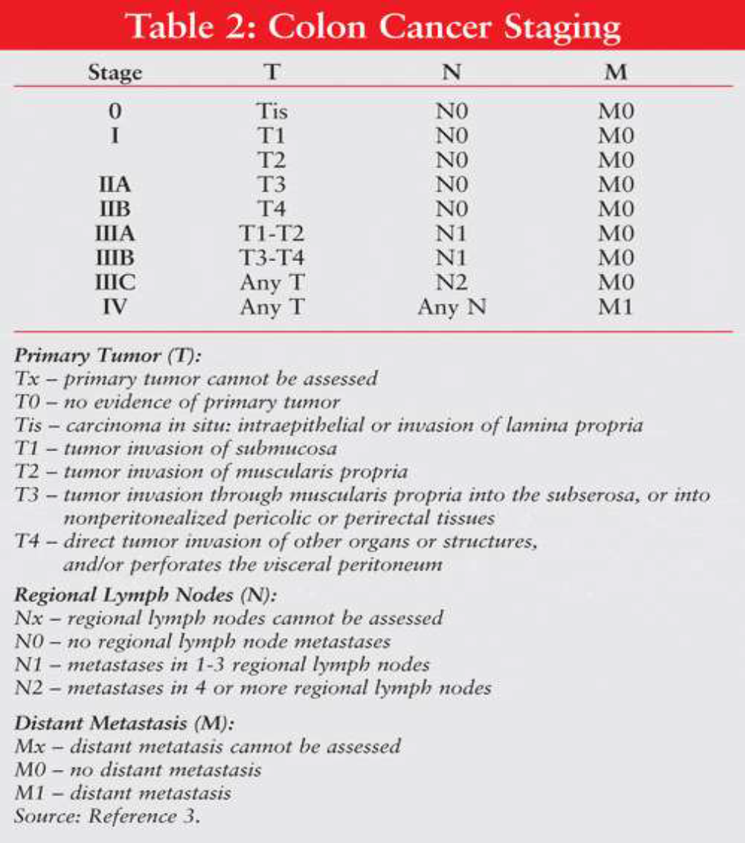

Slide 59
STAGING OF THE TUMOR
The most simple & practical system of staging is: the Modified Duke classifications
Duke stages
A - Tumor is confined to bowel mucosa
B1 - Tumor involved the muscle wall but not completely
B2 - Tumor involve the serosa
C1 - Tumor involve the muscle wall but not completely, local L.Ns involved
C2 - Involves the serosa & local LNs
D - Distant metastasis

Slide 60
TREATMENT
Surgical
Palliative chemo
Radiotherapy

Slide 61
PREVENTION
A ) Screening :
Reduces Mortality Risk Upto 15%
Testing options for the early detection of colorectal cancer and adenomatous polyps for asymptomatic adults aged 50 > years
Tests that detect adenomatous polyps and cancer
  Flexible sigmoidoscopy every 5 years, or
  Colonoscopy every 10 years, or
  Double-contrast barium enema every 5 years, or
  computed tomographic colonography every 5 years
  Colonoscopy in every 10 Years ( High Risk Individuals )
Tests that primarily detect cancer
  Annual guaiac-based fecal occult blood test with high test sensitivity for cancer, or
  Annual fecal immunochemical test with high test sensitivity for cancer, or
  Stool DNA test with high sensitivity for cancer, interval uncertain

Slide 62
PREVENTION
B ) Lifestyle Modification & Others
Low-fat and high-fiber diets
Avoid diet high in red or processed meats, or meats cooked at high temperatures
Eat a variety of fruits and vegetables every day.
Engage in physical activity every day.
NSAIDs
Quit Smoking & Alcohol

Slide 63
THANK YOU
ATTENTION, LUNCH TIME!!!!

